Slide 1
PEIC Final Project Project plan and topics
Group1: 邱于瑄、林均翰、劉展佑、張顥譽
Presenter: 劉展佑
Date:2026.05.14

Slide 2
Outline
Literature review
Project spec.
Behavior model simulation

Slide 3
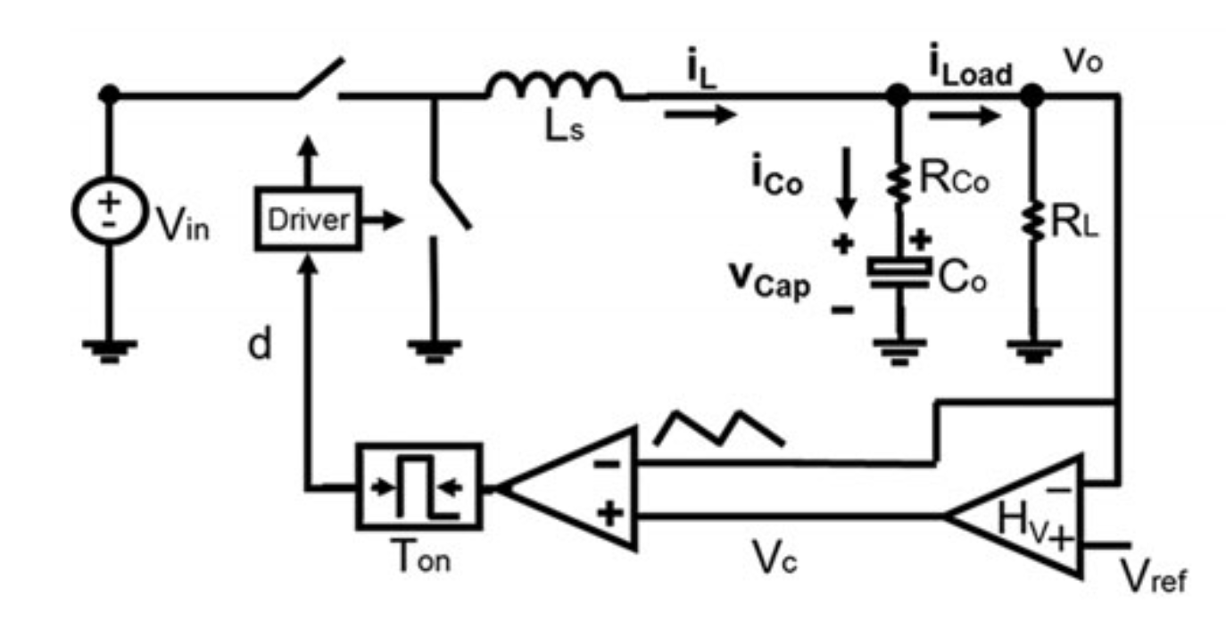
Project
V² Constant ON-Time control for point of load (POL) buck
Motivation
Ultrafast Transient Response
Simple Implementation (no current sensing resistor)
Spec & Application:
Vin = 12V, Vo = 1.2V Io = 1A to 4A
CPU or GPU in mobile device

Slide 4
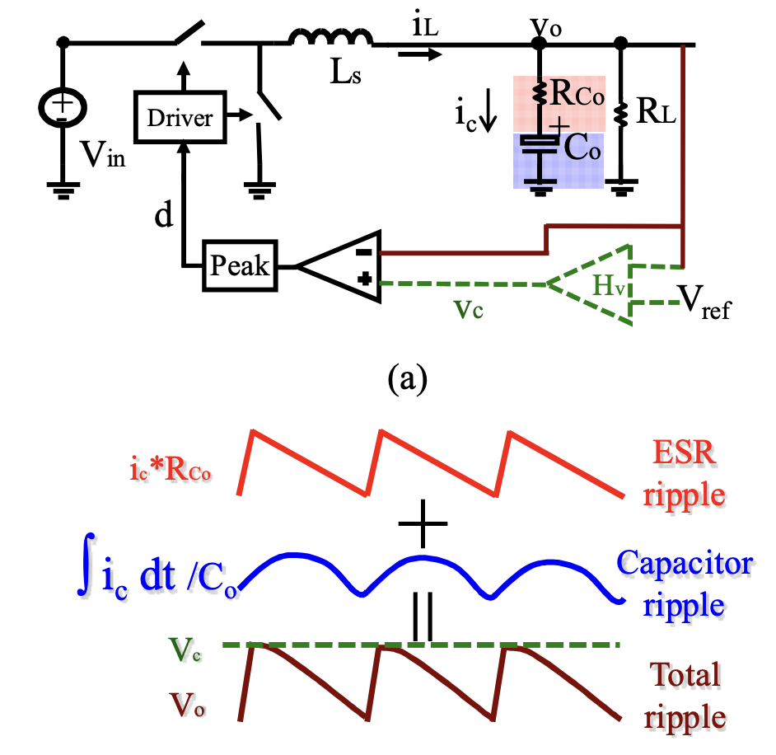
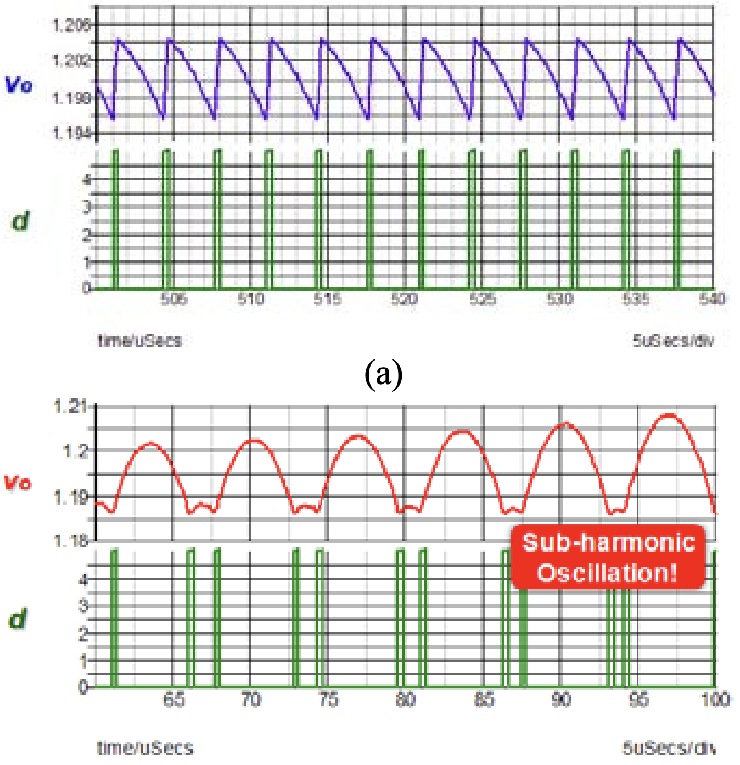
Literature review – Problem of COT
Subharmonic Oscillation:
Both the inductor current and the capacitor voltage ripple information is fed back to the modulator
No subharmonic oscillation in the constant on-time control
Delay due to the capacitor ripple results in sub-harmonic oscillation
System is stable when used with the OSCON capacitor, because the inductor current information dominates the total output voltage ripple
Subharmonic oscillation occurs when the ceramic capacitor is used with the constant on-time control, since the capacitor voltage ripple is relatively too large
Li, Jian, and Fred C. Lee. "Modeling of ${\rm V}^{2} $ Current-Mode Control." IEEE Transactions on Circuits and Systems I: Regular Papers 57.9 (2010): 2552-2563.

Slide 5
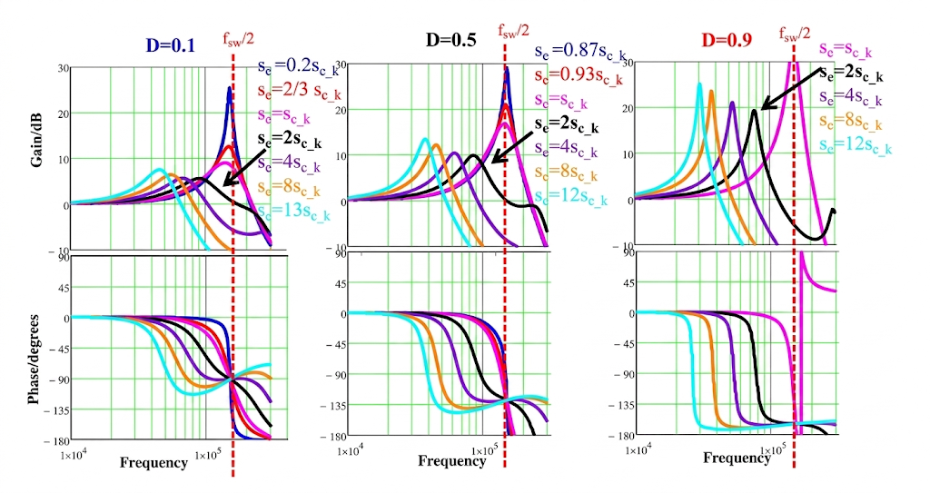
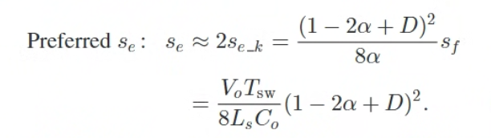

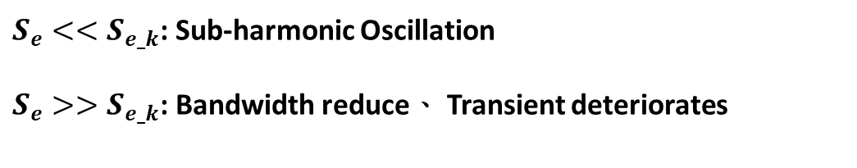
Literature review – External Ramp
$S_{e}<<S_{e_k}$: Sub-harmonic Oscillation
$S_{e}>>S_{e_k}$: Bandwidth reduce、 Transient deteriorates
S_{f}: The "natural voltage drop slope" that occurs naturally without any external ramp.
Bode plots comparison of control-to-output transfer function with different external ramp and duty cycle
D=0.1 , S_{e}=3S_{f}
Shuilin Tian. “Small-Signal Analysis and Optimal Design of External Ramp for Constant On-Time V2 Control With Multilayer Ceramic Caps." (2014).

Slide 6
Spec.
Topology
Input voltage V_{in}
Output voltage V_{o}
Output current I_{o}
Inductance L
Capacitor C
ESR
External ramp slope S_{e} = 3S_{f}
Switching frequency f_{s}
Buck Converter
12 V
1.2 V
4 A
1.8 μH
800 uF
175 uΩ
350 mV/us
300 kHz

Slide 7
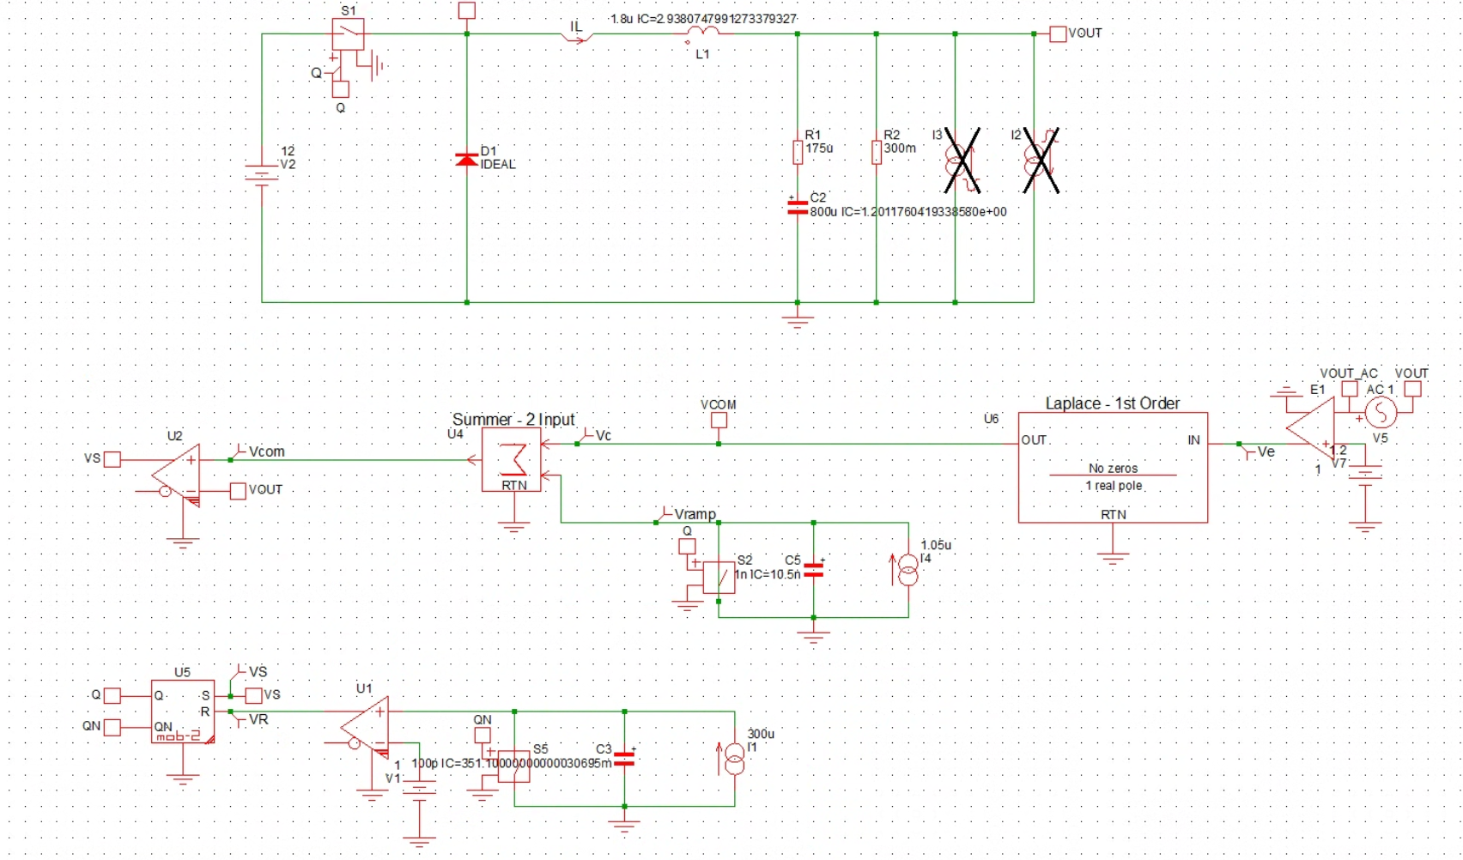
Behavior model simulation (SIMPLIS)
Power Stage
Compensater
Comparator
External Ramp
COT Generator

Slide 8
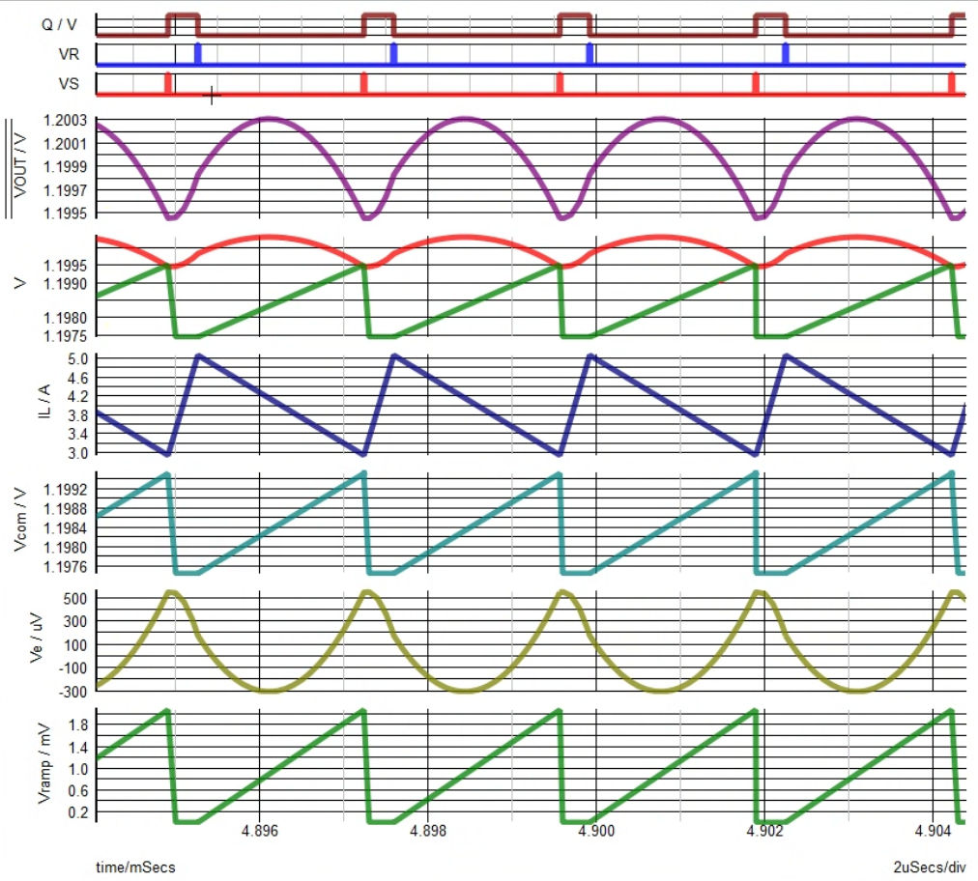
Behavior model simulation (Steady State)

Slide 9
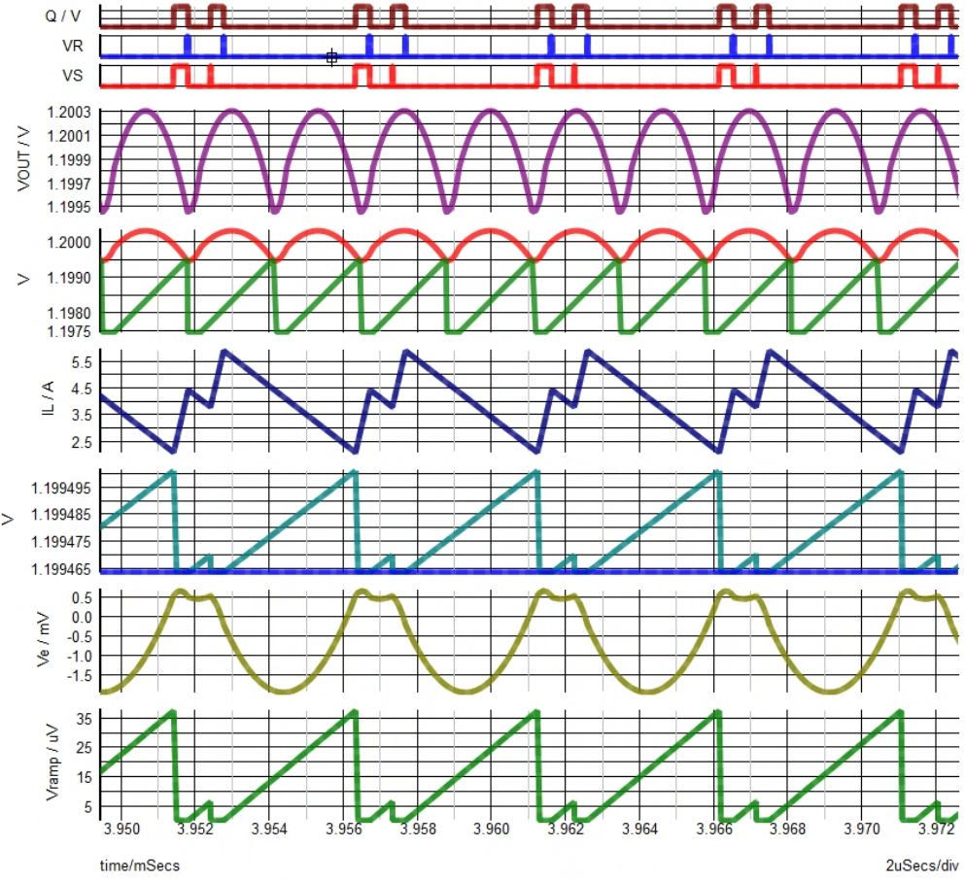
Behavior model simulation ( Insufficient of External Ramp )
Subharmonic Oscillation !

Slide 10
To-do item
Transient, AC simulation (SIMPLIS)
Confirm the spec. for each subblock.

