Slide 1
PEIC Final Project Project plan and topics
Group1: 邱于瑄、林均翰、劉展佑、張顥譽
Presenter:林均翰
Date:2026.05.21

Slide 2
Outline
Literature review
Project spec.
Behavior model simulation

Slide 3
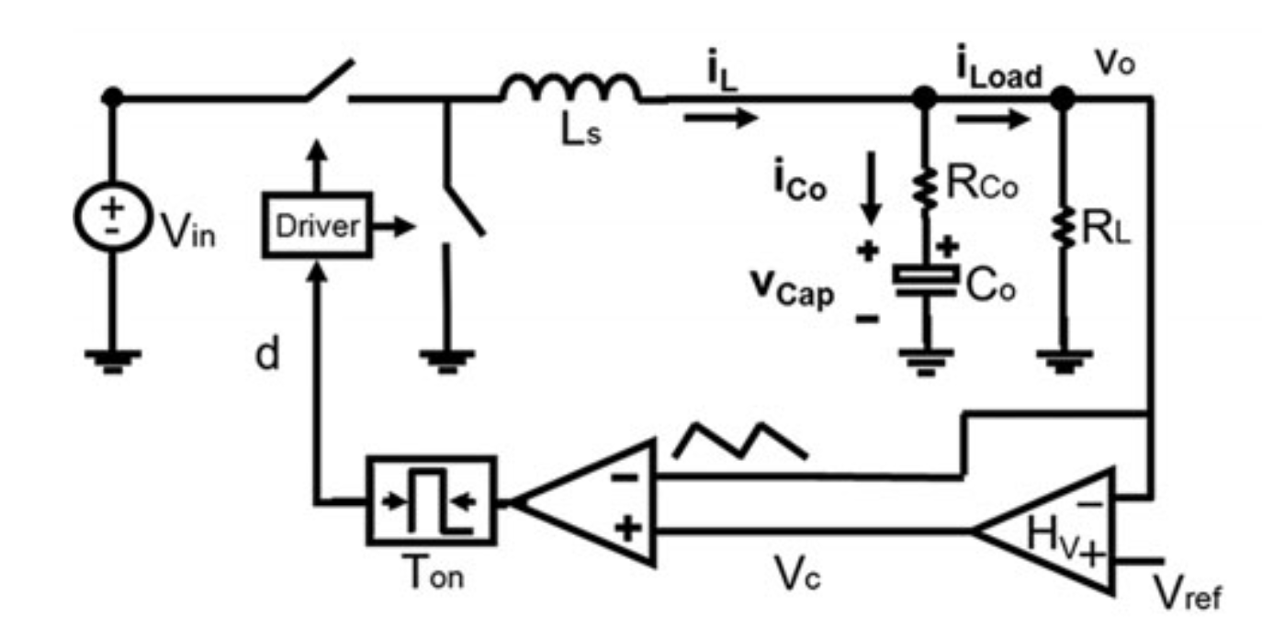
Project
V² Constant ON-Time control for point of load (POL) buck
Motivation
Ultrafast Transient Response
Simple Implementation (no current sensing resistor)
Spec & Application:
Vin = 12V, Vo = 1.2V Io = 1A to 4A
CPU or GPU in mobile device

Slide 4
Spec.
Topology
Input voltage V_{in}
Output voltage V_{o}
Output current I_{o}
Inductance L
Capacitor C
ESR
External ramp slope S_{e} = 3S_{f}
Switching frequency f_{s}
_{Output Voltage Ripple}
Buck Converter
12 V
1.2 V
4 A
1.8 μH
800 uF
175 uΩ
350 mV/us
300 kHz
0.0012 V

Slide 5
V2COT Small-Signal Control to Output Transfer Function
G_{vc} Control to Output Transfer Function
The ESR of ceramic capacitors and T_{ON} are small, it can be simplified to:

Slide 6
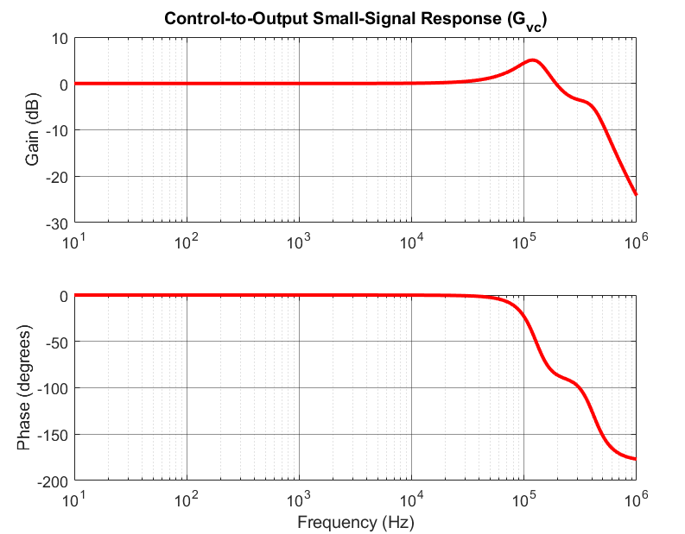
V2COT Small-Signal Control to Output Transfer Function
G_{vc} Control to Output Transfer Function
Double complex poles

Slide 7
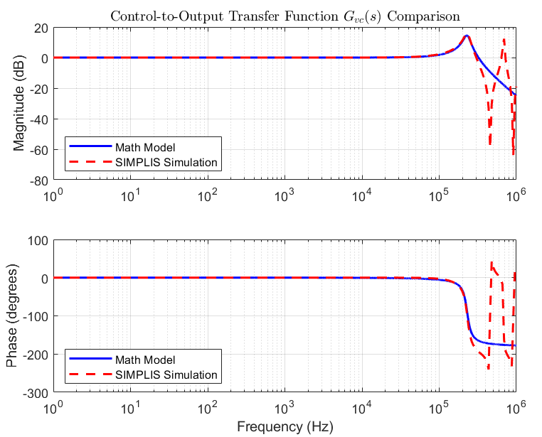
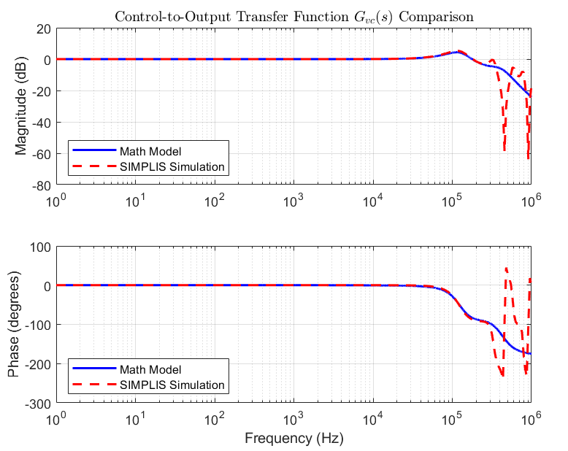
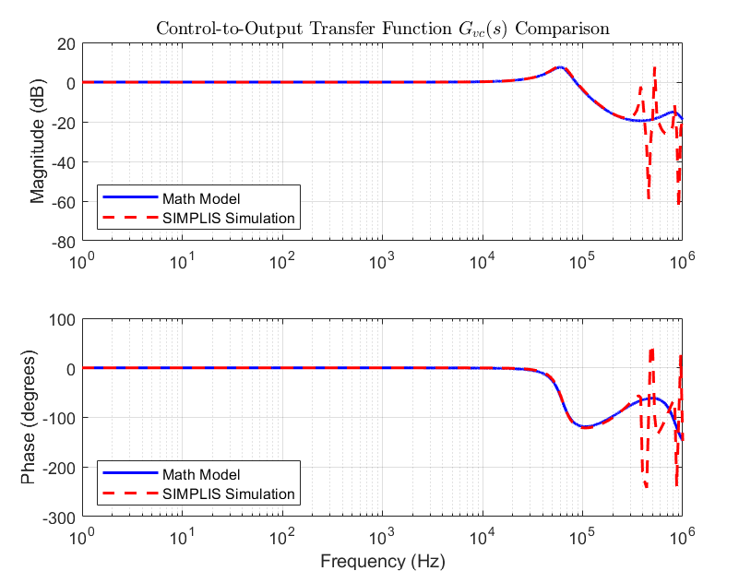
V2COT Small-Signal Control to Output Transfer Function
S_{e} = S_{f} < S_{e_K}
S_{e} > S_{e_K} = 3S_{f}
S_{e} > S_{e_K} = 15S_{f}
Insufficient External Ramp
PM too low.
System instability.
Sufficient External Ramp
Sufficient PM.
System stability .
Excessive External Ramp
Bandwidth limitations.
Poor transient response

Slide 8
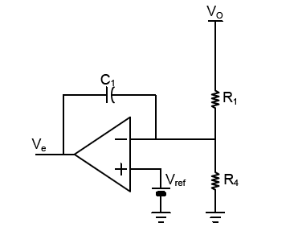
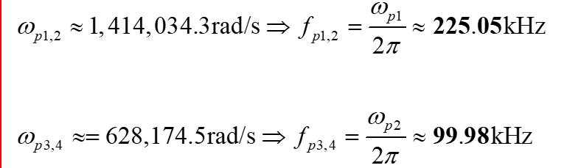
Compensator Design
At low frequency (before 1/2 f_{sw}), both Gain and Phase are 0.
Therefore, compensator can be achieved through an integrator.
The bandwidth design avoids phase margin insufficiency caused by double poles at 30kHz.
f_{sw} =300 kHz , Set f_{c}=0.1 f_{sw} , f_{sw}=30kHz
_{Type I}

Slide 9
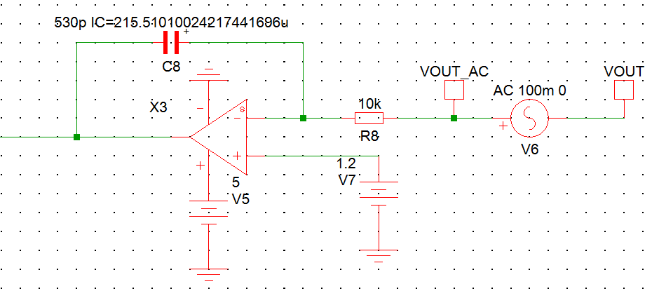
Loop Gain Transfer Function
Type 1 Compensator Circuit
Loop Gain
Crossover Frequency : 31kHz
Gain Margin : 17.1 dB
Phase Margin : 89.4 degree

Slide 10
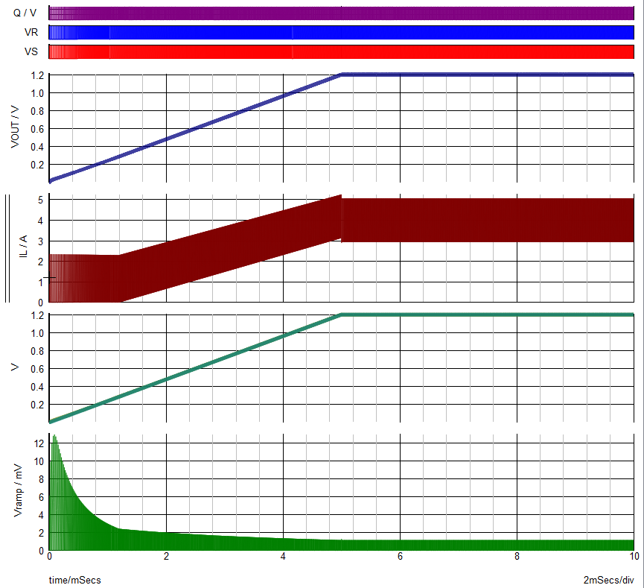
Behavior Model Simulation @ Start-Up
Vout
IL
Vcom
Vramp

Slide 11
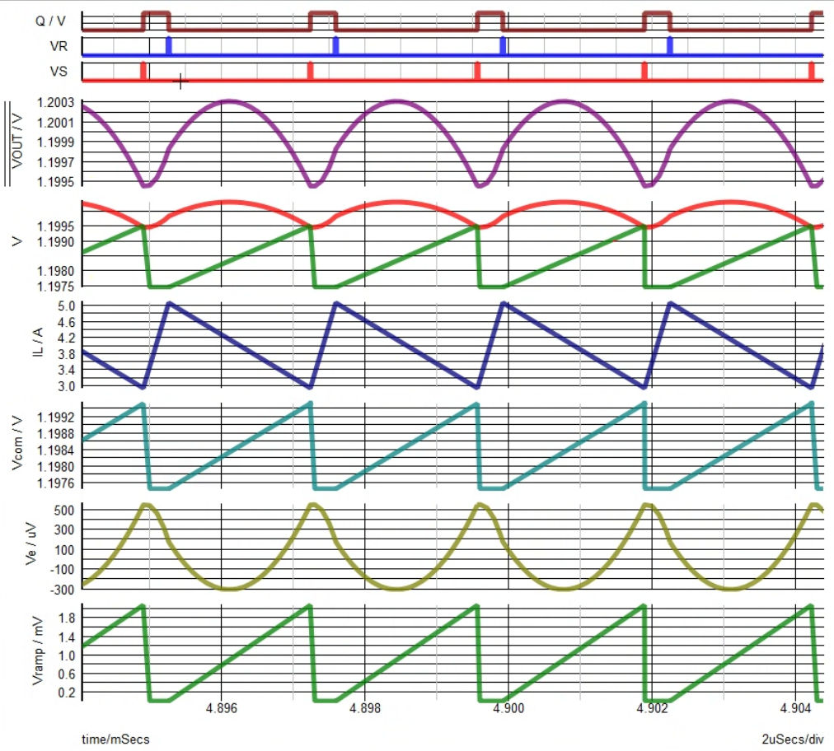
Behavior Model Simulation @ Steady State

Slide 12
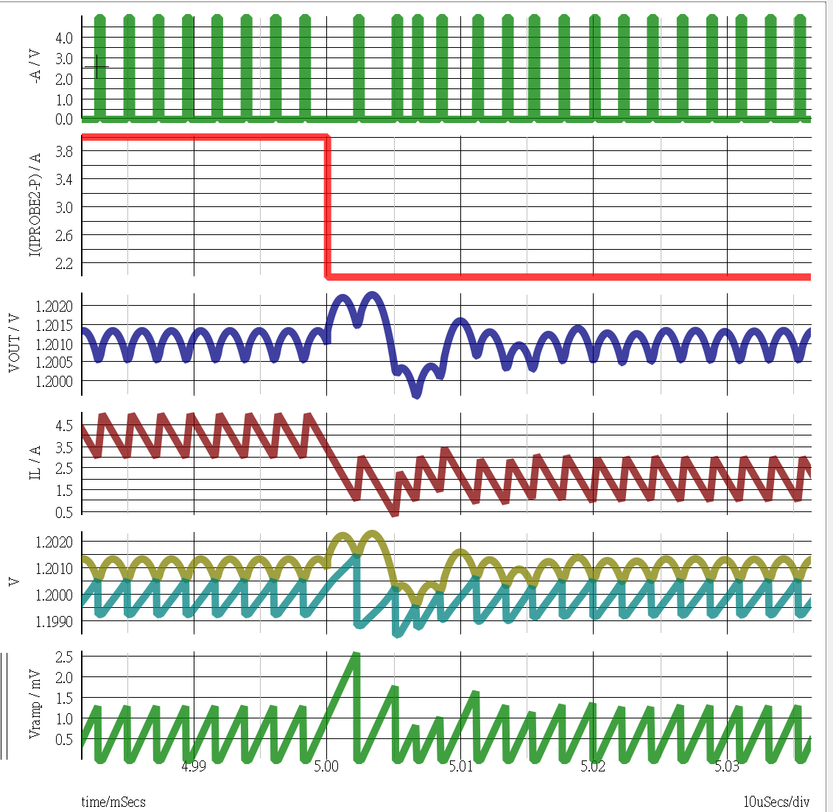
Transient Response @ Step Down 4A → 1A
Duty
Io
1.5mV
Overshoot = 1.5mV
Settling time = 20.38us
Vout
(6Tsw )
IL
Vo , Vcom
Vramp
20.38us

Slide 13
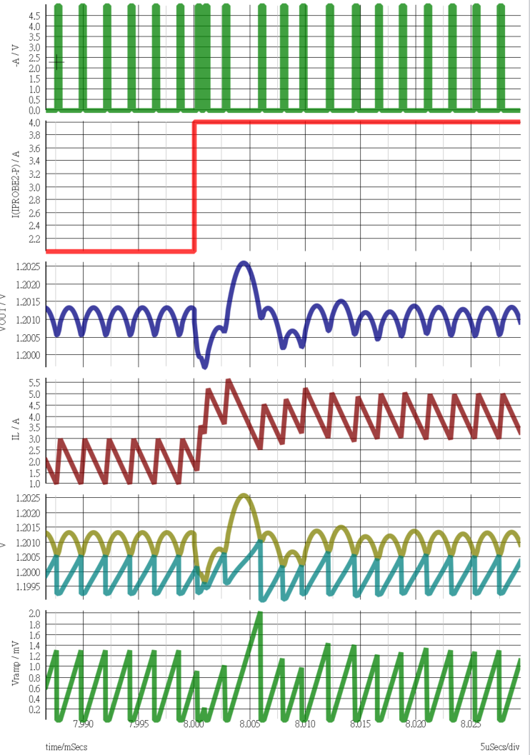
Transient Response @ Step Down 4A → 1A
Duty
Io
Overshoot = 1.8mV
Settling time = 18.43us
Vout
1.8mV
(5Tsw )
IL
Vo , Vcom
Vramp
18.43us

Slide 14
To-do item
IC subblock design and simulation
Specifications for subblocks

