Slide 1
PEIC Final Project Project plan and topics
Group1: 邱于瑄、林均翰、劉展佑、張顥譽
Presenter:邱于瑄
Date: 2026.06.04

Slide 2
Outline
Literature review
Project spec.
IC subblock design and simulation
Operation Amplifier (folded cascoded)
High-Speed Comparator
To-do item

Slide 3
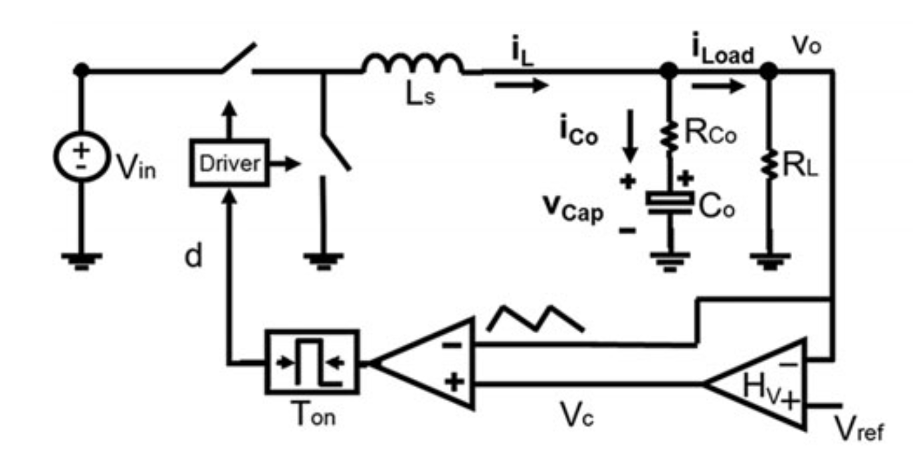
Project
V² Constant ON-Time control for point of load (POL) buck
Motivation
Ultrafast Transient Response
Simple Implementation (no current sensing resistor)
Spec & Application:
Vin = 12V, Vo = 1.2V Io = 1A to 4A
CPU or GPU in mobile device

Slide 4
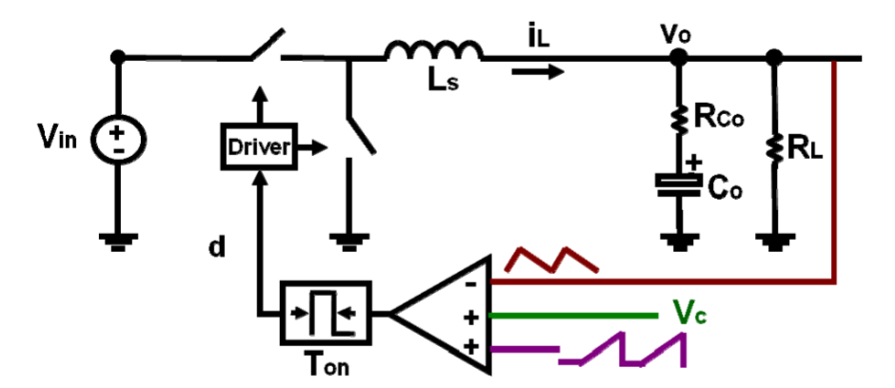
Spec.
Topology | Buck Converter
Input voltage V_{in} | 12 V
Output voltage V_{o} | 1.2 V
Output current I_{o} | 4 A
Inductance L | 1.8 μH
Capacitor C | 800 uF
ESR | 175 uΩ
External ramp slope S_{e} = 3S_{f} | 350 mV/us
Switching frequency f_{s} | 300 kHz
Output Voltage Ripple | 0.0012 V
Our Topology

Slide 5
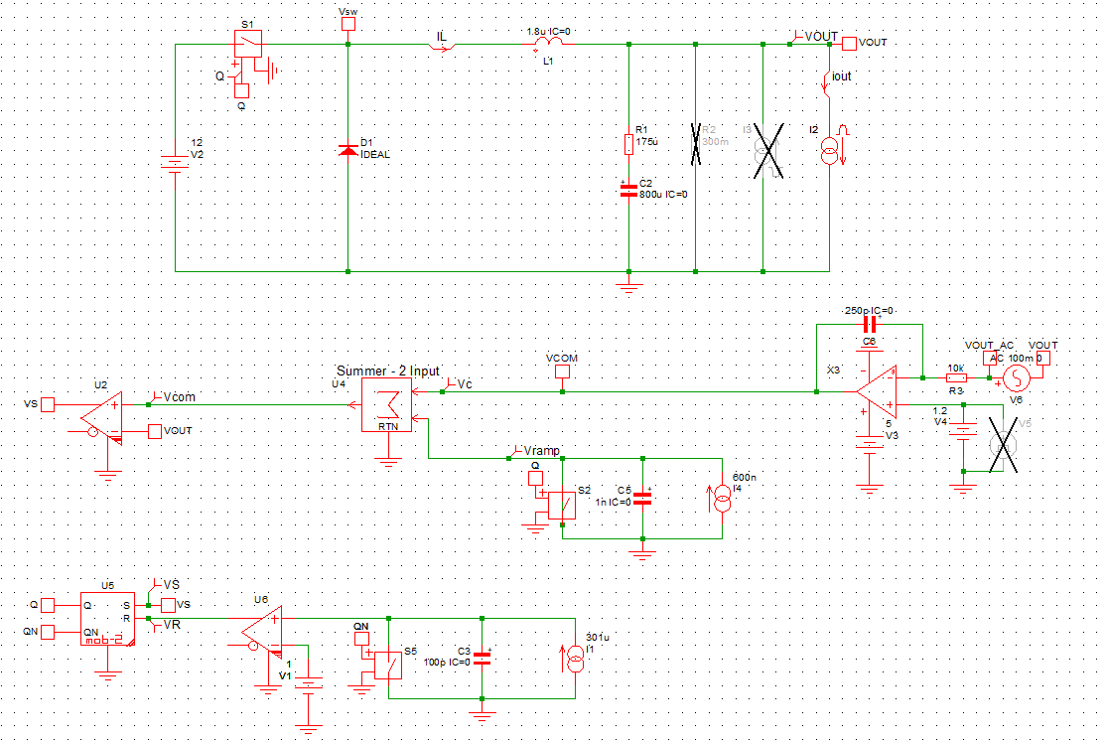
Transistor-level subblock
Process: N16ADFP
OPA
High Speed Comparator
Current Source

Slide 6
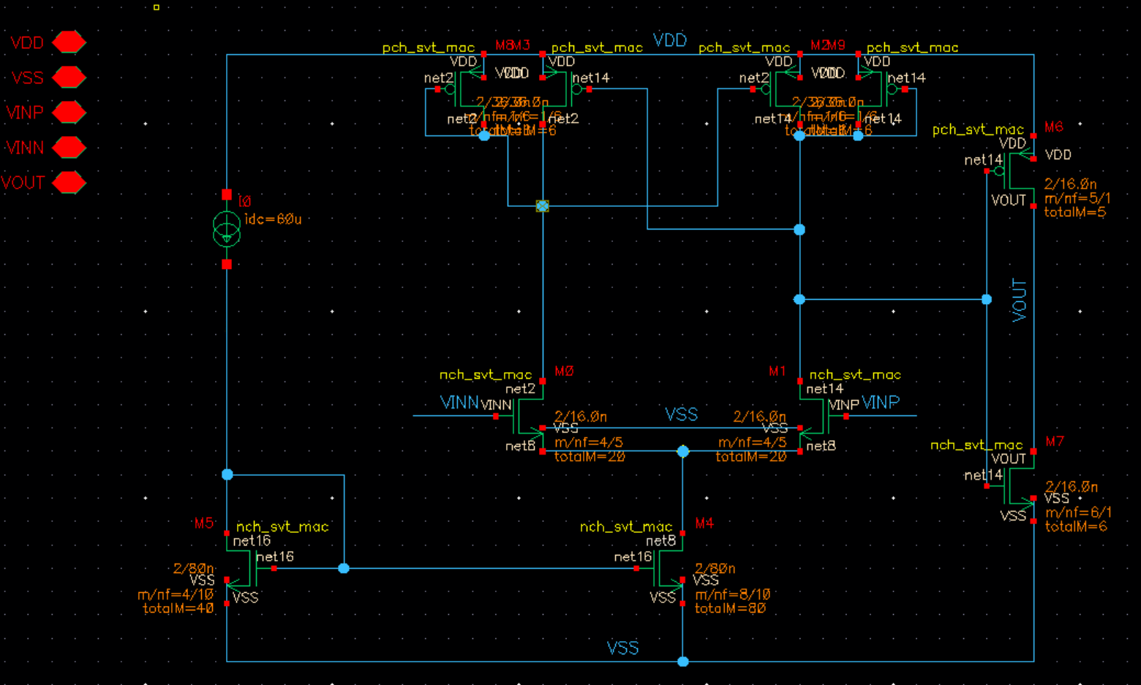
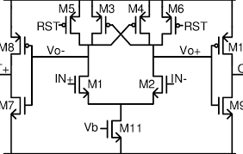
High Speed Comparator
Spec:
Hysteresis: 5 mV - 20 mV, Propagation Delay: <1ns
VDD = 1V, Iref = 60uA

Slide 7
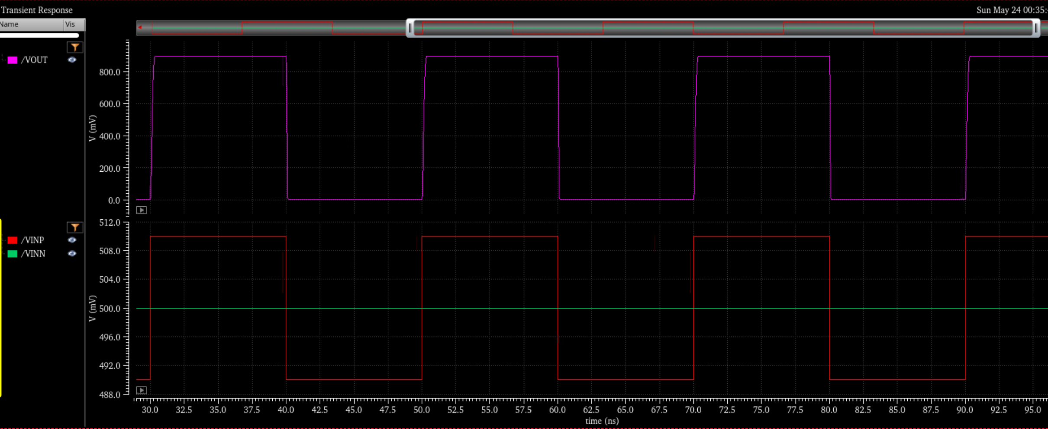
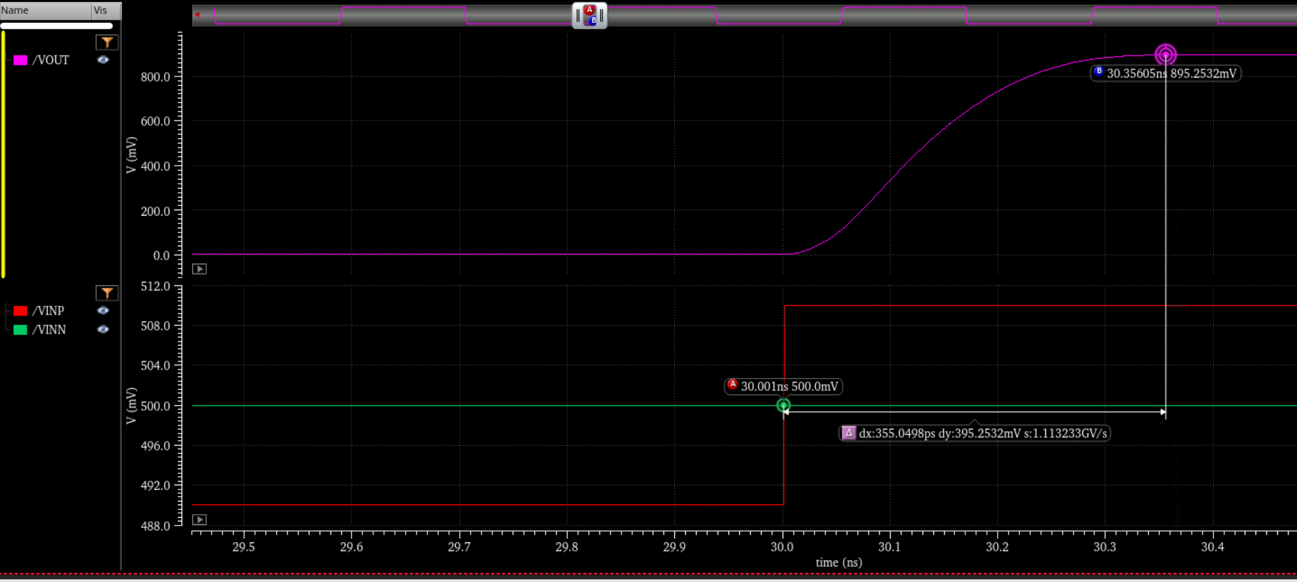
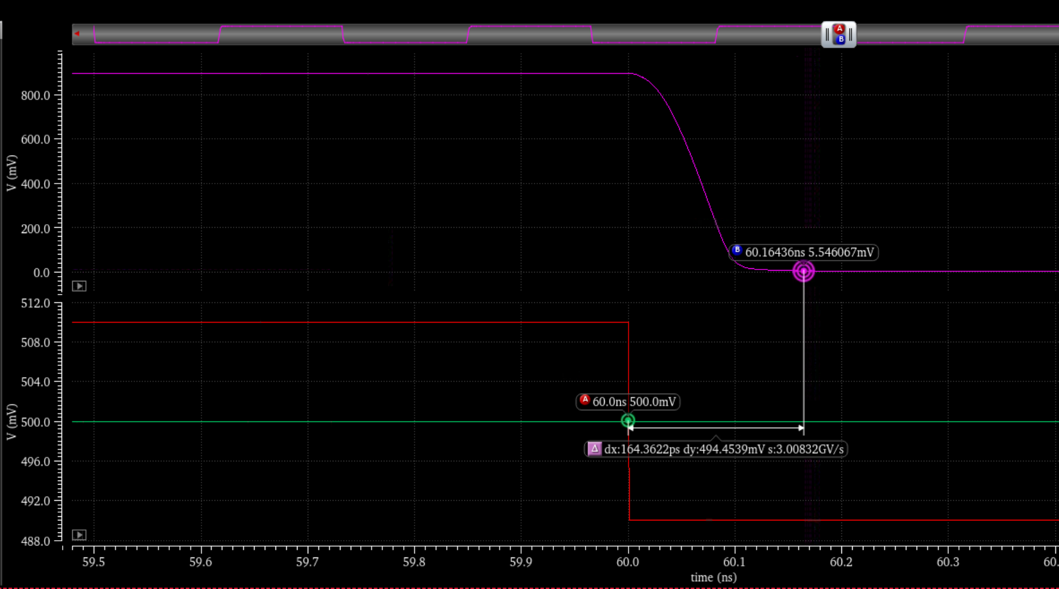
High Speed Comparator - Simulation Result
± 10mV
Propagation delay = 355ps
Propagation delay = 164ps

Slide 8
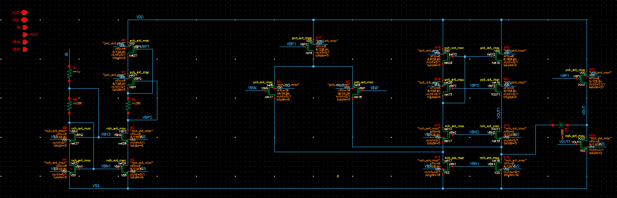
OPA
Folded Cascode Opamp
First Stage
Second Stage
Bias

Slide 9
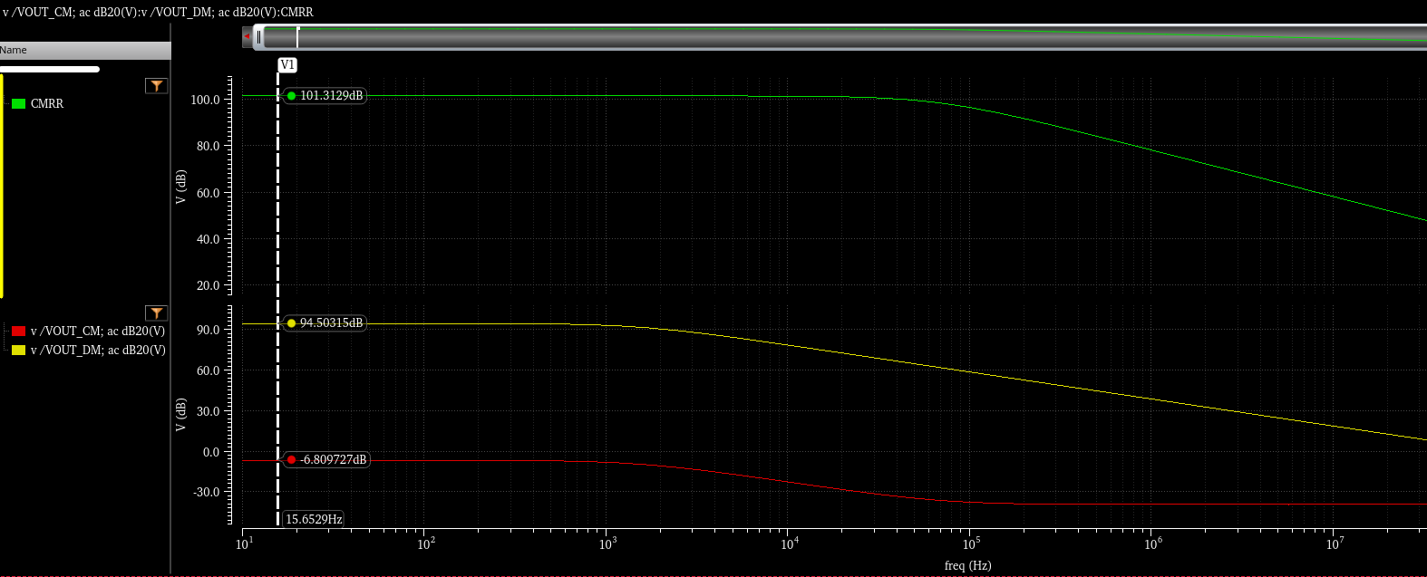
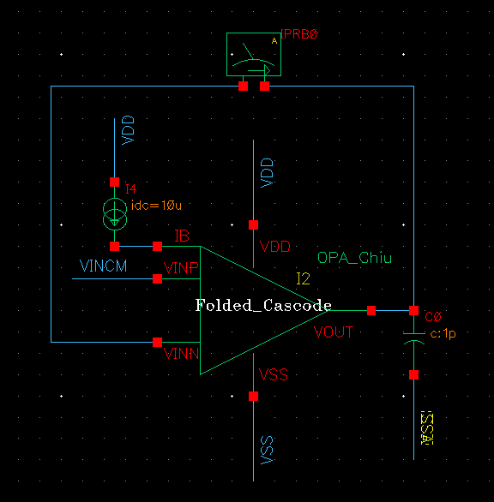
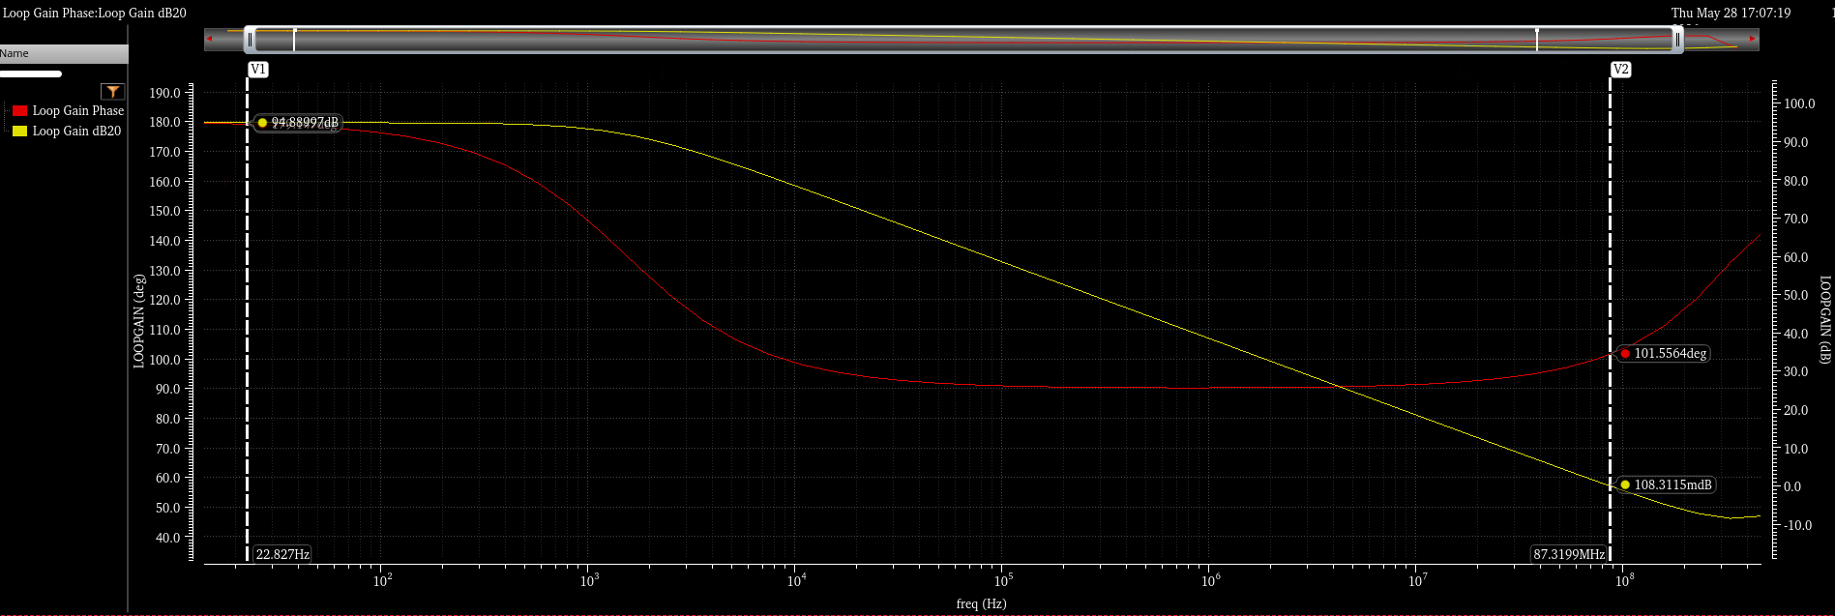
OPA – AC analysis
Gain-Bandwidth: 86.28 MHz
Phase Margin: 101.4∘
Open-Loop Gain: 94.89 dB
CMRR = 101.4dB
CMRR = 101.4dB
Av = 94.89dB
101.4∘

Slide 10
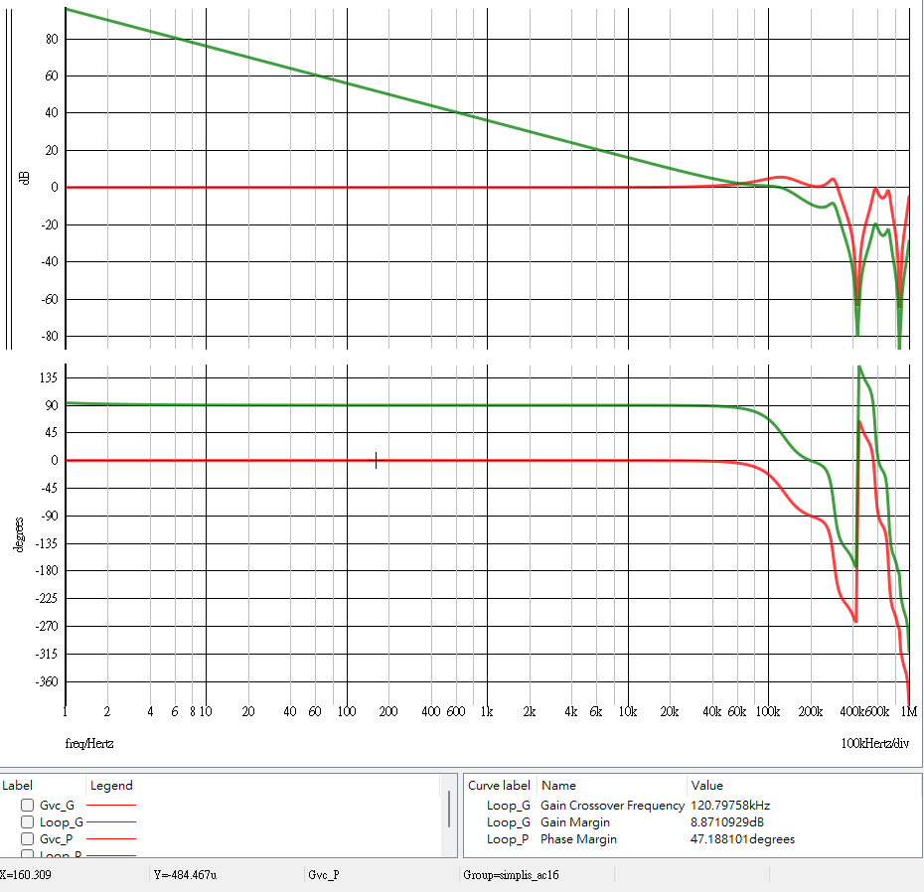
Compensator
Type I compensator
Gain-Bandwidth: 120.8 kHz
Phase Margin: 47.19∘

Slide 11
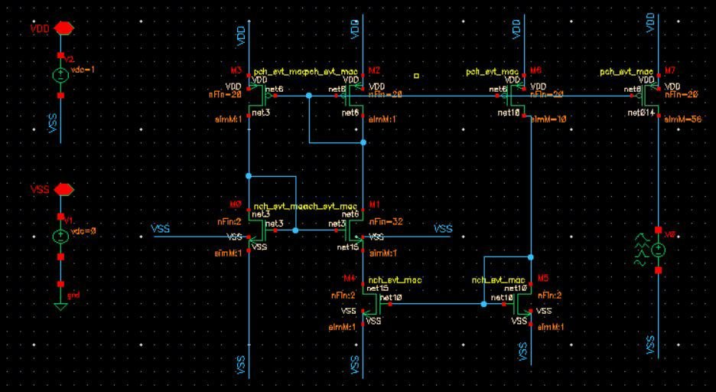
Current Source – Schematic
Resistorless auto bias reference circuit
Better Component Matching
Save Space
Low Power
No Resistor Error
H.J. Oguey, D. Aebicsher, CMOS Current Reference without Resistance, IEEE J. Solid-State Circuits, Volume 32, pag. 1132-1135. 1977.

Slide 12
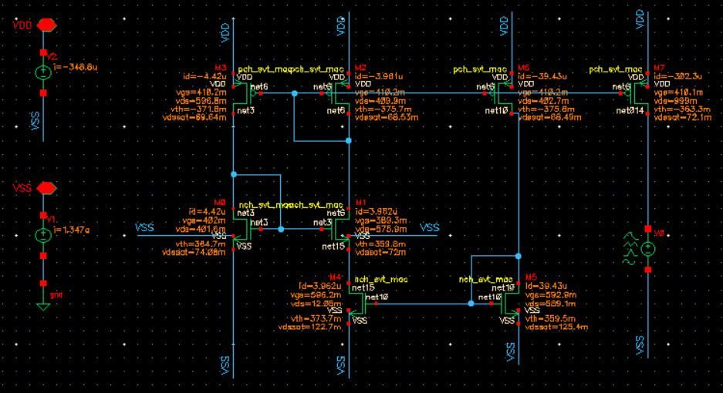
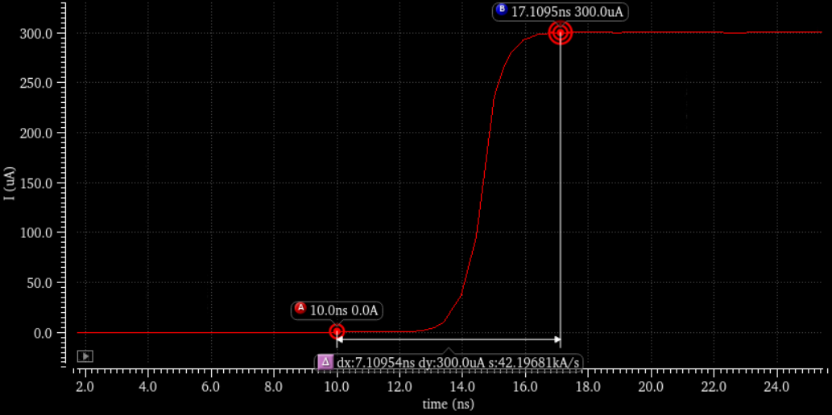



Current Source – Simulation Result
$$300.1 μA$$
$I_{1}$
$$7.72 ns$$

Slide 13
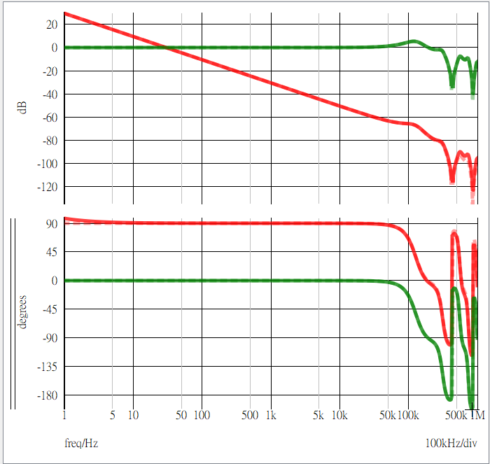


OPA & Current Source Integration
Crossover Frequency : 31 kHz
Gain Margin : 17.1 dB
Phase Margin : 89.4 degree
$$Loop$$
$$G_{vc}$$
Crossover Frequency : 30.5 kHz
Gain Margin : 10.1 dB
Phase Margin : 89.2 degree
Dashed line: Ideal model Solid line: Transistor level

Slide 14
To-do item
IC subblock design and simulation
MOS level blocks + behavior model blocks Simulation

Slide 15
Reference
H.J. Oguey, D. Aebicsher, CMOS Current Reference without Resistance, IEEE J. Solid-State Circuits, Volume 32, pag. 1132-1135. 1977.

