Slide 1
PEIC Final Project Project plan and topics
Group1: 邱于瑄、林均翰、劉展佑、張顥譽
Presenter: 林均翰、劉展佑
Date: 2026.06.11

Slide 2
Outline
Introduction
Project spec.
Behavior model simulation
IC subblock analysis and simulation
Conclusions
References

Slide 3
Outline
Introduction
Project spec.
Behavior model simulation
IC subblock analysis and simulation
Conclusions
References

Slide 4
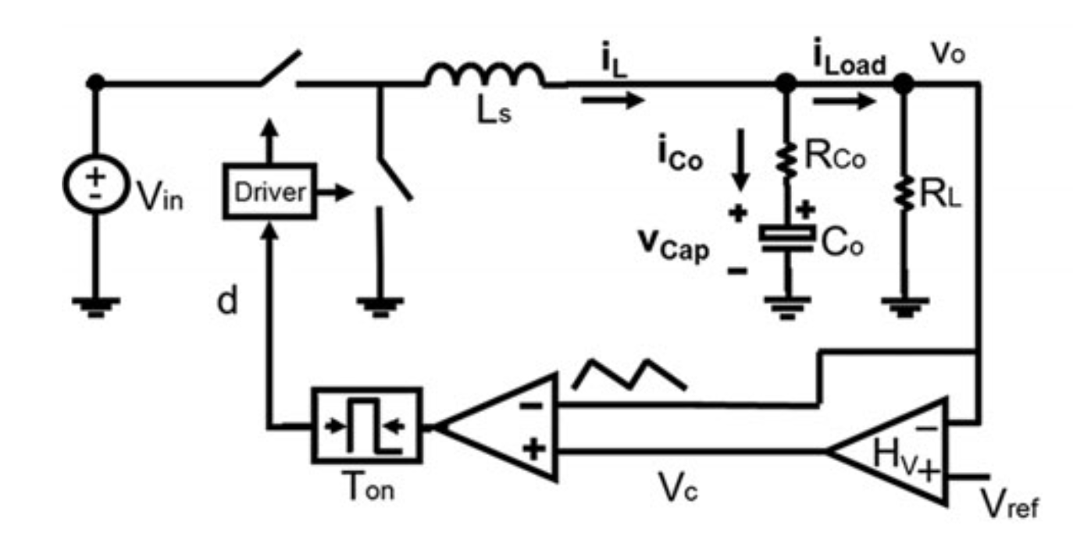
Project Plan
V² Constant ON-Time control for point of load (POL) buck
Motivation
Ultrafast Transient Response
Simple Implementation (no current sensing resistor)
Application
Vin = 12V, Vo = 1.2V Io = 1A to 4A in
CPU or GPU in mobile device

Slide 5
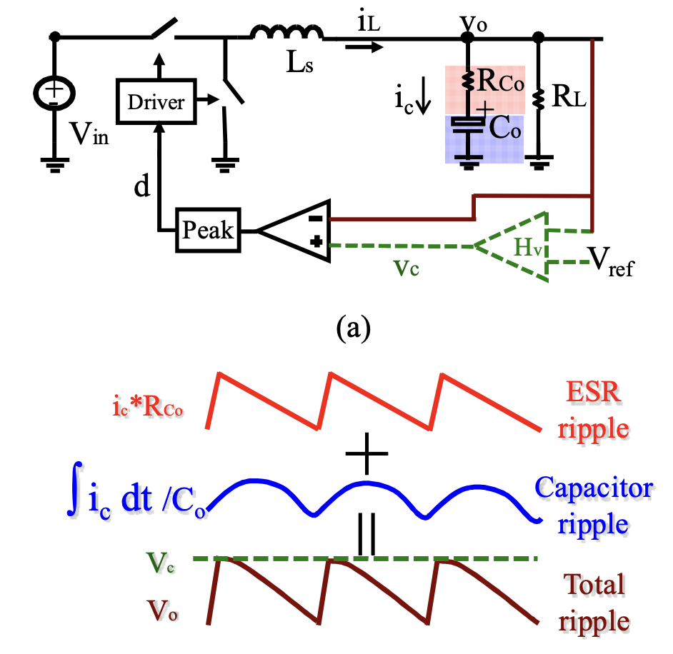
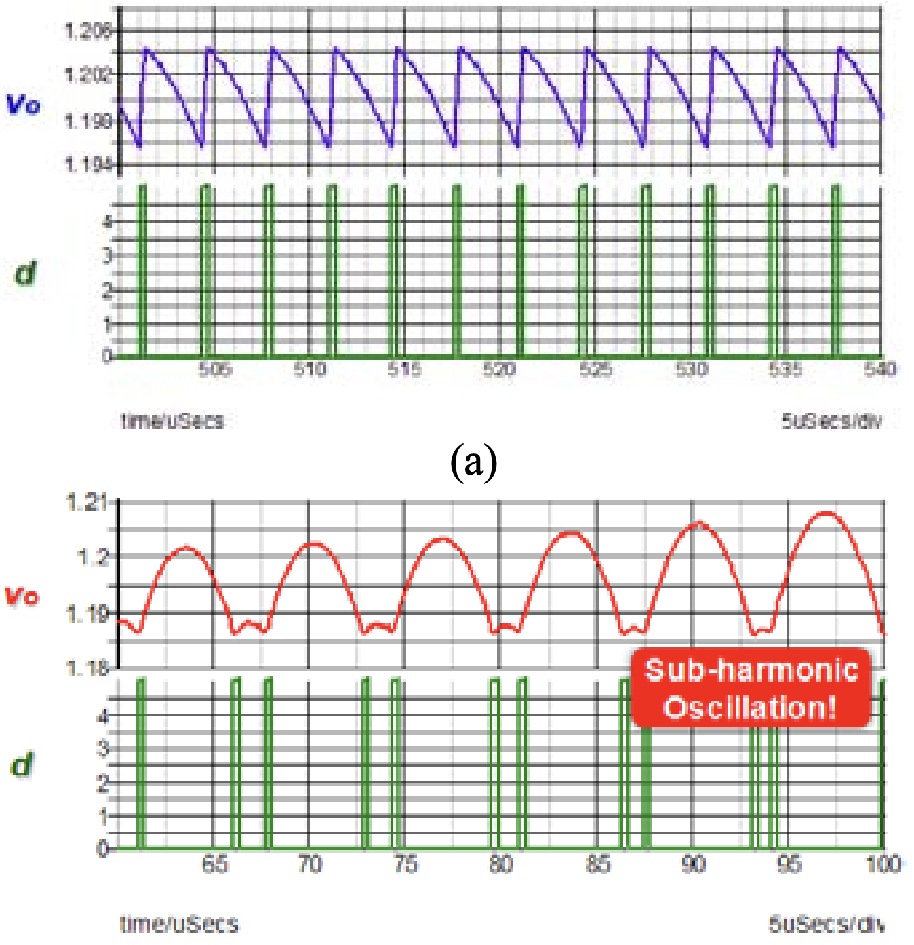
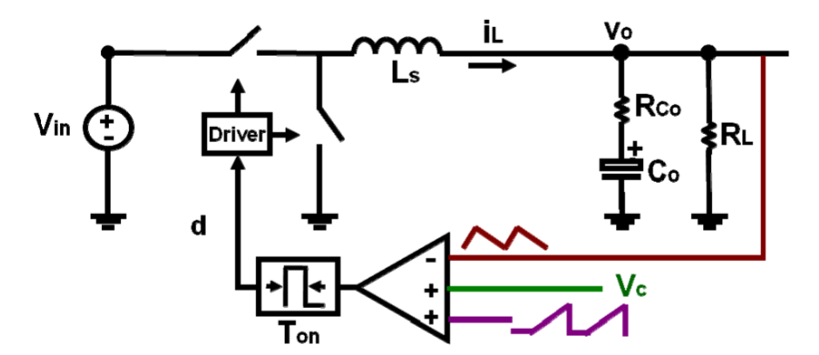
Challenge of COT
Subharmonic Oscillation:
Both the inductor current and the capacitor voltage ripple information is fed back to the modulator
Delay due to the capacitor ripple results in sub-harmonic oscillation
Subharmonic oscillation occurs when the ceramic capacitor is used, since the capacitor voltage ripple is relatively too large
Solution:
Add external ramp to compensate the delay resulted from capacitor voltage ripple
Advantage:
Simple to implement
No current sensing needed
Li, Jian, and Fred C. Lee. "Modeling of ${\rm V}^{2} $ Current-Mode Control." IEEE Transactions on Circuits and Systems I: Regular Papers 57.9 (2010): 2552-2563.

Slide 6
Outline
Introduction
Project spec.
Behavior model simulation
IC subblock analysis and simulation
Conclusions
References

Slide 7
Outline
Project spec
Topology | Buck Converter
Input voltage V_{in} | 12 V
Output voltage V_{o} | 1.2 V
Output current I_{o} | 4 A
Inductance L | 1.8 μH
Capacitor C | 800 uF
ESR | 175 uΩ
External ramp slope S_{e} = 3S_{f} | 350 mV/us
Switching frequency f_{s} | 300 kHz
Output voltage ripple | 0.0012V
Our Topology

Slide 8
Outline
Introduction
Project spec.
Behavior model simulation
IC subblock analysis and simulation
Conclusions
References

Slide 9
System Architecture
V_{IN}
Power Stage
Filter
V_{OUT}
Logic Control
Compensation & Modulator
RS Latch
Sensing Feedback
V_{out}
Type-I Compensation
Timing Generator
Comparator
Summer
Ramp Generator

Slide 10
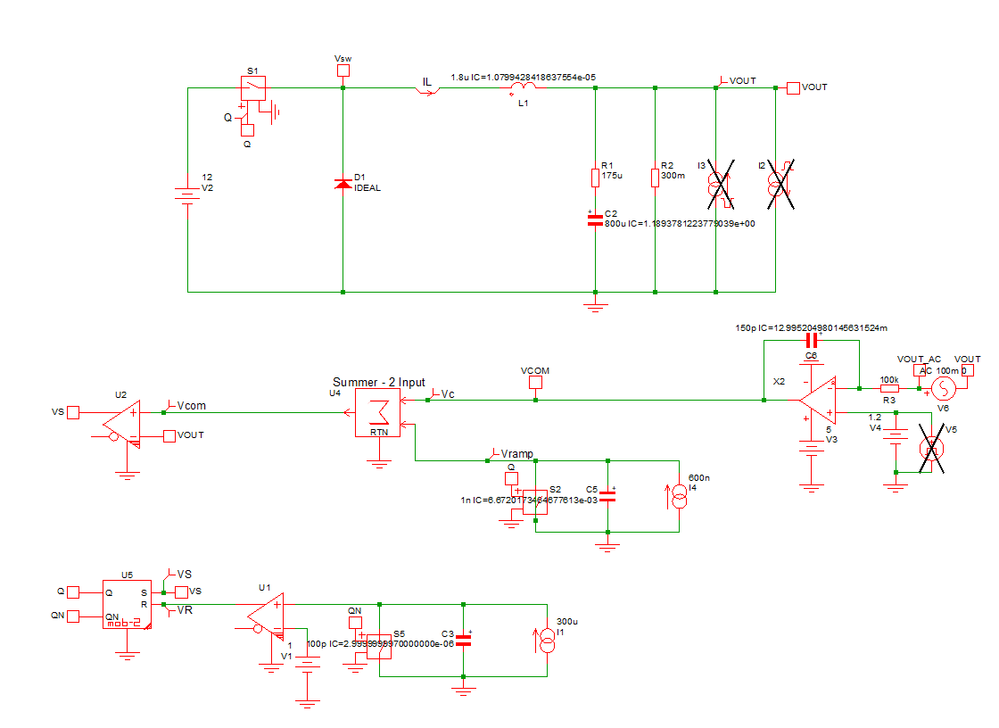
Behavior model simulation (SIMPLIS)
Power Stage
Compensater
Comparator
External Ramp
COT Generator

Slide 11
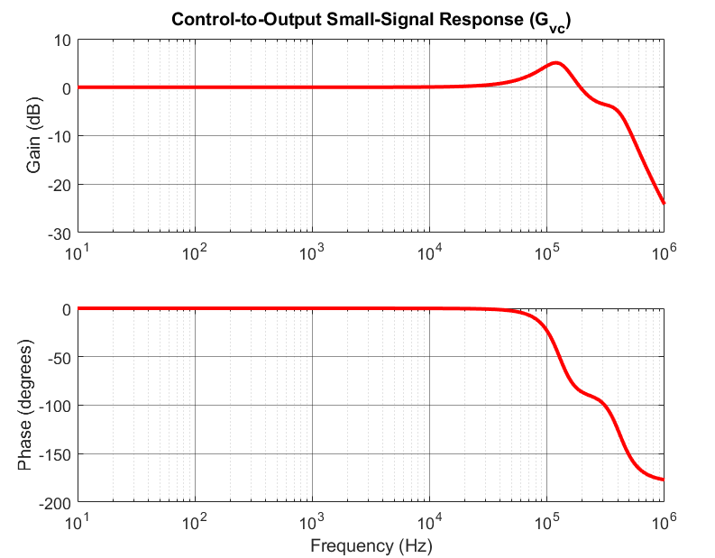
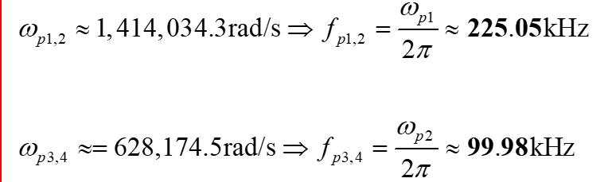
V²COT Small-Signal Control to Output Transfer Function
G_{vc} Control to Output Transfer Function
The ESR of ceramic capacitors and TON are small, and can be simplified to:
S_{e}: the slope of the external ramp during off-time
S_{f} = RC_{o}V_{o} / L_{s}
Double complex poles

Slide 12
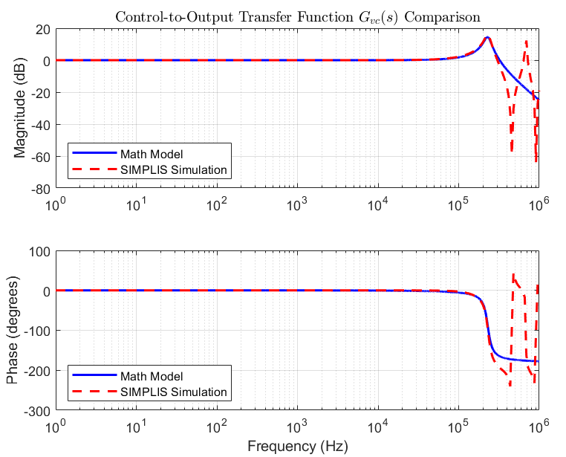
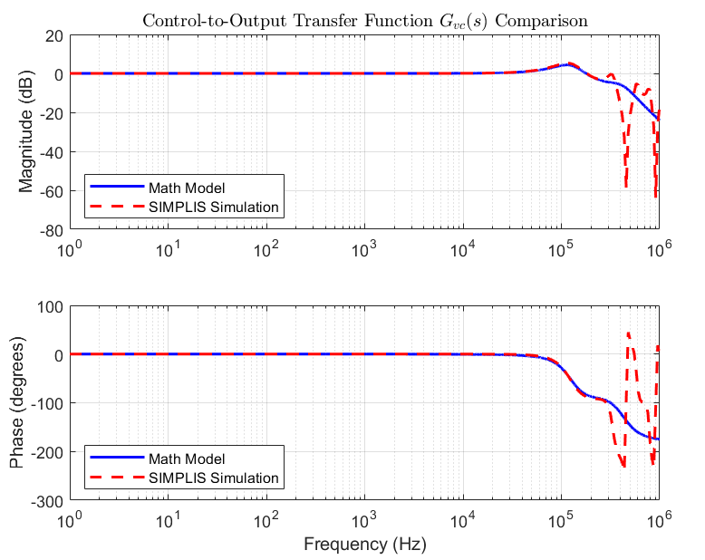
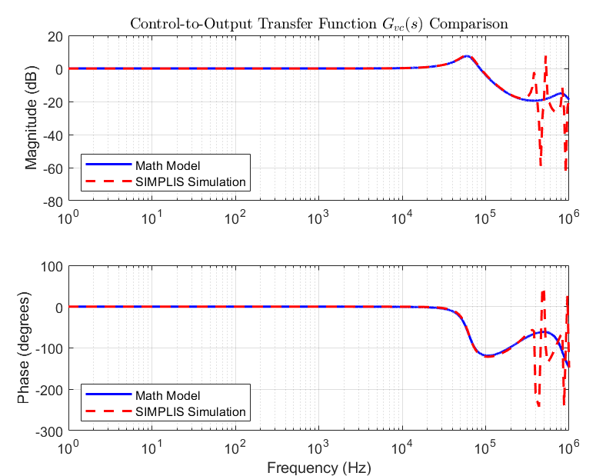
G_{vc} under different ramp slope
S_{e} = S_{f} < S_{e_K}
S_{e} > S_{e_K} = 15S_{f}
S_{e} > S_{e_K} = 3S_{f}
Insufficient External Ramp
PM too low
System instability
Sufficient External Ramp
Sufficient PM
System stability
Excessive External Ramp
Bandwidth limitations
Poor transient response

Slide 13
Gvc under different ramp slope
S_{e} = S_{f} < S_{e_K}
S_{e} > S_{e_K} = 15S_{f}
S_{e} > S_{e_K} = 3S_{f}
Insufficient External Ramp
PM too low
System instability
Sufficient External Ramp
Sufficient PM
System stability
Excessive External Ramp
Bandwidth limitations
Poor transient response

Slide 14
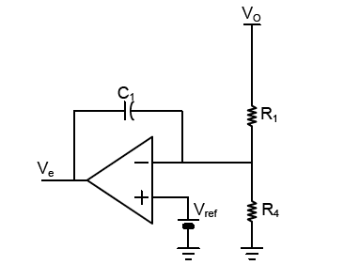
Compensator Design
At low frequency (before 1/2 f_{sw}), both Gain and Phase are 0.
Therefore, compensator can be achieved through an integrator.
The bandwidth design avoids phase margin insufficiency caused by double poles at 30kHz.
f_{sw} =300 kHz , Set f_{c}=0.1 f_{sw} , f_{sw}=30kHz
_{Type I}

Slide 15
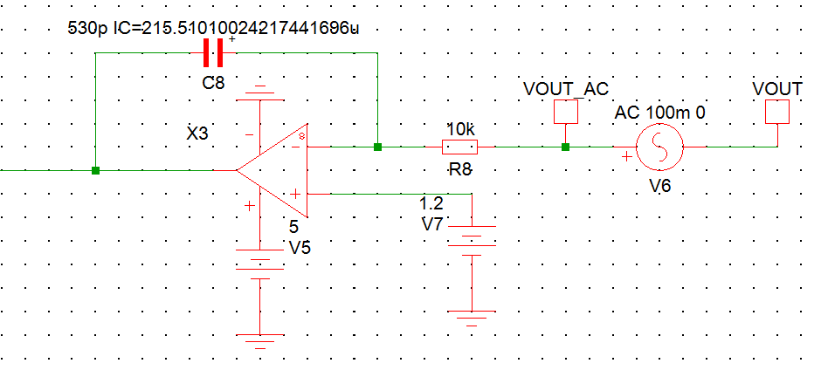
Loop Gain Transfer Function
Type 1 Compensator Circuit
Loop Gain
Crossover Frequency : 31kHz
Gain Margin : 17.1 dB
Phase Margin : 89.4 degree

Slide 16
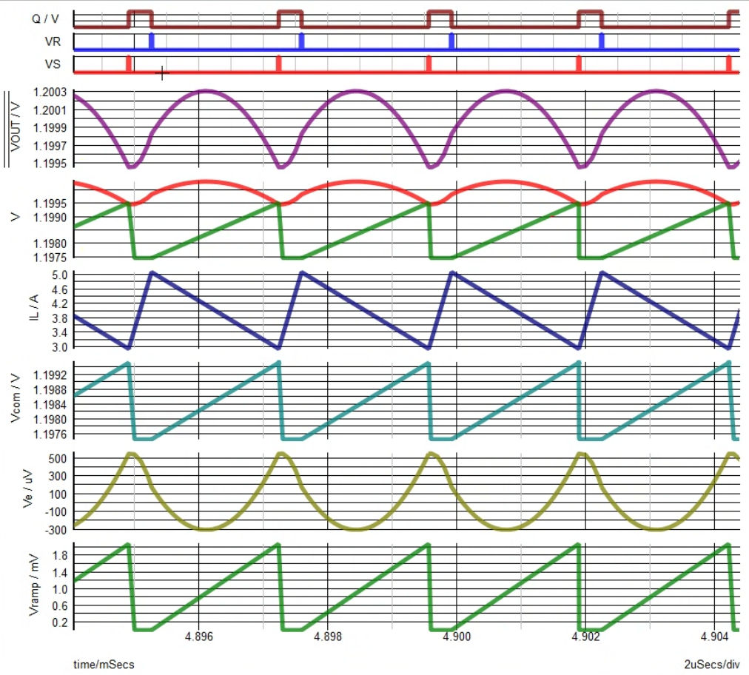
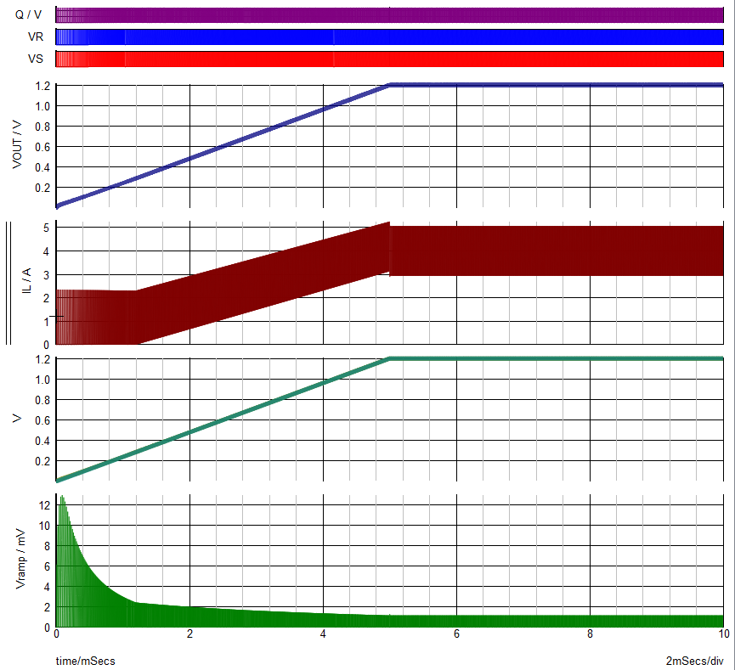
Behavior Model Simulation
Vout
Vout
IL
IL
Vcom
Vcom
Vramp
Vramp
@ Startup
@ Steady State

Slide 17
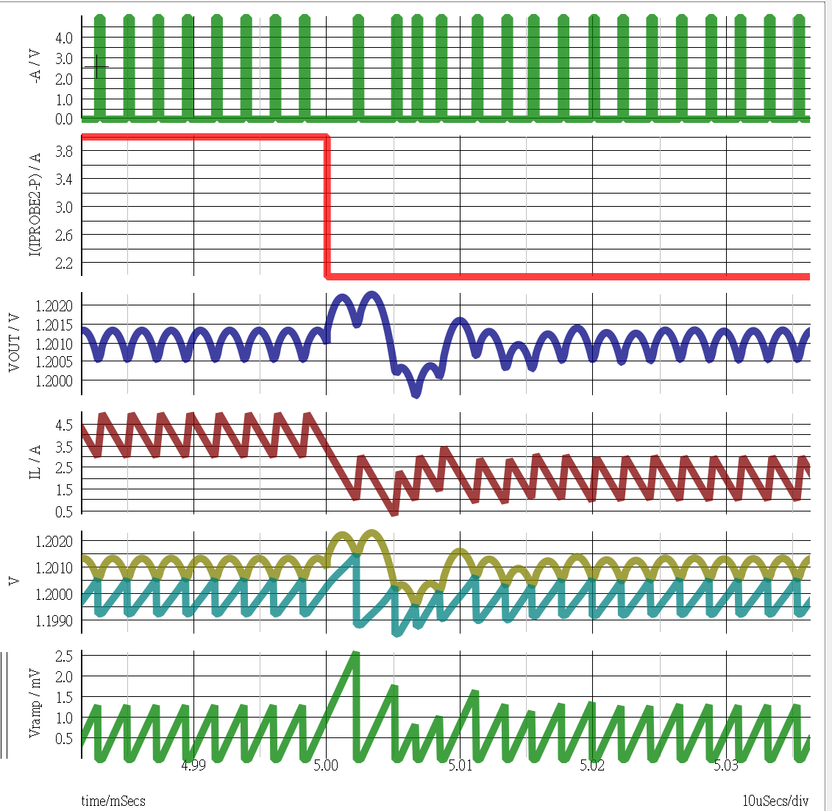
Behavior Model Simulation – Load transient (4A→1A)
Duty
Io
1.5mV
Overshoot = 1.5mV
Settling time = 20.38us
Vout
(6Tsw )
IL
Vo , Vcom
Vramp
20.38us

Slide 18
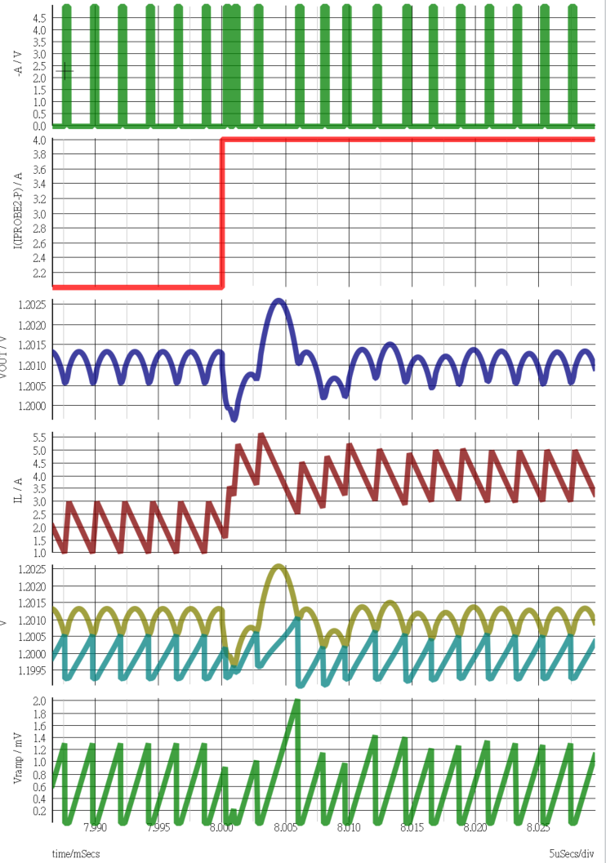
Behavior Model Simulation – Load transient (1A→4A)
Duty
Io
Overshoot = 1.8mV
Settling time = 18.43us
Vout
1.8mV
(5Tsw )
IL
Vo , Vcom
Vramp
18.43us

Slide 19
Outline
Introduction
Project spec.
Behavior model simulation
IC subblock analysis and simulation
Conclusions
References

Slide 20
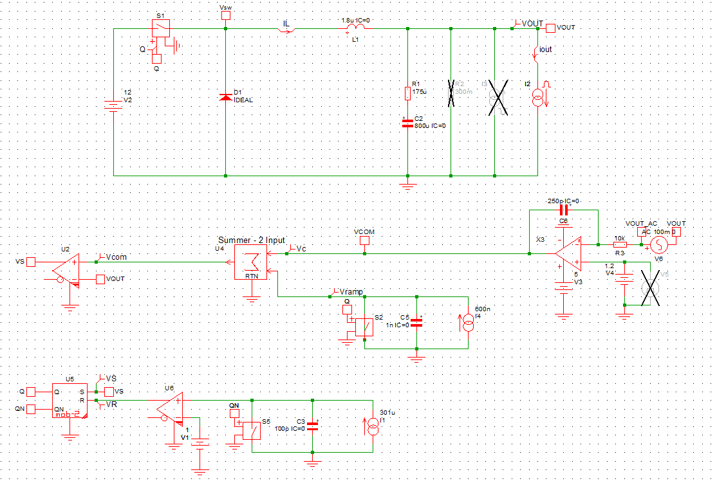
Transistor-level subblock
Process: N16ADFP
OPA
High Speed Comparator
Current Source

Slide 21
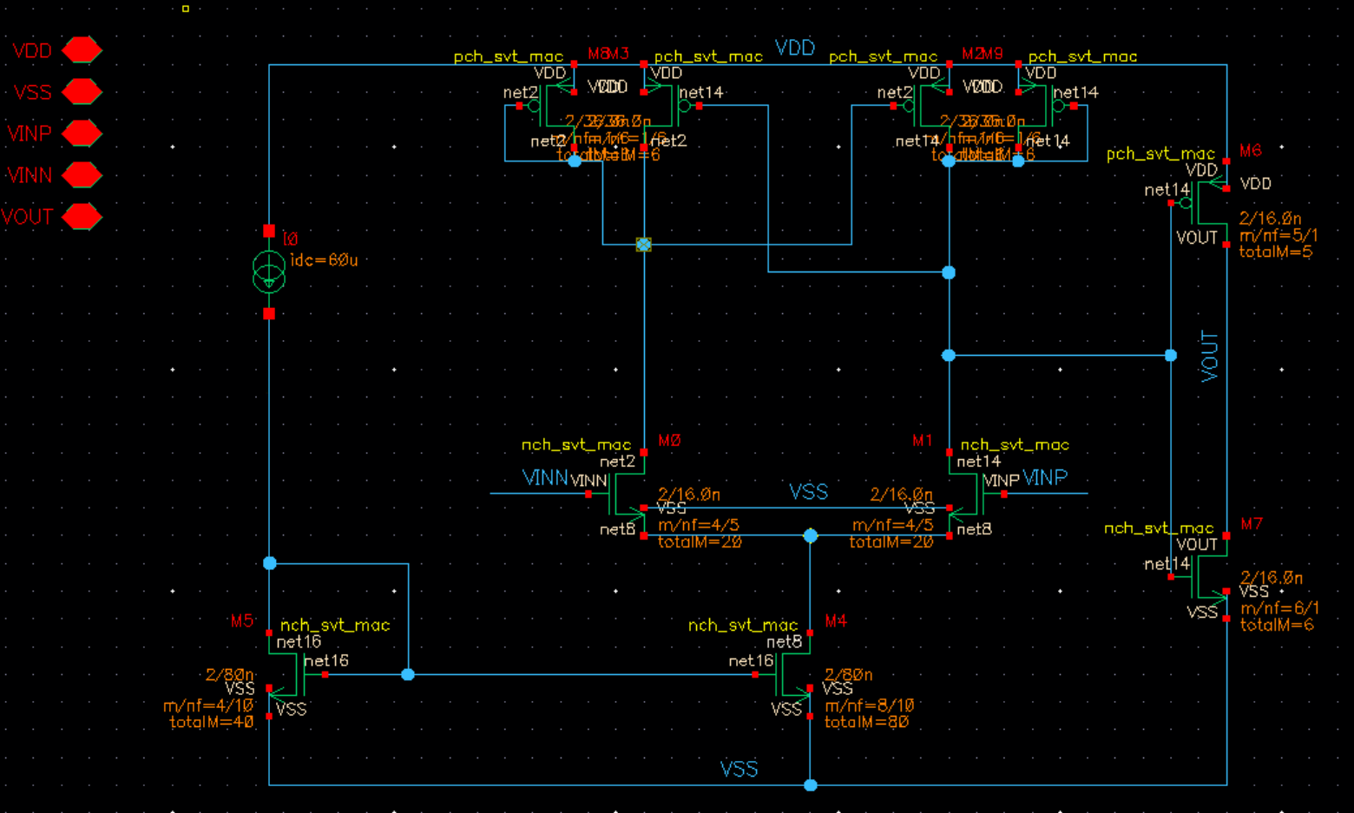
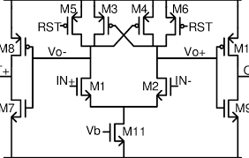
High Speed Comparator
Spec:
Hysteresis: 5 mV - 20 mV, Propagation Delay: <1ns
VDD = 1V, Iref = 60uA

Slide 22
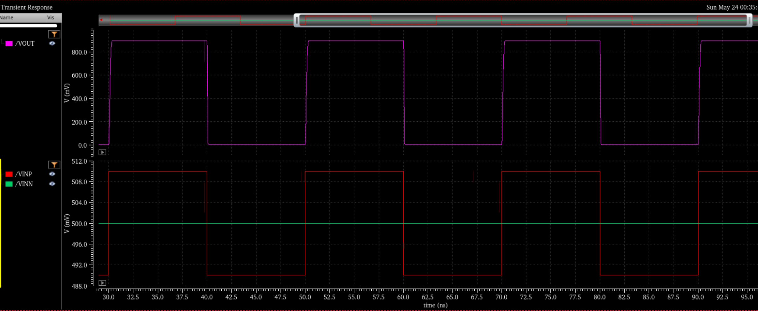
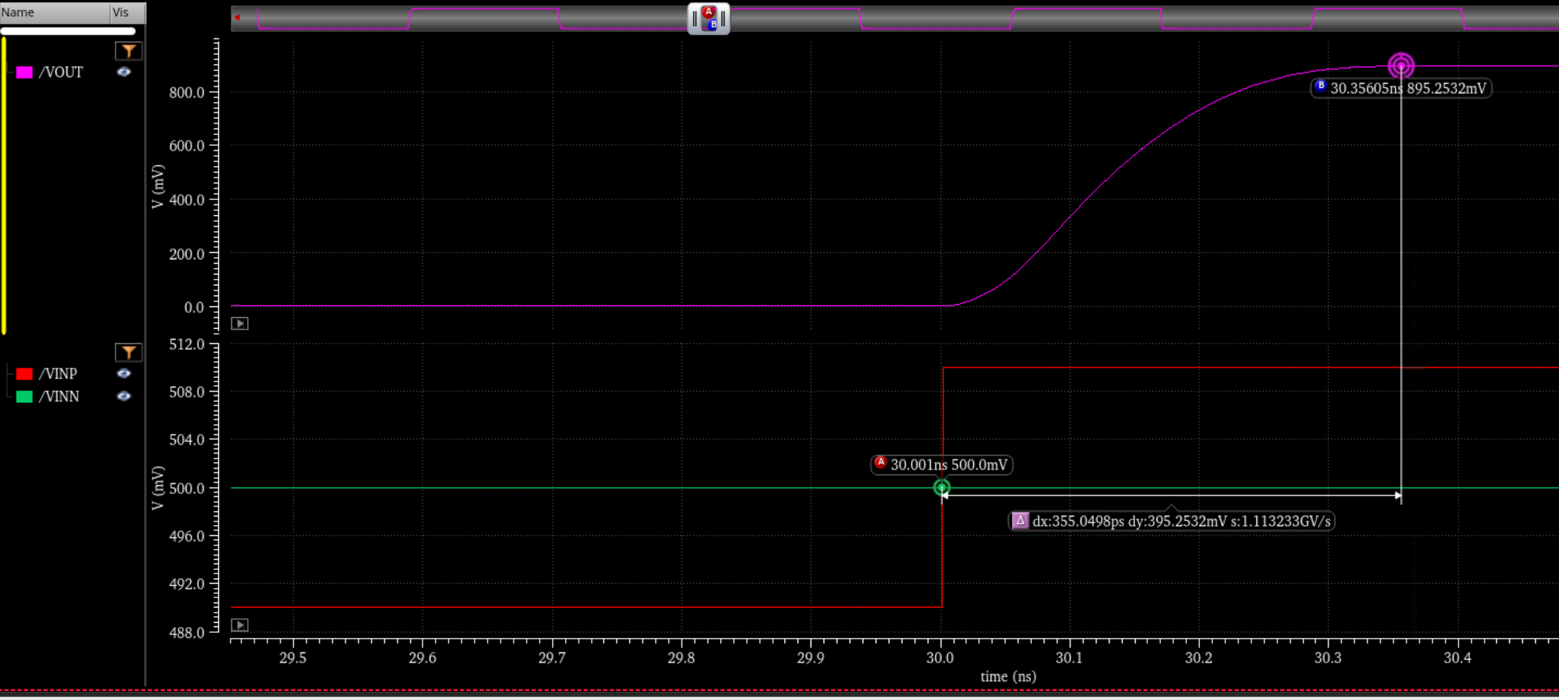
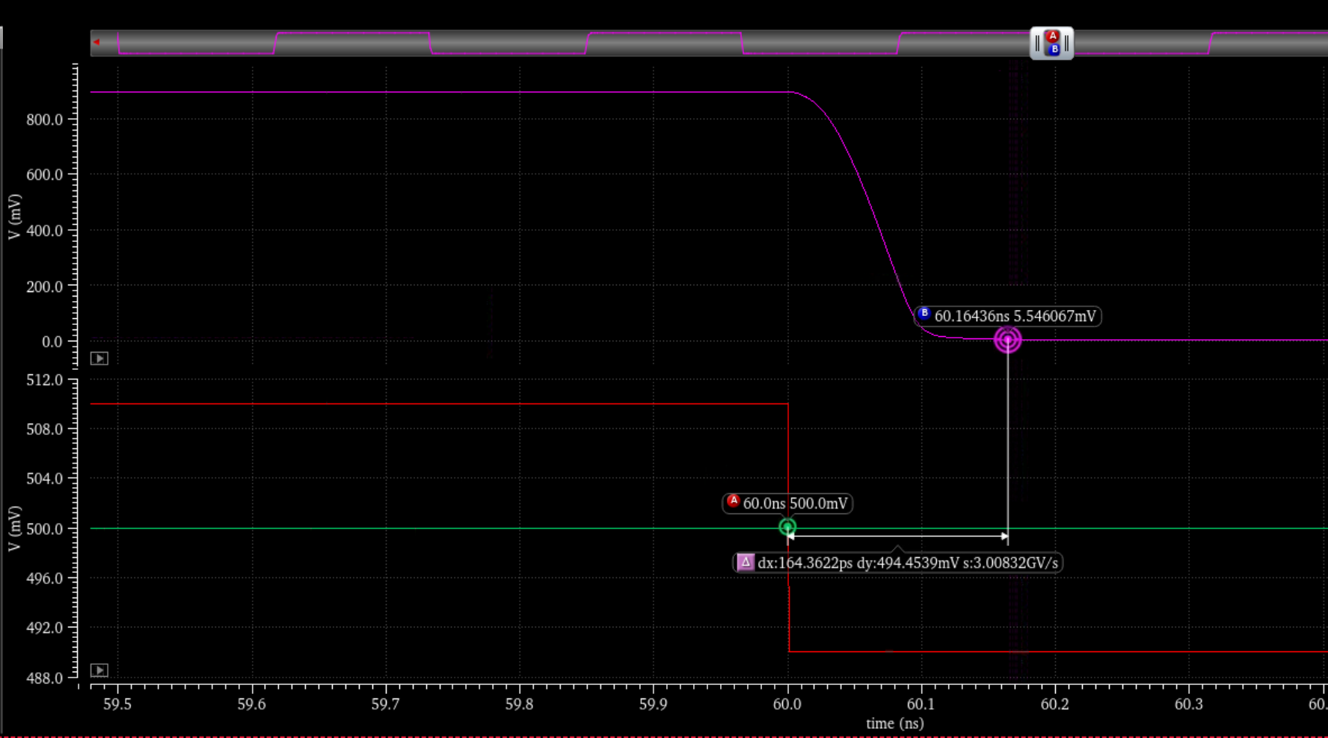
High Speed Comparator - Simulation Result
± 10mV
Propagation delay = 355ps
Propagation delay = 164ps

Slide 23
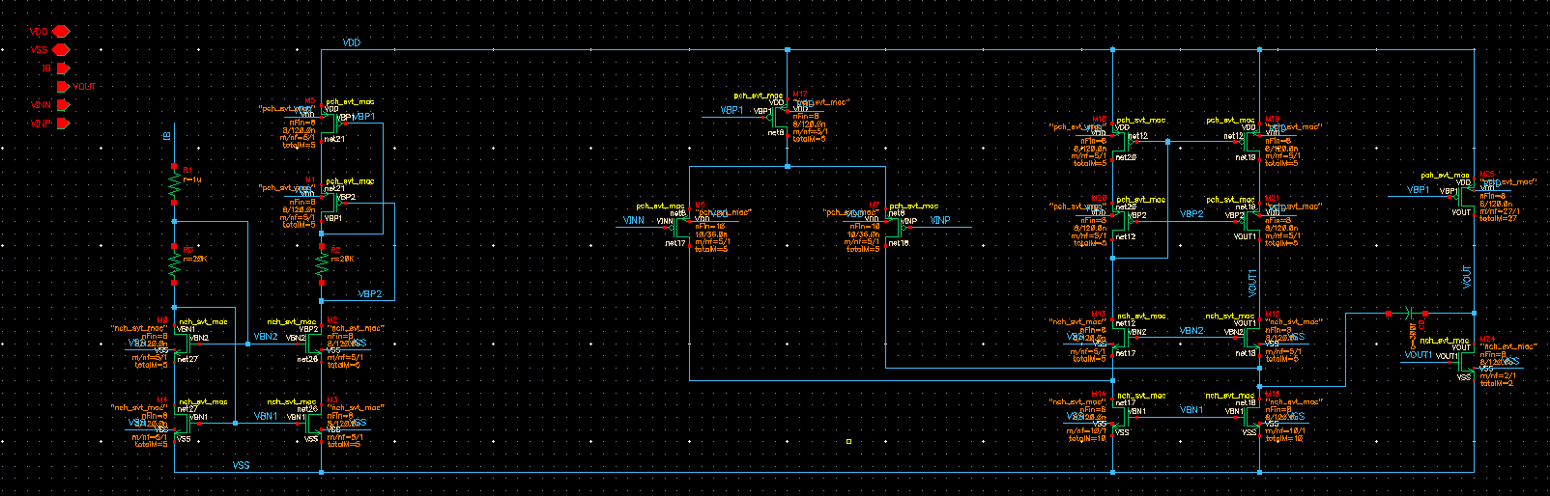
OPA
First Stage
Second Stage
Folded Cascode Opamp
Bias

Slide 24
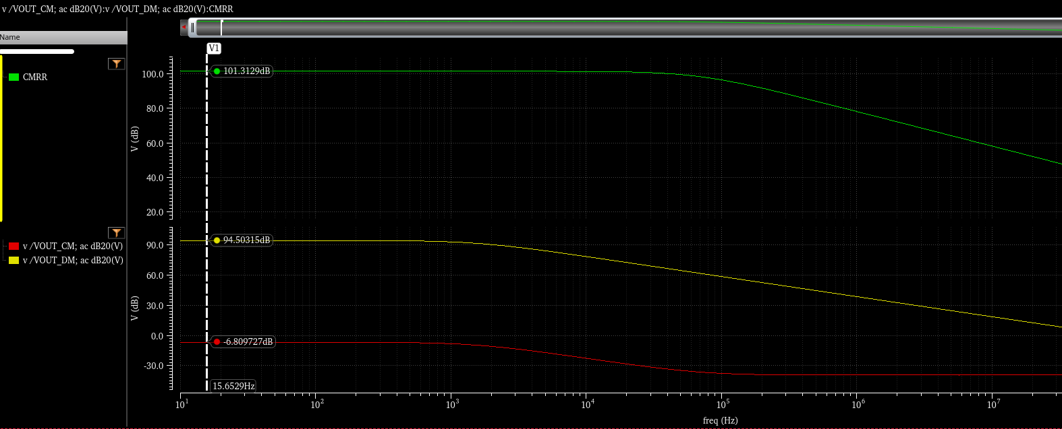
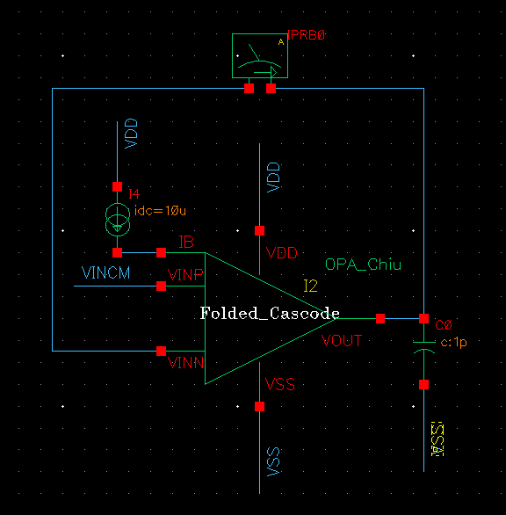
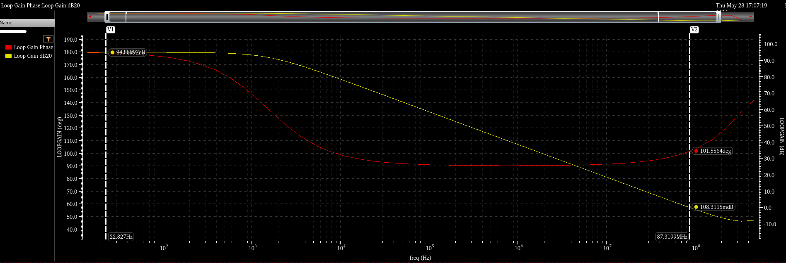
OPA – AC analysis
Gain-Bandwidth: 86.28 MHz
Phase Margin: 101.4∘
Open-Loop Gain: 94.89 dB
CMRR = 101.4dB
CMRR = 101.4dB
Av = 94.89dB
101.4∘

Slide 25
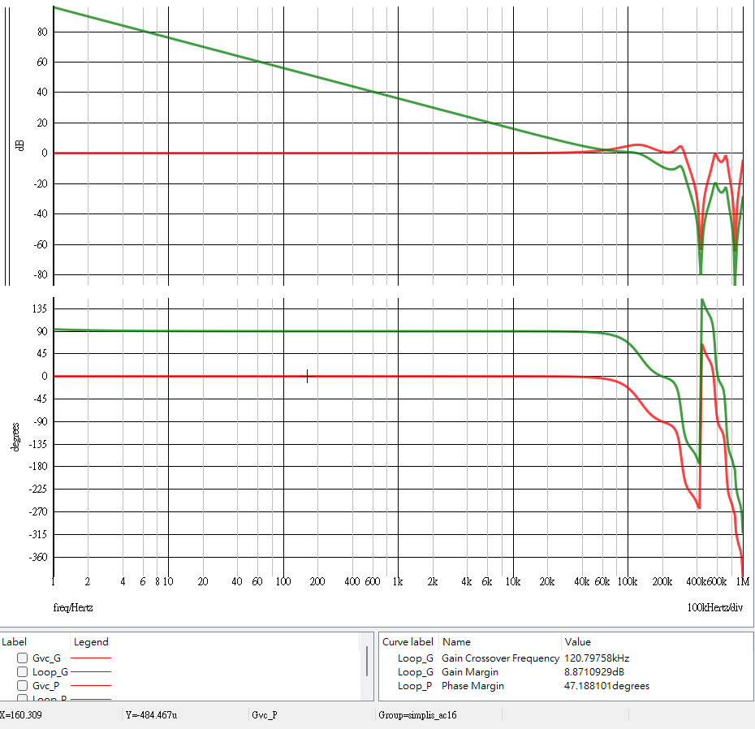
Compensator
Type I compensator
Gain-Bandwidth: 120.8 kHz
Phase Margin: 47.19∘

Slide 26
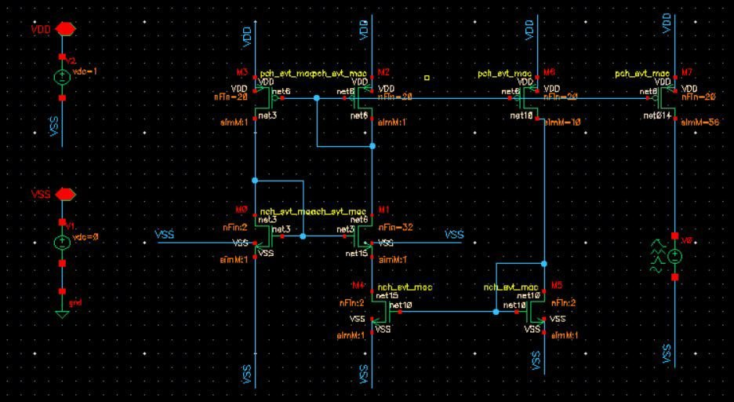
Current Source – Schematic
Resistorless auto bias reference circuit
Better Component Matching
Save Space
Low Power
No Resistor Error
H.J. Oguey, D. Aebicsher, CMOS Current Reference without Resistance, IEEE J. Solid-State Circuits, Volume 32, pag. 1132-1135. 1977.

Slide 27
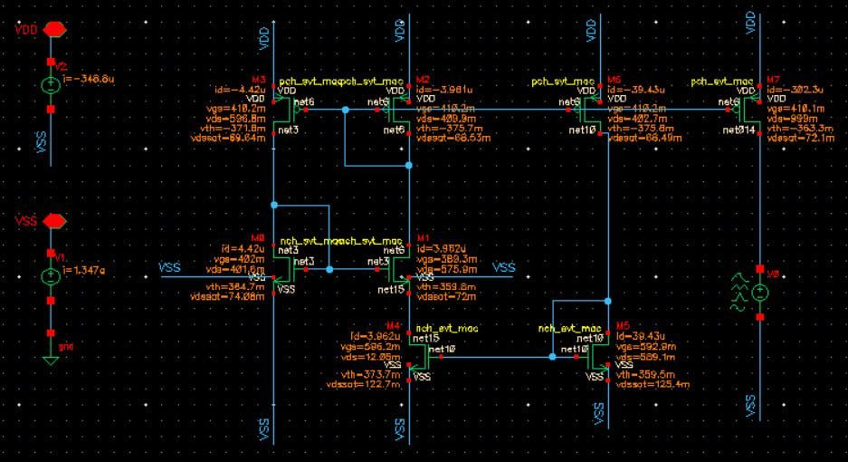
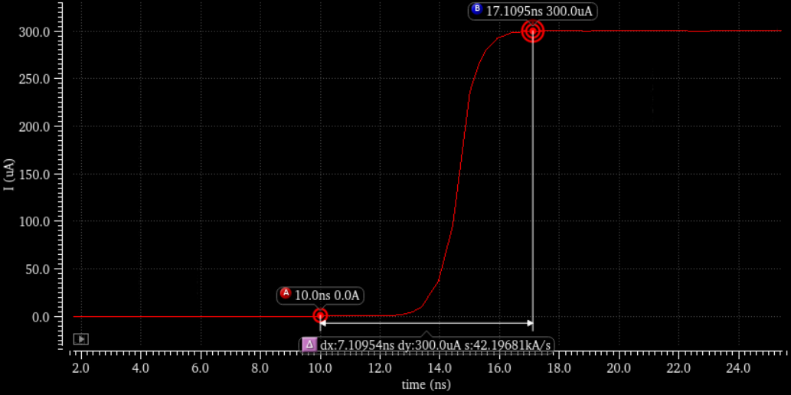



Current Source – Simulation Result
$$300.1 μA$$
$I_{1}$
$$7.72 ns$$

Slide 28
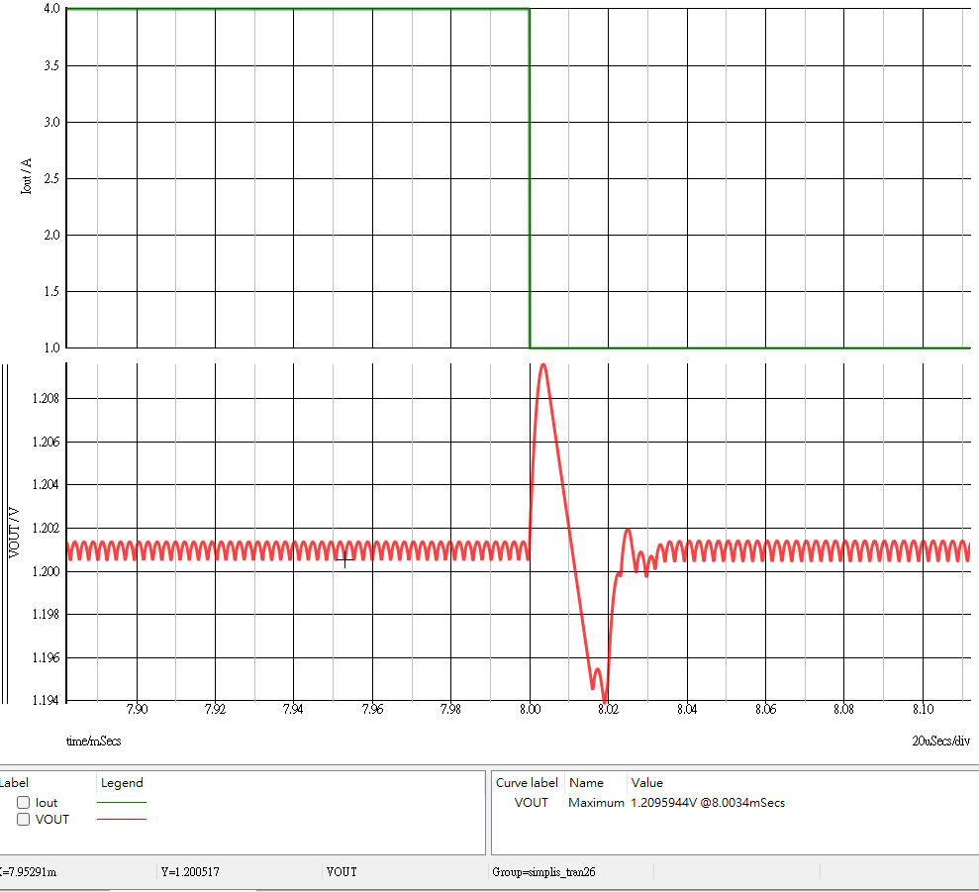
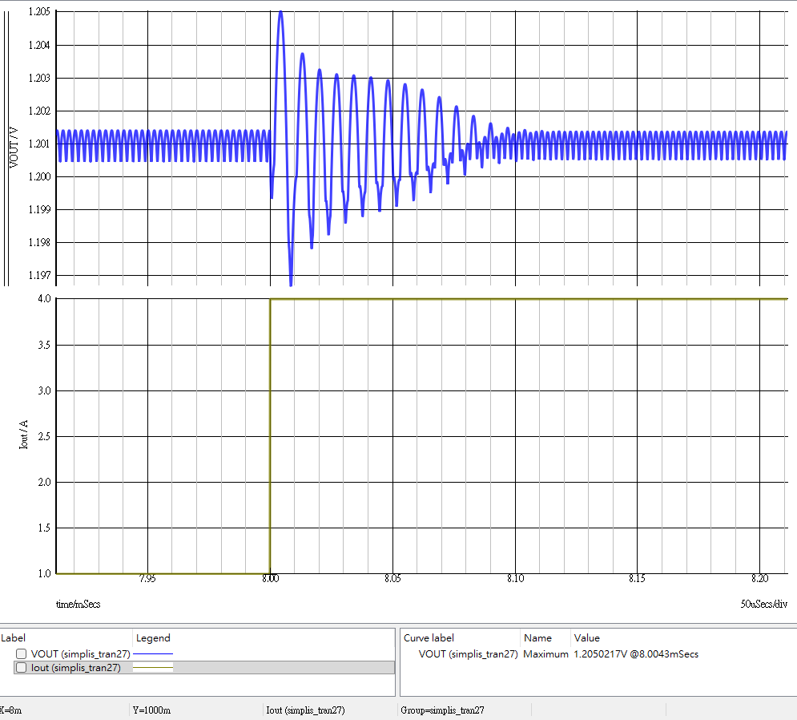
Transistor Level Block in SIMPLS Simulation
Step-down load transient: peak at 1.210V, settling time = 0.04ms
Step-up load transient: peak at 1.197V, settling time = 0.1ms
4A - 1A
1A - 4A

Slide 29
Outline
Introduction
Project spec.
Behavior model simulation
IC subblock analysis and simulation
Conclusions
References

Slide 30
Conclusion
Successfully designed and verified the critical analog sub-blocks for a V² Constant ON-Time controlled Buck converter at the transistor level using TSMC 16nm FinFET technology.
Successful Transistor-Level Design and Verification of Key Sub-Blocks:
Folded Cascode OPA: Achieved a high open-loop gain of 94.89 dB and phase margin of 101.4°.
Type I Compensator: Confirmed stable loop response with a Gain-Bandwidth Product of 120.8 kHz.
Resistorless Current Sources: Successfully generated reference currents of 300.1 μA without utilizing physical resistors.

Slide 31
Reference
Li, Jian, and Fred C. Lee. "Modeling of ${\rm V}^{2} $ Current-Mode Control." IEEE Transactions on Circuits and Systems I: Regular Papers 57.9 (2010): 2552-2563.
H.J. Oguey, D. Aebicsher, CMOS Current Reference without Resistance, IEEE J. Solid-State Circuits, Volume 32, pag. 1132-1135. 1977.

