Slide 1
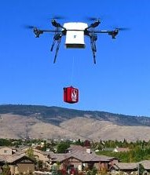

W=W₀+W_{box}
W=W₀
Hovering height h₀
Droping height h_{d}
P₁(x₁,y₁,z₁)
P₀(x₀,y₀,z₀)
z
y
x

