Slide 1


MetaAudio: A Few-Shot Audio Classification Benchmark
Calum Heggan
Mehrdad Yaghoobi UOE Eng
Tim Hospedales UOE Inf
Sam Budgett Thales

Slide 2
Few-shot learning

Slide 3
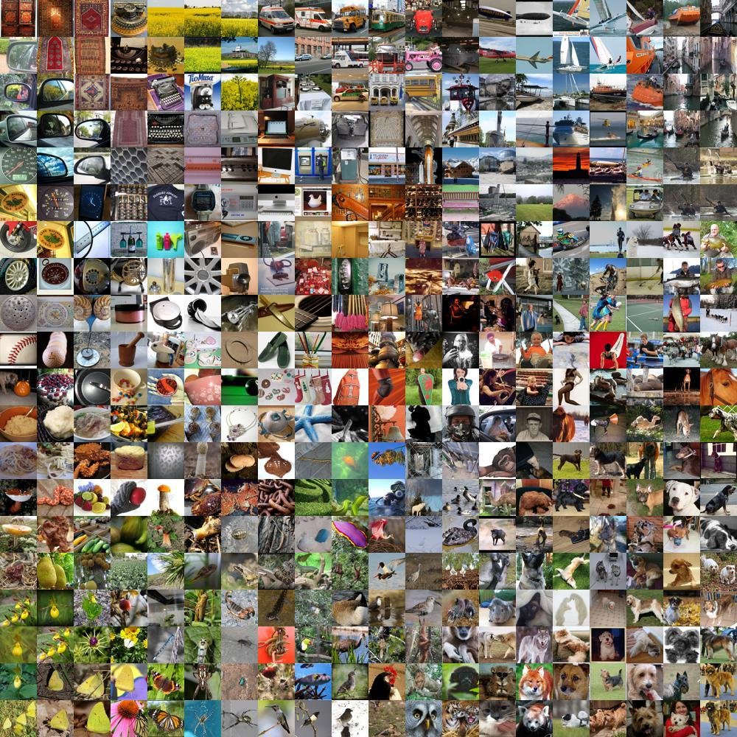
Data Woes
Many successes in machine learning within domains with large quantities of data
Few-shot learning (FSL) aims for minimal data at test time as possible
Most work in FSL exists in imagery
Figure 1: Example of a large dataset corpus

Slide 4
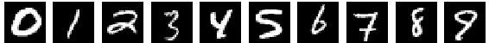
FSL vs Traditional
Traditional typically only contains one type of task, needs mass data for those included objects
FSL wants minimal data at target time, uses distribution p(Ϯ) of similar tasks
Disjoint classes for few-shot learning
Figure 2: Example of batched MNIST, everyone's favourite dataset

Slide 5
Setup & Processing

Slide 6
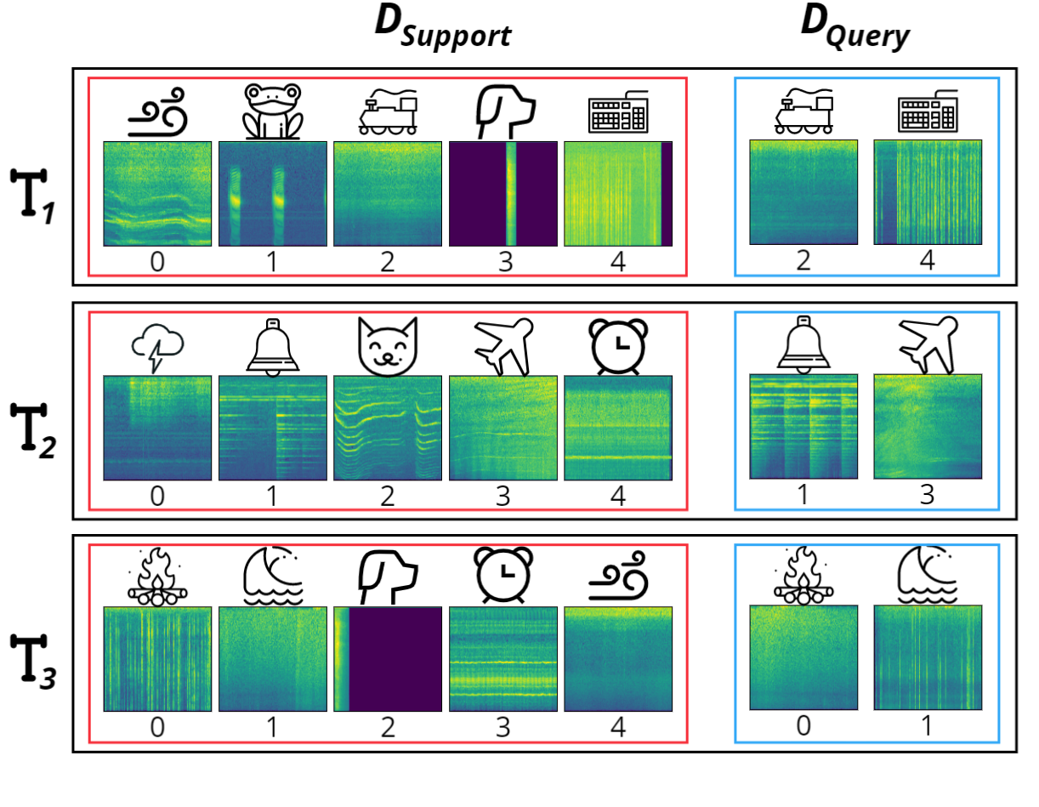
Few-Shot Audio Classification
Training and evaluation in form of tasks
Tasks are sampled as N-way K-shot
Figure 3: Example task sampling for classification. Specifically, this is a 5-way 1-shot problem
Figure 3: Visual of few-shot audio classification

Slide 7
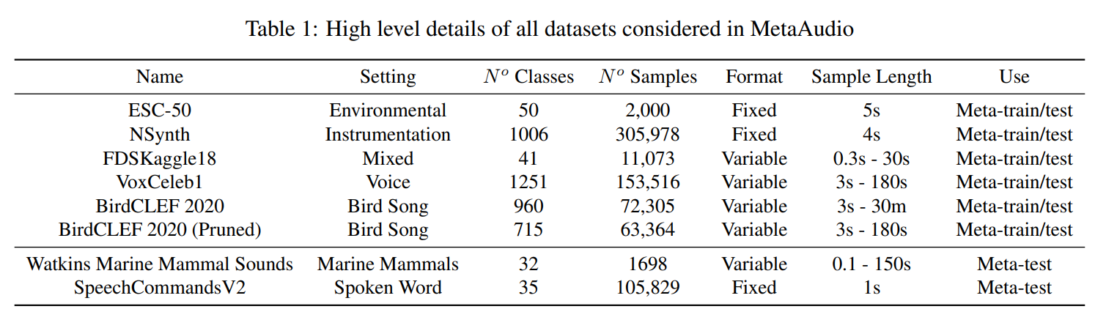
Datasets & Processing
7 datasets covering different sound domains and settings
Processing kept simple with log-mel spectrograms and normalisation

Slide 8
Experimental Results

Slide 9
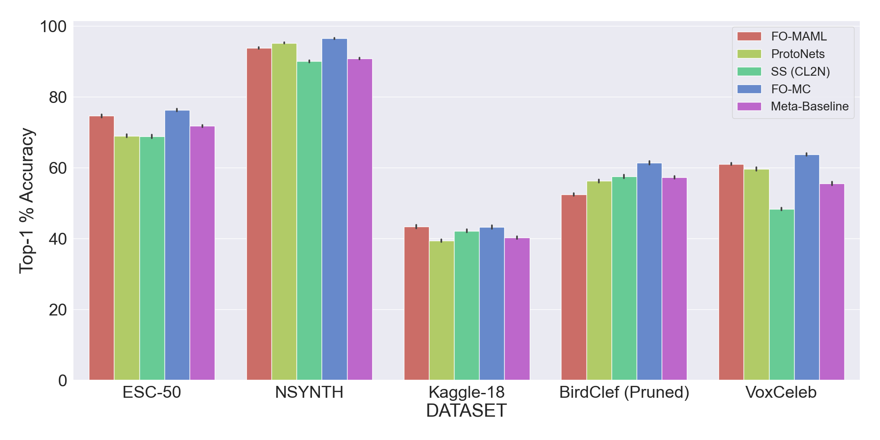
Within Dataset Evaluation
Models are trained and evaluated on different class-wise splits of the same dataset

Slide 10
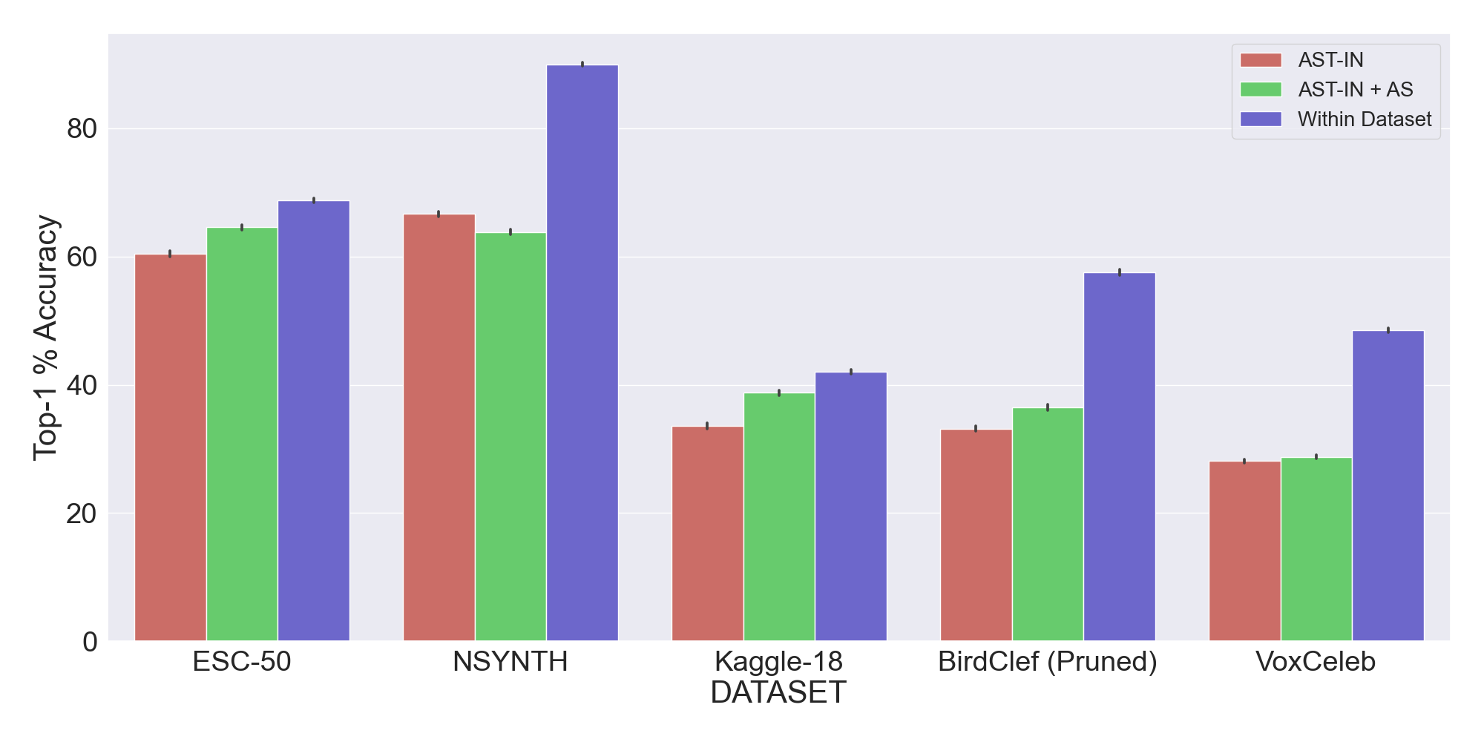
Comparison to Pre-training
Larger models are trained on larger datasets and are used directly for transfer learning

Slide 11
Main Takeaways
Few-shot learning can be an effective tool for low data domains
Work within the few-shot field needs diversification
Most successful algorithms for audio are significantly different than in images
For audio tasks, large scale pre-training falls short of within dataset meta-learning

