Slide 1
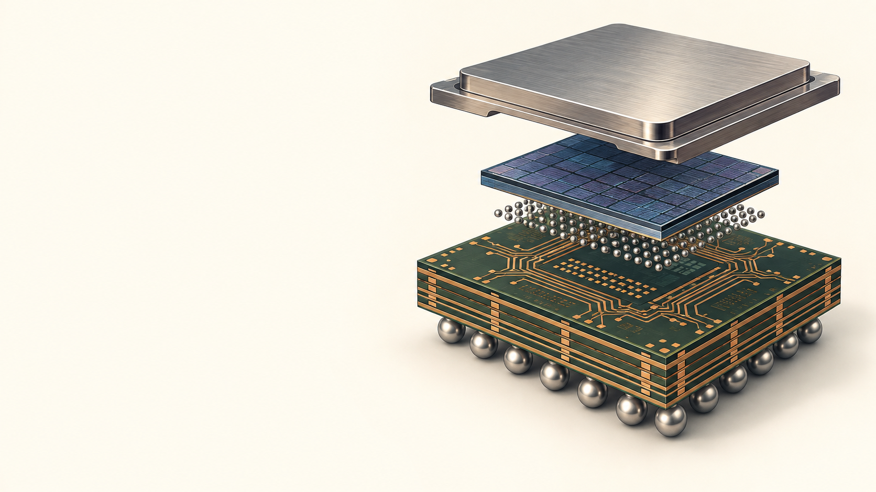


NCKU / DIGITAL TWIN AND IC PACKAGING
30 SEP 2026 H1
TEACHING WEEK 1 / H1
IC packaging process map
The assembly route changes a bare die into a testable package.
Concepts and worked route
01 / 16
Notes:
Timing: 2 min
Teaching intent and transition: Establish the week boundary: September 30 is the first new teaching week after the September 23 introduction. Students will leave with one process, defect, and measurement map.
Visual purpose: The illustration establishes the physical object or engineering problem for this hour. Trace the material state at every operation.
Facilitation prompt: What changes after wafer test?
Expected response: Require a stage-specific answer that names the observable, method, and remaining uncertainty.
Misconception to check: A process label alone explains the mechanism without material state or an observable.
[Sources]
Instructor teaching plan, 23 Sep 2026, 2026_Teaching_Plan_and_Reading_List.md
AI-generated conceptual illustration, 23 Sep 2026, see source-notes.md.

Slide 2

NCKU / DIGITAL TWIN AND IC PACKAGING
30 SEP 2026 H1
The evidence target
One annotated process map is the output for today.
1
2
3
4
input
operation
output
gate
What makes a process map useful for diagnosis?
02 / 16
Notes:
Timing: 2 min
Teaching intent and transition: Show the four columns of the deliverable. Expected answer: a map supports causal tracing because it states where material changed and where evidence was collected.
Visual purpose: The connected chain ties evidence fields to a process or decision. Each step needs an input, transformation, output, and inspection gate.
Facilitation prompt: What makes a process map useful for diagnosis?
Expected response: Require a stage-specific answer that names the observable, method, and remaining uncertainty.
Misconception to check: A screenshot or model prediction is sufficient without case identity, units, and a physical check.
[Sources]
Instructor teaching plan, 23 Sep 2026, 2026_Teaching_Plan_and_Reading_List.md
Editable PowerPoint diagram authored for this lecture, 23 Sep 2026.

Slide 3
NCKU / DIGITAL TWIN AND IC PACKAGING
30 SEP 2026 H1
A known-good die can fail later
Wafer test does not include assembly stress.
1
2
?
wafer test
assembly
final test
Mark one possible failure stage before the answer.
03 / 16
Notes:
Timing: 3 min
Teaching intent and transition: Pause for prediction. Accept bond damage, misalignment, or package stress as hypotheses. The misconception is that a good wafer-level electrical test proves the final package.
Visual purpose: The partial route gives students a place to predict the missing mechanism. Predict where a working die could become an open circuit.
Facilitation prompt: Mark one possible failure stage before the answer.
Expected response: Assembly can introduce an open at a bond, joint, or die interface; wafer test cannot rule this out.
Misconception to check: Wafer test or a final electrical fail identifies the exact later physical cause.
[Sources]
IEEE EPS HIR 2024, Ch. 17 Test Technology | https://eps.ieee.org/wp-content/uploads/2025/11/HIR_2024_ch17_Test_Technology.pdf
Editable PowerPoint diagram authored for this lecture, 23 Sep 2026.

Slide 4
NCKU / DIGITAL TWIN AND IC PACKAGING
30 SEP 2026 H1
Package interfaces
The die connects to the board through two interconnect levels.
silicon die
first-level join
substrate routing
second-level join
PCB
Trace one signal path aloud.
04 / 16
Notes:
Timing: 3 min
Teaching intent and transition: Point to each interface. Ask students to distinguish die-to-package from package-to-board. This terminology is needed before the process map.
Visual purpose: The layered diagram locates the interface in the package stack. First-level joining reaches the package; second-level joining reaches the PCB.
Facilitation prompt: Trace one signal path aloud.
Expected response: Require a stage-specific answer that names the observable, method, and remaining uncertainty.
Misconception to check: A process label alone explains the mechanism without material state or an observable.
[Sources]
IEEE EPS HIR 2024, Ch. 22 Interconnects | https://eps.ieee.org/wp-content/uploads/2025/11/HIR_2024_ch22_2D-3D.pdf
Editable PowerPoint diagram authored for this lecture, 23 Sep 2026.

Slide 5
NCKU / DIGITAL TWIN AND IC PACKAGING
30 SEP 2026 H1
A process map records state changes
Each operation changes geometry, material, or connectivity.
1
2
3
4
5
6
wafer prep
singulation
die attach
interconnect
protect
final test
Which boxes change connectivity?
05 / 16
Notes:
Timing: 4 min
Teaching intent and transition: Move across the route. Have students label material state after each operation. Explain that verification gates may occur at several steps.
Visual purpose: The editable route shows operation order and where state changes occur. Inspections observe selected properties; they do not reverse the process.
Facilitation prompt: Which boxes change connectivity?
Expected response: Require a stage-specific answer that names the observable, method, and remaining uncertainty.
Misconception to check: A process label alone explains the mechanism without material state or an observable.
[Sources]
Instructor teaching plan, 23 Sep 2026, 2026_Teaching_Plan_and_Reading_List.md
Editable PowerPoint diagram authored for this lecture, 23 Sep 2026.

Slide 6

NCKU / DIGITAL TWIN AND IC PACKAGING
30 SEP 2026 H1
Singulation separates the dies
Dicing makes individual dies while they remain supported on tape.
01
wafer
02
saw street
03
dicing tape
Why inspect before die attach?
06 / 16
Notes:
Timing: 4 min
Teaching intent and transition: Use the image to locate the blade, silicon, and tape. The image is conceptual. Expected answer: upstream damage may be hidden or amplified during later assembly.
Visual purpose: The annotated conceptual image shows the physical parts and their spatial relationship. Watch for edge chipping and handling damage.
Facilitation prompt: Why inspect before die attach?
Expected response: Require a stage-specific answer that names the observable, method, and remaining uncertainty.
Misconception to check: Every visible edge feature is a functional failure.
[Sources]
Instructor teaching plan, 23 Sep 2026, 2026_Teaching_Plan_and_Reading_List.md
AI-generated conceptual illustration, 23 Sep 2026, see source-notes.md.

Slide 7
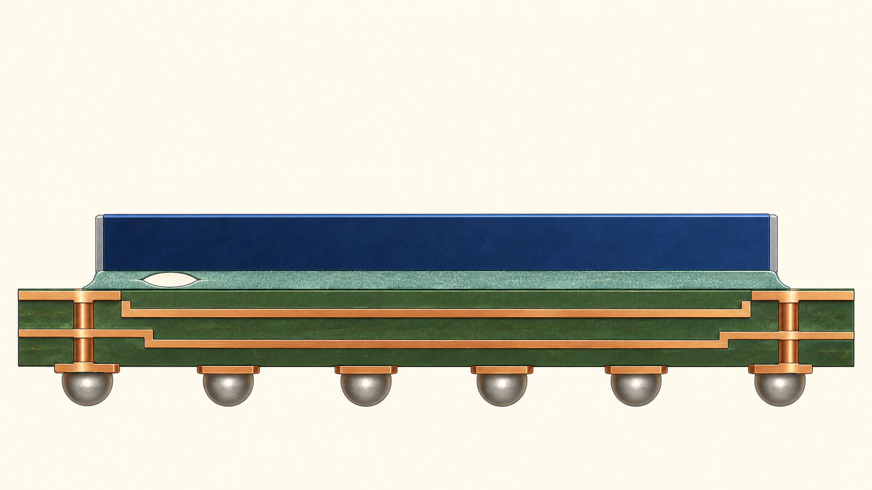
NCKU / DIGITAL TWIN AND IC PACKAGING
30 SEP 2026 H1
Die attach creates an interface
The attach layer carries heat and mechanical load.
01
silicon
02
attach layer
03
void
04
substrate
What could detect a buried void?
07 / 16
Notes:
Timing: 4 min
Teaching intent and transition: Identify the visible void as a conceptual defect, not a measurement. Ask students to connect location and size to possible thermal or mechanical consequence; acoustic inspection is a candidate method.
Visual purpose: The annotated conceptual image shows the physical parts and their spatial relationship. A local void changes the contact area and may concentrate stress.
Facilitation prompt: What could detect a buried void?
Expected response: Require a stage-specific answer that names the observable, method, and remaining uncertainty.
Misconception to check: Every void has the same consequence regardless of area, position, and load.
[Sources]
IEEE EPS HIR 2024, Ch. 22 Interconnects | https://eps.ieee.org/wp-content/uploads/2025/11/HIR_2024_ch22_2D-3D.pdf
AI-generated conceptual illustration, 23 Sep 2026, see source-notes.md.

Slide 8
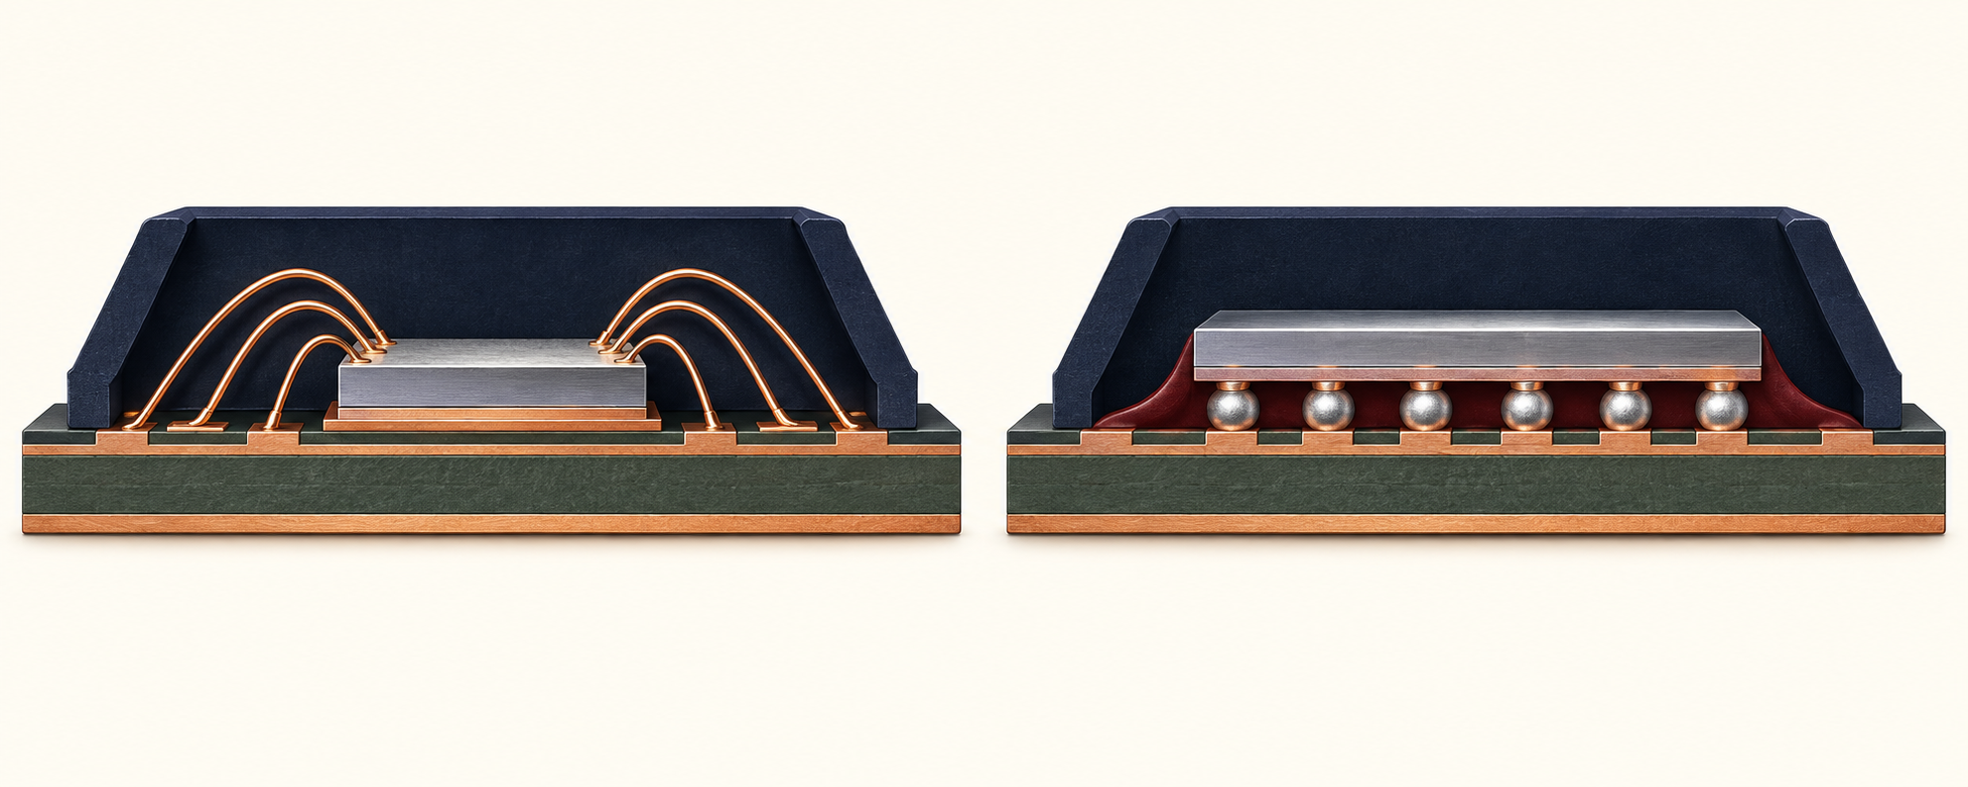
NCKU / DIGITAL TWIN AND IC PACKAGING
30 SEP 2026 H1
The first join has two routes
Wire bonds connect edge pads; flip-chip bumps connect a face-down die.
01
wire bond
02
flip chip
Where is the first-level connection in each?
08 / 16
Notes:
Timing: 4 min
Teaching intent and transition: Do not turn this into an architecture-selection lecture, which belongs later in the semester. Use the comparison only to understand process branch points.
Visual purpose: The annotated conceptual image shows the physical parts and their spatial relationship. The routes change pad access, assembly sequence, and protection.
Facilitation prompt: Where is the first-level connection in each?
Expected response: Require a stage-specific answer that names the observable, method, and remaining uncertainty.
Misconception to check: A process label alone explains the mechanism without material state or an observable.
[Sources]
ASE Flip Chip Packaging | https://ase.aseglobal.com/flip-chip-packaging/
AI-generated conceptual illustration, 23 Sep 2026, see source-notes.md.

Slide 9
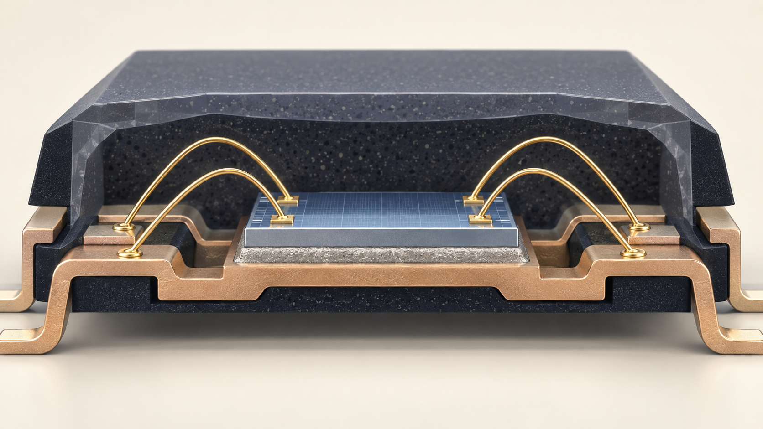
NCKU / DIGITAL TWIN AND IC PACKAGING
30 SEP 2026 H1
Wire bonding has two joints
A bond wire must make sound connections at both ends.
01
first bond
02
loop
03
second bond
Which observation tests the joint rather than the loop?
09 / 16
Notes:
Timing: 4 min
Teaching intent and transition: Trace the path through die pad, first bond, loop, second bond, and substrate pad. A pull or shear sample probes strength; optical inspection primarily reveals geometry.
Visual purpose: The annotated conceptual image shows the physical parts and their spatial relationship. Loop shape and joint quality are separate inspection targets.
Facilitation prompt: Which observation tests the joint rather than the loop?
Expected response: Require a stage-specific answer that names the observable, method, and remaining uncertainty.
Misconception to check: A visually acceptable loop proves the bond joints are strong.
[Sources]
ASE Flip Chip Packaging | https://ase.aseglobal.com/flip-chip-packaging/
AI-generated conceptual illustration, 23 Sep 2026, see source-notes.md.

Slide 10
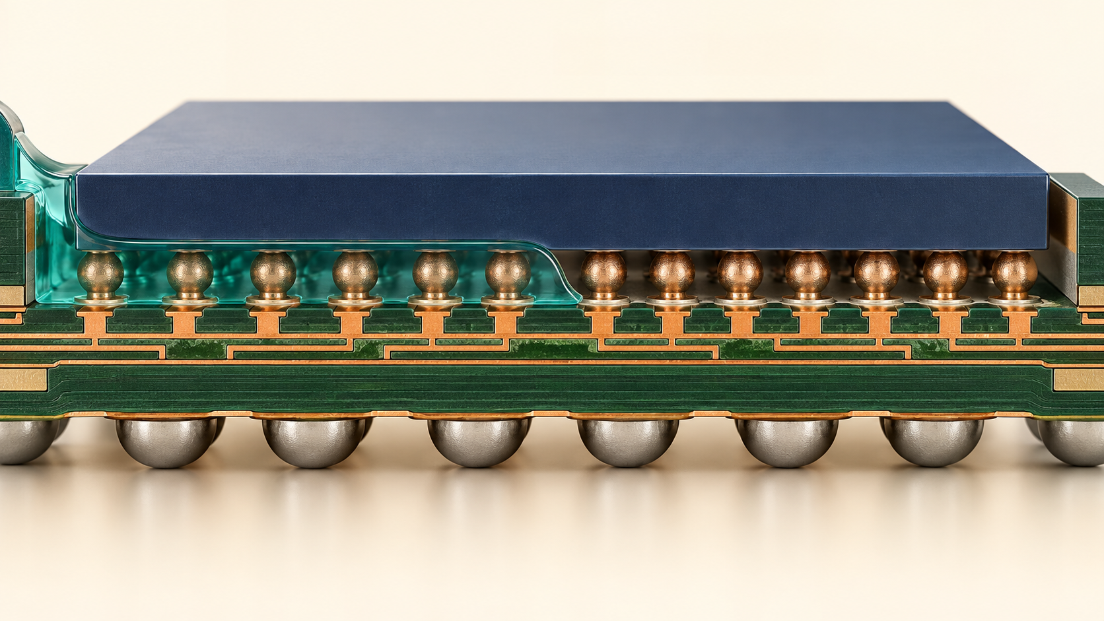
NCKU / DIGITAL TWIN AND IC PACKAGING
30 SEP 2026 H1
Flip-chip assembly fills the gap
Aligned bumps join the die to the substrate before underfill.
01
die
02
bump array
03
underfill front
04
substrate
What remains at risk if flow stops early?
10 / 16
Notes:
Timing: 5 min
Teaching intent and transition: Show the advancing meniscus. Explain that incomplete filling can leave unsupported joints or trapped voids. Avoid claiming a universal underfill recipe.
Visual purpose: The annotated conceptual image shows the physical parts and their spatial relationship. Underfill occupies the die-substrate gap around the joints.
Facilitation prompt: What remains at risk if flow stops early?
Expected response: Require a stage-specific answer that names the observable, method, and remaining uncertainty.
Misconception to check: A joined bump array guarantees that the die-substrate gap filled completely.
[Sources]
ASE Flip Chip Packaging | https://ase.aseglobal.com/flip-chip-packaging/
AI-generated conceptual illustration, 23 Sep 2026, see source-notes.md.

Slide 11
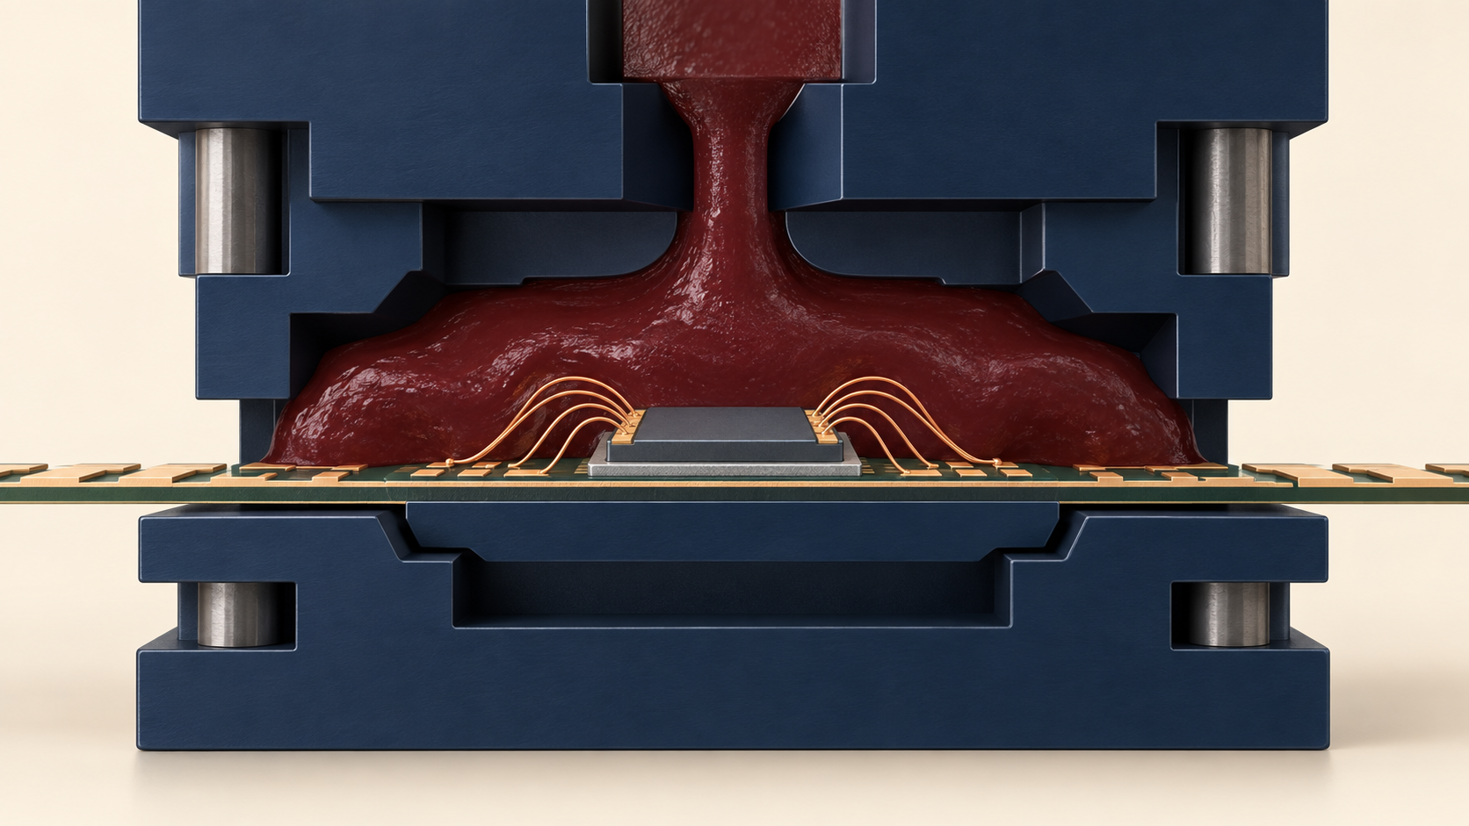
NCKU / DIGITAL TWIN AND IC PACKAGING
30 SEP 2026 H1
Molding protects the structure
Encapsulation covers the die and first-level connections.
01
mold cavity
02
compound
03
wires
04
substrate
Could protection create a new defect?
11 / 16
Notes:
Timing: 4 min
Teaching intent and transition: The generated cutaway is conceptual. Discuss incomplete fill, wire sweep, delamination, and later cure stress as risks, without implying every process uses this exact tool.
Visual purpose: The annotated conceptual image shows the physical parts and their spatial relationship. The protection step also adds material and thermal history.
Facilitation prompt: Could protection create a new defect?
Expected response: Require a stage-specific answer that names the observable, method, and remaining uncertainty.
Misconception to check: Protection steps cannot introduce defects of their own.
[Sources]
Instructor teaching plan, 23 Sep 2026, 2026_Teaching_Plan_and_Reading_List.md
AI-generated conceptual illustration, 23 Sep 2026, see source-notes.md.

Slide 12
NCKU / DIGITAL TWIN AND IC PACKAGING
30 SEP 2026 H1
Test follows assembly stress
Final test checks electrical function after the package is built.
1
2
3
4
inspect geometry
test continuity
test function
record disposition
Can a failed test locate its own root cause?
12 / 16
Notes:
Timing: 5 min
Teaching intent and transition: Explain how assembly can cause a failure after wafer test. Expected answer: final test can detect a problem but often cannot locate the physical cause without further inspection.
Visual purpose: The editable route shows operation order and where state changes occur. Inspection and electrical test answer different questions.
Facilitation prompt: Can a failed test locate its own root cause?
Expected response: Require a stage-specific answer that names the observable, method, and remaining uncertainty.
Misconception to check: A process label alone explains the mechanism without material state or an observable.
[Sources]
IEEE EPS HIR 2024, Ch. 17 Test Technology | https://eps.ieee.org/wp-content/uploads/2025/11/HIR_2024_ch17_Test_Technology.pdf
Editable PowerPoint diagram authored for this lecture, 23 Sep 2026.

Slide 13
NCKU / DIGITAL TWIN AND IC PACKAGING
30 SEP 2026 H1
Worked route: attach void
A void introduced at die attach may remain latent until later.
PROCESS STAGE
HYPOTHESIS
1
2
3
4
die attach
local void
acoustic indication
possible heat-path change
Which link is a hypothesis rather than an observation?
13 / 16
Notes:
Timing: 4 min
Teaching intent and transition: Work each link explicitly. The void is an illustrative scenario; the thermal consequence depends on geometry and load. An acoustic indication is evidence of an interface feature, not proof of a performance loss.
Visual purpose: The chain separates a defect hypothesis from an observed result. Trace the stage, observable, possible mechanism, and next action.
Facilitation prompt: Which link is a hypothesis rather than an observation?
Expected response: Require a stage-specific answer that names the observable, method, and remaining uncertainty.
Misconception to check: Every void has the same consequence regardless of area, position, and load.
[Sources]
IEEE EPS HIR 2024, Ch. 22 Interconnects | https://eps.ieee.org/wp-content/uploads/2025/11/HIR_2024_ch22_2D-3D.pdf
Editable PowerPoint diagram authored for this lecture, 23 Sep 2026.

Slide 14
NCKU / DIGITAL TWIN AND IC PACKAGING
30 SEP 2026 H1
Inspection follows the question
Choose a method for the defect you suspect.
suspected feature
candidate observation
blind spot
attach void
acoustic image
size / significance
wire loop
optical view
bond strength
open circuit
continuity test
physical location
Which method helps with a buried attach void?
14 / 16
Notes:
Timing: 3 min
Teaching intent and transition: Model the selection: acoustic microscopy may reveal interface discontinuity, while electrical test cannot localize it. Mention method resolution and interpretation limits.
Visual purpose: The editable matrix relates methods and physical observables. Internal interface, visible geometry, and electrical behavior need different observations.
Facilitation prompt: Which method helps with a buried attach void?
Expected response: Require a stage-specific answer that names the observable, method, and remaining uncertainty.
Misconception to check: One inspection method can detect every relevant failure mechanism.
[Sources]
IEEE EPS HIR 2024, Ch. 17 Test Technology | https://eps.ieee.org/wp-content/uploads/2025/11/HIR_2024_ch17_Test_Technology.pdf
Editable PowerPoint diagram authored for this lecture, 23 Sep 2026.

Slide 15
NCKU / DIGITAL TWIN AND IC PACKAGING
30 SEP 2026 H1
A final fail is not a diagnosis
The same electrical fail can follow different process faults.
bond open
joint bridge
die damage
What extra observation would separate these?
15 / 16
Notes:
Timing: 3 min
Teaching intent and transition: Challenge the misconception that a pass/fail bit identifies root cause. Ask for one discriminating observation for each candidate mechanism.
Visual purpose: The ruled comparison separates alternatives under a common question. Use location and mechanism evidence before naming the cause.
Facilitation prompt: What extra observation would separate these?
Expected response: One electrical symptom can arise from several physical faults; choose a discriminating observation.
Misconception to check: Wafer test or a final electrical fail identifies the exact later physical cause.
[Sources]
IEEE EPS HIR 2024, Ch. 17 Test Technology | https://eps.ieee.org/wp-content/uploads/2025/11/HIR_2024_ch17_Test_Technology.pdf
Editable PowerPoint diagram authored for this lecture, 23 Sep 2026.

Slide 16
NCKU / DIGITAL TWIN AND IC PACKAGING
30 SEP 2026 H1
H1 checkpoint
Complete the route from die preparation to final test.
step
material state
defect
gate
Save the map for H2.
16 / 16
Notes:
Timing: 2 min
Teaching intent and transition: Collect a map with all major stages and two gates. H2 will use it to test whether each defect can be observed at the chosen gate.
Visual purpose: The blank grid is the artifact students fill and save. Add two inspection gates and one plausible latent defect.
Facilitation prompt: Save the map for H2.
Expected response: Require a stage-specific answer that names the observable, method, and remaining uncertainty.
Misconception to check: A process label alone explains the mechanism without material state or an observable.
[Sources]
Instructor teaching plan, 23 Sep 2026, 2026_Teaching_Plan_and_Reading_List.md
Editable PowerPoint diagram authored for this lecture, 23 Sep 2026.

