Slide 1
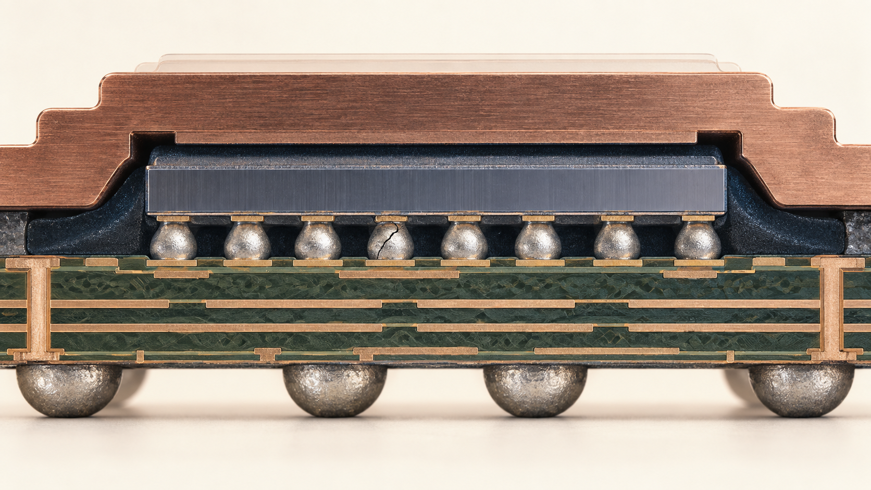


NCKU / DIGITAL TWIN AND IC PACKAGING
30 SEP 2026 H2
TEACHING WEEK 1 / H2
Defects and inspection gates
A defect map links where a fault begins to where it can be seen.
Guided process analysis
01 / 16
Notes:
Timing: 2 min
Teaching intent and transition: Restore the H1 map. The conceptual image shows one possible interconnect failure; it is not a measured micrograph.
Visual purpose: The illustration establishes the physical object or engineering problem for this hour. The task is to defend an observation, not merely name a defect.
Facilitation prompt: Which gate would you add first?
Expected response: Require a stage-specific answer that names the observable, method, and remaining uncertainty.
Misconception to check: One inspection method can detect every relevant failure mechanism.
[Sources]
Instructor teaching plan, 23 Sep 2026, 2026_Teaching_Plan_and_Reading_List.md
AI-generated conceptual illustration, 23 Sep 2026, see source-notes.md.

Slide 2

NCKU / DIGITAL TWIN AND IC PACKAGING
30 SEP 2026 H2
Retrieval: locate the origin
A failed final test may reflect an earlier assembly operation.
1
2
?
final fail
inspection record
candidate stage
Which H1 gate would narrow the search?
02 / 16
Notes:
Timing: 2 min
Teaching intent and transition: Ask students to bring the H1 map. Expected answer varies by available records; the misconception is that the final test directly reveals the origin.
Visual purpose: The partial route gives students a place to predict the missing mechanism. Work backward from a nonfunctional package.
Facilitation prompt: Which H1 gate would narrow the search?
Expected response: Require a stage-specific answer that names the observable, method, and remaining uncertainty.
Misconception to check: A process label alone explains the mechanism without material state or an observable.
[Sources]
IEEE EPS HIR 2024, Ch. 17 Test Technology | https://eps.ieee.org/wp-content/uploads/2025/11/HIR_2024_ch17_Test_Technology.pdf
Editable PowerPoint diagram authored for this lecture, 23 Sep 2026.

Slide 3
NCKU / DIGITAL TWIN AND IC PACKAGING
30 SEP 2026 H2
The H2 evidence product
Add one row per credible failure mechanism.
1
2
3
4
5
stage
defect
observable
method
decision
What must be measurable in the row?
03 / 16
Notes:
Timing: 3 min
Teaching intent and transition: Display the template used in guided practice. Explain that a test name alone is not enough; the student must say what it observes.
Visual purpose: The connected chain ties evidence fields to a process or decision. For each row, record stage, defect, observable, method, and decision.
Facilitation prompt: What must be measurable in the row?
Expected response: Require a stage-specific answer that names the observable, method, and remaining uncertainty.
Misconception to check: A screenshot or model prediction is sufficient without case identity, units, and a physical check.
[Sources]
Instructor teaching plan, 23 Sep 2026, 2026_Teaching_Plan_and_Reading_List.md
Editable PowerPoint diagram authored for this lecture, 23 Sep 2026.

Slide 4
NCKU / DIGITAL TWIN AND IC PACKAGING
30 SEP 2026 H2
Four observation classes
Geometry, interface integrity, continuity, and function differ.
geometry
internal interface
continuity
function
loop height
bond gap
open net
logic fail
die edge
attach void
short net
timing fail
visible
buried
electrical
system
Where does a visual microscope have a blind spot?
04 / 16
Notes:
Timing: 3 min
Teaching intent and transition: Define each class with a concrete example. An optical microscope can inspect exposed geometry but cannot see a buried attach void.
Visual purpose: The editable matrix relates methods and physical observables. A method can be strong for one class and blind to another.
Facilitation prompt: Where does a visual microscope have a blind spot?
Expected response: Require a stage-specific answer that names the observable, method, and remaining uncertainty.
Misconception to check: A process label alone explains the mechanism without material state or an observable.
[Sources]
IEEE EPS HIR 2024, Ch. 17 Test Technology | https://eps.ieee.org/wp-content/uploads/2025/11/HIR_2024_ch17_Test_Technology.pdf
Editable PowerPoint diagram authored for this lecture, 23 Sep 2026.

Slide 5
NCKU / DIGITAL TWIN AND IC PACKAGING
30 SEP 2026 H2
Dicing damage is local
Edge chips and cracks may begin at singulation.
scribe street
possible edge chip
What would you inspect before placement?
05 / 16
Notes:
Timing: 4 min
Teaching intent and transition: Use the editable die-edge diagram to show the possible location. Do not imply every chip causes failure; impact depends on extent and later loading.
Visual purpose: The editable locator identifies distinct physical failure sites. An apparently intact die can still need a targeted check.
Facilitation prompt: What would you inspect before placement?
Expected response: Require a stage-specific answer that names the observable, method, and remaining uncertainty.
Misconception to check: Every visible edge feature is a functional failure.
[Sources]
Instructor teaching plan, 23 Sep 2026, 2026_Teaching_Plan_and_Reading_List.md
Editable PowerPoint diagram authored for this lecture, 23 Sep 2026.

Slide 6
NCKU / DIGITAL TWIN AND IC PACKAGING
30 SEP 2026 H2
Attach voids hide at an interface
A void can evade surface viewing.
die
attach
local void
substrate
Why could electrical test still pass?
06 / 16
Notes:
Timing: 4 min
Teaching intent and transition: The device may function electrically despite a local attach void. Acoustic imaging may help locate a discontinuity; thermal measurements address performance consequence.
Visual purpose: The cross-section places a small local void inside the attach layer. The observable is interface discontinuity, not simply 'heat is bad'.
Facilitation prompt: Why could electrical test still pass?
Expected response: Require a stage-specific answer that names the observable, method, and remaining uncertainty.
Misconception to check: Every void has the same consequence regardless of area, position, and load.
[Sources]
IEEE EPS HIR 2024, Ch. 22 Interconnects | https://eps.ieee.org/wp-content/uploads/2025/11/HIR_2024_ch22_2D-3D.pdf
Editable PowerPoint diagram authored for this lecture, 23 Sep 2026.

Slide 7

NCKU / DIGITAL TWIN AND IC PACKAGING
30 SEP 2026 H2
Wire bonds have several failure sites
First bond, heel, loop, and second bond are distinct locations.
01
first bond
02
heel
03
loop
04
second bond
Which observation probes strength?
07 / 16
Notes:
Timing: 4 min
Teaching intent and transition: Use the conceptual single-wire cutaway to locate the four sites. Pull or shear testing probes joint strength on samples; optical inspection checks loop geometry.
Visual purpose: The annotated conceptual image shows the physical parts and their spatial relationship. Match inspection to the suspected site.
Facilitation prompt: Which observation probes strength?
Expected response: Require a stage-specific answer that names the observable, method, and remaining uncertainty.
Misconception to check: A visually acceptable loop proves the bond joints are strong.
[Sources]
ASE Flip Chip Packaging | https://ase.aseglobal.com/flip-chip-packaging/
AI-generated conceptual illustration, 23 Sep 2026, see source-notes.md.

Slide 8
NCKU / DIGITAL TWIN AND IC PACKAGING
30 SEP 2026 H2
Flip-chip joints can fail differently
Opens, bridges, and underfill gaps can produce different evidence.
open joint
solder bridge
gap / delamination
What would electrical continuity miss?
08 / 16
Notes:
Timing: 4 min
Teaching intent and transition: Electrical testing can reveal an open or short but may not localize it. An underfill gap can exist while continuity remains normal.
Visual purpose: The ruled comparison separates alternatives under a common question. A single image modality may miss one of them.
Facilitation prompt: What would electrical continuity miss?
Expected response: Require a stage-specific answer that names the observable, method, and remaining uncertainty.
Misconception to check: A joined bump array guarantees that the die-substrate gap filled completely.
[Sources]
ASE Flip Chip Packaging | https://ase.aseglobal.com/flip-chip-packaging/
Editable PowerPoint diagram authored for this lecture, 23 Sep 2026.

Slide 9
NCKU / DIGITAL TWIN AND IC PACKAGING
30 SEP 2026 H2
Protection adds its own risks
Encapsulation and underfill add new material interfaces.
1
2
3
4
mold / underfill
cure
cool
inspect
Which observation would you collect after cure?
09 / 16
Notes:
Timing: 4 min
Teaching intent and transition: Connect flow and cure to the H1 sequence. Avoid claiming all package families use the same protective process.
Visual purpose: The editable route shows operation order and where state changes occur. The process can create voids, delamination, or wire movement.
Facilitation prompt: Which observation would you collect after cure?
Expected response: Require a stage-specific answer that names the observable, method, and remaining uncertainty.
Misconception to check: Protection steps cannot introduce defects of their own.
[Sources]
IEEE TCPMT 2019, Fan-Out Warpage | https://ieeexplore.ieee.org/document/8590768
Editable PowerPoint diagram authored for this lecture, 23 Sep 2026.

Slide 10
NCKU / DIGITAL TWIN AND IC PACKAGING
30 SEP 2026 H2
Observability matrix
Select a method based on its physical signal.
method
signal observed
example use
blind spot
optical
visible geometry
wire loop
buried gap
X-ray
attenuation
solder geometry
thin interface
acoustic
echo / interface
delamination
electrical function
electrical
circuit response
open / short
physical cause
Which pair could separate an open joint from underfill void?
10 / 16
Notes:
Timing: 4 min
Teaching intent and transition: Walk the class across the matrix. X-ray can show some solder geometry, acoustic methods can reveal some internal delamination, and electrical test measures circuit behavior.
Visual purpose: The editable matrix relates methods and physical observables. Optical, X-ray, acoustic, and electrical methods answer different questions.
Facilitation prompt: Which pair could separate an open joint from underfill void?
Expected response: Require a stage-specific answer that names the observable, method, and remaining uncertainty.
Misconception to check: One inspection method can detect every relevant failure mechanism.
[Sources]
IEEE EPS HIR 2024, Ch. 17 Test Technology | https://eps.ieee.org/wp-content/uploads/2025/11/HIR_2024_ch17_Test_Technology.pdf
Editable PowerPoint diagram authored for this lecture, 23 Sep 2026.

Slide 11
NCKU / DIGITAL TWIN AND IC PACKAGING
30 SEP 2026 H2
Worked case: an open after reflow
An electrical open after reflow narrows the search, but not to one cause.
OBSERVED OPEN
CAUSE HYPOTHESES
1
2
3
4
reflow
electrical open
candidate mechanism
next inspection
Which measurement distinguishes candidates?
11 / 16
Notes:
Timing: 5 min
Teaching intent and transition: State this as a hypothetical case. Start with the observed open. Show that multiple physical mechanisms are consistent with that observation.
Visual purpose: The chain separates a defect hypothesis from an observed result. List alignment, joint formation, and die damage as hypotheses.
Facilitation prompt: Which measurement distinguishes candidates?
Expected response: An open is observed; the physical cause is still a hypothesis.
Misconception to check: Wafer test or a final electrical fail identifies the exact later physical cause.
[Sources]
IEEE EPS HIR 2024, Ch. 17 Test Technology | https://eps.ieee.org/wp-content/uploads/2025/11/HIR_2024_ch17_Test_Technology.pdf
Editable PowerPoint diagram authored for this lecture, 23 Sep 2026.

Slide 12
NCKU / DIGITAL TWIN AND IC PACKAGING
30 SEP 2026 H2
Worked case: choose the next test
The next test should separate competing hypotheses.
X-ray geometry
Observed open
cross-section sample
continuity map
What result would change your hypothesis?
12 / 16
Notes:
Timing: 5 min
Teaching intent and transition: Work through conditional reasoning: a visible bridge or missing joint changes the likely cause, while a normal X-ray does not prove the interface is sound. Cross-sectioning may follow if needed.
Visual purpose: The decision tree separates hypotheses through a proposed test. Prefer a discriminating observation before destructive analysis.
Facilitation prompt: What result would change your hypothesis?
Expected response: Require a stage-specific answer that names the observable, method, and remaining uncertainty.
Misconception to check: A screenshot or model prediction is sufficient without case identity, units, and a physical check.
[Sources]
IEEE EPS HIR 2024, Ch. 17 Test Technology | https://eps.ieee.org/wp-content/uploads/2025/11/HIR_2024_ch17_Test_Technology.pdf
Editable PowerPoint diagram authored for this lecture, 23 Sep 2026.

Slide 13
NCKU / DIGITAL TWIN AND IC PACKAGING
30 SEP 2026 H2
Guided case record
Read a deliberately synthetic record before mapping a defect.
01
observed open
02
X-ray inconclusive
03
no acoustic record
What can you conclude, and what remains unknown?
13 / 16
Notes:
Timing: 4 min
Teaching intent and transition: Explicitly label these as synthetic teaching observations. Expected answer: an open is established; physical location and mechanism remain unresolved.
Visual purpose: The ruled record shows exactly what students must capture for a rerun. Observed: one net is open; X-ray shows no clear bridge; no acoustic record.
Facilitation prompt: What can you conclude, and what remains unknown?
Expected response: Require a stage-specific answer that names the observable, method, and remaining uncertainty.
Misconception to check: A screenshot or model prediction is sufficient without case identity, units, and a physical check.
[Sources]
Instructor teaching plan, 23 Sep 2026, 2026_Teaching_Plan_and_Reading_List.md
Editable PowerPoint diagram authored for this lecture, 23 Sep 2026.

Slide 14
NCKU / DIGITAL TWIN AND IC PACKAGING
30 SEP 2026 H2
Build the five-column map
Document the stage-to-decision chain.
stage
defect
observable
method
decision
Stop when both rows name an observable and method.
14 / 16
Notes:
Timing: 3 min
Teaching intent and transition: Give students six minutes of group work across this and the next slide. Check that their method actually observes the named feature. The peer challenge then identifies each method's blind spot.
Visual purpose: The blank grid is the artifact students fill and save. Write one row for the open and one row for an attach-interface concern.
Facilitation prompt: Stop when both rows name an observable and method.
Expected response: Require a stage-specific answer that names the observable, method, and remaining uncertainty.
Misconception to check: A process label alone explains the mechanism without material state or an observable.
[Sources]
Instructor teaching plan, 23 Sep 2026, 2026_Teaching_Plan_and_Reading_List.md
Editable PowerPoint diagram authored for this lecture, 23 Sep 2026.

Slide 15
NCKU / DIGITAL TWIN AND IC PACKAGING
30 SEP 2026 H2
Peer challenge
A credible map admits what its methods cannot see.
claim
supporting observation
missing check
What is the smallest useful next test?
15 / 16
Notes:
Timing: 3 min
Teaching intent and transition: Ask each pair to identify a leap from observation to cause. The stopping condition is one corrected inference and one proposed test.
Visual purpose: The ruled comparison separates alternatives under a common question. Exchange maps and mark one unsupported inference.
Facilitation prompt: What is the smallest useful next test?
Expected response: Require a stage-specific answer that names the observable, method, and remaining uncertainty.
Misconception to check: A process label alone explains the mechanism without material state or an observable.
[Sources]
NIST Credibility Consideration for Digital Twins | https://www.nist.gov/publications/credibility-consideration-digital-twins-manufacturing
Editable PowerPoint diagram authored for this lecture, 23 Sep 2026.

Slide 16
NCKU / DIGITAL TWIN AND IC PACKAGING
30 SEP 2026 H2
H2 checkpoint
Save the map with at least two defensible rows.
1
2
3
two rows
one blind spot
one next test
Can a peer reproduce your reasoning?
16 / 16
Notes:
Timing: 2 min
Teaching intent and transition: Collect the annotated five-column map. Bridge to H3: model results may prioritize a concern, but measured evidence still has to be recorded separately.
Visual purpose: The connected chain ties evidence fields to a process or decision. H3 will turn the same map into an InPack.AI evidence record.
Facilitation prompt: Can a peer reproduce your reasoning?
Expected response: Require a stage-specific answer that names the observable, method, and remaining uncertainty.
Misconception to check: A process label alone explains the mechanism without material state or an observable.
[Sources]
Instructor teaching plan, 23 Sep 2026, 2026_Teaching_Plan_and_Reading_List.md
Editable PowerPoint diagram authored for this lecture, 23 Sep 2026.

