Slide 1
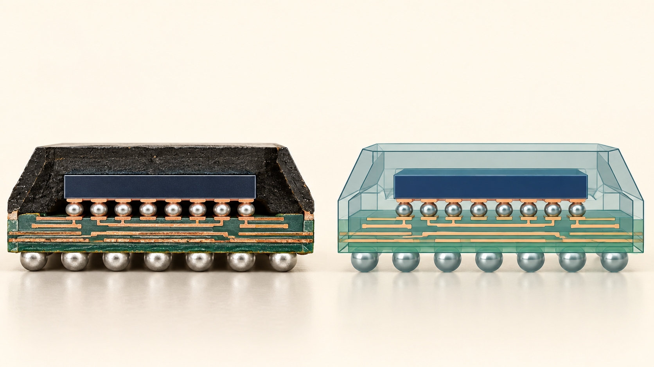


NCKU / DIGITAL TWIN AND IC PACKAGING
30 SEP 2026 H3
TEACHING WEEK 1 / H3
InPack.AI evidence lab
Use a package case to connect process risk with model evidence.
Guided lab and explain-back
01 / 16
Notes:
Timing: 2 min
Teaching intent and transition: Open with the distinction between a real package and a model. The generated illustration is conceptual and includes no platform screen or result.
Visual purpose: The illustration establishes the physical object or engineering problem for this hour. Record inputs and outputs before stating a preference.
Facilitation prompt: What would make a comparison reproducible?
Expected response: Require a stage-specific answer that names the observable, method, and remaining uncertainty.
Misconception to check: A screenshot or model prediction is sufficient without case identity, units, and a physical check.
[Sources]
Instructor teaching plan, 23 Sep 2026, 2026_Teaching_Plan_and_Reading_List.md
AI-generated conceptual illustration, 23 Sep 2026, see source-notes.md.

Slide 2

NCKU / DIGITAL TWIN AND IC PACKAGING
30 SEP 2026 H3
Restore the H2 map
The lab begins from a documented defect and inspection question.
1
2
3
4
stage
defect
observable
test
Which row will your team investigate?
02 / 16
Notes:
Timing: 2 min
Teaching intent and transition: Ask teams to select one H2 row. A model output needs to answer a specific engineering question; it does not replace the map.
Visual purpose: The connected chain ties evidence fields to a process or decision. Carry forward one candidate fault and its observable.
Facilitation prompt: Which row will your team investigate?
Expected response: Require a stage-specific answer that names the observable, method, and remaining uncertainty.
Misconception to check: A process label alone explains the mechanism without material state or an observable.
[Sources]
Instructor teaching plan, 23 Sep 2026, 2026_Teaching_Plan_and_Reading_List.md
Editable PowerPoint diagram authored for this lecture, 23 Sep 2026.

Slide 3
NCKU / DIGITAL TWIN AND IC PACKAGING
30 SEP 2026 H3
Evidence contract
A reusable case record names the case, revision, inputs, and result.
01
case ID
02
revision
03
inputs + units
04
result
05
reference
Which field prevents a later rerun from using the wrong case?
03 / 16
Notes:
Timing: 3 min
Teaching intent and transition: Show the output record. Expected answer: case ID and revision together identify the run; values and units are needed to reproduce it.
Visual purpose: The ruled record shows exactly what students must capture for a rerun. Also record a validation reference and decision limit.
Facilitation prompt: Which field prevents a later rerun from using the wrong case?
Expected response: Require a stage-specific answer that names the observable, method, and remaining uncertainty.
Misconception to check: A screenshot or model prediction is sufficient without case identity, units, and a physical check.
[Sources]
NIST Credibility Consideration for Digital Twins | https://www.nist.gov/publications/credibility-consideration-digital-twins-manufacturing
Editable PowerPoint diagram authored for this lecture, 23 Sep 2026.

Slide 4
NCKU / DIGITAL TWIN AND IC PACKAGING
30 SEP 2026 H3
Two access paths
Use the live course case or its instructor export.
InPack.AI course account
Course case
instructor-provided export
What must the export contain?
04 / 16
Notes:
Timing: 3 min
Teaching intent and transition: Do not pretend the platform is available. Live users transcribe exact settings; export users transcribe the same inputs and outputs from an approved case.
Visual purpose: The fork depicts process or access alternatives. Both paths use the same evidence record.
Facilitation prompt: What must the export contain?
Expected response: Require a stage-specific answer that names the observable, method, and remaining uncertainty.
Misconception to check: A process label alone explains the mechanism without material state or an observable.
[Sources]
Instructor teaching plan, 23 Sep 2026, 2026_Teaching_Plan_and_Reading_List.md
Editable PowerPoint diagram authored for this lecture, 23 Sep 2026.

Slide 5
NCKU / DIGITAL TWIN AND IC PACKAGING
30 SEP 2026 H3
Audit the inputs
Geometry, materials, loads, and units define the model question.
01
geometry
02
materials
03
load / stage
04
units
Which omission could reverse a comparison?
05 / 16
Notes:
Timing: 3 min
Teaching intent and transition: Have students check one field at a time. A material property without temperature or units can make a comparison uninterpretable.
Visual purpose: The ruled record shows exactly what students must capture for a rerun. Mark missing values as unknown rather than guessing.
Facilitation prompt: Which omission could reverse a comparison?
Expected response: Require a stage-specific answer that names the observable, method, and remaining uncertainty.
Misconception to check: A process label alone explains the mechanism without material state or an observable.
[Sources]
NIST Credibility Consideration for Digital Twins | https://www.nist.gov/publications/credibility-consideration-digital-twins-manufacturing
Editable PowerPoint diagram authored for this lecture, 23 Sep 2026.

Slide 6
NCKU / DIGITAL TWIN AND IC PACKAGING
30 SEP 2026 H3
Predict before viewing results
State a conditional expectation for two designs.
candidate A
candidate B
same load
What assumptions make your prediction plausible?
06 / 16
Notes:
Timing: 3 min
Teaching intent and transition: Students write a prediction before seeing results. Do not claim a particular material change always lowers warpage.
Visual purpose: The ruled comparison separates alternatives under a common question. A different underfill or geometry may shift warpage, but direction is not universal.
Facilitation prompt: What assumptions make your prediction plausible?
Expected response: Require a stage-specific answer that names the observable, method, and remaining uncertainty.
Misconception to check: A process label alone explains the mechanism without material state or an observable.
[Sources]
IEEE TCPMT 2019, Fan-Out Warpage | https://ieeexplore.ieee.org/document/8590768
Editable PowerPoint diagram authored for this lecture, 23 Sep 2026.

Slide 7
NCKU / DIGITAL TWIN AND IC PACKAGING
30 SEP 2026 H3
Enter the case identity
Copy the actual InPack.AI case settings.
01
package ID
02
material set
03
load condition
04
run revision
Where is your source of truth?
07 / 16
Notes:
Timing: 3 min
Teaching intent and transition: Use only fields present in the course account or approved export. If no case is supplied, use the synthetic worked example for rehearsal and leave the live run blank.
Visual purpose: The ruled record shows exactly what students must capture for a rerun. Keep package, material, temperature, and revision together.
Facilitation prompt: Where is your source of truth?
Expected response: Require a stage-specific answer that names the observable, method, and remaining uncertainty.
Misconception to check: A screenshot or model prediction is sufficient without case identity, units, and a physical check.
[Sources]
Instructor teaching plan, 23 Sep 2026, 2026_Teaching_Plan_and_Reading_List.md
Editable PowerPoint diagram authored for this lecture, 23 Sep 2026.

Slide 8
NCKU / DIGITAL TWIN AND IC PACKAGING
30 SEP 2026 H3
Record the output meaning
A number needs a quantity, unit, location, and process stage.
1
2
3
4
quantity
unit
location
stage
Is the value a maximum, average, or local reading?
08 / 16
Notes:
Timing: 3 min
Teaching intent and transition: Students identify what the output actually measures. Distinguish predicted warpage from physical measurement.
Visual purpose: The connected chain ties evidence fields to a process or decision. A screenshot without these labels cannot support a decision.
Facilitation prompt: Is the value a maximum, average, or local reading?
Expected response: Require a stage-specific answer that names the observable, method, and remaining uncertainty.
Misconception to check: A process label alone explains the mechanism without material state or an observable.
[Sources]
NIST Credibility Consideration for Digital Twins | https://www.nist.gov/publications/credibility-consideration-digital-twins-manufacturing
Editable PowerPoint diagram authored for this lecture, 23 Sep 2026.

Slide 9
NCKU / DIGITAL TWIN AND IC PACKAGING
30 SEP 2026 H3
Synthetic comparison example
A worked example separates predicted and measured warpage.
Candidate | Predicted warpage (µm) | Measured warpage (µm)
A | 80 | 92
B | 60 | 64
SYNTHETIC TEACHING DATA · 25°C after reflow
Which candidate is lower at 25°C after reflow?
09 / 16
Notes:
Timing: 4 min
Teaching intent and transition: Use synthetic values in micrometres at 25°C after reflow. The purpose is calculation and evidence interpretation, not platform performance.
Visual purpose: The native PowerPoint table compares labeled synthetic values at one condition. Illustrative values at 25°C after reflow; not InPack.AI output.
Facilitation prompt: Which candidate is lower at 25°C after reflow?
Expected response: Candidate B has lower predicted and measured warpage in the synthetic example.
Misconception to check: Synthetic teaching numbers are measured InPack.AI results or one small residual validates a model.
[Sources]
Instructor teaching plan, 23 Sep 2026, 2026_Teaching_Plan_and_Reading_List.md
Editable PowerPoint diagram authored for this lecture, 23 Sep 2026.

Slide 10
NCKU / DIGITAL TWIN AND IC PACKAGING
30 SEP 2026 H3
Compute the residual
Residual equals measured minus predicted.
Residual = measured − predicted
A
92 − 80
= +12 µm
B
64 − 60
= +4 µm
Does the smaller residual prove the model is validated?
10 / 16
Notes:
Timing: 4 min
Teaching intent and transition: Show the arithmetic and units. Expected answer: no; one comparison under one condition is insufficient for general validation.
Visual purpose: The arithmetic layout makes each intermediate subtraction visible. A: 92 − 80 = +12 µm. B: 64 − 60 = +4 µm.
Facilitation prompt: Does the smaller residual prove the model is validated?
Expected response: A is +12 µm and B is +4 µm. One residual comparison does not validate the model.
Misconception to check: Synthetic teaching numbers are measured InPack.AI results or one small residual validates a model.
[Sources]
NIST Credibility Consideration for Digital Twins | https://www.nist.gov/publications/credibility-consideration-digital-twins-manufacturing
Editable PowerPoint diagram authored for this lecture, 23 Sep 2026.

Slide 11
NCKU / DIGITAL TWIN AND IC PACKAGING
30 SEP 2026 H3
Bound the design claim
Candidate B is lower in this synthetic comparison.
1
2
3
4
claim
support
limit
next check
What data would you request before release?
11 / 16
Notes:
Timing: 4 min
Teaching intent and transition: Model a bounded sentence. We would investigate B further because both predicted and observed warpage are lower in the synthetic example; repeatability and other reliability outcomes remain unknown.
Visual purpose: The connected chain ties evidence fields to a process or decision. The evidence covers only 25°C after reflow in one illustrative pair.
Facilitation prompt: What data would you request before release?
Expected response: Require a stage-specific answer that names the observable, method, and remaining uncertainty.
Misconception to check: A process label alone explains the mechanism without material state or an observable.
[Sources]
NIST Credibility Consideration for Digital Twins | https://www.nist.gov/publications/credibility-consideration-digital-twins-manufacturing
Editable PowerPoint diagram authored for this lecture, 23 Sep 2026.

Slide 12
NCKU / DIGITAL TWIN AND IC PACKAGING
30 SEP 2026 H3
Run the course case
Complete one InPack.AI case record with actual settings.
input table
output table
difference
source record
Stop when another student can identify the exact case.
12 / 16
Notes:
Timing: 10 min
Teaching intent and transition: This is the independent activity. If account access is unavailable, use the instructor export. Stopping condition: a complete record with case identity, units, stage, and both candidate results.
Visual purpose: The blank grid is the artifact students fill and save. Compare two candidates on one common metric and stage.
Facilitation prompt: Stop when another student can identify the exact case.
Expected response: Require a stage-specific answer that names the observable, method, and remaining uncertainty.
Misconception to check: A screenshot or model prediction is sufficient without case identity, units, and a physical check.
[Sources]
Instructor teaching plan, 23 Sep 2026, 2026_Teaching_Plan_and_Reading_List.md
Editable PowerPoint diagram authored for this lecture, 23 Sep 2026.

Slide 13
NCKU / DIGITAL TWIN AND IC PACKAGING
30 SEP 2026 H3
Check comparison conditions
A comparison fails when units or conditions differ.
check
evidence needed
if mismatched
stage / temperature
same state
do not compare
unit / quantity
convert and define
recalculate
geometry / material
same baseline
separate sensitivity
Which mismatch is present in your record?
13 / 16
Notes:
Timing: 4 min
Teaching intent and transition: Ask students to audit a peer record. A numerical difference has no design meaning if the compared conditions or quantities differ.
Visual purpose: The editable matrix relates methods and physical observables. Review temperature, geometry, material set, and output definition.
Facilitation prompt: Which mismatch is present in your record?
Expected response: Require a stage-specific answer that names the observable, method, and remaining uncertainty.
Misconception to check: A process label alone explains the mechanism without material state or an observable.
[Sources]
NIST Credibility Consideration for Digital Twins | https://www.nist.gov/publications/credibility-consideration-digital-twins-manufacturing
Editable PowerPoint diagram authored for this lecture, 23 Sep 2026.

Slide 14
NCKU / DIGITAL TWIN AND IC PACKAGING
30 SEP 2026 H3
Peer reproduction check
A peer should be able to retrace the conclusion from the record.
1
2
3
4
input
prediction
observation
inference
What claim cannot you verify from the record?
14 / 16
Notes:
Timing: 4 min
Teaching intent and transition: Swap records. The peer reads the case identity, recalculates any difference, and states one missing check. They need not trust a screenshot without metadata.
Visual purpose: The connected chain ties evidence fields to a process or decision. Mark every claim as input, prediction, observation, or inference.
Facilitation prompt: What claim cannot you verify from the record?
Expected response: Require a stage-specific answer that names the observable, method, and remaining uncertainty.
Misconception to check: A process label alone explains the mechanism without material state or an observable.
[Sources]
NIST Credibility Consideration for Digital Twins | https://www.nist.gov/publications/credibility-consideration-digital-twins-manufacturing
Editable PowerPoint diagram authored for this lecture, 23 Sep 2026.

Slide 15
NCKU / DIGITAL TWIN AND IC PACKAGING
30 SEP 2026 H3
Evidence card for submission
The card states a narrow claim and the next physical check.
01
claim
02
model result
03
measurement
04
uncertainty
05
next test
Does each line cite its source?
15 / 16
Notes:
Timing: 2 min
Teaching intent and transition: Collect one evidence card per team. If no measured reference exists, the measurement line must say not available, and the decision stays provisional.
Visual purpose: The ruled record shows exactly what students must capture for a rerun. Keep model prediction distinct from measured evidence.
Facilitation prompt: Does each line cite its source?
Expected response: Require a stage-specific answer that names the observable, method, and remaining uncertainty.
Misconception to check: A screenshot or model prediction is sufficient without case identity, units, and a physical check.
[Sources]
NIST Credibility Consideration for Digital Twins | https://www.nist.gov/publications/credibility-consideration-digital-twins-manufacturing
Editable PowerPoint diagram authored for this lecture, 23 Sep 2026.

Slide 16
NCKU / DIGITAL TWIN AND IC PACKAGING
30 SEP 2026 H3
Exit: prepare for materials
Next week begins with material properties and temperature dependence.
1
2
3
4
property
unit
temperature
source
What input will you verify before the next run?
16 / 16
Notes:
Timing: 2 min
Teaching intent and transition: Use the exit ticket to bridge to October 7. Students identify one material input and its units, temperature, and source for the next class.
Visual purpose: The connected chain ties evidence fields to a process or decision. List one missing material value that limits today's case.
Facilitation prompt: What input will you verify before the next run?
Expected response: Require a stage-specific answer that names the observable, method, and remaining uncertainty.
Misconception to check: A process label alone explains the mechanism without material state or an observable.
[Sources]
Instructor teaching plan, 23 Sep 2026, 2026_Teaching_Plan_and_Reading_List.md
Editable PowerPoint diagram authored for this lecture, 23 Sep 2026.

