Slide 1
Intermediate Macroecomics
Instructor: Yuki Tada

Slide 2
Shadow Banking
Narrow banking: mostly with financial intermediaries, which are financial institutions that receive funds from some investors and then lend these funds to others.
Shadow banking: “non-banks,” for example mortgage companies, money market funds, hedge funds, and such.

Slide 3
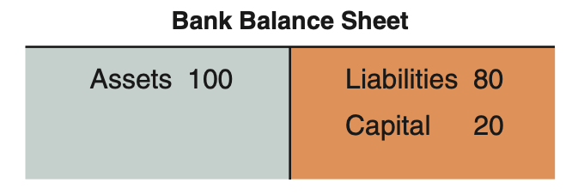
Asset of Banks
In the modern banking the banks does not only hold loans on the liability side but they could hold various financial assets
reserves (central bank money),
loans to consumers,
Loans to firms,
loans to other banks,
mortgages,
government bonds,
or other forms of securities.

Slide 4
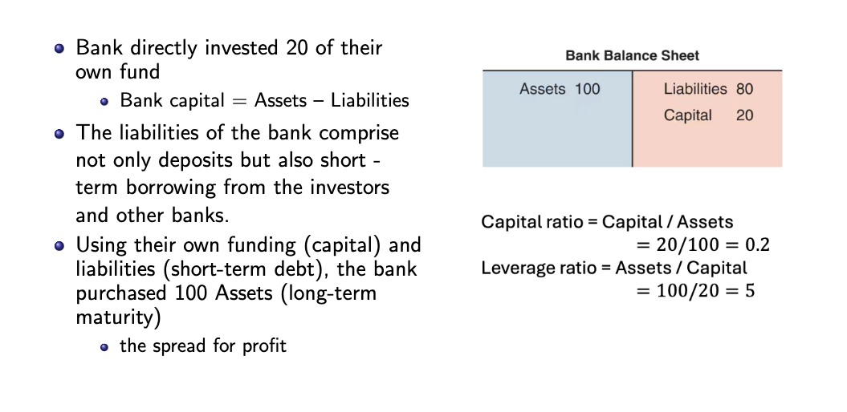
Modern Banking

Slide 5
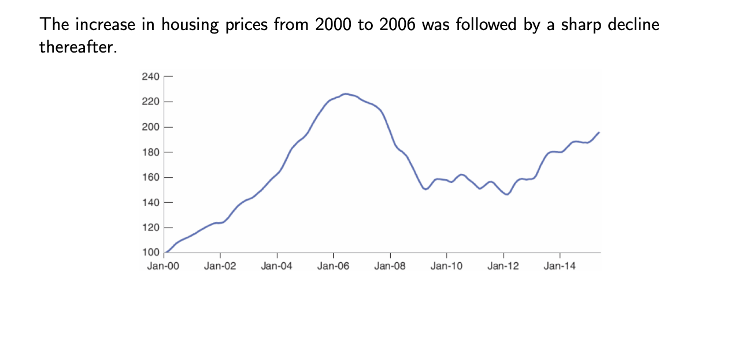
From a housing to a Financial Crisis

Slide 6
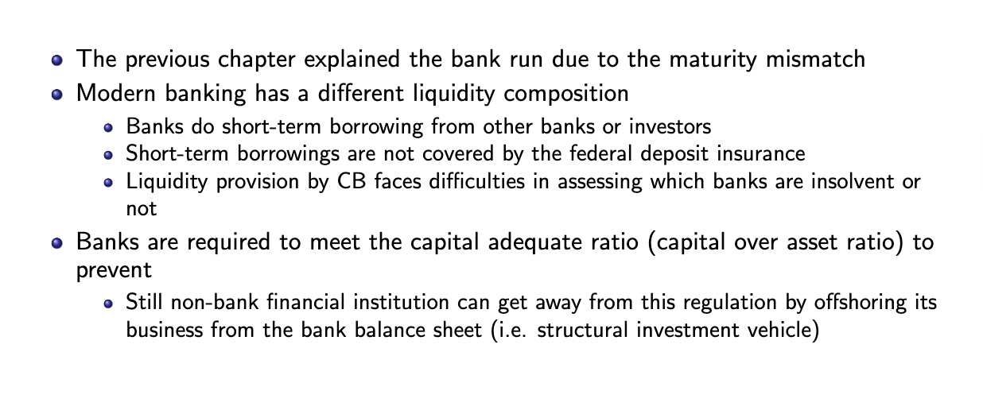
Modern banking

Slide 7
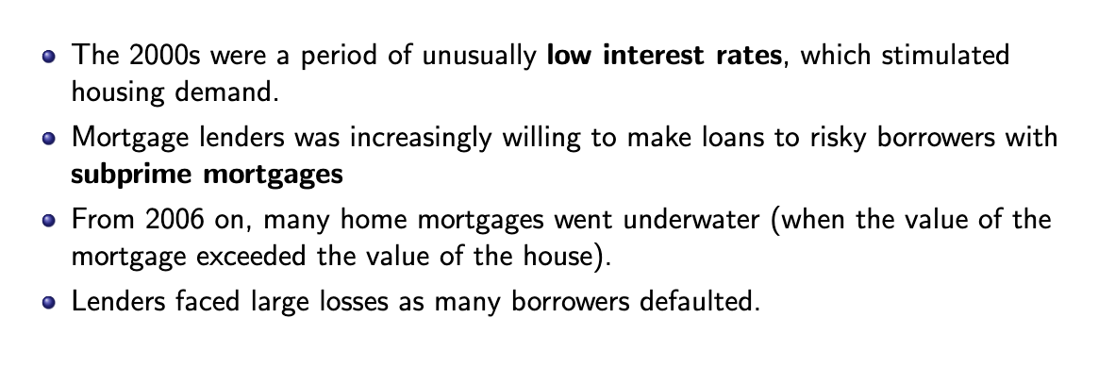
From a Housing Problem to a Financial Crisis

Slide 8
Leverage
With capital 20 (capital ratio as 20%)
Suppose the expected rate of return on assets is 5%, and the expected rate of return on liabilities is 4%.
The expected profit of the bank: 100*0.05 - 80*0.04 = 1.8
Given that, capital as 20 (own funds) and the expected profit per unit of capital as 1.8/20 = 9%
Now capital goes down to 10 (capital ratio as 10%)
Expected profit would be 1.4 and the and the expected profit per unit of capital as 1.4/10 =14%
Higher the risk higher the return
However, cannot continue taking the higher leverage at some point the value of leverage outweight the value of assert

Slide 9
Leverage
Supporse that banks now experience that the asset price declines. The Asset 100 → 90 and the capital goes down from 90-80 = 10 (20-->10)
How to maintain a healthy balance sheet?
1. banks can ask other investors for the capital
2. Decrease the size of the balance sheet
call back some of the loans from 90 – 40 = 50 and use the 40 to decrease the liability 80 -40 = 40 (now capital ratio as 20%)

Slide 10
Liquidity
You see the banks reduced the lending which signals investors of the value of the asset of the bank which create asset price further declines.
Investors withdraw their fund out of bank
Bank faces a major problem in the shortage of liquidity needs to find the funds to repay the investors.
Despite selling the loans could be a solution but hard to asset the value
Such sales however only make matters worse for the bank.
→ the value of the assets further decreases
Notes:
Note that this can happen
even if the initial doubts of investors were totally unfounded, even if the value of
the bank assets had not decreased in the first place. The decision by investors to
ask for their funds, and the fire sales this triggers, can make the bank insolvent
even if it was fully solvent to start.

Slide 11
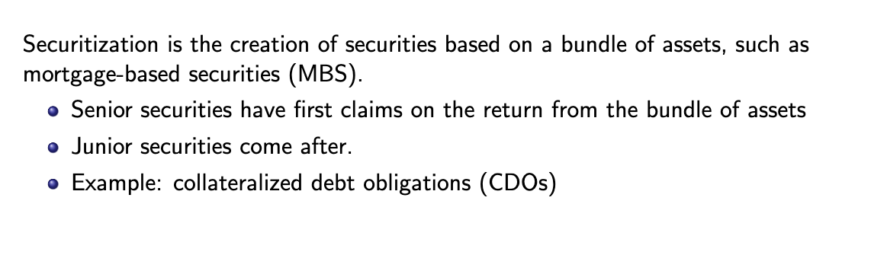
Securitization

Slide 12
Housing credit and mortgage
In the United States, the most common securitization trusts are sponsored by Fannie Mae and Freddie Mac, US government-sponsored enterprises.
Fannie Mae was established by the U.S. Congress in 1938 by amendments to the National Housing Act as part of Franklin Delano Roosevelt's New Deal.
Ginnie Mae, a US government-sponsored enterprise backed by the full faith and credit of the US government, guarantees that its investors receive timely payments but buys limited numbers of mortgage notes.
These agencies are to provide local banks with federal money to finance home loans in an attempt to raise levels of home ownership and the availability of affordable housing
Notes:
Ginnie Mae is similar to Fannie Mae (Federal National Mortgage Association) and Freddie Mac (Federal Home Loan Mortgage Corporation) with the difference being that Ginnie Mae is a wholly owned government corporation whereas Fannie Mae and Freddie Mac are "government-sponsored enterprises" (GSEs), which are federally chartered corporations privately owned by shareholders.

Slide 13
Speculation
Banks such investment banking are highly leveraged.
1 banks cannot realize the actual risk they are taking
2. Asset managers rewarded with a higher compensation which makes them to chase a higher return without fully taking the risk of bankruptcy into account.
3. financial innovation allows banks to speculate despite the rule to put the capital ratio above minimum .

Slide 14
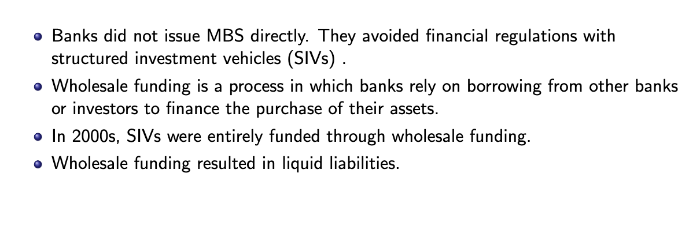
Securitization and Wholesale funding

Slide 15
Structured investment vehicles (SIVs).
In order to meet the capital ratio to meet to regulatory capital requirements, banks set create a separate vehicle.
The main reason was bank to be able to increase leverage.
On the liability side, SIVs borrowed from investors, typically in the form of short-term debt.
On the asset side, SIVs held various forms of securities.
To reassure the investors that they would get repaid, SIVs typically had a guarantee from the bank that had created them that, if needed, the bank would provide funds to the SIV

Slide 16
Securitization
This is the idea behind securitization. Securitization is the creation of securities based on a bundle of assets (e.g., a bundle of loans, or a bundle of mortgages).
For instance, a mortgage-based security (MBS) for short, is a title to the returns from an bundle of mortgages, with the number of underlying numerous mortgages.
By holding various mortgage, they can diversify the risk which is preferred also by the investors.
Notes:
Traditionally, the financial intermediaries that made loans or issued
mortgages kept them on their own balance sheet. This had obvious drawbacks. A local
bank, with local loans and mortgages on its books, was much exposed to the local eco-
nomic situation. When, for example, oil prices had come down sharply in the mid-1980s
and Texas was in recession, many local banks went bankrupt. Had they had a more
diversified portfolio of mortgages, say mortgages from many parts of the country, these
banks might have avoided bankruptcy.

Slide 17
Collateralized debt obligations
Securitization is the creation of securities based on a bundle of assets, such as mortgage-based securities (MBS).
Investment banks create those financial products tailor to the investor’s need and level of risk averse…
Senior securities have first claims on the return from the bundle of assets
Junior securities come after.
Example: collateralized debt obligations (CDOs)
Notes:
To create a CDO, investment banks gather cash flow-generating assets—such as mortgages, bonds, and other types of debt—and repackage them into discrete classes or tranches based on the level of credit risk the investor assumes.3
These tranches of securities become the final investment products, bonds, whose names reflect their specific underlying assets. For example, mortgage-backed securities (MBS) comprise mortgage loans, and asset-backed securities (ABS) contain corporate debt, auto loans, or credit card debt.

Slide 18
Wholesale funding
1990s and 2000s was the development of wholesale funding, they relied on borrowing from other banks or other investors, in the form of short-term debt, to finance the purchase of their assets, a process known as wholesale funding.
SIVs, the financial entities set up by banks, were entirely funded through such wholesale funding.
If investors are in doubt the value of the assets held by the banks or the SIVs, they asked for their funds back.

