Slide 1
Moving network files using powershell
Liz brooks
6 march 2024

Slide 2
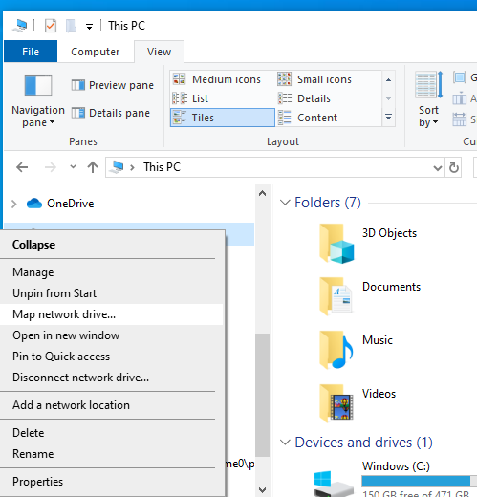
Map your current and new network drives
Right click on This PC in Windows Explorer, and select ‘Map Network Drive’

Slide 3
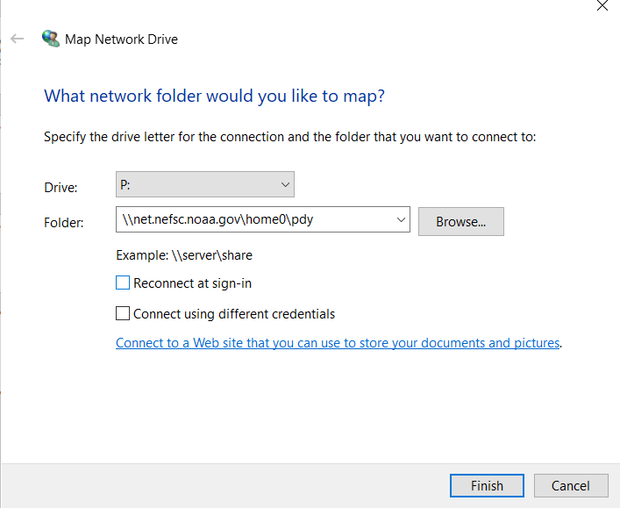
Map your current and new network drives
For ‘Drive’ pick a letter, and then for ‘Folder’ enter the path to your current network drive, e.g.
\\net.nefsc.noaa.gov\home0\pdy
Click Finish at the bottom
Do not check the box ‘Reconnect at sign-in’ (if you do, I have found it won’t connect and you actually have to ‘Disconnect network drive’ and then re-do the steps to map it

Slide 4
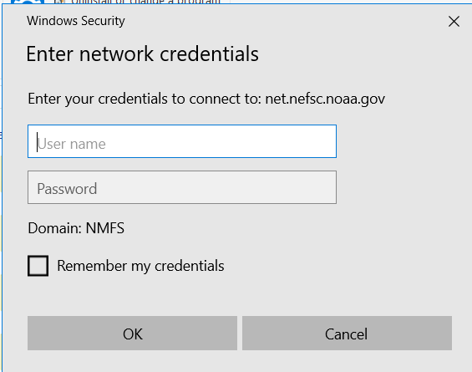
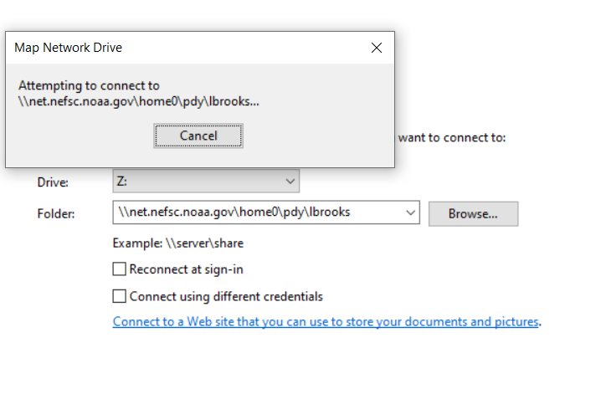
Login to the network (if at home, you need to be on VPN)
After you are connected, you will be prompted to login to the laptop; sometimes it offers CAC login first—if so, select ‘Other’ at the bottom and login to NMFS Domain
Connecting to network

Slide 5
Map your new network folder
You probably got an email from IT about how to login to your new network folder
I followed the same procedure to map my new network folder

Slide 6
How to move files at the commandline
Drag and drop between two Windows Explorer windows is slow, and will modify the date on all folders to the date that you move them
I use Powershell to move the files, and with explicit commandline option to preserve the data, attributes, and timestamps on the files moved
I also specify to overwrite if the file exists and has an older time stamp (because I use this process for backups, too)

Slide 7
Commandline flags that I use
/DCOPY:DCflag[s] : What to COPY for Directories (default is /DCOPY:DA)
(DCflags : D=Data, A=Attributes, T=Timestamps,
E=EAs, X=Skip alt data streams)
/XO : Exclude Older - if destination file already exists and is the same date
or newer than the source, don’t overwrite it
See here for brief summary of commands: https://ss64.com/nt/robocopy.html
and also here:
https://lazyadmin.nl/it/robocopy-ultimate-guide/

Slide 8
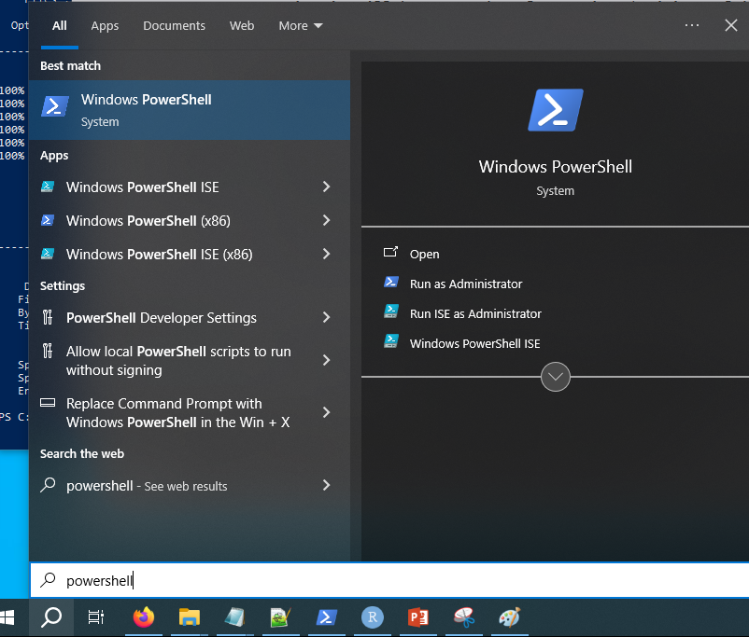
Launch Powershell
Click on the ‘Search’ Icon, and type ‘powershell’ in the search window
Click on Windows Powershell icon to launch it

Slide 9
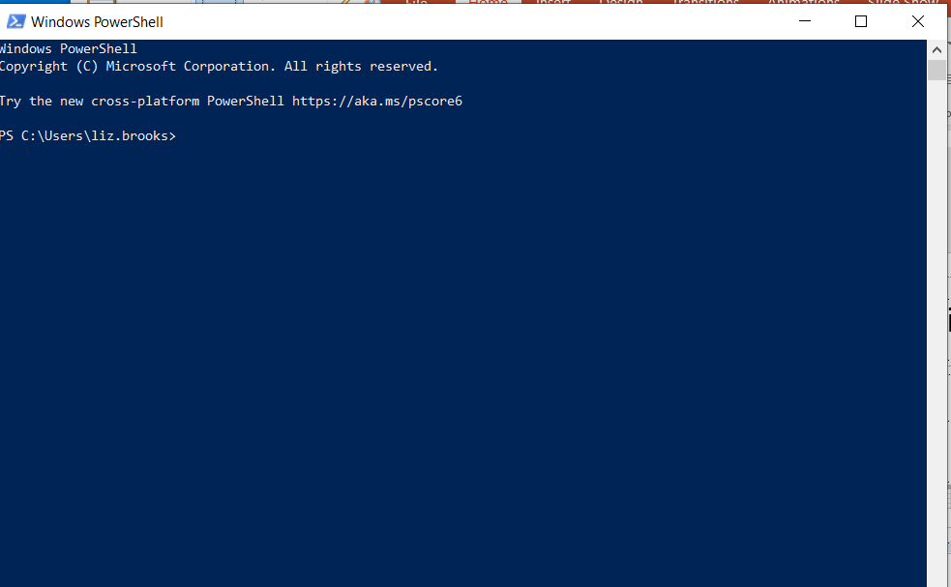
Powershell – it looks like this for me

Slide 10
Example
Z: is my current network drive that I mapped and assigned the drive letter ‘Z’
L: is my new network folder that I mapped and assigned the drive letter ‘L’
I have >>5GB currently, so I have been looking at Z: to decide which folders I want to move and if it is big then I guess I will have to make it a project (however that works)
I literally have started a text tile of folder names (just the top level in Z) that I want to move, and then I can move them with this command:
robocopy Z:\foldername L:\foldername /S /DCOPY:DAT /XO

Slide 11
Example (cont.)
robocopy Z:\foldername L:\foldername /S /DCOPY:DAT /XO
I copy this from my text tile, and then to paste that text into powershell; to do this, I put my mouse next to the powershell cursor and right click to paste the text, then hit <Enter>
You can paste more than one line and it will execute them in order, e.g.
robocopy Z:\adios_plots L:\adios_plots /S /DCOPY:DAT /XO
robocopy Z:\admb L:\admb /S /DCOPY:DAT /XO
robocopy Z:\admb_evalmcmc L:\admb_evalmcmc /S /DCOPY:DAT /XO
You could also copy the folder on Z: to a new folder name on L:
robocopy Z:\adios_plots L:\survey_adios_plots /S /DCOPY:DAT /XO

Slide 12
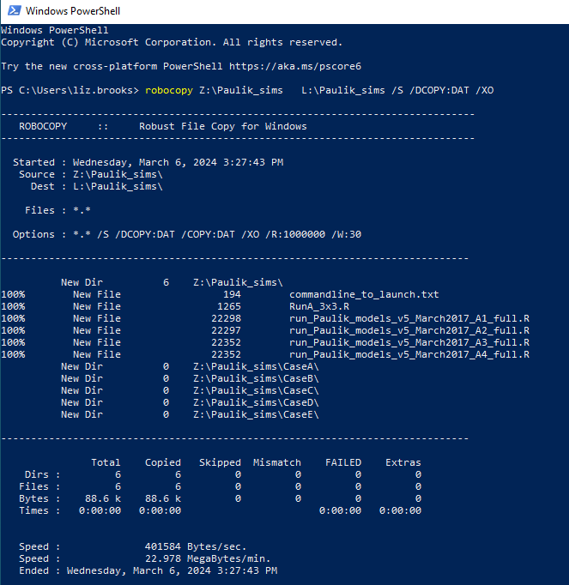
Result
After the files are copied, it summarizes what it did
It shows how many directories there were, how many copied, how many skipped, Files, Bytes, and the speed
It is way faster than drag and drop copying in Windows Explorer and it preserves timestamp attributes

Slide 13
Notes and Issues
ISSUE: I have noticed that it won’t work if the directory has a space in the name (I always avoid spaces in file names and directories, but I have a couple folders like this that were shared with me) – so, note to self, avoid spaces in file names and folder names. I haven’t figured out a workaround for this, but I suppose if you just go into Windows Explorer and change the folder name from “My SAS Programs” to “My_SAS_Programs” then it will copy just fine… but if you have programs pointing to that directory with spaces in the name then it will mess that up.
Solution is to use quotes
robocopy “Z:\folder name” “L:\folder name” /S /DCOPY:DAT /XO
NOTE: As noted in an earlier slide, I use this to make back-ups of my laptop to an external drive, and the /XO part of the command will only copy over files that are newer

Slide 14
Notes and Issues (cont.)
Feel free to add your own useful notes or issues that you discover.
/s will copy all sub-directories
/e will ensure you copy all empty subdirectories
*.* will explicitly specify that all files with any extensions get copied

