Slide 1
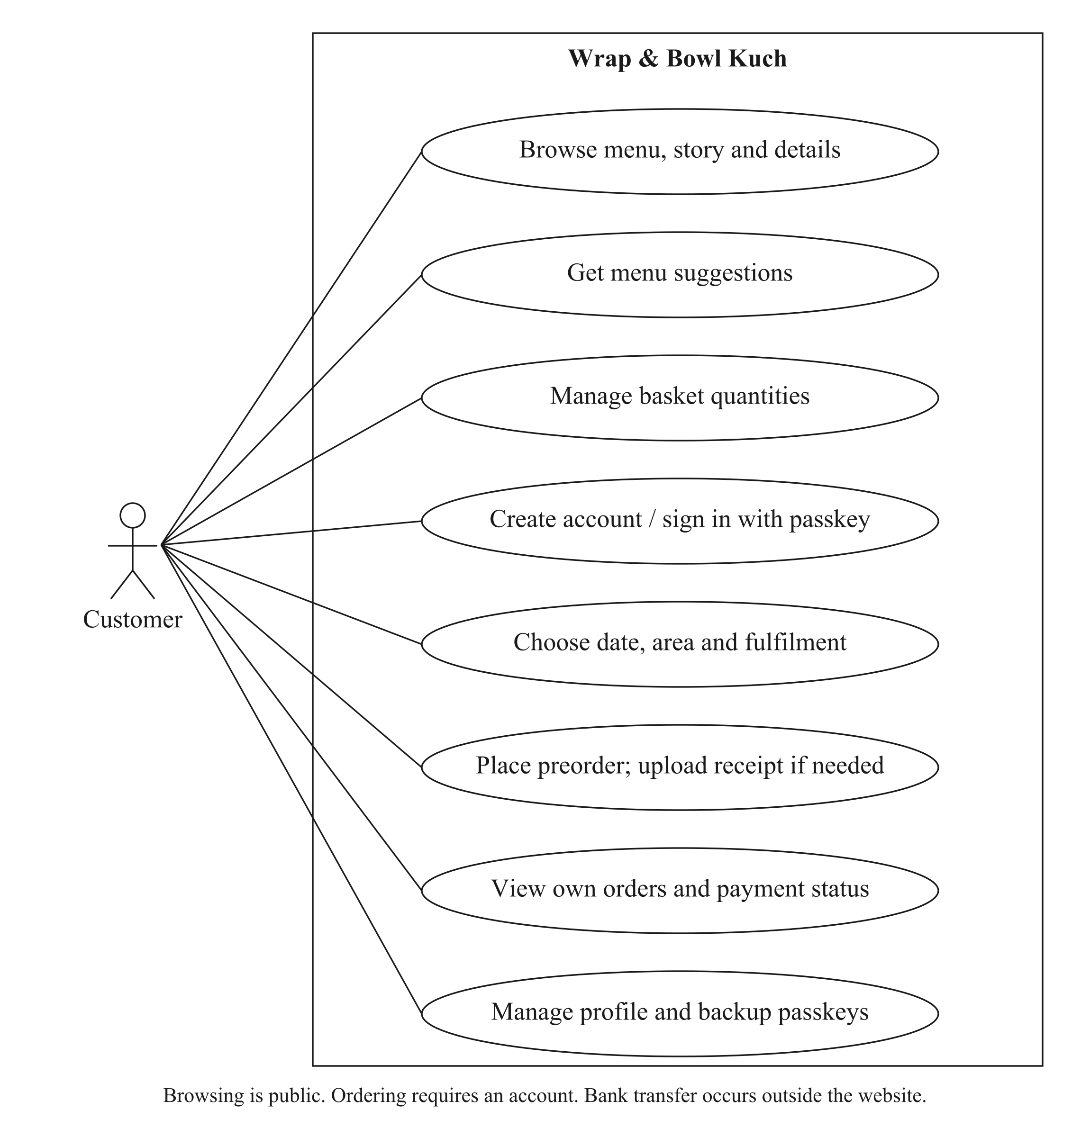
Customer use cases
Christopher Hansen · 2402081406
01
Notes:
Source: Current FYP report, Chapter 3. The editable diagrams.net source is supplied in the package. Use this slide during questions; it is outside the ten-minute talk.

Slide 2
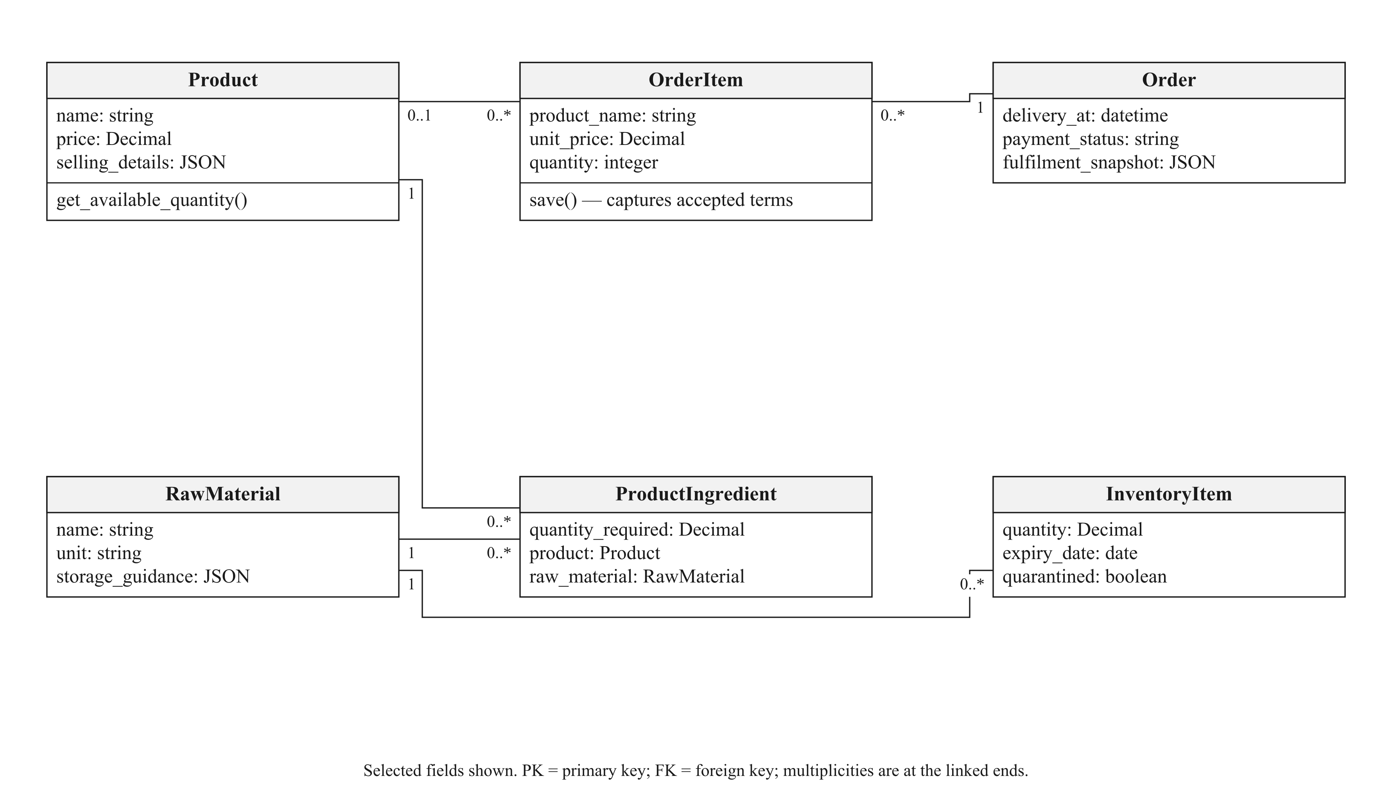
Core class model
Christopher Hansen · 2402081406
02
Notes:
Source: Current FYP report, Chapter 3. The editable diagrams.net source is supplied in the package. Use this slide during questions; it is outside the ten-minute talk.

Slide 3
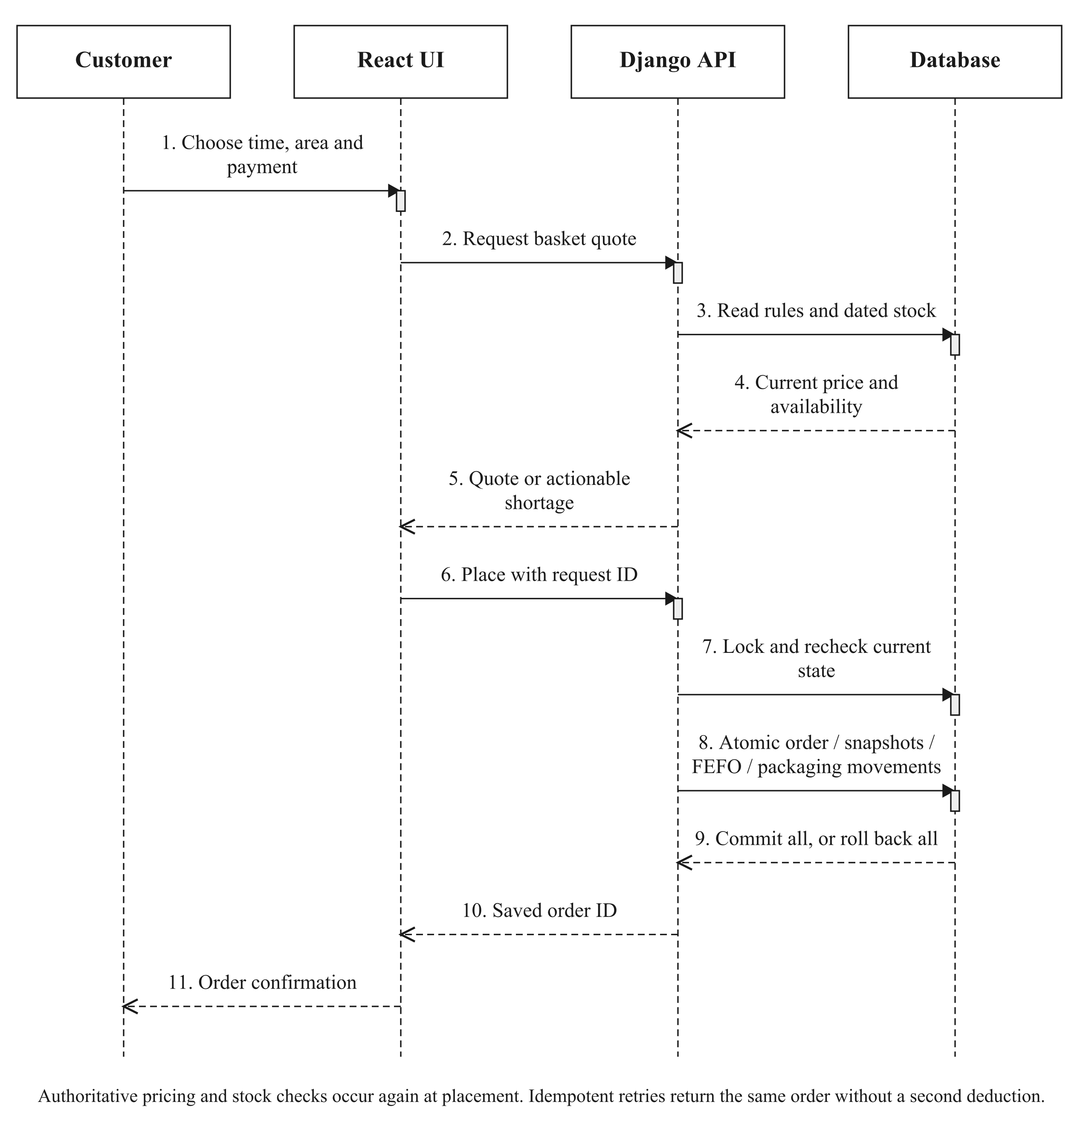
Order-placement sequence
Christopher Hansen · 2402081406
03
Notes:
Source: Current FYP report, Chapter 3. The editable diagrams.net source is supplied in the package. Use this slide during questions; it is outside the ten-minute talk.

