Slide 1
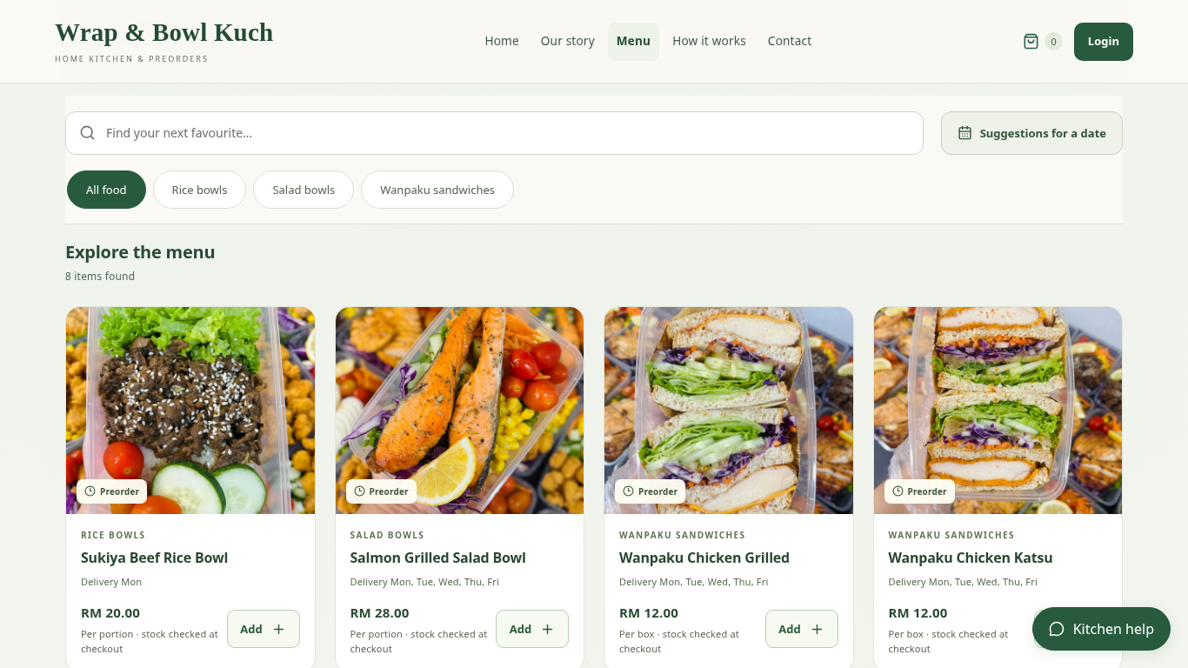
Browse the menu
Christopher Hansen · 2402081406
01
Notes:
Current local application screenshot with isolated example records and client menu photos. The receiving QR is supplied by the user; receipt evidence is a sample. Use this fallback only if video playback is unavailable.

Slide 2
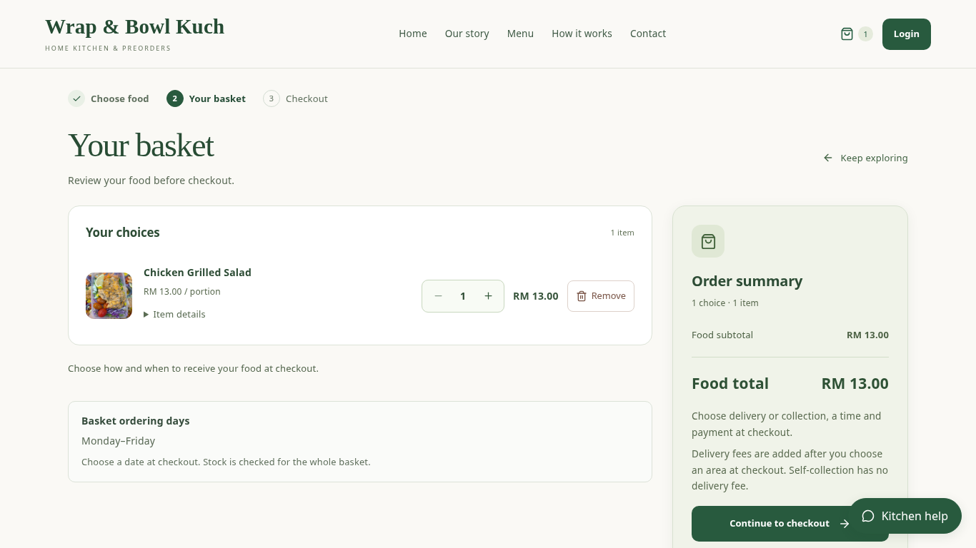
Review the basket
Christopher Hansen · 2402081406
02
Notes:
Current local application screenshot with isolated example records and client menu photos. The receiving QR is supplied by the user; receipt evidence is a sample. Use this fallback only if video playback is unavailable.

Slide 3
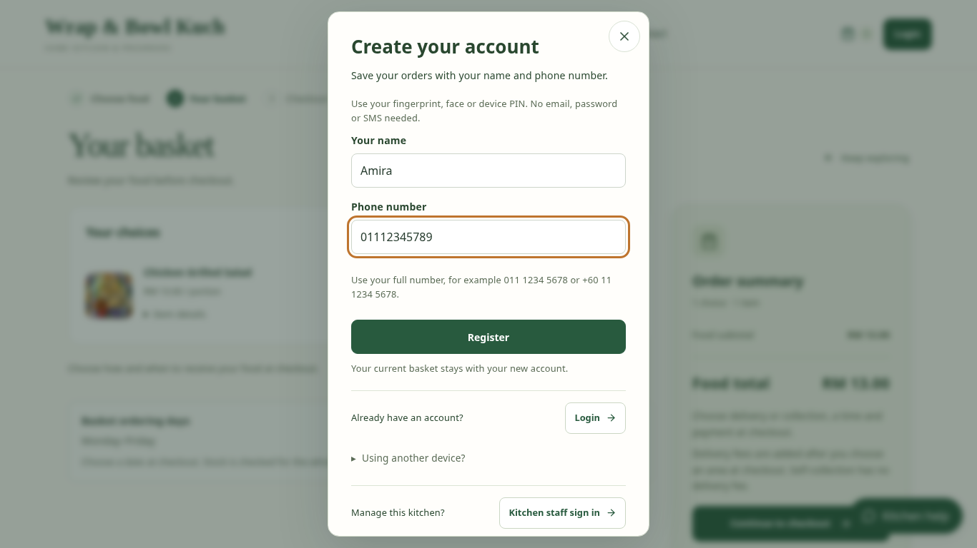
Create the account
Christopher Hansen · 2402081406
03
Notes:
Current local application screenshot with isolated example records and client menu photos. The receiving QR is supplied by the user; receipt evidence is a sample. Use this fallback only if video playback is unavailable.

Slide 4
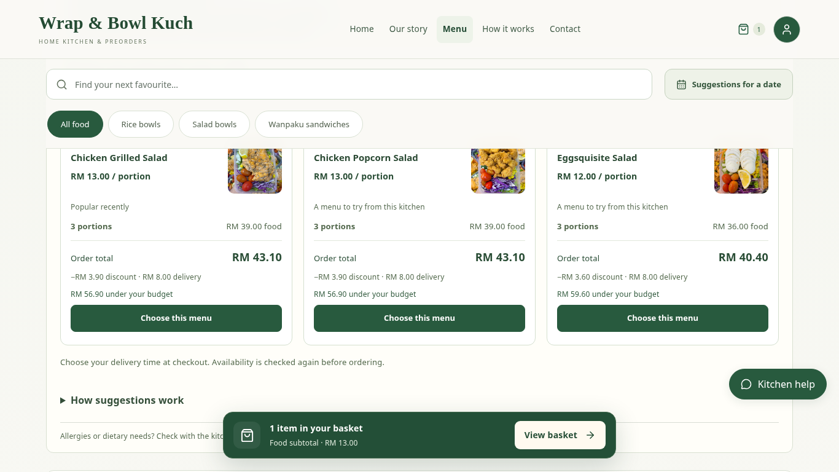
Request suggestions
Christopher Hansen · 2402081406
04
Notes:
Current local application screenshot with isolated example records and client menu photos. The receiving QR is supplied by the user; receipt evidence is a sample. Use this fallback only if video playback is unavailable.

Slide 5
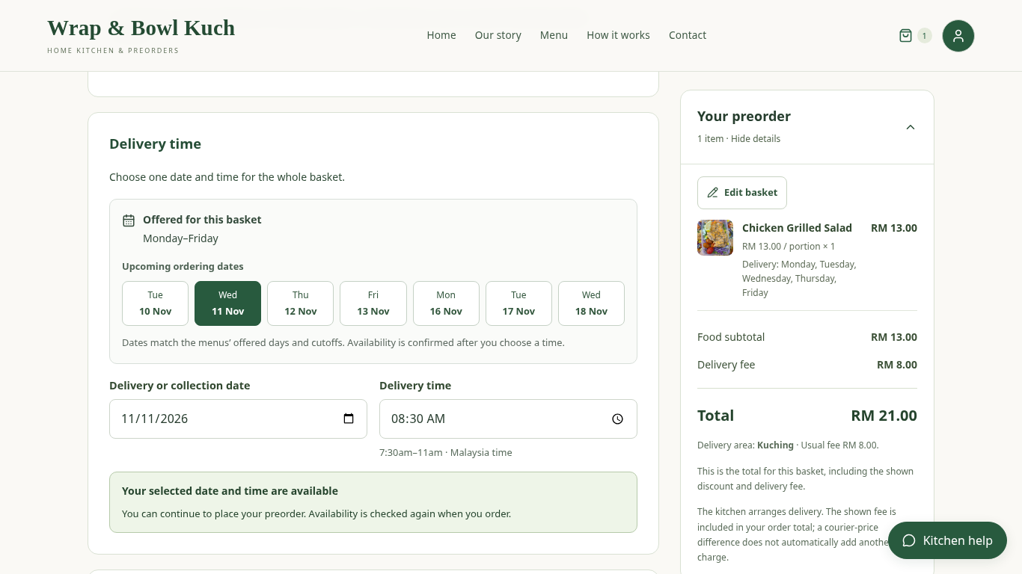
Confirm time and total
Christopher Hansen · 2402081406
05
Notes:
Current local application screenshot with isolated example records and client menu photos. The receiving QR is supplied by the user; receipt evidence is a sample. Use this fallback only if video playback is unavailable.

Slide 6
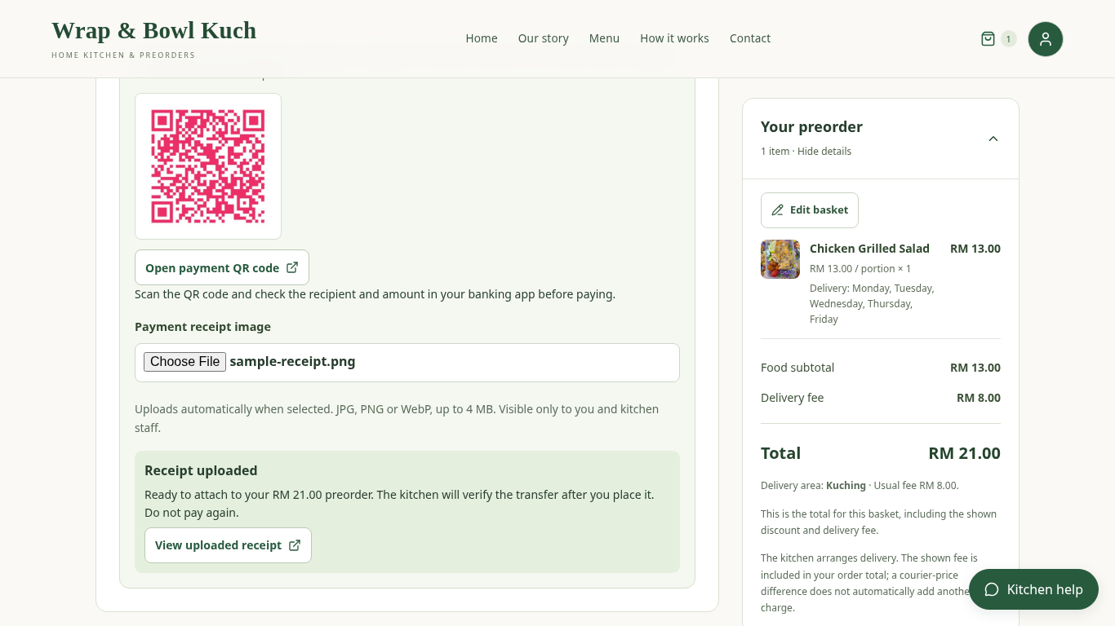
Upload receipt evidence
Christopher Hansen · 2402081406
06
Notes:
Current local application screenshot with isolated example records and client menu photos. The receiving QR is supplied by the user; receipt evidence is a sample. Use this fallback only if video playback is unavailable.

Slide 7
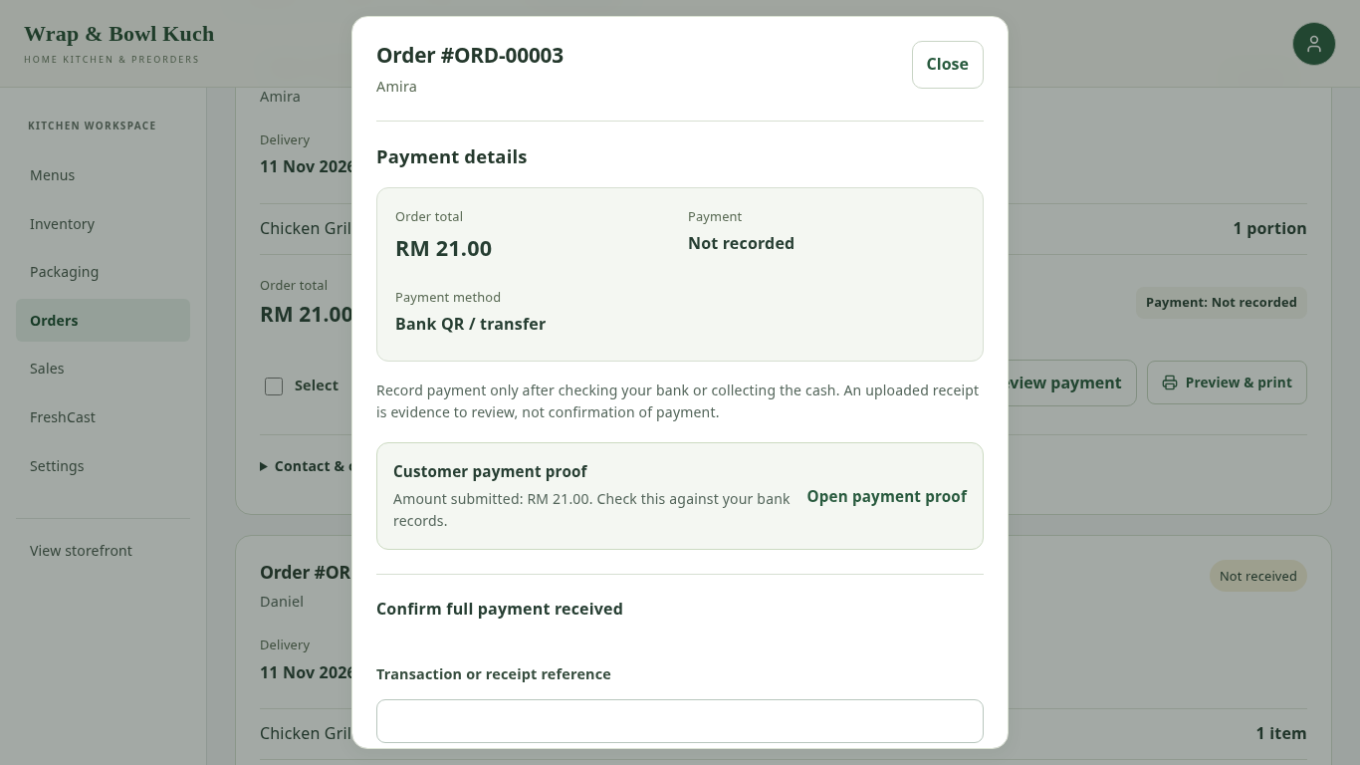
Review payment separately
Christopher Hansen · 2402081406
07
Notes:
Current local application screenshot with isolated example records and client menu photos. The receiving QR is supplied by the user; receipt evidence is a sample. Use this fallback only if video playback is unavailable.

Slide 8
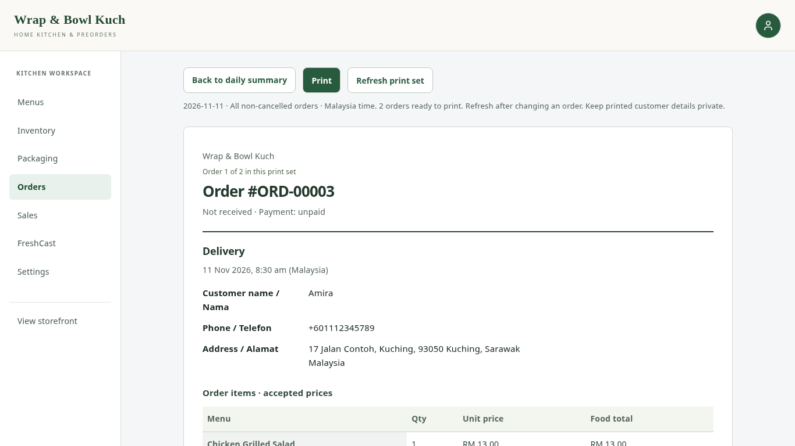
Print daily orders
Christopher Hansen · 2402081406
08
Notes:
Current local application screenshot with isolated example records and client menu photos. The receiving QR is supplied by the user; receipt evidence is a sample. Use this fallback only if video playback is unavailable.

