Slide 1
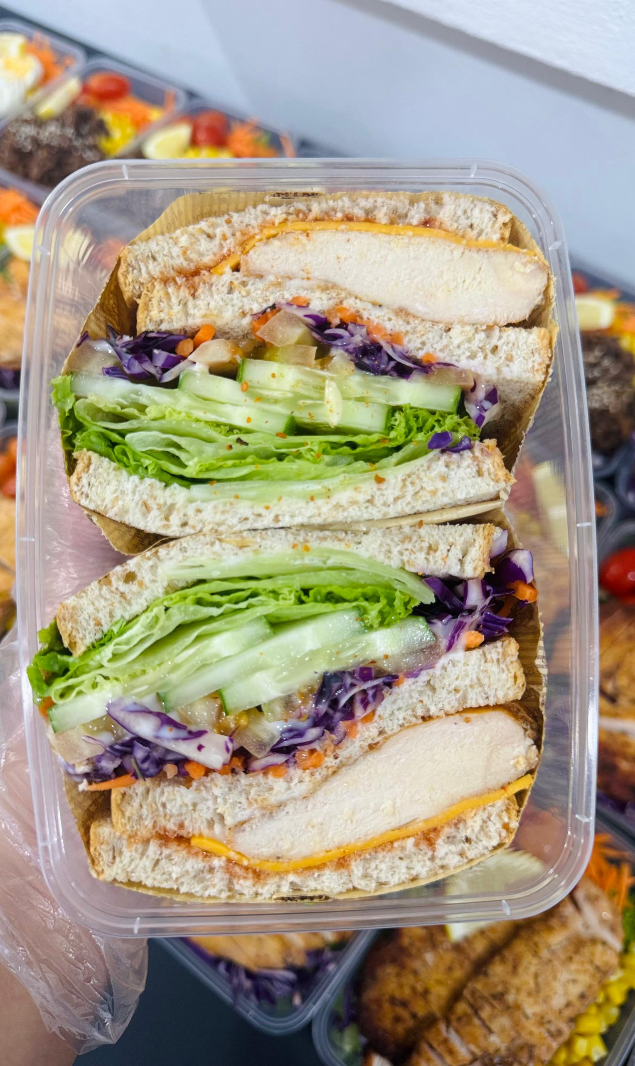
Web-Based Preorder and Freshness Management System for Home-Based Entrepreneurs
Wrap & Bowl Kuch · Kuching, Sarawak
Christopher Hansen · 2402081406
Supervisor: Ms. Nur Elana Binti Mohd Saferinor
Notes:
Timing: 20 seconds.
Good morning. I am Christopher Hansen. My project is a web-based preorder and freshness management system for home-based food entrepreneurs. The case-study business is Wrap and Bowl Kuch in Kuching. I will explain the problem, solution and mechanism, then the main functions and evaluation. I will finish with a two-minute demonstration.
Sources: Current FYP report, Chapters 1–6; current application and controlled local records captured 9 November 2026. Client photographs and receiving QR supplied by the user.

Slide 2
Problem statement
Preorder details can be scattered across messages.
Ingredient deadlines need to be considered when accepting an order.
The kitchen needs its own identity, order records and sales information.
Christopher Hansen · 2402081406
02
Notes:
Timing: 40 seconds.
This project addresses the gaps described in the report’s background and platform review. An order may begin in a conversation, while ingredient records and sales information are kept elsewhere. The kitchen needs to know whether recorded stock can cover the requested date, and customers need clear prices, delivery choices and order details. A dedicated storefront also gives one business control of its own menu and identity. Food-safety concerns motivate better records, but the website does not detect contamination or certify that food is safe.
Sources: Current FYP report, Chapters 1–6; current application and controlled local records captured 9 November 2026. Client photographs and receiving QR supplied by the user.

Slide 3
Project objectives
1. To design and develop a web application that supports flexible date-based food preordering and scheduling for home-based food entrepreneurs.
2. To implement a food stock freshness monitoring feature based on ingredient shelf life and storage duration.
3. To develop a personalised single-vendor storefront module that allows sellers to strengthen branding without direct competitor distraction.
4. To implement a sales analytics dashboard that supports data-driven business decision-making for home-based food operators.
5. To develop a menu recommendation system that reduces customer decision fatigue and improves purchase conversion rates.
Christopher Hansen · 2402081406
03
Notes:
Timing: 40 seconds.
The five objectives cover date-based preordering, ingredient shelf-life records, a personalised storefront, sales analytics and menu recommendations. The complete original statements are shown here. The implemented functions address those objectives at a software level. The fifth objective also mentions reduced decision fatigue and improved purchase conversion. Those are user and business outcomes that still require suitable evaluation; they cannot be established simply by demonstrating a recommendation or counting passing tests.
Sources: Current FYP report, Chapters 1–6; current application and controlled local records captured 9 November 2026. Client photographs and receiving QR supplied by the user.

Slide 4
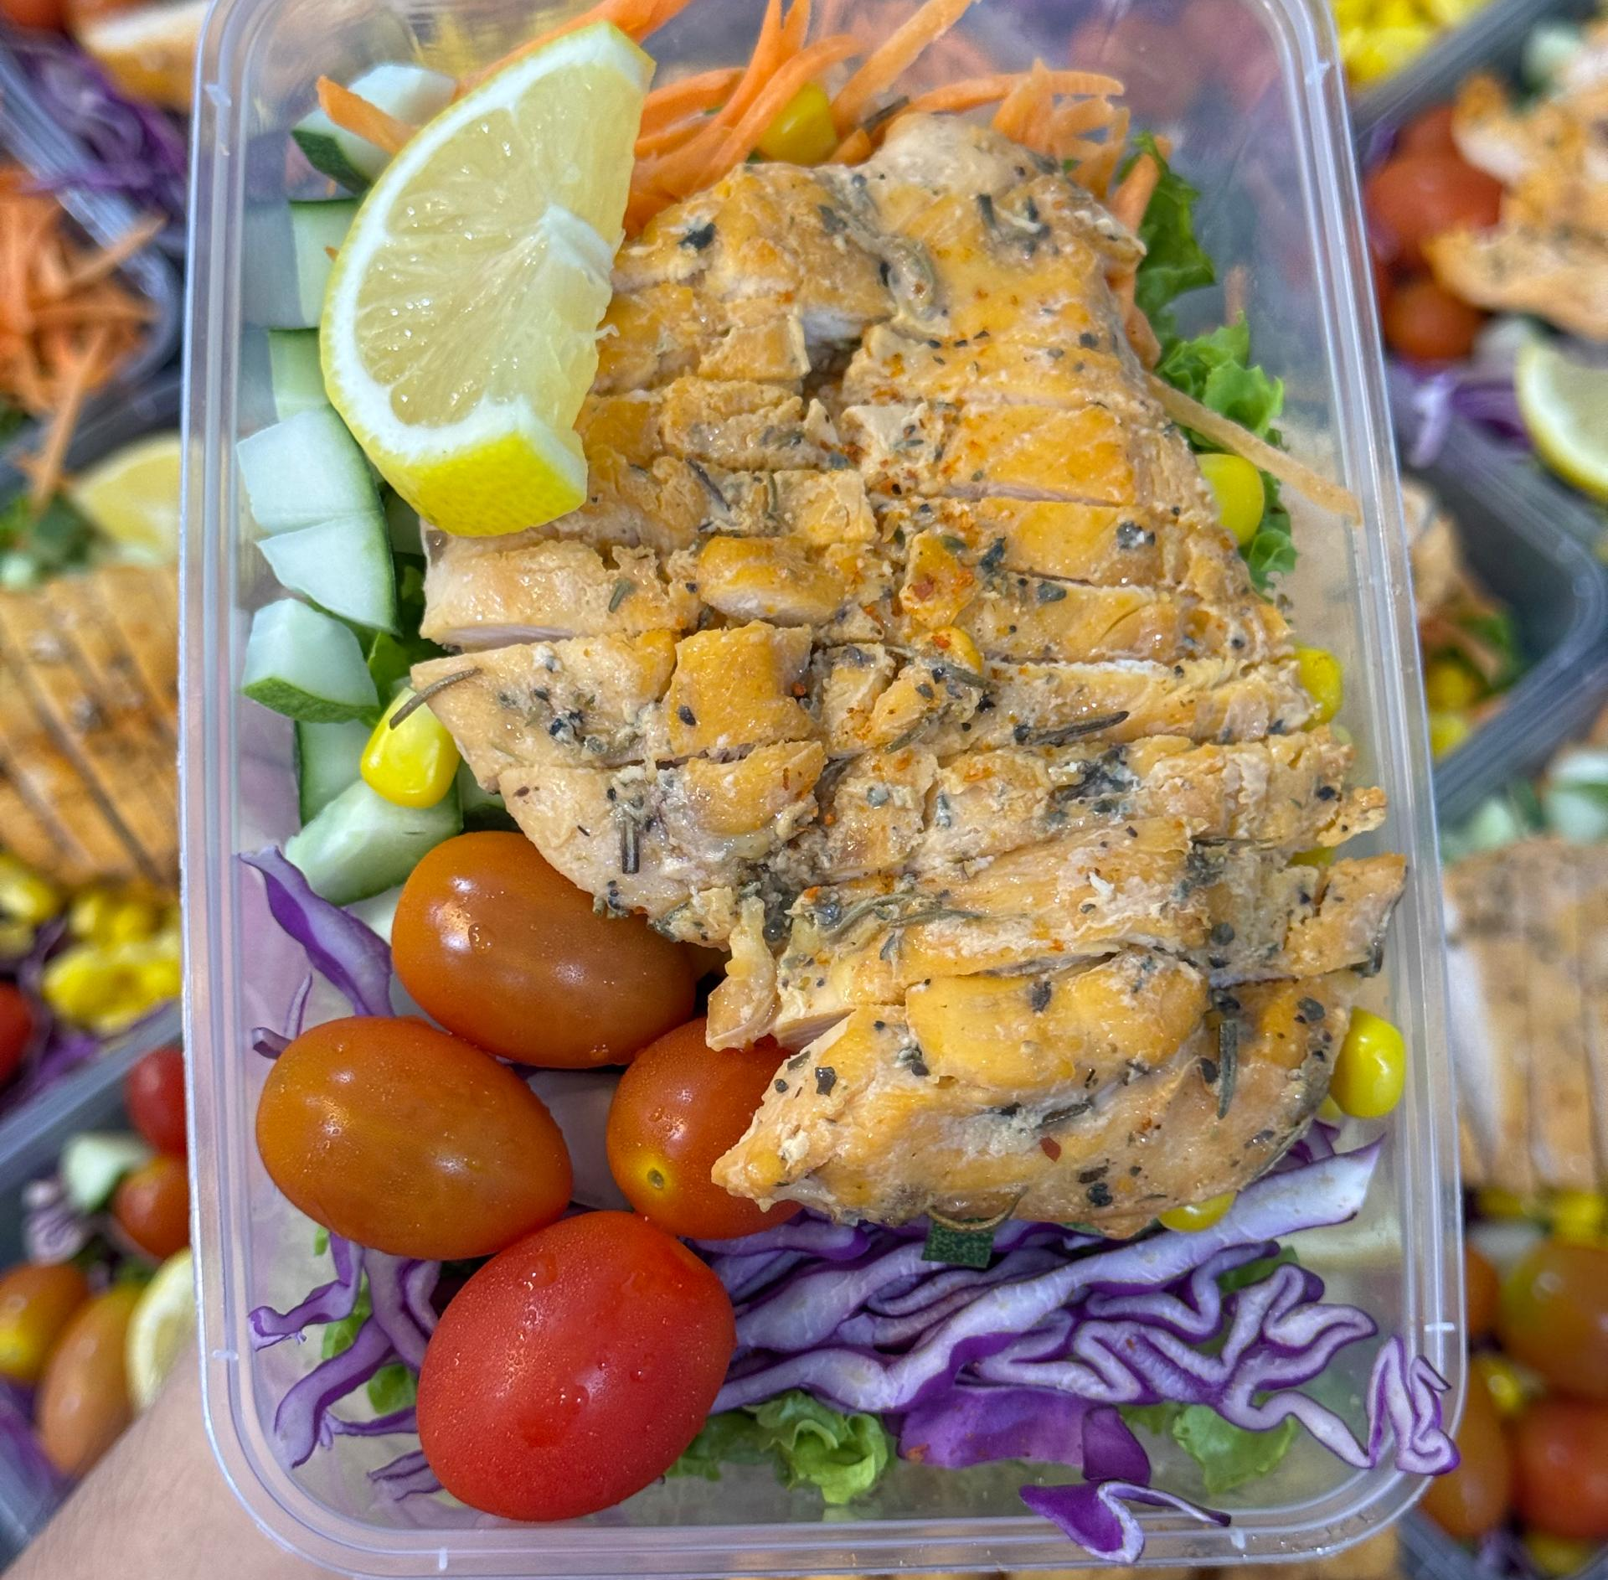
Client requirements
Morning delivery, collection and area-based fees
Ingredient batches and packaging quantities
Receipt uploads, order printing and simple handover records
Banking and delivery arrangements remain outside the website.
Christopher Hansen · 2402081406
04
Notes:
Timing: 35 seconds.
The application was developed in stages and refined through client feedback. The client asked for packaging records, immediate stock deductions, simpler customer details, morning delivery, payment evidence and printing. The normal workflow therefore uses offered ordering dates and handover times without requiring detailed cooking-plan steps. The website records the accepted order and its stock requirements. Bank verification, customer conversations and the actual delivery arrangement still depend on the kitchen’s work outside the website.
Sources: Current FYP report, Chapters 1–6; current application and controlled local records captured 9 November 2026. Client photographs and receiving QR supplied by the user.

Slide 5
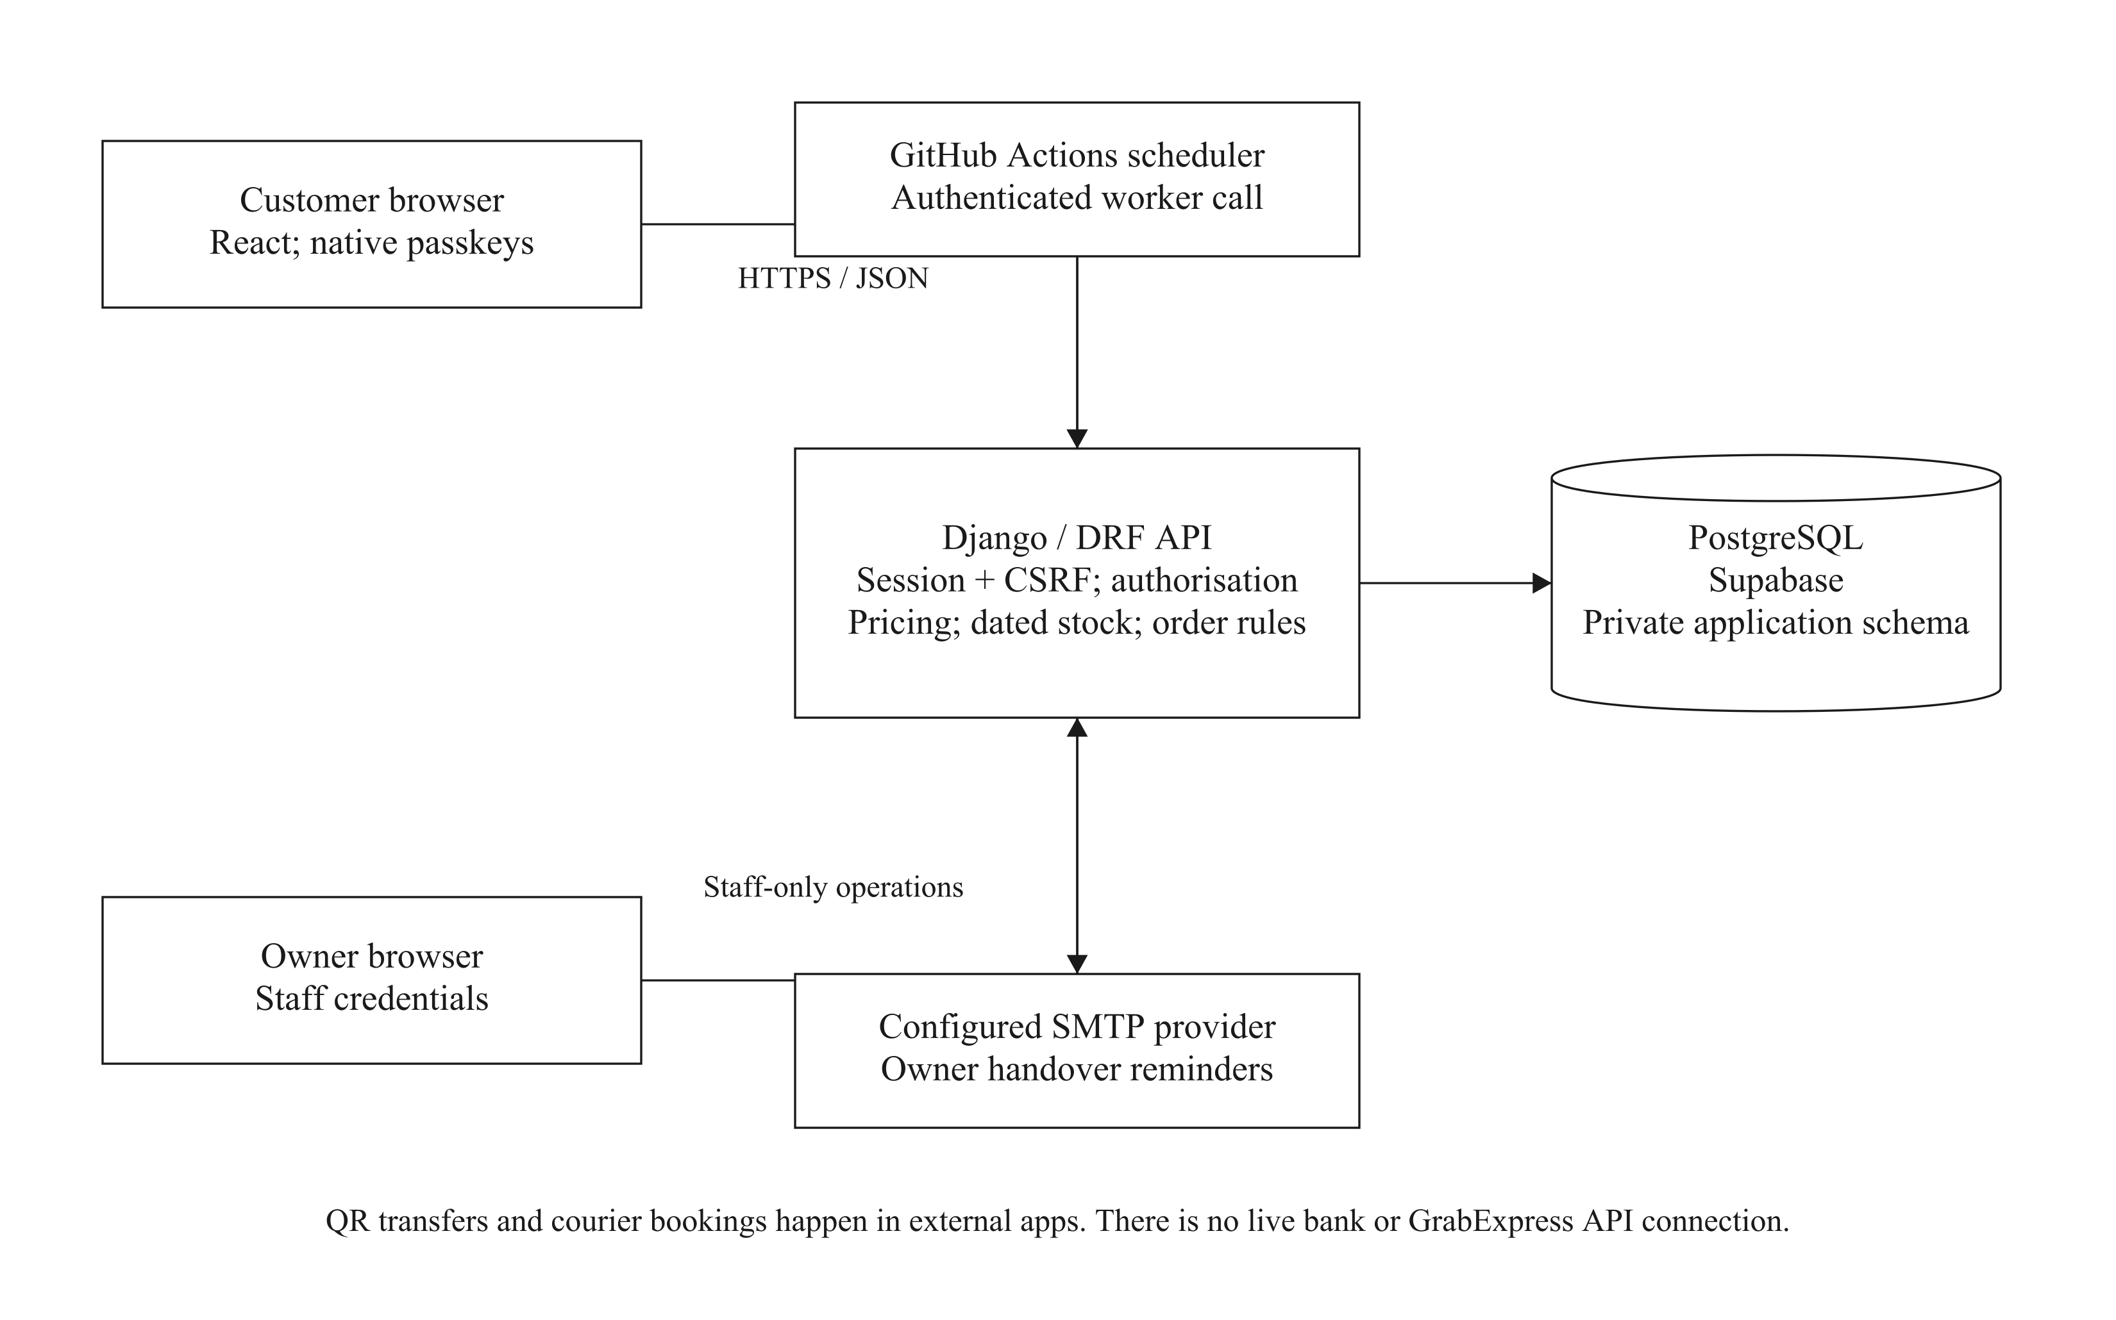
Order processing
1 Confirm the date, total and usable stock
2 Save the accepted order details
3 Deduct ingredients and packaging
4 Review payment evidence
5 Confirm the actual food handover
Order placement and stock deduction share one transaction.
Christopher Hansen · 2402081406
05
Notes:
Timing: 60 seconds.
The React interface gathers the choices, Django applies the business rules, and PostgreSQL stores the records. The server checks the actual basket, offered date, service hours, delivery fee, ingredients and packaging. An order can use only recorded batches that are eligible on the selected date. The system does not assume that the owner will restock later. Saving an order and deducting stock form one transaction. Accepted names, prices and requirements are retained so later edits do not rewrite the order. Payment review and confirmation of food receipt remain separate actions.
Sources: Current FYP report, Chapters 1–6; current application and controlled local records captured 9 November 2026. Client photographs and receiving QR supplied by the user.

Slide 6
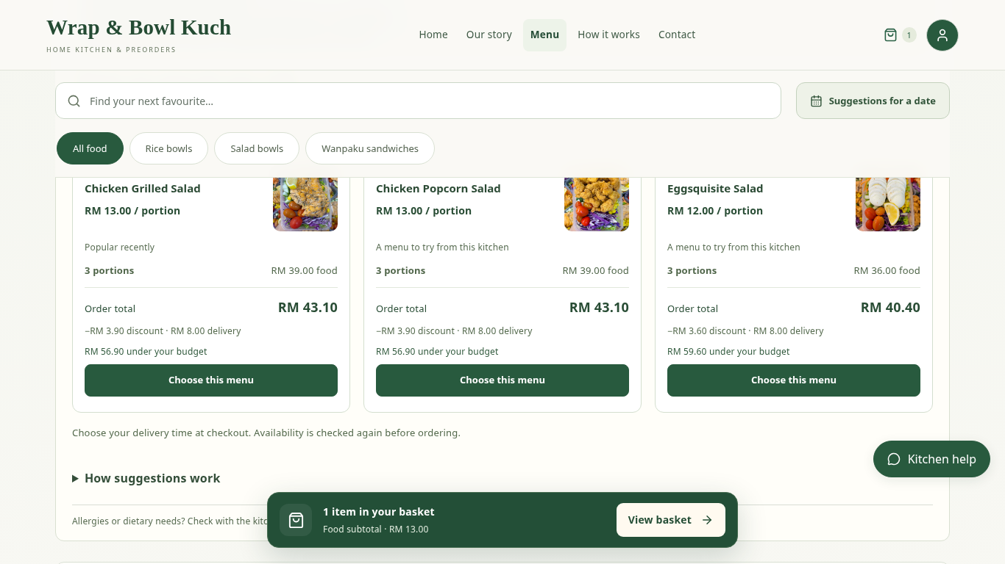
Menu choices
Browse one branded kitchen
Request suggestions for a date, quantity and budget
Compare a mix of menus or one menu repeated
Controlled example records
Christopher Hansen · 2402081406
06
Notes:
Timing: 40 seconds.
The storefront uses the client’s menu photographs, prices and descriptions of each selling unit. Customers can browse normally and put food into a basket before signing in. The optional finder uses the chosen date, total quantity and whole-order budget. It can propose a mix or a repeated menu type. A proposed option is still subject to the actual date, stock and total checks at checkout. This feature provides choices; it is not evidence by itself that customers feel less decision fatigue or complete more purchases.
Sources: Current FYP report, Chapters 1–6; current application and controlled local records captured 9 November 2026. Client photographs and receiving QR supplied by the user.

Slide 7
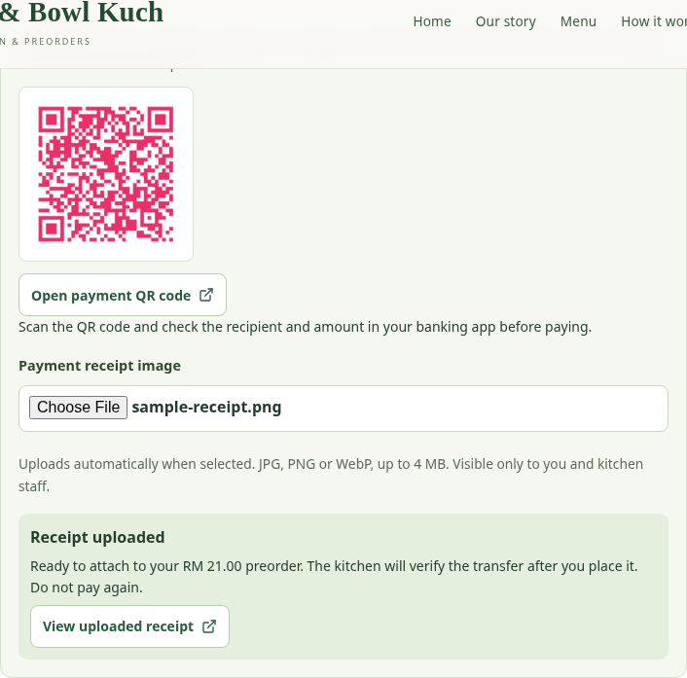
Checkout and account access
Review the basket before signing in
Choose an offered date, morning time and delivery area
Confirm the total and upload payment evidence
Controlled example records
Christopher Hansen · 2402081406
07
Notes:
Timing: 50 seconds.
Continuing from the basket opens customer account access. Registration uses a name, full phone number and passkey, without a separate memorised website password or required email. Checkout shows permitted dates, service hours and the applicable area fee. Changing the delivery area keeps a valid selected time and checks fees and availability again. The kitchen’s receiving QR is shown after the total is confirmed. Uploading a receipt attaches evidence; it does not mark the payment as verified. Delivery also supports cash where configured, while collection requires QR payment evidence.
Sources: Current FYP report, Chapters 1–6; current application and controlled local records captured 9 November 2026. Client photographs and receiving QR supplied by the user.

Slide 8
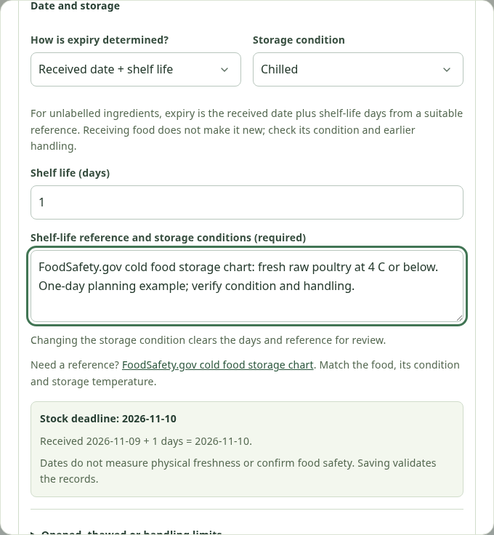
Ingredient dates and packaging
Printed expiry or documented shelf life
Received-date and manufacture-date calculations
Earlier limits and held batches affect usable stock
Controlled example records
Christopher Hansen · 2402081406
08
Notes:
Timing: 50 seconds.
The owner can enter a printed expiry date or calculate a planning deadline from a received or manufacture date and documented shelf life. The selected reference must match the ingredient and storage conditions. Earlier printed, opened or thawed limits can shorten the deadline, and held batches are excluded. An accepted order deducts its recorded ingredients and assigned packaging together. In this controlled demonstration, one meal uses one hundred and thirty grams of chicken and one salad bowl. These records guide allocation; handling and actual food safety still require owner judgment.
Sources: Current FYP report, Chapters 1–6; current application and controlled local records captured 9 November 2026. Client photographs and receiving QR supplied by the user.

Slide 9
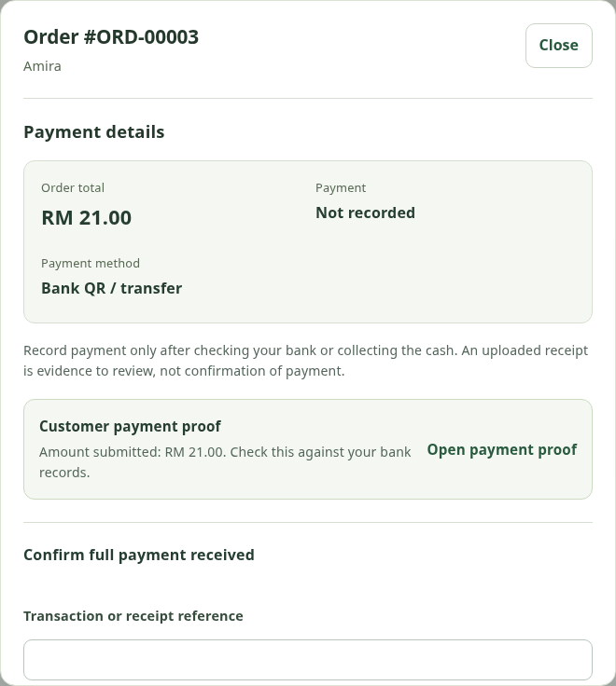
Payment and food receipt
Verify the bank transfer or collected cash before recording payment
Confirm food received only after actual handover
Review cancellation and eligible time changes separately
Controlled example records
Christopher Hansen · 2402081406
09
Notes:
Timing: 40 seconds.
An uploaded image and a completed handover are different facts. The owner checks bank records or cash before recording payment, and confirms food received after actual delivery or collection. The order queue keeps those records separate. Customers can cancel eligible orders and contact the kitchen, while a time change must remain eligible under the recorded allocation rules. A cancellation does not automatically refund money or return ingredients to stock. The owner must review those actions separately so that a status change does not imply an event that never happened.
Sources: Current FYP report, Chapters 1–6; current application and controlled local records captured 9 November 2026. Client photographs and receiving QR supplied by the user.

Slide 10
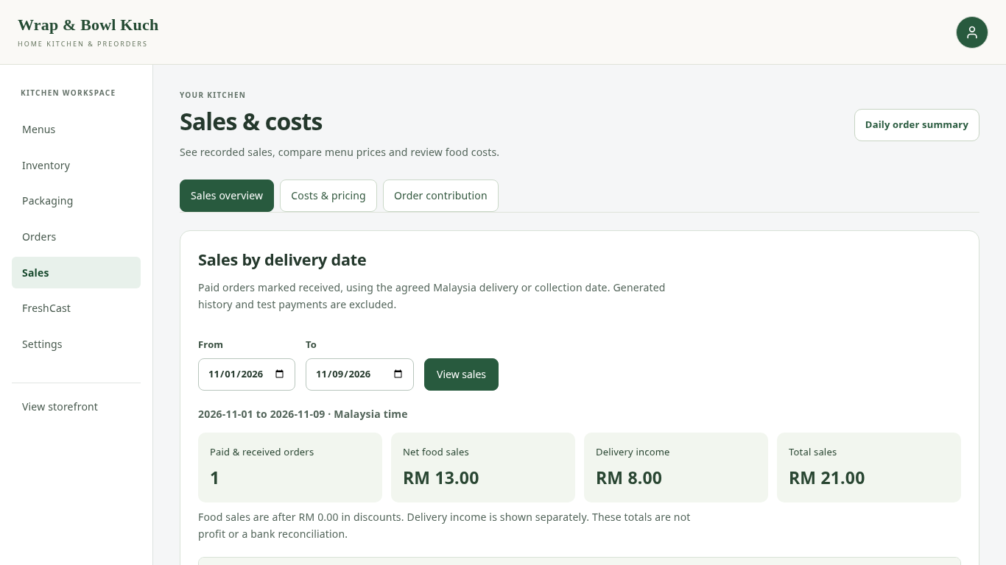
Daily orders and sales
Daily summaries and Print all support fulfilment
Sales views follow their stated payment and receipt rules
Unknown costs remain incomplete
Controlled example records
Christopher Hansen · 2402081406
10
Notes:
Timing: 35 seconds.
The daily summary helps the owner prepare and hand over orders for a date. Print all opens every matching slip as one print set, including records beyond a list page. Sales and cost views answer a different question: they apply their stated payment, receipt and cost rules. A contribution estimate is not automatically net profit, and an unknown ingredient or packaging cost is not treated as zero. The demonstration uses example records, so these amounts are functional examples rather than measurements of the client’s real trading results.
Sources: Current FYP report, Chapters 1–6; current application and controlled local records captured 9 November 2026. Client photographs and receiving QR supplied by the user.

Slide 11
Verification and evaluation
1,049
Later interface checks
Checkout, receipts and settings
Client acceptance
Results pending
backend tests passed
Recorded PostgreSQL run
9 November 2026
Customer survey
Results pending
Functional passes do not measure satisfaction or purchase conversion.
Christopher Hansen · 2402081406
11
Notes:
Timing: 50 seconds.
The recorded backend run on the ninth of November passed one thousand and forty-nine tests without skips. Subsequent interface changes were checked separately through relevant regressions and browser interactions. Representative cases cover valid and invalid dates, totals, stock deductions, access, payment evidence and selected simultaneous requests. These automated results support the behaviour that was tested. They do not supply client opinions or participant survey answers. The report includes decision tables, behavioural procedures and editable client and survey result templates. Genuine observations must complete those human-evaluation sections.
Sources: Current FYP report, Chapters 1–6; current application and controlled local records captured 9 November 2026. Client photographs and receiving QR supplied by the user.

Slide 12
Contribution and limits
A connected ordering and record-keeping workflow for one kitchen
Recorded dates support planning; payment and handover need real evidence
User and business outcomes still require evaluation
Christopher Hansen · 2402081406
12
Notes:
Timing: 20 seconds.
The implemented website connects the five objectives through one kitchen’s ordering and records. It keeps the boundaries clear: date records support planning, payment needs verification, and actual handover needs confirmation. Formal user findings remain pending. I will now show the two-minute customer-to-kitchen workflow.
Sources: Current FYP report, Chapters 1–6; current application and controlled local records captured 9 November 2026. Client photographs and receiving QR supplied by the user.

Slide 13
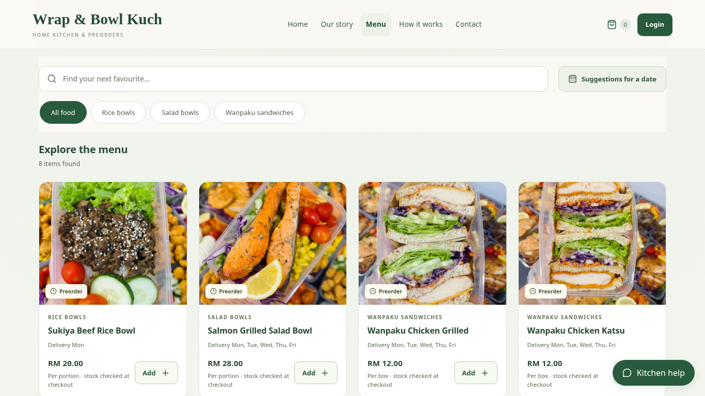
System demonstration
2 minutes
Customer preorder
to kitchen records
Click the video
to play
Christopher Hansen · 2402081406
13
Notes:
Timing: 120 seconds.
Play the embedded two-minute demonstration. The recording uses the current application with isolated example records and the kitchen’s supplied menu photographs and receiving QR. The receipt is a sample, and no real bank transfer or customer transaction was made. The matching standalone MP4 is supplied in case this presentation software cannot play the embedded video.
Sources: Current FYP report, Chapters 1–6; current application and controlled local records captured 9 November 2026. Client photographs and receiving QR supplied by the user.

Slide 14
Questions
Thank you
Christopher Hansen · 2402081406
14
Notes:
Timing: 0 seconds.
Use the separate design backup slides for questions about use cases, the class model and the order-placement sequence. Refer to the report and genuine evaluation records for further detail.
Sources: Current FYP report, Chapters 1–6; current application and controlled local records captured 9 November 2026. Client photographs and receiving QR supplied by the user.

