Slide 1
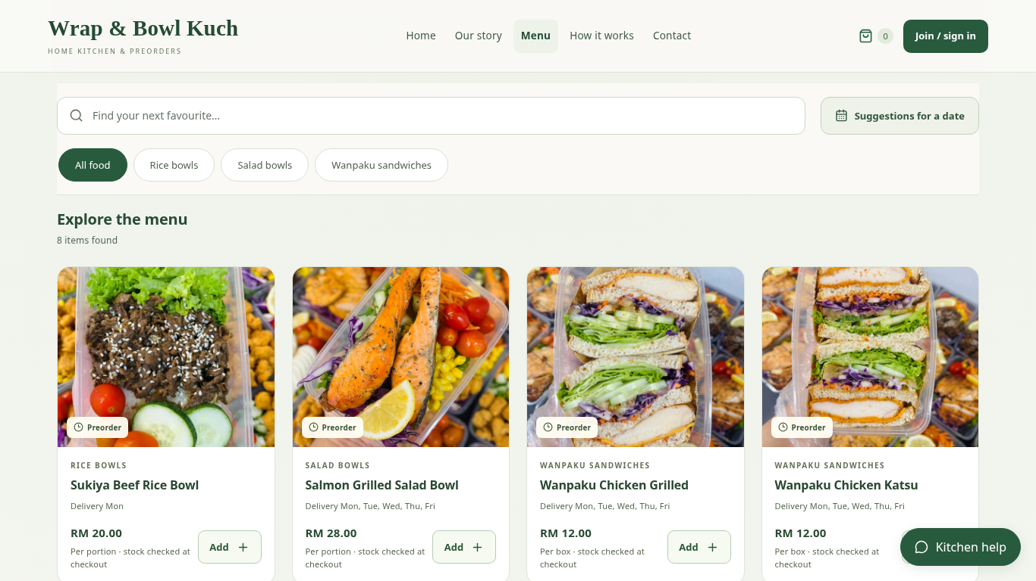
IT PROJECT 2 / WRAP & BOWL KUCH
Preorder & Freshness Management
Web-Based Preorder and
Freshness Management
System for Home-Based
Entrepreneurs
Case study: Wrap & Bowl Kuch
Kuching, Sarawak
Supervisor: Ms. Nur Elana Binti Mohd Saferinor
Christopher Hansen · 2402081406 | FYP presentation draft
01
Notes:
Allocated time: 20 seconds.
Good morning. I am Christopher Hansen. My FYP is a web-based preorder and freshness management system for home-based food entrepreneurs, developed with Wrap & Bowl Kuch in Kuching. I will explain the problem, the connected workflow, the key functions and testing, then finish with a two-minute demonstration.

Slide 2
IT PROJECT 2 / WRAP & BOWL KUCH
The problem: separate tasks and records
•
Preorder details can be scattered across messages.
•
Food-safety concerns motivate clearer ingredient storage records.
•
The reviewed platforms give limited control over flexible preorders and an
individual business’s branding.
Christopher Hansen · 2402081406 | FYP presentation draft
02
Notes:
Allocated time: 50 seconds.
The problem statement follows Chapters 1 and 2. Messaging orders require separate recording and coordination. The review describes limits in advance-ordering support and a business’s independent branding. Malaysian food-poisoning reports motivate better ingredient records, but dates do not detect contamination. I am not claiming that every home kitchen is unsafe or that current platforms all have identical policies.

Slide 3
IT PROJECT 2 / WRAP & BOWL KUCH
The five original objectives
1. To design and develop a web application that supports flexible date-based food preordering and
scheduling for home-based food entrepreneurs.
2. To implement a food stock freshness monitoring feature based on ingredient shelf life and storage
duration.
3. To develop a personalised single-vendor storefront module that allows sellers to strengthen
branding without direct competitor distraction.
4. To implement a sales analytics dashboard that supports data-driven business decision-making for
home-based food operators.
5. To develop a menu recommendation system that reduces customer decision fatigue and improves
purchase conversion rates.
Christopher Hansen · 2402081406 | FYP presentation draft
03
Notes:
Allocated time: 40 seconds.
The objectives are unchanged: date-based preordering, recorded ingredient shelf life, one business’s storefront, sales information and menu recommendations. The software implements the functions. Reduced decision fatigue and improved paid conversion need user or operational evidence; a software test alone cannot prove those outcomes.

Slide 4
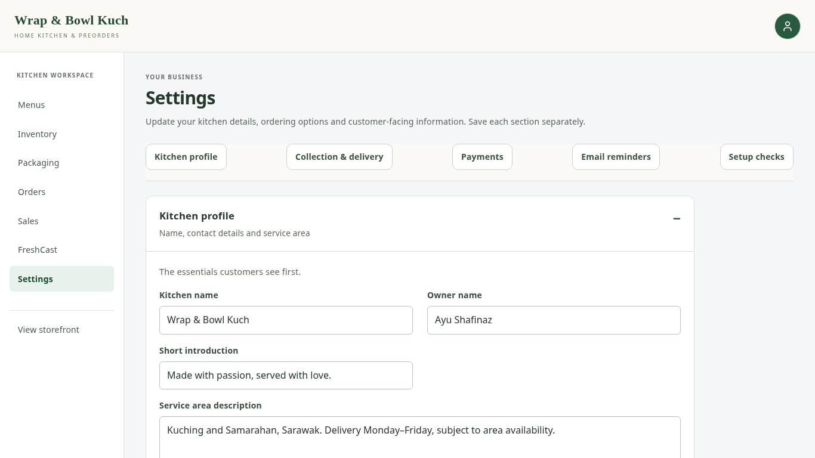
IT PROJECT 2 / WRAP & BOWL KUCH
The solution was shaped by the client
•
One branded customer and
owner website.
•
Morning handover, area fees,
packaging stock and payment
evidence.
•
Client feedback simplified
preparation planning and order
receipt.
Actual local application capture with client photos / example records
Christopher Hansen · 2402081406 | FYP presentation draft
04
Notes:
Allocated time: 40 seconds.
I developed the system in stages, checked the functions, and revised them following client meetings. The client asked for packaging records, automatic ingredient deductions, simpler customer details, morning delivery and payment receipt uploads. Detailed preparation planning did not fit her routine, so it is not required for normal ordering. These meetings informed requirements; do not describe them as a scored formal acceptance study.

Slide 5
IT PROJECT 2 / WRAP & BOWL KUCH
How one preorder connects the records
01
02
03
04
05
Choose food,
date and area
→
Check total
and stock
→
Save order
and snapshots
→
Deduct
ingredients
and packaging
→
Review
payment
and food receipt
Saving the order and deducting stock are one transaction.
React interface → Django rules → Supabase / PostgreSQL records
Christopher Hansen · 2402081406 | FYP presentation draft
05
Notes:
Allocated time: 50 seconds.
React presents the interface, Django validates the rules and Supabase PostgreSQL stores the records. The server checks the actual basket price, offered date, area fee, ingredients and packaging. Saving the order and deducting stock are one transaction. Accepted item names, prices and requirements are retained as order snapshots. Checking payment evidence and confirming actual food receipt remain separate owner actions.

Slide 6
IT PROJECT 2 / WRAP & BOWL KUCH
Browse one kitchen and compare choices
•
Client photos, clear prices and
selling units.
•
Optional suggestions use date,
quantity and whole-order budget.
•
Customers can compare
mixed-menu and one-menu
options.
Actual local application capture with client photos / example records
Christopher Hansen · 2402081406 | FYP presentation draft
06
Notes:
Allocated time: 45 seconds.
The storefront presents one business rather than a marketplace of competing sellers. Menu cards explain what a portion or box contains. Customers may browse directly or request suggestions for their date, quantity and budget. The finder compares complete options; it does not treat a three-unit total as the price of one unit. Recommendation calculations do not by themselves show that decision fatigue was reduced.

Slide 7
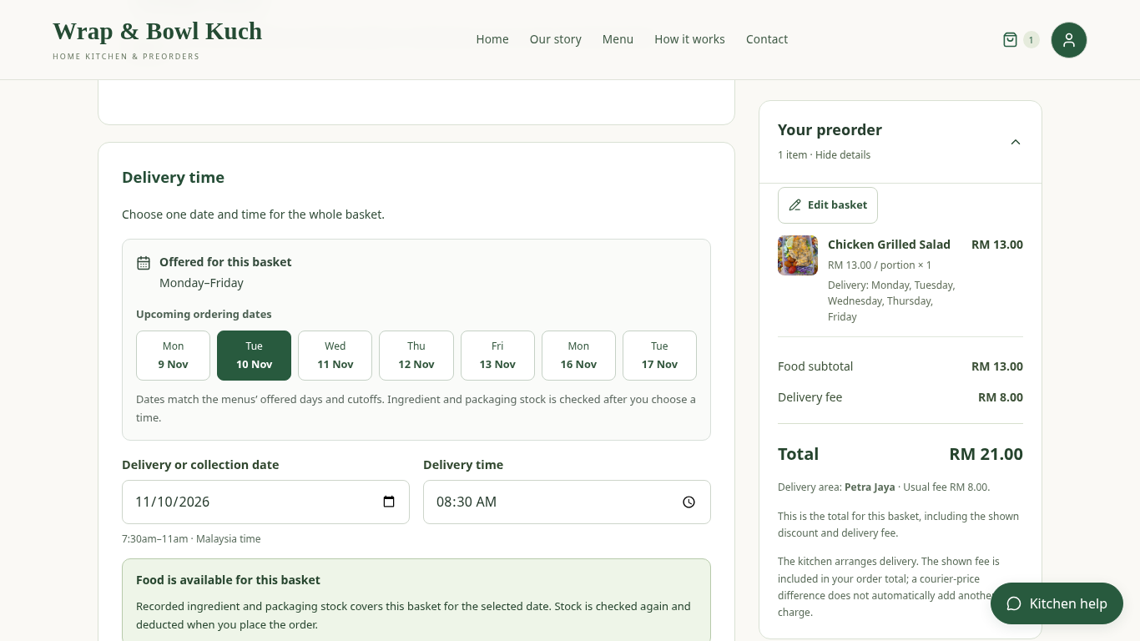
IT PROJECT 2 / WRAP & BOWL KUCH
Choose a date and see the full total
•
Account access uses name,
phone and a passkey.
•
Checkout shows offered dates
and the selected area fee.
•
Bank/QR proof needs owner
review; delivery can also use
cash.
Actual local application capture with client photos / example records
Christopher Hansen · 2402081406 | FYP presentation draft
07
Notes:
Allocated time: 50 seconds.
An account uses name and phone details with a saved passkey, avoiding a separate memorised website password. A phone number alone is not authentication. Checkout guides the customer to offered dates, a morning time and an area-based delivery fee. QR or bank-transfer evidence is uploaded for manual review. Delivery permits cash where configured; collection requires QR payment evidence. Uploading a picture does not mark the order paid.

Slide 8
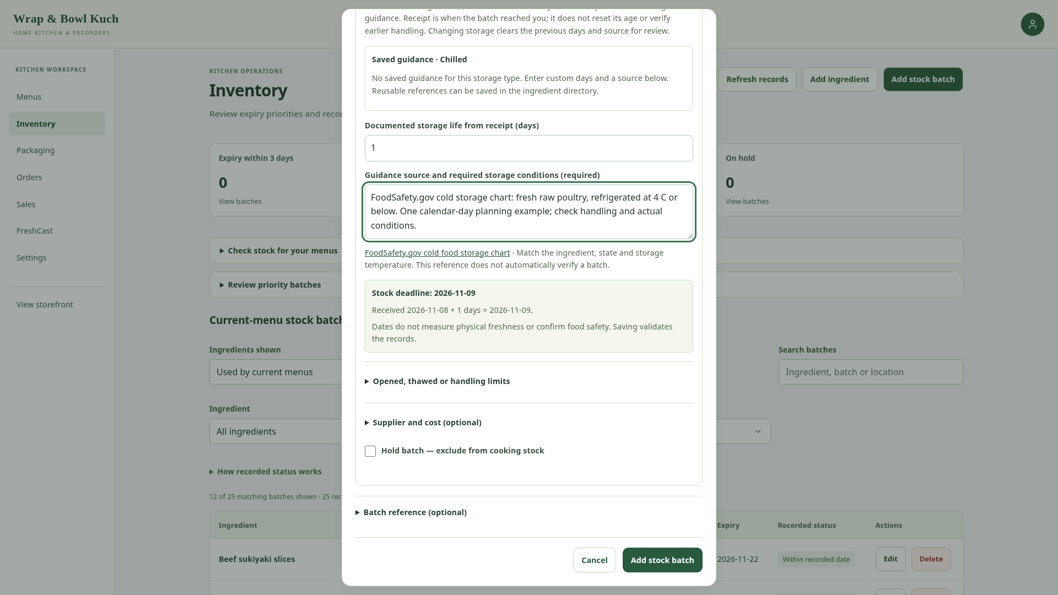
IT PROJECT 2 / WRAP & BOWL KUCH
Recorded dates guide usable stock
•
Printed dates or documented
storage life support unlabelled
ingredients.
•
Earlier deadlines and held
batches affect allocation.
•
Orders deduct eligible ingredients
and assigned packaging.
Actual local application capture with client photos / example records
Christopher Hansen · 2402081406 | FYP presentation draft
08
Notes:
Allocated time: 50 seconds.
The owner records a batch received date, actual storage and either a printed deadline or documented storage life. The earliest relevant deadline, including opening or thawing where recorded, guides allocation. Held or past-deadline batches are excluded. In the captured local order, chicken decreased by 130 grams and one salad bowl was deducted. These are recorded-date rules, not a measurement of physical safety.

Slide 9
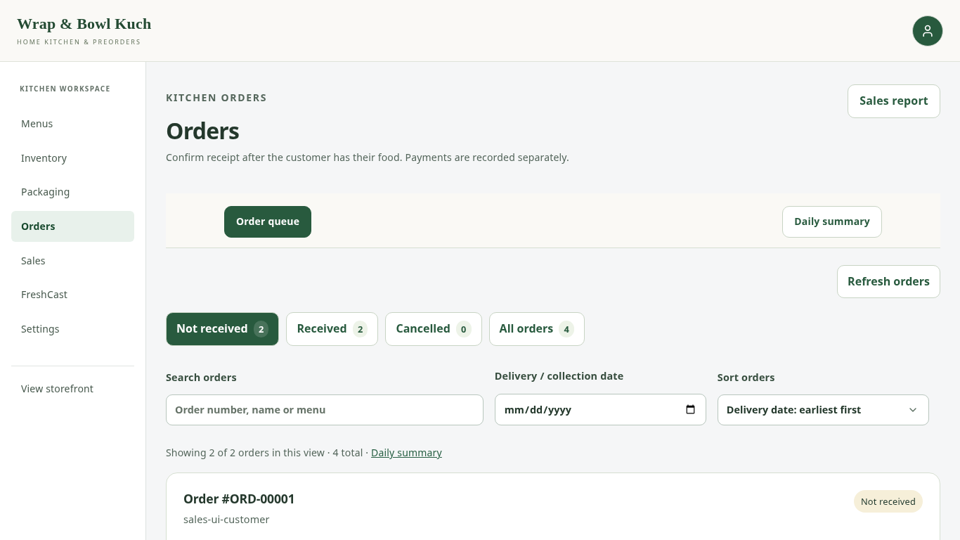
IT PROJECT 2 / WRAP & BOWL KUCH
Manage the order without confusing payment
•
Record payment only after
checking the bank or cash.
•
Confirm received only after actual
delivery or collection.
•
Daily summaries and printable
slips support fulfilment.
Actual local application capture with client photos / example records
Christopher Hansen · 2402081406 | FYP presentation draft
09
Notes:
Allocated time: 40 seconds.
Payment confirmation and food receipt mean different things. The owner checks the transfer or collected cash before recording payment, and marks the food received only after actual delivery or collection. Order queues, daily summaries and printable slips include the accepted order details. A courier API is not integrated, so the site does not automatically assert delivery merely because the planned time has passed.

Slide 10
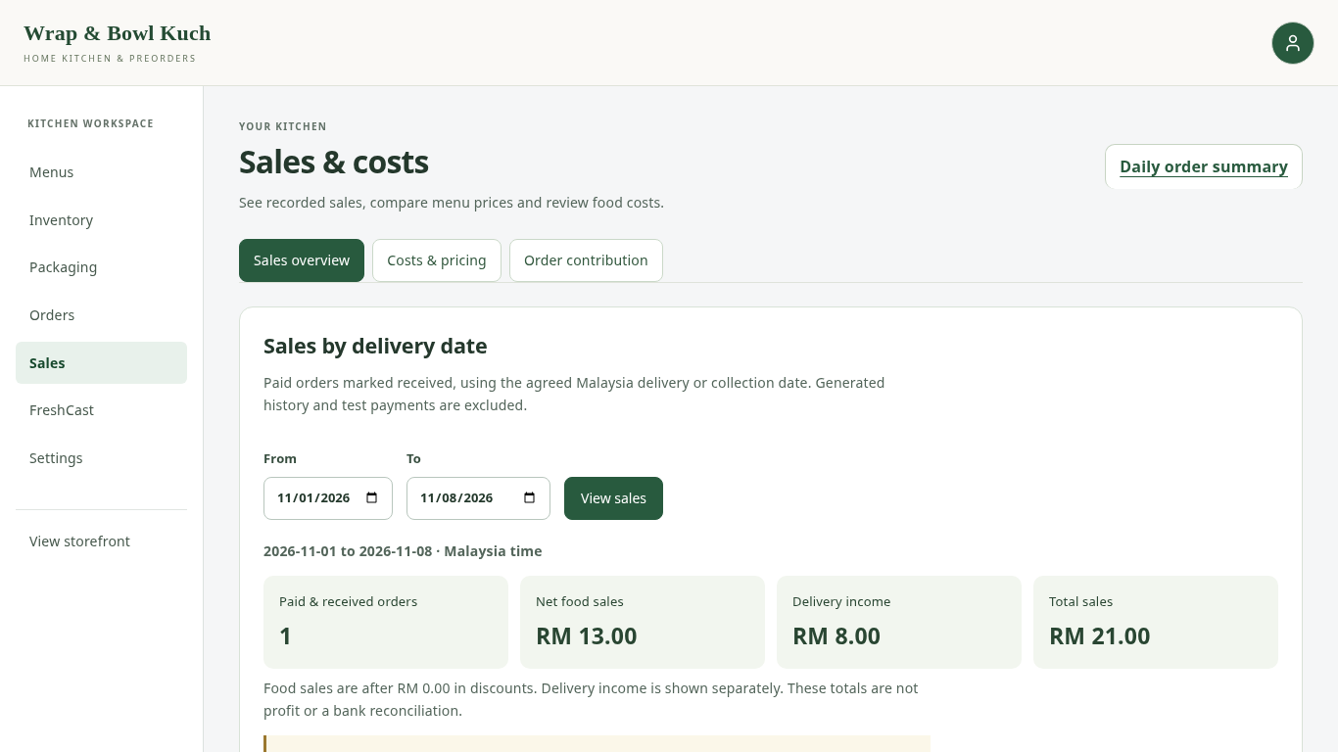
IT PROJECT 2 / WRAP & BOWL KUCH
Use sales information with its cost limits
•
Daily order totals and realised
sales answer different questions.
•
Sales, cost assumptions and
contribution are explained
separately.
•
Unknown ingredient or packaging
costs do not become zero.
Actual local application capture with client photos / example records
Christopher Hansen · 2402081406 | FYP presentation draft
10
Notes:
Allocated time: 40 seconds.
The daily order summary helps the owner prepare and hand over orders for a date. Sales reports apply the stated payment and receipt rules. Contribution considers recorded ingredient and packaging costs where available; it is not automatically net profit. Missing costs are shown as incomplete rather than converted to zero. The local history forecast is separate from the FreshCast Genpact demonstration and is not evidence of real-business demand accuracy.

Slide 11
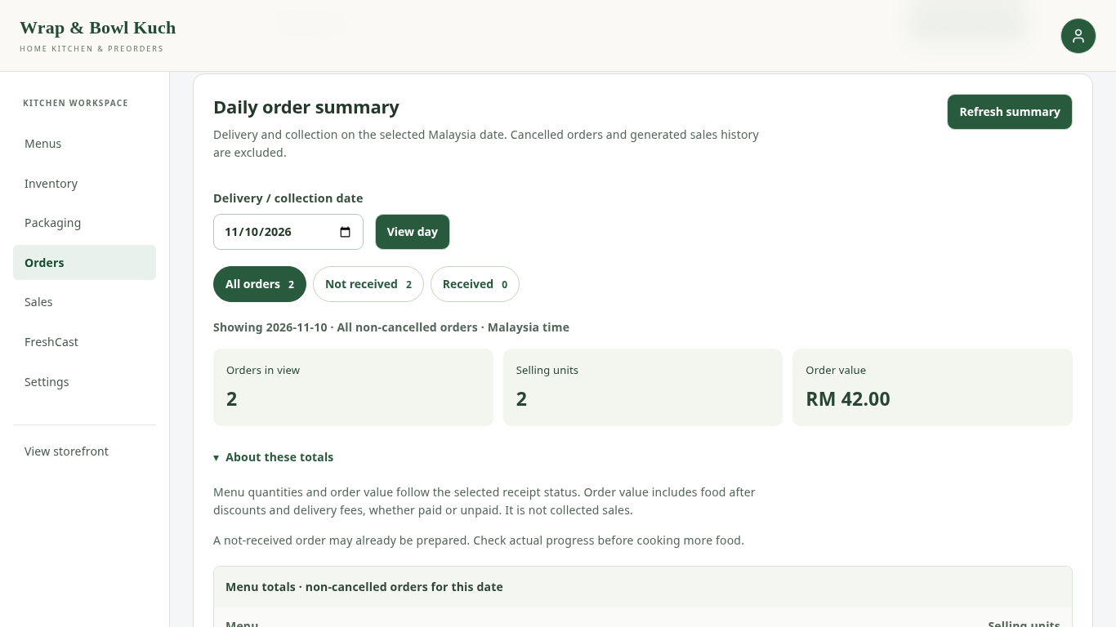
IT PROJECT 2 / WRAP & BOWL KUCH
What has been tested—and what needs feedback
•
Functional checks cover dates,
totals, stock, payment evidence
and access.
•
Browser checks exercise
customer and owner journeys.
•
User evaluation is separate from
these software checks.
Actual local application capture with client photos / example records
Christopher Hansen · 2402081406 | FYP presentation draft
11
Notes:
Allocated time: 30 seconds.
These are development and browser checks, not survey answers. The captured order-to-stock journey completed with no recorded page error. Some environment-dependent regression checks are skipped, and they are not passes. BEFORE FINAL PRESENTATION: replace or extend this slide with actual client and student evaluation findings once collected. State real participant numbers, tasks, findings and changes; do not invent scores.

Slide 12
IT PROJECT 2 / WRAP & BOWL KUCH
One connected workflow for a home kitchen
•
The five objectives guide the implemented functions.
•
Dates support planning; bank and courier events still need real evidence.
•
Next: the recorded customer-to-kitchen walkthrough.
Christopher Hansen · 2402081406 | FYP presentation draft
12
Notes:
Allocated time: 25 seconds.
The contribution is a connected workflow adapted to the client: customers choose food and an offered date while accepted orders update ingredient and packaging records for owner follow-up and reporting. These functions have practical limits and still need formal user feedback. I will finish with the recorded demonstration, then take questions.

Slide 13
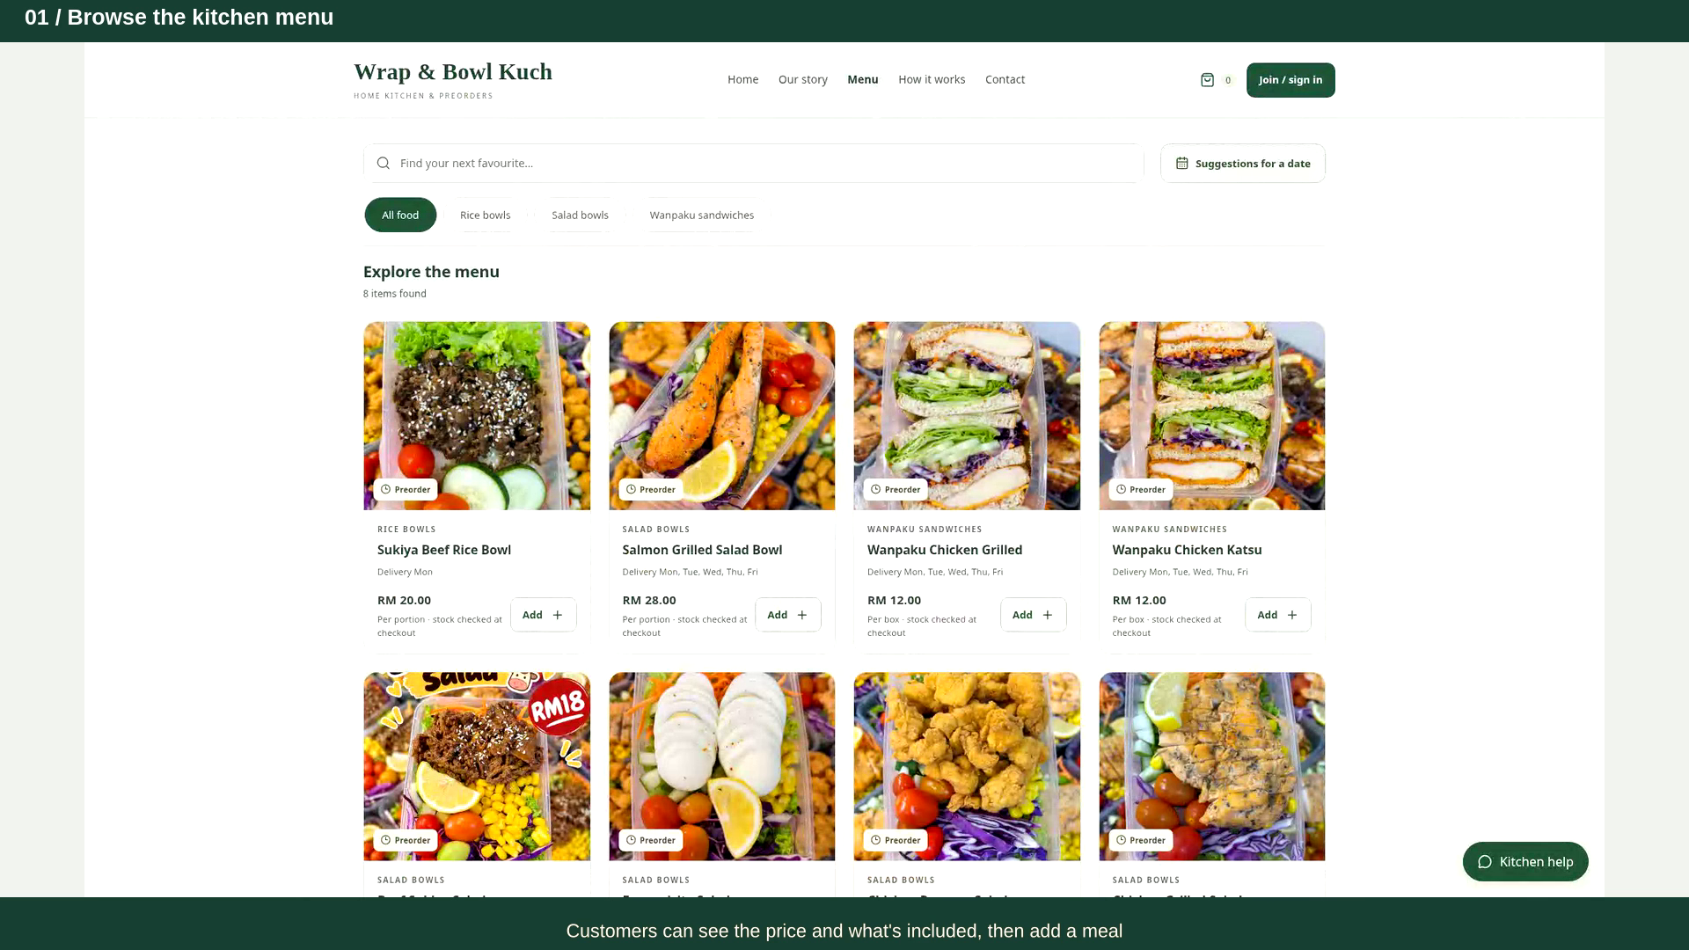
IT PROJECT 2 / WRAP & BOWL KUCH
Demo: customer order to kitchen records
PLAY THE
2-MINUTE DEMO
Click the video in
PowerPoint.
Fallback: open the MP4 or
screenshot PDF.
Local application recording · client photos · example records
Christopher Hansen · 2402081406 | FYP presentation draft
13
Notes:
Allocated time: 120 seconds.
Play the embedded two-minute client-photo video. It uses the actual application running locally with supplied client photographs, separate example accounts/orders/stock and a virtual passkey. No real bank transfer, live customer order or courier booking was made. Click the video in PowerPoint; if the editor does not support embedded playback, open Demo_120s_Client_Photos_1080p.mp4 from the same folder. If video fails, use Screenshot_Fallback.pdf. End with questions after the demo.

Slide 14
IT PROJECT 2 / WRAP & BOWL KUCH
Questions
Thank you.
Questions about the workflow, stock rules, data model or evaluation?
Christopher Hansen · 2402081406 | FYP presentation draft
14
Notes:
Allocated time: 0 seconds.
Thank you. Use the separate design backup slides or the full report if the panel asks about the data model, access control, stock allocation or evaluation limits.

