Slide 1
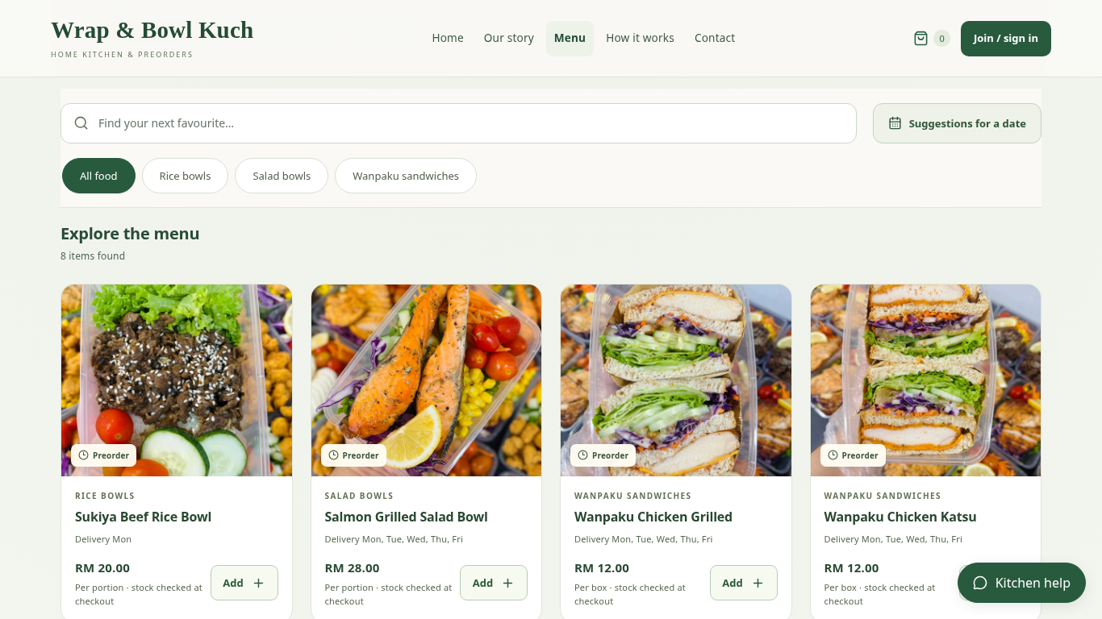
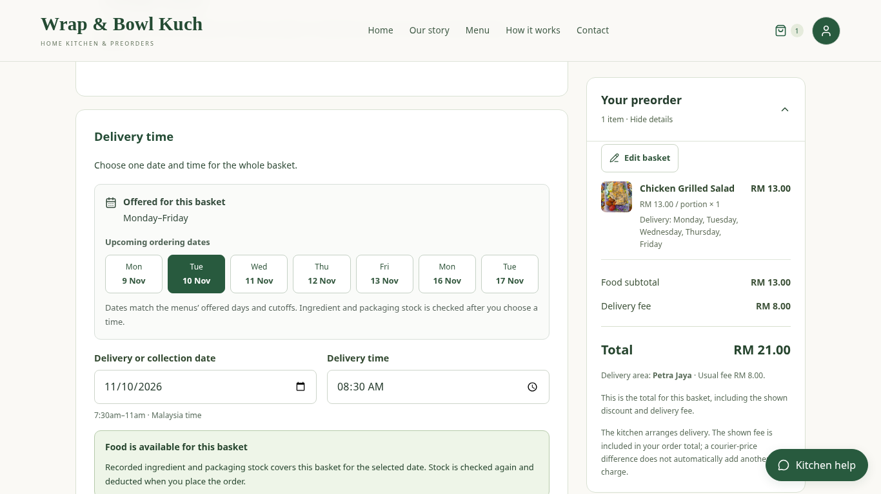
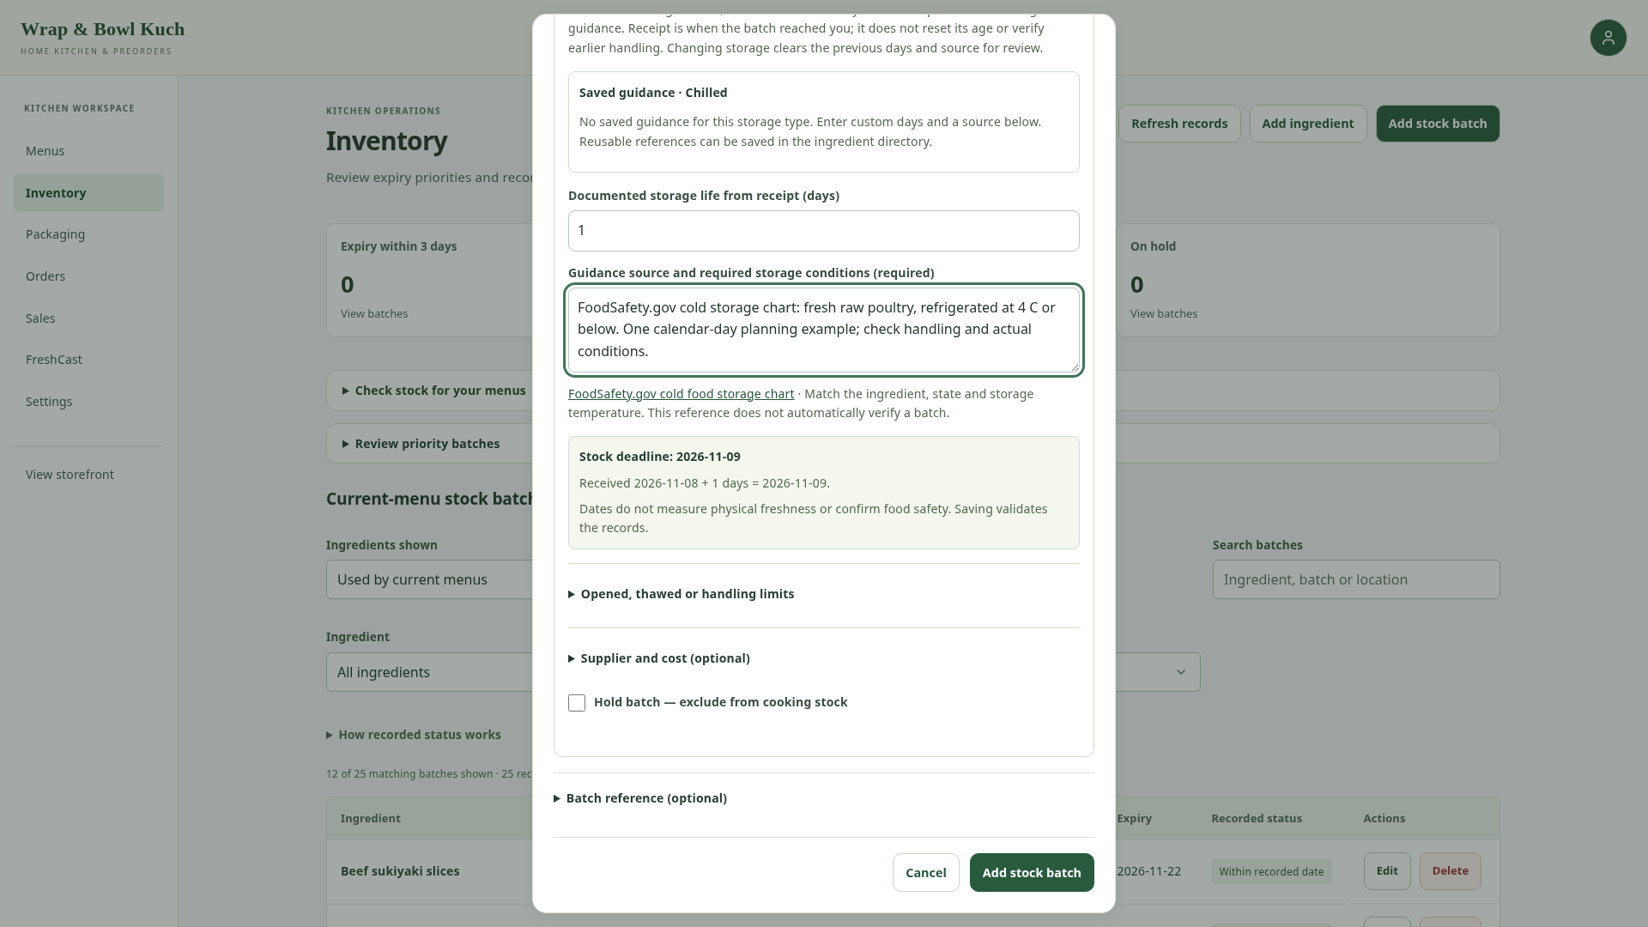
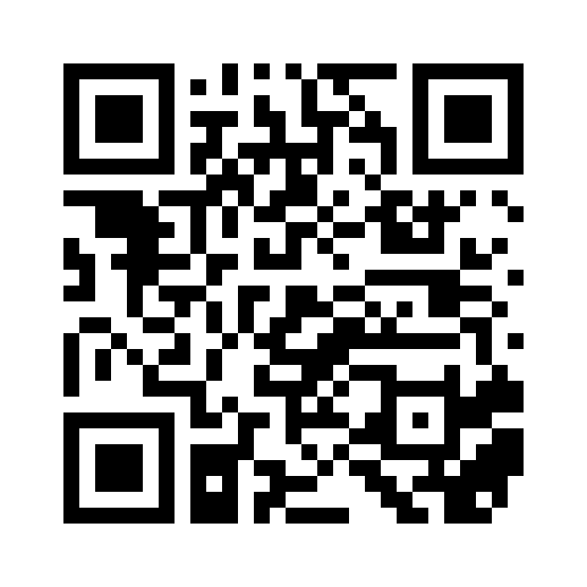
IT PROJECT 2 | SARAWAK TUN OPENG UNIVERSITY OF TECHNOLOGY
Web-Based Preorder and Freshness
Management System for Home-Based Entrepreneurs
CASE STUDY: WRAP & BOWL KUCH · KUCHING, SARAWAK
Christopher Hansen · 2402081406 | Supervisor: Ms. Nur Elana Binti Mohd Saferinor
SIMPLIFIED ORDER-PLACEMENT SEQUENCE
Customer
Submit preorder
Web application
Django server
Database
Send basket + date
Save order + deduct stock
Return order details
Order saved
Show confirmation
01 Background & scope
04 Working system
Preorder details can be scattered across
messages.
Food-safety concerns motivate clearer
ingredient storage records.
Reviewed platforms provide limited control
over preordering and independent branding.
Scope: customer preorders and suggestions; owner
menus, stock, orders and sales.
02 Original objectives
1. To design and develop a web application that
supports flexible date-based food preordering
and scheduling for home-based food
entrepreneurs.
2. To implement a food stock freshness
monitoring feature based on ingredient shelf life
and storage duration.
3. To develop a personalised single-vendor
storefront module that allows sellers to
strengthen branding without direct competitor
distraction.
Client menu photos, prices and selling units in one branded storefront.
05 Connected preorder and stock records
4. To implement a sales analytics dashboard
that supports data-driven business
decision-making for home-based food operators.
5. To develop a menu recommendation system
that reduces customer decision fatigue and
improves purchase conversion rates.
Preorder and stock deduction
Recorded storage life
03 Development approach
Checkout checks an offered date and total.
Order placement deducts eligible ingredients
and packaging together.
The owner records date evidence and storage
life. Earlier deadlines and holds affect stock
allocation.
Review literature and client needs.
IMPLEMENTATION
Build and refine the application from client
feedback.
React
Django
Supabase / PostgreSQL
Check functions; collect formal user feedback
next.
Customer and owner screens
Pricing, access and stock rules
Persistent application records
06 Testing & results
Conclusion & next step
Explore
the menu
Example local preorder test:
The prototype connects preorders, recorded
stock life and sales information.
Ordering one meal deducted 130 g of
chicken and one salad bowl.
Scan to open the live
storefront.
Recorded stock changed as expected.
Formal client and student evaluation is
planned.
Public menu
Not a payment QR
Screens: local application, client photos and example records. Dates support planning; they do not guarantee food safety.
Selected references: Pallianysamy et al. (2025), Home-based Foods in Malaysia; FoodSafety.gov, Cold Food Storage Chart.
Notes:
A1 portrait, 594 × 841 mm. Source client-photo captures are local application screens with example orders/stock. Original five objectives are unchanged. Formal client/student evaluation remains planned. QR links to the public menu, not a bank payment. Body type is Arial; keep it embedded/available when exporting. Blank upper-right logo area: x=1422 pt, y=38 pt, width=190 pt, height=190 pt. No i-CATS logo is used. Final poster requirements have not yet been issued; review the handoff checklist when they arrive.

