Slide 1
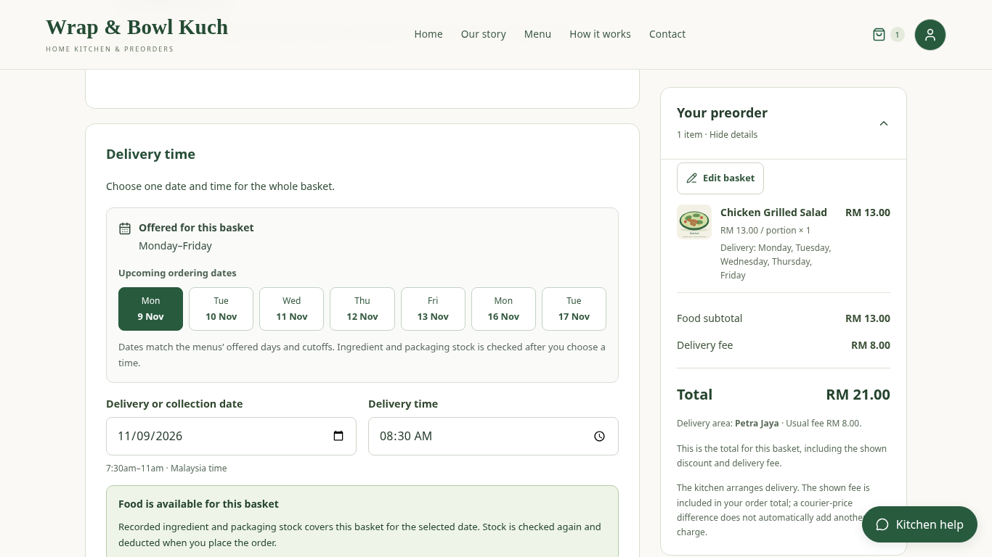
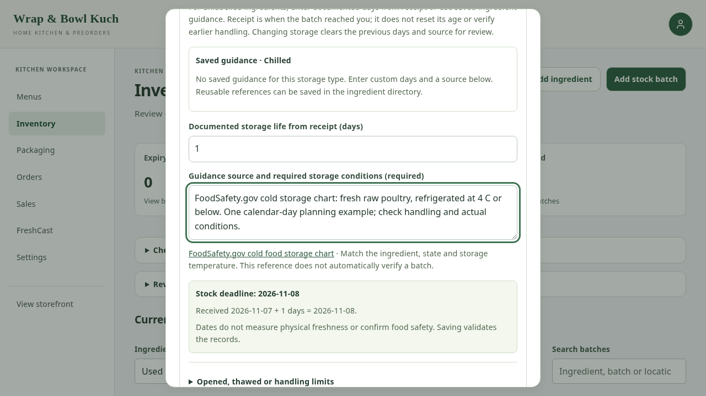
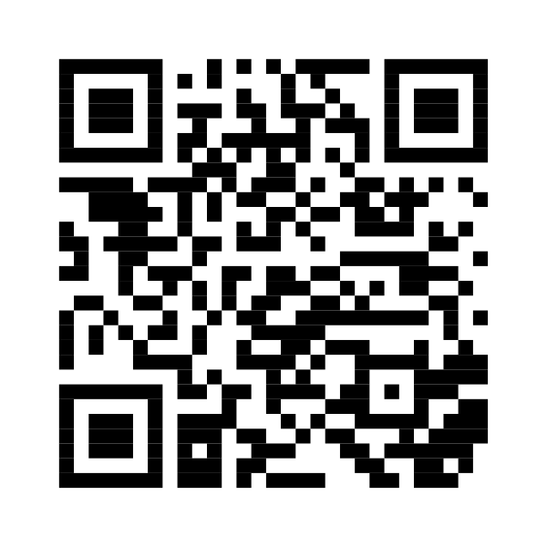
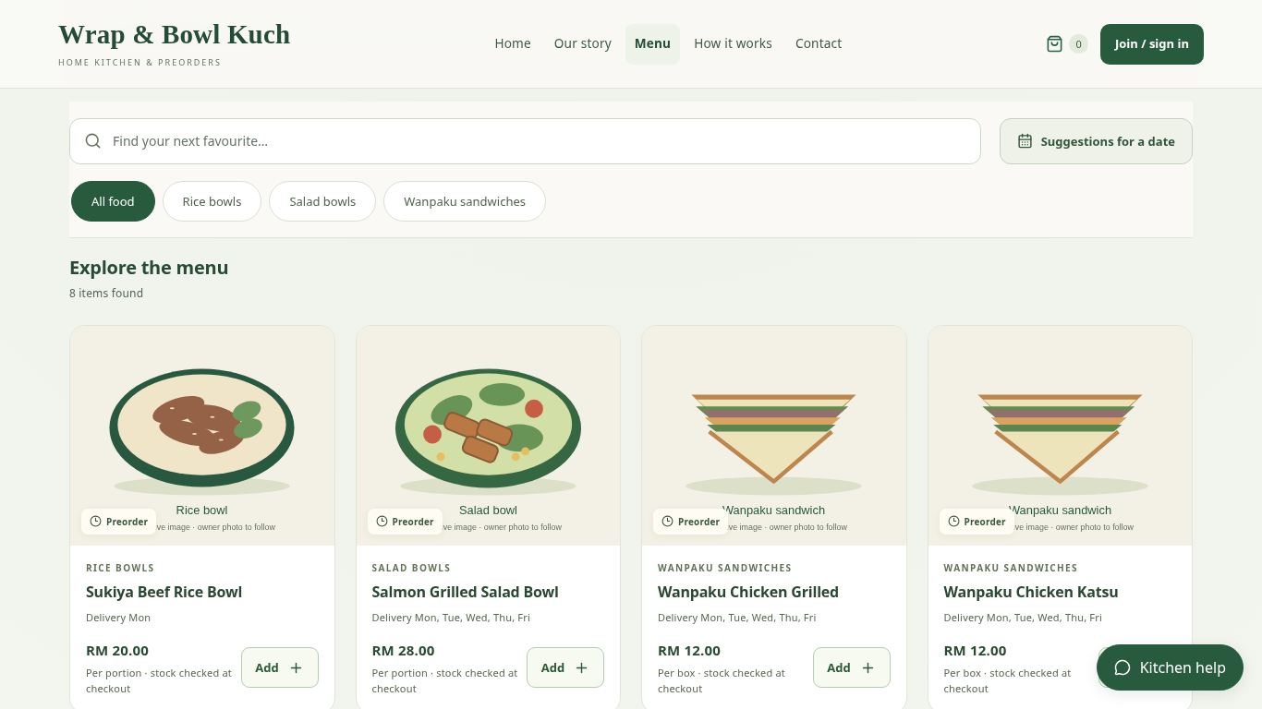
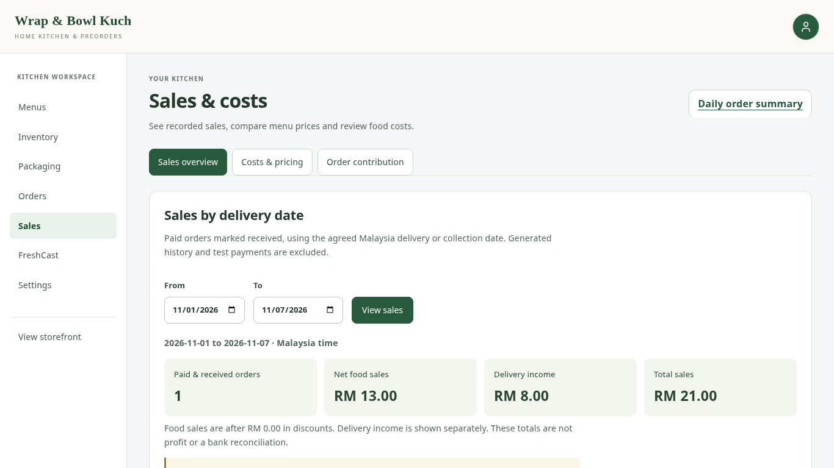
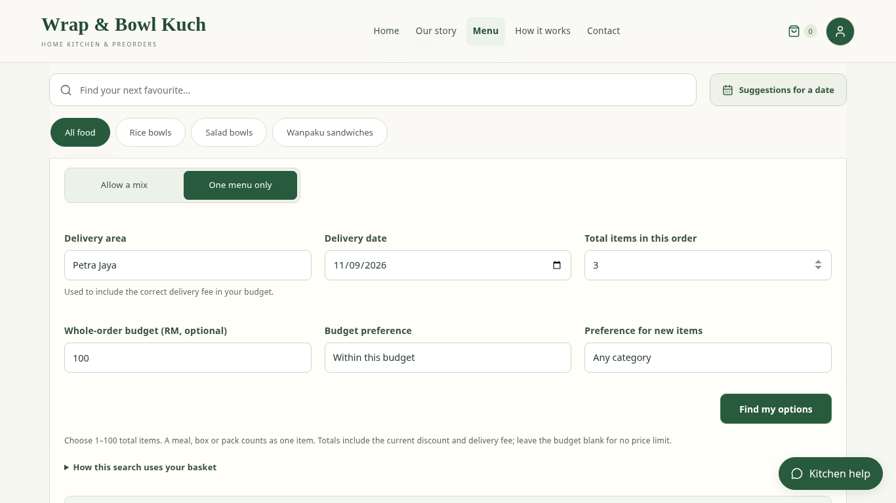
IT PROJECT 2 | SARAWAK TUN OPENG UNIVERSITY OF TECHNOLOGY
A connected workflow
for home-kitchen preorders.
Web-Based Preorder and Freshness Management System
for Home-Based Entrepreneurs
Christopher Hansen · 2402081406 | Supervisor: Ms. Nur Elana Binti Mohd Saferinor
CASE STUDY / WRAP & BOWL KUCH, KUCHING
01
→
02
→
03
→
04
→
05
Browse food
Choose date + area
Validate price + stock
Save order + deduct
Review and report
WHY THIS PROJECT?
TWO FEATURE STORIES
DESIGN & EVIDENCE
•
Preorder dates can remain scattered across
messages.
REACT
•
Ingredient shelf-life records sit outside the
ordering tools reviewed.
Customer and owner interfaces
•
A home kitchen needs its own identity and
useful decision information.
DJANGO
Permissions, pricing and stock rules
Motivation: Chapter 1 problem statements and Chapter 2
platform/literature review.
POSTGRESQL / SUPABASE
1 CUSTOMER PREORDER
Persistent application records
FIVE ORIGINAL OBJECTIVES
Clear date choices and totals. Placement
rechecks the basket and records ingredient and
packaging deductions together.
FUNCTIONAL CHECKS
1. To design and develop a web application that
supports flexible date-based food preordering and
scheduling for home-based food entrepreneurs.
•
Dates, totals and one-time stock deduction.
•
Access controls and payment-evidence rules.
2. To implement a food stock freshness monitoring
feature based on ingredient shelf life and storage
duration.
•
Daily summaries, sales and budget suggestions.
3. To develop a personalised single-vendor storefront
module that allows sellers to strengthen branding
without direct competitor distraction.
4. To implement a sales analytics dashboard that
supports data-driven business decision-making for
home-based food operators.
USER EVALUATION
5. To develop a menu recommendation system that
reduces customer decision fatigue and improves
purchase conversion rates.
Client follow-up and student feedback are
planned. No survey scores or conversion gains
are claimed.
2 RECORDED STOCK LIFE
Printed or documented date evidence guides
usable stock. Earlier limits and holds affect
allocation.
CLIENT-LED CHANGES
DATE RECORDS HAVE LIMITS
Morning handover · area fees · packaging stock
· payment proof · simpler order receipt.
They support stock planning. They do not
detect contamination or guarantee physical food
safety.
Explore the public menu
preorder-freshness.vercel.app/menu
SUPPORTING VIEWS
Dedicated menu and kitchen identity
Sales and cost information
Optional date and budget suggestions
Screens show the current local application with example records. General storage reference: FoodSafety.gov.

