Slide 1
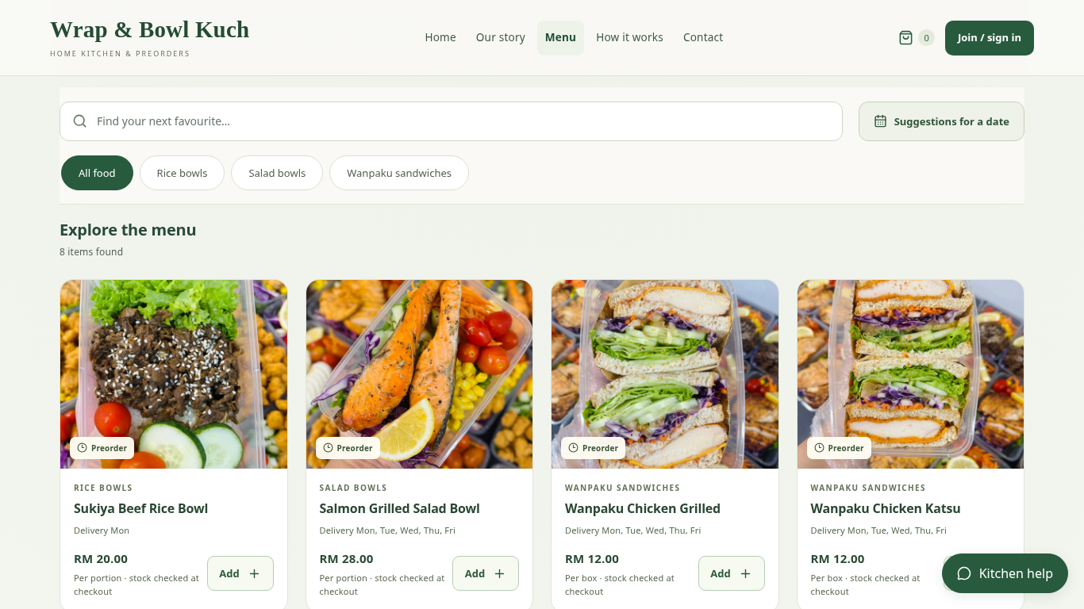
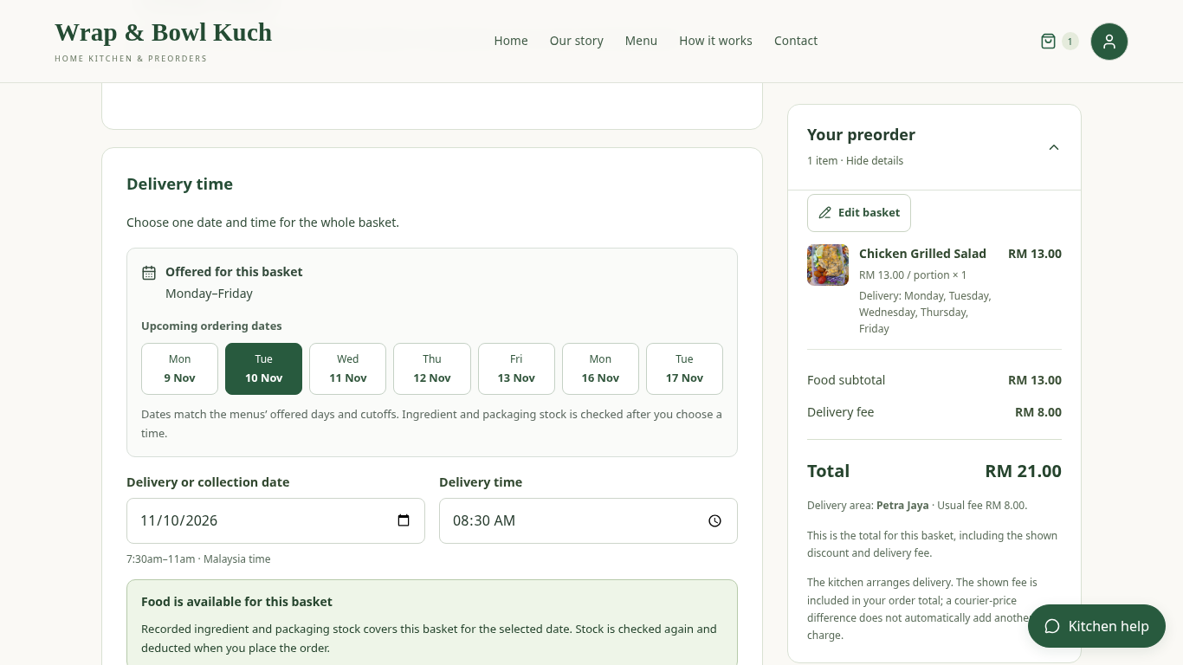
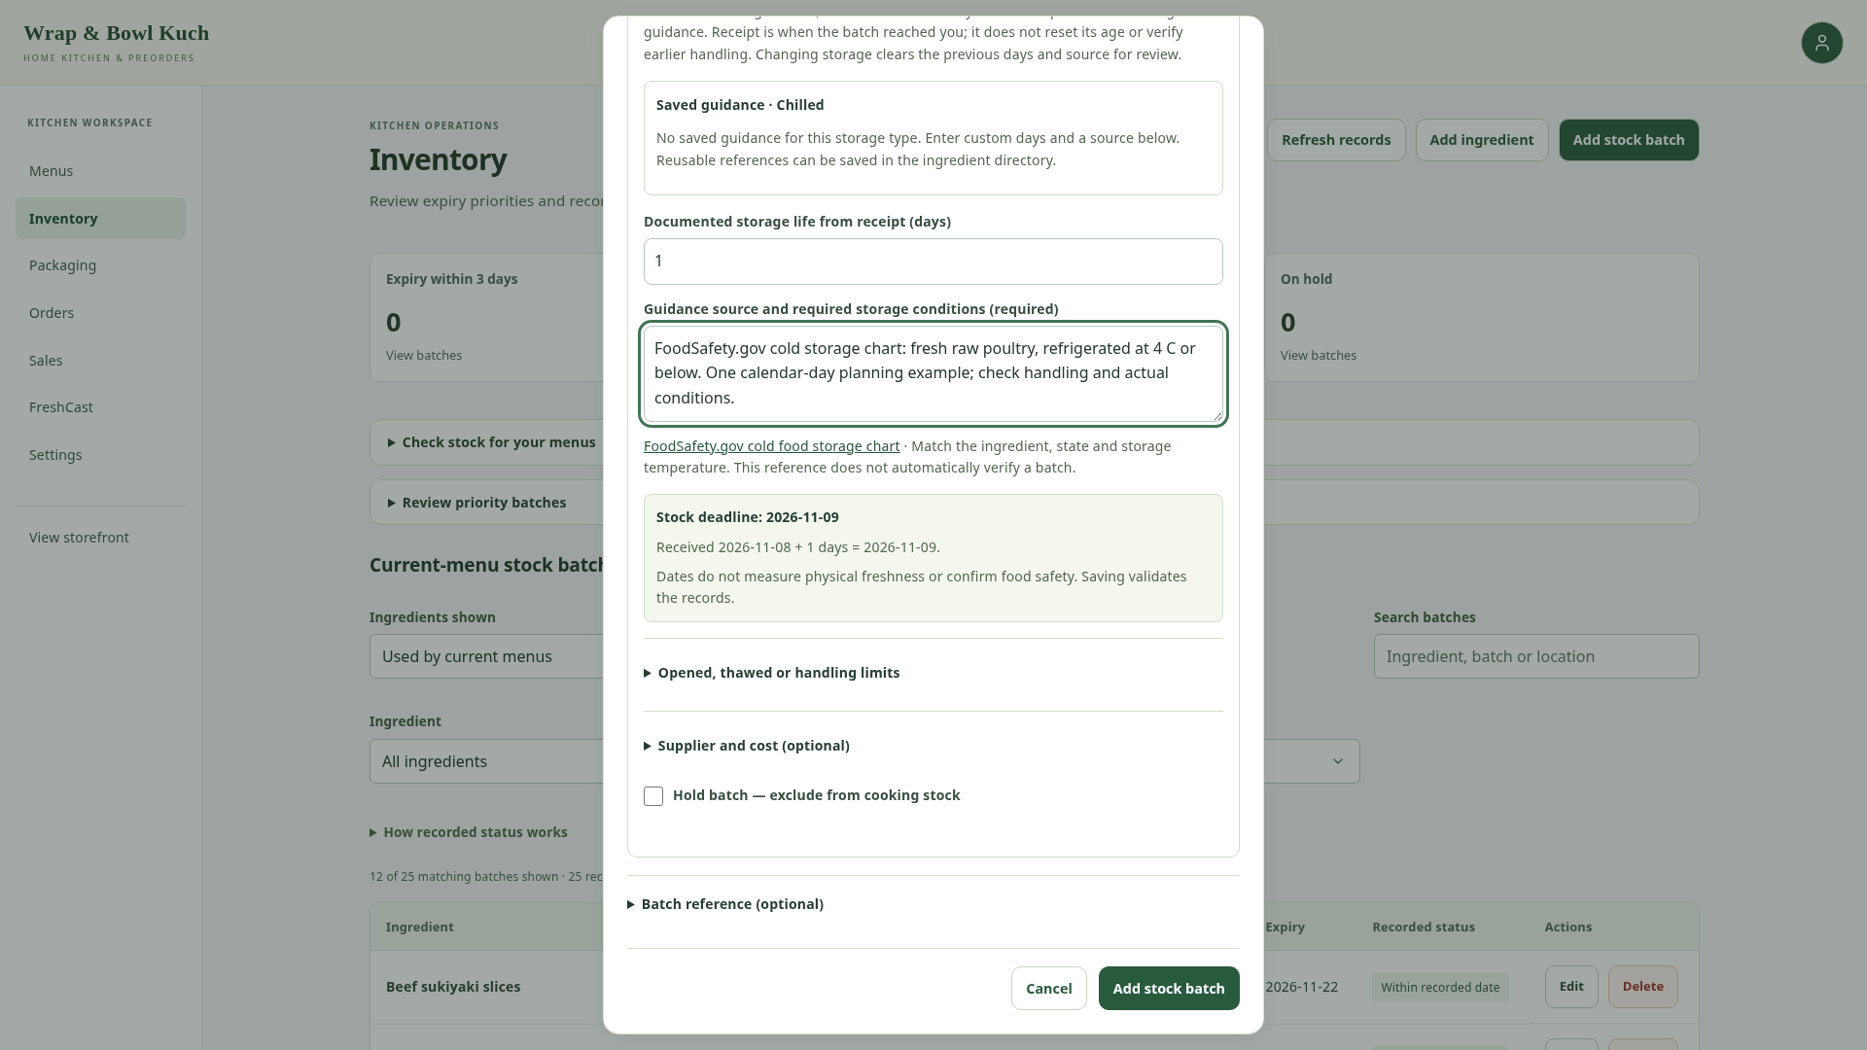
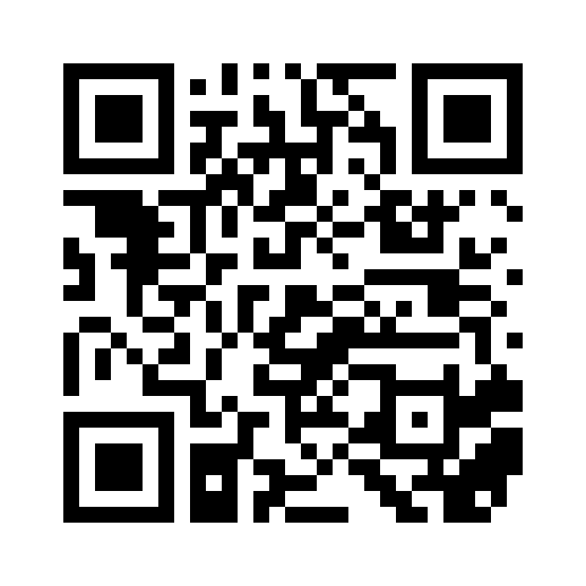
IT PROJECT 2 | SARAWAK TUN OPENG UNIVERSITY OF TECHNOLOGY
Web-Based Preorder and Freshness
Management System for Home-Based Entrepreneurs
CASE STUDY: WRAP & BOWL KUCH · KUCHING, SARAWAK
Christopher Hansen · 2402081406 | Supervisor: Ms. Nur Elana Binti Mohd Saferinor
HOW THE SYSTEM CONNECTS THE WORK
01
02
03
04
05
Browse food
Choose date
and area
Check total
and stock
Save order
and deduct stock
Review orders
and sales
01 Background
04 Working system
Preorder details can be scattered across
messages.
Food-safety concerns motivate clearer
ingredient storage records.
Reviewed platforms provide limited control
over preordering and independent branding.
02 Original objectives
1. To design and develop a web application that
supports flexible date-based food preordering
and scheduling for home-based food
entrepreneurs.
2. To implement a food stock freshness
monitoring feature based on ingredient shelf life
and storage duration.
3. To develop a personalised single-vendor
storefront module that allows sellers to
strengthen branding without direct competitor
distraction.
Client menu photos, prices and selling units in one branded storefront.
05 Connected preorder and stock records
4. To implement a sales analytics dashboard
that supports data-driven business
decision-making for home-based food operators.
5. To develop a menu recommendation system
that reduces customer decision fatigue and
improves purchase conversion rates.
Preorder and stock deduction
Recorded storage life
03 Development approach
Checkout checks an offered date and total.
Order placement deducts eligible ingredients
and packaging together.
The owner records date evidence and storage
life. Earlier deadlines and holds affect stock
allocation.
Review literature and client needs.
IMPLEMENTATION
Build and refine the application from client
feedback.
React
Django
Supabase / PostgreSQL
Check functions; collect formal user feedback
next.
Customer and owner screens
Pricing, access and stock rules
Persistent application records
06 Verification
Conclusion & next step
Explore
the menu
One recorded preorder changed:
The prototype connects preorders, recorded
stock life and sales information.
Chicken: 5,000 g → 4,870 g
Salad bowls: 200 → 199
Scan to open the live
storefront.
Observed in the local functional test.
Formal client and student evaluation is
planned.
Public menu
Not a payment QR
Screens: local application, client photos and example records. Dates support planning; they do not guarantee food safety.
Selected references: Pallianysamy et al. (2025), Home-based Foods in Malaysia; FoodSafety.gov, Cold Food Storage Chart.
Notes:
A1 portrait, 594 × 841 mm. Source client-photo captures are local application screens with example orders/stock. Original five objectives are unchanged. Formal client/student evaluation remains planned. QR links to the public menu, not a bank payment. Body type is Arial; keep it embedded/available when exporting.

