Slide 1
CASE Specification
Container Application Software for Enterprises specification for IBM Cloud Paks and certified containers

Slide 2
Agenda
CASE overview
Why do we need it?
What does it solve?
How is it used today?
How does this fit with Operators / OLM?

Slide 3
Cloud Paks and IBM certified container software
Cloud Paks = collection of:
Red Hat Certified Images
Red Hat Certified Operators (goal)
IBM certified container software
Cloud Pak for: Applications, Automation, Data, Integration, Multicloud Management, Security
CASE = Metadata and Packaging for all IBM certified container software and Cloud Paks
https://www.ibm.com/partnerworld/cloud/independent-software-vendors
https://ibm-10.gitbook.io/certified-for-cloud-pak-onboarding/
https://www.ibm.com/cloud/paks/
Cloud Pak CASE
Certified containerized software CASEs

Slide 4
I have a Cloud Pak or container software, but…
What is it?
What’s inside the box?
How do I install it?
How do I operate it?
How do know how good it is?
Is it safe to use?
Is my cluster compatible?

Slide 5
Solve some Enterprise Use Cases
Install, Manage, Operate, Upgrade, Uninstall complex software using multiple roles/personas
Manage software over multiple namespaces
Manage software in a multi-tenant cluster (Helm 2)
Manage software in a multi-cluster cloud
Flexibility to allow both simple and complex (tailored) use cases.
Easy button is important
Customization is ALSO important
Transparent and obvious security posture
Defense in depth, zero trust & Least privilege
Off-line / Air-Gapped installations

Slide 6
And some IBM Use Cases
Certification of both Cloud Paks and containerized software for both IBM and ISVs
Leverage existing infrastructure
Minimize churn for existing certified Helm Charts
CICD support: Certification and Publish
Support multiple catalogs and marketplaces
Support multiple installers/managers
Support software entitlements
Support consistency with prescriptive patterns, yet also be flexible
Support Operators

Slide 7
CASE Metadata – How consumed?
CASE
Install
Operate
Discover
Learn
Integrate
Reuse
Distribute

Slide 8
Alternative Packaging and Lifecycle Managers
Helm
Missing enterprise use cases.
Difficult to enhance.
Helm 3 is brand new and has somewhat destabilized the platform for now.
TODO: Maturity model reference
Operator Lifecycle Manager (OLM)
Focus on Operator pattern. Not so much on Operand/binding.
Limited extensibility.
Missing enterprise use cases (getting better)
Everything MUST be an OLM Operator
Includes an adapter for Helm and Ansible
Still Alpha – Not production grade yet
Other technologies: CNAB, Docker, TUF, yum, RPM, APT, Homebrew, Gopkg, KPM…

Slide 9

CASE Contents
Inventory Items
README.md
case.yaml
roles.yaml
prereqs.yaml
inventory
<inv-item>
files
inventory.yaml
resources.yaml
actions.yaml
LICENSE
licenses
certifications
signature.yaml
digests.yaml
Software Information
Scoped Item
Actor Roles
Actions
Prerequisites
Files
Licenses
Helm Chart Refs
Certifications
Container Image Refs
Signature
Digests

Slide 10
CASE Consumption Primary Use Cases
As a <persona>, I want to view a CASE <attribute>
Security architect: security posture
Cloud architect: Databases, Storage and Network requirements
Cluster administrator: namespace, pod security, persistent volume requirements
Data scientist: Product capabilities
As a <role>, I want to <action> a <inventory item>
As a cluster admin, I want to setup the cluster prerequisites
As a namespace admin, I want to install the application.
As an application administrator, I want to backup the database.

Slide 11
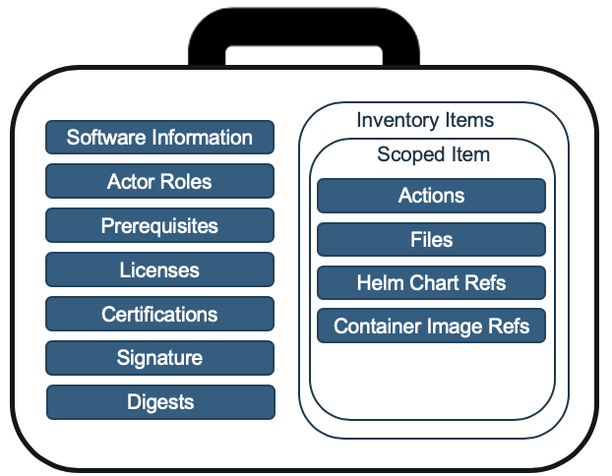
CASE Contents – case.yaml
Catalog information:
Name, version, Description, icon, categories…
Support summary
Architectures, clouds, Kubernetes distros…
Other relevant info…

Slide 12
CASE Contents – roles.yaml
Identifies arbitrary roles used by defined actions when interacting with the case.
Examples:
Cluster Admin
Namespace Admin
Namespace Operator
Application Admin
Application User

Slide 13
CASE Contents – prereqs.yaml
Globally identifies possible prerequisites that portions of the CASE require.
Kubernetes distribution and versions
Kubernetes API versions
Kubernetes Resource Instances
IBM Shared/Manged/Core services

Slide 14
CASE Contents - Inventory
Decomposes the CASE into multiple units, by Scope and Role.
Adds the ability for consumers to answer the question:
As a <role>, I want to <action> a <inventory item>

Slide 15
CASE Contents – Inventory Item
An inventory item contains:
Resources
Actions
Readme (instructions)
An inventory item applies to ONE scope:
Cluster or
Namespace
Resources are embedded files or references to repositories of files/software.
Actions are the verbs that apply to all resources

Slide 16
CASE Contents – Inventory Item Action
Inventory item is a series of Actions that are applied to all Resources in the item.
Actions:
Are verbs: install, configure, deploy, remove…
Map to one or more Roles (cluster admin)
Include Kubernetes RBAC permission requirements to run the action.
Include prerequisite rules
Kube APIs (operator
Kube resources (operator instance, csv)
IBM Core Service instance
Helm Releases (TBD)
CNAB Claim (TBD)

Slide 17
CASE Contents – Inventory Item Resources
There are two types of resources:
Files
Files are embedded within the files subdirectory and included with the CASE.
These can be scripts, text files, Kubernetes resource files, etc.
Each file is included in the resources.yaml with the relative name in the files directory and the SHA-256 hash of the file.
References
Software that is considered part of the CASE, but is stored elsewhere (other CASEs, Helm Charts, etc)
Information on HOW to retrieve the resource is not included here.
The reference declares WHAT is included in the CASE

Slide 18
CASE Contents – Inventory Item Helm Chart Refs
Helm Chart References include:
Helm Chart Name
Version
Digital Signature / Hash of the chart archive
Size

Slide 19
CASE Contents – Inventory Item Container Images
Container Images references are stored in two places:
files/manifest.yaml file (deprecated, for compatibility with cloudctl catalog commands)
resources.yaml
Resources.yaml contains a reference to the image manifest OR the manifest list.
If a manifest list, each manifest is also included.
Registry, Image, Version, Digest
Manifest lists
Architecture, os, variant

Slide 20
CASE Contents – certs, sig, digest
The following files are injected by the certification tool:
certifications/<vendor><type>.yaml
signature.yaml
digests.yaml
Together, they include detailed information on
WHAT was certified,
WHEN it was certified,
WHEN the certification expires and
WHO certified it.
If a CASE is missing any of these files it is NOT certified.

Slide 21
CASE Tooling – casectl and cloudctl
Extensive go library exists: casectl (not yet publically available):
Product Builder:
Create new and convert Helm chart to CASE
Generate Digests
Validate all metadata
Consumer:
Validate integrity and authenticity (digests/signature)
Validate prereqs and permissions
Airgap: Resolve/Download/Transfer CASE References (Images, Charts, other CASEs)
Bash script launcher
Public CLI tool cloudctl exposing features for the Consumer (coming soon):
Airgap support
Bash script launcher

Slide 22
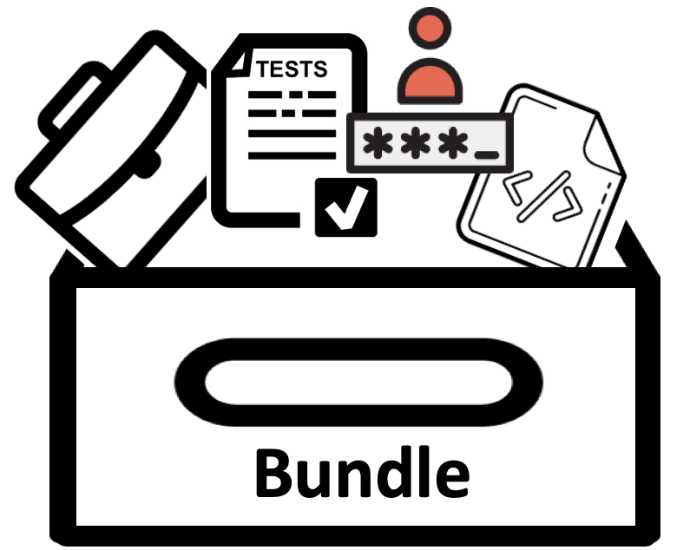
CASE Bundles
CASE Bundles extend a CASE to include:
operator-sdk source
Helm Chart source
Tests
Registry overrides (e.g. image repos)
Not available publically yet.

Slide 23
OLM Integration – Thoughts and Discussion

Slide 24
Add Operator / OLM Integration to CASE
CASE doesn’t yet have first-class Operator support
The operator manifests (operator-sdk/deploy) are stored directly in an inventory item in the case.
Integration options:
Operator Bundle Reference
Catalog Sources
What would this look like?
Inventory Items
Scoped Item
Actions
Files
Helm Chart Refs
Container Image Refs
Operator Refs
Catalogs

Slide 25
Add CASE integration into OLM
Add missing features into CSVs
Certifications
Metadata
Scripts
…
Add CASE to an operator bundle?
https://github.com/openshift/enhancements/blob/master/enhancements/olm/operator-bundle.md
Add CASE to catalog source?
Add additional manifests (CSVs will become too large)

Slide 26
Add CASE to Operator Bundle
The CASE is just a directory of files.
A CASE Archive is just a tgz of those files
The Operator Bundle could embed the CASE within:
Add CASE directory to the image files
Add labels to the image metadata
manifests
testbackup.crd.yaml
testcluster.crd.yaml
testoperator.v0.1.0.csv.yaml
testrestore.crd.yaml
metadata
annotations.yaml
case
testoperator-0.1.0
README.md
case.yaml
roles.yaml
prereqs.yaml
…

