Slide 1
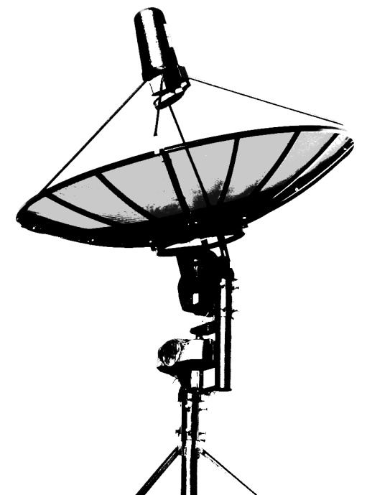
Fast Radio Burst Detection Project at Custer
RADIO ROOM
FIELD
Keyboard/
Monitor/
Mouse
(Dumb Terminal)
To outside Debian SBC
RACK
Weatherproof Enclosure
Low Voltage AC Power Supply
Run over existing RF cable… 25VAC?
GNURadio running FFT plot, waterfall, and audio with GUI controls for frequency, etc. Also terminal for issuing pointing commands to mount. Plugin for skychart program?
Display GRC output on public monitor upstairs.
Continuously dumps I/Q data to file in batches.
Run analysis scripts on I/Q data (Python) for signal search. Build long-term database and improve analysis, rerunning as needed.
SSH into this computer to check latest analysis, backup data, etc.
AC-DC Adaptors
For PC, KVM, SDR, LNA
KVM over Ethernet
1.7 Ghz Feed
Horn
KVM over Ethernet
Debian SBC
SDR
RTL-SDR to start
LNA
INTERNET
Mount Controller
Arduino for motor control and encoder reporting
J. Haupt 2/7/17

