Slide 1
Survey Results

Slide 2
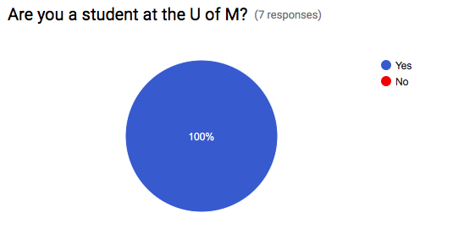
Are you a student at the U of M?

Slide 3
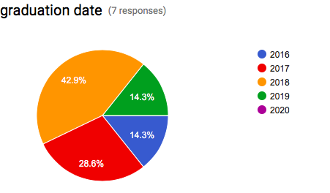
Graduation Date?

Slide 4
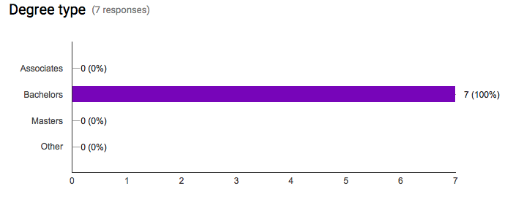
Degree Type?

Slide 5
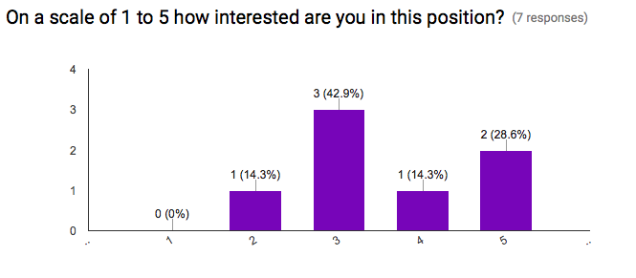
Interest?

Slide 6
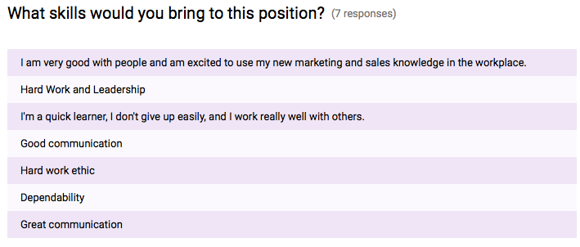
What skills do you bring to the position?

Slide 7
Summary
After conduction our survey we have identified several different findings.
All students apply for this position currently attend the U of M.
These students have a variety of different graduation dates, with 2018 being the most common.
All students are pursing for their bachelors degree.
The students showed only moderate interest in this position.
The students have a variety of different skills they could bring to this particular position.

