Slide 1
Course #3:
Auto-encoders and Recurrent Neural Networks

Slide 2
Roadmap
Recap from course #2
Auto-encoders
Recurrents Neural Networks

Slide 3
Lecture. #2
Things to know
Convolution layers
Pooling layers
Activation layers
Dropout layers
Padding and stride
Fine-tuning
Over-fitting
Data augmentation
Notes:
feedforward network = feedforward neural network = multilayer perceptron

Slide 4
Auto-encoders
Notes:
Pas eu le temps d’abord l’optimisation
Il faut le faire en deuxième séance

Slide 5
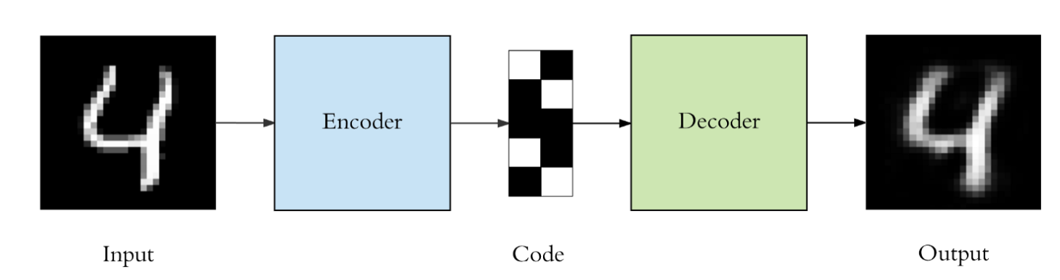
Auto-encoders
Output with the same shape as the input
Application ?
Notes:
feedforward network = feedforward neural network = multilayer perceptron

Slide 6
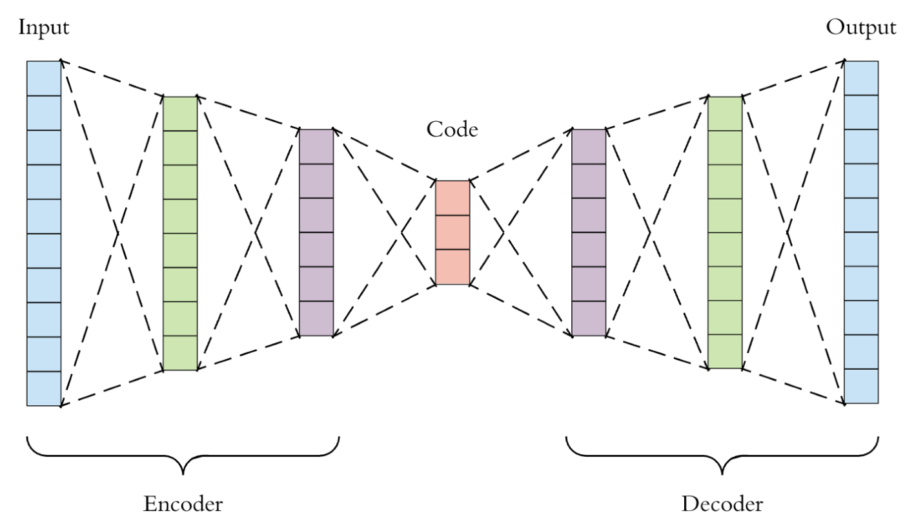
Dense auto-encoders
Notes:
feedforward network = feedforward neural network = multilayer perceptron

Slide 7



PCA/EOF
X
Z
PCA as a linear auto-encoder architecture.
Which additional constraint ?
Notes:
feedforward network = feedforward neural network = multilayer perceptron

Slide 8
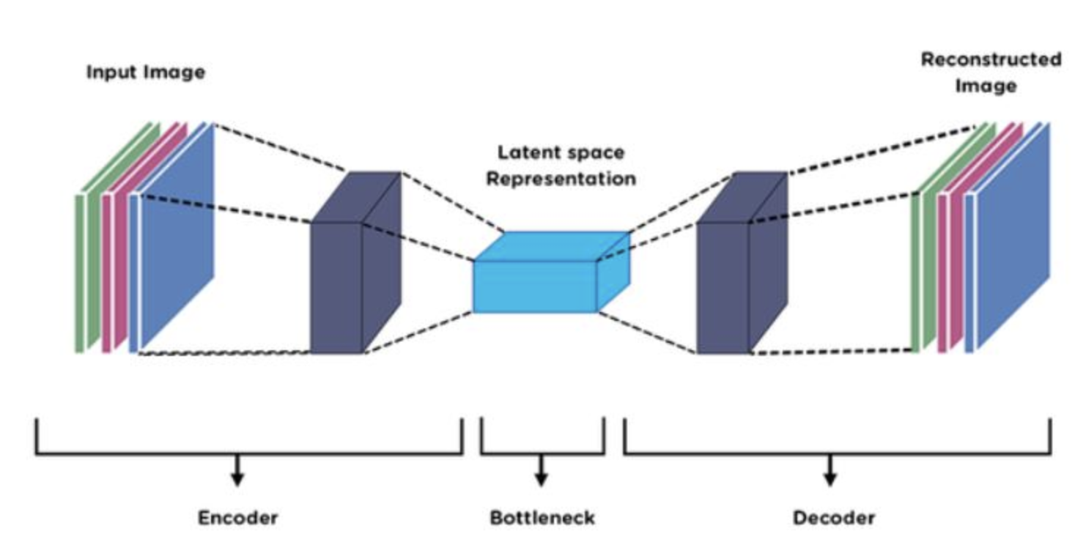
Convolutional auto-encoders
Source: https://www.analyticsvidhya.com/
Notes:
feedforward network = feedforward neural network = multilayer perceptron

Slide 9
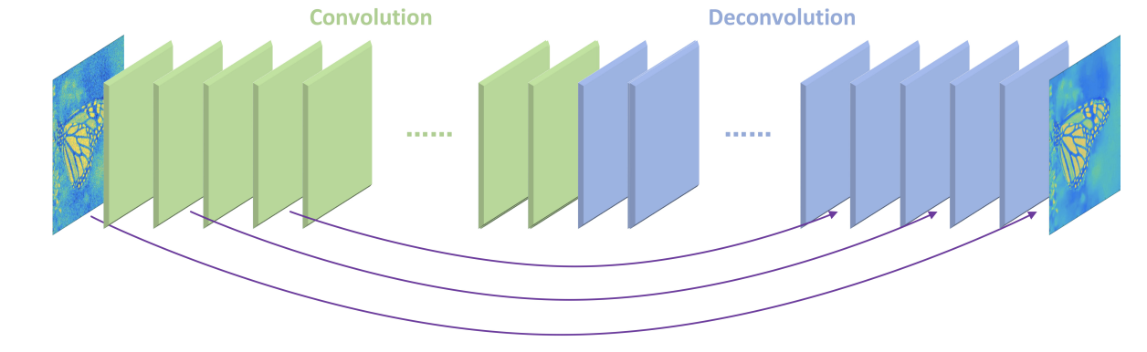

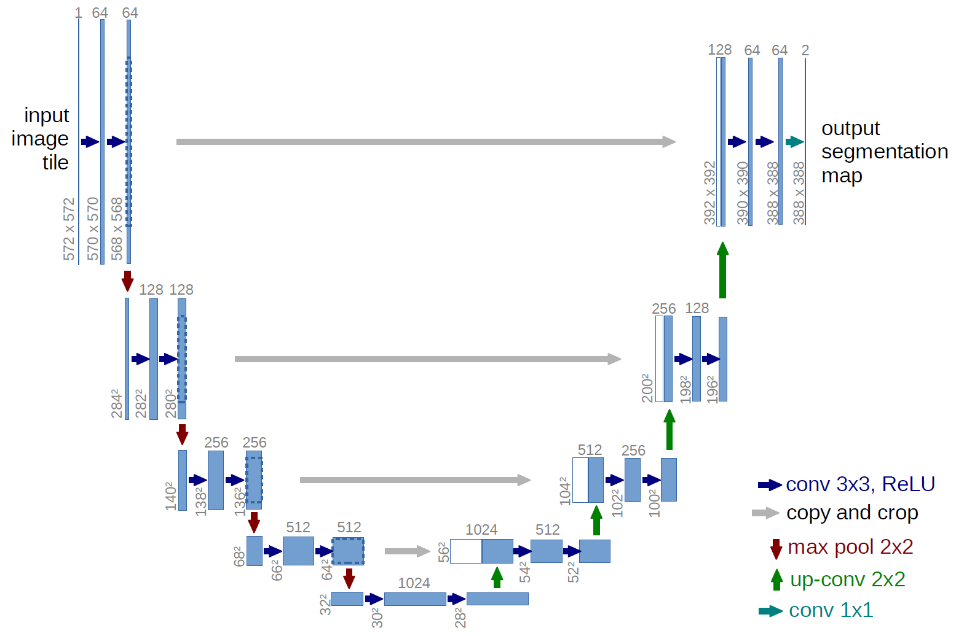
Convolutional AE Zoo
Many applications do not require a low-dimensional representation (e.g., densoising, interpolation, super-resolution,….)
https://arxiv.org/pdf/1606.08921.pdf
UNet
Ronneberger et al., 2015
Notes:
feedforward network = feedforward neural network = multilayer perceptron

Slide 10

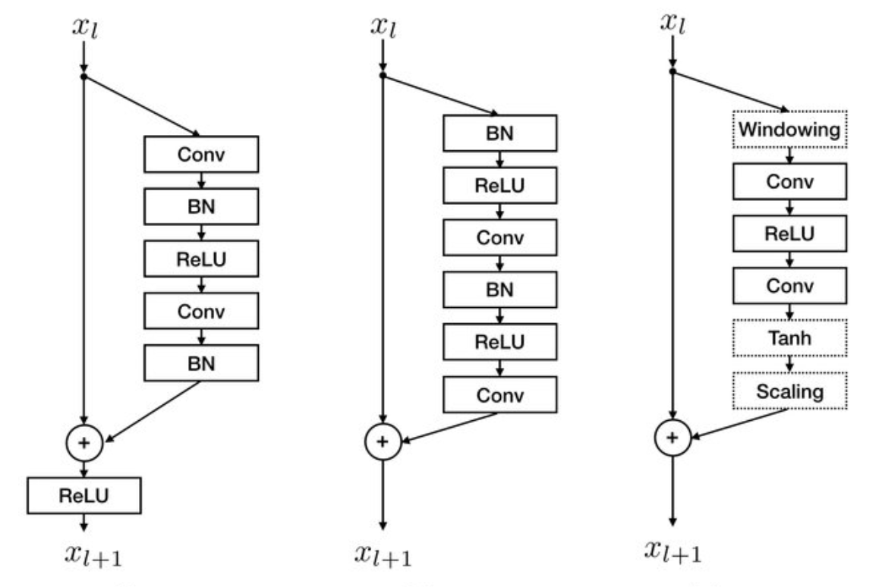
Convolutional AE Zoo
Residual Block (ResNet)
Rousseau et al., 2019
Often used to address vanishing gradients (“very” deep networks)
Notes:
feedforward network = feedforward neural network = multilayer perceptron

Slide 11
Auto-encoders for image denoising and image generation
Pytorch version
https://github.com/CIA-Oceanix/DLOA2023/blob/main/lectures/notebooks/notebook_MNIST_AutoEncoder_students.ipynb
Lightning version
https://github.com/CIA-Oceanix/DLOA2023/blob/main/lectures/notebooks/notebook_PytorchLightning_MNIST_AutoEncoder_students.ipynb
Question 1. Fill in the architecture of the dense encoder module to train a dense auto-encoder
Question 2. Add dropout layers in the convolutional encoder and decoder
Question 3. Modify the code to test a linear auto-encoder (cf. AE and PCA)
Notes:
feedforward network = feedforward neural network = multilayer perceptron

Slide 12
PyTorch Lightning
Notes:
Pas eu le temps d’abord l’optimisation
Il faut le faire en deuxième séance

Slide 13

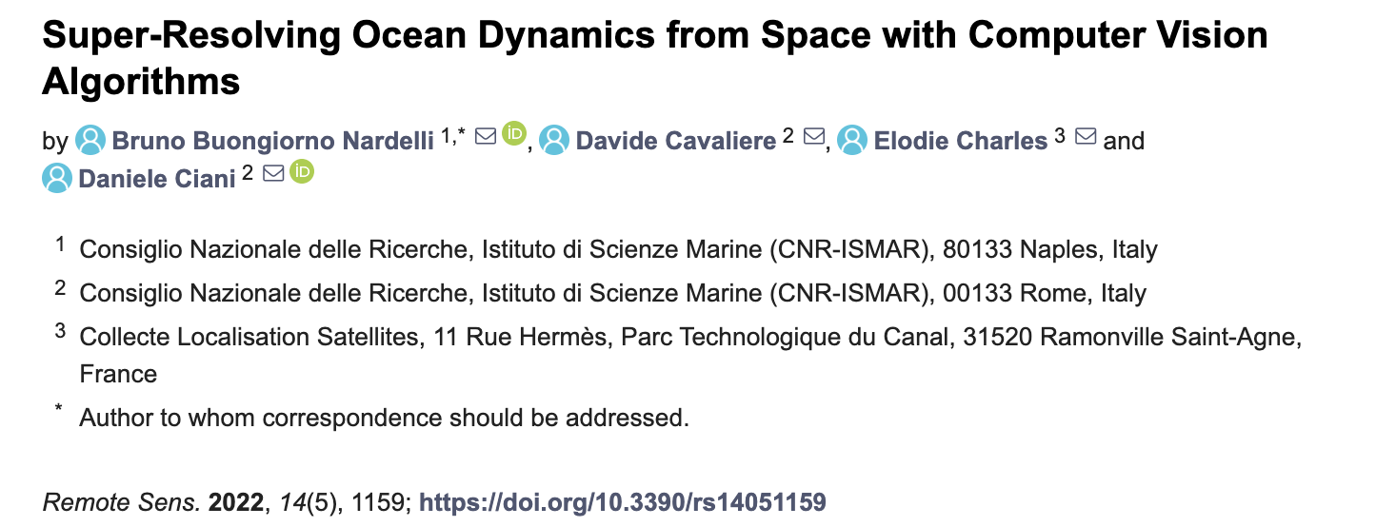
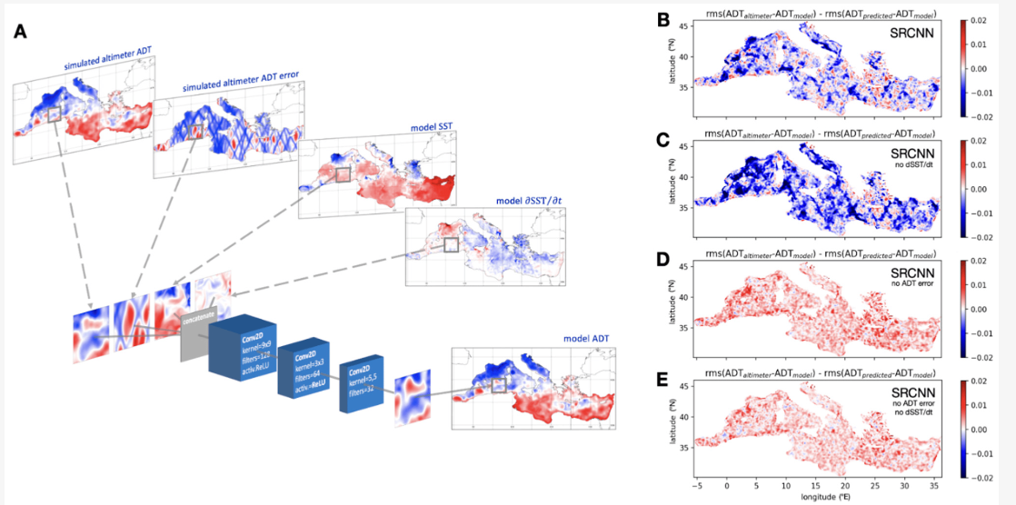
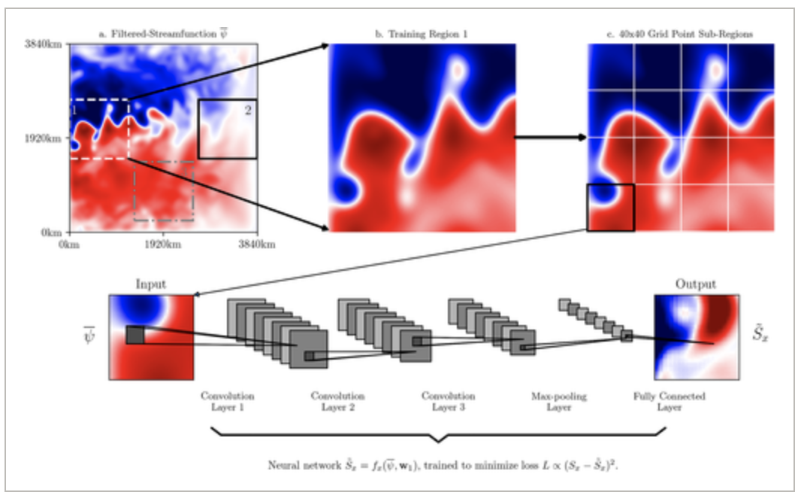
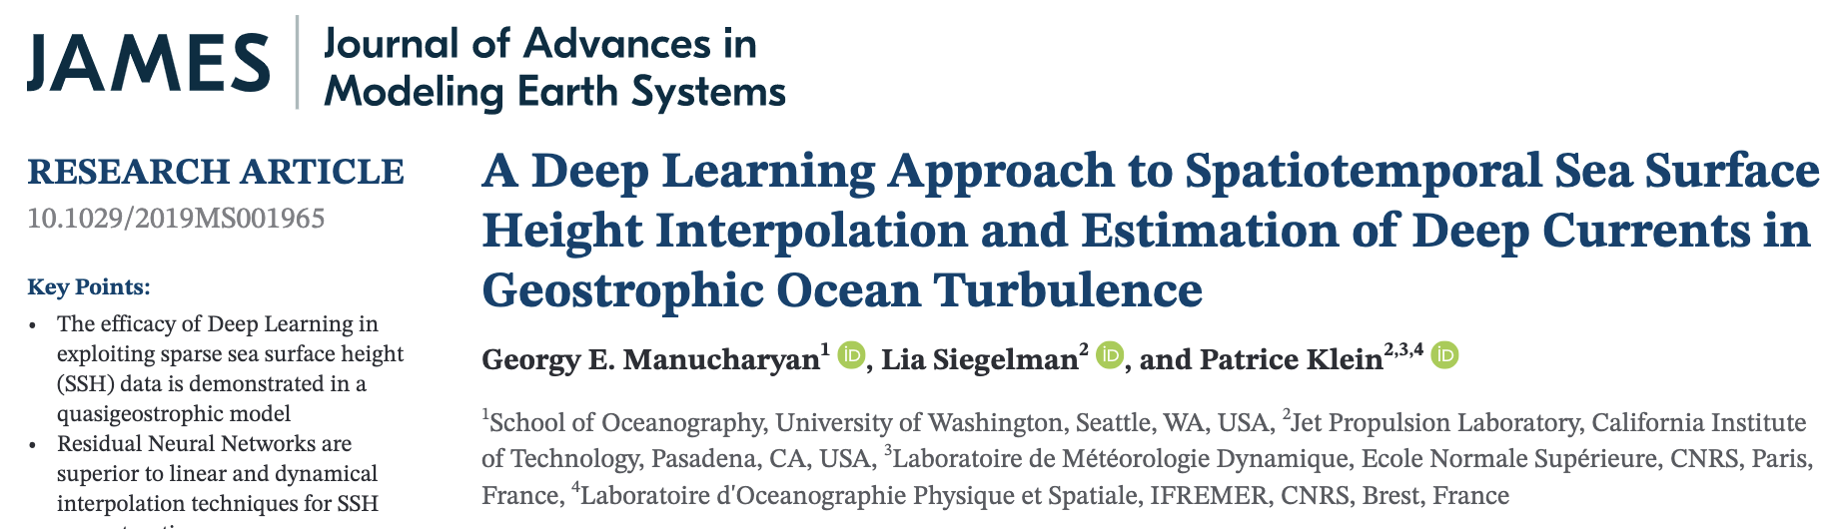
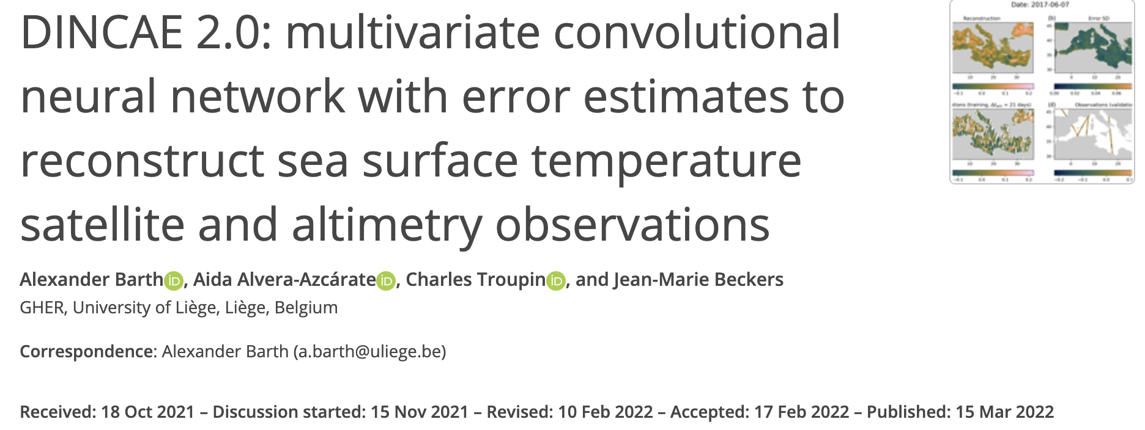
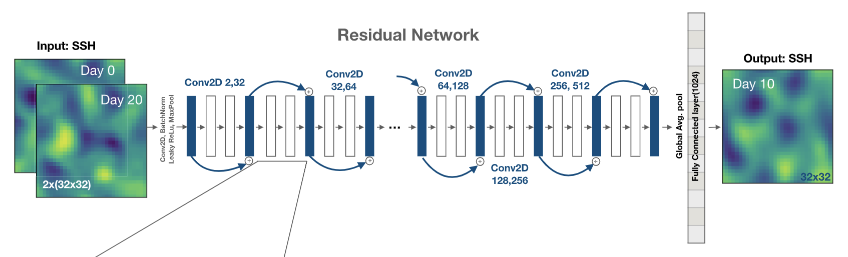
ConvAE & Ocean Dynamics
https://agupubs.onlinelibrary.wiley.com/doi/epdf/10.1029/2018MS001472
https://www.mdpi.com/2072-4292/14/5/1159
https://agupubs.onlinelibrary.wiley.com/doi/epdf/10.1029/2019MS001965
https://gmd.copernicus.org/articles/15/2183/2022/
Notes:
feedforward network = feedforward neural network = multilayer perceptron

Slide 14
ConvAE & Ocean Dynamics
Literature review
Considered papers:
Topic#1 https://gmd.copernicus.org/articles/15/2183/2022/
Topic#2 https://agupubs.onlinelibrary.wiley.com/doi/epdf/10.1029/2018MS001472
Topic#3 https://agupubs.onlinelibrary.wiley.com/doi/epdf/10.1029/2019MS001965
Topic#4 https://arxiv.org/abs/2010.04663
Questions:
Which problem ?
Which convolutional architecture ?
Comments ?
Notes:
feedforward network = feedforward neural network = multilayer perceptron

Slide 15
ConvAE architectures for Ocean Dynamics ?
Notes:
feedforward network = feedforward neural network = multilayer perceptron

Slide 16
Lecture. #3
Things to know (AE)
Auto-encoder
Latent variable
UNet
ResNet
Notes:
feedforward network = feedforward neural network = multilayer perceptron

