Slide 1
Landrace Gap Analysis
Common bean database

Slide 2
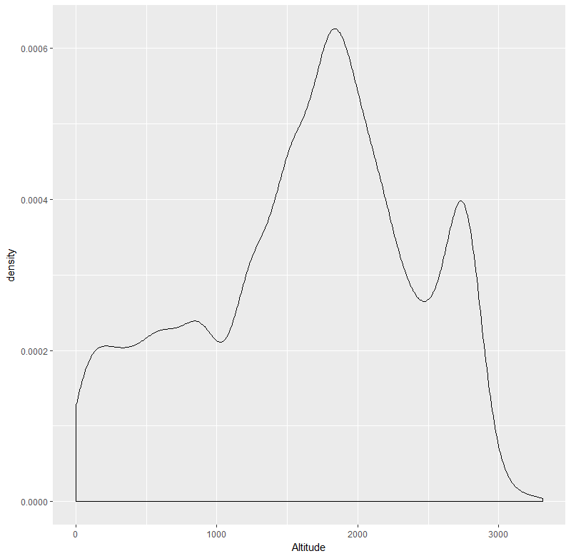
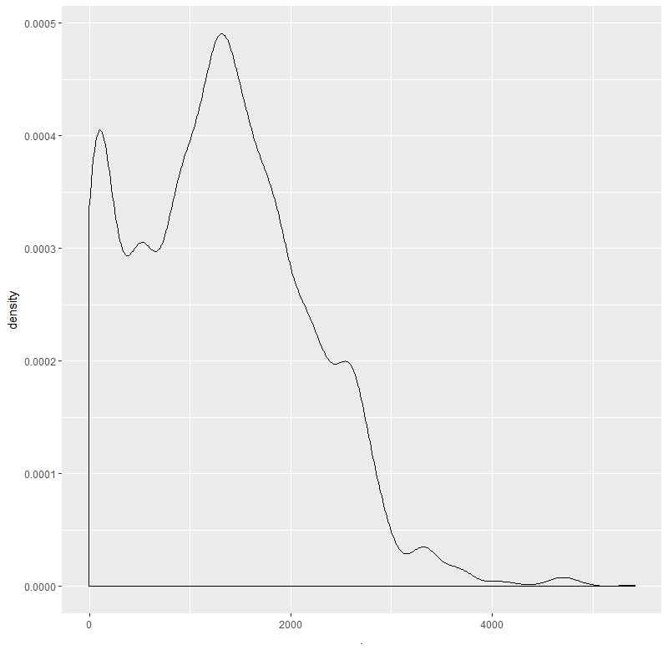
Original altitude data distribution
Altitude data distribution from SRTM
$$P\left(Altitude≥3000\right)=0.01251908$$
$$P\left(Altitude≥3500\right)=0.002565249$$

Slide 3
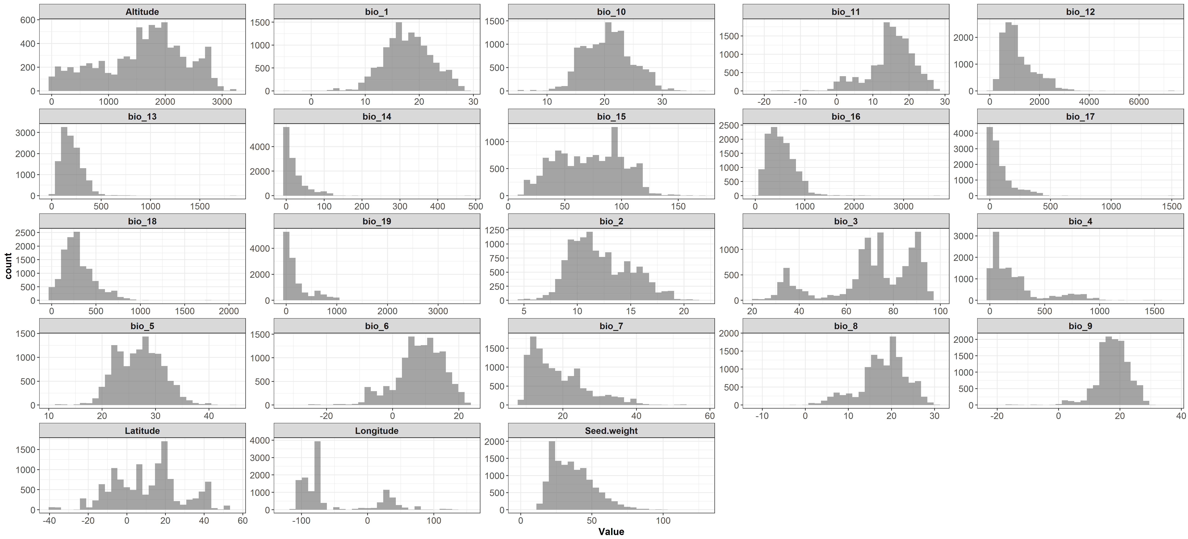
Quantitative variables

Slide 4
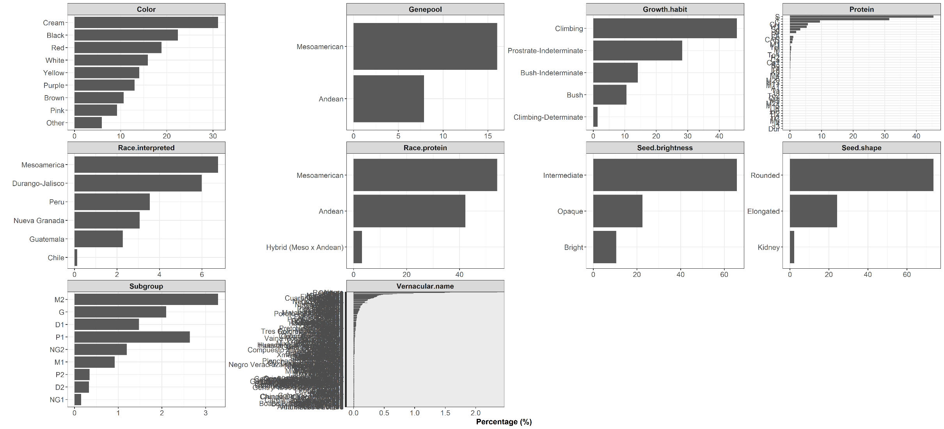
Qualitative variables

Slide 5
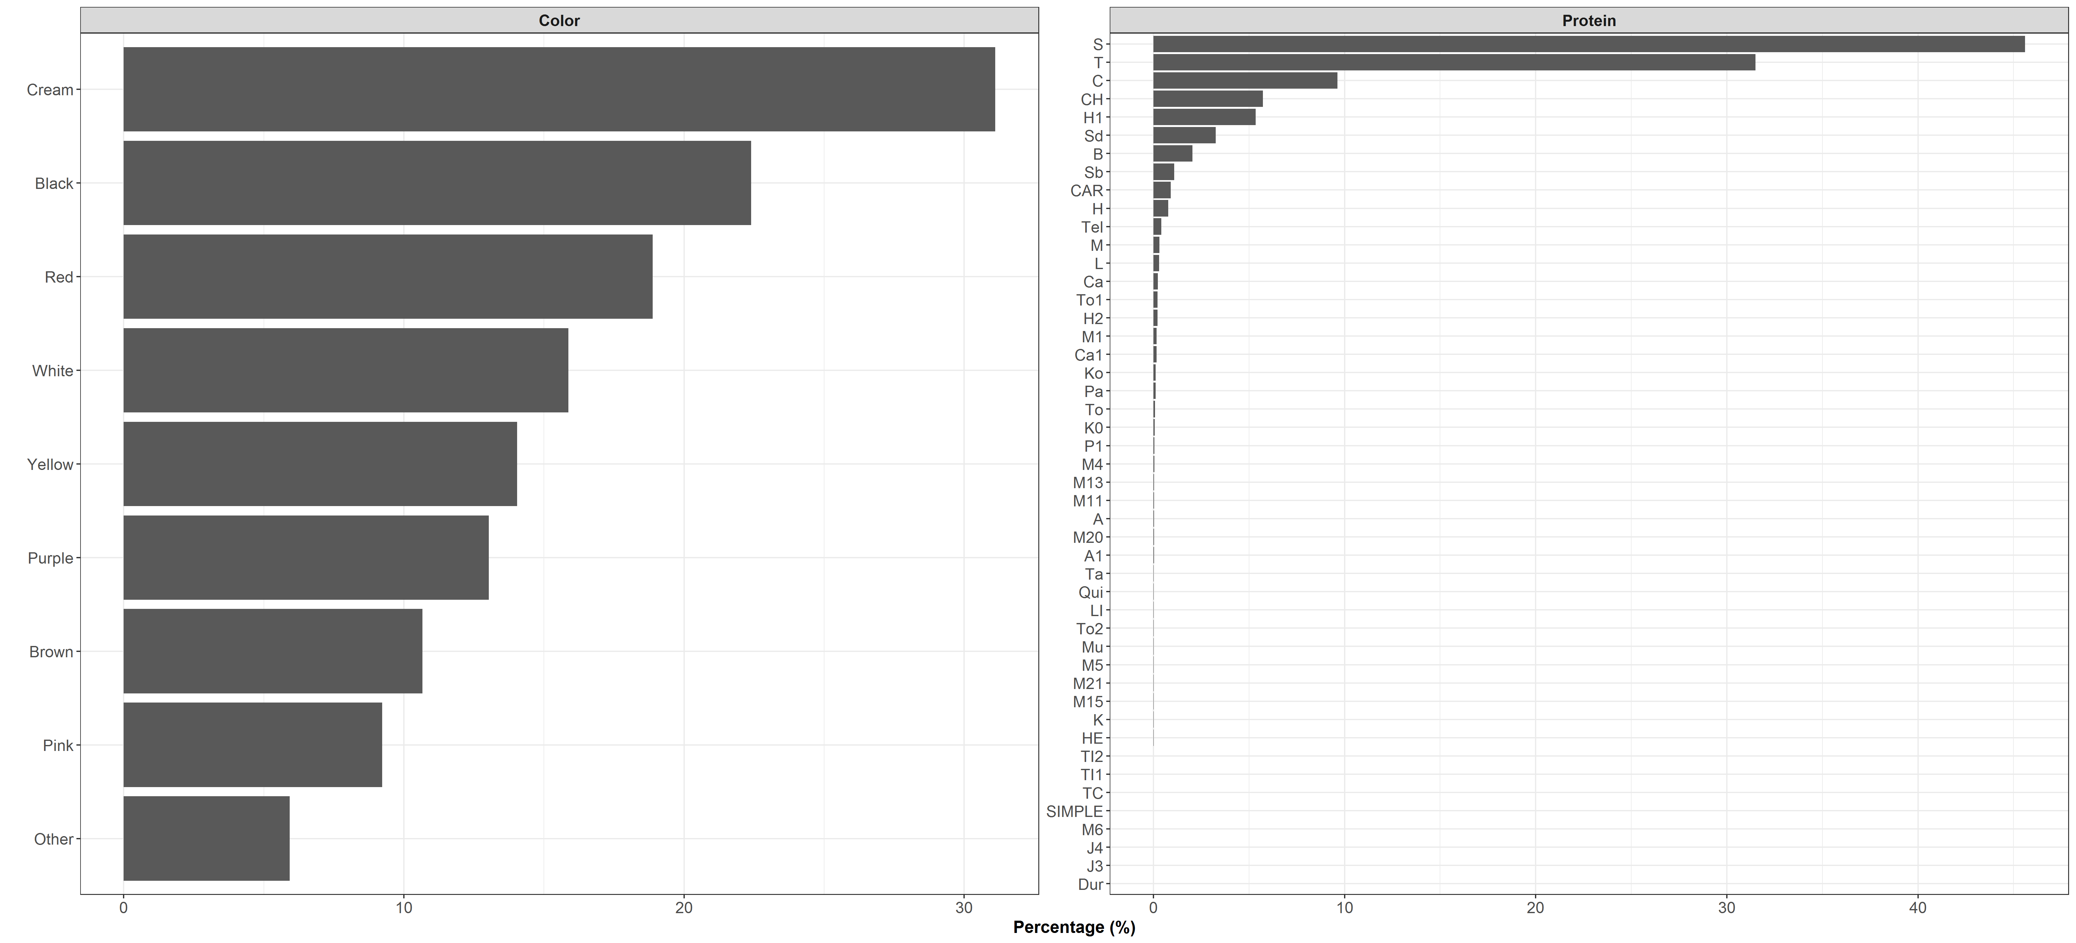
Qualitative variables

Slide 6
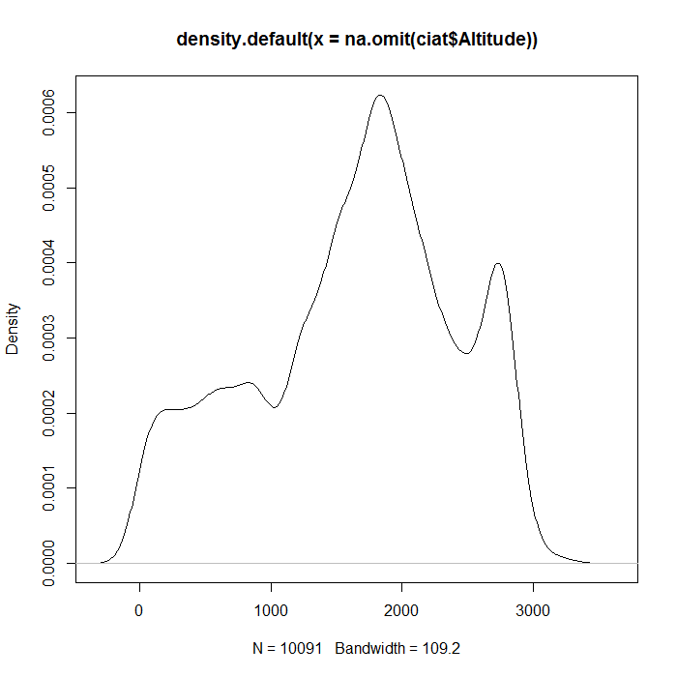
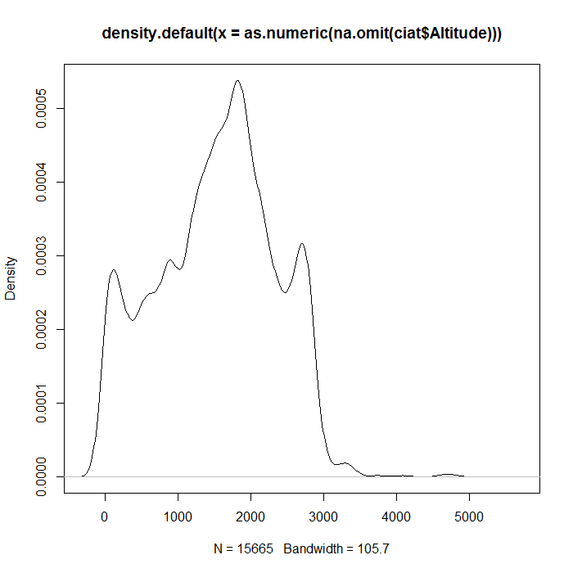
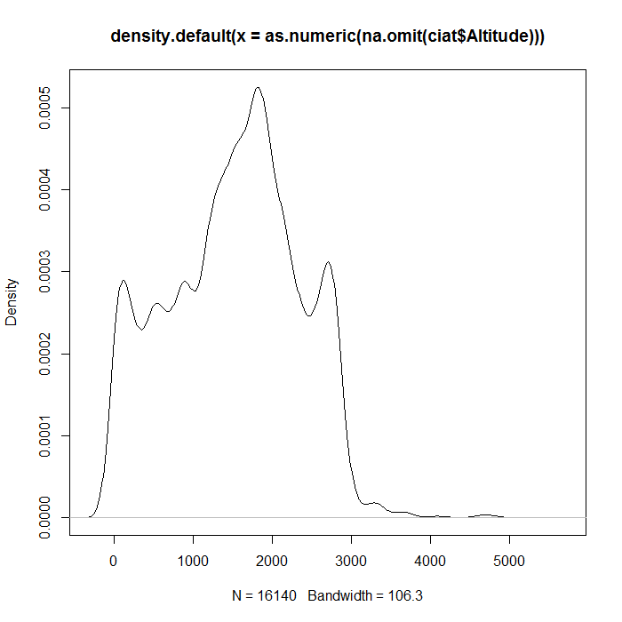
Original altitude data distribution
Altitude data distribution updated with SRTM
Cut-off point = 3500 mts
$$P\left(Altitude≥3000\right)=0.006958508$$
$$P\left(Altitude≥3000\right)=0.01251908$$
$$P\left(Altitude≥3500\right)=0.002565249$$

Slide 7
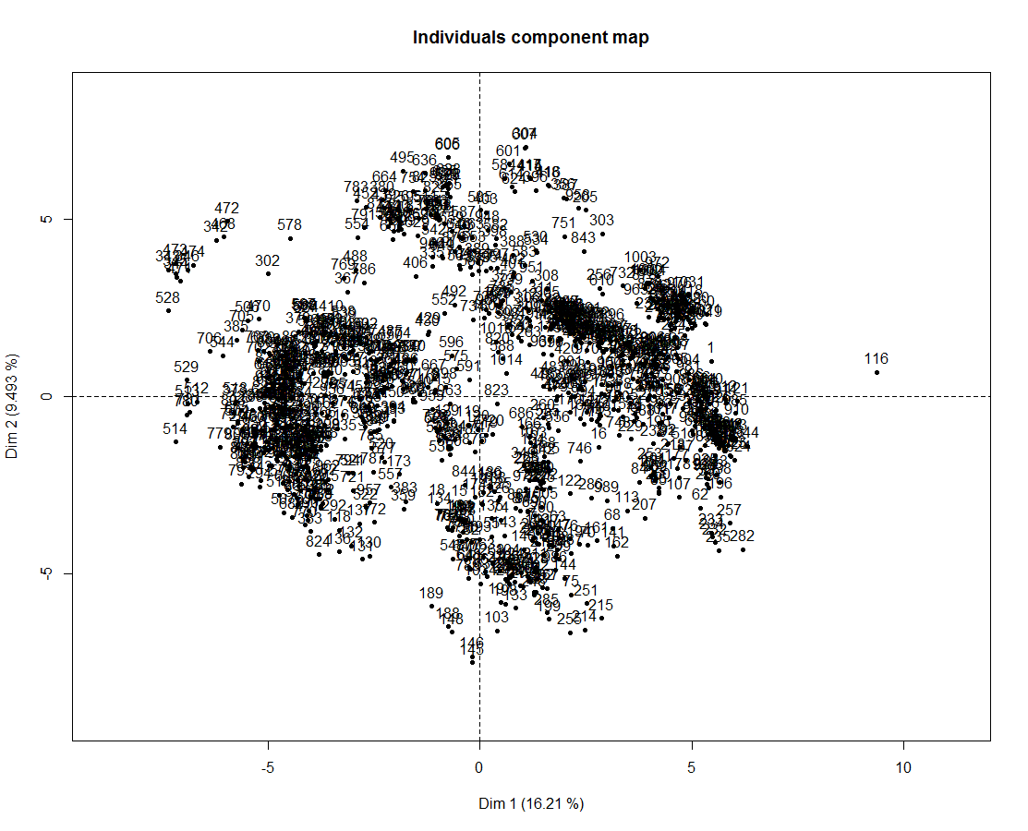
Principal Component Analysis

Slide 8
Genepool analysis
Race analysis
Subgroup analysis

Slide 9
Genepool analysis

Slide 10
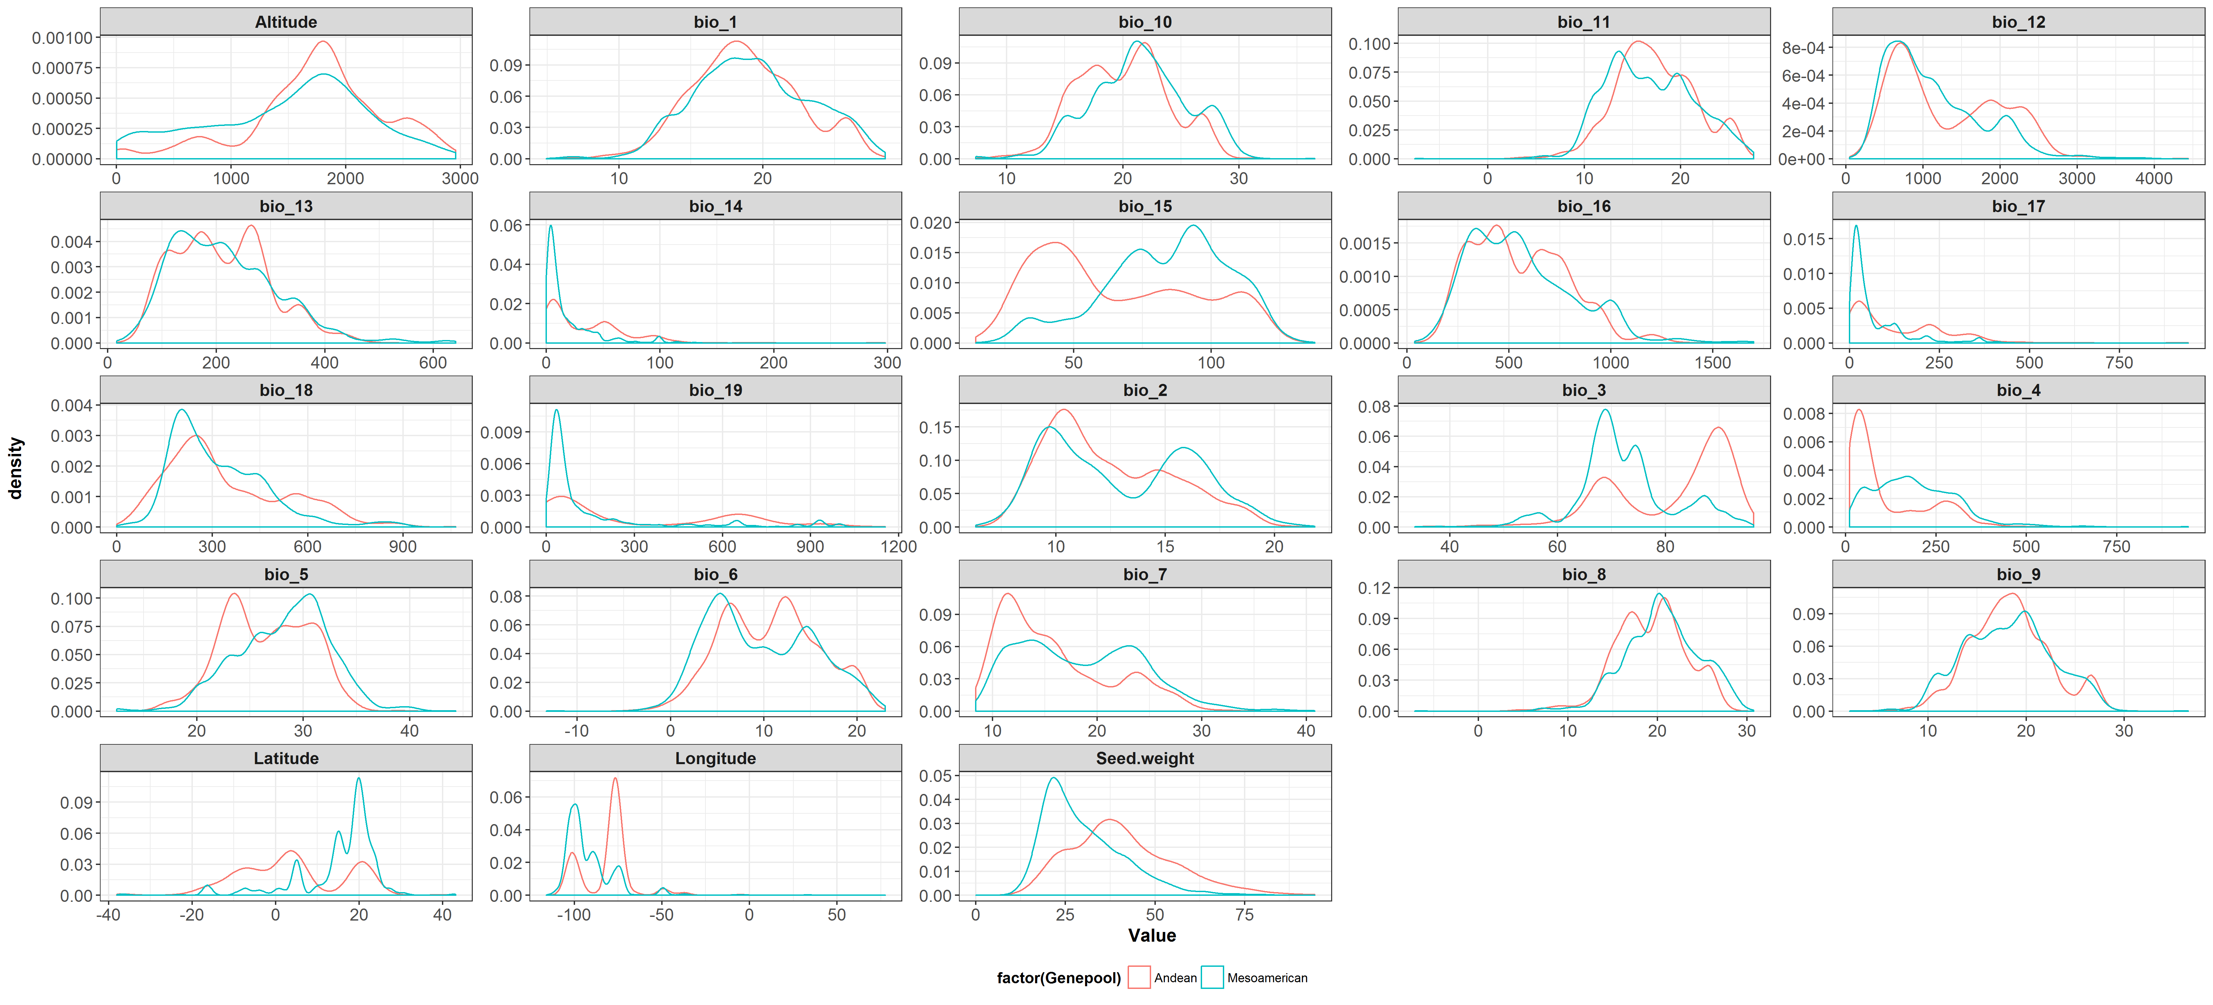
Quantitative variables

Slide 11
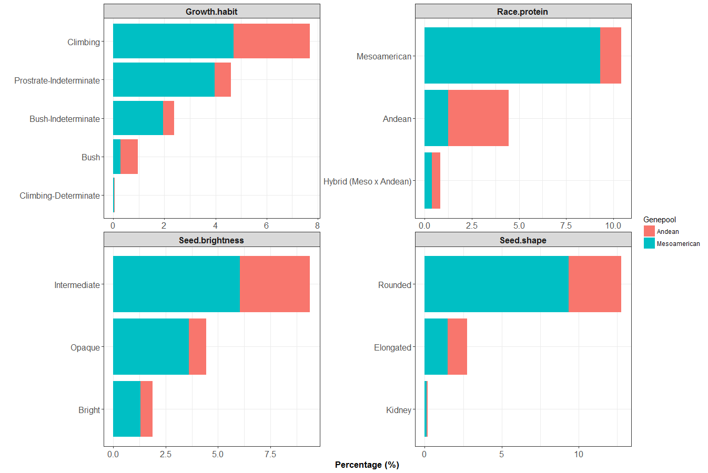
Qualitative variables

Slide 12
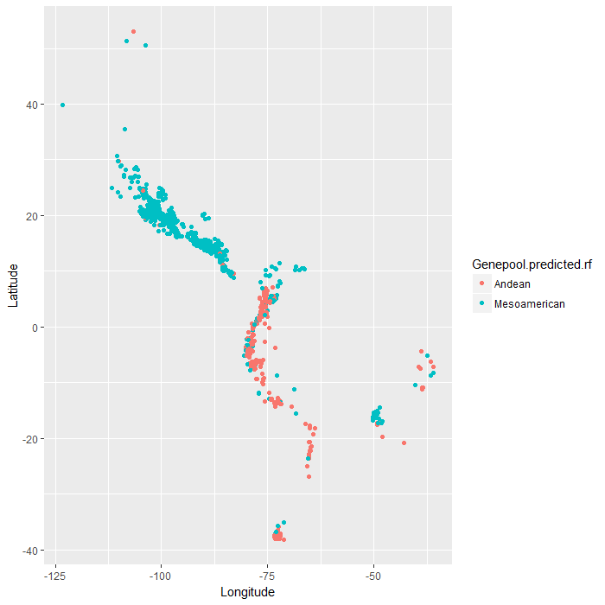
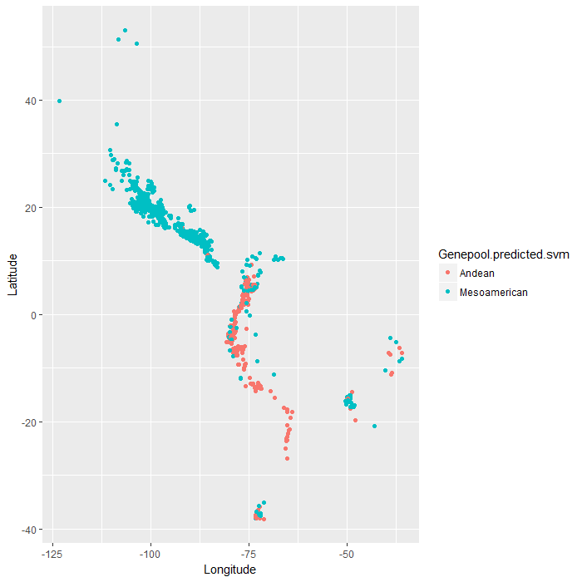
Random Forest
Support Vector Machines
Accuracy = 0.910692
Accuracy = 0.8924528

Slide 13
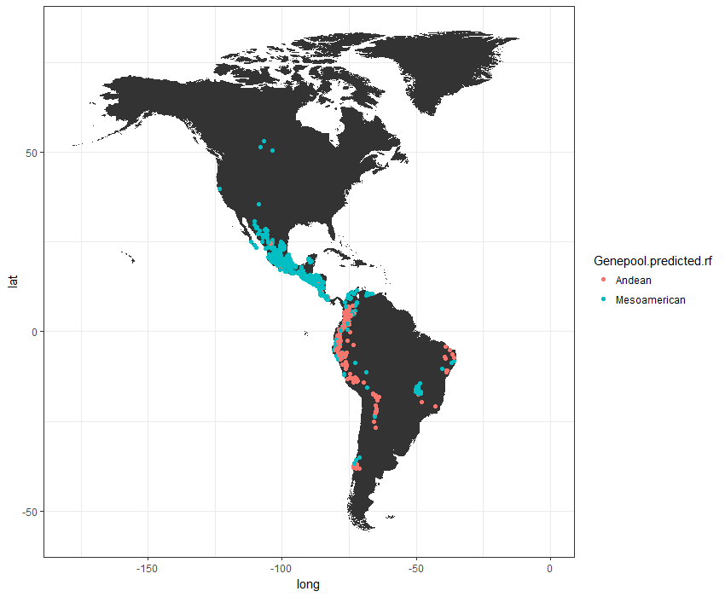
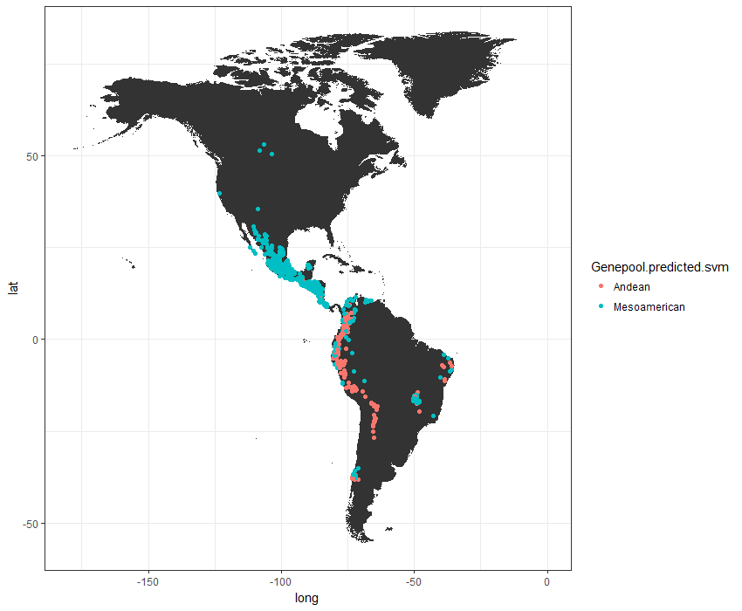
Random Forest
Support Vector Machines

Slide 14
Genepool | Accuracy
Andean | 0.8883764
Mesoamerican | 0.9282319

Slide 15
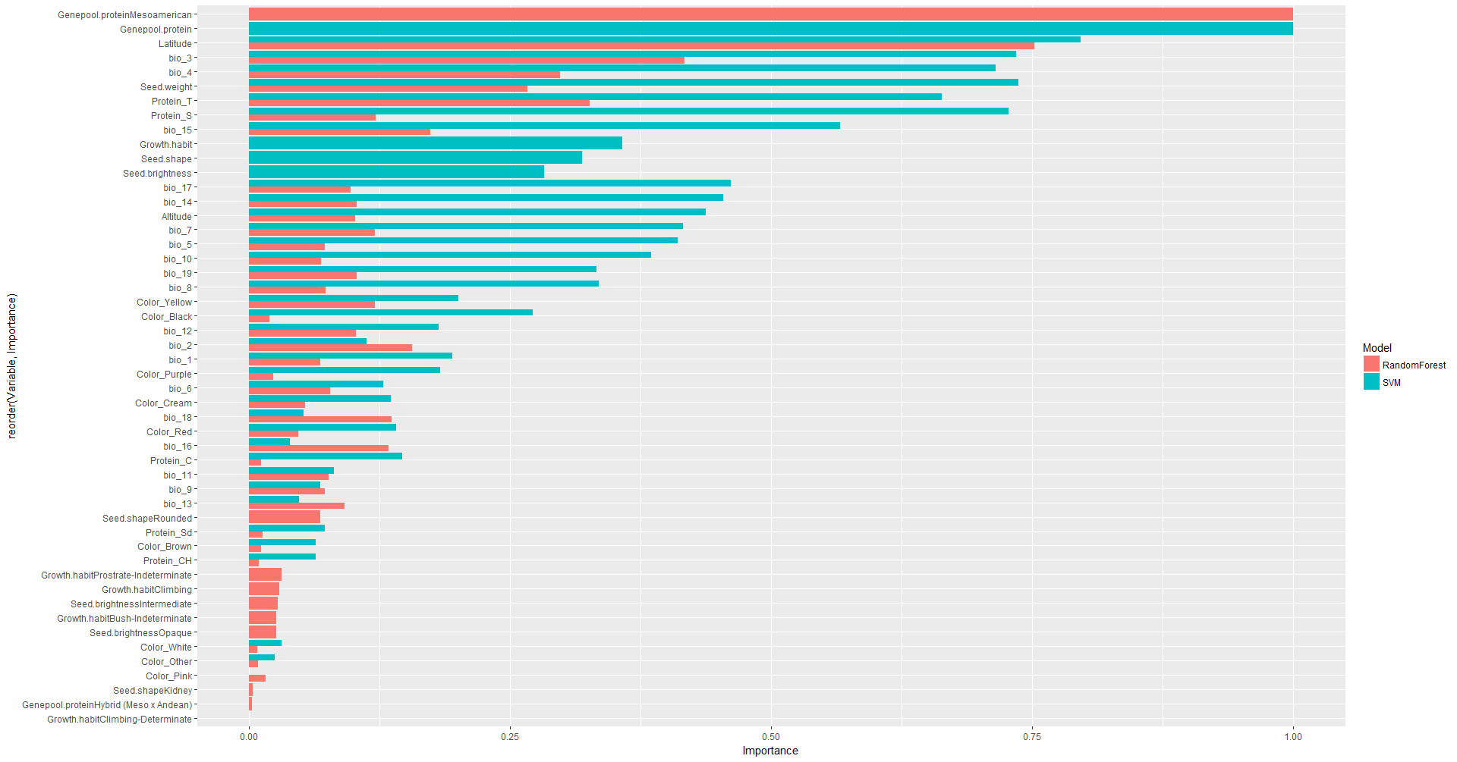

Slide 16
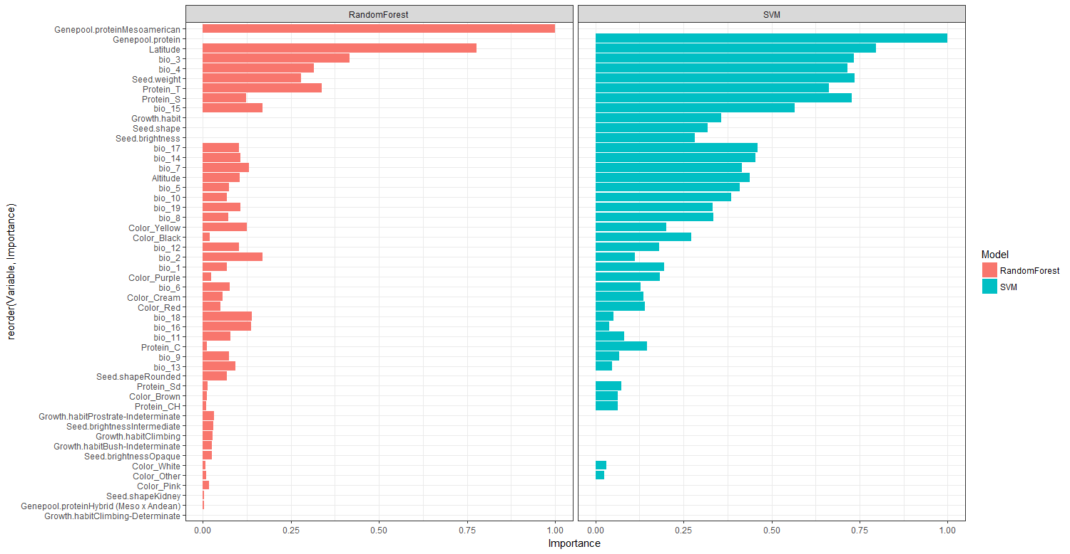

Slide 17
Race analysis

Slide 18
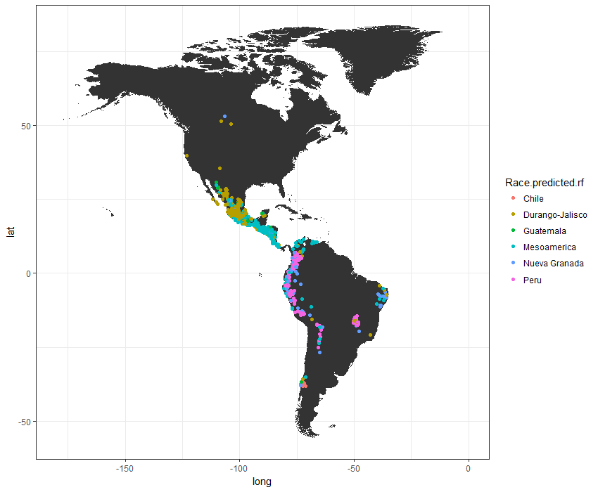
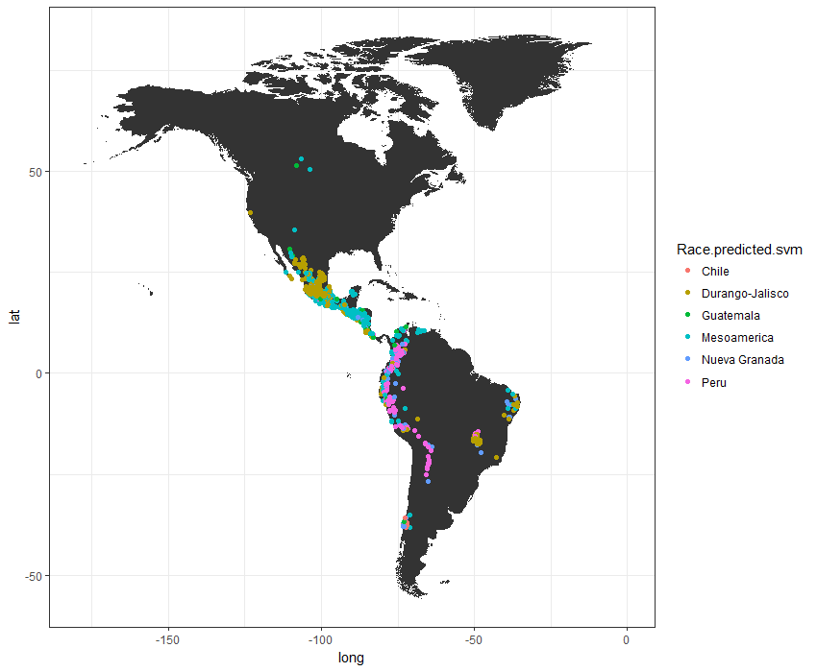
Random Forest
Support Vector Machines
Accuracy = 0.7770073
Accuracy = 0.70588

Slide 19
Race | Accuracy
Chile | 0.5833333
Durango-Jalisco | 0.7241798
Guatemala | 0.793722
Mesoamerica | 0.8014101
Nueva Granada | 0.8022284
Peru | 0.7086207

Slide 20
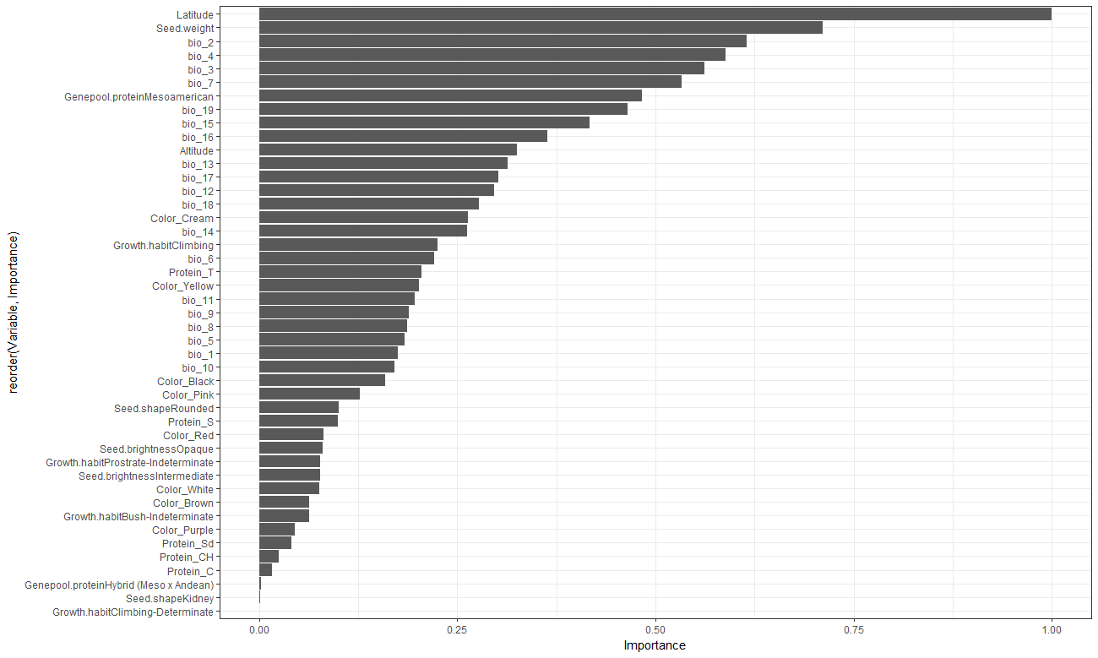

Slide 21

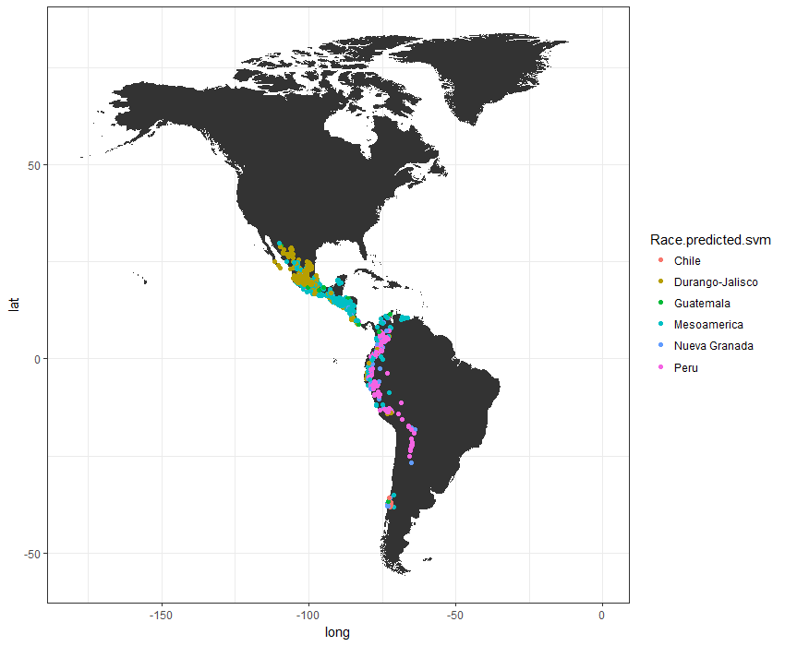
Random Forest
Support Vector Machines
Accuracy = 0.7778612
Accuracy = 0.7127371

Slide 22


Slide 23
Subgroup analysis

Slide 24
PCA analysis

Slide 25
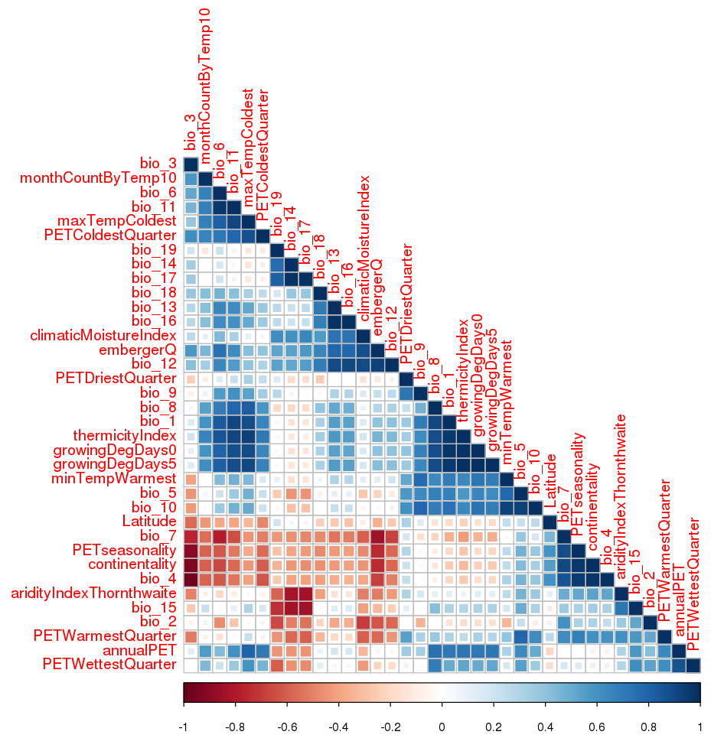

Slide 26
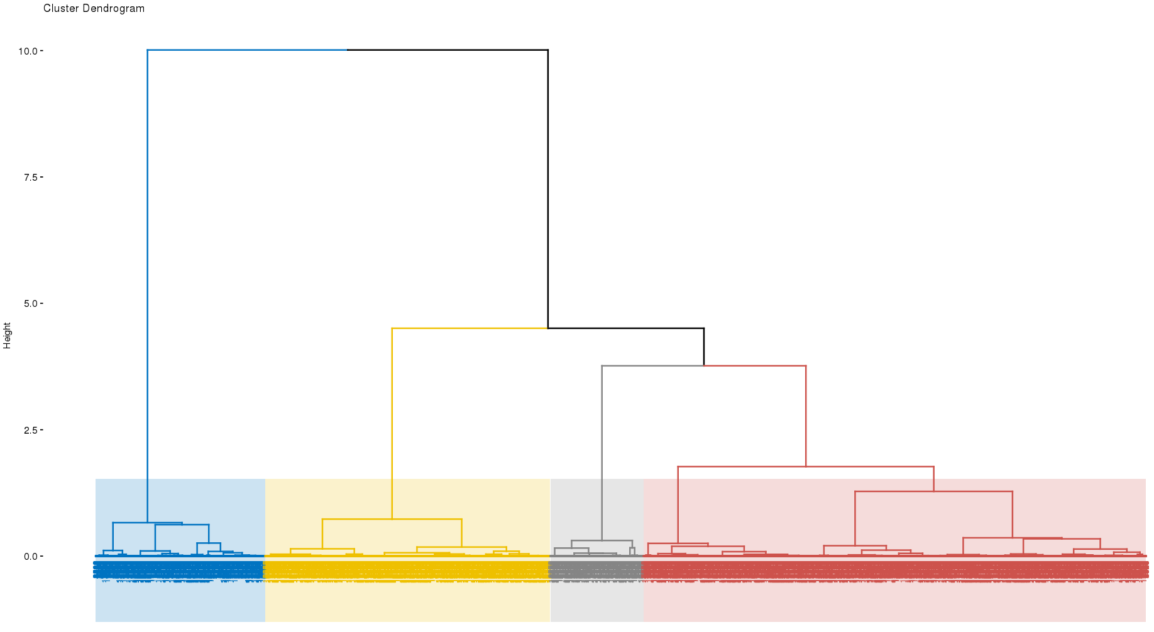

Slide 27
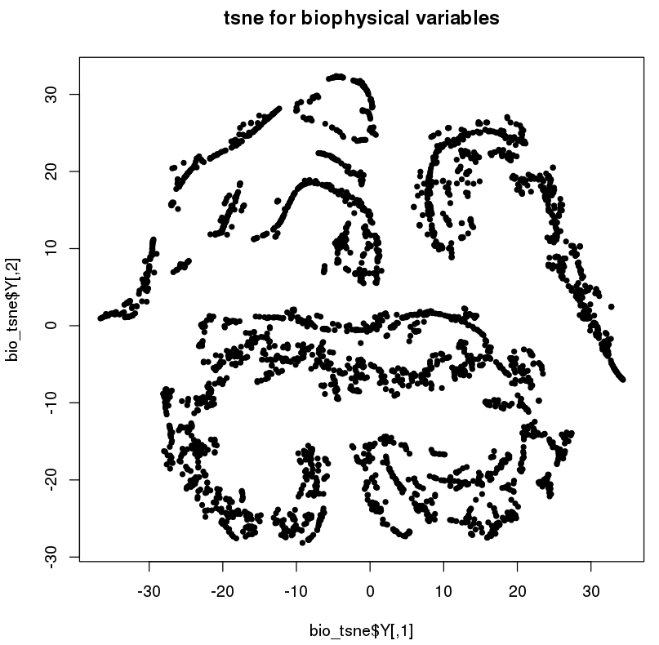
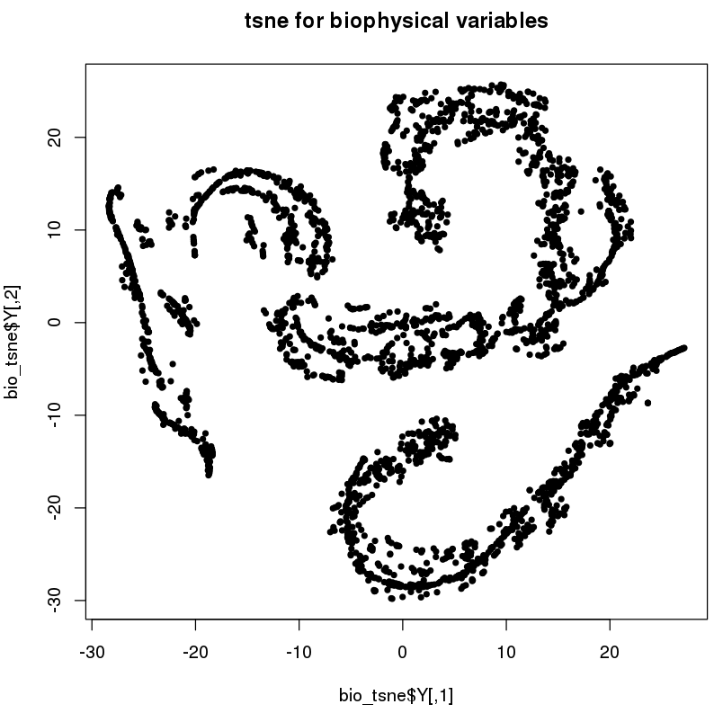
Perplexity = 30
Perplexity = 50

