Slide 1
Landrace Gap Analysis
Results

Slide 2
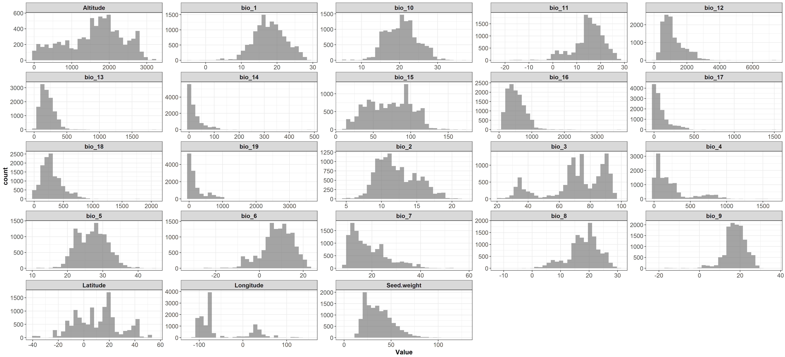
Quantitative variables

Slide 3
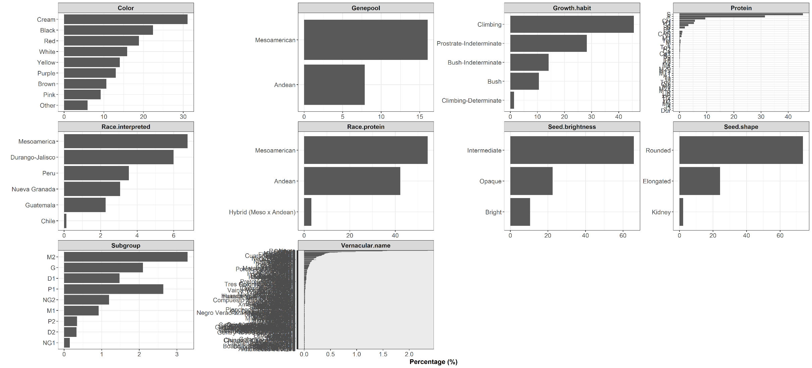
Qualitative variables

Slide 4
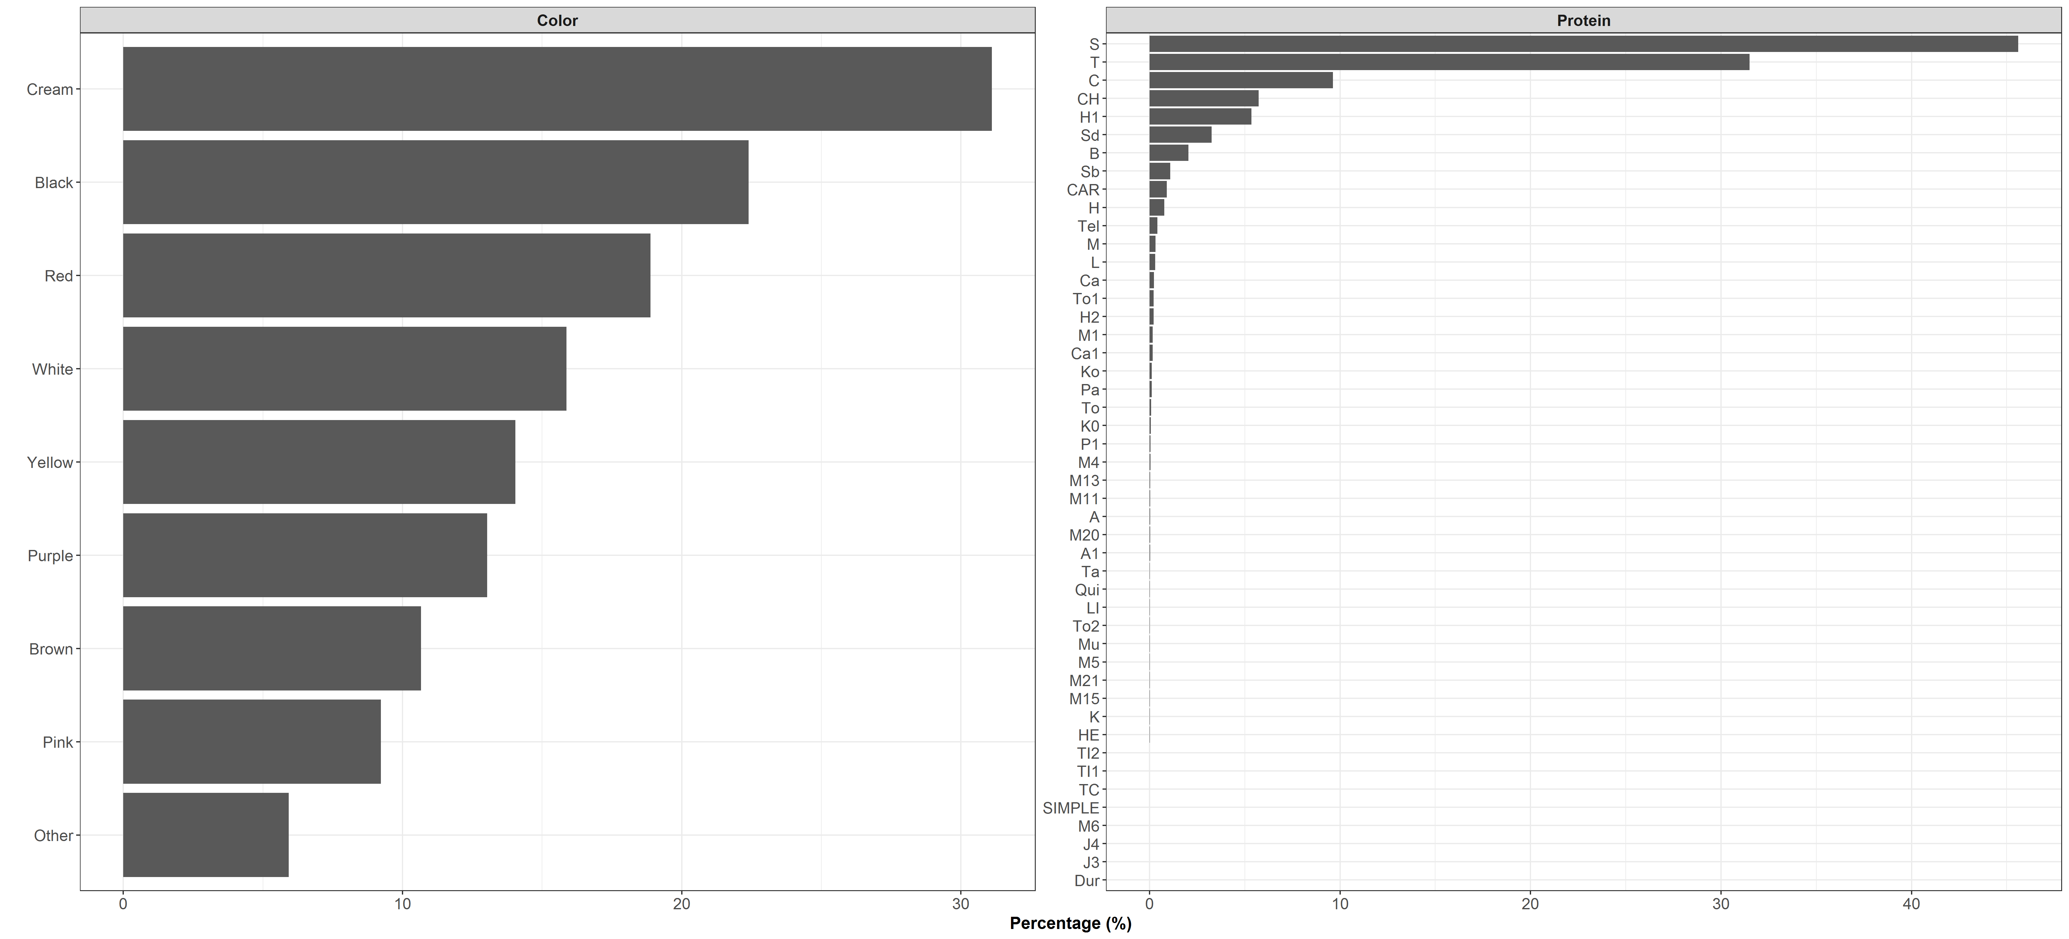
Qualitative variables

Slide 5
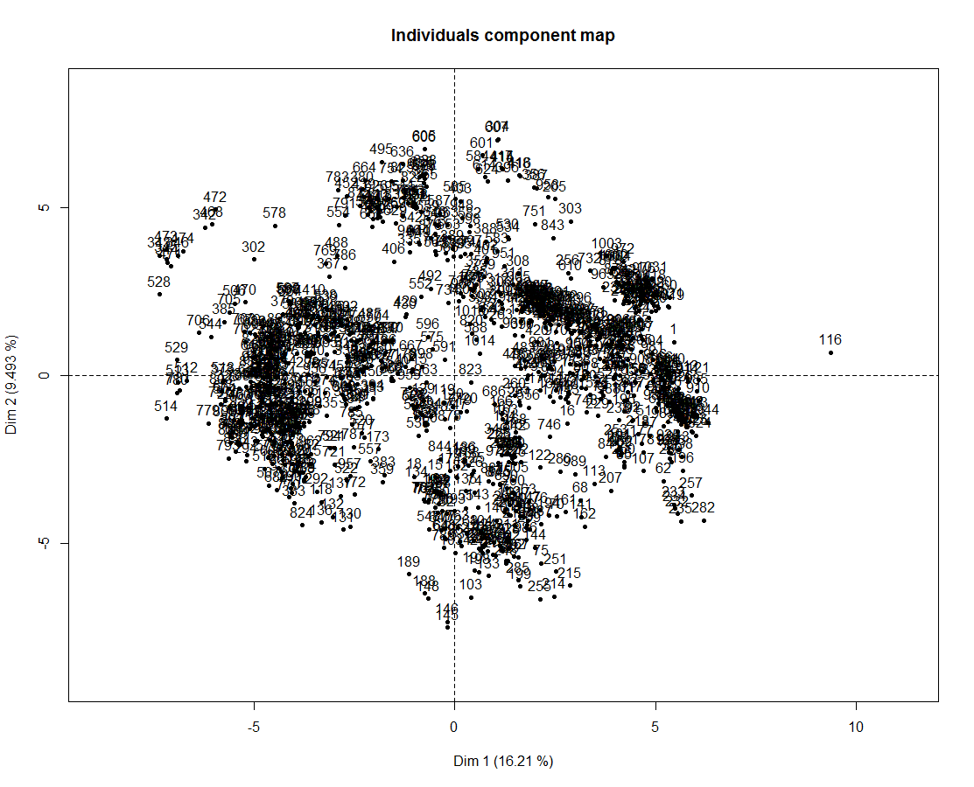
Principal Component Analysis

Slide 6
Genepool analysis
Race analysis
Subgroup analysis

Slide 7
Genepool analysis

Slide 8
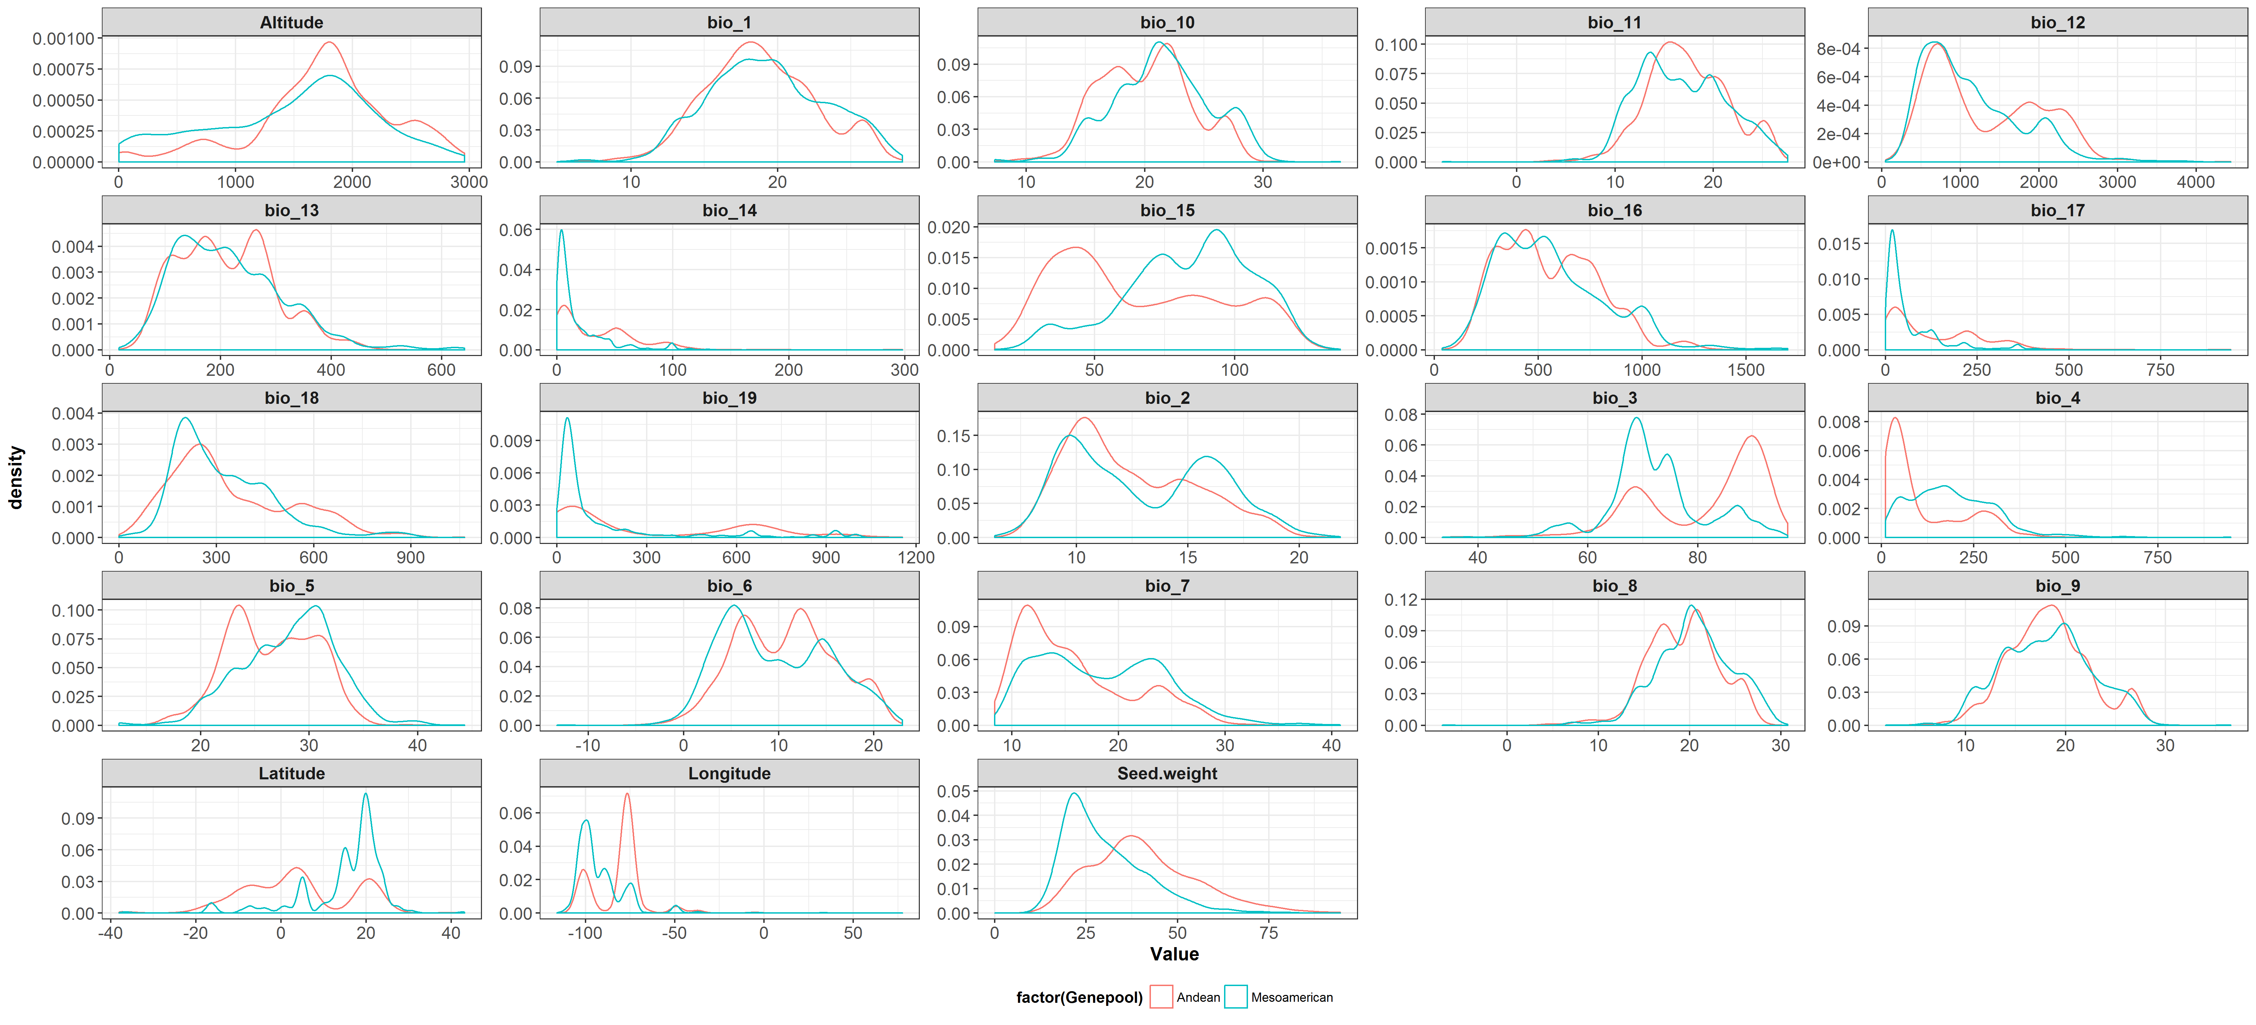
Quantitative variables

Slide 9
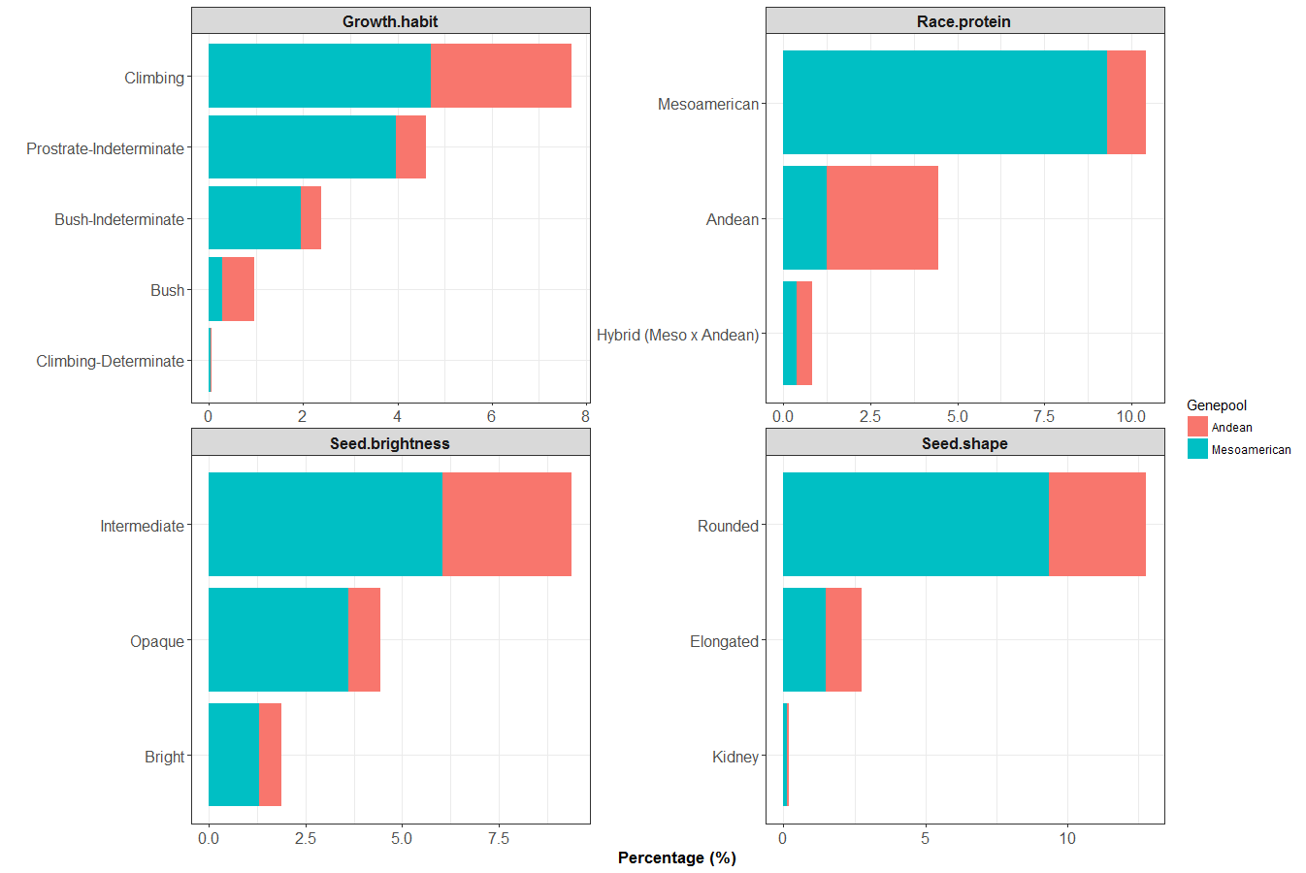
Qualitative variables

Slide 10
Race analysis

Slide 11
Subgroup analysis

