Slide 1
Livestock production in Vietnam
Tu Mai
Position: Vietnam Field Coordinator
t.mai@cigar.org
21/6/2020

Slide 2
Importance of livestock production in Vietnam
In 2011, animal husbandry accounted for 7.4% of the country GDP and 38% of Agricultural, Forestry and Aquaculture Sector GDP (Calculated from GSO)
Average contribution of animal husbandry was 30,5% in 2011-2015,32% in 2018, lower than the target of 38% and 42% in 2015 and 2018, respectively (IPSARD, 2019).
In 2016, about 6 million hhs involved in animal husbandry in Vietnam (AgroCensus, GSO)
Notes:
Discuss on one of the enterprises:
How much does it contribute to GDP?
How many people are involved in the country?

Slide 3
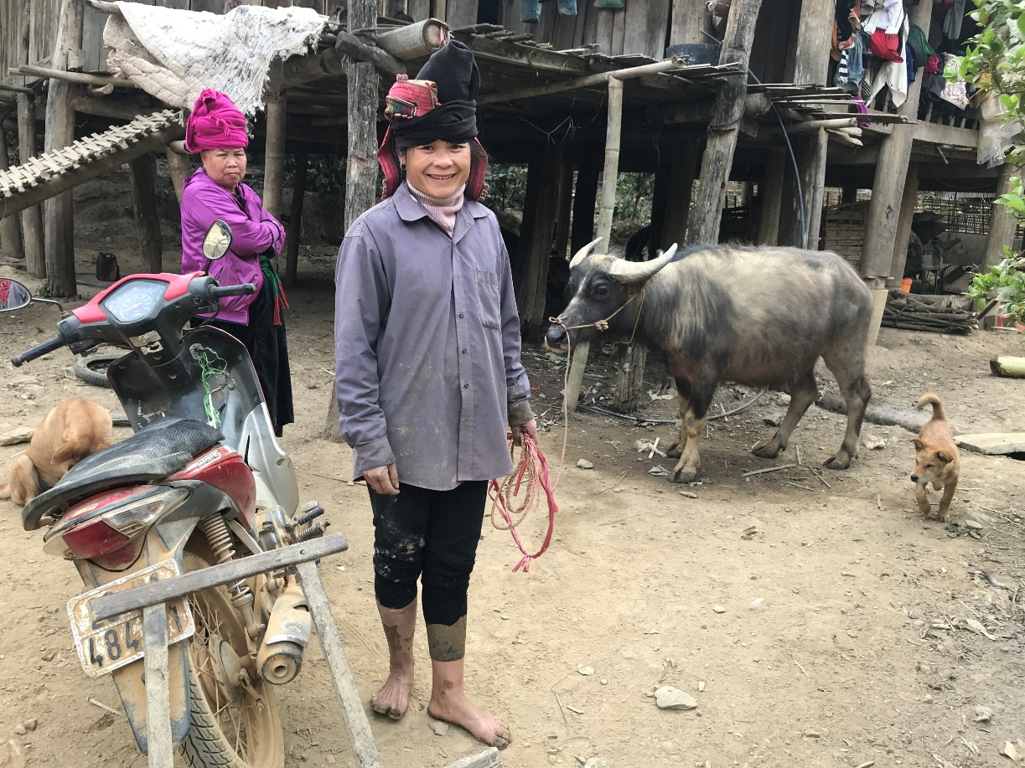
Livestock masters plans and future projections
According to the Master Plan of MARD:
By 2030, most of livestock products will be produced in modern farms, following quality and environment standards and ensuring animal welfare
Livestock production will accounts for 40% of Agriculture, Forestry and Aquaculture GDP by 2030 (38% by 2025).
Good disease management; improved food safety assurance; reasonable use of medicines and chemicals.
The livestock raising farms need to ensure bio-safety, animal and people health.
Notes:
Change the photo:
Are the any masters plans for livestock or big implementation policies in the country? If yes kindly state and if possible a link to the master plan (if you have it on hard copy send that through)
What are the key messages for development? Grow by what percentage? To achieve what?

Slide 4
Livestock & Environment challenges and opportunities
Emission
The standard QCVN 62-MT:2016/BTNMT, QCVN 08:2008/BTNMT by Ministry of Ressources and Environment is not feasible and do not make use of animal dung as organic fertilizer or aquaculture feed.
47% hhs engaging in animal husbandry do not have any waste management methods (MARD, 2019).
Mitigations methods:
+ 596000 hhs used biogas (pig raising hhs accounted for 85,2%)
+ Composting is applied with 3 million hhs and 9335 farms
+ Micro-organism is used in 196000 hhs and 1059 farms
+ Some new methods: worm composting and BSF
Notes:
Name the key environmental challenges from the livestock sector ( 2 should suffice)
Are there ways to mitigate these challenges (e.g better feeds, biogas etc), current innovations/technologies

Slide 5
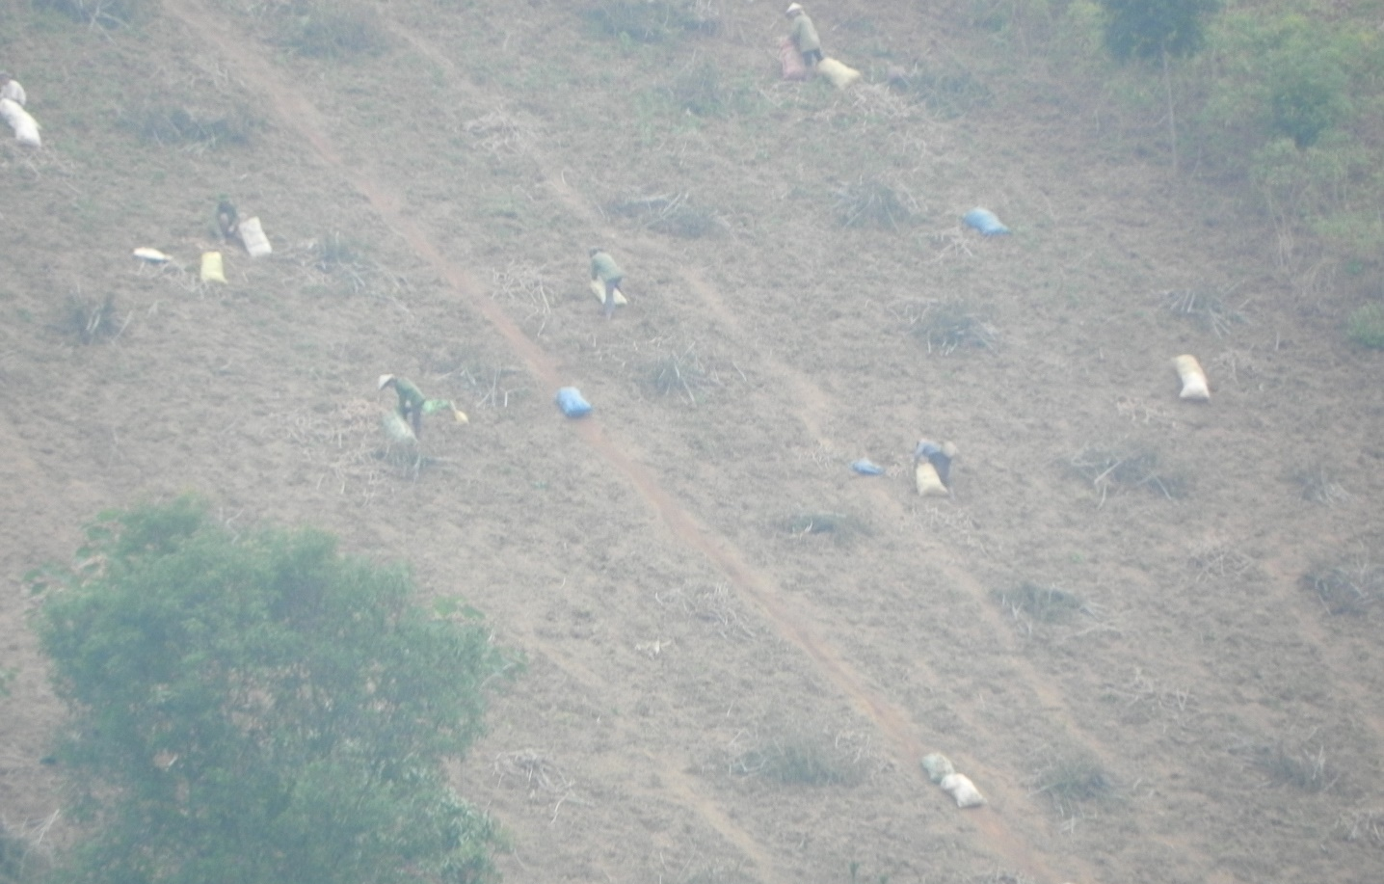
Livestock & Environment challenges and opportunities
Soil erosion, lack of water in dry season: soil erosion caused by mono-cropping, no contour line

Slide 6
Country Environmental Benchmarks
By 2030:
At least 80% farms will apply waste management; 10% of big farms will recycle 100% of hard organic waste by 2030
100% small-holder farmers will use waste management methods
3 million tonnes carbon will be reduced
(Livestock Master Plan 2020-2030 (Draft), MARD 2019).
Notes:
Are there specific country targets to lower environmental impacts . E.g. Carbon emissions, soil erosion.
Discuss 2 points

Slide 7
Thank you!
Tu Mai
Vietnam Field Coordinator
t.mai@cigar.org

