Slide 1
CLEANED – Virtual Training 22nd /06/2020 – 03rd /07/2020
Author: Jessica Mukiri, An Notenbaert, Emmanuel Mwema, Birthe Paul, Rein Van der Hoek
Cleaned@cgiar.org
CLEANED virtual training: 01/07/2020

Slide 2

Recap

Slide 3
Learning outcomes day 5
Breakdown the calculations used for output dimensions
Identify the key input and parameter data needed for calculations

Slide 4
Soil Health
Notes:
Spend time getting the group to talk about the questions above. You can follow up the question of Why are you here? With “What do you want to leave these workshops knowing?”
Use a flip chart to record their expectations.

Slide 5
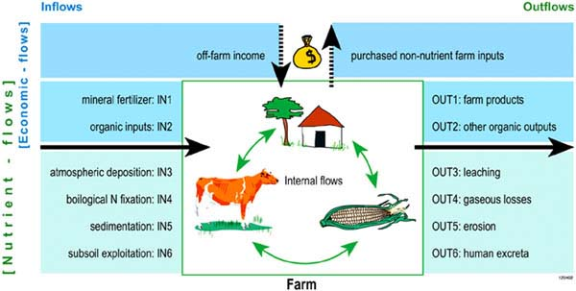
N Balance → NUTMON
CLEANED
IN1 |  | OUT1
IN2 |  | OUT2
IN3 |  | OUT3
IN4 |  | OUT4
Notes:
Inputs and outputs

Slide 6
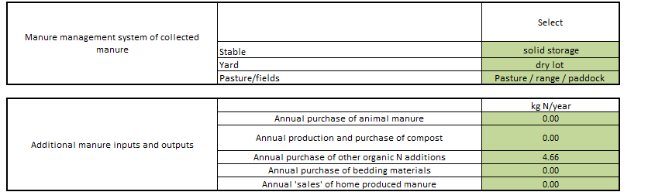
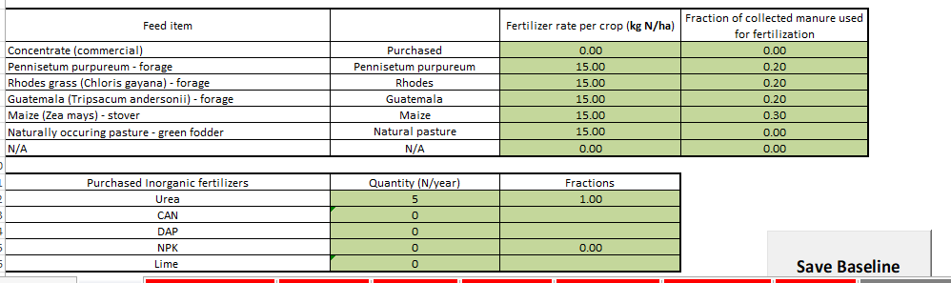

Slide 7
Soil Erosion using RUSLE
RUSLE (Revised Universal Soil Loss Equation) is widely used for estimating the rate of soil loss by water.
A = R x K x L x S x C x P
A: annual soil loss per acre
R: rainfall erosivity
K: soil erodibility
L: slope length
S: slope steepness
C: vegetative cover
P: erosion control practices

Slide 8
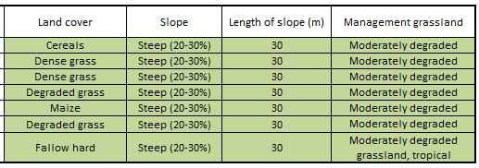

Slide 9

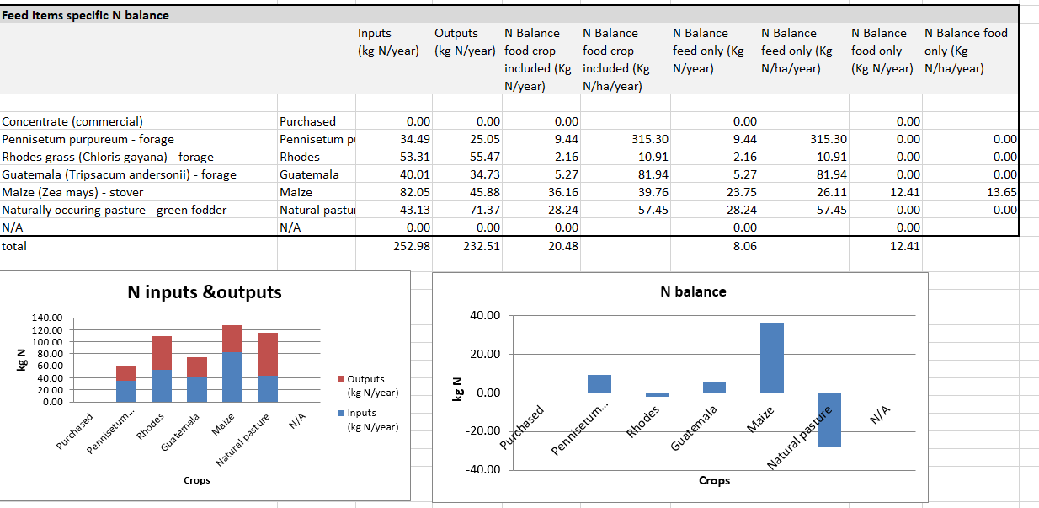
Soil health as seen in CLEANED

Slide 10
Water Impacts
Notes:
Spend time getting the group to talk about the questions above. You can follow up the question of Why are you here? With “What do you want to leave these workshops knowing?”
Use a flip chart to record their expectations.

Slide 11
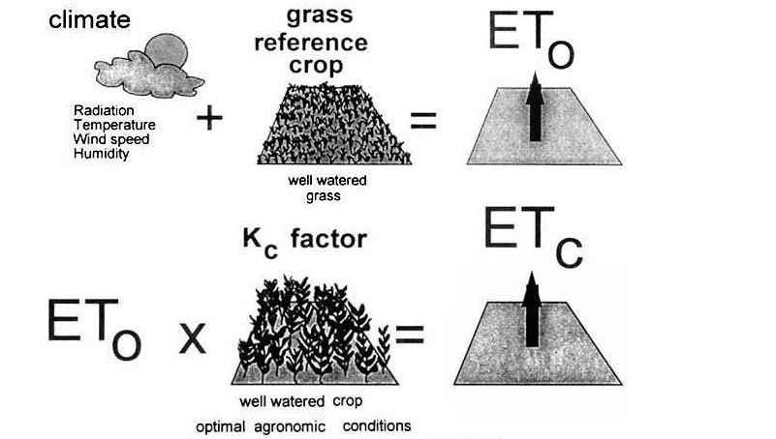
Water Using -> Evapotranspiration (ET)

Slide 12
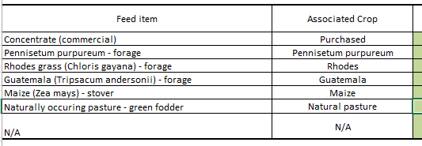
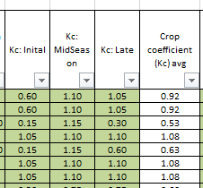
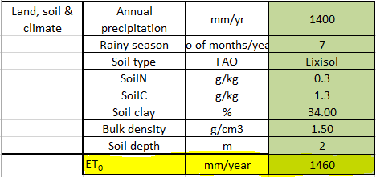
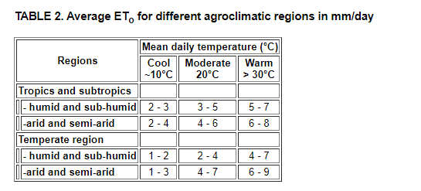
X
X
Notes:
http://www.fao.org/3/x0490e/x0490e04.htm

Slide 13
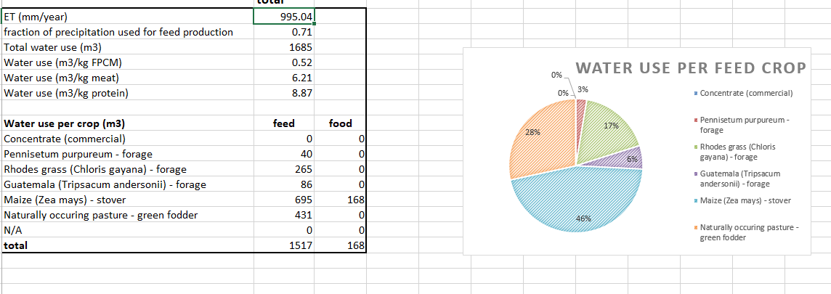
Water impacts as seen in CLEANED

Slide 14
Greenhouse gas emissions
Notes:
Spend time getting the group to talk about the questions above. You can follow up the question of Why are you here? With “What do you want to leave these workshops knowing?”
Use a flip chart to record their expectations.

Slide 15
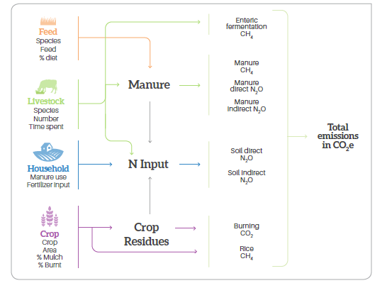
GHG
2006 IPPC Guidelines for National Greenhouse Gas Inventories.
Tier 1 and 2

Slide 16
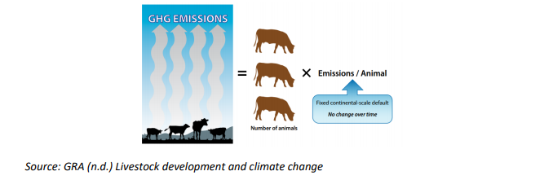
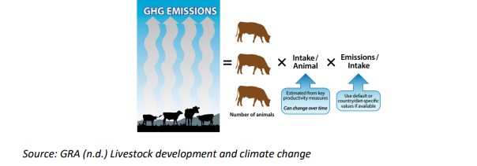
The Calculations
Tier 1
Tier 2
Notes:
https://globalresearchalliance.org/wp-content/uploads/2018/12/Livestock-Tier-2-collection_Final_181130.pdf

Slide 17

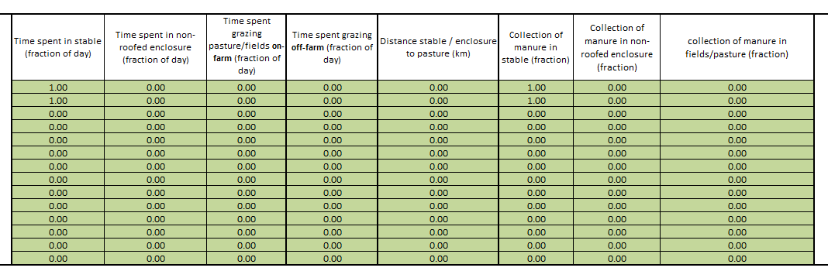
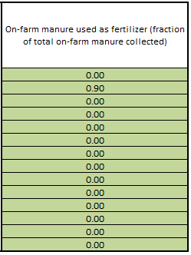
X
X

Slide 18
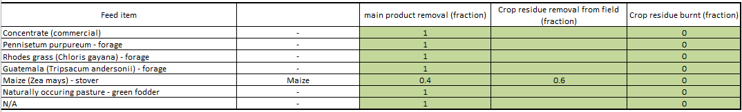

Slide 19
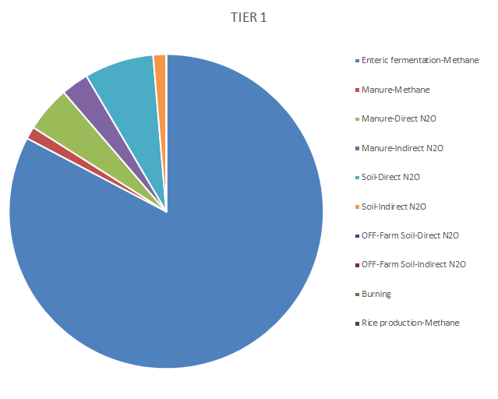
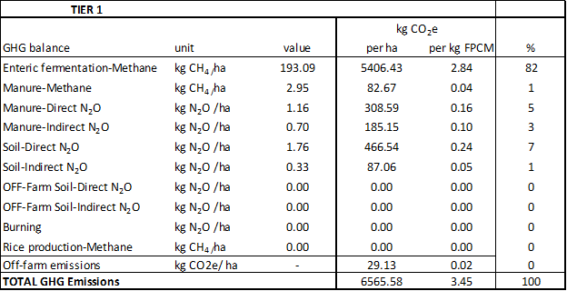
GHG emissions as seen in CLEANED

Slide 20
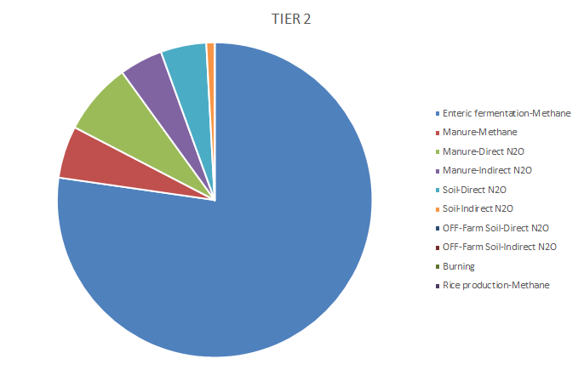
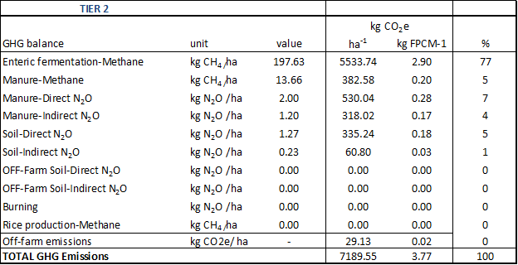
GHG continued

Slide 21
Final Presentation
What were your objectives
Area of interest
Challenges including env. impacts
Goals (e.g increase productivity, decrease env impacts)
Baseline results
What was parameters did you change
How was the process which parameters did you find most difficulty finding?
Results
Scenario results
Scenarios (to improve challenges and goals)
Notes:
Copy of 16_1_2018_T1_S3_V1_2.KN_1DC_2-1_3000L

Slide 22
Assignment
Submit the CLEANED_V4_2 using the form below
Based on your dairy enterprise, change:
*One feed parameter (change the weight)
*One crop parameter (change the FW and fraction indicator

Slide 23
Pre-recorded material
To access the CLEANED workbook please see
link: https://cleanedtraining.netlify.app/
To go directly to day 5: https://cleanedtraining.netlify.app/paramters-calculations-for-impacts-1.html

Slide 24
Recap on what to do?
Quiz 5 :
https://forms.office.com/Pages/ResponsePage.aspx?id=AA76ahT6t0CKLiKn-MNX1aE1vfzSBf5GkjzzKvqgj8ZUN1pFV1UxVUVIUENERkNWUVNOUUZUVVpOTC4u
Final Assignement:
Deadline for Final is tomorrow 13:00hrs GMT.
You access Rein, Emmanuel and Jess using this email Cleaned@cgiar.org between 15:00Hrs - 17:00Hrs today and between 08:00hrs and 11:00Hrs tomorrow.
Looking forward to seeing you all again on Friday morning.

Slide 25
Thank you!

