Slide 1
Cross-Domain Sentiment Analysis of Product Reviews by Combining Lexicon-based and Learn-based Techniques
Presented by Xi Zhou
11/30/2018

Slide 2
Content Layout
Abstract
Introduction(discover the history)
Methods( diagram, graph, table)
Algorithm Outline
Conclusion
Future Work
References

Slide 3
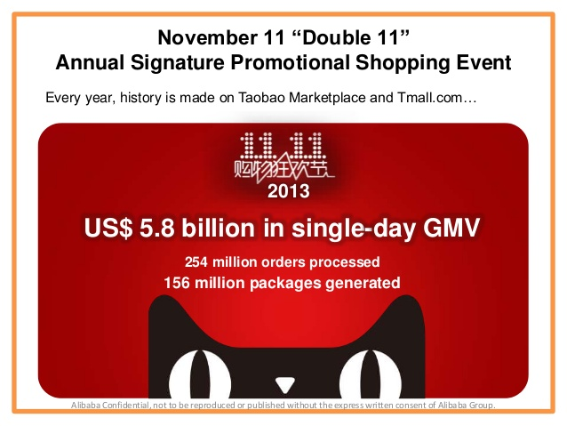
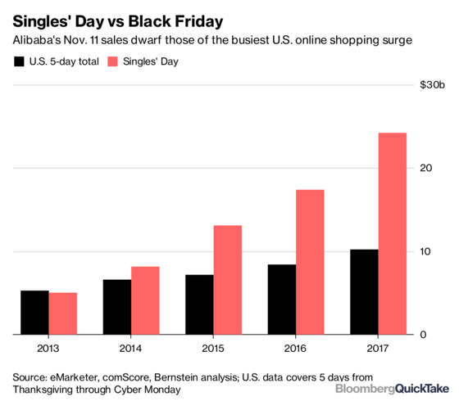
Background
$1 billion worth of orders placed in the first 5 minutes in 2016.
China has a population of 1.35 billion including 590 million Internet users which take up 44% of the proportion.

Slide 4
Introduction
Like or
Hate
One Star or
Five Star
Online reviews for products are important for both buyers’ purchasing decisions and sellers’ marketing strategies.
This Paper proposes a method called CLL (combines Lexicon-based and Learn-based techniques) for Chinese product reviews sentiment analysis.

Slide 5
Methods: a Novel Framework CLL
Build 3 domain-adaptive sentiment lexicons
Use 4 categories of 16 features to build 6 classifiers
Conduct experiments to evaluate the method by using different lexicons and classifiers

Slide 6
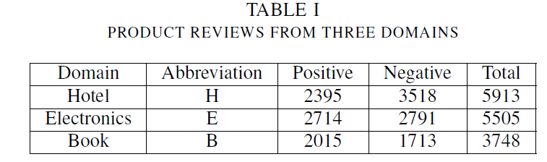
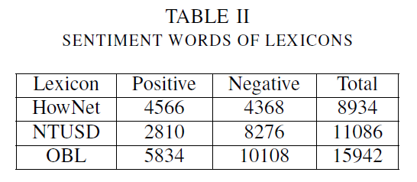
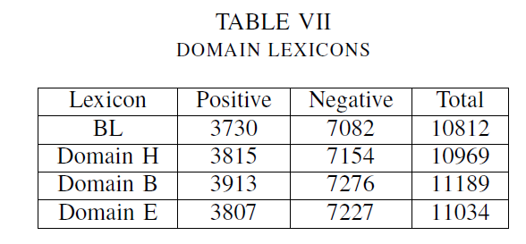
Two Major Algorithms: Filter evaluation objects ----→ distinguish word polarity of candidate words
Algorithm1: Domain Lexicon Generating method
extractWord(OBL,corpus,b)
Input: Chinese original basic lexicon OBL; the Chinese product domain specific reviews corpus; the frequency threshold b
Output: a domain lexicon( DL )
Variables:
NS : collection of nouns ;
OBS: collection of evaluation objects;
MS: modified structures between objects and emotional words;
MSs : the collection of modified structures between objects and emotional words;
SENTS :the collection of sentences ,
canWords :the collection of candidate words.
Two Chinese Sentiment lexicons to generate original basic lexicon

Slide 7
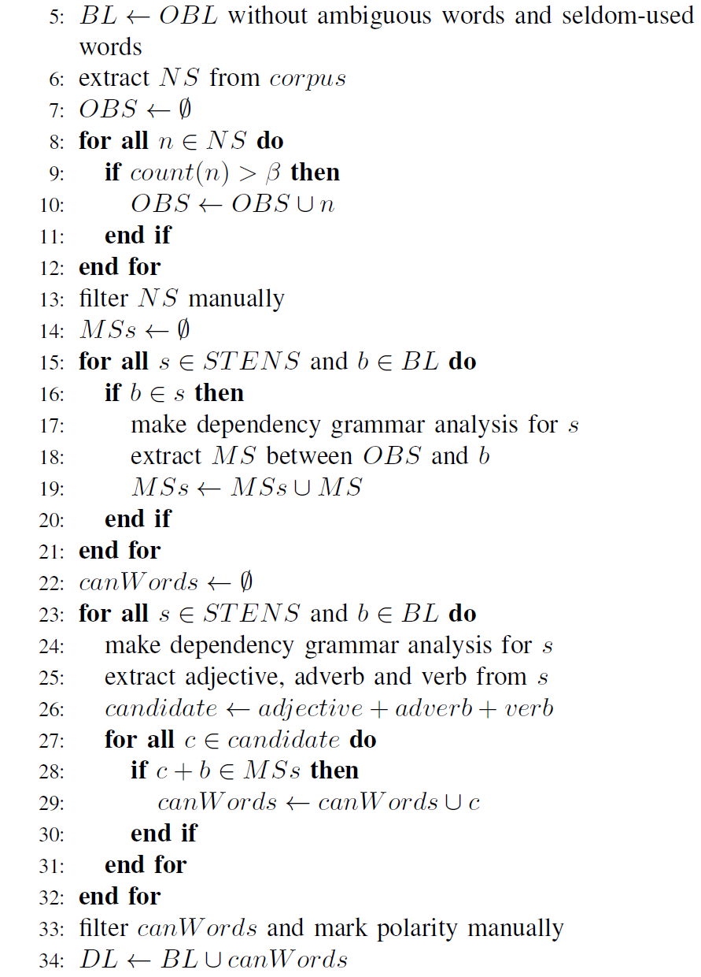
Pseudo Code:

Slide 8
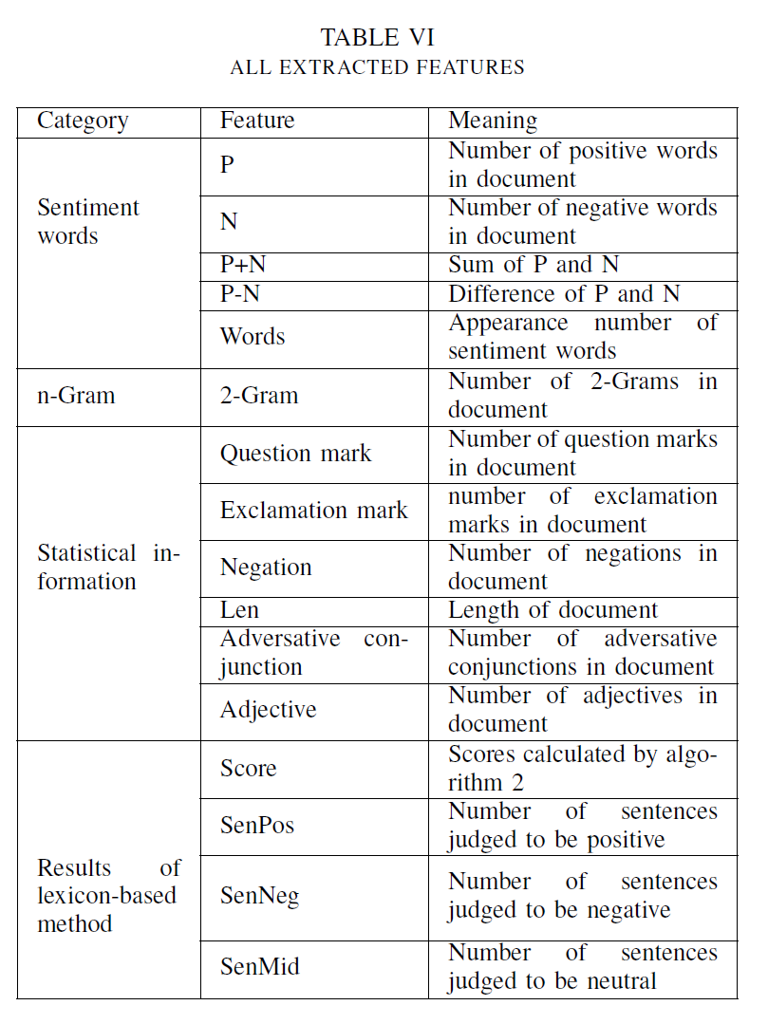
Two Major Algorithms
Algorithm 2 Polarity Distinguishing Method
1: lexiconPol (DL, corpus, Threshold)
2: Input: a domain lexicon DL, a score threshold Threshold
3: Output: the sentiment polarity of a document Pol.
4: Variables:
w: a sentiment word
I: the position of word w in a sentence
p: the polarity value of word
the weight of word degree, the words between wi−1 and wi minWords,
senWords: The sentiment words in a sentence
ns : the number of negations in minWords
5: score ← 0

Slide 9
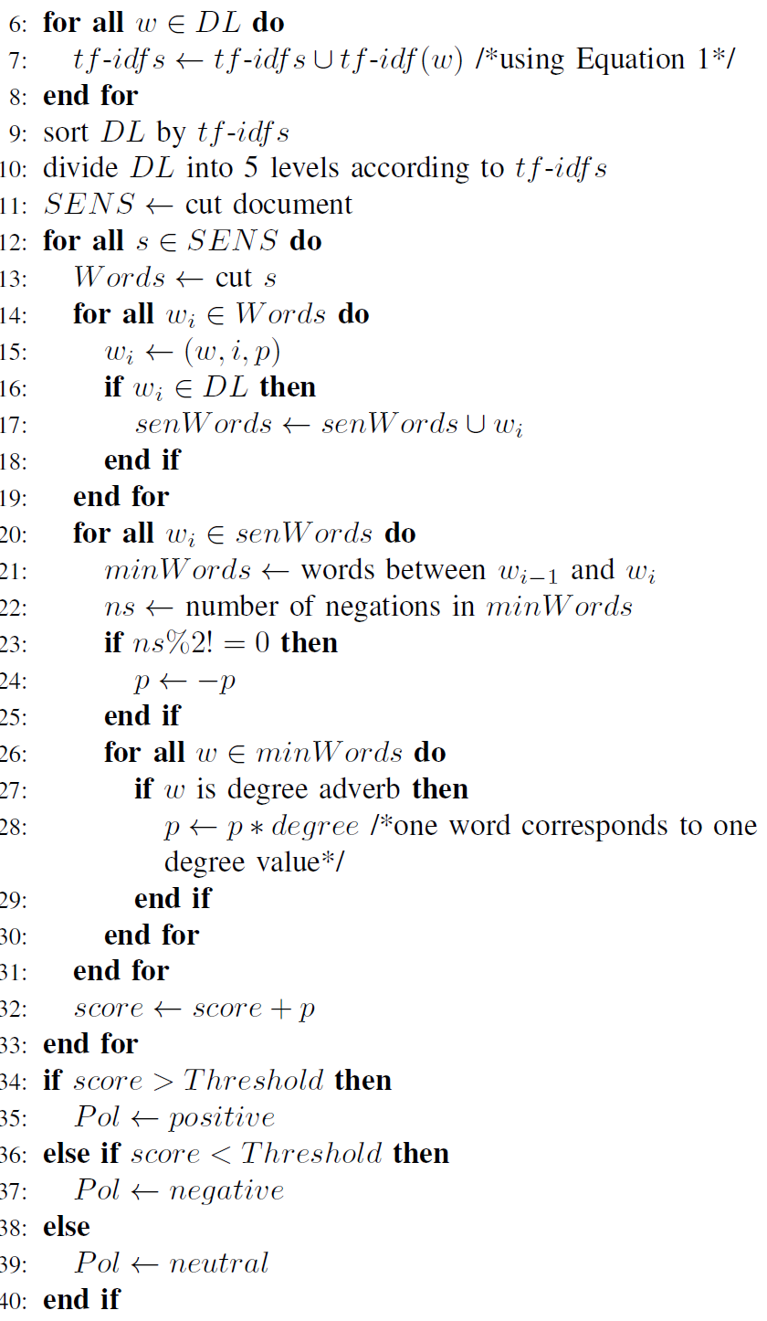



Pseudo Code:
( TF-IDF score to grade the sentiment words.
Equality for identify the polarity of documents )

Slide 10
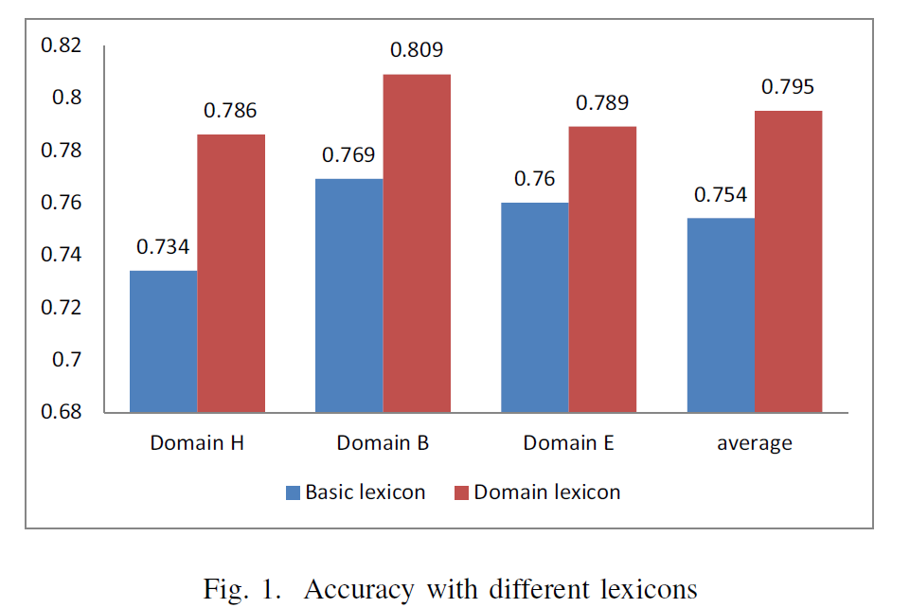
Conclusions:
Conclusion1
Domain lexicons are more suitable for sentiment polarity classification

Slide 11
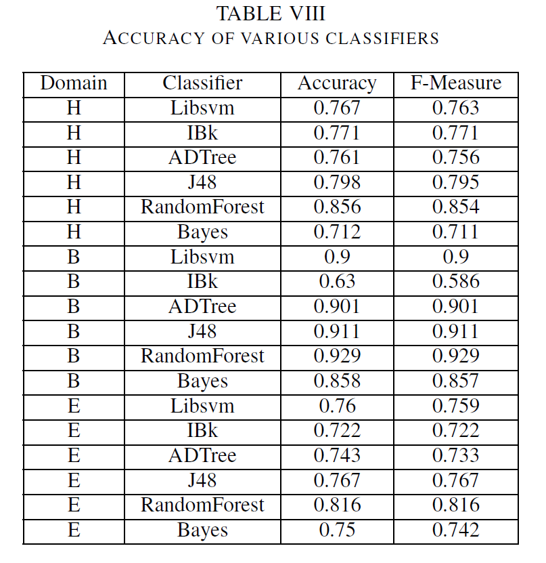
Conclusions:
Conclusion2
Random Forest is the best classifier for all the three domains

Slide 12
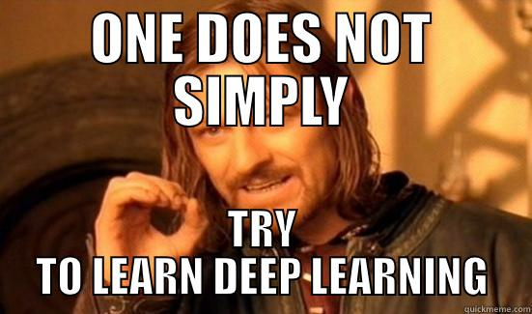
Future Work

Slide 13
References:
P. Melville, W. Gryc, and R. D. Lawrence, “Sentiment analysis of blogs by combining lexical knowledge with text classification,” in Proceedings of the 15th ACM SIGKDD international conference on Knowledge discovery and data mining. ACM, 2009, pp. 1275–1284
R. Socher, J. Pennington, E. H. Huang, A. Y. Ng, and C. D. Manning, “Semi-supervised recursive autoencoders for predicting sentiment distributions,” in Proceedings of the Conference on Empirical Methods in Natural Language Processing. Association for Computational Linguistics, 2011, pp. 151–161.
M. Ghiassi, J. Skinner, and D. Zimbra, “Twitter brand sentiment analysis: A hybrid system using n-gram analysis and dynamic artificial neural network,” Expert Systems with applications, vol. 40, no. 16, pp. 6266–6282, 2013.
C. Lin, Y. He, R. Everson, and S. Ruger, “Weakly supervised joint sentiment-topic detection from text,” Knowledge and Data Engineering,IEEE Transactions on, vol. 24, no. 6, pp. 1134–1145, 2012.
S. Tan and J. Zhang, “An empirical study of sentiment analysis for chinese documents,” Expert Systems with Applications, vol. 34, no. 4,pp. 2622–2629, 2008.
S. Tan, Y. Wang, and X. Cheng, “Combining learn-based and lexicon-based techniques for sentiment detection without using labeled examples,” in Proceedings of the 31st annual international ACM SIGIR conference on Research and development in information retrieval.ACM,2008, pp. 743–744.
D.Tang, “Research on domain adaptive chinese sentiment lexicon construction,” Ph.D. dissertation, Harbin: Harbin Institute of Technology,2012.

