Slide 1
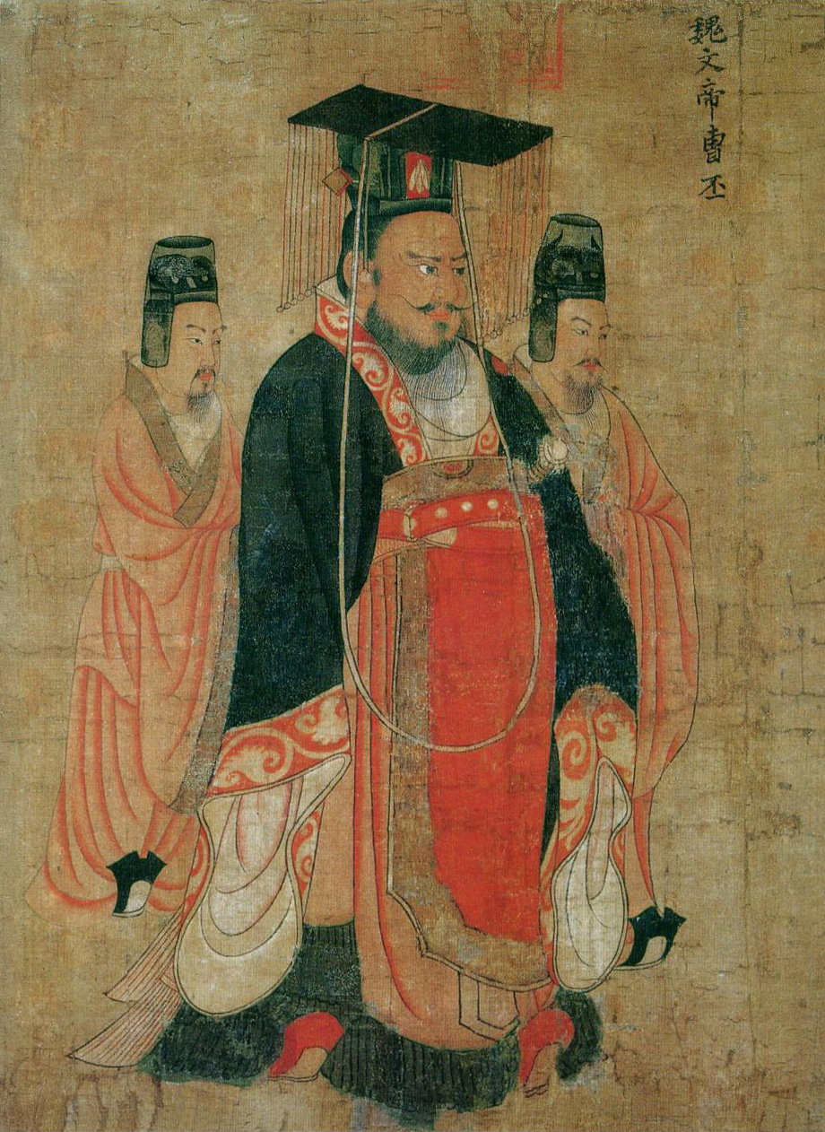
CICS 110: Lecture 19
Slides: Kobi Falus
Edited: Cole A. Reilly
Image: Cao Pi, by Yan Liben
Today: Inheritance, Overloading, Classes 2

Slide 2
Learning Goals
Inheritance
What is Inheritance?
Parent and Child classes
Coding an Inherited Class
Overloading
What is Overloading?
What methods can be Overloaded?
Practice Overloading Methods

Slide 3
Announcements
Participation 10 due Thursday
Last participation
Quiz 11 cancelled
Quiz 12 released on thursday
Lab on Friday
HW6 DUE TODAY
CAPSTONE PROJECT PROPOSAL DUE FRIDAY

Slide 4
Warm up
Some Class work on your own

Slide 5
Warm up
Design a Class that represents a Person
What Properties should it have?
What Methods should it have?
After, talk to a partner and see what you had in common

Slide 6
Inheritance
Relating classes to each other

Slide 7
Inheritance
Imagine we wanted to represent animals using Objects
We could create a class for each animal, one for dog, one for cat
They would have a lot of common properties/methods
Can we avoid have redundant work? Can we have generic methods whose specifics can differ based on the animal?
Animals
Dogs
Parrots

Slide 8
Inheritance
One way to do this is Inheritance
With inheritance we can copy all the properties and methods from one class to another
The class that is giving all the methods/properties is called the parent, the other is the child
Animals
Dogs
Parrots

Slide 9
Inheritance
Animal
Properties: age, height Methods: eat, sleep
We could create an Animal class
The Animal class would have Properties/Methods that are common between all animals
Then, we can have specific animals inherit from the Animal class
Dog
Properties: breed Methods: bark
Parrot
Properties: color(s) Methods: speak

Slide 10
Inheritance
Animal
Properties: age, height Methods: eat, sleep
If Dog inherits from Animal:
Properties: age, height, breed
Methods: eat, sleep, bark
Dog gets all the properties/ methods its parent class had, plus some specific to a Dog
Dog
Properties: breed Methods: bark
Parrot
Properties: color(s) Methods: speak

Slide 11
Inheritance
Animal
Properties: age, height Methods: eat, sleep
What Properties does a Parrot have?
Age
Height
Breed
Color(s)
Eat
Dog
Properties: breed Methods: bark
Parrot
Properties: color(s) Methods: speak

Slide 12
Inheritance
Animal
Properties: age, height Methods: eat, sleep
What Methods does a Parrot have?
Eat
Sleep
Bark
Speak
Age
Dog
Properties: breed Methods: bark
Parrot
Properties: color(s) Methods: speak

Slide 13
Inheritance
Animal
Properties: age, height Methods: eat, sleep
Why use this:
Reduces repeated code (easier to fix mistakes)
More organized (easier to find things)
Easier to create new Animals (a cat only needs cat specific properties/methods)
Dog
Properties: breed Methods: bark
Parrot
Properties: color(s) Methods: speak

Slide 14
Inheritance Code
Apply those ideas to Python

Slide 15
Inheritance
Animal
Properties: age, height Methods: eat, sleep
For inheritance, we need 2 classes
A Parent class (Animal)
A Child class (Dog)
These are both on the website
Dog
Properties: breed Methods: bark
Parrot
Properties: color(s) Methods: speak

Slide 16
Inheritance
The Animal Class:
Properties: Age and Height
Set in Constructor
Methods: Eat and Sleep
class Animal:
def __init__(self, age, height):
self.age = age
self.height = height
def eat(self):
print("I am eating")
def sleep(self):
print("ZzzZzzzZzz")

Slide 17
Inheritance
class Animal:
def __init__(self, age, height):
self.age = age
self.height = height def eat(self):
print("I am eating") def sleep(self):
print("ZzzZzzzZzz")
The Dog Class:
Inherits from Animal
We’re going to not show the Animal class code on future slides to save space. It is there though.
class Dog(Animal):
def __init__(self, age, height, breed):
super().__init__(age, height)
self.breed = breed
def bark(self):
print("Woof!")

Slide 18
Inheritance
class Dog(Animal):
def __init__(self, age, height, breed):
super().__init__(age, height)
self.breed = breed
def bark(self):
print("Woof!")
The Dog Class:
Inherits from Animal
Properties: Breed, Age, Height
Methods: Bark, Eat, Sleep
Remember, Dog has all the properties and methods an Animal does

Slide 19
Inheritance
class Dog(Animal):
def __init__(self, age, height, breed):
super().__init__(age, height)
self.breed = breed
def bark(self):
print("Woof!")
How to inherit:
On the line where you create the class, add the class you are inheriting in parenthesis
In the __init__ method, call super().__init__() to call the parent class’s constructor

Slide 20
Inheritance
class Dog(Animal):
def __init__(self, age, height, breed):
super().__init__(age, height)
self.breed = breed
def bark(self):
print("Woof!")
How to inherit:
On the line where you create the class, add the class you are inheriting in parenthesis
In the __init__ method, call super().__init__() to call the parent class’s constructor
This tells python that you are inheriting from another class

Slide 21
Inheritance
class Dog(Animal):
def __init__(self, age, height, breed):
super().__init__(age, height)
self.breed = breed
def bark(self):
print("Woof!")
How to inherit:
On the line where you create the class, add the class you are inheriting in parenthesis
In the __init__ method, call super().__init__() to call the parent class’s constructor
Super() gets the parent class, so super().__init__() calls the parent class’s constructor. Without this, the code in the parent class’s constructor won’t run

Slide 22
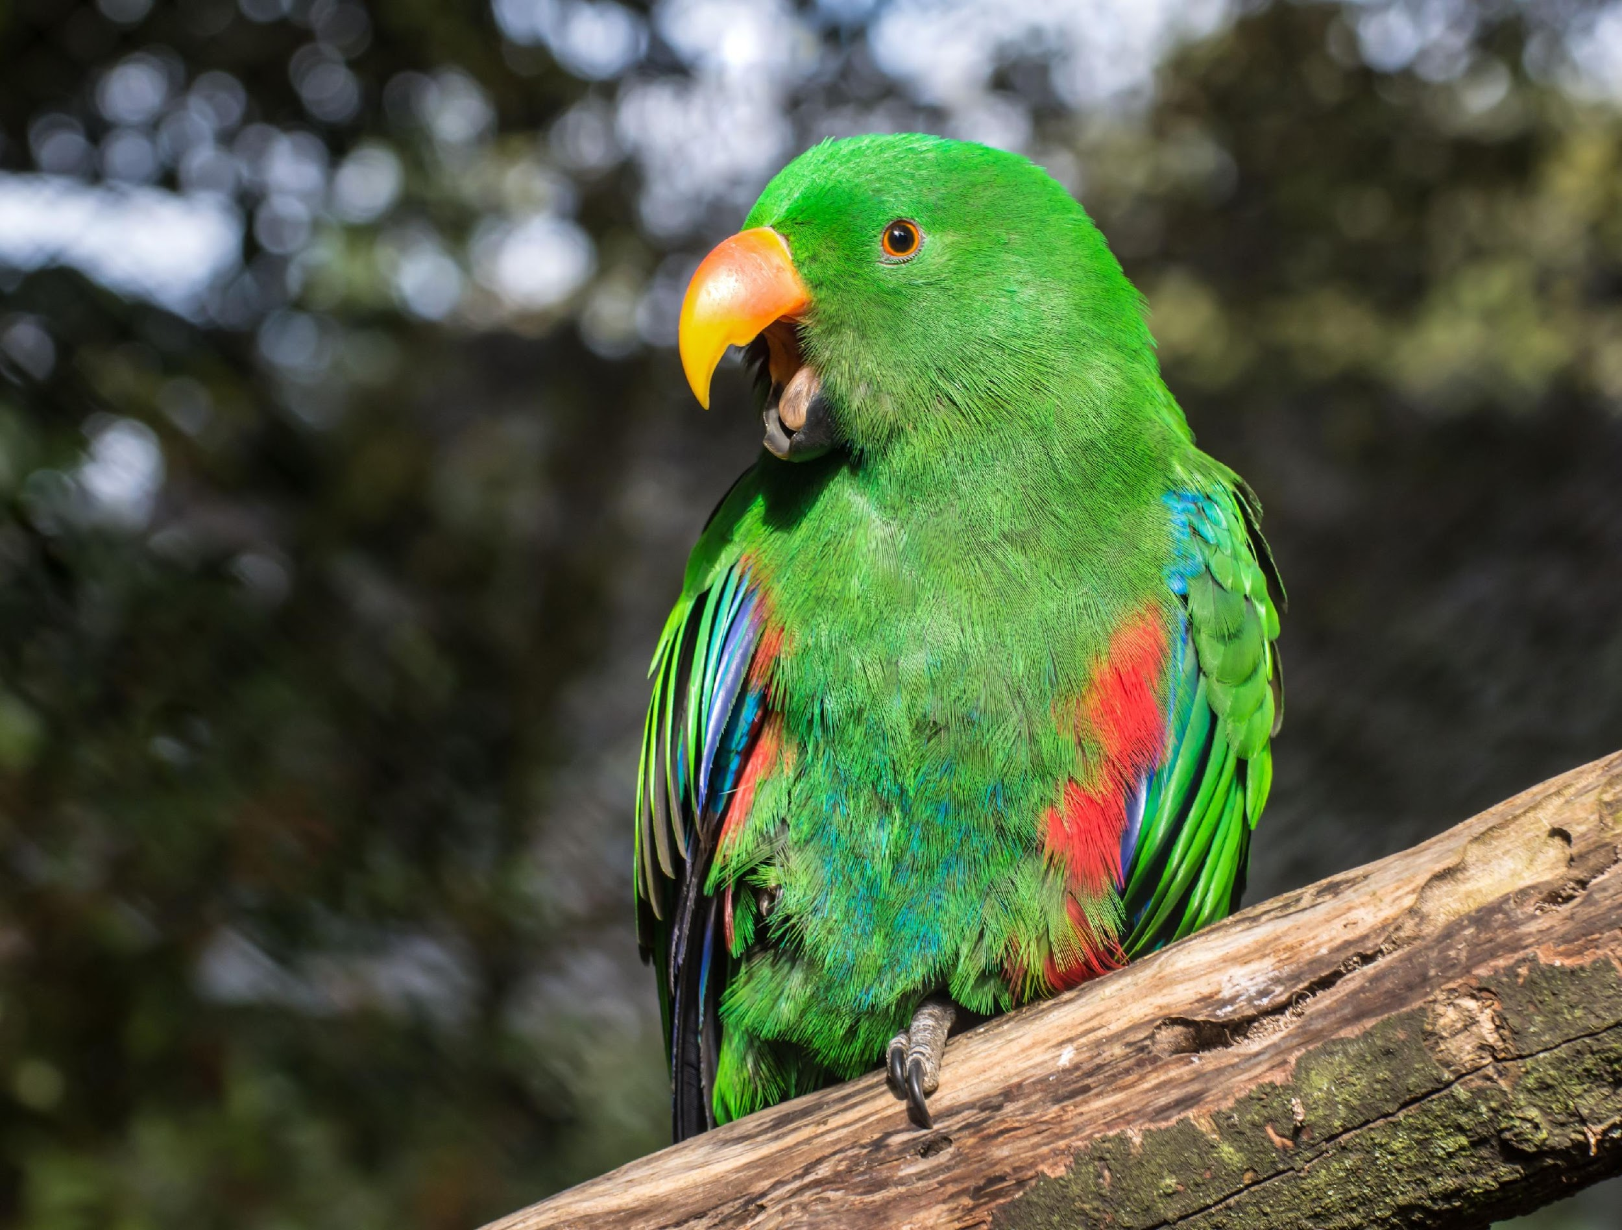
Activity
Make a Parrot class
It should inherit from the Animal class (on website)
It should have a property for the Parrot’s color (set in the Parrot’s constructor)
It should have a method to Speak (print out something)

Slide 23
Overloading
Changing default python functionality for our classes

Slide 24
Overloading
class MyClass:
pass
my_object = MyClass()
print(my_object)
In python, printing an object often prints out it’s memory address
Is there a way to have it print something more useful?
Output:
<__main__.MyClass object at 0x0000021BACD6BCD0>
Note: pass just tells python that there is no content inside the class’s code block

Slide 25
Overloading
class MyClass:
def __str__(self):
return "Hi" my_object = MyClass()
print(my_object)
Yes, we can do this with Overloading
Overloading is the process of changing an already defined method in python
In this case, we can Overload the built-in __str__ method to change what the class prints out
Output:
Hi

Slide 26
Activity
class MyClass:
def __str__(self):
return "Hi" my_object = MyClass()
print(my_object)
Make your Dog class’s print nice
In the Dog class, make it so when you call print on a dog it says the dog’s age, height, and breed
Output:
Hi

Slide 27
Currency
class Currency:
def __init__(self, dollars, cents):
self.dollars = dollars
self.cents = cents
currency = Currency(5, 50) # $5.50
print(currency)
Imagine you wanted to keep track of dollars and cents in a class
You could overload the __str__ method to print out the value nicely
Output:
<__main__.Currency object at 0x??????????>

Slide 28
Currency
class Currency:
def __init__(self, dollars, cents):
self.dollars = dollars
self.cents = cents
def __str__(self):
return f"${self.dollars}.{self.cents}"
currency = Currency(5, 50) # $5.50
print(currency)
Imagine you wanted to keep track of dollars and cents in a class
You could overload the __str__ method to print out the value nicely
Output:
$5.50

Slide 29
Currency
class Currency:
def __init__(self, dollars, cents):
self.dollars = dollars
self.cents = cents
def __str__(self):
return f"${self.dollars}.{self.cents}"
currency_1 = Currency(5, 50) # $5.50
currency_2 = Currency(1, 75) # $1.75
total = currency_1 + currency_2
print(total)
What happens when we try to add two currencies together?
The operation hasn't been defined yet
Output:
TypeError: unsupported operand type(s) for +: 'Currency' and 'Currency'

Slide 30
Adding
class Currency:
def __init__(self, dollars, cents):
self.dollars = dollars
self.cents = cents
def __str__(self):
return f"${self.dollars}.{self.cents}"
def __add__(self, other):
pass
currency_1 = Currency(5, 50) # $5.50
currency_2 = Currency(1, 75) # $1.75
total = currency_1 + currency_2
print(total) # Should be $7.25
We can also overload the add operator (the plus sign, +)
To do this, we need to overload the __add__(self, other) method

Slide 31
Adding
class Currency:
def __init__(self, dollars, cents):
self.dollars = dollars
self.cents = cents
def __str__(self):
return f"${self.dollars}.{self.cents}"
def __add__(self, other):
pass
currency_1 = Currency(5, 50) # $5.50
currency_2 = Currency(1, 75) # $1.75
total = currency_1 + currency_2
print(total) # Should be $7.25
The add method takes in two instances of the class
Self (currency_1) Other (currency_2)
It should return a NEW instance of the class that represents their sum

Slide 32
Adding
class Currency:
def __init__(self, dollars, cents):
self.dollars = dollars
self.cents = cents
def __str__(self):
return f"${self.dollars}.{self.cents}"
def __add__(self, other):
dollars = self.dollars + other.dollars
cents = self.cents + other.cents
return Currency(dollars, cents)
currency_1 = Currency(5, 50) # $5.50
currency_2 = Currency(1, 75) # $1.75
total = currency_1 + currency_2
print(total) # Should be $7.25
In this case, we calculate the new dollars and cents, then return a NEW Currency object

Slide 33
Adding
class Currency:
def __init__(self, dollars, cents):
self.dollars = dollars
self.cents = cents
def __str__(self):
return f"${self.dollars}.{self.cents}"
def __add__(self, other):
dollars = self.dollars + other.dollars
cents = self.cents + other.cents
return Currency(dollars, cents)
currency_1 = Currency(5, 50) # $5.50
currency_2 = Currency(1, 75) # $1.75
total = currency_1 + currency_2
print(total) # Should be $7.25
There’s something wrong with this code
It’s printing out
$6.125
Any guesses why?

Slide 34
Adding
class Currency:
def __init__(self, dollars, cents):
self.dollars = dollars
self.cents = cents def __str__(self):
return f"${self.dollars}.{self.cents}" def __add__(self, other):
dollars = self.dollars + other.dollars
cents = self.cents + other.cents
if cents >= 100:
dollars += 1
cents -= 100
return Currency(dollars, cents) currency_1 = Currency(5, 50) # $5.50
currency_2 = Currency(1, 75) # $1.75
total = currency_1 + currency_2
print(total) # $7.25
Remember to check to make sure your code works by testing it!
If we have more than 100 cents, then we want to convert them to a dollar

Slide 35
Overloading
Action | Method to Overload | Called by
Addition | __add__(self,other) | Object1 + Object2
Subtraction | __sub__(self,other) | Object1 + Object2
Multiplication | __mul__(self,other) | Object1 * Object2
Division | __truediv__(self,other) | Object1 / Object2
Modulo | __mod__(self,other) | Object1 % Object2
Absolute Value | __abs__(self) | abs(Object)
Convert to Int | __int__(self) | int(Object)
Convert to Str | __str__(self) | str(Object)
Convert to Float | __float__(self) | float(Object)
Get Length | __len__(self) | len(Object)
Here are some methods that can be overloaded
All of them can be seen in the official python documentation (Link)

Slide 36

Activity
The Currency code is on the website
Try to Overload the __sub__ method
__sub__ takes in self,other and should return a new Currency that has the difference in money between self and other

Slide 37
Expansion to Currency
We could make our currency objects work with any monetary type (USD, CAD, EUR, JPY, INR, ect)
We'd want to add an attribute for what type of currency it is, and a dict to link those names to their symbol
We could then add a convert function, and change our overload of add to work using that conversion, or stop the addition if we don't have the conversion defined

Slide 38
Fraction Class
Building a useful class for Python

Slide 39
Floats are odd
In a lot of ways, floats are kind of busted in python:
https://docs.python.org/3/tutorial/floatingpoint.html
To some extent, it's not pythons fault, but it'd be useful if we had a class that can do some of the things floats can't
So let's build a fraction class

Slide 40
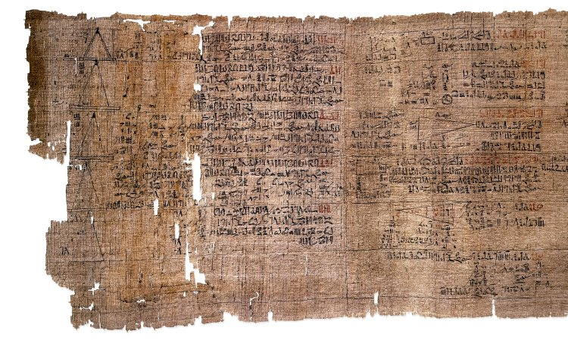
Let's build a fraction class
Attributes?
Methods?
Overloads?

Slide 41
Let's build a fraction class
Attributes?
Numerator
Denominator
Methods?
Overloads?

Slide 42
Let's build a fraction class
Attributes?
Numerator
Denominator
Methods?
Simplify
GCD
Overloads?

Slide 43
Let's build a fraction class
Attributes?
Numerator
Denominator
Methods?
Simplify
GCD
Overloads?
str
add
sub
multiply
divide

Slide 44
Recap + Closing
Let’s review

Slide 45
What did we learn?
Inheritance
Copies all methods and properties from the Parent class to the Child class
Reduces duplicated code
Overloading
Change what built-in python operators do (like +, -, …)
Change what is printed when you call print
Saw a bunch of overloadable methods

Slide 46
Announcements
Participation 10 due Thursday
Last participation
Quiz 11 cancelled
Quiz 12 released on thursday
Lab on Friday
HW6 DUE TODAY
CAPSTONE PROJECT PROPOSAL DUE FRIDAY

