Slide 1

CICS 110 Lab 2
String Formatting
Slides prepared by Manan Talwar

Slide 2
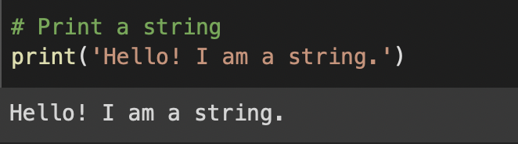
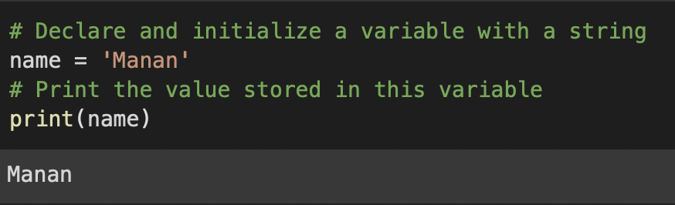
Strings
What are strings used for?
Strings are used to model text in Python.
How to identify strings in Python?
Strings are surrounded by ".. " or '..'
Is there any difference between ".. " and '..'?
No! They are equivalent ☺
Can you show me an example?
Example: "hello"/"hello", "2", etc.
Can you store a string in a variable?
Yes! Any variable can store a string.

Slide 3
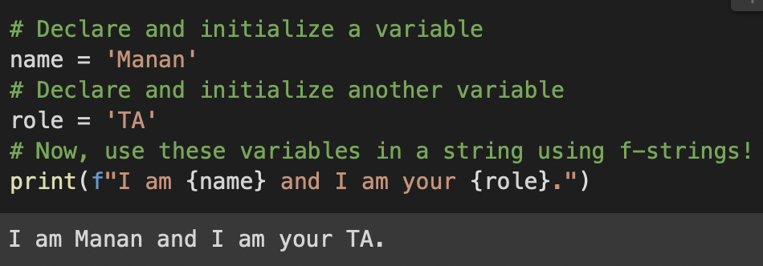
String Formatting in Python using f-strings
What is f-strings?
It’s an easy way to plug-and-play into strings.
How do I use f–strings in code?

Slide 4
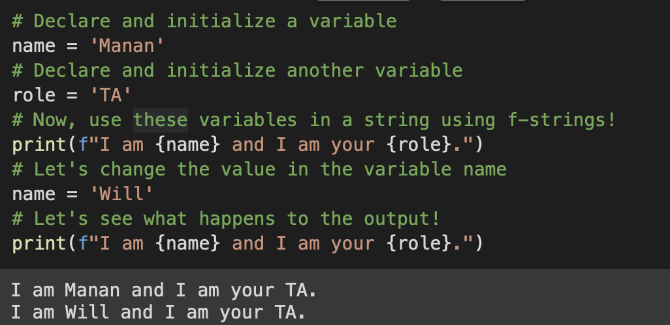
Core Rules of the Game
f-strings syntax: f"…. " or f'…. '
How can you use variables in f-strings? {var_name}

Slide 5
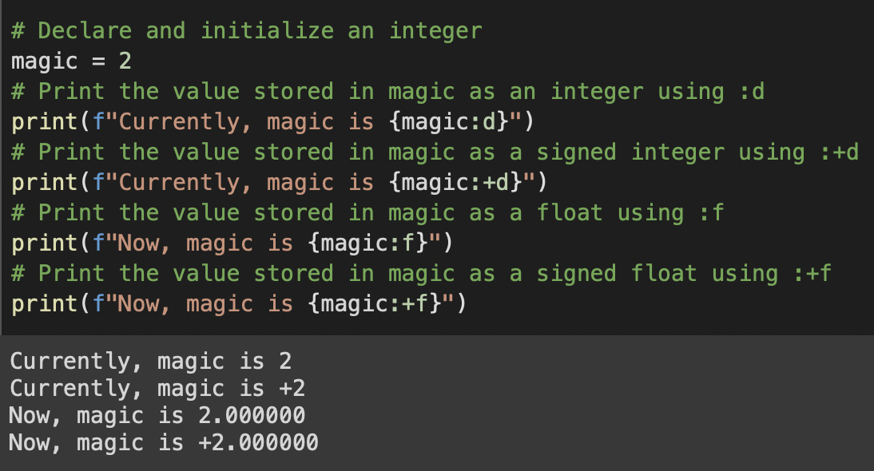
Formatting Numbers

Slide 6
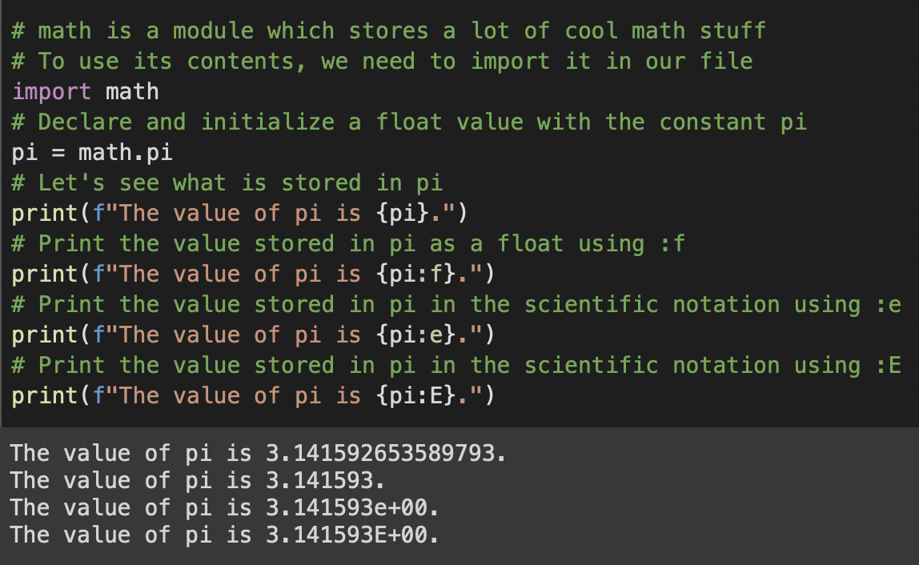
Scientific Notation

Slide 7
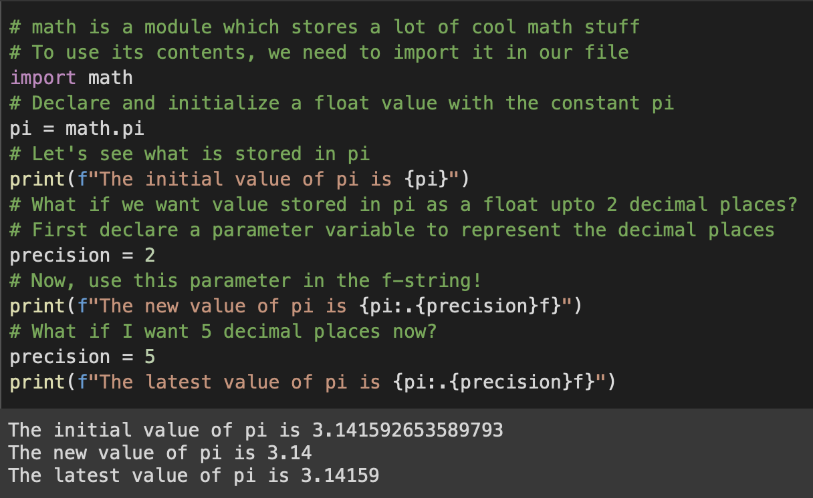
Parametrized Formatting

Slide 8
Much More!
There is much more we can do with f-strings!
Check the documentation at https://fstring.help

