Slide 1
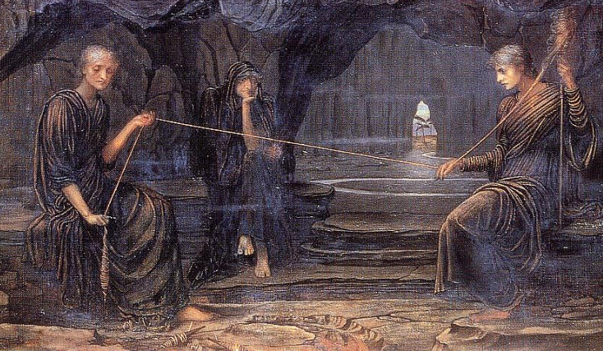
CICS 110: Lecture 13
Slides: Kobi Falus
Edited: Cole A. Reilly
Today: Try-Except, Exceptions, Built-in Modules!

Slide 2
Learning Goals
Errors/Exceptions
What types are there?
Try/Except
How to handle errors
Built-in Modules
Modules that exist in python
Documentation
Learning from other resources

Slide 3
Announcements
Participation 7 due Thursday
Quiz 8 due Thursday
Lab on Friday
HW5 DUE APRIL 12th
Next Wednesday

Slide 4
Recap
Reviewing Last Week's Lecture

Slide 5
Comprehensions
Mapping:
Apply an operation to every element in a collection
times_2 = [x * 2 for x in range(10)]
Filtering:
Get a subset of a collection
odd = [x for x in range(10) if x % 2 == 1]
Ternary:
If..else statements in 1 line
num = 3
to_str = "Odd" if num % 2 == 1 else "Even"

Slide 6
The Problem
Investigating code that isn't working

Slide 7
Problem
Sometimes, code doesn’t work. It can print out something like this.
x = 2
if x == 2:
print(x)
IndentationError: expected an indented block after 'if' statement on line 2

Slide 8
Errors
While coding, things can go wrong. When this happens, we get an Error
When an Error is printed out automatically, what we see is an Exception. They tend to be more descriptive as well.
x = 2
if x == 2:
print(x)
IndentationError: expected an indented block after 'if' statement on line 2
Notes:
The error is a syntactical one, but the exception itself is called an IndentationError, and tells us what line it occurred on

Slide 9
Errors
While coding, things can go wrong. When this happens, we get an Error
Errors can be put in 3 broad categories:
Syntax Errors
Runtime Errors
Logic Errors
x = 2
if x == 2:
print(x)
IndentationError: expected an indented block after 'if' statement on line 2

Slide 10
Syntax Error
An error in the structure of the code itself, a violation in the grammar of Python

Slide 11
Syntax Errors
Syntax Errors – Errors that are found before the code has run This is some fundamental error violating the grammar of python
Examples:
Missing Indentation
Missing Commas
Misspelled Words
x = 2
if x == 2:
print(x)
File "(FILE LOCATION)", line 3
print(x)
^
IndentationError: expected an indented block after 'if' statement on line 2

Slide 12
Errors
Syntax Errors – Errors that are found before the code has run This is some fundamental error violating the grammar of python
Examples:
Missing Indentation
Missing Commas
Misspelled Words
my_list = [1 2 3]
File "(FILE LOCATION)", line 1
my_list = [1 2 3]
^^^
SyntaxError: invalid syntax. Perhaps you forgot a comma?

Slide 13
Errors
Syntax Errors – Errors that are found before the code has run This is some fundamental error violating the grammar of python
Examples:
Missing Indentation
Missing Commas
Misspelled Words
x = [1, 2, 3]
fro x in my_list:
print(x)
File "(FILE LOCATION)", line 2
fro x in my_list:
^
SyntaxError: invalid syntax

Slide 14
Reading an Error
Syntax Errors often tell you what line they occur near
They may even give recommendations on how to fix them!
my_list = [1 2 3]
File "(FILE LOCATION)", line 1
my_list = [1 2 3]
^^^
SyntaxError: invalid syntax. Perhaps you forgot a comma?
Note: Line numbers can be misleading. You may have to check around the line to find the error.

Slide 15
Runtime Error
An error in performing actions undefined by python

Slide 16
Runtime Errors
Runtime Errors – Errors that are found while the code is running
Runtime errors attempt illegal actions, but 'look' like valid python code.
Examples:
Unable to Cast
Invalid Operation
Index out of Bounds
x = input('Enter a number: ')
x_num = int(x)
print(x_num)
Enter a number: abc
File "(FILE LOCATION)", line 2, in <module>
x_num = int(x)
ValueError: invalid literal for int() with base 10: 'abc'

Slide 17
Runtime Errors
Runtime Errors – Errors that are found while the code is running
Runtime errors attempt illegal actions, but 'look' like valid python code.
Examples:
Unable to Cast
Invalid Operation
Index out of Bounds
x = input('Enter a number: ')
y = x + 2
print(y)
Enter a number: abc
File "(FILE LOCATION)", line 2, in <module>
y = x + 2
TypeError: can only concatenate str (not "int") to str

Slide 18
Runtime Errors
Runtime Errors – Errors that are found while the code is running
Runtime errors attempt illegal actions, but 'look' like valid python code.
Examples:
Unable to Cast
Invalid Operation
Index out of Bounds
nums = [1, 2, 3]
x = int(input('Enter a number: '))
print(nums[x])
Enter a number: 12
File "(FILE LOCATION)", line 3, in <module>
print(nums[x])
IndexError: list index out of range

Slide 19
Logic Error
'Functioning' Code that doesn't work as Intended/Described

Slide 20
Logic Errors
Logic Errors - Code that runs to completion, but not as intended. Produces different output or works in a way different then intended/described.
While they occur when the code is run, often only found after completion.
- Don’t cause the program to Stop with an Exception
- Don’t have associated Error Messages
nums = [1,2,3]
doubled = [x*3 for x in nums]
# Logic Error: Should be x*2

Slide 21
Logic Errors
Logic Errors – Occur when code runs, but stop the program from running correctly without crashing.
Examples:
Running wrong operation
Case not accounted for
Infinite Loops (when not intended)
nums = [1,2,3]
doubled = [x*3 for x in nums]
# Logic Error: Should be x*2

Slide 22
Logic Errors
Logic Errors – Occur when code runs, but stop the program from running correctly without crashing.
Examples:
Running wrong operation
Case not accounted for
Infinite Loops (when not intended)
x = int(input('Enter a number: '))
if x == 2:
print('x is 2')
else:
print('x is greater than 2')
# Logic Error: x can be less than 2

Slide 23
Logic Errors
Logic Errors – Occur when code runs, but stop the program from running correctly without crashing.
Examples:
Running wrong operation
Case not accounted for
Infinite Loops (when not intended)
count = 0
while count >= 0:
print(count)
count += 1
# Logic Error: Infinite loop

Slide 24
Activity
On the website are many blocks of code. For each one:
Identify if there is an error and the error category
Syntax Error
Runtime Error
Logic Error
Fix the Error

Slide 25
Try-Except
Handling Runtime Errors Gracefully

Slide 26
Try Except
Note: Else and Finally are optional, but Try and Except aren't
Try/Except catches exceptions when they occur so your code can continue running
1. Try: Code that might raise an exception
2. Except: Code that runs if an exception occurs
3. Else: Code that runs if no exception occurs
4. Finally: Code that always runs
try:
x = input('Enter a number: ')
y = int(x)
except:
print('Input not number')
else:
print('Entered number is', y)
finally:
print('Done')

Slide 27
Try Except
Note: Else and Finally are optional, but Try and Except aren't
Try/Except catches exceptions when they occur so your code doesn’t stop
try:
x = input('Enter a number: ')
y = int(x)
except:
print('Input not number')
else:
print('Entered number is', y)
finally:
print('Done')
1. Try: Code that might raise an exception
If an error occurs in this section, the code will not immediately stop

Slide 28
Try Except
Note: Else and Finally are optional, but Try and Except aren't
Try/Except catches exceptions when they occur so your code doesn’t stop
try:
x = input('Enter a number: ')
y = int(x)
except:
print('Input not number')
else:
print('Entered number is', y)
finally:
print('Done')
2. Except: Code that runs if an exception occurs
If an error occurred in the try section, this code is run (and the exception disappears)

Slide 29
Try Except
Note: Else and Finally are optional, but Try and Except aren't
Try/Except catches exceptions when they occur so your code doesn’t stop
try:
x = input('Enter a number: ')
y = int(x)
except:
print('Input not number')
else:
print('Entered number is', y)
finally:
print('Done')
3. Else: Code that runs if no exception occurs
This code is run only if no error occurred in the try section

Slide 30
Try Except
Note: Else and Finally are optional, but Try and Except aren't
Try/Except catches exceptions when they occur so your code doesn’t stop
try:
x = input('Enter a number: ')
y = int(x)
except:
print('Input not number')
else:
print('Entered number is', y)
finally:
print('Done')
4. Finally: Code that always runs
This code is always run, regardless of if an error occurs in the try, except, or else blocks

Slide 31
Finally Weirdness
def mystery(x):
try:
print("TRY")
return 10/x
except:
print("EXCEPT")
return False
finally:
print("FINALLY")
return True
print(mystery(0))
print(mystery(1))
This massive link is a python tutor example of the code written here
The finally clause can add some unexpected results to your code sometimes
https://pythontutor.com/visualize.html#code=def%20mystery%28x%29%3A%0A%20%20%20%20try%3A%0A%20%20%20%20%20%20%20%20print%28%22TRY%22%29%0A%20%20%20%20%20%20%20%20return%2010/x%0A%20%20%20%20except%3A%0A%20%20%20%20%20%20%20%20print%28%22EXCEPT%22%29%0A%20%20%20%20%20%20%20%20return%20False%0A%20%20%20%20finally%3A%0A%20%20%20%20%20%20%20%20print%28%22FINALLY%22%29%0A%20%20%20%20%20%20%20%20return%20True%0Aprint%28mystery%280%29%29%0Aprint%28mystery%281%29%29&cumulative=false&curInstr=0&heapPrimitives=nevernest&mode=display&origin=opt-frontend.js&py=3&rawInputLstJSON=%5B%5D&textReferences=false

Slide 32
Built-in Modules
Using the web to expedite the programming process

Slide 33
What is a module
Built-in modules are modules already added to python
A Module is a collection of code you can use
They have code written by other people
import math
x = int(input('Enter a number: '))
print(f'Log is {math.log(x)}')
print(f'Square root is {math.sqrt(x)}')
print(f'Pi is {math.pi}')

Slide 34
What is a module
Built-in modules are modules already added to python
A Module is a collection of code you can use
You’ve already done this with math!
We can also do this with the code we've written in class
import math
x = int(input('Enter a number: '))
print(f'Log is {math.log(x)}')
print(f'Square root is {math.sqrt(x)}')
print(f'Pi is {math.pi}')

Slide 35
PPrint
It allows you to print dictionaries (and other types) nicely
Pprint (Pretty Print) is a module built-in to python
Try it out! Modify the dict and see how the output changes!
import pprint
my_dict = {'name': 'John', 'favorite_numbers': [1, 2, 3], 'favorite_colors': ['red', 'blue', 'green']}
print(my_dict)
pprint.pprint(my_dict)

Slide 36
A Selection from the Standard Library
Module name | Description | Documentation link
datetime | Creation and editing of dates and times objects | https://docs.python.org/3/library/datetime.html
random | Functions for working with random numbers | https://docs.python.org/3/library/random.html
copy | Create complete copies of objects | https://docs.python.org/3/library/copy.html
time | Get the current time, convert time zones, sleep for a number of seconds | https://docs.python.org/3/library/time.html
math | Mathematical functions | https://docs.python.org/3/library/math.html
os | Operating system informational and management helpers | https://docs.python.org/3/library/os.html
sys | System specific environment or configuration helpers | https://docs.python.org/3/library/sys.html
pdb | The Python interactive debugger | https://docs.python.org/3/library/pdb.html
urllib | URL handling functions, such as requesting web pages | https://docs.python.org/3/library/urllib.html

Slide 37
Documentation/Datetime
Using the web to expedite the programming process

Slide 38
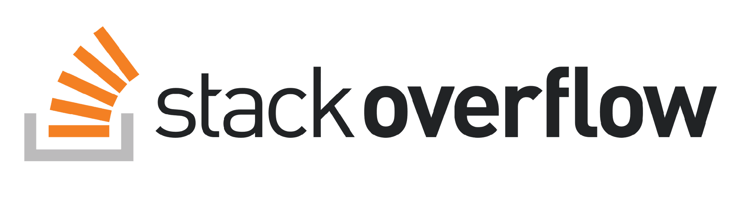
Documentation
Information about modules (and python in general) is stored online. This information is called documentation
Some trustworthy sources are:
w3schools.com
geeksforgeeks.org
tutorialspoint.com
stackoverflow.com
Let’s use these to learn how to use a module!

Slide 39
Datetime
Datetime is a built-in module that lets you do math with dates
It can let you:
Get the current date
Find How many days it has been since January 1st
Print out how many days have passed
Let’s use the following documentation to learn about module w3schools.com/python/python_datetime.asp
Notes:
NOTE: W3Schools Documentation does not have relative date calculation (Ex: get date 3 days ago). Need to use another resource for that

Slide 40
Datetime
Sometimes a single resource doesn’t have all the information you would need
Let’s try to find out what day it was 61 days ago!
Try Searching: “python datetime days ago”
Notes:
NOTE: W3Schools Documentation does not have relative date calculation (Ex: get date 3 days ago). Need to use another resource for that

Slide 41
Activity
Use datetime and documentation to:
Get the current date
Find out the day of the week 61 weeks ago
Print out the day of the week!
If you are stuck, try looking up how to do it!
Googling format: “Python {my_problem}”

Slide 42
Recap + Closing
Let’s review

Slide 43




What did we learn?
Errors
Syntax, Runtime, Logic Using Exceptions
Try-Except
Stopping your code from crashing
Documentation
Using Documentation to further our understanding
Modules
Using code not originally written in the file Built-in Modules

Slide 44
Announcements
Participation 7 due Thursday
Quiz 8 due Thursday
Lab on Friday
HW5 DUE APRIL 12th
Next Wednesday

