Slide 1
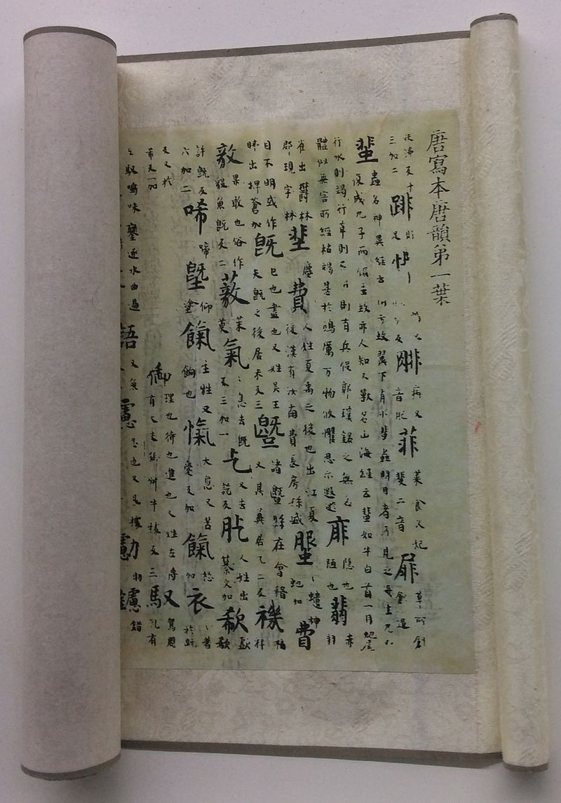

CICS 110: Lecture 11
Slides: Kobi Falus
Edited: Cole A. Reilly
Today: Sets, Dictionaries!

Slide 2
Learning Goals
Data Structures
Organizing data to solve a problem
Sets
Representing mathematical sets in python
Dictionaries
Keys and values paired together

Slide 3
Announcements
Participation 6 due Thursday
Quiz 6 due Thursday
Lab on Friday

Slide 4
Recap
Output
>> 1
>> 2
>> a
>> b
my_list = [1, 2, 'a', 'b']
for element in my_list:
print(element)
Output
>> 1
>> 2
>> a
>> b
my_tuple = (1, 2, 'a', 'b')
for element in my_tuple:
print(element)
Output
>> a
>> b
>> c
>> d
>> e
my_string = 'abcde'
for letter in my_string:
print(letter)
Output
>> 1
>> 3
>> 5
>> 7
>> 9
my_range = range(1,10,2)
for number in my_range:
print(number)

Slide 5
And there are even more!
Python Data Types
Dictionary
dict()
x = {“name”: “Aaron”, “age”: 15}
Collection
Changeable, ordered**, no duplicates
Numeric
Boolean
bool()
x = True
Primitive
Only two values: True, False
Sequence
Set
set()
x = {1,2,3}
Collection
unordered, unindexed, unchangeable*, no duplicates
Integer
int()
x = -3
Primitive
Positive/Negative whole numbers, including 0
Float
float()
x = 10.557
Primitive
Numbers with decimals
Complex
complex()
x = complex(3,5)
Primitive
A combination of a real and imaginary numbers
Strings
str()
x = “hello world”
Sequence/Primitive
Anything you could type with a keyboard. A sequence of characters. Ordered
List
list()
x = [1,2,”hello”]
Sequence/Collection
Ordered, changeable, duplicates
Tuple
tuple()
x = (1,2,2)
Sequence/Collection
Ordered, unchangeable, duplicates
*Values in sets are unchangeable, but items can be added/removed
**Dicts ordered as of python 3.7

Slide 6
Can store any data type
Can only store characters
Lists | Tuples | Strings
Declared with Square Brackets: [1, 1.0, 'one'] | Declared with Parenthesis: (1, 1.0, 'one’) | Declared with Quotes: 'Hello' or "Hello"
Mutable, can be changed after creation
Immutable, can't be changed after creation

Slide 7
Data Structures
How can organizing data work to solve problems

Slide 8

Why have a Data Structure?
Your computer needs to store a lot of data.
We could choose not to organize it, but that would make it hard to find things, and even harder to solve problems
So, we put the data in organization structures called data structures

Slide 9
What is a Data Structure?
A data structure is a way of storing multiple pieces of data together in memory
Examples:
String (str) [sort-of]
Tuple (tuple)
List (list)
Greeting
str
H
e
l
l
o
str | 'one'
list | ones | 0 | 1 | 2
float | 1.0
int | 1

Slide 10
What is a Data Structure?
A data structure is a way of storing multiple pieces of data together in memory
Some new data structures:
Set (set)
Dictionary (dict)
Greeting
str
H
e
l
l
o
str | 'one'
list | ones | 0 | 1 | 2
float | 1.0
int | 1

Slide 11

Data Structures as Problem Solving
One of the main utilities of data structures is they allow for unique forms of problem solving.
If we get the data into a certain form, it can be much easier to solve certain kinds of problems. If a list is sorted, it's incredibly quick to find the max, min, or median.
This way of problem solving is the focus of the class CICS 210.

Slide 12
Sets
Values that are unique, and unordered

Slide 13
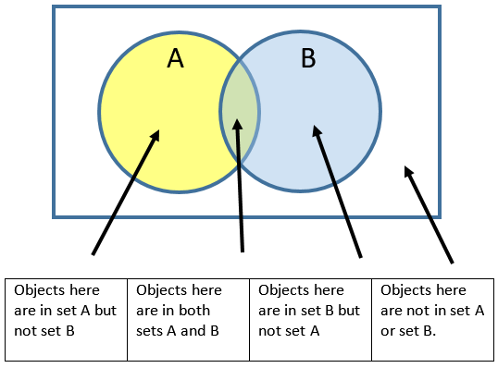
What is a set?
A set is a collection of data where the data is:
All unique
Unordered
Sets are incredibly important in mathematics, and their use can solve a great many kinds of problems.
Set notation is traditionally built around the venn diagram

Slide 14
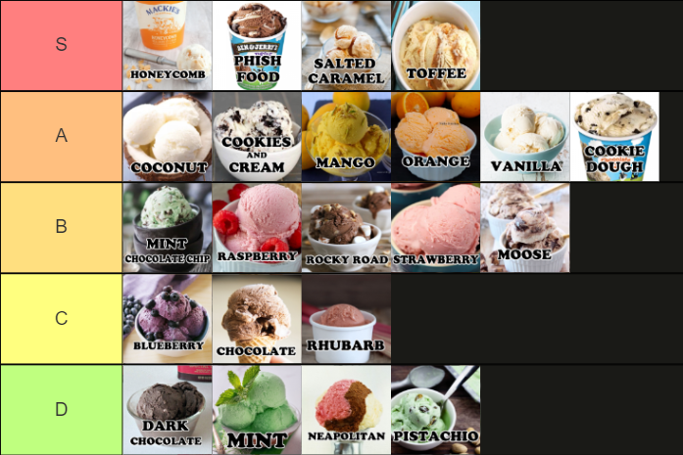
Making a set
A set is declared using curly brackets: { }, or the set constructor set( )
A Tier list is a collection of sets (each row is a set)
No item appears in a row more than once
The order of the items in a set has no meaning
S_tier = {'honeycomb','phish food','salted caramel','toffee'}
C_tier = set('Blueberry','Chocolate','Rhubarb')

Slide 15
Making a set
Memory
str | 'Rhubarb'
A set is declared using curly brackets: { } or the set constructor set( )
set | C_tier
str | 'Blueberry'
str | 'Chocolate'
C_tier = {'Blueberry','Chocolate','Rhubarb’}

Slide 16
Making a set
Memory
str | 'Rhubarb'
A set is declared using curly brackets: { } or the set constructor set( )
Since a set is unordered, it can not be indexed
set | C_tier
str | 'Blueberry'
str | 'Chocolate'
C_tier = {'Blueberry','Chocolate','Rhubarb’}
print(C_tier[0])
Output:
>> TypeError: 'set' object is not subscriptable

Slide 17
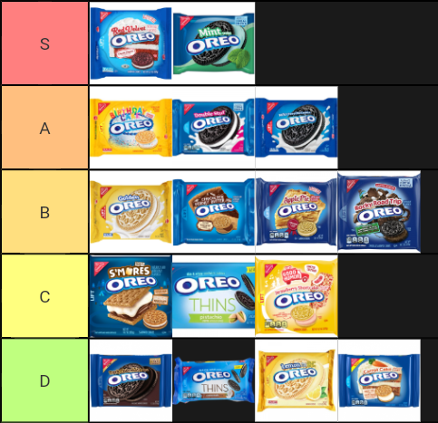
Activity: Tier List Part 1
Try to make a tier list of foods!
There should be 5 tiers (5 sets): S, A, B, C, and D Make sure you save it, because we will use them later in the lesson.
Another tier list I hard disagree with

Slide 18
Sets Methods
What can we do with sets

Slide 19
Some Set Methods
fruits = {'apple', 'banana', 'lime'}
fruits.add('orange')
print(fruits)
fruits.discard('banana')
print(fruits)
random_fruit = fruits.pop()
print(random_fruit)
print(fruits)
Add(element): Adds an element to the set
Discard(element): Removes the element from the set
Pop(): Removes a random element and returns it
Output:
>> {'banana', 'orange', 'apple', 'lime’}
>> {'orange', 'apple', 'lime’}
>> lime
>> {'apple', 'orange'}

Slide 20
Some Set Methods
fruits = {'apple', 'banana', 'lime’}
fruits.add('orange')
fruits.add('orange')
print(fruits)
fruits.discard('banana')
print(fruits)
random_fruit = fruits.pop()
print(random_fruit,fruits)
Creating a set, starting it with three elements
Memory
str | 'apple'
set | fruits
Output:
str | 'banana'
str | 'lime'

Slide 21
Some Set Methods
fruits = {'apple', 'banana', 'lime’}
fruits.add('orange')
fruits.add('orange')
print(fruits)
fruits.discard('banana')
print(fruits)
random_fruit = fruits.pop()
print(random_fruit,fruits)
Add(element): Adds an element to the set
Memory
str | 'apple'
str | 'orange'
set | fruits
Output:
str | 'banana'
str | 'lime'
Notice how the arrow orders changed, this is because there is no determined order in a set

Slide 22
Some Set Methods
fruits = {'apple', 'banana', 'lime’}
fruits.add('orange')
fruits.add('orange')
print(fruits)
fruits.discard('banana')
print(fruits)
random_fruit = fruits.pop()
print(random_fruit,fruits)
No Duplicates: Add does not add an element if it is already in the set. No error is thrown, the program just moves on
Memory
str | 'apple'
str | 'orange'
set | fruits
Output:
>> {'banana', 'orange', 'apple', 'lime’}
str | 'banana'
str | 'lime'

Slide 23
Some Set Methods
fruits = {'apple', 'banana', 'lime’}
fruits.add('orange')
fruits.add('orange')
print(fruits)
fruits.discard('banana')
print(fruits)
random_fruit = fruits.pop()
print(random_fruit,fruits)
Discard(element): Removes the element from the set
Memory
str | 'apple'
str | 'orange'
set | fruits
Output:
>> {'banana', 'orange', 'apple', 'lime’}
>> {'orange', 'apple', 'lime’}
str | 'lime'
Notice again how the arrow orders changed, this is because there is no determined order in a set

Slide 24
Some Set Methods
fruits = {'apple', 'banana', 'lime’}
fruits.add('orange')
fruits.add('orange')
print(fruits)
fruits.discard('banana')
print(fruits)
random_fruit = fruits.pop()
print(random_fruit,fruits)
Pop(): Removes a random element and returns it
Memory
str | 'apple'
str | 'orange'
set | fruits
Output:
>> {'banana', 'orange', 'apple', 'lime’}
>> {'orange', 'apple', 'lime’}
>> lime
>> {'apple', 'orange'}
random_fruit | str | 'lime'

Slide 25
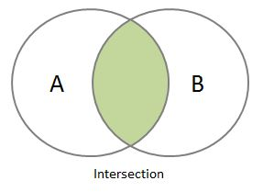
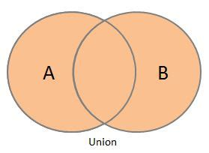
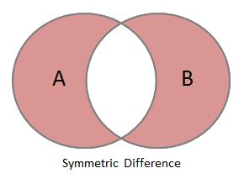
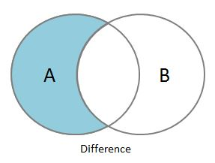
Mathematical Set Methods
You don’t need to memorize these, just showing what sets can do
set1 = {'a', 'b', 'c'}
set2 = {'c', 'd', 'e'}
print(set1.union(set2)) # {'a', 'b', 'c', 'd', 'e'}
print(set1.intersection(set2)) # {'c'}
print(set1.difference(set2)) # {'a', 'b'}
print(set1.symmetric_difference(set2)) # {'a', 'b', 'd', 'e'}

Slide 26
Activity: Tier List 2
Try to use these methods to see what foods you and a neighbor agree should be in a tier!
set1 = {'a', 'b', 'c'}
set2 = {'c', 'd', 'e'}
print(set1.union(set2)) # {'a', 'b', 'c', 'd', 'e'}
print(set1.intersection(set2)) # {'c'}
print(set1.difference(set2)) # {'a', 'b'}
print(set1.symmetric_difference(set2)) # {'a', 'b', 'd', 'e'}

Slide 27
Dictionaries
A key-value pair to link values together

Slide 28
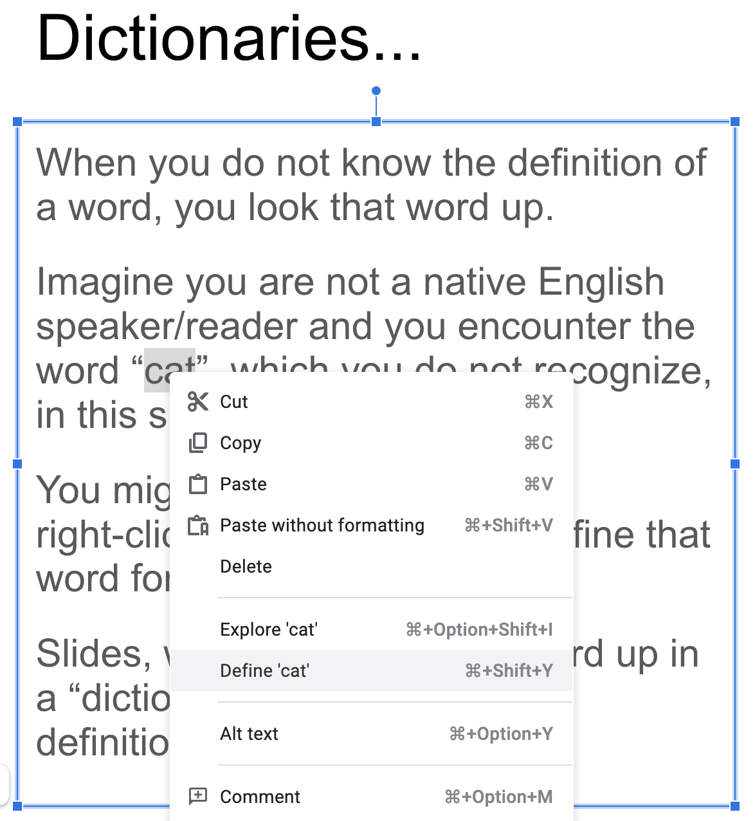

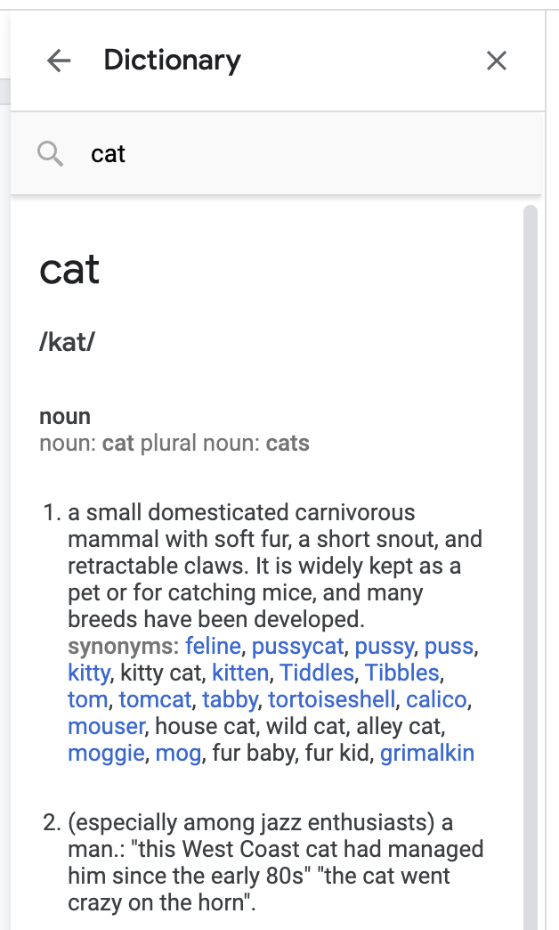
Dictionaries...
When you do not know the definition of a word, you look that word up.
Imagine you are not a native English speaker/reader and you encounter the word “cat”, which you do not recognize, in this slide.
You might highlight the word, right-click, and ask Slides to define that word for you.
Slides, would then look that word up in a “dictionary” and retrieve the definition.

Slide 29
Dictionaries...
The relationship between "cat" and its definition is associative.
That is, "cat" is associated with some words describing what a "cat" is.

Slide 30
Dictionary Example
In python, a dictionary lets you look up keys, and see their associated values
Imagine a student:
Keys: Name, Major, Exam1, Exam2
Values: Poorav, English, 87.9, 91.4
To get "Poorav", you would have to ask for the student’s name
Student
Name | Poorav
Major | English
Exam1 | 87.9
Exam2 | 91

Slide 31
Dictionary Example
To create a dictionary, start with curly braces { }
Then, inside add key:value with comma(s) separating the pairs
Instead of accessing the values by an index, we are accessing them by providing the key
Student
Name | Poorav
Major | English
Exam1 | 87.9
Exam2 | 91
assert(Student['Name'] == "Poorav")
S_list = ['Poorav', 'English',...]
assert(S_list[0] == "Poorav")

Slide 32
Dictionary Example
student = {
'name': 'Poorav',
'Major': 'English',
'Exam1': 87.9,
'Exam2': 91
}
To create a dictionary, start with curly braces { }
Then, inside add key:value with comma(s) separating the pairs

Slide 33
Dictionary Example
student = {
'name': 'Poorav',
'Major': 'English',
'Exam1': 87.9,
'Exam2': 91
}
print(student['name'])
print(student['Major'])
To get a value in a dictionary, you can access it with a key
All the keys need to be unique to prevent indexing from giving different values
Output:
>> Poorav
>> English

Slide 34
Dictionary Methods
rabbit = {
'name': 'Judy',
'age': 2,
'dislikes': 'crime'
}
rabbit['age'] = 3
rabbit['likes'] = 'carrots'
del rabbit['dislikes']
You can update or add a key/value pair by assigning the key to a (new) value
You can remove a key/value pair by writing del followed by accessing the value of the dictionary

Slide 35
Dictionary Methods
rabbit = {
'name': 'Judy',
'age': 2,
'dislikes': 'crime'
}
rabbit['age'] = 3
rabbit['likes'] = 'carrots'
del rabbit['dislikes']
Memory
str | 'name'
str | 'Judy'
rabbit: dict
str | 'age'
int | 2
str | 'dislikes'
str | 'crime'
Creating a dictionary, populating it with some k,v

Slide 36
Dictionary Methods
rabbit = {
'name': 'Judy',
'age': 2,
'dislikes': 'crime'
}
rabbit['age'] = 3
rabbit['likes'] = 'carrots'
del rabbit['dislikes']
Memory
str | 'name'
str | 'Judy'
rabbit: dict
str | 'age'
int | 3
str | 'dislikes'
str | 'crime'
Assign an old key to a new value

Slide 37
Dictionary Methods
rabbit = {
'name': 'Judy',
'age': 2,
'dislikes': 'crime'
}
rabbit['age'] = 3
rabbit['likes'] = 'carrots'
del rabbit['dislikes']
Memory
str | 'name'
str | 'Judy'
rabbit: dict
str | 'age'
int | 3
str | 'dislikes'
str | 'crime'
str | 'likes'
str | 'carrots'
Creating a new key/value pair

Slide 38
Dictionary Methods
rabbit = {
'name': 'Judy',
'age': 2,
'dislikes': 'crime'
}
rabbit['age'] = 3
rabbit['likes'] = 'carrots'
del rabbit['dislikes']
Memory
str | 'name'
str | 'Judy'
rabbit: dict
str | 'age'
int | 3
str | 'likes'
str | 'carrots'
Removing a key value pair

Slide 39
Finishing the Tier List
Store all the tier sets in a dictionary
Add code to let someone add a food to the list
Ask for the tier they want to add to
Ask for the food they want to add
Add the food
Print out the dictionary
Input/Output
>> Tier: A
>> Food: French Fries
>> <The Dictionary>

Slide 40
Miscellaneous
In operation, += operation, Empty

Slide 41
Check membership
my_list = [1, 2, 3, 4, 5]
print(1 in my_list) # True
print(6 in my_list) # False
my_tuple = (1, 2, 3, 4, 5)
print(1 in my_tuple) # True
print(6 in my_tuple) # False
my_string = 'Hello'
print('ello' in my_string) # True
print('xyz' in my_string) # False
my_set = {1, 2, 3, 4, 5}
print(1 in my_set) # True
print(6 in my_set) # False
my_dict = {'a': 1, 'b': 2}
print('a' in my_dict) # True
print(1 in my_dict) # False
The in operator evaluates to True if the thing on the left is inside the thing on the right
Note: for a dict, in only is True if the value on the left is a key

Slide 42
Casting
my_string = 'Hello'
print(list(my_string))
print(tuple(my_string))
print(set(my_string))
print(list(set(my_string)))
For the most part, you can cast between lists, strings, tuples, and sets.
Though, casting to a set will remove duplicates
Can’t cast to a dictionary (yet) since we don’t have key/value pairs
Output:
>> ['H', 'e', 'l', 'l', 'o']
>> ('H', 'e', 'l', 'l', 'o')
>> {'H', 'l', 'o', 'e'}
>> ['H', 'l', 'o', 'e']

Slide 43
Empty
empty_string = ''
empty_list = []
empty_tuple = ()
empty_set = set()
empty_dict = {}
empty_string += 'Hello'
empty_list.append('Hello')
empty_tuple += ('Hello',)
empty_set.add('Hello')
empty_dict['Hello'] = 'Hello'
Sometimes, you don’t know what data you want inside your list, dict, etc.
For that, you can start with an empty version (contains no data) then add to it
Note: For Tuples and Strings, this isn’t appending to the old one. It is creating a new one then assigning it to the old variable

Slide 44
Looping
Using Loops with our data structures

Slide 45
For Loops
my_set = {1, 2, 3, 'a', 'b'}
for element in my_set:
print(element)
Dictionaries and Sets are both iterable, so we can loop through them with a for loop
Here’s a for loop with a Set.
Since sets don’t have an order, the order of items appearing in the loop is not controlled
Output
>> 1
>> b
>> 3
>> 2
>> a

Slide 46
For Loops
my_dict = {
'name': 'John',
'age': 30,
'height': 1.80
}
for key in my_dict:
print(key, my_dict[key])
Dictionaries and Sets are both iterable, so we can loop through them with a for loop
Here’s a for loop with a Dictionary. Notice it loops through the KEYS (not the values), and the order they are looped through may change.
Output
>> age 30
>> name John
>> height 1.8

Slide 47
For Loops
my_dict = {
'name': 'John',
'age': 30,
'height': 1.80
}
for value in my_dict.values():
print(value)
Dictionaries and Sets are both iterable, so we can loop through them with a for loop
If you want to loop through the values only, use the .values() method.
Output
>> John
>> 1.8
>> 30

Slide 48
Recap + Closing
Let’s review

Slide 49
Data Structure Differences
 | String:str | Tuple:tuple | List:list | Set:set | Dictionary:dict
Declared: | ‘text’ or “text” | (val,val,val) | [val,val,val] | {val,val2} | {key:val,key,val}
Empty: | '' or "" | ( ) | [ ] | set() | { }
Add to: | None | None | list.append(val) | set.add(val) | dict[key]=val
Modify: | None | None | list[index]=val | None | dict[key]=val
Remove: | None | None | list.remove(val) | set.discard(val) | del dict[key]
Data: | Letters | Any | Any | Unique | Unique→Any
Ordered: | Yes | Yes | Yes | No | No
For characters.
Sort-of a DS
For Data you don’t want to change
For Data you want to change later
For Unique Data
For data that has keys and values

Slide 50
And there are even more!
Python Data Types
Dictionary
dict()
x = {“name”: “Aaron”, “age”: 15}
Collection
Changeable, ordered**, no duplicates
Numeric
Boolean
bool()
x = True
Primitive
Only two values: True, False
Sequence
Set
set()
x = {1,2,3}
Collection
unordered, unindexed, unchangeable*, no duplicates
Integer
int()
x = -3
Primitive
Positive/Negative whole numbers, including 0
Float
float()
x = 10.557
Primitive
Numbers with decimals
Complex
complex()
x = complex(3,5)
Primitive
A combination of a real and imaginary numbers
Strings
str()
x = “hello world”
Sequence/Primitive
Anything you could type with a keyboard. A sequence of characters. Ordered
List
list()
x = [1,2,”hello”]
Sequence/Collection
Ordered, changeable, duplicates
Tuple
tuple()
x = (1,2,2)
Sequence/Collection
Ordered, unchangeable, duplicates
*Values in sets are unchangeable, but items can be added/removed
**Dicts ordered as of python 3.7

Slide 51
List Functions To ADD/REMOVE
Function Name | Purpose | Return? | Note
.append(value) | Adds the given value at the end of the list | None, just changes the list | append(value) and insert(-1,value) function identically
.insert(index, value) | Adds the given value at the given index | None, just changes the list
.remove(value) | Searches for the list for the provided value and removes it | None, just changes the list | Only removes first occurrence of value
.pop(index) | Removes the value and the provided index | Gives you the removed value | Providing an index is optional, if not provided uses -1

Slide 52
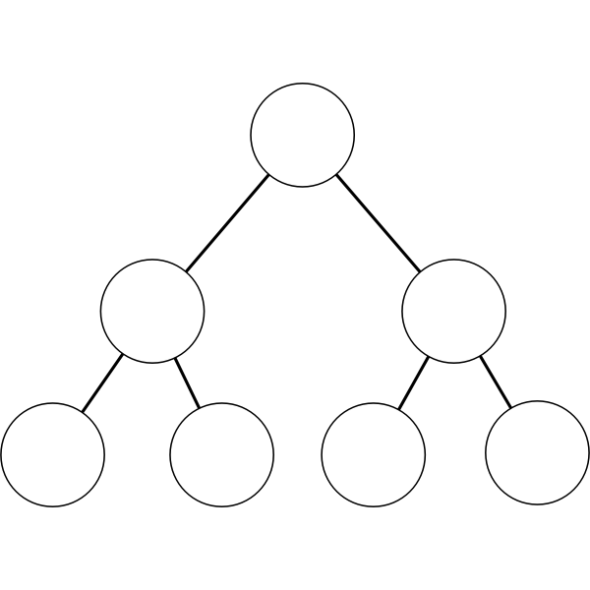
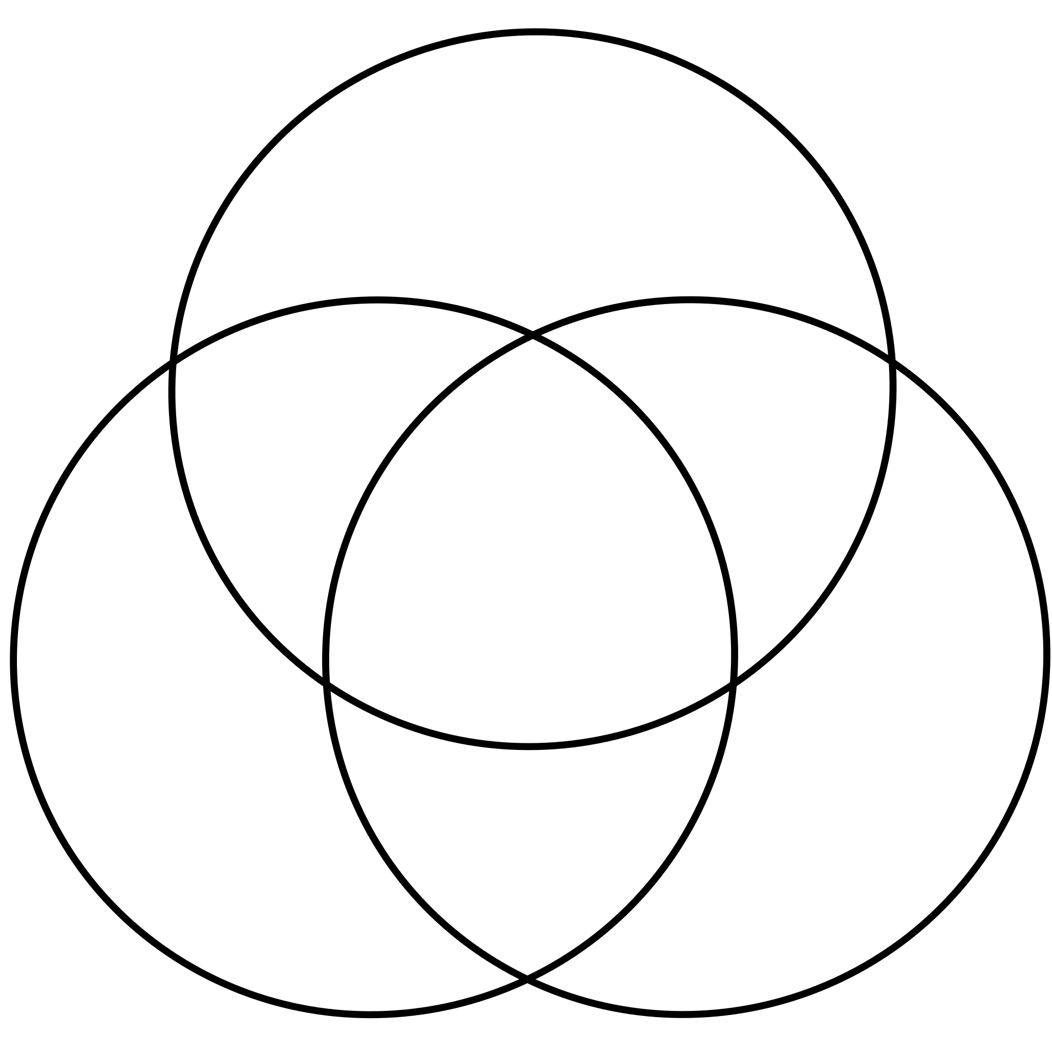


What did we learn?
Data Structures
Store a number of values together, in some specific order
Sets
A Data structure for holding unique values
Misc.
In operator, casting between data structures, making empty versions
Dictionaries
A data structure for holding key-value pairs

Slide 53
Announcements
Participation 6 due Thursday
Quiz 6 due Thursday
Lab on Friday

