Slide 1
Copilot
Semi Autonomous
Autonomous
LLM Framework
LLM
Agent
Tools
Multi-Turn Session
Tasks
Context Eng. Framework
Embedding Model
Episodic
Vector Store
Context
Data Store
Memory
Short Term
Graph DB
Long Term

Slide 2
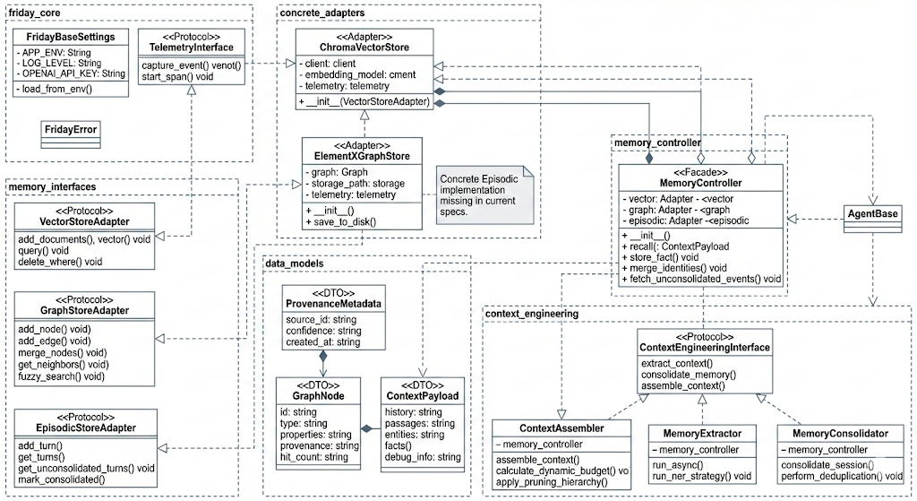

Slide 3
