Slide 1
The impact of vaping on adolescent lung function and nasal epithelium gene expression
Sarah Commodore, Trent Hawkins, Cheyret Wood, Cuining Liu,
Katerina Kechris, Sunita Sharma

Slide 2
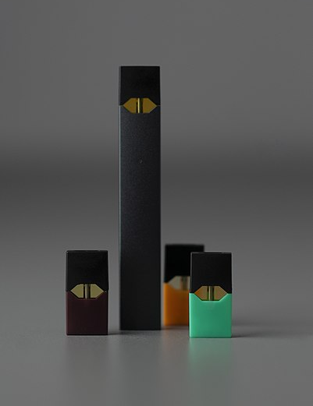
Background
Vaping has been advertised as a safer alternative to smoking
Vaping has become popular among adolescents and has surpassed tobacco use in recent years
According to the National Youth Tobacco Survey (2018), almost 21% of high schoolers had vaped in the last 30 days¹.
In Colorado, that estimate could be as high as 26% in 2019².
https://commons.wikimedia.org/wiki/File:Electronic-Cigarettes-E-Cigs-E-Cigarettes-Juul-Vape-Pod.jpg
Notes:
Over the last decade, vaping has been advertised as a safer alternative to smoking
If you have watched the news, you probably know that vaping has become extremely popular among teens and other young people.
A survey in 2018 showed that almost 20% of highschoolers had vaped in the last 30 days from when the survey was conducted.
In Colorado, a separate survey showed that 26% answered yes to a similar question
Obviously, we have a classic conundrum on our hands where a product with unknown health effects has been unleashed on the public.

Slide 3
Study Population
 | Did Not Vape in Last 6 Months (N=37) | Vaped in Last 6 Months (N=13) | Total (N=50)
Sex
Female | 17 (45.9%) | 8 (61.5%) | 25 (50.0%)
Male | 20 (54.1%) | 5 (38.5%) | 25 (50.0%)
Age (yrs)
Mean (SD) | 14.6 (1.4) | 14.8 (1.4) | 14.6 (1.4)
Range | 12.0 - 17.0 | 13.0 - 17.0 | 12.0 - 17.0
Recruitment Center
Aurora | 15 (40.5%) | 0 (0.0%) | 15 (30.0%)
CommCity/Denver | 13 (35.1%) | 1 (7.7%) | 14 (28.0%)
Pueblo | 9 (24.3%) | 12 (92.3%) | 21 (42.0%)
Ethnicity
LatinX | 23 (62.2%) | 11 (84.6%) | 34 (68.0%)
Non-LatinX | 14 (37.8%) | 2 (15.4%) | 16 (32.0%)
50 students recruited from high schools across the Front Range
“Have you vaped in the last 30 days?”
“Have you ever vaped?”
”How many days since you last vaped?”
Notes:
For this study, Sarah Commodore, Sunita Sharma, and their team in pulmonary recruited 50 highschool students from Aurora, Denver, and Pueblo
Asked a series of questions about vaping
From that series of questions, we were able to construct the variable “Have you vaped in the last 6 months?”

Slide 4
Study Population
 | Did Not Vape in Last 6 Months (N=37) | Vaped in Last 6 Months (N=13) | Total (N=50)
Sex
Female | 17 (45.9%) | 8 (61.5%) | 25 (50.0%)
Male | 20 (54.1%) | 5 (38.5%) | 25 (50.0%)
Age (yrs)
Mean (SD) | 14.6 (1.4) | 14.8 (1.4) | 14.6 (1.4)
Range | 12.0 - 17.0 | 13.0 - 17.0 | 12.0 - 17.0
Recruitment Center
Aurora | 15 (40.5%) | 0 (0.0%) | 15 (30.0%)
CommCity/Denver | 13 (35.1%) | 1 (7.7%) | 14 (28.0%)
Pueblo | 9 (24.3%) | 12 (92.3%) | 21 (42.0%)
Ethnicity
LatinX | 23 (62.2%) | 11 (84.6%) | 34 (68.0%)
Non-LatinX | 14 (37.8%) | 2 (15.4%) | 16 (32.0%)
50 students recruited from high schools on the Front Range
“Have you vaped in the last 30 days?”
“Have you ever vaped?”
”How many days since you last vaped?”
Notes:
For this study, Sarah Commodore, Sunita Sharma, and their team in pulmonary recruited 50 highschool students from Aurora, Denver, and Pueblo
Asked a series of questions about vaping
From that series of questions, we were able to construct the variable “Have you vaped in the last 6 months?”
Looking at this Table 1, does anyone see any problems?

Slide 5
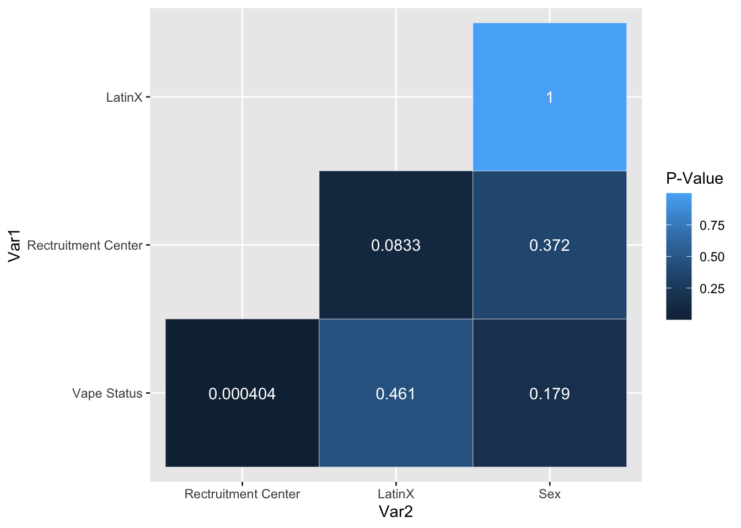
Data Exploration
Fisher’s Exact Tests for Association
Recruitment center multicollinear with ethnicity?
Notes:
Impulse Oscillometry System: IOS is a simple, noninvasive method requiring only passive patient cooperation that allows for the evaluation of lung function through the measurement of both airway resistance and airway reactance. IOS uses sound waves to rapidly detect airway changes and requires only normal tidal breathing from the patient.
X5: Reactance at 5 Hz (X5) relates to the physical properties of the lung parenchyma and its ability to expand and facilitate alveolar filling.
Higher is worse for both.

Slide 6
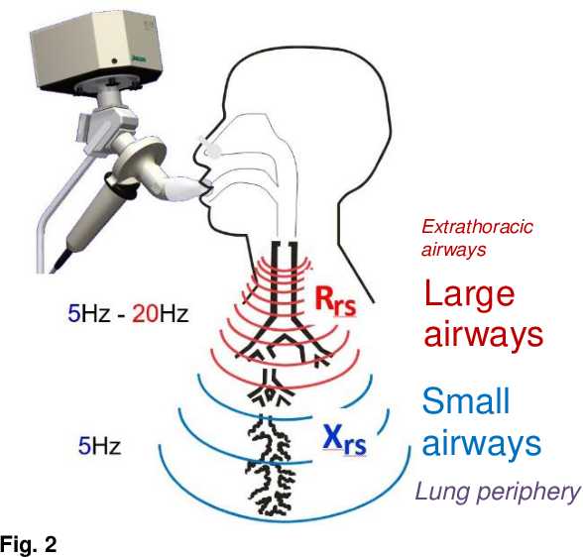
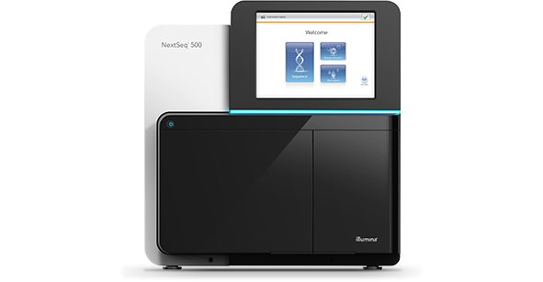
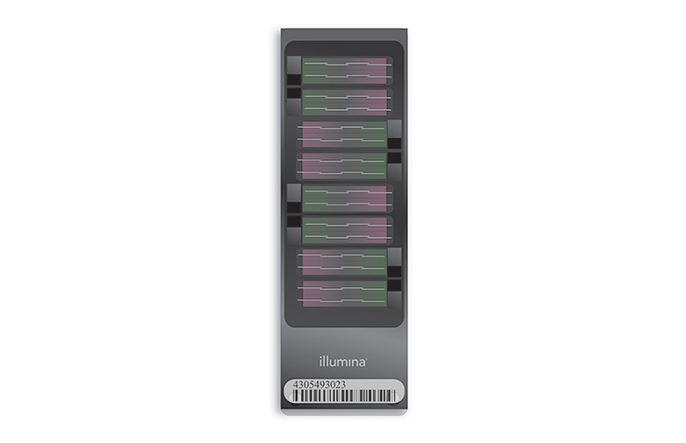
Data Collection
Impulse Oscillometry System (IOS)
RNA-Seq
Illumina HiSeq Platform
Methylation
Illumina EPIC 850K Array
Notes:
For each student, they collected Impulse Oscillometry (respiratory measure)
RNA-Seq
Methylation
Only going to talk about Impulse Oscillometry and RNA-Seq today

Slide 7
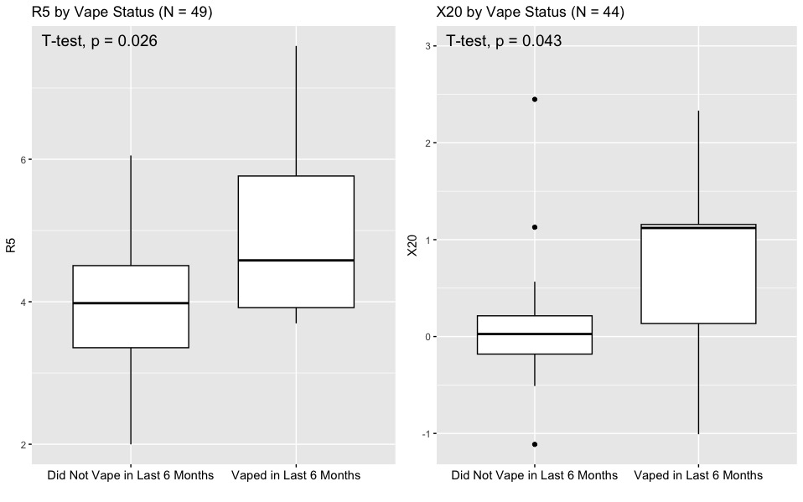
Impulse Oscillometry System (IOS)
Resistance at 5 Hz (R5)
Reactance at 20Hz (X20)
Notes:
Impulse Oscillometry System: IOS is a simple, noninvasive method requiring only passive patient cooperation that allows for the evaluation of lung function through the measurement of both airway resistance and airway reactance. IOS uses sound waves to rapidly detect airway changes and requires only normal tidal breathing from the patient.
X5: Reactance at 5 Hz (X5) relates to the physical properties of the lung parenchyma and its ability to expand and facilitate alveolar filling.
Higher is worse for both.
You can see that just from the more traditional measures, there is an observable difference in lung function between our vapers and non-vapers

Slide 8
RNA-Seq Overview
Sequencing
Illumina HiSeq platform
Quality Control and Alignment
FastQC
STAR
Normalization
Removal of Unwanted Varaince (RUV)
Low variance reads
Low counts
Differential Expression Analysis
DESeq2
Gene Set Enrichment Analysis (GSEA)
fGSEA
Machine: $654K
Sequencing: $24K/Run
Notes:
This diagram gives you an idea of the overall flow of an RNASeq analysis
There are MANY ways to conduct analyses. This is just the workflow that we used.
Illumina HiSeq Costs $650K to purchase and $24K per run, and takes 11 days to run.
From Illumina HiSeq, you get a bunch of “reads”, which are fragments of DNA
You have to align those reads to the genome and often go through a process called “trimming”
FastQC and STAR are command-line based tools for completing that process
You then will get an n X j matrix of n samples and j genes that is a count of reads for each sample (n) at gene (j)
You will then usually want to perform some kind of normalization. Often, this normalization is meant to counter batch effects, but it can be used to filter other non-biological signal as well.
Differential Expression analysis comes next, it will help us find associations between our exposure of interest and whether a gene is being over or under-expressed compared to the unexposed.
Gene Set Enrichment Analysis uses the empirical evidence from DE to help us arrive at more tangible and clinically meaningful results

Slide 9
RNA-Seq Overview
Sequencing
Illumina HiSeq platform
Quality Control and Alignment
FastQC
STAR
Normalization
Removal of Unwanted Varaince (RUV)
Low variance reads
Low counts
Differential Expression Analysis
DESeq2
Gene Set Enrichment Analysis (GSEA)
fGSEA
Machine: $654K
Sequencing: $24K/Run
Notes:
I primarily focused on the section in orange so that is mostly what I will talk about today, but I will also talk a bit about filtering.

Slide 10
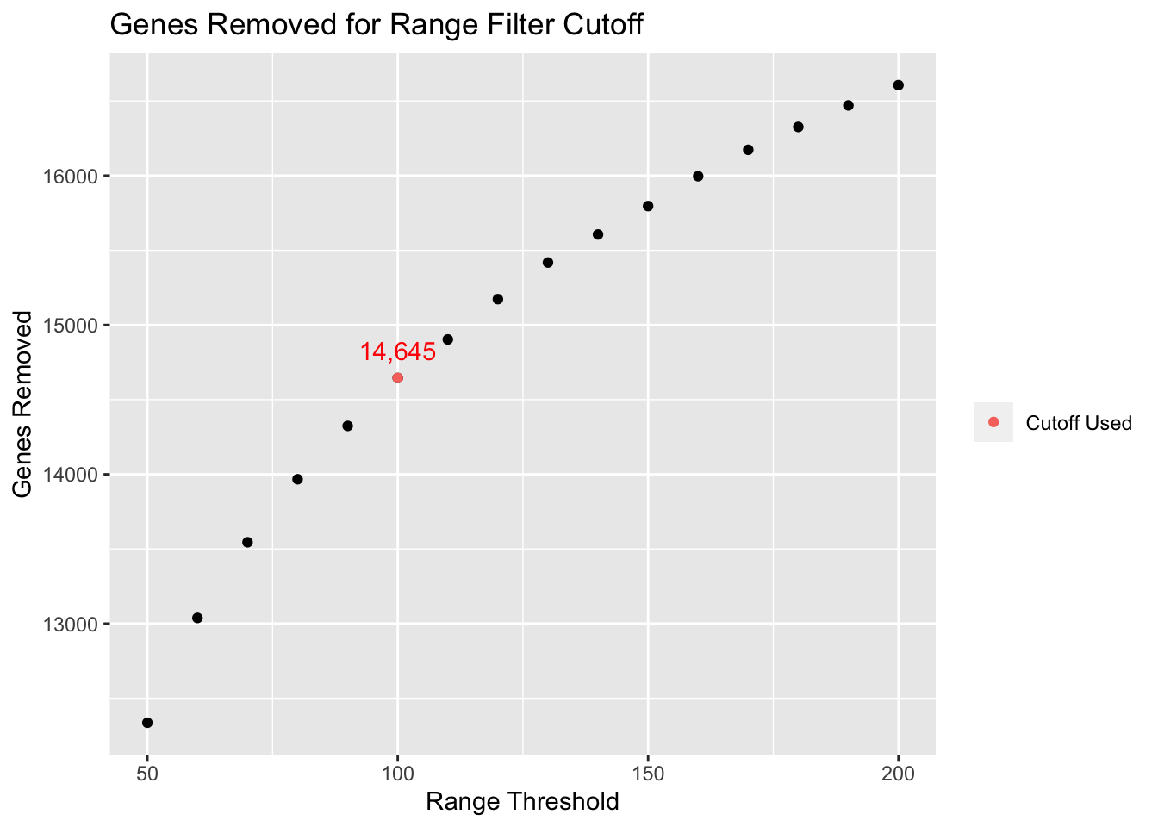
Gene Filtering
Filter | Incluison Criteria | Gene Count Before | Gene Count After | Genes Removed
1 | At least 25% of the samples have > 0 reads | 60,651 | 31,505 | 29,146
2 | The range of reads across all samples > 100 | 31,505 | 16,860 | 14,645
Notes:
Start out with 60,651 genes.
Not all of these genes are important. Some may have low quality reads or are considered “housekeeping” genes.
In order to remove those genes, we applied 2 filters:
At least 25% of the samples have > 0 reads
The range of reads across all samples is > 100
Filtering is a very common thing to do in Omics for dimension reduction.
Often look at plots for an ‘elbow’ or look to the literature for filters.

Slide 11
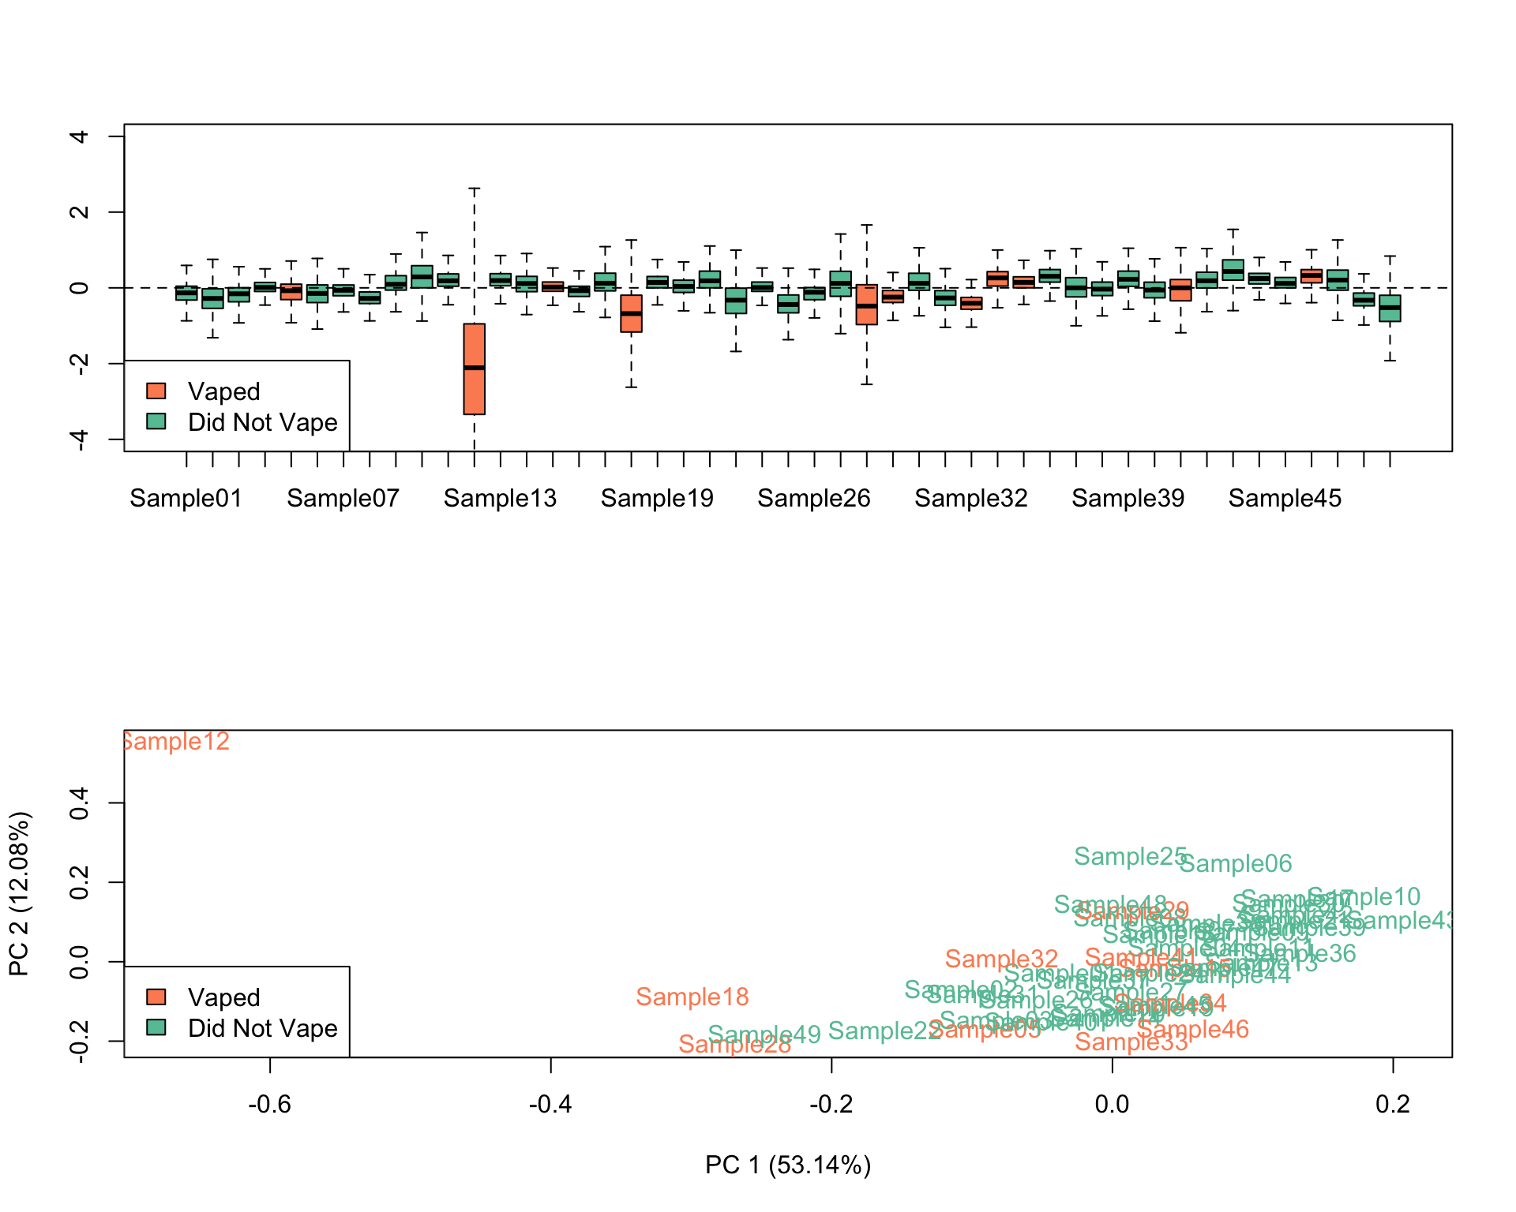
Outlier Samples
Tools for identifying outliers:
Relative Log Expression (RLE) Plots
PCA
Identified sample 12 as a strong outlier
R Package(s): RUVSeq, DESeq2, edgeR
Notes:
After removing low quality reads, we need to look for low-quality samples.
Relative Log Expression plots
PCA
Can also use dendrograms

Slide 12
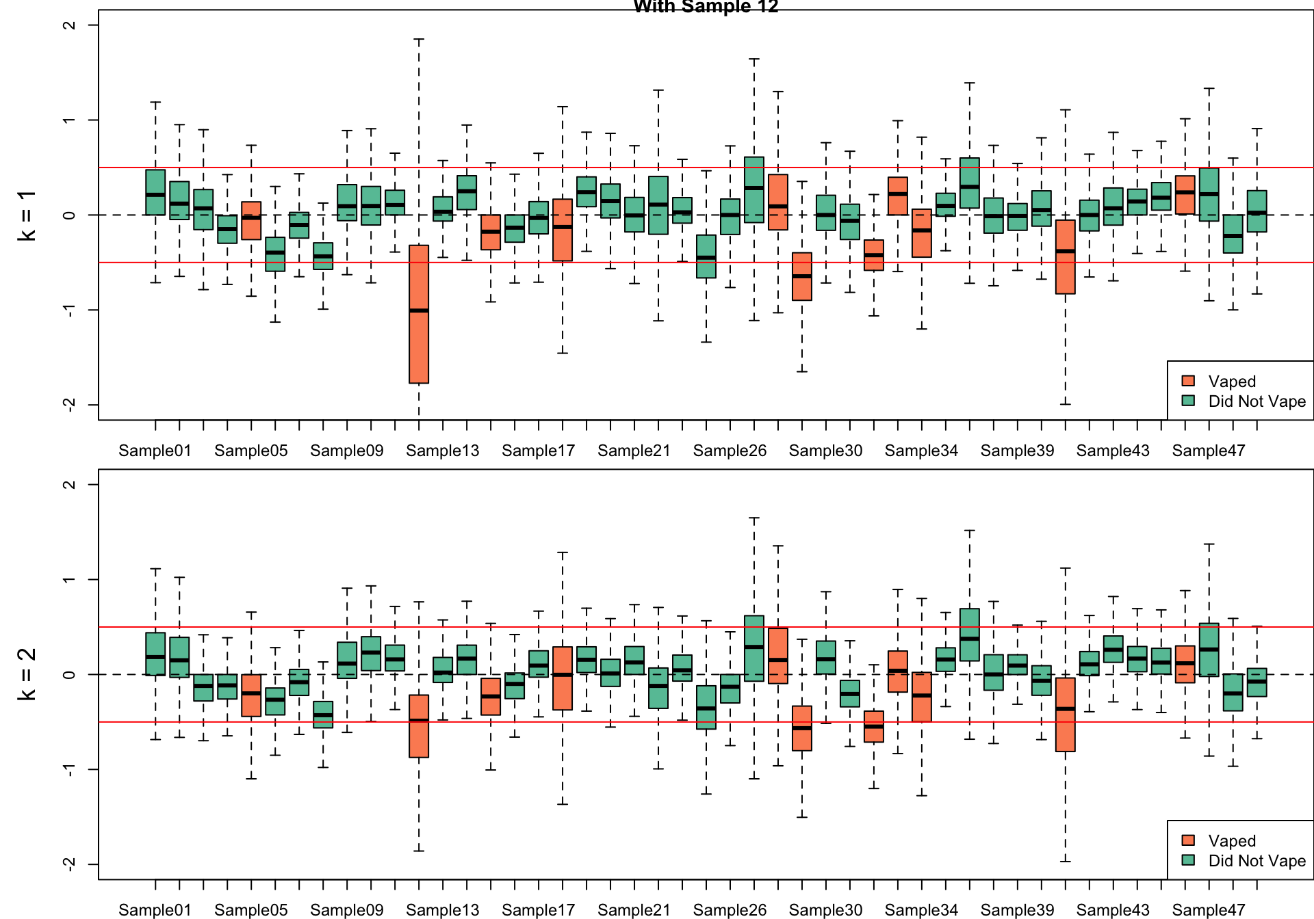
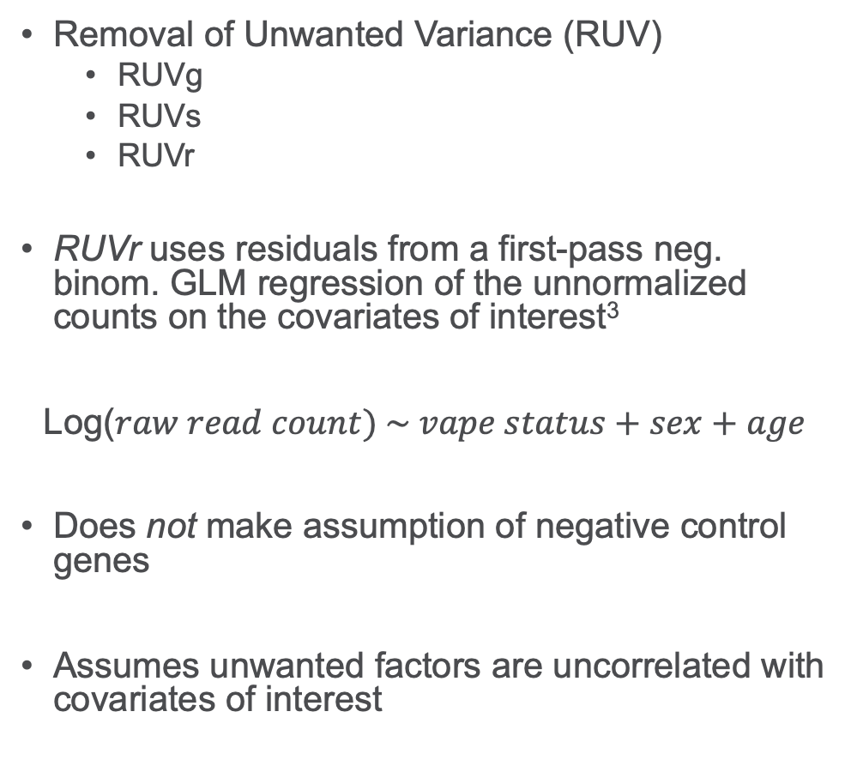
Normalization
Removal of Unwanted Variance (RUV)
RUVg
RUVs
RUVr
RUVr uses residuals from a first-pass neg. binom. GLM regression of the unnormalized counts on the covariates of interest³
Log($raw read count) \sim vape status+sex+age$
Does not make assumption of negative control genes
Assumes unwanted factors are uncorrelated with covariates of interest
R Package(s): RUVSeq, DESeq2, edgeR
Notes:
There are many tools for conducting factor analysis to control for batch effect or other sources of unwanted variance
For this project, we used RUV
There are many types of RUV. RUVg and RUVs both use negative control genes.
Negative Control Genes (spike-ins): are not affected by the biological covariates of interest and are affected by the factors of unwanted variation in the same way as the rest of the genes.
We did not have spike-ins since we only ran one batch, so we were left with RUVr.
First pass neg. binom. GLM
Singular value decomposition on the deviance residuals from that GLM
Refits the GLMs and estimates factors of unwanted variation to include in the modeling process.

Slide 13
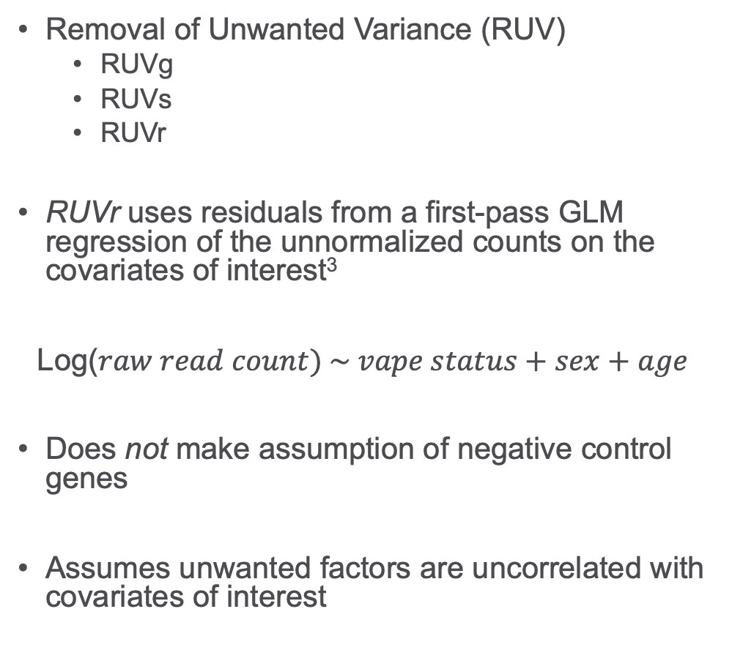
Normalization
Removal of Unwanted Variance (RUV)
RUVg
RUVs
RUVr
RUVr uses residuals from a first-pass GLM regression of the unnormalized counts on the covariates of interest³
Log($raw read count) \sim vape status+sex+age$
Does not make assumption of negative control genes
Assumes unwanted factors are uncorrelated with covariates of interest
R Package(s): RUVSeq, DESeq2, edgeR
Notes:
We used elbow plots, dendrograms etc. to decide on including 2 factors of unwanted variation
Power also a concern.
You can see that it corrected sample 12, and we were able to keep it.

Slide 14
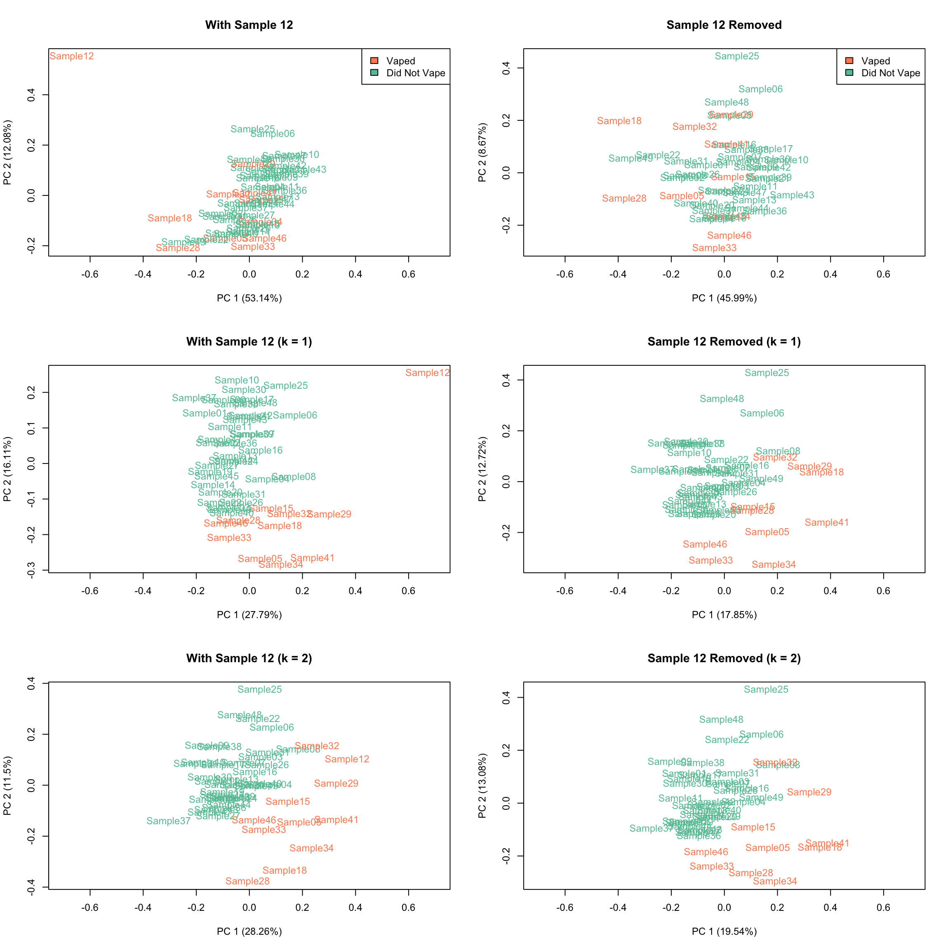
Normalization
Removal of Unwanted Variance (RUV)
RUVg
RUVs
RUVr
RUVr uses residuals from a first-pass GLM regression of the unnormalized counts on the covariates of interest³
Log($raw read count) \sim vape status+sex+age$
Does not make assumption of negative control genes
Assumes unwanted factors are uncorrelated with covariates of interest
R Package(s): RUVSeq, DESeq2, edgeR
Notes:
Here it is again with PCA

Slide 15
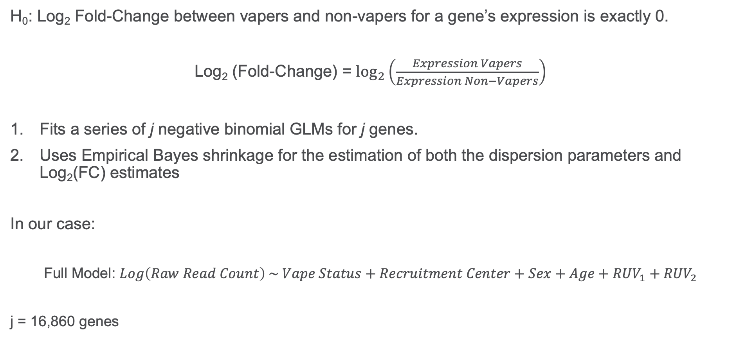
Differential Expression
H₀: Log₂ Fold-Change between vapers and non-vapers for a gene’s expression is exactly 0.
Log₂ (Fold-Change) = $\log_{2}\left(\frac{Expression Vapers}{Expression Non−Vapers}\right)$
Fits a series of j negative binomial GLMs for j genes.
Uses Empirical Bayes shrinkage for the estimation of both the dispersion parameters and Log₂(FC) estimates
In our case:
Full Model: $Log\left(Raw Read Count\right) \sim Vape Status+Recruitment Center+Sex+Age+RUV_{1}+RUV_{2}$
j = 16,860 genes
R Package(s): DESeq2, edgeR
Notes:
H0: Fold-change is exactly = 0
Log2FC are the “beta” values that we are estimating.
We are particularly interested in the vaping model.
Notice that we included Recruitment Center in this model, but not the previous model.
Essentially treating recruitment center as “batch” effect.

Slide 16
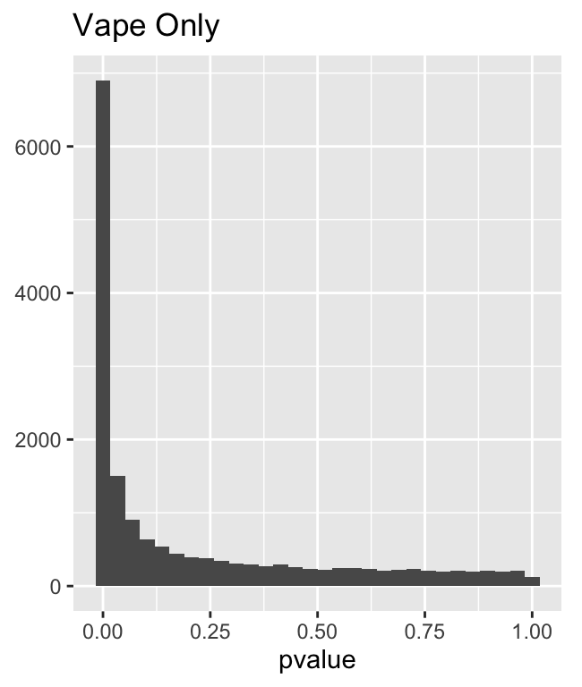
Differential Expression
Multiple Testing
False Discovery Rate (FDR) typically used for correction
Summary of Significant LRT Results (Full Model the same across all tests)
Model | Total Significant Genes (FDR < 0.05) | Unique Significant Genes (FDR < 0.05)
Vape and Center | 8,696 | 1,982
Vape Only | 7,136 | 660
Center Only | 366 | 0
R Package(s): DESeq2
Notes:
Generally want to see a histogram that is:
Anti-conservative
Uniform
We had 7,136 differentially expressed genes at an FDR of 0.05
Fit the other models to assess confounding by recruitment center.

Slide 17
Differential Expression
Multiple Testing
False Discovery Rate (FDR) typically used for correction
Summary of Significant LRT Results (Full Model the same across all tests)
Model | Total Significant Genes (FDR < 0.05) | Unique Significant Genes (FDR < 0.05)
Vape and Center | 8,696 | 1,982
Vape Only | 7,136 | 660
Center Only | 366 | 0
R Package(s): DESeq2
Notes:
Generally want to see a histogram that is:
Anti-conservative
Uniform
We had 7,136 differentially expressed genes at an FDR of 0.05
Fit the other models to assess confounding by recruitment center.

Slide 18
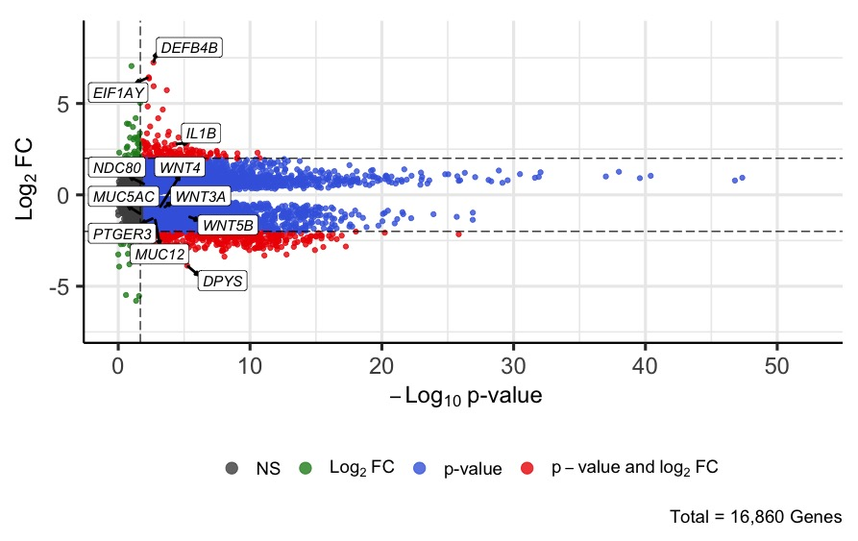
Differential Expression
R Package(s): DESeq2, EnhancedVolcano
Notes:
Green is above L2FC cutoff, but not significant,
Grey is not significant and below L2FC cutoff
Red is both
Blue is significant only

Slide 19



Gene Set Enrichment Analysis
Gene set enrichment analysis (GSEA): associates a disease phenotype to a group of genes/proteins⁴.
Pathways
Ontology
Pathways: More succinct and directed at a specific function or phenotype
Ontologies: More detailed and allow for redundancy
R Package(s): fGSEA, reactome.db, biomaRt, clusterprofiler
Notes:
When you carry out this analysis, you often have to switch between gene naming conventions. Clusterprofiler can help with that.

Slide 20
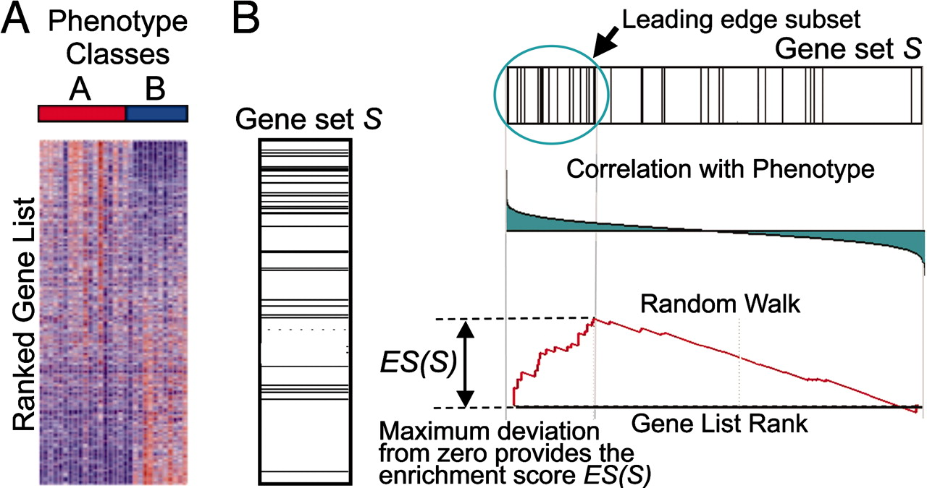
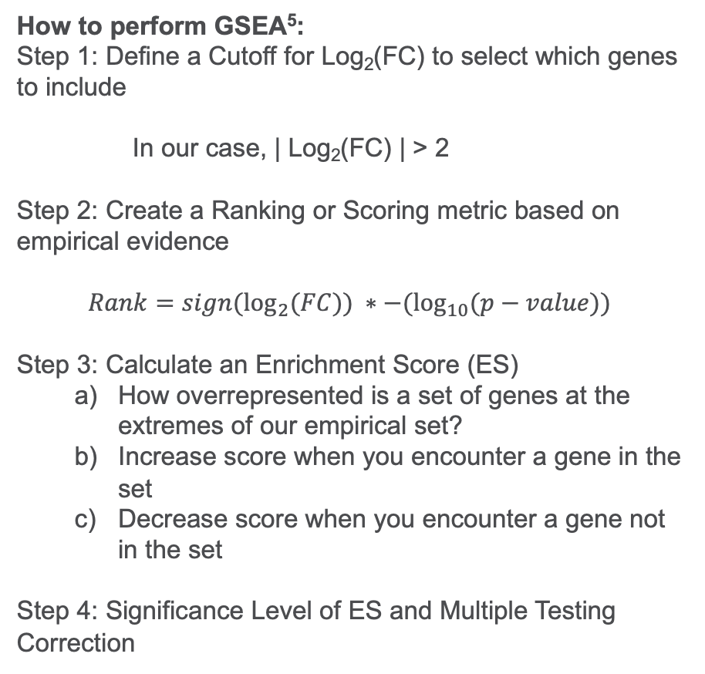
Methods (RNASeq) – Gene Set Enrichment Analysis (fGSEA)
How to perform GSEA⁵:
Step 1: Define a Cutoff for Log₂(FC) to select which genes to include
In our case, | Log₂(FC) | > 2
Step 2: Create a Ranking or Scoring metric based on empirical evidence
$$Rank=sign(\log_{2}{(FC)) ∗−(\log_{10}{(p−value))}}$$
Step 3: Calculate an Enrichment Score (ES)
How overrepresented is a set of genes at the extremes of our empirical set?
Increase score when you encounter a gene in the set
Decrease score when you encounter a gene not in the set
Step 4: Significance Level of ES and Multiple Testing Correction
https://www.pnas.org/doi/10.1073/pnas.0506580102
R Package(s): fGSEA, reactome.db, biomaRt, clusterprofiler
Notes:
Use a kind of permutation test to determine p-values for the pathways

Slide 21
Results – Gene Ontology (GO)
Dependent Ontology | Idependent Ontology | p-value | FDR | ES | NES | size | No. Up-Regulated Genes | No. Down-Regulated Genes
inflammatory response | Ind | <0.001 | <0.001 | 0.67 | 3.70 | 27 | 21 | 0
immune system process | Ind | <0.001 | <0.001 | 0.70 | 3.69 | 24 | 19 | 0
immune response | Ind | <0.001 | <0.001 | 0.72 | 3.45 | 19 | 18 | 0
cytoplasm | Ind | <0.001 | <0.001 | -0.49 | -1.84 | 154 | 0 | 103
cytokine-mediated signaling pathway | Ind | <0.001 | <0.001 | 0.81 | 3.37 | 14 | 13 | 0
inhibitory MHC class I receptor activity | Ind | <0.001 | <0.001 | 0.92 | 2.73 | 7 | 7 | 0

Slide 22
Limitations
Pilot Study (n = 50)
Construction of the primary question of interest
Potential uncontrolled confounding between ethnicity and geography

Slide 23
Conclusion
Adolescent vape exposure is associated with increased airflow obstruction and increased expression of inflammatory genes in the nasal epithelium of vape users.
Found increased IOS measures in vapers compared to non-vapers
Vaping in adolescence could lead to dysregulation of pathways which could lead to reduced immune function and inflammatory response later in life. A larger study is still needed.

Slide 24
References
Cullen KA, A.B., Gentzke AS, Apelberg BJ, Jamal A, King BA, Notes from the field: use of electronic cigarettes and any tobacco product among middle and high school students—United States, 2011-2018. MMWR Morb Mortal Wkly Rep; 67(45):1276-1277. 2018.
Risso, D., Ngai, J., Speed, T. P., & Dudoit, S. (2014). Normalization of RNA-seq data using factor analysis of control genes or samples. Nature Biotechnology, 32(9), 896-902. https://doi.org/10.1038/nbt.2931
Zito, A., Lualdi, M., Granata, P., Cocciadiferro, D., Novelli, A., Alberio, T., Casalone, R., & Fasano, M. (2021). Gene Set Enrichment Analysis of Interaction Networks Weighted by Node Centrality [Original Research]. Frontiers in Genetics, 12. https://doi.org/10.3389/fgene.2021.577623
Subramanian, A., Tamayo, P., Mootha, V. K., Mukherjee, S., Ebert, B. L., Gillette, M. A., Paulovich, A., Pomeroy, S. L., Golub, T. R., Lander, E. S., & Mesirov, J. P. (2005). Gene set enrichment analysis: A knowledge-based approach for interpreting genome-wide expression profiles. Proceedings of the National Academy of Sciences, 102(43), 15545-15550. https://doi.org/10.1073/pnas.0506580102

