Slide 1
National Institutes of Hackers
Lucas Gillenwater
Evan Stene
Shahab Helmi

Slide 2
General Approach
Extract Shapelets
Mine Event Sequences
Data
Filter
Correlate Event Sequences

Slide 3
General Approach
Extract Shapelets
Mine Event Sequences
Data
Filter
Correlate Event Sequences

Slide 4
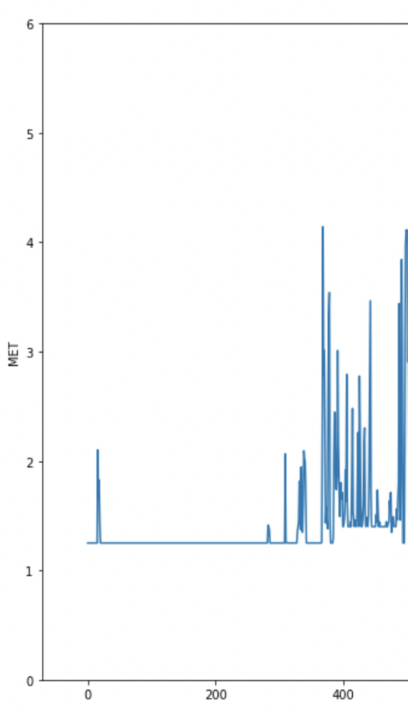
Detecting Sleep

Slide 5
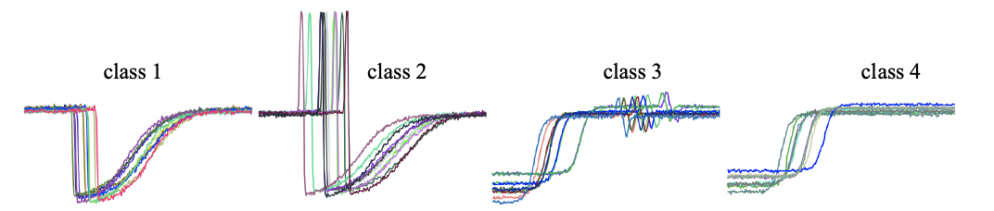
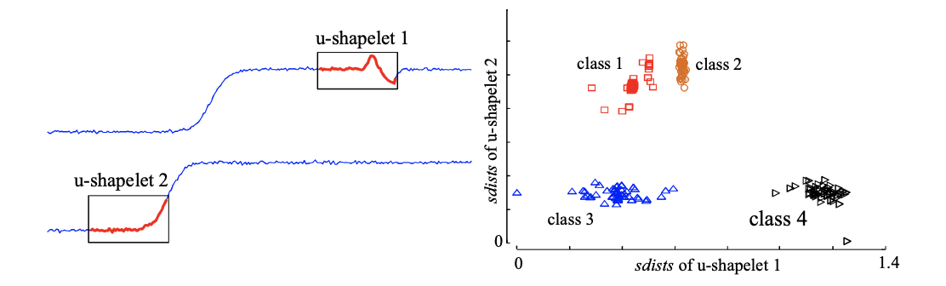
U-Shapelet Mining
From: J. Zakaria, A. Mueen and E. Keogh, "Clustering Time Series Using Unsupervised-Shapelets,"
2012 IEEE 12th International Conference on Data Mining, Brussels, 2012, pp. 785-794.
doi: 10.1109/ICDM.2012.26

Slide 6
Ushapelet Parameters
Must appear in at least 5 days
Minimum shape: 120 minutes
Maximum shape: 240 minutes
Intervals of 1 hour

Slide 7
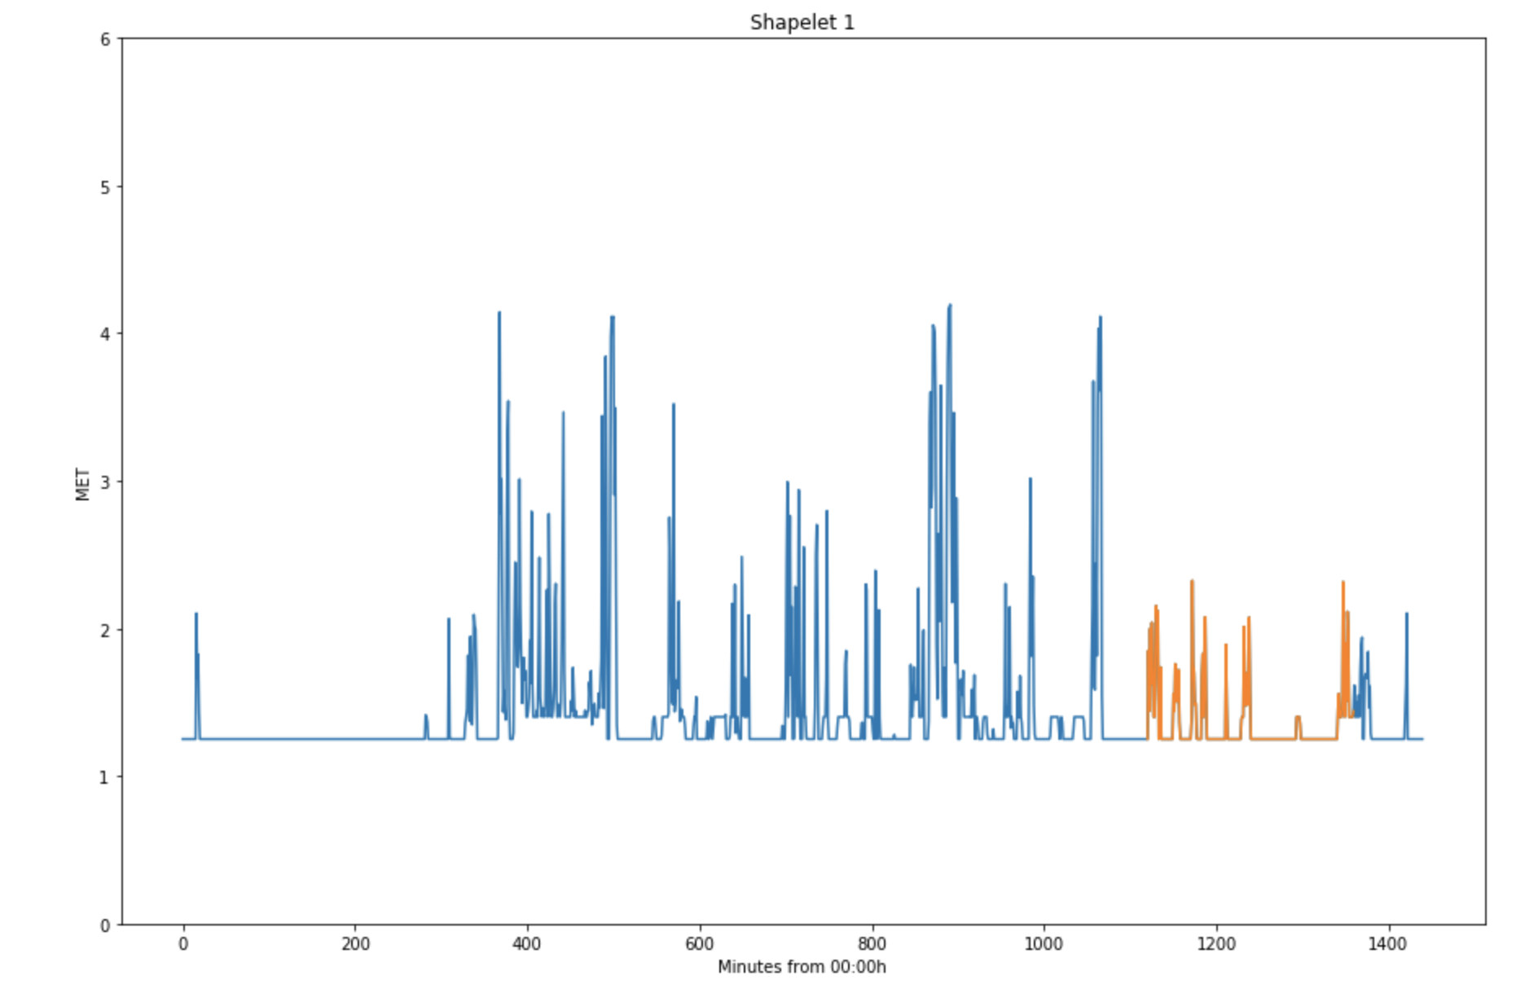

Slide 8
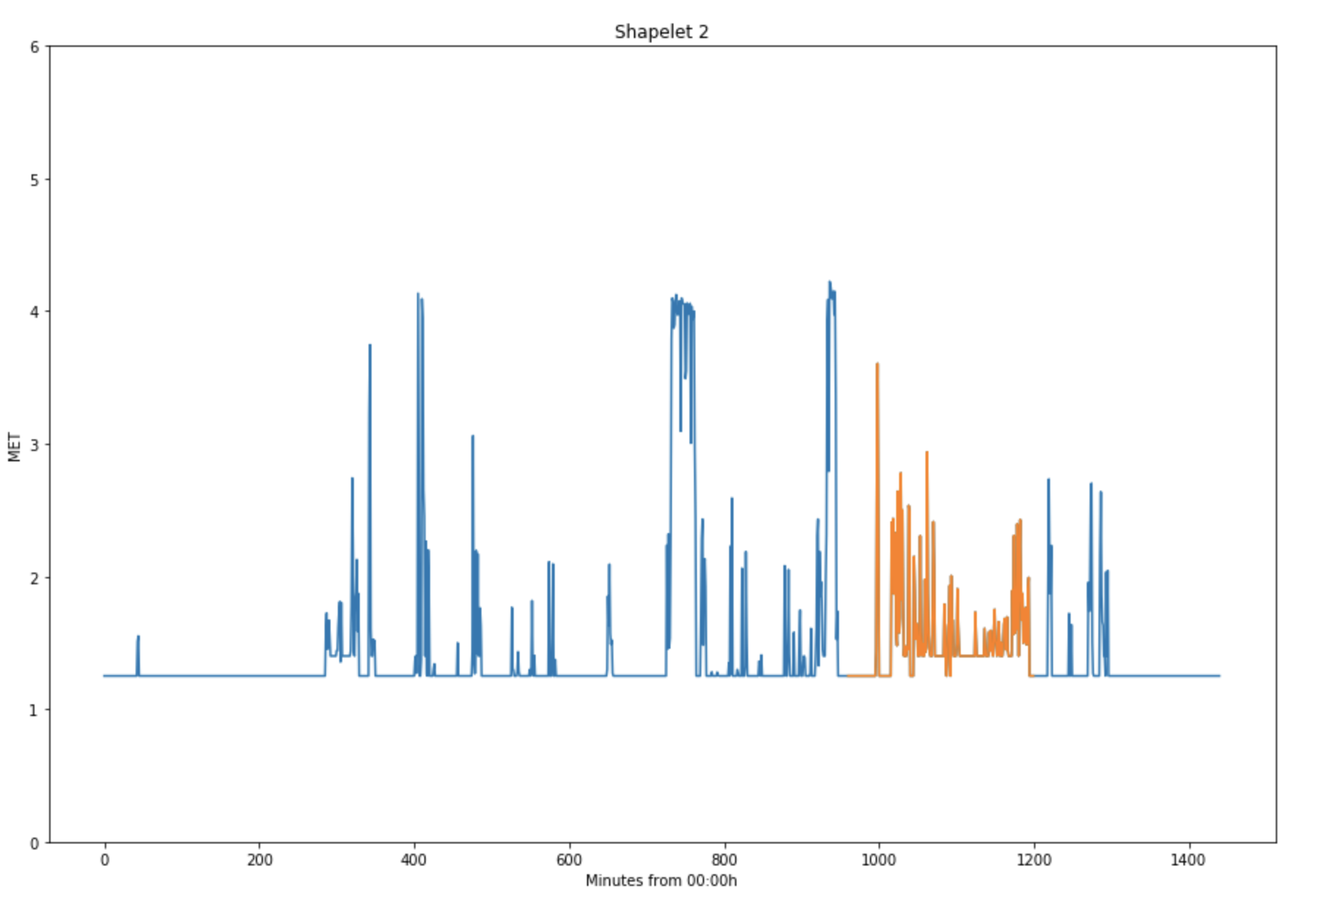

Slide 9
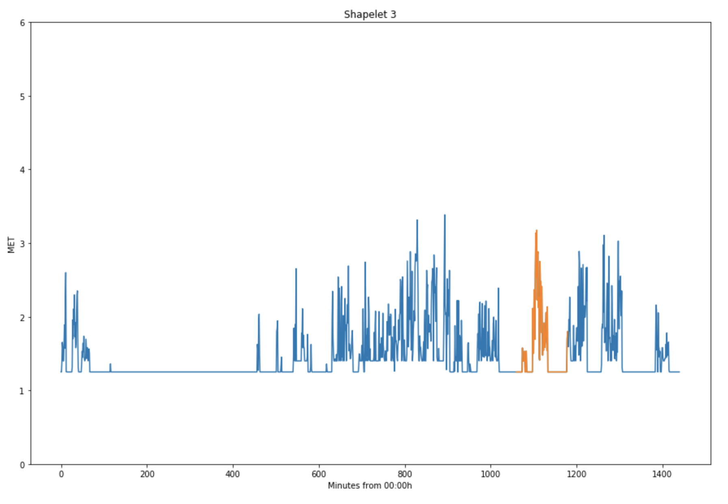

Slide 10
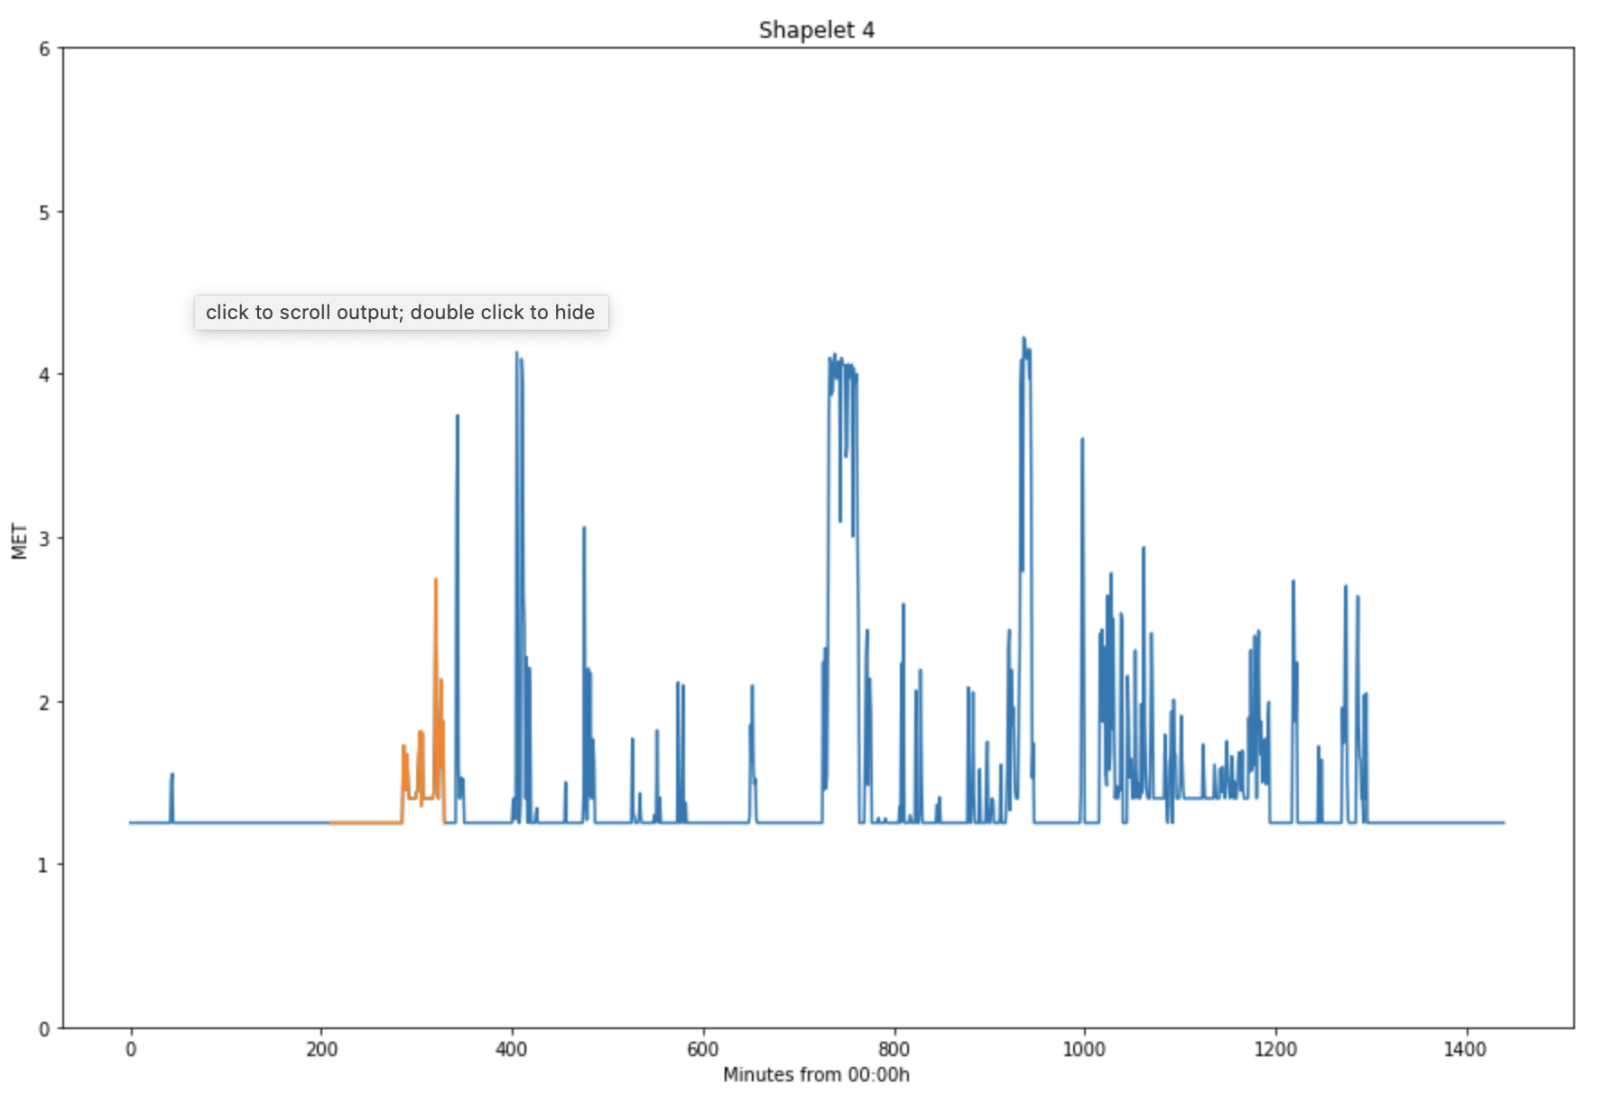

Slide 11
Conclusion
Shapelet mining…
Can find patterns in activity data
Can classify subjects
Does not differentiate time of day
Lacks sequential interpretability
Is computationally intensive

