Slide 1
Why you shouldn’t use our code for your experiment
Raeann Goering and Divya Kolakada
(Molecular Biology)

Slide 2
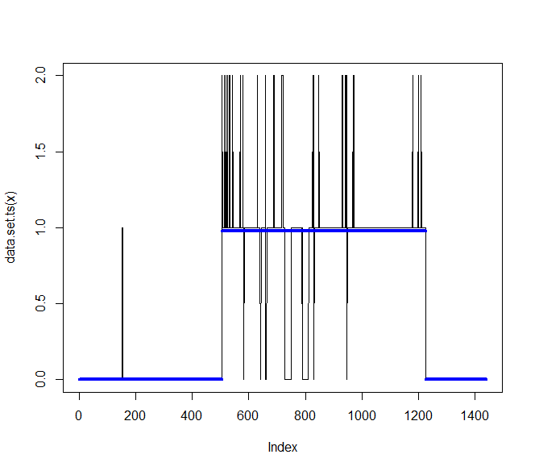
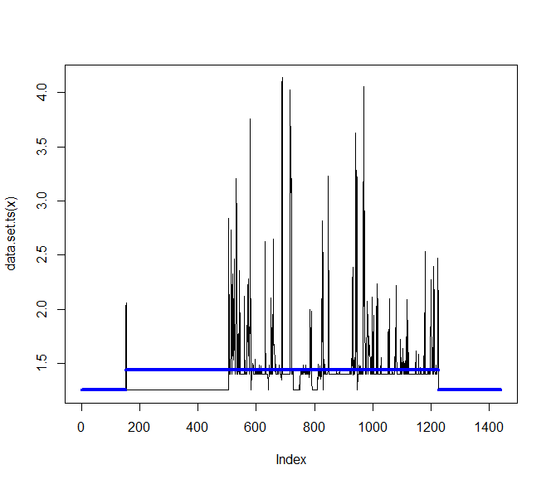
Methods
The R package Changepoint
Pros: unbiased sleep detection
Cons: Wildly Inaccurate

Slide 3
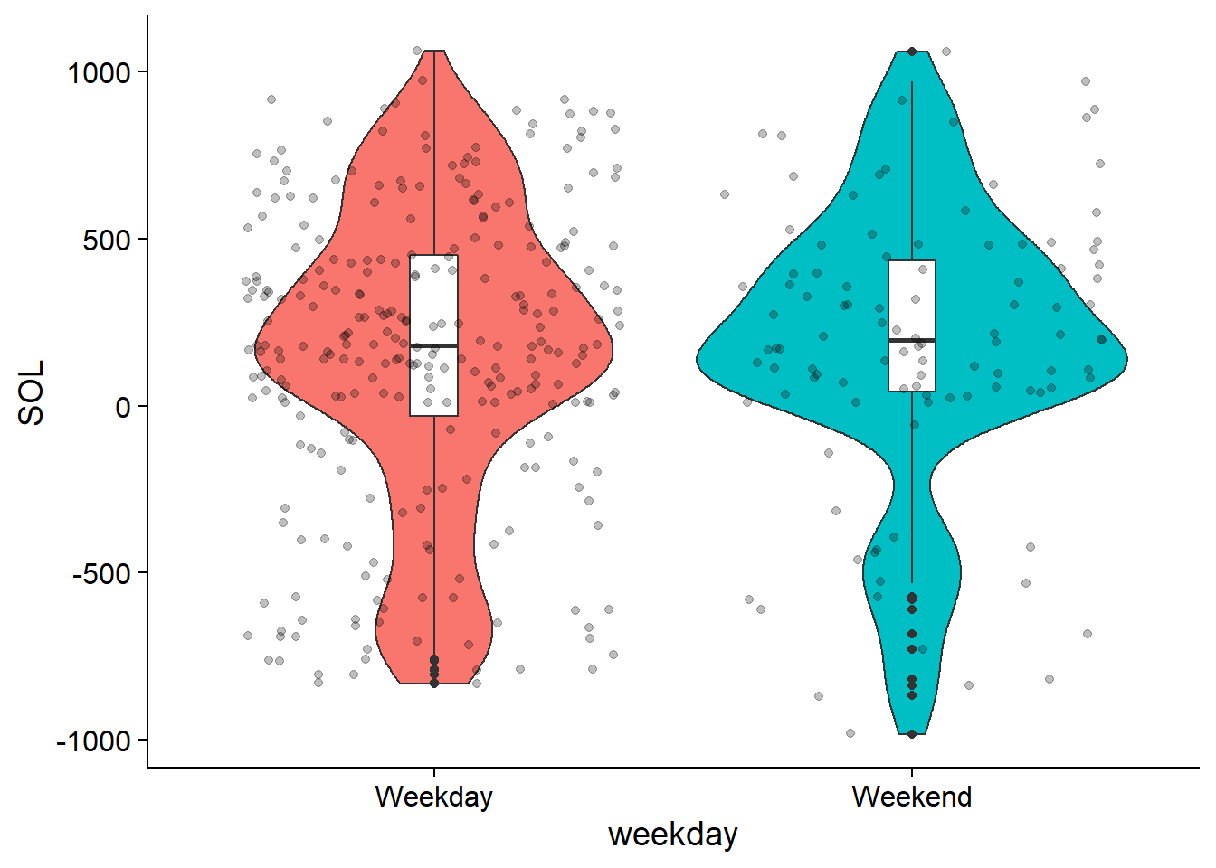
Changepoint allows for interesting conclusions
Many subjects take a negative number of minutes to fall asleep at night.

Slide 4
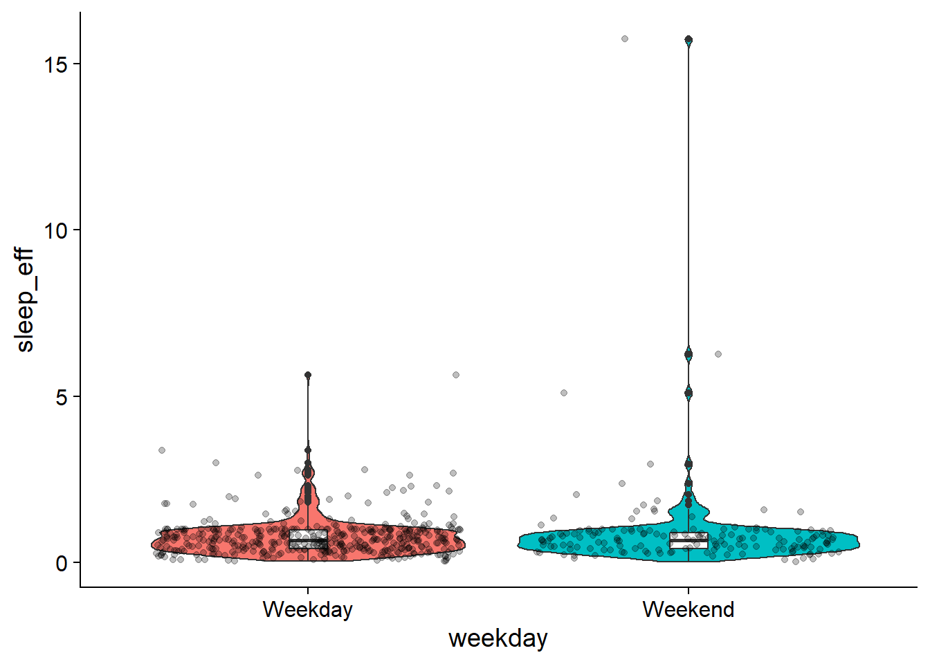
Changepoint allows for interesting conclusions
Sleep efficiency is often greater than 1, sometimes as high as 15.
This indicates events where subjects fall asleep before lying down.

Slide 5
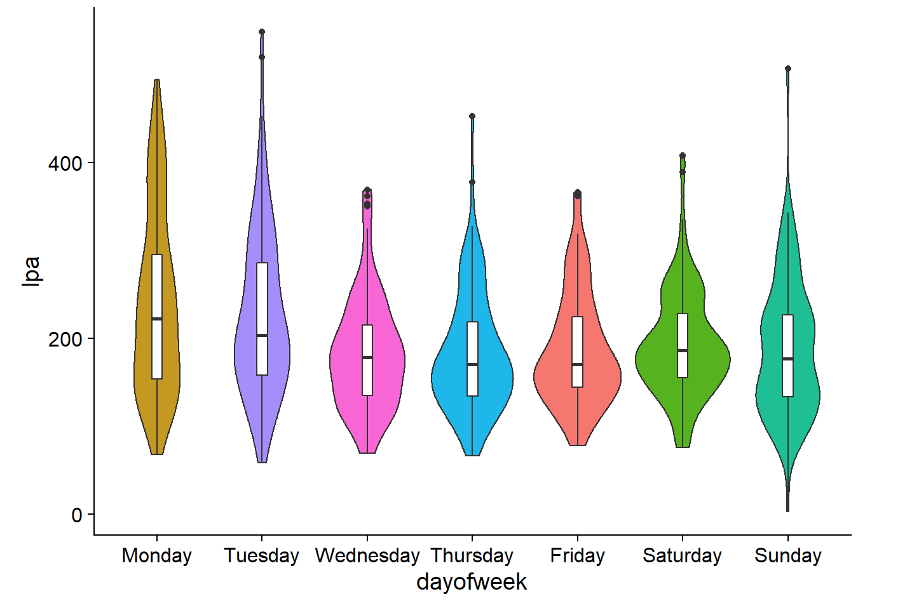
Subjects Exhibit Some Patterns in Physical Activity
Light physical activity is most common on Mondays

Slide 6
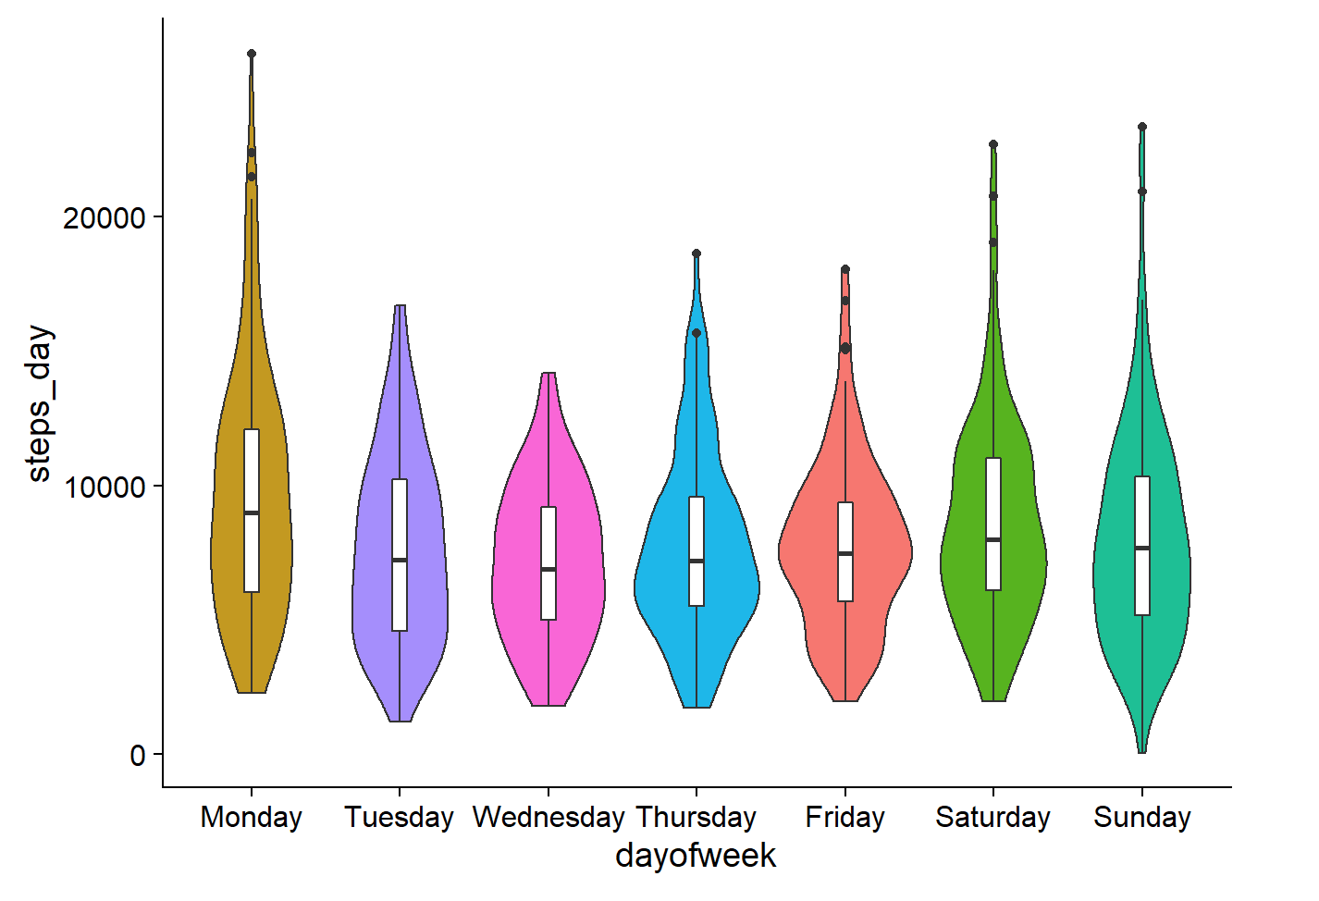
Subjects Exhibit Some Patterns in Physical Activity
Subjects take most steps in a day
on Mondays

Slide 7
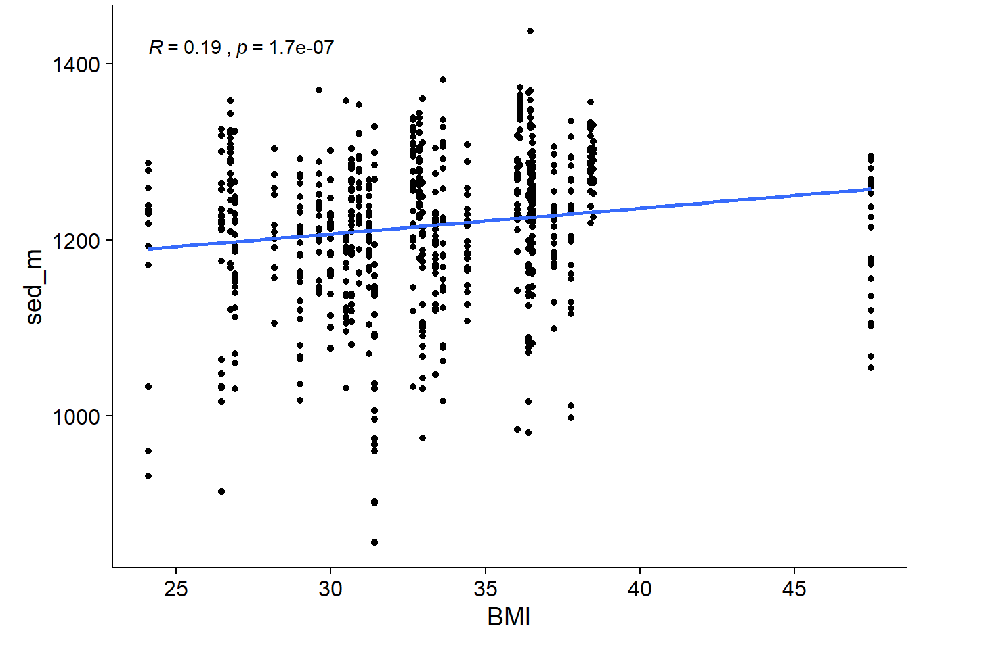
Correlations in demographics
Subjects with higher BMI are
sedentary for more time

Slide 8
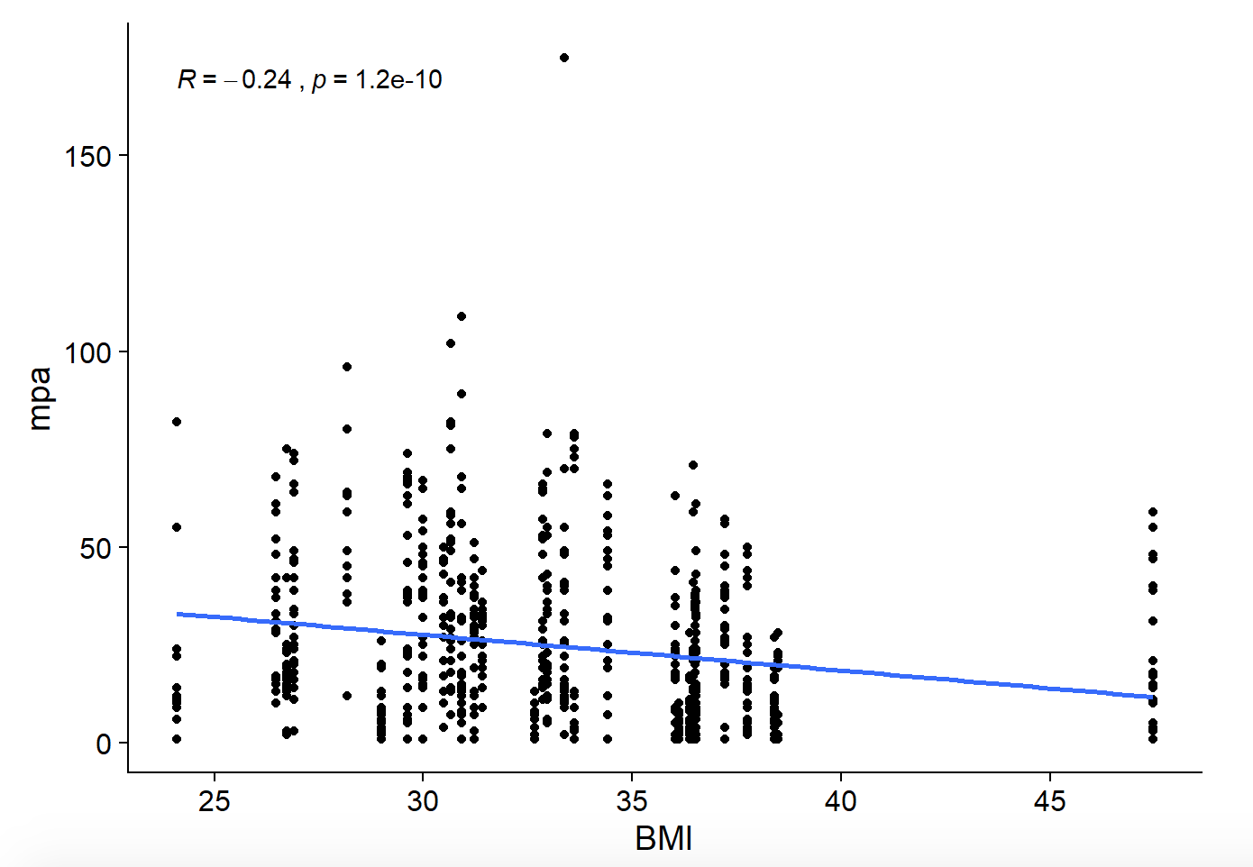
Correlations in demographics
Moderate physical activity decreases as BMI increases

