Slide 1



Lock-in (5kHz) Simulation Results

Slide 2
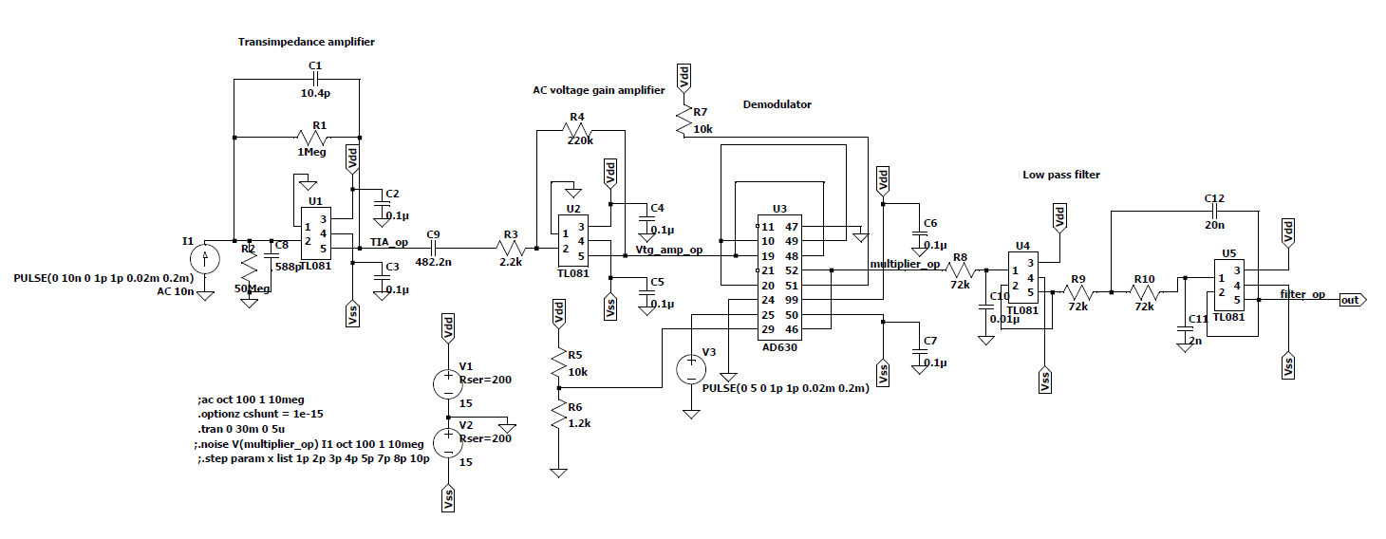
Schematic

Slide 3
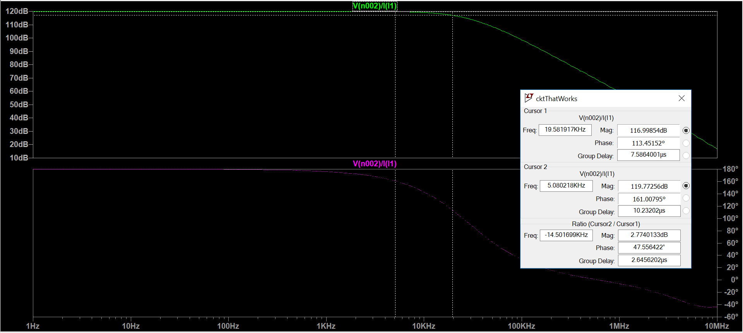
Transimpedance amplifier – AC analysis – 1 to 10 MHz decade sweep
Gain: 120 dB, Gain at 5kHz: 119.7 dB, 3dB frequency: 19.58kHz, phase charac show 180 deg (inv)

Slide 4
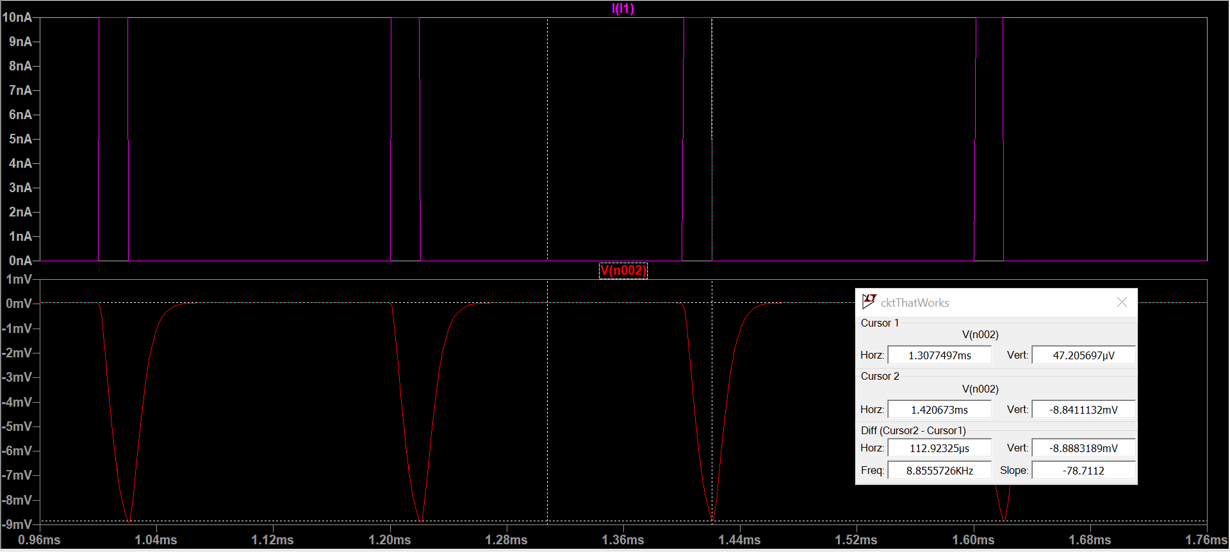
Transimpedance amplifier- Transient analysis- up to 5m sec, input – 10nA
Observed Transient Gain: 118.9 dB, phase inversion

Slide 5
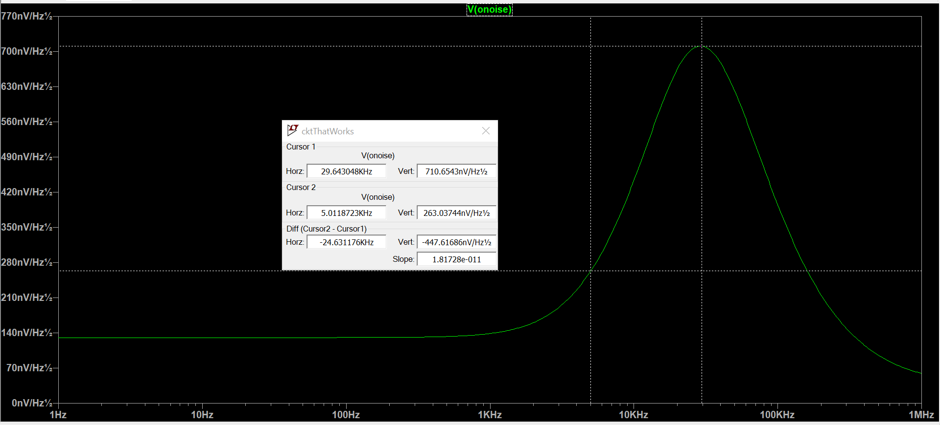
Transimpedance amplifier – Noise analysis
Noise at 29.64kHz = 710.654 nV/Hz^{1/2}, Noise at 5 kHz: 263.037nV/Hz^{1/2}

Slide 6
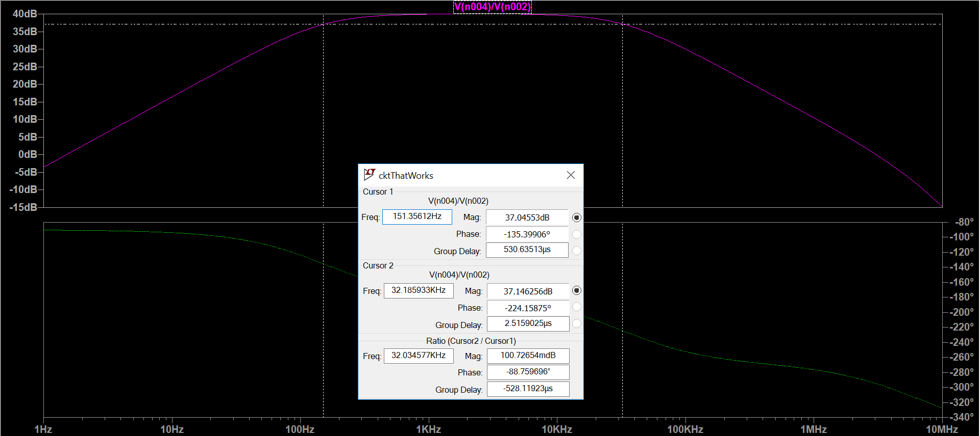
Voltage Amplifier (40 dB bandpass gain) AC analysis 1 to 10 MHz, 150 to 34 kHz
Measured bandwidth: 151.35 Hz to 32.185 kHz

Slide 7
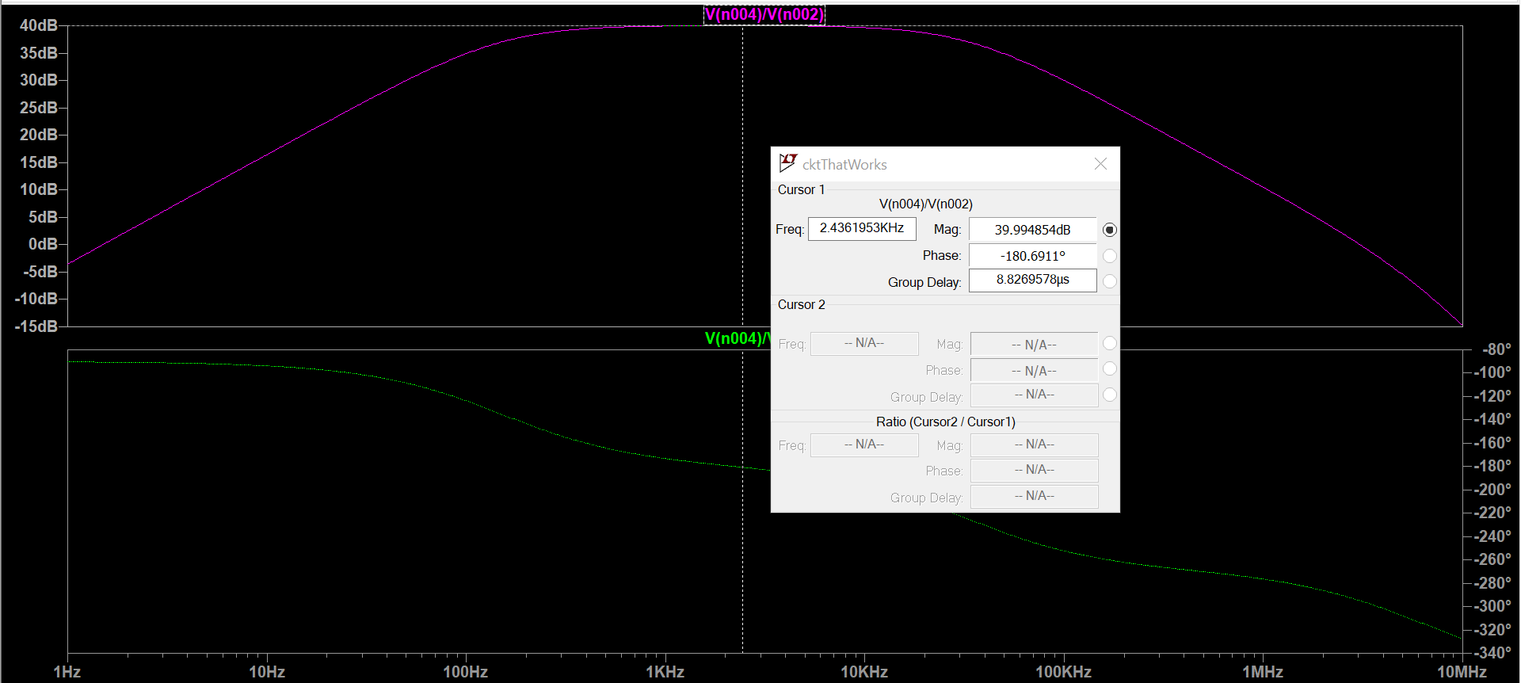
Voltage Amplifier (40 dB bandpass gain) AC analysis 1 to 10 MHz, 150 to 34 kHz
AC Gain: 39.99 dB

Slide 8
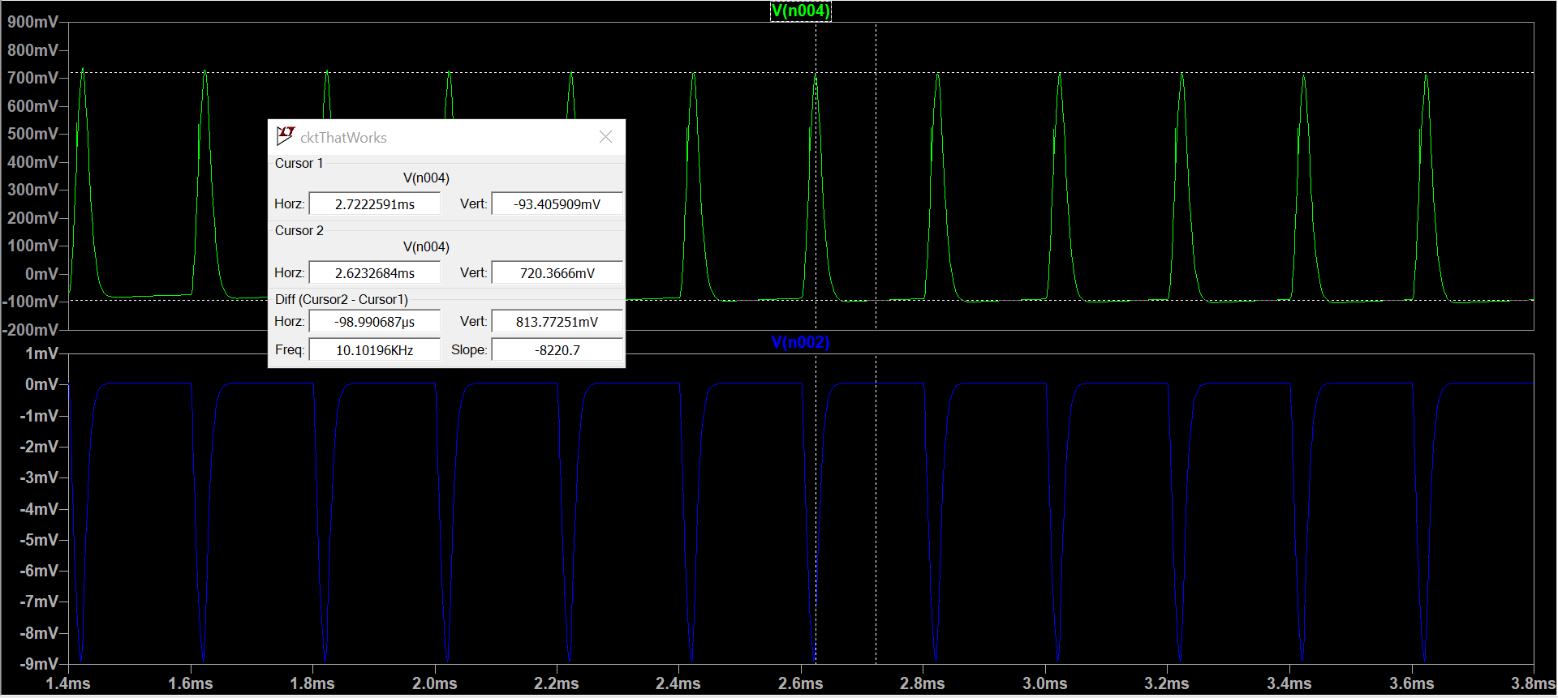
Voltage amplifier Transient analysis
Output Voltage: 813.77mV

Slide 9
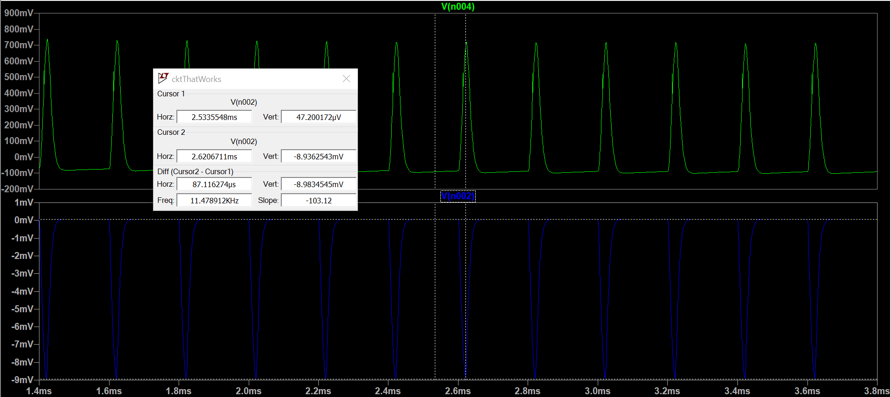
Voltage amplifier Transient analysis
Input Voltage: 8.98mV, Transient gain: 39.14 dB

Slide 10
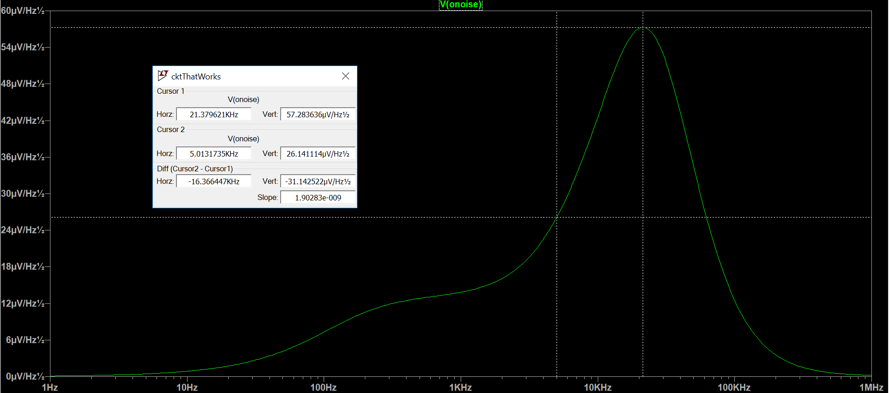
TIA + Voltage amplifier noise
Noise at 21.37kHz = 57.2836 uV/Hz^{1/2}, Noise at 5 kHz: 26.14 uV/Hz^{1/2}

Slide 11
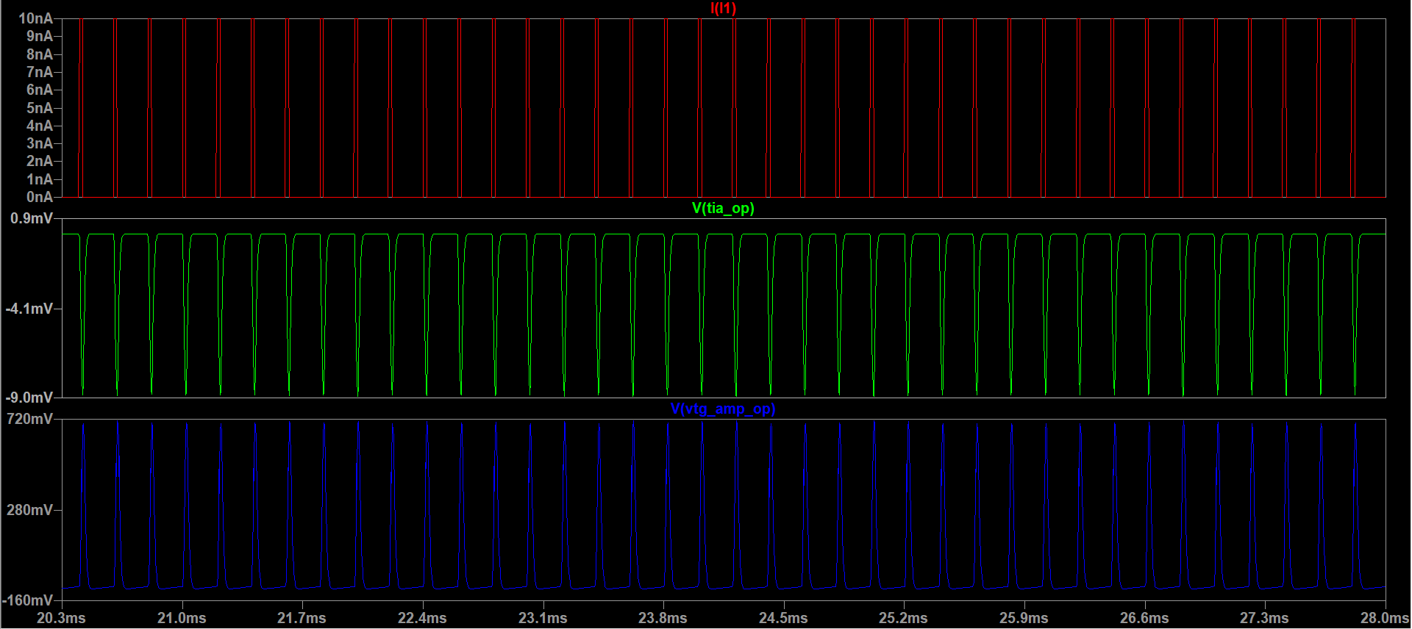
Input current and opamp outputs (transient)

Slide 12
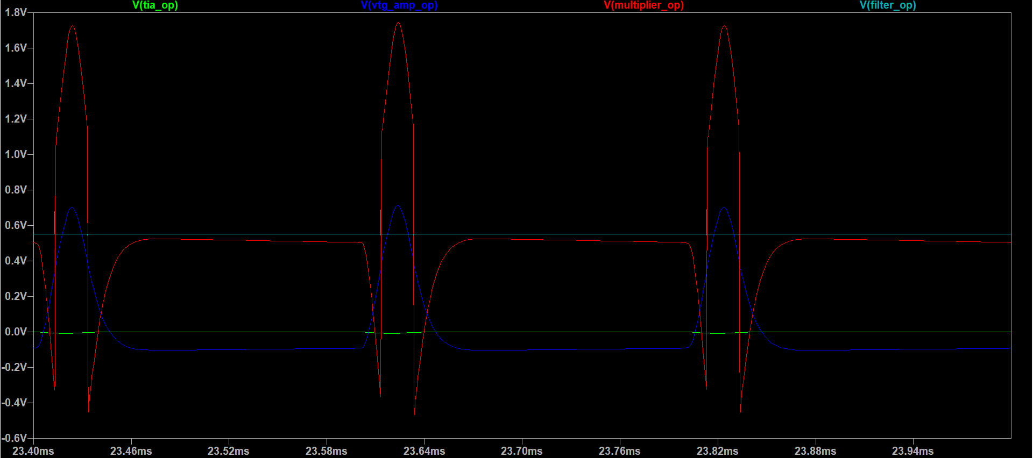
All traces (transient)
TIA output: (-) 8.9mV, Vtg amplifier output: 814.1mV, multiplier output: 2.2V, filter output: 550.7mV

Slide 13
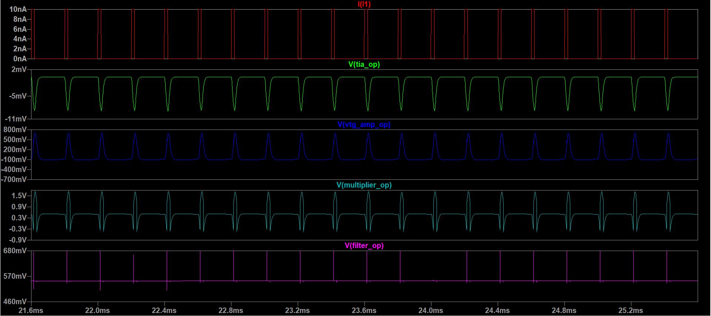
All traces (transient)

Slide 14
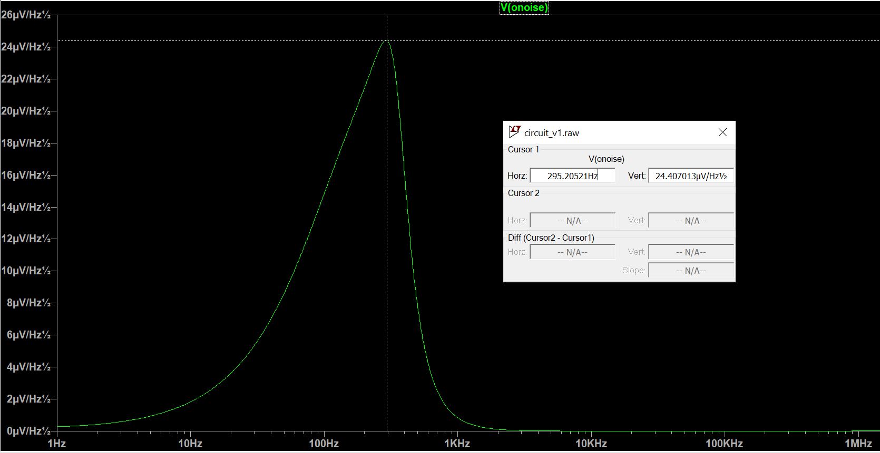
Output noise (After filtering)
Noise at 295.2052 Hz = 24.407 uV/Hz^{1/2}

Slide 15
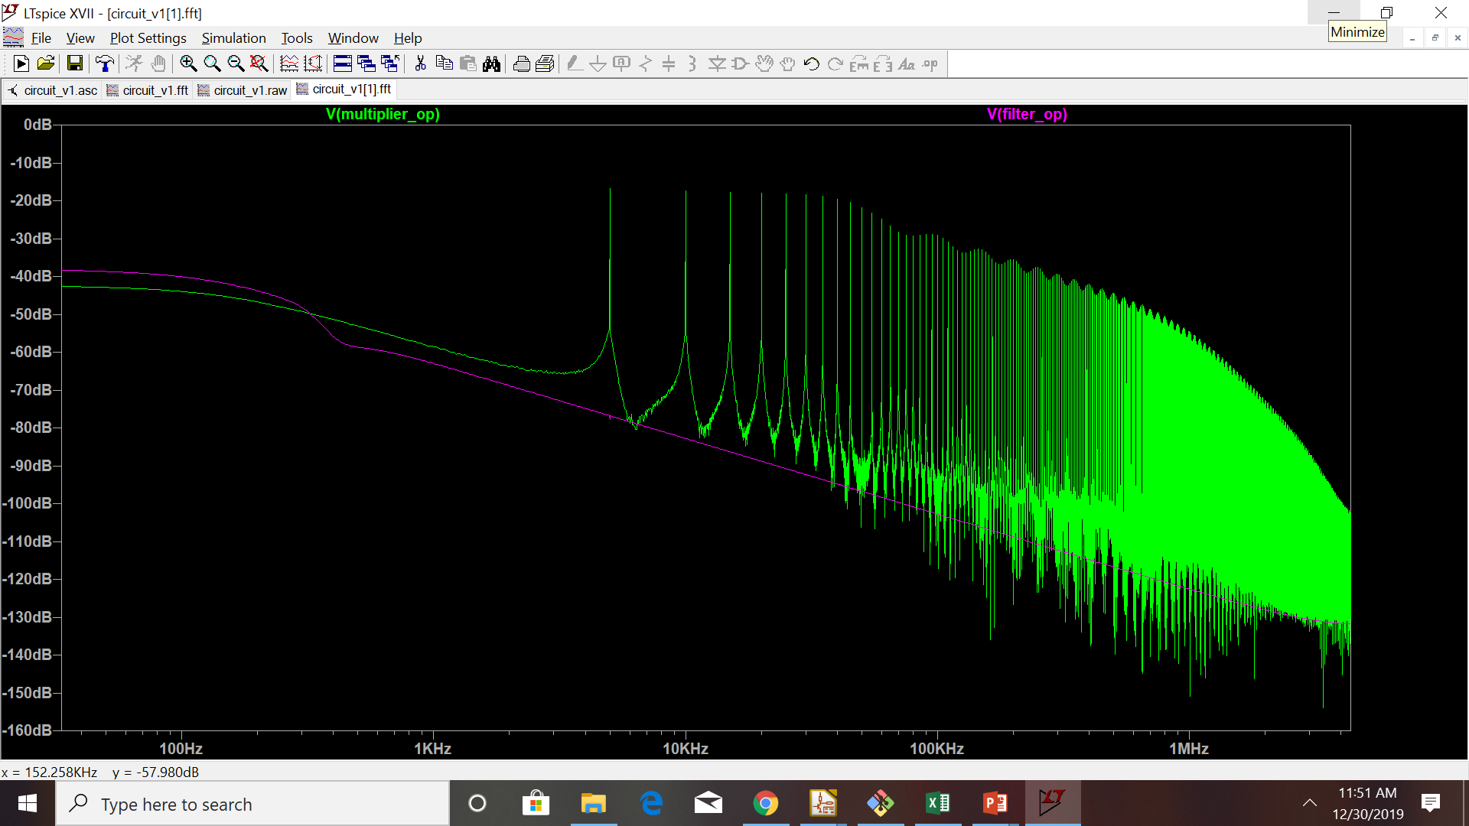
FFT (Multiplier and filter o/p)

