Slide 1



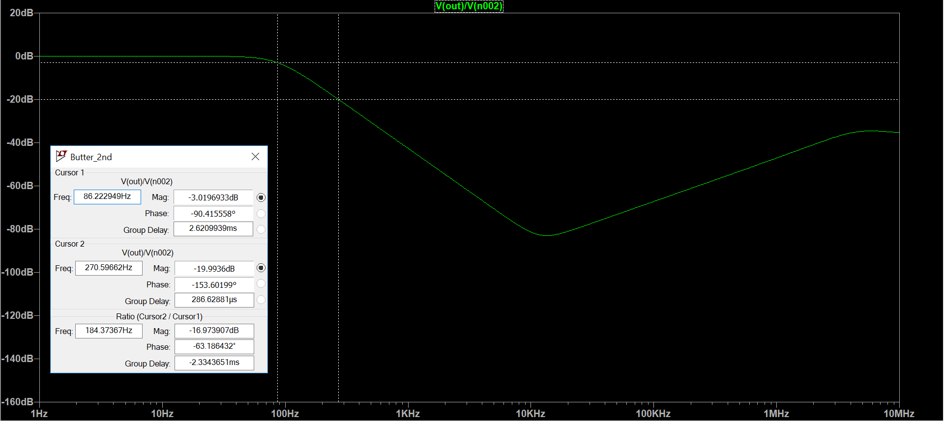
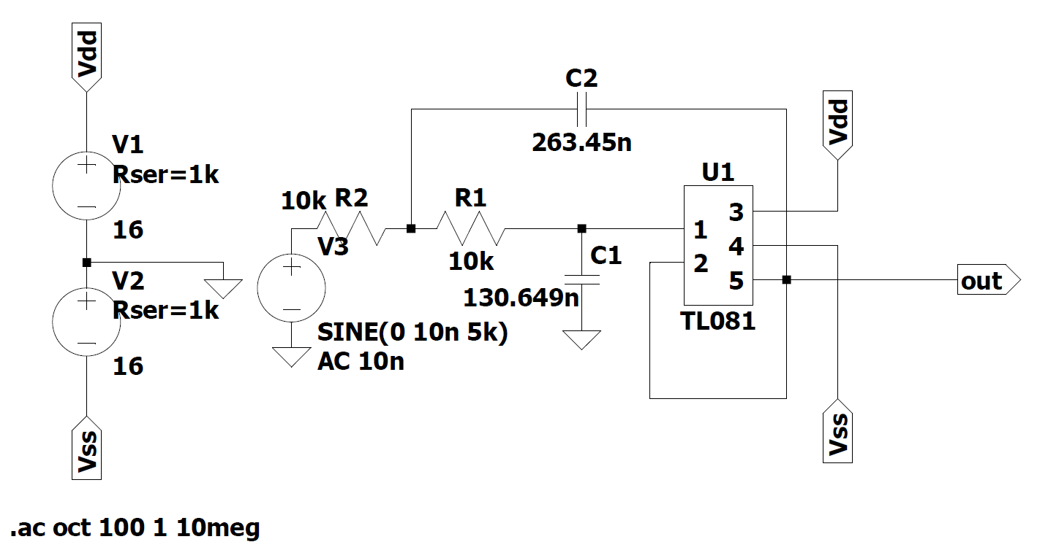
Second Order Butterworth Filter AC analysis
3 dB frequency: 86 Hz, 20 dB attenuation at 271 Hz

