Slide 1



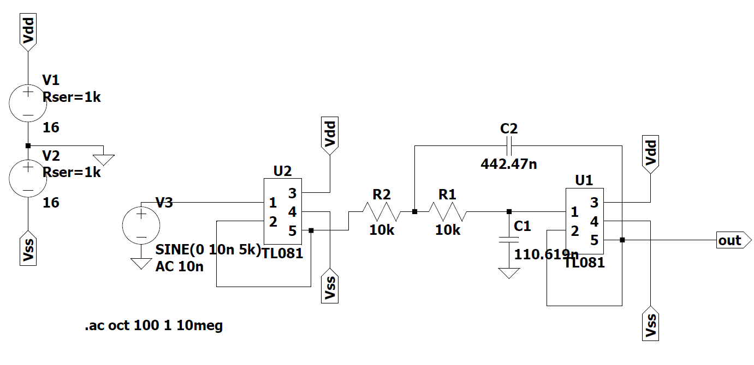
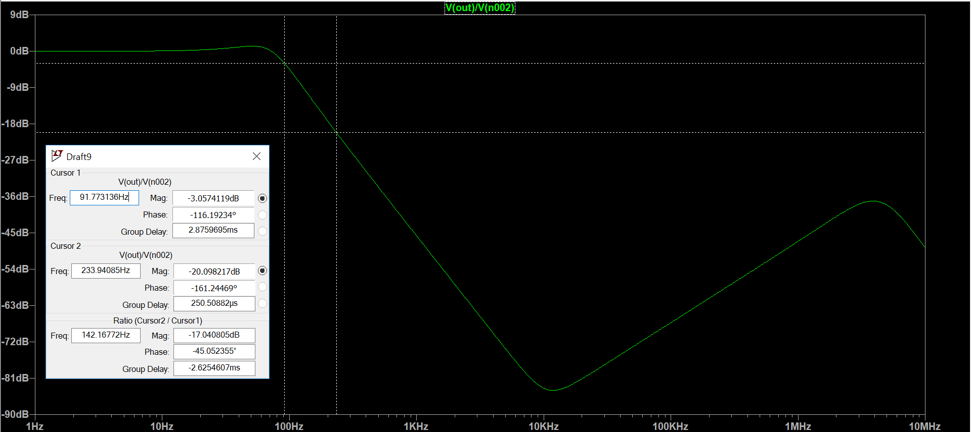
Third Order Butterworth Filter AC analysis
3 dB frequency: 92 Hz, 20 dB attenuation: 234 Hz

