Slide 1



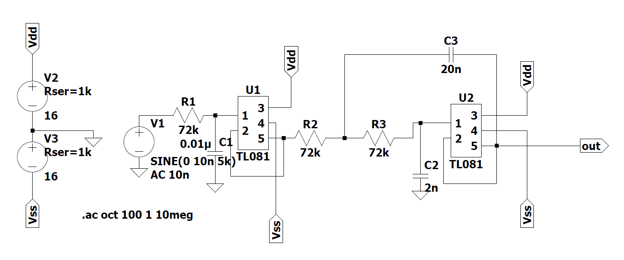
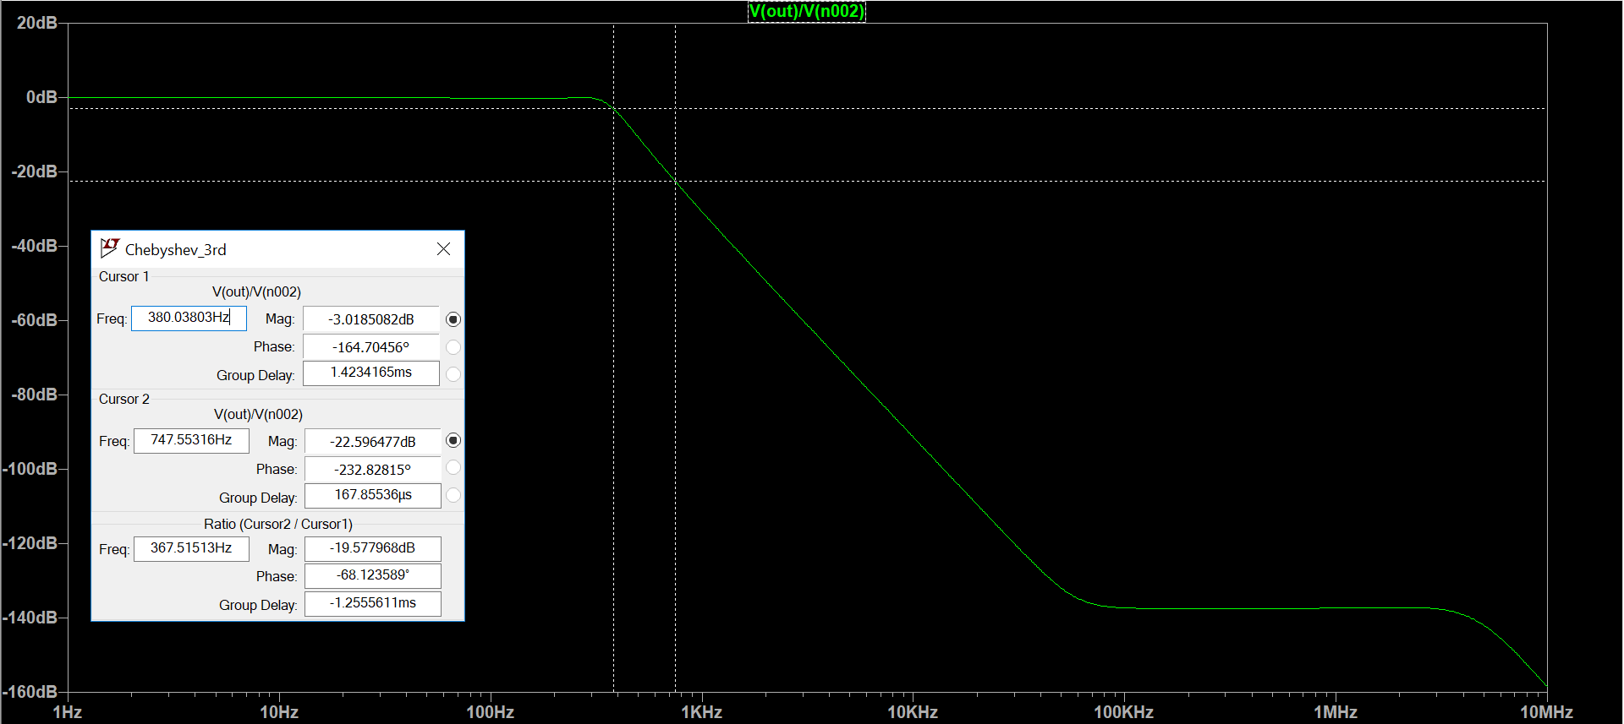
Third Order Chebyshev Filter AC analysis
3 dB frequency: 380 Hz, 20 dB attenuation: 740 Hz

