Slide 1
Genome Manipulation
Notes:
When genetically modifying a cell, one can add additional DNAs, such as plasmids, that replicate as distinct molecules in the host. Alternatively, one can modify the sequence of the host’s genomic DNA. Today we will discuss the various means of modifying a preexisting DNA inside a cell.

Slide 2
Phage Integration
Site-Specific Recombinases
Homologous Recombination
CRISPR
Conjugation
Transposons
Phage Transduction
Notes:
We will discuss: Phage att site Integration, Site-Specific Recombinases, Homologous Recombination, CRISPR, Conjugation, Transposons, and
Phage Transduction

Slide 3
Why change the genome?
Some applications require both the addition of functions and removal of existing genes (ie, knocking out a branch of biosynthesis for small molecule production)
For larger systems, it is difficult to put large numbers of genes into plasmids
Get better genetic stability (plasmids can get lost somewhat easily)
Many plasmids in one cell is usually a little toxic and unstable
To preserve local context
Best way to get stable “single-copy” number
Notes:
There are a variety of reasons one might choose to modify the genome rather than introduce a plasmid. Most applications require both the addition of genes and removal of native genes. For example, one might knock out a branch of biosynthesis for small molecule production to divert flux towards a desired product.
Genetic manipulations are most conveniently done in vitro on plasmid DNAs for cassettes as large as 30kb. However, for larger DNAs, it is easier to assemble such molecules in vivo.
For most end-use applications, putting genes into the genome is necessary for genetic stability. Cells tend to lose plasmid DNAs when there is some evolutionary incentive to do so.
Related to the previous, trying to put too many plasmids in one cell is usually toxic and unstable leading to growth defects and inconsistent behavior
Additionally, the genome allows you to park genes at distinct loci that enables one to preserve the local context of the gene and potentially obtain more consistent expression upon additional changes
Finally, parking a DNA in the genome is the best way to get stable “single-copy” number. There are some plasmids that replicate at very low levels, but the only way to guarantee that your genes are at the exact same copy number as the native ones is to put them in the genome.

Slide 4
att Integrases
Employing site-specific integrases from various phages to insert a DNA at a single locus of the genome.
Notes:
Phage-derived att integrases employ a site specific recombinase to insert a DNA at a single locus of the genome.

Slide 5
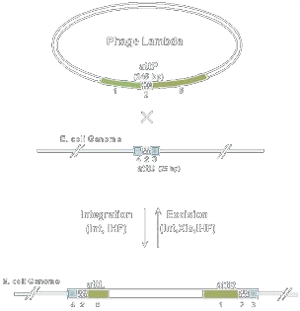
Phage att site integration
CRIM systems: Conditional-Replication, Integration, Excision, and Retrieval Plasmid-Host Systems for Gene Structure-Function Studies of Bacteria
Based on native phage-integration sites
Multiple orthogonal systems: phi80, lambda, HK022, P21, P22, and phiC31
Site specific recombination of a circular DNA into the att site of the genome
phiC31 allows the integration of >10kb DNAs
Involves “Helper Plasmids”
J Bacteriol. 2001 Nov;183(21):6384-93 PMID: 11591683
Notes:
In these methods, you first construct a circular plasmid DNA containing the attP sequence. That plasmid is then introduced into cells engineered with att integrases. The plasmid recombines itself into the genome.
The CRIM system is one popular implementation of this biochemistry. The CRIM plasmids can be inserted into the genome using an integrase, and then later excised by expression of integrase and xis.
These attP and integrase components are derived from various phages which integrate themselves into genomes at these sites
There are at least 6 of these systems, many-but-not-all are from E. coli phages. The common ones are phi80, lambda, HK022, P21, P22, and phiC31
In each case, there is a specific attB sequence in the genome that undergoes recombination with the attP sequence. Different phages use different attB sequences, and each encodes its own sequence-specific integrase.
Most of these systems only work on DNAs up to around 10kb. PhiC31 is distinctive in that it allows the integration of DNAs larger than 10kb. Thus, in the more advanced usages of phage att site integration, such as its use in mammalian cells, phiC31 is usually employed.
The integration chemistry requires the use of “Helper Plasmids” to transiently produce the phage-derived integrase. Helper plasmids are typically constructed from temperature-sensitive origins of replication and thus transformed bacteria can be ‘cured’ by growth at elevated temperatures.

Slide 6
CRIM att _{φ80} integration
Integration site
Present in all MG1655 lineage strains (unless explicitly modified)
attB_{φ80}
Genome
J Bacteriol. 2001 Nov;183(21):6384-93 PMID: 11591683
Notes:
Let me describe the different stages of the CRIM integration experiment. Let’s consider that it is the phi80 system. First, we start with an E. coli cell. MG1655, the grandaddy of most modern lab E. coli strains, contains the phi80 att site, so most laboratory strains are acceptible for this experiment.

Slide 7
CRIM att _{φ80} integration
int _{φ80}
bla
ori_{ts}
CmR
ori_{R6K}
attP_{φ80}
attB_{φ80}
Genome
The various E. coli origins of replication are described at http://openwetware.org/wiki/Arking:JCAOligoTutorial8
J Bacteriol. 2001 Nov;183(21):6384-93 PMID: 11591683
Notes:
A helper plasmid with a beta-lactamase gene is introduced into the cell by transformation and selected on ampicillin. The plasmid contains a temperature sensitive origin of replication, so the cells are grow at the permissive temperature of 30 degrees. It also encodes the phi80 integrase, and the cells start producing the protein.
*
The cells are then transformed again with the CRIM plasmid. This plasmid has a conditional origin of replication called R6K. In a cell that lacks the pir gene, which is true of most laboratory strains, this origin cannot replicate. Thus, this plasmid is only transiently present in the cell. It also contains an antibiotic selection marker (CmR) and the attP site.

Slide 8
CRIM att _{φ80} integration
int _{φ80}
bla
ori_{ts}
attL_{φ80}
ori_{R6K}
CmR
attR_{φ80}
Genome
J Bacteriol. 2001 Nov;183(21):6384-93 PMID: 11591683
Notes:
Integrase from the helper plasmid catalyzes the single-crossover recombination of the CRIM plasmid into the attB site of the genome. Now that it is in the genome, it will replicate with the rest of the genome. The CmR gene confers chloramphenicol resistance allowing the selection of integrants on anitbiotic-containing medium.
*
The cells are grown at a temperature non-permissive for replication of the helper plasmid, 42degrees, resulting in the final product, which is a cell with the CRIM inserted into the genome, and no other residual modification to the strain’s original composition.

Slide 9
Flp/FRT Marker Excision
FRT
CmR
FRT
Flp Recombinase
FRT
Notes:
There are various ways in which you can make this process markerless. One common strategy is to ‘flox’ the selectable marker. Here, a DNA is constructed with FRT sites in a parallel orientation flanking an antibiotic resistance gene. This cassette is introduced into the genome confiring chloramphenicol resistance allowing selection. Subsequently, Flp recombinase is introduced into the cell resulting in excision of the marker leaving behind only the FRT site.

Slide 10
Markerless integration
Flp
bla
ori_{ts}
attL
FRT
ori_{R6K}
CmR
FRT
gene
attR
Notes:
Let’s take a look at how that would be implemented in the CRIM system. First, the helper plasmid is used to insert the CRIM into the genome and then cleared.
*
The cell is now transformed with a second helper plasmid encoding the Flp recombinase.

Slide 11
Markerless integration
Flp
bla
ori_{ts}
attL
FRT
gene
attR
Notes:
The recombinase will excise the intervening region of the DNA leaving behind only the FRT site.
*
The cells are grown again at 42 degrees to cure them of the helper plasmid. At the end of this process, a gene and a single FRT site are introduced into the genome of an otherwise unmodified cell containing no residual selectable markers.

Slide 12
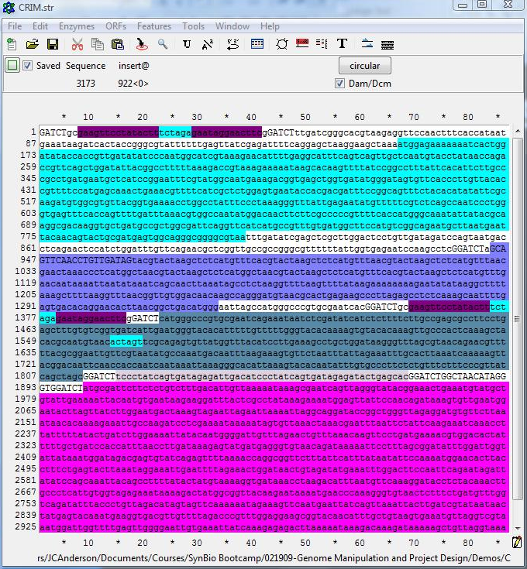
CRIM att _{φ80} integration

Slide 13
Homologous
Recombination
Inserting genes into the genome at arbitrary locations based on homology
Notes:
Homologous recombination underlies many genome engineering methods. It involves inserting DNAs into the genome at arbitrarily-chosen locations of the genome based on their homology to that sequence.

Slide 14
Lambda Red Recombinase
E. coli by itself is very inefficient at homologous recombination (unlike yeast and B. subtilis)
Expression of the phage lambda Red genes (exo, gam, and bet) enhances recombination dramatically
Commonly used for knockins and knockouts
Active species is linear single stranded DNA (can use oligonucleotides)
Exo protein degrades linear double stranded DNAs to single-stranded DNAs (can use PCR-derived DNAs)
Won’t work directly on circular DNAs
Proc Natl Acad Sci U S A. 2000 Jun 6;97(12):6640-5 PMID: 10829079
Notes:
In E. coli and other bacteria that lack efficient homologous recombination systems, this functionality can be enhanced by expression of lambda red recombinase.
*
Lambda red is in common use for producing knockins and knockouts in prokaryotic genomes
*
Mechanistically, the recombinagenic species is linear single-stranded DNA, such as oligonucleotides that is introduced into the cell by transformation
*
Alternatively, a linear-double stranded DNA can be provided and the exo protein of lambda red will degrade it into single-stranded molecules that can undergo recombination. Often that linear DNA is a PCR product.
*
The method does not work directly on circular DNAs, but linear DNAs can be generated from circular DNAs by treatment with any of the various restriction enzymes.

Slide 15
Datsenko/Wanner KOs
pKD46
Under a Pbad promoter (arabinose inducible)
Red genes
bla
ori_{ts}
target
Notes:
A very popular setup for homologous recombination in E. coli and other prokaryotes is the Datsenko/Wanner method. It is a lambda red-based method for knocking out genes in the genome. It begins with pretty much any E. coli strain containing the target sequence we wish to remove. * The cell is first transformed with a helper plasmid, pKD46 and grown at the permissive temperature of 30 degrees. * This temperature-sensitive plasmid encodes the lambda red genes under a Pbad promoter. Growth of the cells with arabinose present will induce expression of this cassette resulting in the production of lambda red and enhancement of homologous recombination in the cell.

Slide 16
Datsenko/Wanner KOs
CmR
40 bp
homology to target
20 bp homology to pKD3 or pKD4 (or other template)
Red genes
bla
ori_{ts}
target
Notes:
* The knockout cassette begins with a template plasmid. * The plasmids pKD3, pKD4, and pKD13 were originally designed for this experiment, and they essentially are sources of the chloramphenicol resistance (for pKD3), or the kanamycin resistance gene (for pKD4). There are specific 20bp regions of the plasmid called p1 and p2 which are the sites where oligos can prime to amplify the selectable marker by PCR. * These PCR oligos are designed to contain these 20bp sequences on their 3’ ends, and then 40bp of homology to the genome target on their 5’ ends. PCR results in

Slide 17
Datsenko/Wanner KOs
CmR
Red genes
bla
ori_{ts}
target
Notes:
A double stranded, linear pcr product with homology to the genome on both ends. The cells containing the lambda red genes are * transformed with this PCR product usually by electroporation.

Slide 18
Datsenko/Wanner KOs
Red genes
bla
ori_{ts}
CmR
Notes:
Inside the cell, the lambda red genes cause the double-crossover recombination of the PCR product over the sequence homologous to its ends in the target. Because recombined cells contain the chloramphenicol resistance gene, they can be selected by growth on antibiotic-containing medium.

Slide 19
Datsenko/Wanner KOs
Red genes
bla
ori_{ts}
CmR
Notes:
The helper plasmid pKD46 is then cleared from the cell by growth at elevated temperature. This results in a strain in which the target sequence has been disrupted

Slide 20
Markerless Knockouts
Flp
bla
ori_{ts}
FRT
CmR
FRT
Notes:
As with other genome modification strategies, there are several ways to make them markerless. If the original template sequence contains FRT sites flanking the selectable marker, recombination of the PCR product into the genome will retain these sequences.
*
Transformation with a second helper plasmid encoding a site-specific recombinase will

Slide 21
Markerless Knockouts
Flp
bla
ori_{ts}
FRT
Notes:
Catalyze the excision of the intervening marker, leaving behind only a single FRT site in the genome. Growth of the cells at a non-permissive temperature results in clearance of the helper plasmid. Thus, the original target is disrupted with no residual modifications.
Datsenko/Wanner is just one specific use case of homologous recombination. In some organisms like S. cervisiae yeast, homologous recombination is sufficiently robust out-of-the-box that unmodified strains can be transformed with PCR products like those used in this experiment to disrupt a gene. In mammalian and plant cells, homologous recombination is also fairly robust, but is greatly enhanced by introduction of double-stranded breaks into the genome near sites of intended recombination. Though here we describe knocking out genes. This same procedure can just as easily be used to knock-in sequence to the genome. All you have to do is incorporate the desired sequence into the PCR product, and it will become inserted wherever that DNA’s ends direct it.

Slide 22
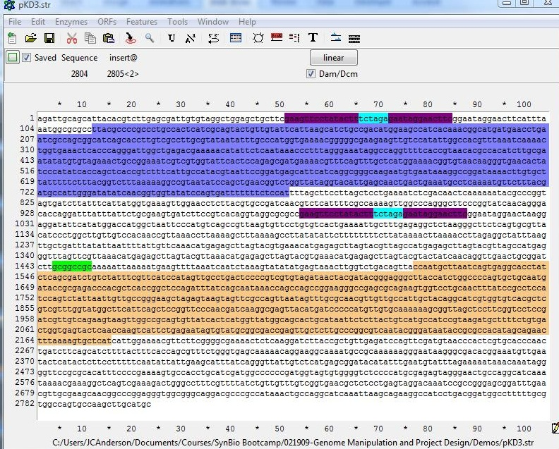
Knockout of glgS

Slide 23
Cas9 and CRISPR

Slide 24
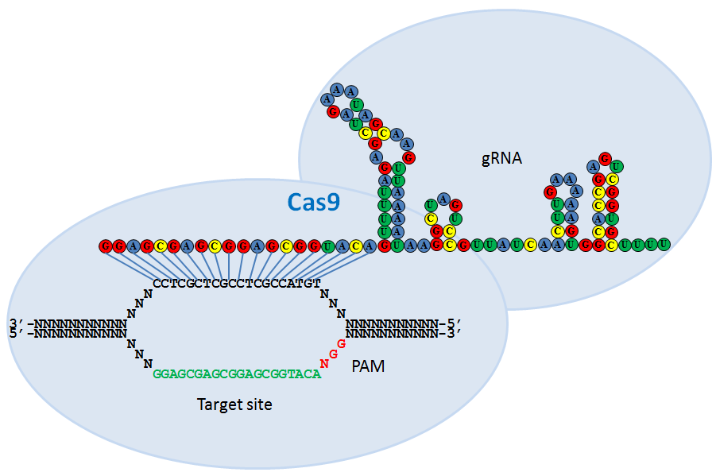
Cas9

Slide 25
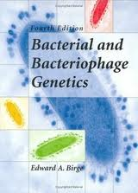
Conjugation, Transposition, and Transduction
Knocking in/out DNAs randomly with transposons, and transferring genome loci by phage transduction or conjugation
ISBN-13: 978-3540942702
Notes:
Conjugation, Transposition, and Transduction are ‘old-school’ ways of performing genome manipulation that pre-date recombinant DNA methods. Despite their age, they are still commonly used techniques. Conjugation involves the transfer of DNAs from one cell to another through mating. Transduction involves the transfer of DNAs from one cell to another via a phage particle intermediate. Transposition is the process of randomly inserting a DNA into the genome. * This book here is an excellent resource for describing these and many other traditional genetic methods.

Slide 26
Conjugation
Requires many additional genes provided in trans (genomically or episomally encoded)
Conjugation initiates from an oriT sequence in cis
Proceeds by rolling circle amplification generating a single stranded DNA that is exported through a pilus to a recipient cell
oriT
Conjugation Proteins
Plasmid
Genome
Conjugation Genes
Notes:
Conjugation requires the action of many genes provided in trans. These are often supplied in the genome with special strains, or sometimes they are provided on a separate plasmid.
*
The site of conjugation on the DNA being transferred is called oriT and this is referred to as an ‘origin of transfer’
*
Multiple proteins provided in trans are required for this elaborate process, but they all ultimately act upon the oriT sequence of the DNA being transferred
*
The initiation of conjugation begins with rolling circle amplification from the oriT sequence generating a single-stranded DNA that is exported from the cell through a pilus. The pilus attaches on its other end to a recipient cell, and the DNA is delivered through this conduit.

Slide 27
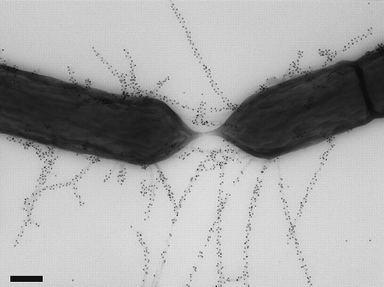
Conjugation
Requires many additional genes provided in trans (genomically or episomally encoded)
Conjugation initiates from an oriT sequence in cis
Proceeds by rolling circle amplification generating a concatenated single stranded DNA that is exported through a pilus to a recipient cell
oriT
Conjugation Proteins
Plasmid
Genome
Conjugation Genes
Notes:
Here is an electron micrograph showing two E. coli undergoing conjugation through an F-pilus.

Slide 28
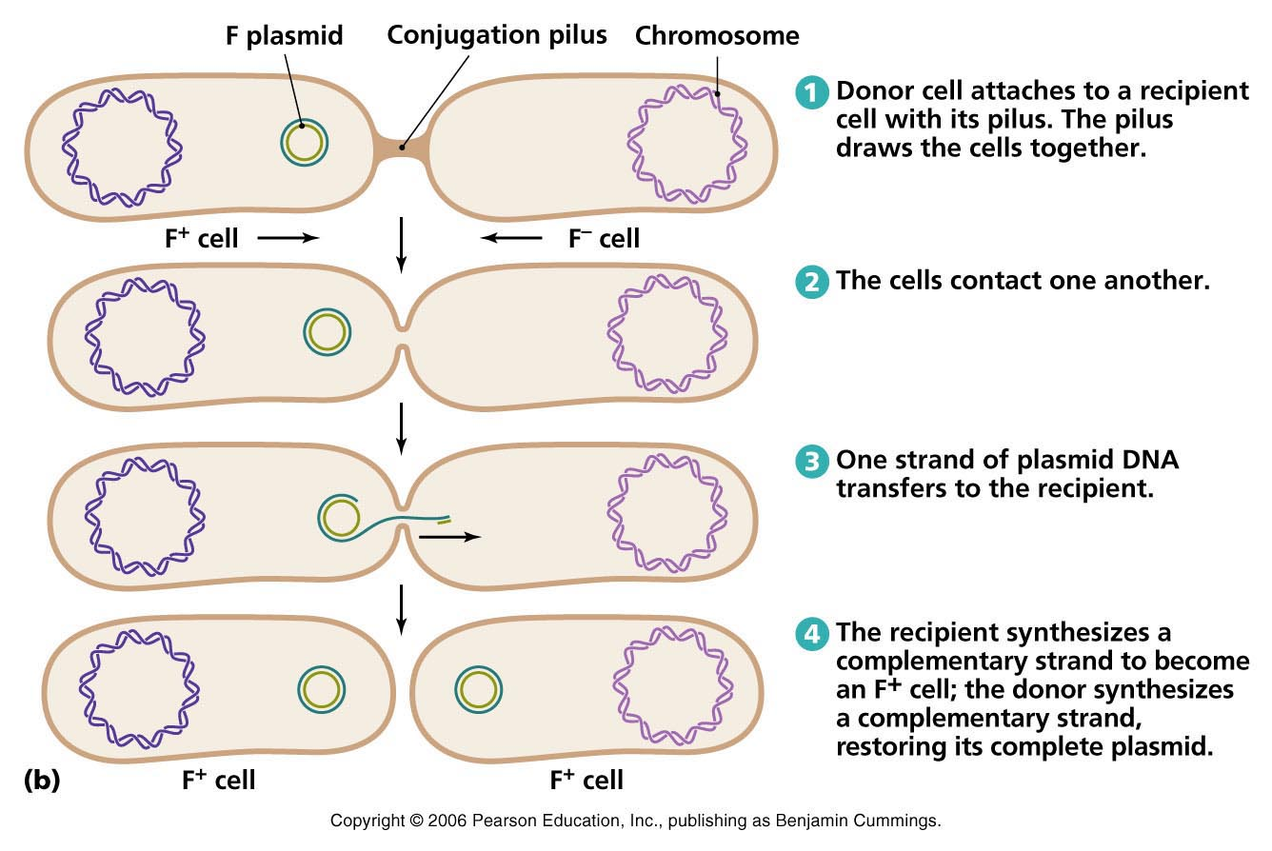
Conjugation
Two types are common F and RP4 (broad host range)
Notes:
The donor strain contains the oriT-encoding DNA, and mixing of these cells with cells lacking F-plasmid without shaking results in attachment of the cells by a conjugation pilus. That pilus is encoded by genes in the F plasmid, or on another DNA in the donor cell. The pilus brings the two cells together, and the oriT-containing DNA is transferred into the recipient cell as a single-stranded intermediate. The single-stranded molecule is resolved in the recipient cell as a circular plasmid, where it continues to replicate normally.
*
There are two commonly used conjugation systems in E. coli: F plasmid and RP4. F plasmid is E. coli-specific, but RP4 enables E. coli to mate with other bacteria and even yeasts. These conjugation systems are most commonly used to transfer plasmid DNAs to one cell to another. However, it is also possible to transfer regions of the genome. If the F-plasmid oriT sequence is incorporated into the genome of the donor cell, a region of the genome will be transferred into the recipient cell where it can undergo recombination with the native sequence. By controlling how long the two cells are allowed to mate, one can control what fraction of the genome gets transferred.

Slide 29
Transposons/Transposomes
Traditional “forward” genetics
Tn5, Tn10, Mu
Transposons are donated from a plasmid encoding the transposon, usually by conjugation
Transposomes (a commercial product from companies like Epicentre) involve transformation of an in vitro-produced adduct of a DNA and purified transposase
Can also use transposons to randomly integrate DNAs into the genome
Tn5
CmR
Tn5
Tn5 Transposase binding site: AGATGTGTATAAGAGACAG
Notes:
Transposons are the workhorse of traditional forward genetics. They involve the random insertion of a DNA into the genome. There are 3 commonly-used systems: Tn5, Tn10, and Mu, and each is defined by a transposase protein and a short sequence that is in cis to and flanking the sequence-to-be-transposed. These short sequences are often called ‘terminal repeats’ * Transposons are usually encoded as plasmid DNAs or PCR products and are introduced into the cell by conjugation or transformation. * In all cases, a protein:DNA complex is generated by reaction of the DNA with the tranposase. If the transposase is genetically encoded on an introduced DNA, this complex is generated inside the cell transiently. Alternatively, purified transposase can be reacted in vitro with the DNA. You can even purchase such transposomes ready for transformation from companies like Epicentre. * Transposons are most commonly used to knockout genes in the genome. Whenever they insert into a host gene, that gene’s function is disrupted. However, transposons can also be used to randomly integrate a DNA into the genome and is thus useful as a knock-in strategy. Whatever sequence you place between the terminal repeats will be incorporated into a random site of the genome.

Slide 30
Transposons/Transposomes
A typical Tn5 donor plasmid
Use in combination with an RP4 donor strain like (WM3064)
Notes:
A common setup involves Tn5 tranposons. Here is pRL27, a popular variation. Working clockwise from 12-o-clock, this plasmid encodes the transposase followed by a Tn5 terminal repeat, a conditional R6K origin of replication, a kanamycin resistance gene, then another Tn5 terminal repeat, the an RP4 origin of transfer. The transposon is defined by the sequence flanked by Tn5 sites. Thus, the R6K and KnR features are both present in the transposon. This plasmid is transformed into a donor strain such as WM3064. This strain contains the pir gene for stable replication of the R6K origin, the RP4 conjugation genes, and a mutation in the dapD gene. This mutation renders the strain unable to grow without added diaminopimelic acid and thus other cells can be selected over WM3064 by growth on normal LB medium lacking this chemical. To do the mutagenesis experiment, you mix these pRL27/WM3064 cells with the cells you wish to mutate by smearing a paste of the two cells on a piece of filter paper. The conjugation machinery transfers the DNA into the recipient cell. Without the pir gene, those recipient cells are unable to replicate the plasmid, but the transposase will nevertheless become expressed. This results in the formation of transposomes that hop into the recipient cell’s genome. Because the transferred cassette includes a selectable marker, mutant cells can be selected by growth on kanamycin medium.

Slide 31
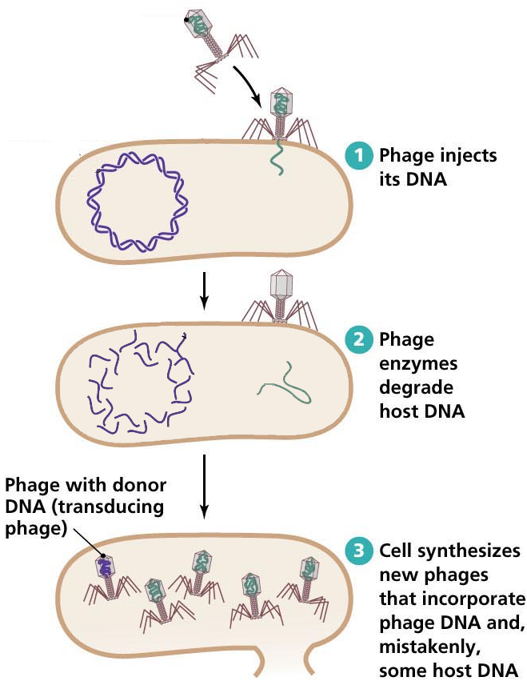
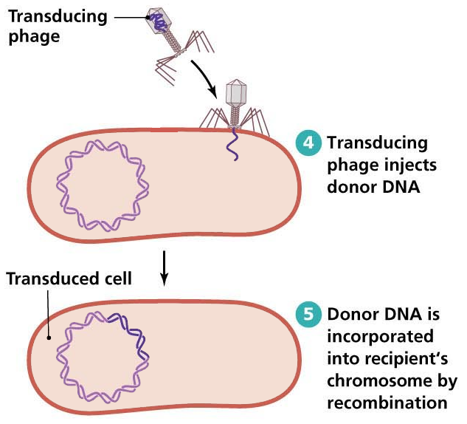
P1 Generalized Transduction
Moves ~90kb chunks of genome at a time
Some E. coli strains (like DH10B) are P1 resistant
Adapted from:
http://academic.pgcc.edu/~kroberts/Lecture/Chapter%207/horizontal.html
Notes:
P1 generalized transduction involves the transfer of random DNA fragments from one strain of E. coli to another. First, the donor cell is infected with P1vir phage. When a lytic phage infects a cell, usually it will package its own DNA. However, the process incorporates a piece of genomic DNA instead around 2% of the time, and the sequence incorporated into the phage head is a random one.
*
The cell lysate is then sterilized with chloroform to kill any un-lysed bacteria and then added to a sample of recipient cells. For the rare phages that contain a piece of genome, this DNA will be injected into the recipient cell where it will undergo homologous recombination with the recipient genome. If that fragment of DNA contains a selectable marker, these ‘transduced’ cells can be selected by growth on selective medium.
*
P1 transduction moves 90kb random chunks of the genome. It is thus useful for transferring single genes or even large gene clusters from one genome to another. Often people will use homologous recombination or phage att integration methods to first modify one cell’s genome, and then combine several such mutant genomes into one using P1 transduction. Note that some of the popular E. colis trains such as DH10B are resistant to P1 and thus cannot be used in this procedure. However, most older strains like MC1061 are emenable to the technique.

Slide 32
Manipulation of Non-Model Genomes
Similar methods exist in various other organisms including other bacteria, yeast, and human cells
Notes:
I have primarily discussed genome modification in E. coli and to some degree yeast. The basic mechanisms of genome manipulation are the same regardless of organism, but not all organism are equally amenable to the various techniques. There are many organisms that have no methods of deliberate genetic manipulation, but many organisms have at least one method.

Slide 33
Other organisms: bacteria
Very many bacteria don’t have transformation technology (you can’t just pop in plasmids easily)
“Plan B” is to use broad-host-range replicons on double-stranded circular dnas, and deliver them via RP4-based conjugation.
People also develop species-specific tools for specific popular model organisms, often this is done with phage systems or shuttle vectors
Notes:
Many bacteria don’t have transformation capability. So, you can’t just pop in a plasmid to these organisms.
In these cases, “Plan B” is to use broad-host-range replicons on double-stranded circular dnas, and deliver them via RP4-based conjugation. If there are no known replicons that work in the organism, you can also deliver a transposon via RP4 conjugation, and the DNA will hop randomly into the genome where it can replicate.
People often develop species-specific tools for particular organisms of interest. Often this is done by tweaking phage native to the organism, or through the construction of shuttle vectors. Shuttle vectors are plasmid DNAs that contain both an E. coli origin of replication and one that works in the recipient cell.

Slide 34
Other organisms: yeast
There are at least 3 commonly-used “model” yeasts: S. cerevisiae, S. pombe, and P. pastoris, but also many industrially-used, non-’model’ strains
The origins of replication are different, but there are yeast plasmids (circular, double stranded)
S. cerevisiae is awesome at homologous recombination, so much so that going straight into the genome with a DNA is as common as episomal cloning
There are tricks you can do with mating
Rarer to do anything virus/transposon-esque
Notes:
There are at least 3 commonly-used “model” yeasts: S. cerevisiae, S. pombe, and P. pastoris, but also many industrially-used, non-’model’ strains. For example, the S. cerevisiae used to make beer, wine, or biofuel is genetically quite different from the lab strains.
The origins of replication one uses in yeast are different than those in E. coli, but there are yeast plasmids and they are similarly circular, double stranded molecules
S. cerevisiae is awesome at homologous recombination, so much so that going straight into the genome with a DNA is as common as episomal cloning
Many yeast have diploid genomes and can be induced to be haploid or diploid. There are many tricks you can do with mating yeasts together that cannot be done in the haploid bacterial genomes.
It is rare to employ viruses and transposons in yeast. These things are just not part of a yeast’s natural biology. They don’t tend to be infected by phages or viruses like bacteria and animal cells are.

Slide 35
Other organisms: human
Many human cell lines can be transiently transfected with double stranded DNAs (usually linearized) for a few days. Most experiments are done this way.
There are episomal replicons like Epstein-Barr, but that isn’t the common thing-to-do
Stable cell lines are currently most commonly achieved using retrotransposons, but things like phi C31 att-site integration are also common tricks
Targeted genome manipulations are done by homologous recombination aided by zinc finger, tal nuclease or CRISPR
If done in embryonic stem cell lines, stable transgenics can be developed back into adult animals (and cloning)
Most animal cells also do siRNA
Different animals/mammals differ greatly in the efficiency of various procedures
Notes:
Many animal-derived cell lines, including mammalian and even humans are amenable to some form of genetic manipulation. Many human cell lines can be transiently transfected with double stranded DNAs (usually linearized) for a few days. Most experiments are done this way because it is the easiest and most robust procedure.
There are episomal replicons like Epstein-Barr, but that isn’t the common thing-to-do
What is common is to produce stable cell lines either by random integration of transfected DNAs, or by use of randomly-integrating viruses such as retrotransposons. There are also phi C31 att-site and Cre-based integration strategies for site-specific integration of DNAs into the genome.
Targeted genome manipulations are done by homologous recombination. However, this process is greatly enhanced through induction of double-stranded breaks near the site of recombination. These cuts can be generated with zinc finger or tal nucleases, and more recently using CRISPR.
If done in embryonic stem cell lines, stable transgenics can be developed back into adult animals. This capability leads to the ability to generate clonal populations of animals
In addition to manipulating DNA in animal cells, most animal cells also do siRNA and thus gene expression can be manipulated epigenetically
Different animals/mammals differ greatly in the efficiency of various procedures, and even different cell lines from a single organism vary greatly in their ability to be modified.

Slide 36

Questions to Ponder

Slide 37
Design oligos to do a Datsenko/Wanner markerless knockout of the fimA gene in MG1655 using plasmids pKD3 and pKD46
Predict the product of the genome locus from the above experiment before excision of the FRT-CmR-FRT cassettes
Predict the product of the genome locus from the above experiment after excisions
Susan did a markerless glgS knockout of MG1655, a second knockout with CmR of the rfaE gene into another MG1655, and then tried to move the rfaE::Cm marker into the glgS knockout strain using P1 transduction. Her products only have rfaE knocked out. What happened?
Why can’t you use a normal pUC plasmid for doing CRIM integration?
Why would I want to put a DNA into the genome of E. coli rather than put it on a plasmid?

