Slide 1
in vitro Characterization
Biochemical Analysis
Product Studies
Notes:
Today we’ll discuss assay methods that require destruction of the organism. These in vitro methods of characterization include Biochemical Analysis, and Product Studies.

Slide 2
A two-step process
Purify the component of interest (destroys the cells)
Measure the activity of the component (some aspect of its molecular function)
Notes:
There are two steps: first we isolate the component of interest and in the process destroy the cells, and in step 2, we measure the activity or abundance of the component we have purified. We’ll go through both of these subjects, but keep in mind that these are two very distinct problems.

Slide 3
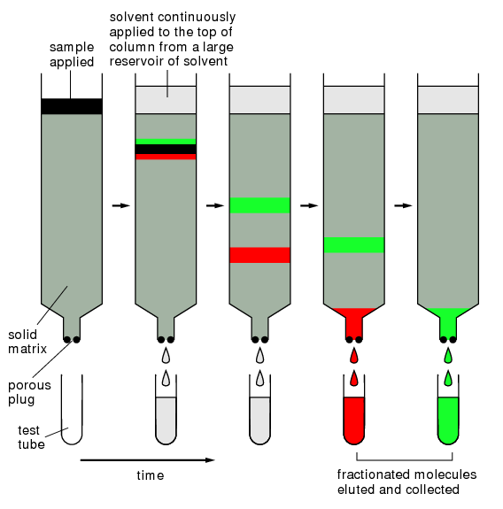
Chromatography
Notes:
There are a large set of methods used to do purification. Chromatographic methods are some of the most popular. Here, you pack a column with a resin that will separate the components of your sample as they travel through. By collecting samples at different time points coming off the column, different chemicals will come out in different bins. There are many different chromatography methods, and this is only one category of purification techniques.

Slide 4
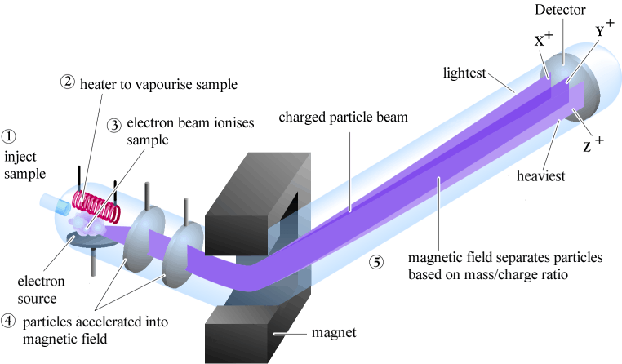
Mass Spectrometry
Notes:
The second step is analysis, in which the property being probed is turned into a quantitative signal. For many applications, this readout will be mass spectrometry, but again, this is only one of many methods that exist, and different methods are appropriate for different use cases. In mass spec, you ionize your sample and then whisk it through a magnet. The magnet will cause curvature to the path of the charged particles, and the degree of curvature depends on the charge and mass of the particle. As a result, the detector sees the molecule at different positions and this can be interpretted precisely as a specific mass and charge.

Slide 5
Protein Purification
Notes:
Protein purification is a process wherein you isolate a protein component from disrupted cells. Purifying specific proteins from a genetically unaltered organism is very challenging. However, when you control the gene for the protein you wish to purify, there are many tricks to simplify the task.

Slide 6
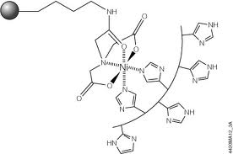

His-TAG Purifcation on Ni-NTA
His6-Tag = HHHHHH (6 histidines in a row, on N or C terminus)
Spin the bacteria out of media
Lyse the bacteria
Clear lysate by centrifugation
Bind to Ni-NTA resin
Wash away unbound material
Elute in Imidazole
Dialyze out the imidazole
Notes:
The workhorse method is his tag. The sequence HisHisHis HisHisHis, on the N or C terminus of a protein is the his tag. This short sequence of amino acids binds to nickel ion. After immobilizing nickel in a column using the ligand NTA, you can affinity purify proteins with his tags. The peptide binds tightly and specifically to Ni-NTA allowing you to wash out all the other proteins. The protein is then released from the column by elution with imadazole. This is the molecule matching the side-chain of histidine. You must add imadazole at high concentrations, but it will compete for Ni ions and the protein is released.

Slide 7
Affinity Purification of Protein
His-Tag / Ni-NTA resin
Glutathione S-transferase / Glutathione resin
Maltose binding protein / Maltose resin
Chitin binding domain / Chitin resin
Epitope Tag / Antibody resin
Myc Tag
HA Tag
FLAG Tag
TAP Tag
Antibody / Protein A resin
Notes:
His tag is just one of a suite of affinity purification techniques you can use. For His-Tag, the resin is Nickel-NTA. Glutathione S-transferase, Maltose-binding protein, and chitin-binding protein are small E. coli proteins that have commercially-available resins. Often, fusing these proteins to a protein you wish to purify will improve its solubility and expression.
Additionally, there are a number of peptide tags that can bind to specific antibodies. Immobilizing antibodies to a column or to magnetic beads provides another means of specifically isolating proteins from a complex mixture.

Slide 8
Other protein purifications
The field here is usually called “Protein Chemistry” or “biochemistry” (like, ‘do some biochemistry’ not like ‘Journal of Biochemistry’)
Size Exclusion chromatography
Anion Exchange chromatography
Cation Exchange chromatography
Hydrophobic Interaction Chromatography
Hydroxyapatite Chromatography
Heat Denaturation (Example: Taq polymerase)
Ammonium Sulfate “cuts”
Immunoprecipitation
Electrophoresis
Notes:
The space of protein purification is vast. When you try purifying proteins without affinity tags, many techniques are required to separate proteins based on physical or biochemical properties. This field is usually considered a subdomain of protein chemistry or biochemistry. Scientists use the word biochemistry colloquially to refer to laboratory techniques involving lysed cell samples. Protein purification is one such set of techniques. *
Size Exclusion chromatography separates the proteins by size. Large proteins spend less time diffusing into the resin and elute faster. Often size exclusion is performed after affinity purification. The combination of these two methods is the most common way of making high-purity protein samples.
Anion and Cation exchange separates proteins by size. Hydrophobic interaction chromatography separates proteins that have hydrophobic residues on their surface. There are also some more specific resins like hydroxyapatite. This mineral of apatite and phosphate mimics nucleic acids and thus will somewhat selectively bind proteins that bind RNAs and DNAs. *
There are non-chromatographic methods too. For thermostable proteins, you can separate them by boiling the cells. All the other proteins precipitate leaving behind only your thermostable one. Ammonium sulfate ‘cuts’ involve adding the salt to your sample, and different proteins will precipitate at different concentrations. If you have antibodies against your protein, you can cause your protein to aggregate and precipitate by reaction with the antibody. Finally, there is electrophoresis PAGE electrophoresis typically involves denaturing your protein, but it is sometimes possible to cut the band out of the gel, elute the protein, and refold it.

Slide 9
Purifying other Biopolymers
Genomic DNA
Plasmid DNA
Total RNA
rRNA, tRNA/small RNA, mRNA individually
Metabolites
Lipids
Carbohydrates
Notes:
There are techniques for isolating every component of the cell. For nucleic acids, there are variations on your miniprep procedure that work for genomic dna, plasmids, total RNA, small RNAs, and mRNAs.
There are also methods for isolating soluble small molecule metabolites, lipids, and even carbohydrates.

Slide 10
Enzymatic Assays
Notes:
After purifying your component of interest from the cell, you are either going assay its function, quantify it, or probe its structure. Molecular function is either binding or catalysis. Here we deal with the assay of catalytic function.

Slide 11
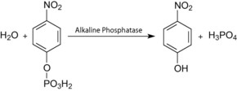
Simplest case
PhoA
phoA
His6
Purify protein
Add reagent
Measure absorbance (fluorescence)
Notes:
Here is a simple example. We encode the phoA gene with a C-terminal His tag on a plasmid and put it in the cell. This results in production of PhoA protein which we purify by Ni-NTA chromatography. We then perform an enzymatic assay. We add the chromagenic substrate p-nitrophenyl phopsphate which gets hydrolyzed to p-nitrophenol which is yellow. The color is easily quantified by photometry. By monitoring the formation of color over time with different amounts of substrate, we can calculate parameters such as Kcat and Km for the enzyme.

Slide 12
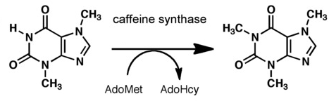
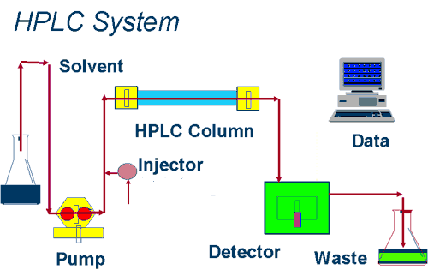
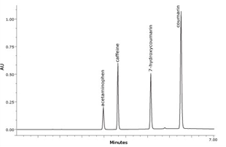
More typical case
Purify protein
Mix with substrates
Run LC-MS
Notes:
However, most enzymes aren’t amenable to simple colorimetric assays. For example, suppose we wish to monitor methylation by caffeine synthase. This molecule isn’t detectable by photometry and thus more sophisticated analytical methods are required.
*
The workhorse method for analytics is LC-MS or GC-MS. Here, you perform an extraction of the small molecules in your sample, and then run them through a column to separate them typically based on hydrophobicity. As the molecules emerge from the end of the column, they are ionized and separated by mass spectrometry. From the resulting spectrum, the molecule you wish to quantify can be identified by its mass.

Slide 13
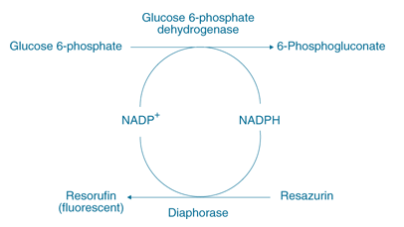
Enzyme Coupled Assays
Involves coupling the product of your reaction with another reaction that forms a detectable product
Exist for glucose, NADH, phosphate, and inorganic pyrophosphate
Notes:
Another way to monitor the course of an enzymatic reaction is an enzyme coupled assay. Here you mix another enzyme in with the one you are trying to monitor. In this example, they are monitoring the enzyme glucose-6-phosphate dehydrogenase. When this enzyme performs its reaction, it consumes NADP+. The enzyme diaphorase, which is the enzyme being mixed in, uses the NADPH generated from the monitored reaction to reduce resazurin resulting in a fluorescent dye. That dye can be quantified by fluorimetric methods. These assays exist to monitor not only NADPH formation, but also for NaDH, phosphate, and inorganic pyrophosphate.

Slide 14

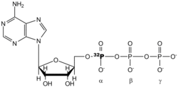
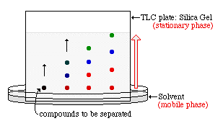
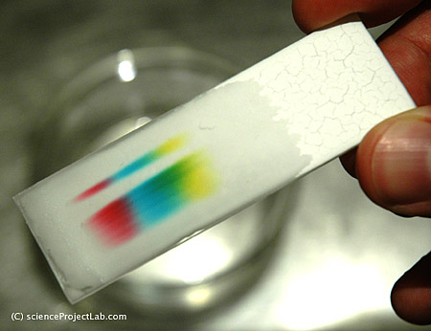
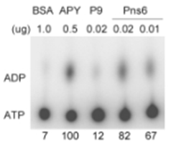
Radioactive substrates
Notes:
Though they are disfavored due to the dangers of working with radiation and the associated logistics and beurocracy of such work, radiation-based assays are powerful tools for monitoring biochemical reactions.
*
Suppose I want to monitor this reaction that consumes ATP. * I can purchase radioactive ATP that is labeled at the alpha position with 32P. If I dope some of this reagent into my reaction, it will be hydrolyzed to ADP. I then separate the molecules in my sample by thin-layer chromatography. Like the other chromatrography methods we have encountered, this one uses a stationary phase typically composed of silica gel. You place one end of the plate in a solvent and allow it to soak into the plate. As the solvent spreads through the plate, it will separate the compounds along the vertical axis of the plate. Thus, the ATP and ADP will separate. By placing the plate on a piece of radiation-sensitive film, you get an image of where the radioactive compounds came out. Based on the density of the bands, you can calculate the degree of chemical conversion.

Slide 15

Site-specific incorporation of unnatural amino acids
Pbad
MjTyrRS
His6
Total E. coli tRNA
Purified MjTyrRS
Notes:
Monitoring enzymatic reactions on large molecules, such as nucleic acids or proteins is often challenging. For example, let’s say you want to monitor the aminoacylation of a tRNA by an aminoacyl-tRNA synthases. First, you would * purify the synthetase, probably with a His tag. In this case, the protein is the M. jannaschii tyrosine synthase. * We want to quantify whether this synthetase accepts E. coli total tRNA as a substrate.

Slide 16
Filter binding assays
Tritium-labeled Tyrosine
ATP
Notes:
We purchase Tritium-labeled tyrosine. You can buy radioactive versions of many of the common metabolites and cofactors, and all the amino acids are available. You will incubate the tRNA sample, the synthetase sample, ATP, and hot tyrosine in a reaction. * The tritium-labeled tyrosine becomes covalently attached to the 3’ end of the tRNA.

Slide 17
Filter binding assays
Trichloroacetic Acid (TCA)-soaked Filter paper
Notes:
After incubation, we transfer the reaction to a piece of filter paper that has been soaked in trichloroacetic acid and then dried out. The acidity will quickly denature the sample and cause the tRNA and protein to precipitate in the paper.

Slide 18
Filter binding assays
Dispense reaction on TCA-soaked filter paper
Wash with 10% TCA multiple times to remove small molecules
Exchange out water with ethanol
Dry out ethanol with ether
Measure radioactivity with a scintillation counter
Notes:
So, now the reaction is quenched and all the metabolites are in the paper. * We then soak the filters in 10% TCA. Unreacted hot tyrosine * diffuses out of the paper. * After several washes we soak the paper in ethanol to remove water, then dry it out with ether, then place the filter in a vial and quantify the radioactivity with a scintillation counter. We can then calculate how much of the hot tyrosine remains on the filter, and from this quantify the conversion during the reaction.

Slide 19
Radioactive assays
Gamma-32P ATP is a commonly used reagent for assays employing kinases
Can transfer the “hot” phosphate to other biomolecules and then detect them in filter-binding assays
Alpha-labeled NTPs and dNTPs are also commonly used for labeling and detecting nucleic acids in assays
Detect with film after running a PAGE or agarose gel, or using a scintillation counter
Other common radioactive probes are I131-labeled proteins (make any protein “hot”), Acetyl-CoA (transfer “hot” acetate to a biomolecule)
Notes:
Another common reagent is Gamma-32p ATP. Amongst other uses, it is great for monitoring kinase reactions. Whenever the recipient molecule is a polymer, you can detect its labeling using the filter-binding assay. So, gamma-32P filter binding assays can be used to watch kinases that phosphorylate proteins. Many assays will involve body-labeling a nucleic acid with radioactivity. This done by doping in alpha-32P labeled NTPs or dNTPs during synthesis of the nucleic acid. The radioactivity will then cause the bands to light up after separation on a PAGE or agarose gel. Other common radioactive probes are I131-labeled proteins, and radioactive acetyl-coa.

Slide 20
Binding Assays
Notes:
The other type of molecular function is binding, and there are ways of monitoring non-covalent interactions too.

Slide 21
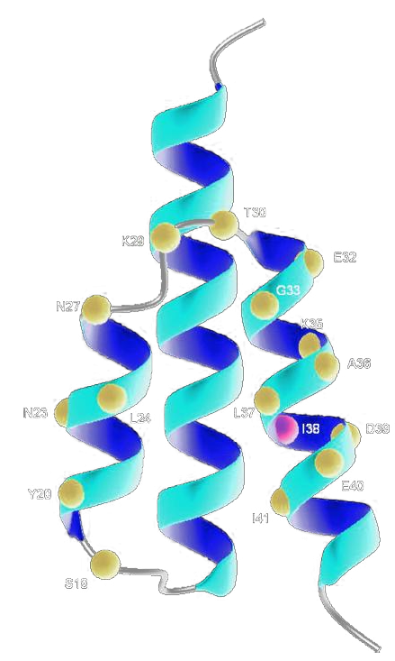
Human Serum Albumin Affibody
(Example of an ELISA assay)
Trying to engineer a protein that binds human serum albumin
I have some “hits”, but how do I confirm them?
Put individual genes in an E. coli expression system
Lyse the cells
Use ELISA to screen for ones that are human-specific (don’t bind to Rat Serum Albumin)
PMID: 18499681
Notes:
The most popular methods are variations on ELISA, or enzyme-linked immunosorbent assays. As an example, consider that we wish to engineer a protein that binds specifically to human serum albumin. Perhaps I designed a protein in silico and now wish to test whether it does what it was designed to do. In this case, it is an affibody which are short proteins derived from protein A. First, I will overexpress a gene encoding the affibody in E. coli, lyse the cells, and purify my protein. I will then perform ELISA to determine whether the protein binds to human albumin and not other albumins such as rat.

Slide 22
Affibody ELISA
(Enzyme-Linked ImmunoSorbent Assay)
Detect with H2O2/ABTS
(2,2'-azino-bis-(3-benzthiazoline-6-sulfonic acid) )
Yellow product
Add Streptavidin-HRP conjugate
ABTS
Add anti-protein A IgG/Biotin conjugate
Add affibody
Y
Y
Y
Y
Block with milk why?
Human Serum Albumin
PMID: 18499681
Notes:
I start with a maxisorb plate. ELISA plates are distinct from those used to culture cells. The polymer suface is sticky towards proteins. So, when we * add the human serum albumin or rat sample to the well, the protein becomes immobilized on the surface of the plate. We then * block the surface with milk to coat any surfaces of the plate that did not pick up the albumin. * We then add the purified affibody, and if it binds to the albumin, it will become immobilized. Unreacted affibody is washed away. * we then add an anti-protein A IgG/Biotin conjugate. Affibodies derived from protein A such as ours will react with the IgG antibody. This reagent will become immobilized on the plate as well. The Biotin is chemically reacted with the antibody in the company that supplies it, so biotin is now also immobilized on the plate. * We then add streptavidin-HRP conjugate which will bind to the Biotin. * Finally, we add hydroxgen peroxide and a chemical substrate called ABTS. Upon reaction with HRP a detectable product results. Thus, ultimately we are monitoring HRP reactions, but the HRP will only still be present in the well if all these other non-covalent reactions took place.

Slide 23
Other binding assays
Gel shift in native gels
Size-exclusion chromatography
Immunoprecipitation “pulldown assay”
Surface plasmon resonance “Biacore”
Capillary electrophoresis with an immobilized partner
Many microfluidic versions of binding assays available
Other higher-information binding assays:
Footprinting (determine where something binds, usually to nucleic acids)
Photo-Crosslinking (UV causes labeling)
ChIP on Chip (immunoprecipitation + microarray)
Notes:
There are many variations on ELISA assays. In all cases, you build up a sandwich of interactions that ultimate results in retention of a readily detected enzyme or a fluorophore and then read this out using the appropriate photometric or fluorometric method. There are other techniques. Gel shifts in native gels are one way of monitoring non-covalent interactions between proteins and DNAs. Here, you incubate the DNA with the protein and then run a gel. The band will migrate differently if it is bound to protein, and this can be quantified from the intensity of the bands. Gel shifts also can monitor protein : protein interactions. Size exclusion chromatography is another option. The complex formed by two interacting biomolecules is larger than either component, and it will result in a new band in the column which can be quantified. Surface plasmon resonance involves immobilizing the biomolecule on a solid surface and firing a laser at it. Larger complexes affect how light travels across the surface of the plate. Like affinity chromatography, you can line the surface of a capillary with one of your biomolecule partners. As you run a test partner through the capillary, it becomes bound and elutes later. Microfluidic technologies have been directed towards quantifying binding, and many such setups exist.
There are additional binding-based assays that are used to tease out additional information about your sample. In footprinting, you are not only asking whether a protein binds to a DNA, but also where does it bind to the DNA. You incubate the protein and DNA together and then treat it with chemical mutagens or a nuclease. In the regions where the protein binds, the DNA will be protected from modification. You later run a gel on the DNA and you can deduce which postiions of the sequence were protected. Photo-crosslinking involves modifying one of the partner biomolecules with a crosslinkable moiety such as benzophenone. Upon irradiation with UV light, that moiety will react with nearby nucleophiles on the partner biomolecule. You can then determine chemically which residues on the partner became crosslinked and is thus near the labeling site in the complex. CHIP on CHIP involves immunoprecipitation of a DNA-binding protein in crude lysates of cells. Pulling down the protein also pulls down any DNAs that it binds. You can then detect which sequences were pulled down using microarrays or deep sequencing.

Slide 24
Product Studies
Composition
Qualitative
Quantitative
Endpoint
Timecourse
Notes:
The other type of in vitro method is a product study. Here you are analyzing the chemical composition of the cells. Product studies can be qualitative or quantitative. Qualitative product studies ask some question about the structure of molecules in the cell. Quantitative product studies are interested in the concentrations of particular chemicals. These experiments can be endpoint assays, or they may contain multiple time points.

Slide 25
A two-step process
Purify the component or fraction of interest
Characterize the purified material
Notes:
In all cases, a product study involves first purifying the component of interest from the cells, and then characterizing the purified material using some appropriate analytical instrument.

Slide 26
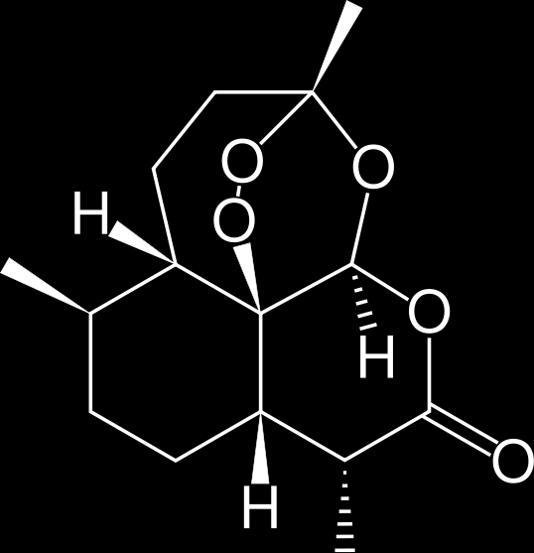
Microbial Synthesis of Artemisinin
100,000
10,000
1000
100
atoB
HMGS
tHMGR
10
1
MK
PMK
MPD
idi
ispA
Isoprenoid (mg/L)
0.1
0.01
ADS
AMO
CPR
0.001
0.0001
2001
2002
2003
2004
2005
2006
Keasling Lab, UC Berkeley
Notes:
Let’s start with an example. The Keasling lab and Amyris performed a well-known project in which they optimized production of amorphadiene, a precursor to an antimalarial drug. * Their experiment involved variant biosynthetic pathways and strain modifications, and in each case they need to quantify how much chemical each strain produces. In this chart, they are performing an endpoint product study. For the best strain available in each year, they are quantifying the maximal yield of amorphadiene in the cultures using GC-MS. For such an experiment, they needed to choose an appropriate extraction method and an appropriate analytical method for detecting the molecule they care about.

Slide 27
Extraction of small molecules
Methanol Extraction
Toluenization
Hot phenol/Water
Permeabilization with mild detergents
Fraction-specific methods:
Bligh–Dyer extraction of lipids
Liquid-Liquid extraction of Ammonia-treated material for alkaloids
Analysis methods
Liquid chromatography (UV or MS readout)
Gas chromatograph (UV, flame, or MS readout)
Thin-Layer chromatography (UV or radioactivity readout)
Mass spectrometry
Nuclear magnetic resonance (NMR)
Notes:
There are many methods for extracting small molecules from cells, and each isolates a different subset of material. There are very general methods like Methanol extraction, toluenization, hot-phenol, and detergents, but there are also protocols that more specifically isolate a fraction of the cell. A Blgih-Dyer extraction procedure is used to isolate membrane lipids. For alkaloids, there are ammonium extraction methods that take advantage of the distinctive pH-dependent solubility of these molecules. The best method for any molecule is something an experienced analytical chemist can determine, but does not reduce to trivial rules.
*
There are also many choices for analyzing the product. In liquid chromatography, the mobile phase is a liquid, typically water, methanol, or acetonitrile, and the column is beads typically coated with C18 hydrocarbon chains. Usually the tail end of an LC is connected to an MS. LC-MS is the method of choice for non-volatile chemicals. GC involves a gaseus mobile phase and is useful for volatile chemicals. It also usually is connected to a mass spec. You typically have more than one detector on a chromatographic instrument. UV is very common. For some chemicals, including radioactive ones, thin-layer chromatography is preferred. In addition to chromatographic methods, some product studies will require closer inspection of the molecule’s structure. For this, the various NMR techniques can precisely identify the structure of a pure molecule.

Slide 28
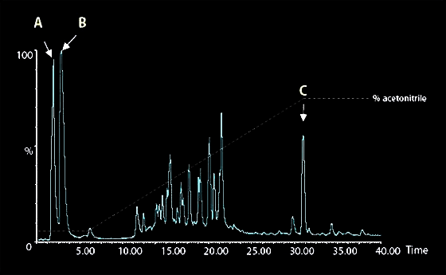
Endpoint Product Study
(Characterization of amorphadiene product)
Extract small small molecule fraction from cells by:
Solubilization with methanol
Extraction into ethyl acetate containing an internal standard (trans-caryophyllene)
Analyze products by GCMS (gas chromatagraphy-mass spectrometry)
Notes:
In the amorphadiene example, the extraction method chosen involved solubilization with methanol followed by extraction in ehtyl acetate doped with an internal standard, in this case trans-caryophyllene. An internal standard is used to calibrate the concentration of your chemical in the sample. If you know the molar concentration of the standard, you can relate the intensity of the peaks to this value and back-calculate the concentration of your unknown. For the analysis step, they choose GCMS because amorphadiene is mostly hydrocarbon and thus volatile. They get traces off the column, and using authentic standards they can determine at what time amorphadiene and caryophyllene elute. Thus they can identify the peaks for these compounds in their spectra, integrate the area under these peaks, and use those numbers to calculate concentration. By comparing different strain designs, they can identify modifications that improve the yield.
In this example, we are performing an endpoint analysis on a single chemical component. A related technique is metabolomics. Here you are performing an endpoint product study, but examing many different metabolites in the cell. Experimentally, the basic setup is the same, but it requires a more expensive, higher-resolution mass spectrometer.

Slide 29
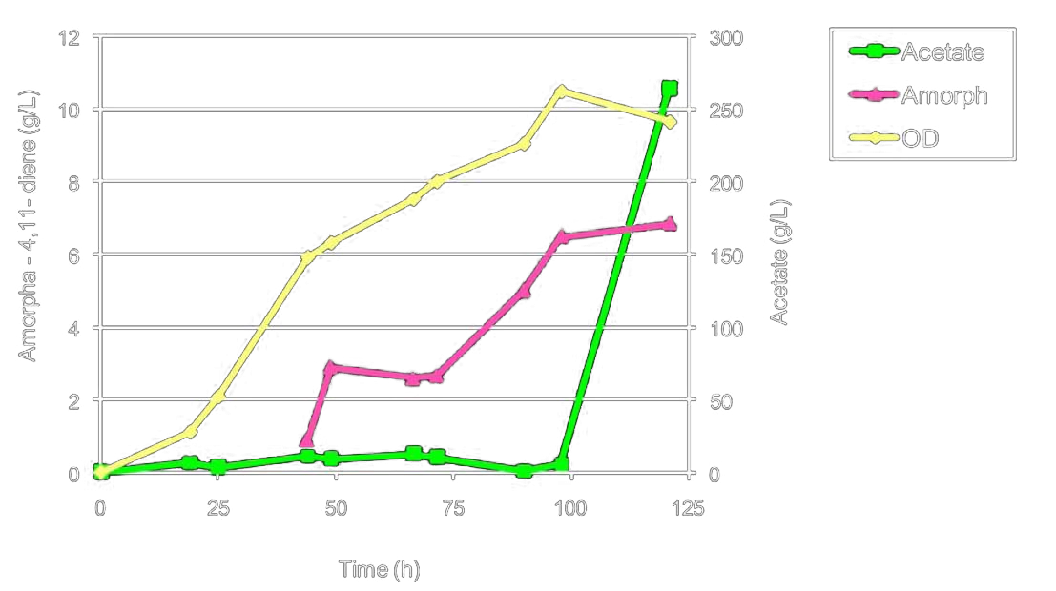
Kinetic Product Study
(Timecourse of amorphadiene production)
PMID: 19221601
Notes:
In other related experiments, they perform timecourse experiments. Here, they are following a culture of amorphadiene-producing cells in a bioreactor over time and quantifying the optical density, amount of amorphadiene, and amount of acetate at different times. In the previous endpoint experiment, the goal was to compare different strains. In this experiment, the goal is to characterize a single strain in the context of a scaled-up bioreactor. They want to know how to optimally run the bioreactor to maximize product yield. Acetate accumulation is common byproduct during fermentation and is one route by which carbon can be lost during conversion from glucose. Minimizing this loss is often the goal of these projects. So, when dealing with microbial chemical factory apps involving small molecules, the scope of analytical techniques you need to consider is fairly clear.

Slide 30

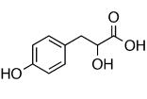
Alpha Hydroxy Acids
TAG
UaaRS
o-tRNA
DHFR-TAG
How can we determine if this is working?
His6
UAG
PMID: 18069708
Notes:
When you diverge from the small molecule apps, things get more complicated. Here is an example of a microbial chemical factory app that produces a more complex product: it makes a protein containing an alpha-hydroxy linkage in the backbone. The E. coli cell is engineered with three genes. The first encodes the target protein. The site where an alpha-hydroxy acid will be incorporated is encoded by a TAG stop codon. The cell also contains a tRNA that can decode the TAG stop. The third gene is an aminoacyl-tRNA synthetase that specifically charges the tRNA with the alpha-hydroxy acid. There is a long story to how you engineer such synthetases and tRNAs, but the quesiton for us today is how do you analyze such a product?

Slide 31
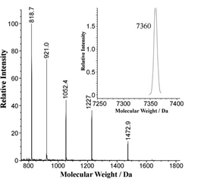
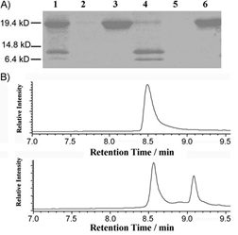
Analysis of protein products
Electrospray MS
MALDI of tryptic fragments
In this case, NaOH hydrolysis
PMID: 18069708
Notes:
Like any product study, the first step is to purify the component you wish to analyze. Because the target is a protein and we have control over its gene sequence. So, we can add a his tag to the gene and purify it with Ni-NTA chromatography. Just like with the small molecules, there are mass spec methods for detecting protein products. The LC-MS setups used to monitor small molecules typically don’t work for larger proteins. It is a more expensive mass spectrometer for proteins, but the basic idea is the same – you will ionize the protein then zip it through a magnet. In Electrospray, you vaporize the sample, and as the solvent evaporates ions get trapped in the particle giving it charge, allowing detection by mass spec. You end up with several bands in the spectrum for each protein corresponding to particles with different charge. Software can backcalculate the size of the protein from this data very precisely. In the case of the alpha-hydroxy acid, the only difference between the desired product and the normal all-peptide product is an exchange of a nitrogen atom for an oxygen atom. Thus, the size difference turns out to be only one dalton. However, electrospray is sufficiently precise to distinguish this subtle difference.
*
For this particular product, there is another analytical method we can use to unambiguously confirm the identity of the product. Unlike peptide linkages, an ester linkage is susceptible to hydrolysis with base. So, if you incubate the sample and some controls in sodium hydroxide, the desired product will get cleaved at the site of the alpha hydroxy acid. You then run a PAGE gel to separate the fragments. In lane 4 of this gel, you see the expected fragmentation of the product.

Slide 32


Plasmid Based Gateway in vivo
Kill Device
Gateway Device
Chloramphicol Resistance
Kanamycin Resistance
Notes:
Only for class
32

Slide 33
Plasmid Based Gateway in vivo
Notes:
33

Slide 34
Plasmid Based Gateway in vivo
Kanamycin and Chloramphenicol Sensitive
Kanamycin and Chloramphenicol Sensitive
Contains Lethal ccdB
Survives
Notes:
34

Slide 35
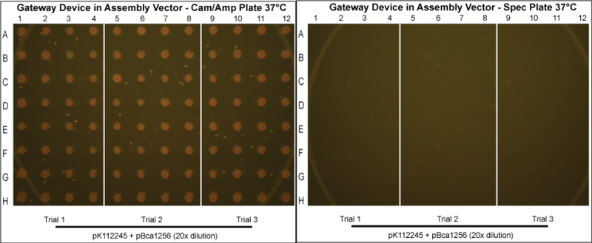
in vivo Gateway
How do you know the chemistry is working?
Do a product study:
Purify the plasmid (the product)
Sequence it and see if it is the correct sequence

Slide 36
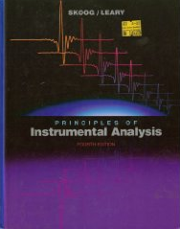
This is Analytical Chemistry!
Search for papers where they analyze the biomolecules you are interested in
Read the materials and methods section and see how they quantified it
Notes:
What we’ve been discussing is analytical chemistry, and there is a great textbook covering all aspects of the field called ‘principles of analytical chemistry’. In the real world, your choices about the appropriate test protocol will begin with a literature search. You will locate papers where the experimentalists analyzed molecules similar to yours, then look in the materials and methods section for how they did it.

Slide 37

Questions to Ponder

Slide 38
I’ve constructed a “yellow pigment device” that makes xanthophyll. My cells are turning yellow. What type of experiment should I do to characterize my device?
I’ve taken my yellow pigment device and joined it to an HIV biosensor device. What experiment should I do to characterize the entire system?
I’m trying to make a “cancer cell adhesion device” that displays a Thomsen-Friedenreich antigen binding lectin on E. coli’s surface. It isn’t working, and I think my lectin part might be a dud. What should I make with the lectin part, and what experiment should I do to see if it works?
I’ve read that a phage protein will covalently attach itself to the 5’ hydroxy of a DNA with a 5’ phosphate. I made a part out of the coding sequence. What should I do to characterize the activity of this part?

