Slide 1
Refactoring
Notes:
Refactoring refers to the rewriting of computer code to improve it by altering its internal structure without changing its external behavior. In the context of biology, this means altering a set of genes without disrupting their original function. Two scenarios are often encountered. One is genome refactoring. Here, a genome of an organism is rewritten to introduce convenient cloning sites for further investigation, or for defining the minimal set of genes for that organism. Such work has been carried out with phage T7, the Mycobacterium genome, and Yeast chromosomes. The other context is refactoring of genetic devices often as a prelude to transferring those genes into another organism.

Slide 2
Complex Devices and Refactoring
Notes:
Refactoring refers to the rewriting of computer code to improve it by altering its internal structure without changing its external behavior. In the context of biology, this means altering a set of genes without disrupting their original function. Two scenarios are often encountered. One is genome refactoring. Here, a genome of an organism is rewritten to introduce convenient cloning sites for further investigation, or for defining the minimal set of genes for that organism. Such work has been carried out with phage T7, the Mycobacterium genome, and Yeast chromosomes. The other context is refactoring of genetic devices often as a prelude to transferring those genes into another organism.

Slide 3
Regulation: Transcriptional Control
A
B
C
P
Changing promoters eliminates transcriptional control
Notes:
In the context of biosynthesis, we discussed how we could refactor a biosynthetic pathway by stripping the enzyme-coding genes of their regulation and then recombining them with well-studied parts.

Slide 4
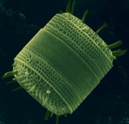
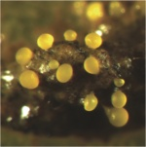
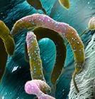
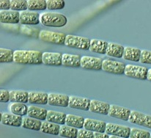
Diversity of Natural Devices
Diatoms
Myxococcus xanthus
Caulobacter crescentus
Cyanobacteria
Can we encode these processes as genetic devices?
Can we make new devices on this level of complexity?
Notes:
We’ve also looked at some more complex devices involved in the interactions between microbes and other biological systems. But there are also very exotic processes encoded by microbes that have nothing to do with pathogenesis or commensalism. These include biomineralization, DNA manipulation, DNA uptake, spore formation, fruiting body formation, surface adhesion, photosynthesis, chemotaxis, cannabilism, cell geometry, and so forth. In the next few chapters we will address the questions, can we encode these processes as genetic devices? And can we make *new* devices on this level of complexity?

Slide 5
Core bacterial chassis
Cell growth and division
The Central Dogma
Primary Metabolism
Environment Sensing
~3000 genes common to all bacteria
Encoded by ~3 million bases of DNA
Almost identical among Enterobacteria
Notes:
To explain these more exotic functionalities, let’s start with the basics. Every organism minimally needs to solve 4 issues. They must be able to grow and divide, undergo the central dogma processes, produce the chemicals that enable the central dogma, and have the ability to respond to changes in the outside world. In practice, this requires around 3000 genes for an autotrophic organism such as a non-pathogenic bacterium, and it is encoded by around 3 millsion base pairs of DNA. If you compare these genes from one species to the next you will see they are highly conserved. They are almost identical amongst the enterobacteria, and typically homologs of these genes or alternate solutions are present in all bacteria.

Slide 6
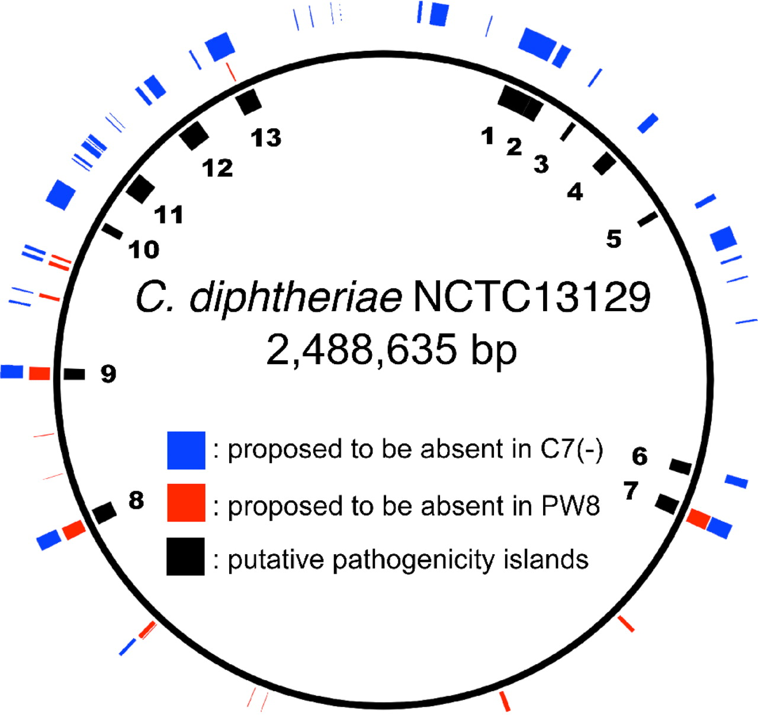
Secondary Functions
Notes:
Then there is the other stuff which varies from strain to strain within one species. It is the existence of these secondary functions that often distinguishes one species of bacteria from another and leads to their specialized adaptation to specific environmental nieches. These are the genes that encode things like secondary metabolism, specialized development programs, virulence factors, and the like. Evolutionary pressure caused by horizontal transfer of these genes pushes their sequence into gene clusters organized at specific regions of the genome. Here you are looking at the Corynebacterium genome. Based on homology to known virulence factors in other organisms, you see the locations of 13 islands. In two other strains of the bacterium, you get similar patches of genes that are present in some strains and not others. This pattern of having conserved loci for a type of gene cluster at specific regions of the genome is very common. For example, if an E. coli strain encodes an O-antigen, it most likely will be present between the gnd and galF genes, but will be an entirely different sequence from one strain to the other. The evidence of clustering implies horizontal gene transfer which implies that somehow these genes are sufficient to encode a process. As we’ve seen in previous chapters, many things can get broken when you move a set of genes to another organism.

Slide 7
When synthesis is (essentially) free
Today, just synthesizing long sequences (10kb+) is something you do cautiously since its expensive
Microbiological devices are pretty much always 10kb+
They rarely transfer from one genome to another
“Refactoring” would generally be some sort of reliable methodology that allowed you to take a known sequence, know the full ensemble of gene functions within it, then rework the coding sequences and regulation so that it works in your organism.
Not a common activity yet. It’s clearly hard.
Hypothesis 1: All these things really are is:
A set of molecular functions encoded as proteins
Transcriptional control over when each protein is produced
Quantitative control of each gene’s expression level
If that’s true, you should be able to gut the regulation, reshuffle all the codon usage, and the thing still work
Notes:
One of the challenges in studying the transfer of clusters from one organism to another is their cost. As of 2013, 10kb of DNA costs $2000, which is non-trivial, and often these clusters are far larger than 10kb. Additionally, the usual result of trying to transfer one of these clusters into a model organism like E. coli is for something to get broken in the process. Thus, in practice you rarely can just clone out or synthesize the sequence present in the source organism and put it into E. coli.
*
A specialized definition for refactoring in the devices context is reliable methodology to take a known sequence and then adapt it to work in your choice organism. This is a very new idea in genetic engineering, and very few example exist yet. The challenge here is what exactly do you need to take into account to have a robust methodology?
*
The simples hypothesis interprets a gene cluster as being defined by a set of molecular functions encoded as proteins, transcriptional control over when each protein is produced and control of each gene’s expression level
*
If that is all that is required to have a well-performing gene cluster, then it should be possible to remove all endogenous regulation by removing 5’ and 3’ UTR sequences, reshuffling the codon usage, then putting back appropriate ribosome binding sites and promoters. It is not clear yet how general this approach is, but time will tell.

Slide 8
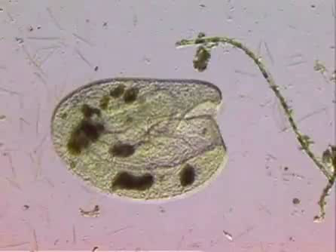
Eukaryotes are a whole other story
Bursaria truncatella
http://video.yandex.ru/users/labx/view/46/?cauthor=labx&cid=3
Notes:
We’re going to stick to simple prokaryotic processes and explain how a few work, but I want to show you this video so that you can see just how complex microbialogical devices can be. This single-celled organism is called Bursaria. If you look at many of these organisms under a microscope you’ll see that they are all structurally identical. They each have equally sized feeding organs that siphen in food particles and then digestion. If this were a worm it wouldn’t be anything extraordinary. Multicellular organisms have things like mouths and stomaches ubiquitously, but this is a single-celled organism. There are no intermediary modular objects inside this one cell—these are in the realm of chemical objects and all this morphology must be encoded as biochemistry. We won’t try to make any sense of Bursaria in these lectures, but clearly the potential for complexity amongst microbiological devices is quite extraordinary.

Slide 9
T7 Refactoring
PMID: 22509035
Notes:
Refactoring involves rewriting a natural genetic sequence for various purposes. Often the goal is to transfer processes from one organism to another, but in other cases the goal is more subtle.

Slide 10
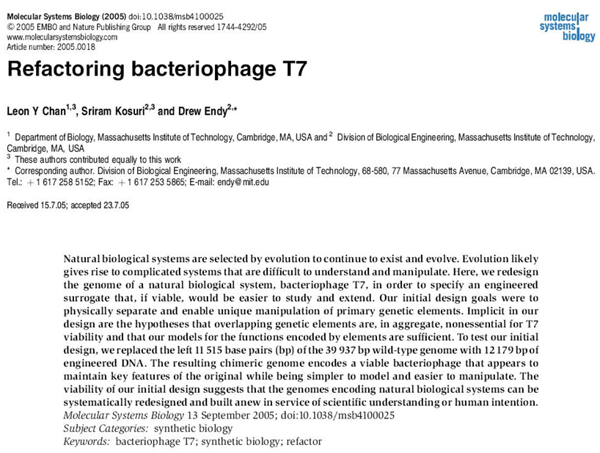
PMID 16729053
Notes:
In this study, Endy and coworkers rewrite the T7 genome to have well-defined gene boundaries amenable to BioBrick-style cloning methods. It was the first introduction to the idea of rewriting a genetic circuit to make it more engineerable through refactoring.

Slide 11
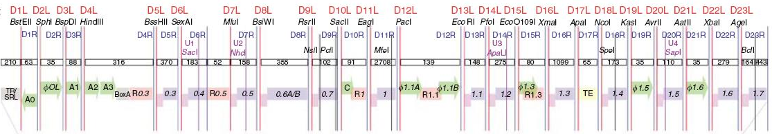
Refactoring T7 Phage
Previous efforts to model T7 phage infection were unable to make predictions about the effects of mutations in T7
Clearly there are aspects of T7 that are either misunderstood, or just not yet identified
To make a “simpler” T7, Endy and co. refactored T7 into a cloning-friendly variant
The essential difference between “T7.1” and wt is the introduction of unique restriction sites at useful spots and the repair of overlapping genes into “normal” separated operons
Notes:
The T7 phage infects E. coli and is encoded by a 40 kb genome encoding 55 proteins. It is an extensively well-studied organism from the perspective of traditional genetics, and a great deal is known about the role of each protein. Many of these proteins are involved in forming the proteinaceous shell of the phage, while others are involved in the DNA replication and packaging steps, lysis of the cell, and a great deal of regulation.
*
In previous studies the authors had done computational models to T7 phage but were unable to make predictions about the effects of mutations in T7
*
It was clear that subtle aspects of T7 were either misunderstood, or not yet identified. Part of the difficulty is that phage often contain overlapping open reading frames in which the coding sequence of one protein overlaps the regulation of another. Such scenarios can give complicated behavior.
*
Their proposed solution is to try to construct a phage that behaves like the model rather than making the model fit the phage. The first step for this would be to introduce sites into the phage that allow them to swap in and out regulation.
*
What they come up with is a variant of T7, called T7.1, and the essential difference between the engineered phage and wildtype is the introduction of restriction sites at useful spots in the genome and the repair of overlapping genes into “normal” style separated operons.

Slide 12
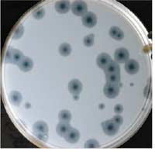
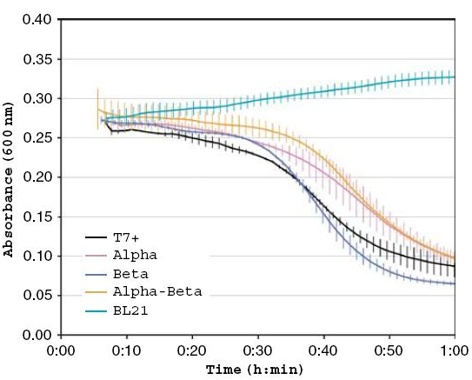
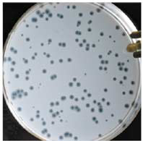
…and it’s still viable
Wildtype
Refactored
Notes:
Though the engineered phage is less potent than the wild-type in lysis assays, the phage is still functional. What this shows is that you can introduce large-scake purturbations to regulatory regions in a genome without breaking it. This is what we might expect based on our understanding of the regulation in this system. The idea of entirely re-writing genomes to make them more engineerable is an ongoing area of research as most actively exemplified by the Synthetic Yeast 2.0 project.

Slide 13
Refactoring Nitrogenase
PMID: 22509035
Notes:
Nitrogenase is an enzyme complex encoded by many bacteria that is able to fix nitrogen from air and reduce it to ammonia.

Slide 14
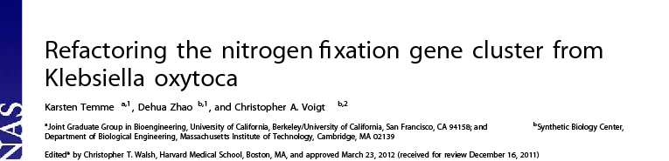
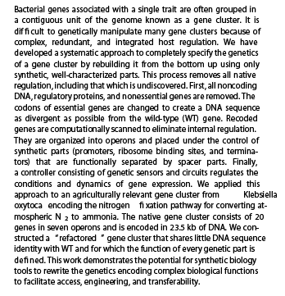
Notes:
In this study, Voigt and coworkers refactored the nitrogen fixation gene cluster from Klebsiella. The ultimate goal is to make these genes portable such that nitrogen fixation could be transferred to other organisms such as plants. In these experiments, they demonstrate the first steps of the process wherein they are able to functionally replace the Klebsiella cluster with the refactored copy.

Slide 15
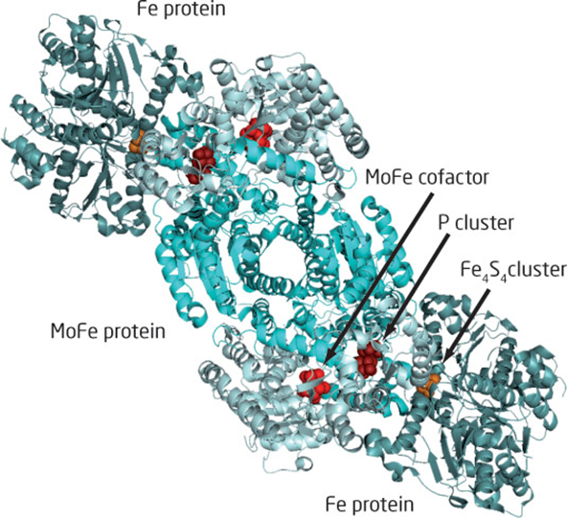
Nitrogenase Complex
Notes:
Nitrogenase is a multi-enzyme complex composed of a heteroterameric Molybrdenum/iron protein and a homodimeric iron protein.

Slide 16
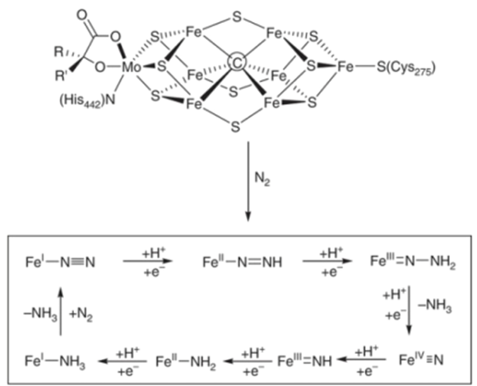
Nitrogenase Reaction
Notes:
The reaction catalyzed by nitrogenase involves reduction of nitrogen with the consumption of ATP to produce ammonia and release hydrogen gas.
*
Reactions like this are usually quite challenging to catalyze. The substrate (N2) is very small and stable, so it is challenging to have an active site that can bind to it. Enzymes that react with very small molecules like gases typically employ a metal center, and for Nitrogenase, this involves a complicated complex of Molybdenum, iron, and sulfur. It isn’t essential that you understand the chemistry to understand this paper. Suffice it to say, nitrogen binds to one of the iron centers and then electrons and protons are transferred iteratively until the N2 molecule is fully reduced to two ammonia molecules. What is important to understand is that iron/sulfur centers are often very challenging to transfer out of their native context. They require their own set of enzymes for biosynthesis.

Slide 17
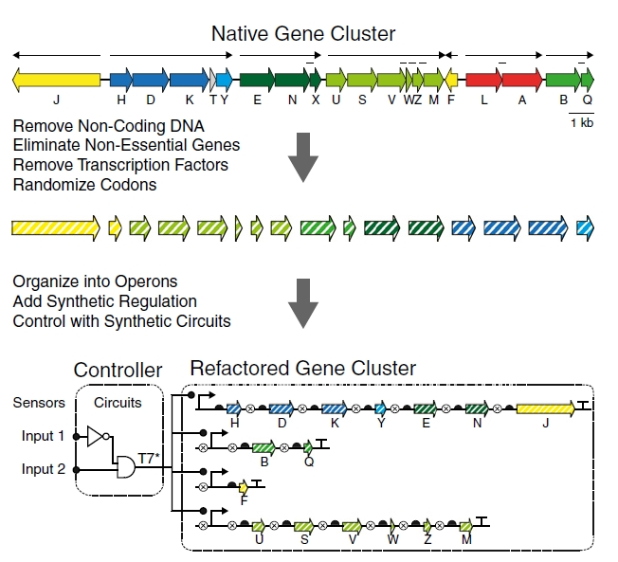
Refactoring Nitrogenase
Notes:
In their native context, the scaffolding proteins nifJ and nifF genes are expressed at low levels, and when you attempt to overexpress them activity drops rapidly. The nifUSVWZM genes, in army green are responsible for biosynthesis of the smaller Fe-S clusters. The nifBQ genes in forrest green are responsible for formation of the iron/molybdenum core. These enzymes are natively expressed 10x higher than the scaffolding genes. There are additional genes, such as nifL and nifA that play regulatory roles within the cluster and thus would be removed during refactoring. In their experiment, the authors start with the wildtype sequence, extract out the open reading frames, and then remove unwanted genes. They remove any genes that through genetic experiments are known to be non-essential for the function of the cluster. They also remove any regulatory genes such that only the functional components of the cluster remain. They then randomize the codons in these ORFS and reassemble synthetic operons with synthetic promoters. The only ambiguous questions to be answered are what ribosome binding sites, promoter strengths, or novel regulation to put in. This last aspect ultimately is the engineering challenge of such an effort. It would be difficult to do a fully combinatorial sampling of the space. For even two choices of rbs at each position, there are 17 genes and thus 2^17 or 132,072 permutations, and most likely more than two choices of rbs would be required.

Slide 18
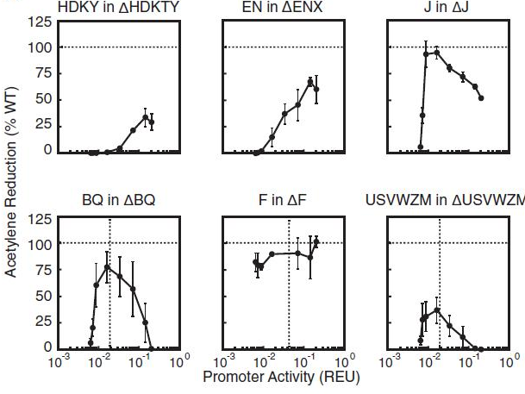
Complementation
Notes:
This question of how to choose the regulation is ultimately a subject of research. In later papers, the Voigt team has taken other optimization strategies that have been more effective in finding the optimum. This experiment, however, gives some notion to the complexity of the fitness landscape. First, they use the RBS calculator to pick a single ribosome binding site for each gene that is predicted to be in the ballpark of the native construct’s RBS strength. They then systematically vary the promoter for each operon and examine whether that operon complements a knockout of the corresponding genes in the native cluster. In each chart, the promoter in front of one operon is being systematically varied, and the nitrogenase activity of each synthetic cluster is the Y axis. What is clear is that the expression level of several of the operons affect the overall activity and have fairly narrow optima.

Slide 19
Photosynthetic Clusters
Notes:
Refactoring photosynthesis isn’t something that has been done yet. However, I want you to understand what goes on inside the more complex gene clusters to see the diversity of processes that can occur. There are many ‘advanced’ gene clusters in prokaryotes. Magnetosomes are another really popular example. In terms of us having extensive knowledge about what is encoded by these clusters in molecular terms, no process is better studied than photosynthesis. Thus, I will describe to you how this process works and how you might approach refactoring it. Refactoring photosystems is one of the problems on the 10-year horizon for our field, but is impractical with existing infrastructure. Nevertheless, it is a good example for thinking through how to approach designing biology in modules.

Slide 20
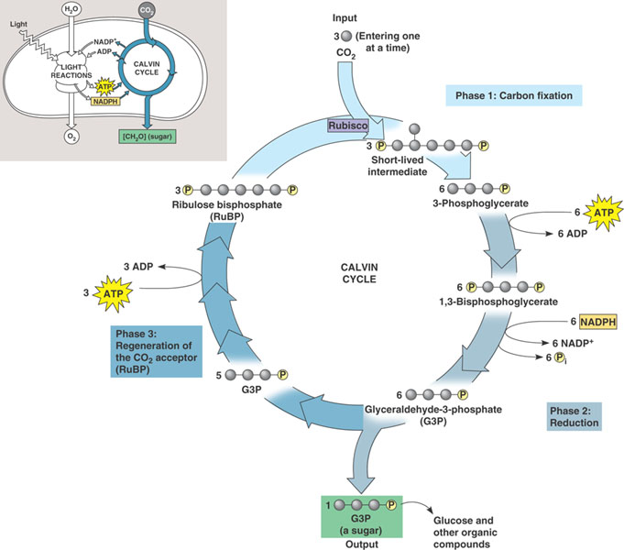
Photosynthesis
Many bacteria, including Cyanobacteria, do photosynthesis
Combination of light harvesting (the photosystem), and carbon fixation (the carboxysome)
Compartmentalized within bacteria
Gene cluster doesn’t do anything in E. coli
CO2 from the air
Energy comes from the photosystem
Goes into gluconeogenesis; also part of glycolysis (central metabolism)
Notes:
Many bacteria including the cyanobacteria perform photosynthesis. The overall process is split into two portions, the light harvesting system otherwise known as the photosytem, and the carbon fixation process that is called a carboxysome. Both of these processes are in some way comparmentalized within bacteria. The carboxysome is an array of enzymes inside a proteinaceous shell, and the photosystem is a series of chromophores decorating a large integral membrane protein. This system has been studied extensively from a genetics and biochemical perspective. The importance and role of the many genes is well known. However, when you move the gene cluster into E. coli, nothing happens. Thus, making a ‘photosynthetic device’ for use in E. coli or other organisms would require a refactoring effort.

Slide 21
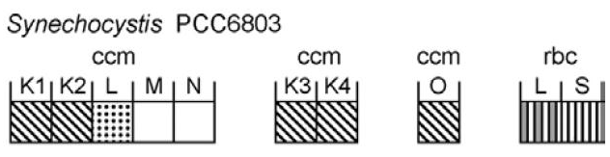
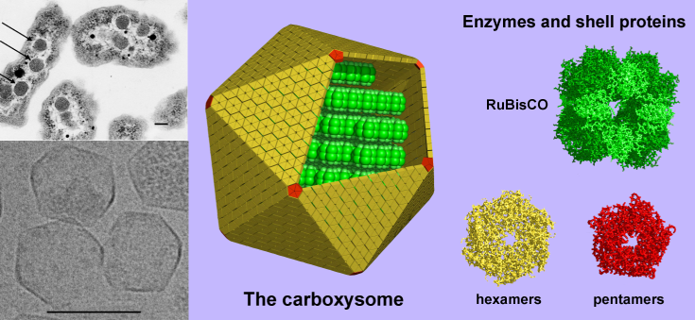
Photosynthesis
A clear modularity point for breaking this apart is between the photosystem and the carboxysome
Genetic analysis in bacteria containing these clusters shows that the connectivity between the two is simply the transfer of metabolic intermediates
Separate the task into making distinct carbon-fixing and light-harvesting devices
All the genes for photosynthesis are known and extensively studied with plenty of genetics
All the enzymes needed to do the Calvin cycle are housed within the carboxysome and are similarly well-studied
Notes:
If we want to reconstruct photosynthesis in E. coli, we’re going to need to simplify the problem. There are 100’s of KB of genes involved in such an experiment, so we’ll need to be able to debug the system with simpler substructure of the entire process. A clear modularity point for breaking this apart is between the photosystem and the carboxysome
Genetic analysis in bacteria containing these clusters shows that the connectivity between the two is simply the transfer of metabolic intermediates. For example, the photosystem process continues to occur even when there is a knockout of the carboxysome.
So, we should be able to separately engineer the two processes. We can separate the task into making distinct carbon-fixing and light-harvesting devices
Fortunately, all the genes for photosynthesis are known and extensively studied with plenty of genetics. Furthermore, all the enzymes needed to do the Calvin cycle are housed within the carboxysome and are similarly well-studied

Slide 22
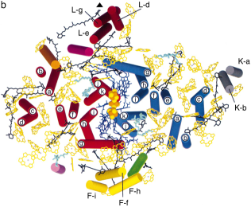
Light Harvesting Complex
There are 2 photosystems: PS1 and PS2, we’ll focus on PS1
There are 2 types of pigments: a carotenoid and bacteriochlorophyll
A multi-protein scaffold that holds these pigments in place in the inner membrane
Light absorbed by the chromophores is translated into chemical energy by splitting water releasing oxygen and protons, in the process creating a proton gradient
Protons drive ATP synthase which generates ATP
Notes:
The first one to tack is the photosystem. The most studied gene cluster for a photosystem is from Rhodobacter sphaeroides. Most organisms have two such photosystems, PS1 and PS2, and we’ll focus on PS1 though PS2 is a fairly similar process.
*
PS1 encodes 2 metabolites which are pigments: one is a carotenoid and the other a bacteriochlorophyll
*
It also encodes a multi-protein scaffold that holds these pigments in place in the inner membrane
*
Light absorbed by the chromophores is translated into chemical energy by splitting water releasing oxygen and protons. This results in a proton gradient. Proton influx drives ATP synthase which generates ATP. Thus, the photosystem converts light energy into the chemical energy stored in phosphodiester bonds.

Slide 23
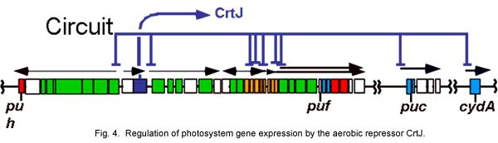
Light Havesting Complex
Notes:
The gene cluster encoding photosystem 1 is 40.7kb in length and contains 38 open reading frames. It is divided into around 8 operons with a complicated regulatory relay under the control of a transcription factor CrtJ. Since we are going to refactor this thing, we will ignore all this regulation.

Slide 24
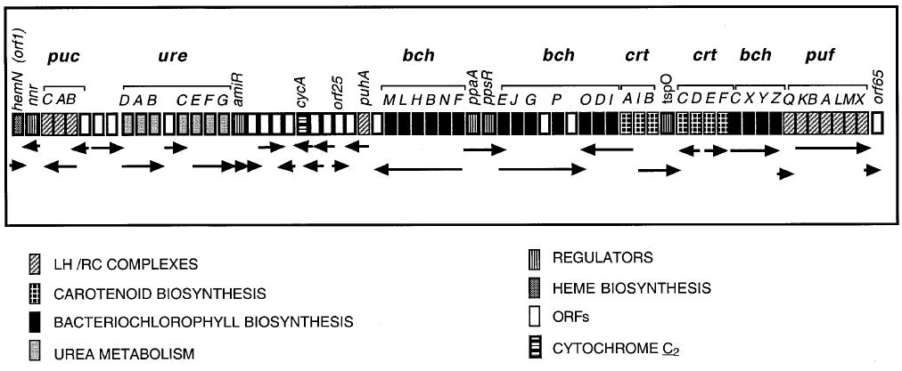
Rhodobacter sphaeroides PS1
Protein scaffold
Biosynthesis of pigments
45kb
Notes:
Thus we just need to focus on the coding sequences. Within the photosystem there are multiple distinct processes underway. There are 3 distinct operons each encoding monofunction enzyme pathways for production of the pigments, there are operons encoding each component of the protein scaffold, and then addition genes encoding related processes such as urea metabolism. If we want to refactor this, we probably need to break it down further into more lab-manageable chunks. The entire gene cluster encodes a singular process in the sense that if we enumerated all the intramolecular interactions in this system, we’d find that each gene touches another gene either by interactions of the proteins in a complex or though the sharing of a metabolite. The most practical way to decompose a project like this would be do divide the task by means of the smaller processes that have assayable phenotypes. One clear place to do this would be around the biosynthetic operons. Though the pigment product of these operons becomes incorporated into the photosystem, the biosynthesis of the pigment itself would occur regardless of whether the photosystem is present. Thus, we should be able to construct operons that just make the pigments as a first step towards constructing the entire device.

Slide 25
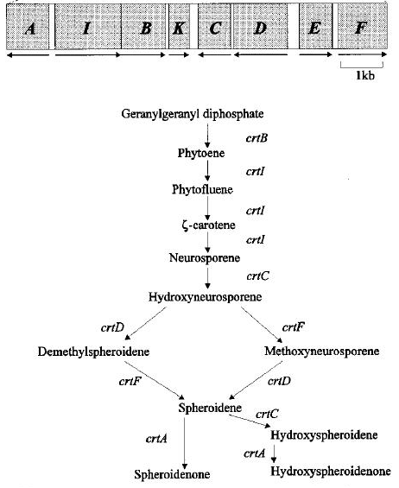
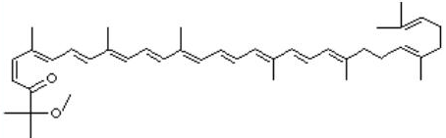

Carotenoid biosynthesis
Spheroidenone
Hydroxypheroidenone
Notes:
Carotenoid biosynthetic pathways have been extensively explored. Like all terpenoids, they fan out from IPP, and more specifically from geranylgeranyl disphosphate and then Phytoene. Two common carotenoids in photosystems are spheroidenone and hydroxyspherodenone, and both are biosynthetically reachable using normal monofunctional enzymes. Thus the task of producing this substructure of the photosystem is no different than any other small molecule biosynthesis problem.

Slide 26
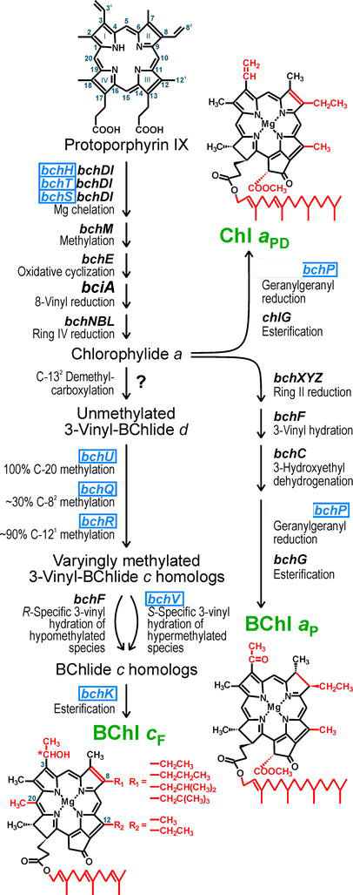
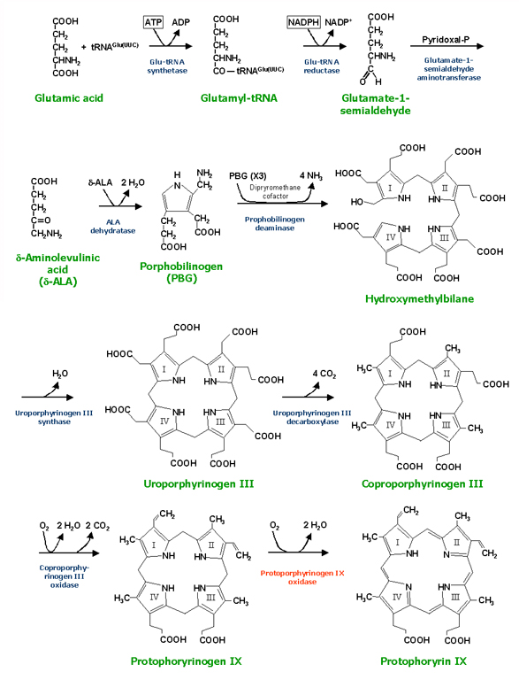
Bacteriochlorophyll biosynthesis
Notes:
Bacteriochlorphyll biosynthesis is similarly just a small molecule biosynthesis problem. It has been noted that it is a very challenging one because these pigments tend to be toxic when there is no light havesting complex to absorb the product. Also, it is a particularly long biosynthesis which would make it more challenging, but nevertheless it is essentially a small molecule biosynthesis problem. Protoporphyrin IX is a key intermediate in the biosynthesis of bacteriochlorophyll, but it is also the penultimate step of heme biosynthesis. Thus, most organisms, including E. coli and yeast, already make this intermediate. The remainder of the genes are specific to photosynthesis and are encoded within the PS1 gene cluster.
In addition to producing all the pigments, they must be taken up into the light havesting complex which also must be expressed. Fortunately, it is known you can functionally separate these steps. If you knockout the biosynthesis of these pigments in the source organism, they can be complemented by exogenous feeding of the pigments with restoration of function. Thus, constructing the photosystem could be divided into three parallel tracks: refactoring of the scaffolding proteins, refactoring of bacteriochlorophyll, and refactoring of the carotenoids.

