Slide 1
Grading
Midterm Exam: Take-home, covers DNA manipulation and analysis
Final Exam: Written exam, covers experimental design, analysis, and interpretation
*Midterm and Project Proposal are due on time. The penalty for late submission is 1 pt per hour unless an alternate due date is arranged at least 5 days in advance
** Tutorials are due on time. You will receive 0 points for late submissions
Proposal: You propose a project, write up a proposal including technical details

Slide 2
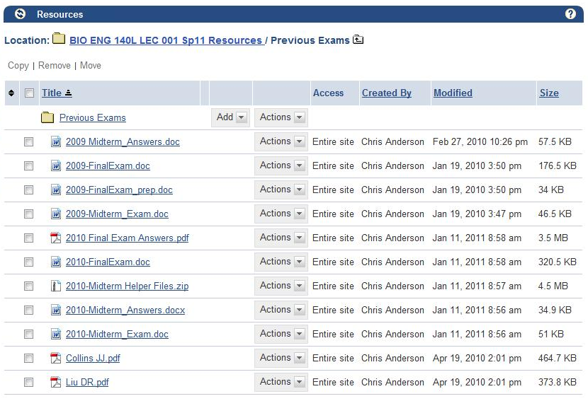
Typical results
Final Grade Distribution:
4A, 3 A-, 2 B+, 5 B-, 1 C-

Slide 3
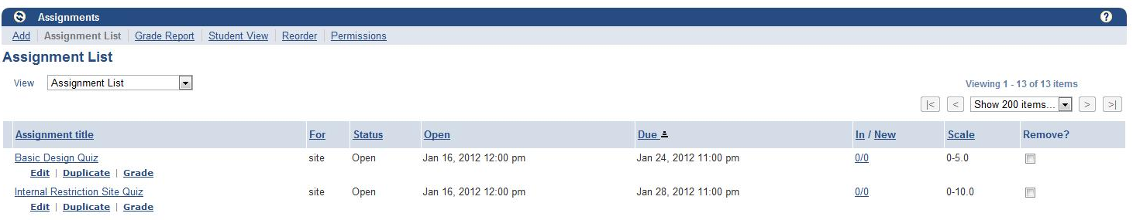
First Assignment
First Tutorial Quiz due Jan 31!
Try to download ApE and read through first sections before Tuesday
Tues work during class time
Bring your laptop if you have one!!

Slide 4
Ground rules
Look at last year’s midterm (posted on bspace) to see what you’re responsible for learning
Sip from the fountain…my lectures tend to be meaty
All these ppt files are available on bspace
Focus on understanding the concepts, you don’t have to memorize anything
The purpose of this lecture is to introduce important DNA modification enzymes and what you can do with them; additionally, it is to begin getting you to think about the functions of proteins and how combinations of biochemicals can interact with predictable results
You may interrupt me at any time with questions
We’ll take a break halfway through

Slide 5
The DNA Manipulation Enzymes
Notes:
This series of lectures will introduce you to the chemistry and utility of DNA manipulation enzymes. This class of catalysts perform chemical reactions on DNA molecules and forms the basis for most methods of DNA fabrication. These lectures describe most of the DNA modification reactions that exist, but focuses on those used in synthetic biology research, particularly for DNA fabrication and installation into genomes.

Slide 6
Endonucleases
Exonucleases
DNA Polymerases
RNA Polymerases
Ligases
Methyltransferases
DNA repair enzymes
Phosphatases/Kinases
Recombinases
Notes:
There are several classes of enzymes that we’ll go through. The nucleases are enzymes that degrade DNAs by acting on the ends of linear molecules or by cleaving internal to the DNA. Polymerases employ a template nucleic acid to construct a complementary copy of the molecule. Ligases join two polynucleotides into a single molecule. Methyltransferases transfer a methyl group to a DNA base. DNA repair enzymes perform a variety of functions primarily associated with common spontaneous damage to DNAs. Phosphatases and kinases affect the phosphorylation state of polynucleotides, and recombinases rearrange DNAs over similar sequences.

Slide 7
Endonucleases
Endo = within
Nuclease = enzyme that cleaves DNA
Restriction Endonuclease
Homing Endonucleases
DNAses
RNAses
Notes:
Endonucleases are enzymes that cleave a DNA internal to its sequence. Because they operate on the internal sequence of a DNA, they operate equally on linear and circular DNAs. * This class includes restriction endonucleases, homing endonucleases, DNAses, and RNAses.

Slide 8
Restriction Endonucleases
Type I
RMS systems (3 subunit proteins)
Typically named HsdR, HsdM, and HsdS
Generally not sequence specific
Not used in vitro
Usually knocked out
Type II
We’ll go through these in detail
Type III
Sequence-specific, but not in common use
Type IV
Cleave modified (methylated, etc.) DNA
McrA, McrBC and Mrr, usually knocked out
Cleave at specific DNA sequences
A nomenclature for restriction enzymes, DNA methyltransferases, homing endonucleases and their genes
PMID: 12654995
Notes:
Restriction endonucleases are classified into 4 types. Type I endonucleases are typified by the RMS systems that are present in most prokaryotic genomes. In E. coli, they are named hsdR, M, and S. These endonucleases play the native immunological role of preventing infection with foreign DNAs. They undoubtedly recognize some molecular pattern, but this pattern is poorly defined and cannot be reduced to a simple sequence like other classes we’ll see. These enzymes are not used in any in vitro DNA manipulation protocols, but they are relevent because knocking them out is necessary for efficient transformation of E. coli.
Type II endonucleases are the one’s you’re likely most familiar with. This class include EcoRI and other seuqence-specific endonucleases. We’ll go through this class in more detail next.
Type III endonucleases are sequence specific, but they are not in common use for in vitro DNA manipulations.
Type Iv are similar to type I in the sense that they are most relevant as common low-specificity enzymes present in prokaryotic genomes. They cleave methylated or otherwise modified DNAs and are typically encoded by 3 proteins. In E. coli, the McrA, McrBC, and Mrr genes are an endogenous type IV system typically knocked out to achieve high transformation efficiency.

Slide 9
Type II Restriction Endonucleases
5’ 4bp Overhang
BamHI G/GATCC
XbaI T/CTAGA
EcoRI G/AATTC
3' 4bp Overhang
PstI CTGCA/G
5' 2bp Overhang
NdeI CA/TATG
3' 2bp Overhang
PacI TTAAT/TAA
Blunt cutters
EcoRV GAT/ATC
Others
5bp, 3bp, and 1bp overhangs
Degenerate cutters
XcmI CCANNNNN/NNNNTGG
PvuII CAG/CTG
AlwNI CAGNNN/CTG
SfiI GGCCNNNN/NGGCC
FalI (8/13) AAGNNNNNCTT (13/8)
List of all available enzymes and their specificities
http://www.neb.com/nebecomm/tech_reference/restriction_enzymes/isoschizomers.asp? Or at http://rebase.neb.com/
Notes:
The type II endonucleases vary in terms of the overhangs they generate and the sequences they recognize. They are defined by being sequence-specific enzymes. There are many enzymes that generate 5’ four-base pair overhangs including BamHI XbaI, and EcoRI. There are also commonly-used enzymes that generate 3’ 4 bp overhangs. There are also many that generate 2bp overhangs either as 3’ or 5’ extensions.
*
Some Type II’s generate blunt ends while there are examples of Type II’s that generate 5bp, 3bp, or even 1bp sticky ends. All the enzymes I have mentioned cleave a specific DNA sequence internal to it. Often these enzymes are palindromic meaning that the reverse complement of the recongized sequence is the same as the original sequence. However, there are also non-palindromic cutters. Additionally, there are enzymes that recongized degenerate sequences. For example, the AlwNI enzyme recognizes the sequence CAGNNNCTG. The first and last portions of that sequence are palindromic, but the internal N’s can be any sequence and thus the sticky ends generated by this enzyme can be any sequence.

Slide 10
Type IIS Restriction Endonucleases
BsaI GGTCTC (1/5)
5’-cttcgGGTCTCggatcctggccgaaaaga…-3’
3’-gaagcCCAGAGcctaggaccggcttttct…-5’
5’-cttcgGGTCTCg
3’-gaagcCCAGAGcctag
+
Gatcctggccgaaaaga…-3’
gaccggcttttct…-5’
Can be used to generate 4bp 5’ overhangs (compatible with BamHI, XbaI, HindIII, XhoI, etc.
Restriction site can be removed during cutting leading to “scarless” junctions
Notes:
Type Iis enzymes recognize a specific sequence but then cleave the DNA external sequence. BsaI and BsmBI are the most commonly-used enzymes in this class. BsaI recognizes the sequence GGTCTC, reaches over one base, and then generates a sticky end composed of the next four bases.
*
The products of BsaI digestion can be joined (by ligation) to the overhangs generated form 4bp 5’ overhang-generating enzymes such as BamHI and EcoRI. These enzymes are particularly usefu8l because the restriction site can be removed during the course of digestion. In the example shown here, the 5’ end of the DNA containing the GGTCTC sequence is removed from the larger DNA leaving no trace of the sequence. Thus, upon ligation, there is no remnent of the restriction site, and this can be used to generate ‘scarless’ junctions between two DNAs.

Slide 11
Type IIG Restriction Endonucleases
BseRI GAGGAG (10/8)
5’-cttcgGAGGAGgctggccggaaaaaga…-3’
3’-gaagcCTCCTCcgaccggcctttttct…-5’
5’-cttcgGAGGAGgctggccgga
3’-gaagcCTCCTCcgaccggc
+
aaaaga…-3’
ctttttct…-5’
Can be used to generate 2bp 3’ overhangs (compatible with PacI, etc.
Many require SAM for function (methyltransferase is part of the enzyme)
Notes:
Type IIG endonucleases are very similar to the type Iis in the sense that they can be used to generate scarless junctions. BseRI is one of the more specific and active enzymes in this class. It recongizes the sequence GAGGAG, reaches over 8bp, and generates a 2bp sticky end.
*
They are distinguished by the generation of 2bp 3’ overhangs that are compatible with enzymes such as PacI. One particular property of this type is the need for S-adenosyl mehtionine for function which is not a common requirement for DNA restriction reactions.

Slide 12
Type II General Notes
Restriction Enzymes come from Methylation/Restriction systems
All have partner methyltransferases
Not all restriction enzymes are equally good
Star Activity (cutting where they shouldn’t cut)
Notes:
The type II restriction enzymes are usually components of methylation/restriction systems from various microbes. In these systems, the restriction enzyme is expressed in the cytoplasm. The genomic DNA is protected from cleavage because it is methylated at cognate sequences. Thus, these systems all have a partner methyltransferase. When cloning DNAs from genomic DNAs, there may be methylation at sites of common restriction enzymes.
*
Not all restriction enzymes are equally good. There is a great deal of heterogeneity amongst these enzymes in terms of how specific they are for their recognition sequence. Additionally, some enzymes remain active in in vitro longer than others. Also, some commercial products have higher specific activity than others and are sold in a more concentrated form.
*
Under non-standard reaction conditions, some restriction enzymes are capable of cleaving sequences which are similar, but not identical, to their defined recognition sequence. This altered specificity is called “star activity“.

Slide 13
Type II General Notes
Restriction Enzymes come from Methylation/Restriction systems
All have partner methyltransferases
Not all restriction enzymes are equally good
Star Activity (cutting where they shouldn’t cut)
Sensitivity to solvents, contaminants
Incomplete cutting
Cutting close to ends http://www.neb.com/nebecomm/tech_reference/restriction_enzymes/cleavage_linearized_vector.asp
Requirements for supercoiling
Requirements for multiple sites in the plasmid
Different enzymes prefer different buffers
Many work in PCR buffer
All generate clean 3’OH and 5’-phosphate ends
Notes:
Star activity or loss of functionality due to denaturation can happen in vitro due to the presence of solvents and contaminants. These toxicants to the reaction can result in incomplete cutting. Also, some restriction enzymes are more prone to incomplete cutting than others.
*
There is also heterogeneity about the tolerance of the enzyme for cleaving near the ends of the DNA. There is a nice table at this URL that goes through the knowledge about what enzymes do what. Some enzymes require that the DNA be supercoiled. The genomic and plasmid DNAs are twisted up like a rubber band in the cell, and some enzymes will only operate on DNAs in this state. Additionally, some require that there be 2 different sites on the same DNA molecule because they operate as a dimer.
*
Different restricction enzymes prefer different buffers, but many if not most work in PCR buffer. There can be total loss of function in putting an enzyme into a different buffer, and additionally use of the wrong buffer can result in star activity. All these subtle properties have been characterized by new england biolabs, and you can look this information up in their catalog at www.neb.com.
*
Though the sequences that are recognized vary, and chemical aspects of the purified protein similarly vary, the chemistry that a restriction endonuclease performs is always the same. They always generate 3’ hydroxyl and 5’ phosphate ends. Let’s take a look at this in more detail:

Slide 14
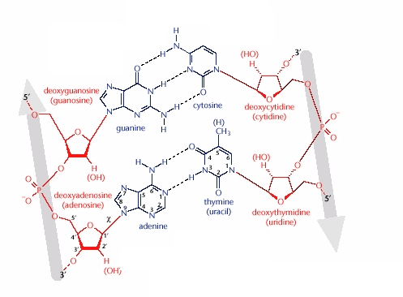
Notes:
Here we’ve zoomed in on the DNA sequence ‘GA’. The ribose backbone is in red. We see a single phosphate of the backbone here, and there are bonds on either end of the phosphate that connect it to the ribose.
*
This topmost bond is attached to the 3’ hydroxyl of a ribose, while
*
This lower bond connects the phosphate to the 5’ hydroxyl of a ribose. When a restriction enzyme cuts a DNA, it is the one connected to the 3’ hydroxyl (in green) that is broken.

Slide 15

Homing Endonucleases
Very long recognitions sequences, often unique in the genome
Come from site-specific recombination systems, often in mitochondria
So, don’t have cognate methyltransferases
Most cut within the recognition sequence
Used for in vivo DNA manipulations
I-SceI
Notes:
Homing endonucleases are restriction enzymes that cleave a very long and specific recognition sequence.
*
For example, I-SceI recongizes this 30bp sequence
*
They come from site-specific recombination systems, often from mitochondria. They don’t have cognate methyltransferases.
*
Most of the them cleave at a specific site internal to the recognition sequence.
*
Often these enzymes are so specific that they cleave uniquely once within a genome. These enzymes are not extensively used in vitro, but have been actively pursued for DNA manipulations in vivo. They can be used to create unique double strand breaks in the genome that stimulate DNA repair and recombination.

Slide 16
DNAse I
Non-specific endonuclease
Very potent enzyme
Products have 5’ phosphates and 3’ hydroxyls
Therefore, competent for ligation on both ends
Using Magnesium in buffer prefers single-strand cuts
Using with Manganese in buffer prefers double-strand blunt cuts
DNAse I
Removing DNA from an RNA sample
Chopping large DNAs into oligonucleotide-length fragments such as for DNA shuffling
Others like nick translation and footprinting
Uses:
Notes:
There are other types of endonucleases outside the scope of the restriction endonucleases because they have very little sequence specificity. DNAse I is a non-specific endonuclease. * It is a very potent enzyme and most protocols employing this enzyme use very little of it * Like the restriction enzymes, the products are 5’ phosphates and 3’ hydroxyls. So, the products of DNAse digestion are competent for other molecular biology reactions. * In most protocols, magnesium must be supplied for activity and this will primarily nick the DNA rather than form double-stranded breaks. However, using manganese instead will alter its specificity towards double-stranded breaks.
*
DNAse I can be used to remove DNA from an RNA sample. It is very specific for DNA over RNA. * it can also be used to partially degrade large DNAs into oligo-length fragments, and this is used in various procedures including DNA shuffling * There are a variety of tricks available from DNAse I. Two of the more useful ones are nick translation and DNA footprinting, which have articles in wikipedia.

Slide 17
RNAses
RNase A
Very potent RNA endonuclease, or "ribonuclease"
Has no effect on DNA
Used extensively in purifications to remove RNA contamination from DNA
RNase H
Present in most cells (including E. coli)
Degrades RNA duplexed to DNA
Used in cDNA synthesis after reverse transcription
RNase P
Processes RNAs that have tRNA-like secondary structure
RNase E
Processing and degradation of cellular mRNA
Frequently implicated in the stability of mRNAs in cells
Ribozymes
RNA sequences that cleave internally (in cis) or other RNAs (in trans)
Most famous is the delta hammerhead ribozyme
Notes:
There are a variety of RNAses, a few of which have utility in DNA manipulations. RNAse A is a very potent non-specific RNA endonuclease. It is often referred to as a ribonuclease. It has no effect on DNA and is used extensively in DNA purifications for removal of RNA contamination.
RNAse H is present in most cells including E. coli. It degrades RNA duplexed to DNA. It is used in vitro during the synthesis of cDNA after reverse transcription of an RNA.
RNAse P is one of a large set of common cellular enzymes. It processes RNAs that have tRNA-like secondary structure.
RNAse E is also common in the cell for processing and degrading mRNAs. Cleavage of specific sequences is frequently implicated in the stability of mRNAs in the cell.
Ribozymes are RNA enzymes that cleave either internally or in trans on another RNA. The most well known ribozyme sequence is the delta hammerhead ribozyme.

Slide 18
Exonucleases
Non-specific exonucleases: Digest any and all DNAs (linear, circular, double stranded, single stranded, methylated, non-methylated, etc.
Micrococcal Nuclease
Nuclease BAL-31
Colicin colE2
Notes:
Exonucleases degrade a DNA from its ends. Thus a circular and undamaged DNA molecule is immune to the action of these enzymes. There are a large number of enzymes that are non-specific exonucleases and can be used to degrade DNA in an RNA sample. Others will also degrade RNA.

Slide 19
More-useful Exonucleases
Footnotes:The ability to act on short extensions and blunt ends operationally distinguishes these enzymes; such ends are conveniently generated by restriction digestion. The 5´ and 3´ extensions tested were 4 nt in length.
Partial digestion of dsDNA by Lambda Exonuclease, T7 Exonuclease and Exonuclease III will produce dsDNA products with ss extensions. Complete digestion produces ssDNA as a product.
Complete hydrolysis of the preferred substrate will generate the listed products.
The ability of an exonuclease to initiate on the end of the preferred DNA substrate (ss or ds) containing a fluorescein group linked to either the 5´ or 3´ end. Phosphoramidite chemistry was used to synthesize oligonucleotides with FAM groups. The 5´ FAM was added to the oligonucleotide as a [(3´,6´-dipivaloylfluoresceinyl)-6-carboxamidohexyl]-l-O-(2-cyanoethyl)-(N,N-diisopropyl)-phosphoramidite while the 3´ FAM oligonucleotides were synthesized using the 1-dimethoxytrityloxy-3-[O-(N-carboxy-(di-O-pivaloyl-fluorescein)-3-aminopropyl)]-propyl-2-O-succinoyl-long chain alkylamino-CPG support.
The S_{p} stereoisomer of the phosphorothioate linkage is known to greatly inhibit cleavage of many nucleases while the R_{p} stereoisomer shows either no or less inhibition. Synthetic oligonucleotides containing approximately an equal ratio of both isomers necessitates the use of multiple phosphorothioates to block cleavage. The presence of 6 consecutive phosphorothioates on oligonucleotides of the preferred substrate blocked all exonucleases effectively (5% or less degradation) except T7 exonuclease which had approximately 10% cleavage. Analysis of exonucleases with oligonucleotides having either one or two consecutive phosphorothioates revealed significant degradation (not shown).
The amount of enzyme in units to cleave greater than 90% of 2 µM 35 mer oligonucleotide (s) of the preferred substrate (ss or dsDNA) in a 10 µl volume using the unit digest reaction conditions. All enzymes tested except for Exo T and RecJ_{f} could effectively cleave the substrate to completion.
Lambda exonuclease has a strong preference for initiating degradation on dsDNA containing a 5´ phosphate. Thus, if linear dsDNA has a 5´ phosphate at one end and lacks a 5´ phosphate on the other end, then lambda exonuclease will preferentially degrade the DNA from the phosphorylated end.
It has been reported that the initial, first product hydrolyzed from dsDNA by T7 Exonuclease is a dinucleotide. Subsequent hydrolytic cleavage releases dNMP.
RecJf is not suitable for making 5´ extensions blunt. Exo I is not suitable for making 3´ extensions blunt. Both RecJf and Exo I require longer length ssDNA extensions to initiate than those generated by restriction enzymes.
Depending upon the DNA sequence and amount of exonuclease, RecJ_{f}, Exo I and Exo T may remove a few nucleotides from flush termini.
Exo I releases dNMP from ssDNA, except at the last hydrolytic step where a dinucleotide is produced.
Exo T can be used to make 3´ extensions blunt, however, it yields 2-4 fold fewer ligatable blunt ends when compared to Klenow polymerase plus dNTP on a test substrate.
BAL31 has been reported as having both ss endonuclease activity as well as 3´→5´ ds exonuclease activity. Thus, any linear DNA is a substrate for BAL31.
Products of Micrococcal Nuclease degradation have 3´ phosphates.
T7 endonuclease recognizes and cleaves non-perfectly matched DNA, cruciform DNA, Holliday structures or junctions. It will act more slowly on nicked dsDNA.
Adapted from: http://www.neb.com/nebecomm/tech_reference/modifying_enzymes/prop_exonucleases_endonucleases.asp
Notes:
There is extensive diversity within the exonucleases about what types of ends they’ll initiate on and which direction they will go. This chart is from NEB, and you can look up these details if the need for an Exo ever crops up. I will describe what the different column headers mean.

Slide 20
Initiates on DNA with _____
5'ext (a 5’ extension)
case: BamHI Digested DNA
5’-cttcgGGATCCgctggcaga…-3’
3’-gaagcCCTAGGcgaccgtct…-5’
5’-cttcgG
3’-gaagcCCTAG
+
GATCCgctggcaga…-3’
Gcgaccgtct…-5’
Notes:
When it says ‘initiates on DNA with a 5’ extension, the sort of end it is referring to is the products one gets from many restriction enzymes like BamHI.

Slide 21
Initiates on DNA with _____
3'ext (a 3’ extension)
case: PstI Digested DNA
5’-cttcgCTGCAGgctggcaga…-3’
3’-gaagcGACGTCcgaccgtct…-5’
5’-cttcgCTGCA
3’-gaagcG
+
Ggctggcaga…-3’
ACGTCcgaccgtct…-5’
Notes:
Ones that initiate on 3’ extensions similarly can act on the ends of a DNA cut by a restriciton enzyme, such as PstI and many of the 2-cutters.

Slide 22
Initiates on DNA with _____
blunt (no overhang, has a 5’ phosphate)
case: EcoRV Digested DNA
5’-cttcgGATATCgctggcaga…-3’
3’-gaagcCTATAGcgaccgtct…-5’
5’-cttcgGAT
3’-gaagcCTA
+
ATCgctggcaga…-3’
TAGcgaccgtct…-5’
Notes:
Blunt ends can result from restriction digestion or the ends of PCR products. For example, EcoRV leaves no sticky ends, and some exonucleases will employ this while others won’t.

Slide 23
Initiates on DNA with _____
Nick (duplex of DNA with a missing bond)
Notes:
Some enzymes can operate on nicks while others don’t. A nick is when one side of the DNA is broken into two molecules. All the atoms including the 5’ phosphate are present in the nick, but the atoms are just not fully attached.

Slide 24
Notes:
Again, it is the bond in green that is broken in a nick

Slide 25
Initiates on DNA with _____
Active without a 5’ phosphate
case: PCR products
Oligonucleotides don’t have 5’ phosphates unless they have been added:
1) Chemically during oligonucleotides synthesis
2) Added them with a kinase
Notes:
Some exos require a 5’ phosphate. A DNA would lack 5’ phosphate if it is synthesized chemically, or if it was treated with a phosphatase. Because the 5’ ends of a PCR product are the actual atoms that were in the oligos not just a copy, the ends of a PCR product similarly will lack 5’ phosphates. Phosphates can be re-added with a kinase.

Slide 26
Initiates on DNA with _____
Polarity
Some remove bases 5’ to 3’
Some remove bases 3’ to 5’
Strandedness
Some only work on double-stranded DNA
Some only work on single-stranded DNA
Some work on either
Notes:
Some exo’s remove bases in the 5’ to 3’ direction, while others act 3’ to 5’. Some require a double-stranded DNA, some require single-stranded DNA, and some work on either.

Slide 27
Some Applications of Exonucleases
Blunting a sticky end
5’-cttcgGGATCCgctggcaga…-3’
3’-gaagcCCTAGGcgaccgtct…-5’
BamHI
5’-cttcgG
3’-gaagcCCTAG
+
GATCCgctggcaga…-3’
Gcgaccgtct…-5’
Mung Bean Nuclease
5’-cttcgG
3’-gaagcC
+
Cgctggcaga…-3’
Gcgaccgtct…-5’
Notes:
Exonucleases have many popular uses including the Gibson method of DNA assembly. Here’s a very traditional example of using an exonuclease to create a blunt sticky end. First, the DNA is cleaved with BamHI which leaves behind 5’ 4bp extensions. The fragments are then treated with mung Bean nuclease that cleaves single-stranded DNAs exclusively. The result is a blunt-ended DNA that can be ligated to other blunt ends such as those generated by EcoRV.

Slide 28
Some Applications of Exonucleases
Turning a PCR product back into an oligo
P
Lambda Exonuclease
Notes:
In a more modern example, you can use an exonuclease to convert a PCR product back into a single-stranded oligo. A 5’ phosphate is added to just one of the two oligos used for PCR. The resulting product incorporates the oligos (in pink) into the final molecule. Upon treatment with lambda exo that requires a 5’ phosphate for initiation, only the strand with the 5’ phosphate is degraded leaving behind a gene-length single-stranded DNA.

Slide 29
DNA Polymerases
Enzymes that add dNTPs to recessed 3’ DNA ends (5’ extensions)
Notes:
DNA polymerases make copies of DNA molecules by adding dNTPs to recessed 3’ DNA ends.

Slide 30
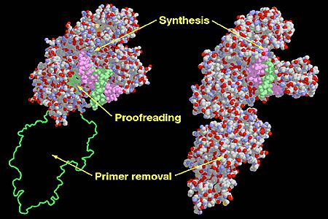
DNA Polymerase I
Involved in replication and DNA repair
Has multiple domains each doing different things
“Klenow Fragment” removes one of these domains
Most thermostable polymerases are homologs of DNA Polymerase I or several subunits thereof
Notes:
There are multiple DNA polymerases operating in both eukaryotic and prokaryotic cells that play different roles within the DNA lifecycle. In E. coli, DNA polymerase I is involved in DNA replication and DNA repair and is encoded by a single polypeptide. The protein has multiple domains responsible for different aspects of its overall reaction including a distinct domain for proofreading. This domain is removed in the Klenow Fragment of DNA polymerase I. Most theremostable polymerases are homologs of full-length DNA polymerase I or of its klenow fragment.

Slide 31
Distinguishing Features
Adapted from: http://www.neb.com/nebecomm/tech_reference/polymerases/properties_dna_polymerases.asp
Notes:
Like with exonucleases that degrade a DNA, the different enzymes that polymerize DNA have diverse and specific subtle variations in behavior. I’ll go through what the different properties here mean.

Slide 32
5'—>3' Exonuclease Activity
This behavior is pretty rare
Taq and E. coli pol 1 have it
Notes:
Many of these variant behaviors of polymerases is how they respond to nicks. Suppose we have this DNA involving 3 polynucleotides annealed together such that there remains a single 3’ recessed end. Any DNA polymerase will extend this recessed end.

Slide 33
5'—>3' Exonuclease Activity
This behavior is pretty rare
Taq and E. coli pol 1 have it

Slide 34
5'—>3' Exonuclease Activity
This behavior is pretty rare
Taq and E. coli pol 1 have it

Slide 35
5'—>3' Exonuclease Activity
This behavior is pretty rare
Taq and E. coli pol 1 have it
Now what?
Notes:
But what will happen when it collides with the other annealed DNA? If the polymerase has 5’ to 3’ exo activity, it will chew up

Slide 36
5'—>3' Exonuclease Activity
This behavior is pretty rare
Taq and E. coli pol 1 have it

Slide 37
5'—>3' Exonuclease Activity
This behavior is pretty rare
Taq and E. coli pol 1 have it

Slide 38
5'—>3' Exonuclease Activity
This behavior is pretty rare
Taq and E. coli pol 1 have it
Notes:
The DNA strand is ultimately entirely replaced by new synthesis

Slide 39
Strand Displacement
The more common scenario
Notes:
The more common scenario is strand displacement. The polymerase synthesizes DNA until it reaches the blocking strand

Slide 40
Strand Displacement
The more common scenario

Slide 41
Strand Displacement
The more common scenario

Slide 42
Strand Displacement
The more common scenario
Now what?
Notes:
And then displaces the blocking strand

Slide 43
Strand Displacement
The more common scenario

Slide 44
Strand Displacement
The more common scenario

Slide 45
Strand Displacement
The more common scenario
Notes:
Until ultimately that DNA is released as a separate complex.

Slide 46
Rolling Circle Amplification (RCF)
Phi29 is the pro at this
Notes:
The enzyme phi29 is the most robust strand-displacing enzymes, and one of the more useful molecular biology tricks is rolling circle amplification with phi29.

Slide 47
Rolling Circle Amplification (RCF)
Phi29 is the pro at this
Notes:
First, the DNA is denatured to separate the strands

Slide 48
Rolling Circle Amplification (RCF)
Phi29 is the pro at this

Slide 49
Rolling Circle Amplification (RCF)
Phi29 is the pro at this
Notes:
This allows the annealing of oligonucleotides that then can initiate polymerization

Slide 50
Rolling Circle Amplification (RCF)
Phi29 is the pro at this

Slide 51
Rolling Circle Amplification (RCF)
Phi29 is the pro at this

Slide 52
Rolling Circle Amplification (RCF)
Phi29 is the pro at this

Slide 53
Rolling Circle Amplification (RCF)
Phi29 is the pro at this
Notes:
The new strand eventually reaches its own 5’ end and will undergo strand displacement.

Slide 54
Rolling Circle Amplification (RCF)
Phi29 is the pro at this

Slide 55
Rolling Circle Amplification (RCF)
Phi29 is the pro at this

Slide 56
Rolling Circle Amplification (RCF)
Phi29 is the pro at this
Notes:
The newly-released strand can initiate further polymerization allowing rapid isothermal amplification of DNAs.

Slide 57
Kunkel Mutagenesis
Use T4 DNA Polymerase
(no 5’-3’ Exo or displacement)
Notes:
Another example of the utility of subtly different polymerase properties is Kunkel mutagenesis. Kunkel involves the use of T4 DNA polymerase which has neither 5’-3’ exo nor displacement behavior.

Slide 58
Kunkel Mutagenesis
Use T4 DNA Polymerase
(no 5’-3’ Exo or displacement)
x
Notes:
An oligo that is homologous to the DNA but contains a mutation designated by the red X is annealed to the DNA. It then undergoes polymerization around the circle.

Slide 59
Kunkel Mutagenesis
Use T4 DNA Polymerase
(no 5’-3’ Exo or displacement)
x

Slide 60
Kunkel Mutagenesis
Use T4 DNA Polymerase
(no 5’-3’ Exo or displacement)
x
Notes:
This DNA is then transformed into E. coli which can repair the nick. If a different polymerase were used that did strand displacement or exo, the X would become dislodged or degraded, and would not be incorporated into the final sequence.

Slide 61
3’ to 5’ Exonuclease Activity
“Proofreading Activity”
Major component determining fidelity
Absent in Taq-like enzymes
Present in Pfu-like enzymes
Without it, extension products typically contain a single 3’ “A” overhang
Notes:
Polymerases can also have 3’ to 5’ exonuclease activity. This is the property referred to by ‘proofreading’ in the context of polymerases. It is the major component of the enzyme that determines its fidelity. It is absent in Taq-like enzymes which also have higher error rates. It is present in Pfu-like enzymes. Enzymes with this activity will produce blunt-ended pcr products, while those without this activity will typically contain a single 3’ A overhang.

Slide 62
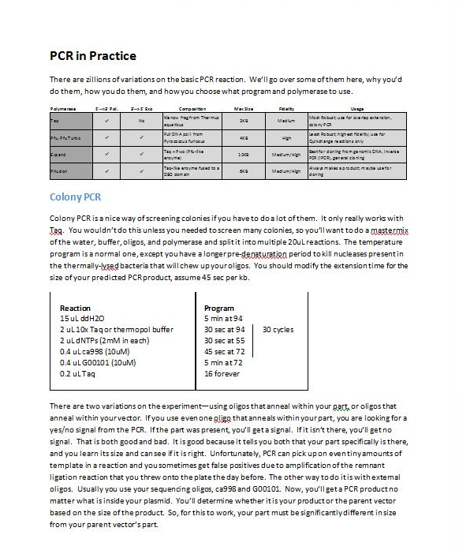
The Thermostable Polymerases
Notes:
This document “the thermostable polymerases” goes into further detail about the subtle differences between the commercially-available thermostable polymerases organized around specific use cases.

Slide 63
Reverse Transcriptase
From Retroviruses
Synthesize DNA from an RNA template
High error rate (for MMLV-RT: 3.3 x10⁻⁵/base)
Used in RT-PCR, microarrays, QPCR
DNA Oligo
RNA Template
Notes:
Reverse transcriptases are enzymes from retroviruses that synthesize DNAs from an RNA template. A DNA oligo is annealed to the RNA and then the enzyme will polymerize it

Slide 64
Reverse Transcriptase
From Retroviruses
Synthesize DNA from an RNA template
High error rate (for MMLV-RT: 3.3 x10⁻⁵/base)
Used in RT-PCR, microarrays, QPCR
DNA Oligo
RNA Template
Notes:
to its end

Slide 65
Terminal Transferase
Template independent polymerase (5’ to 3’)
Works on 3’ protruding or recessed ends, blunt ends, double or single-stranded DNA
No Exonuclease activity
Primarily used for radioactive end-labeling
Can be used to add homopolymeric ends (polyA)
Notes:
Finally there is terminal transferase. It is a template-independent polymerase that operates on protruding 3’ or recessed ends, blunt ends, and on double-stranded or single-stranded DNA. It has no exonuclease activity. It is used primarily for radioactive end-labeling or for adding homopolymeric ends such as poly-A sequences to a DNA end.

Slide 67
RNA Polymerases
Enzymes that initiate a new RNA chain on a DNA template
There are RNA-directed RNA polymerases as well (in some viruses)
Notes:
RNA polymerases are enzymes that initiate a new RNA chain on a DNA template. There are also such things as RNA-directed RNA polymerases. For the purposes of understanding synthetic biology, you are likely to encounter two of these enzymes. First is the one that produces the RNAs in the cell, and the other is T7 RNA polymerase. Though the native enzyme is important to understand in the context of gene expression, only the phage one is commonly used in vitro.

Slide 68
T7 RNA Polymerase
Used for both in vivo and in vitro transcription
Very high protein expression in vivo
Production of tRNAs, mRNAs, or ribozymes/aptamers in vitro
Double Stranded DNA
Notes:
T7 RNAP is used for both in vivo and in vitro transcription. When people speak of T7 expression systems, the pET vectors, BL21 or DE3 strains, they are talking about systems employing the T7 RNA polymase to control the transcription of an engineered gene. It produces very high protein expression levels in vivo, but it also can be used to generate tRNAs, mRNAs, or ribozymes and aptamers in vitro.

Slide 69
T7 RNA Polymerase
Used for both in vivo and in vitro transcription
Very high protein expression in vivo
Production of tRNAs, mRNAs, or ribozymes/aptamers in vitro
T7 Promoter (TAATACGACTCACTATAGGG )
Notes:
The substrate for T7RNAP is a double-stranded DNA with the T7 promoter sequence

Slide 70
T7 RNA Polymerase
Used for both in vivo and in vitro transcription
Very high protein expression in vivo
Production of tRNAs, mRNAs, or ribozymes/aptamers in vitro
Initiation
Notes:
The polymerase binds to this sequence, displaces the sense strand,

Slide 71
T7 RNA Polymerase
Used for both in vivo and in vitro transcription
Very high protein expression in vivo
Production of tRNAs, mRNAs, or ribozymes/aptamers in vitro
New RNA extension
Notes:
And initiates a new molecule from a G residue at the end of the T7 promoter sequence.

Slide 72
T7 RNA Polymerase
Used for both in vivo and in vitro transcription
Very high protein expression in vivo
Production of tRNAs, mRNAs, or ribozymes/aptamers in vitro
New ssRNA product
Notes:
When the polymerase reaches either the end of the DNA (which is called runoff transcription) or when it hits a terminator sequence, the new single-stranded RNA is released and polymerization can begin again.

Slide 73
Ligases
Join 5’ phosphates to 3’ hydroxyls
Requires energy (not a thermodynamically favorable reaction)
Notes:
Ligases join two polynucleotides into one molecule by joining the 5’ phosphate to 3’ hydroxyl groups. The reaction requires coupling to an energy source, either ATP or NAD+, because the reactions itself is not thermodynamically favorable.

Slide 74
T4 DNA Ligase
No homolog in E. coli
Requires 5’ phosphate and 3’ hydroxyl
No mismatches or gaps can be present at junction
Operates on any length of homology (though 1bp is worst)
Principally used to join DNA ends generated by restriction enzymes
5’-cttcgCTGCA
3’-gaagcG
+
Ggctggcaga…-3’
ACGTCcgaccgtct…-5’
5’-cttcgCTGCAGgctggcaga…-3’
3’-gaagcGACGTCcgaccgtct…-5’
Notes:
The one you will most encounter is T4 DNA Ligase. This enzyme has no homolog in E. coli, and moreover its only homologs are in other phages. We’ll see that there is also a native ligase, but this enzyme is quite distinct. It requires a 5’ phosphate and 3’ hydroxyl, and there can be no mismatches or gaps near the junction to be ligated. It operates on any length of homology including the joining of blunt ends. It is commonly used to join DNAs whose ends have been cleaved by restriction enzymes. Here we see the joining of two PstI sticky ends back into a double-stranded DNA with restoration of the restriction site.

Slide 75
E. coli DNA Ligase
Ligase involved in repair/replication in all cells
Forms bonds on nicks only
Requires a 5’ phosphate
Can’t be used to join non-annealed DNA
Notes:
The E. coli DNA ligase is rarely used in vitro, but it is a ubiquitous housekeeping function in cells used during DNA repair and replication. It forms bonds by repairing nicks only. It requires a 5’ phosphate be present, and it can’t be used to join non-annealed DNA. So, it can’t be used to ligate together DNAs cleaved by restriction enzymes.

Slide 76
Notes:
The bond being generated by ligases is the same one we discussed before with restriction enzymes. The phosphate will already be present, and it just needs to be joined to the 3’ hydroxyl.

Slide 77
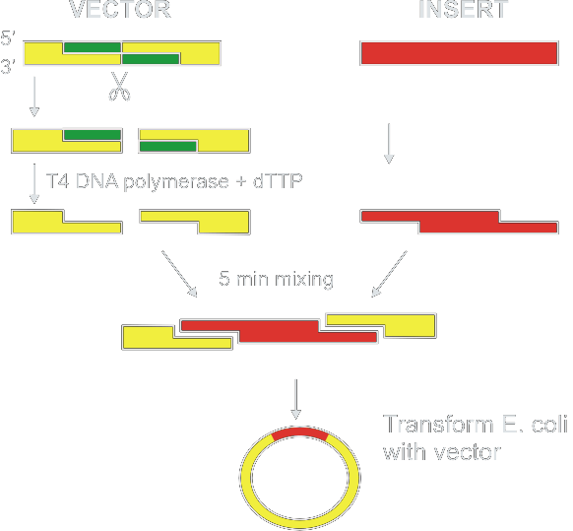
Ligation Independent Cloning (LIC)
14bp overhang
Notes:
Probably all cloning methods at some stage involve the activity of a ligase, but sometimes that activity is provided in vivo. Ligation independent cloning is a popular method of cloning DNAs into vectors. The vector is first digested with a restriction enzyme. Its ends are then chewed back due to the proofreading functionality of T4 DNA polymerase. When only a single base, T, is provided, the polymerase will chew back to the first T resulting in a 14bp overhang at the end of the DNA. An insert is similarly generated with long 14bp overhangs. The two DNAs are then mixed resulting in a circular DNA with four nicks. Upon transformation into E. coli, these nicks are repaired and the plasmid stably replicates.

Slide 78
Taq DNA Ligase
From Thermus aquaticus
Biochemically the same as E. coli DNA ligase
But thermostable
Used in the Ligase Chain Reaction (LCR)
Similar temperature program to PCR
Used to detect polymorphisms
Used in some protocols of gene synthesis
Notes:
Taq DNA ligase, not to be confused with Taq polymerase, is biochemically the same as the E. coli DNA ligase, but it comes from thermus aquaticus. Because that organism is a thermophile, this protein is thermostable. It is primarily used in the Ligase Chain Reaction, or LCR. LCR is similar to PCR in the sense that it involves exponential amplification of a DNA product through cycles of temperature changes. It is used for detection of polymorphisms in high-density assays, or some protocols of gene synthesis.

Slide 79
LCR: Ligase Chain Reaction
Notes:
LCR, like PCR involves a template DNA in trace amounts. It involves 4 oligos instead of two, and it involves a thermostable ligase rather than a polymerase.

Slide 80
LCR: Ligase Chain Reaction
Notes:
The cycling of an LCR is the same as PCR. The first step is thermal denaturation which separates the template into two strands.

Slide 81
LCR: Ligase Chain Reaction
Notes:
The temperature is then dropped and the oligos anneal to the template. The oligos are designed to anneal directly adjacent to one another on the template, and the two sets are reverse-complements of one another.

Slide 82
LCR: Ligase Chain Reaction
Notes:
The ligase joins perfectly-annealed sequences fusing two oligos into one.

Slide 83
LCR: Ligase Chain Reaction
Notes:
In the next round of LcR, these newly-formed molecules denature off and can reanneal to other oligos

Slide 84
LCR: Ligase Chain Reaction
Notes:
Thus, there is exponential amplification of the joining of the oligos into fused molecules.

Slide 85
LCR: Ligase Chain Reaction
Notes:
The product of LCR is thus short duplexes.

Slide 86
T4 RNA Ligase
Ligates single-stranded RNAs head to tail
Joins a 5’ phosphate to a 3’ hydroxyl
T7 RNA Polymerase-derived RNA has a 5’ triphosphate!
Ligates single-stranded DNAs head to tail
Oligonucleotides have no 5’ phosphate!
Notes:
There is also an enzyme called T4 RNA ligase. It is a common lab error to not be aware of this enzyme and mis-discover it in a freezer thinking it is the more popular T4 DNA ligase. It joins single-stranded RNAs head to tail by joining a 5’ phosphate with a 3’ hydroxyl. Note that the 5’ end of most RNAs generated by prokaryotic transcription will have a 5’ triphosphate instead and is thus not immediately available for this reaction.
This enzyme can also be used to ligate two single-stranded DNAs head to tail but requires a 5’ phosphate on one. Thus, oligos are not by default able to participate in this reaction, but can be employed through the addition of a kinase.

Slide 87
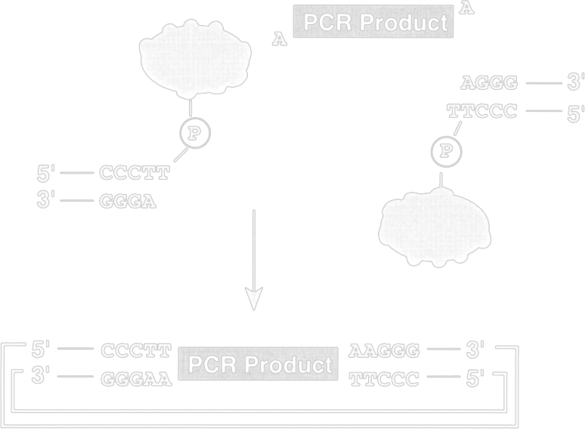
Vaccinia Topoisomerase
Basis of the TOPO TA cloning kit
Sequence-specific cleavage and rejoining of 5'-(T/C)CCTT↓
Involves a Tyrosyl/3’phosphate intermediate
Also will ligate pre-digested ends of correct sequence to a matching compatible cohesive end
Notes:
Though it is technically not classified as a ligase, vaccinia topoisomerase is functionally similar in the context of genetic engineering. It finds common use due to the popularity of the TOPO TA cloning kit. The reaction it performs is seqeunce-specific cleavage and rejoining of the sequence T-or-C CCTT. It forms a stable tyrosyl-3’ phosphate enzyme-bound intermediate, and when you buy a TA kit you are purchasing this intermediate. This intermediate can be reacted with another DNA providing a single-A 3’ extension such as a PCR product.

Slide 88
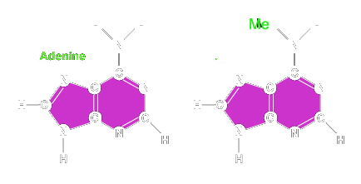
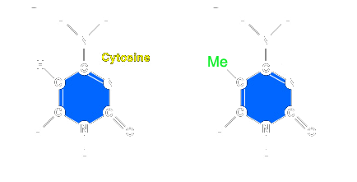
Methyltransferases
Enzymes that add methyl groups to DNA
^{m}A = N6 of Adenine
^{m}C = C5 of Cytosine
N4 Cytosine
Notes:
Methyltransferases add methyl groups to a DNA. They most commonly add the methyl group to either N6 of Adenine or C5 of cytosine.

Slide 89

Type II Restriction Systems
All type II restriction enzymes have cognate methyltransferases
BamHI Methyltransferase hits the N4 position
DNA Methylated by methyltransferases are impervious to digestion by the cognate endonuclease
Notes:
The type II restriction enzymes have cognate methyltransferases. They are used in the native context to protect the genome from the action of the restriction enzyme and thus typically have the same specificity as the restriction enzyme. For example, BamHI methyltranferase modifies the fourth C in the BamHI restriction site. Upon methylation, the activity of the cognate endonuclease is blocked at that site.

Slide 90
Dam and Dcm Methylation
E. coli K12 lab strains encode 2 methyltransferases, dam and dcm
They recognize and methylate:
Dam(GmATC) and Dcm(CmCWGG)
Restriction sites overlapping these sites are sometimes blocked
Strains (like JM110) have dam and dcm knocked out, but they aren’t healthy bacteria
These relationships are documented in the NEB catalog
Example: Dam blocking of XbaI digestion
Methylated Dam sites are the substrate of DpnI endonuclease
Me
5’-TCTAGATC-3’
3’-AGATCTAG-5’
Me
Notes:
Dam and Dcm methylation frequently block restriction endonucleases. The lab strains of E. coli encode these two mehtyltransferases which modify the sequence GATC and CCWGG. When a restriction site overlaps these sites, the enzyme will be blocked. There are some useful strains like JM110 that have these genes knocked out, but these genes also play regulatory roles in the cell and the bacteria aren’t healthy. Whether an enzyme can be blocked by Dam or Dcm methylation is cataloged by NEB. One of the more common ones is XbaI. If the restriction site is followed by the sequence TC, it will overlap a Dam site and thus be methylated and blocked.

Slide 91
CpG Methylation
Eukaryotes (ie, humans) often employ DNA methylation to regulation gene expression
CpG methylation involves methylation of C5 positions
Restriction sites overlapping CpG sites can be blocked
DNA from cells can be methylated in ways that prevent digestion by restriction enzymes
All methylation is reversible and will be reset upon introduction into a new cell following replication
PCR products are similarly unmethylated
Notes:
Eukaryotes also methylate their DNA extensively for controlling gene expression. CpG mehtylation involves methylation of C5 positions in rafts in the genome called CpG islands. Restriction sites overlapping CpG sites may be blocked.
DNA from cells can be methylated in ways that prevent digestion by restriction enzymes. Though you can’t treat a DNA with an enzyme that pops off the methyl groups, replication of the DNA will result in methyl-group-free versions of the molecule. PCR products are thus unmethylated.

Slide 92
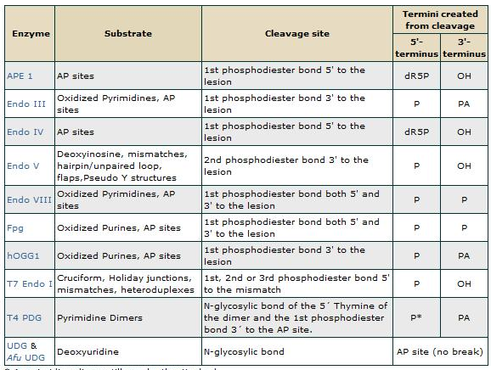
DNA Repair Enzymes
Enzymes involved in fixing DNA damage in cells
Something all cells do
Not frequently used in vitro
Some are on this list:
http://www.neb.com/nebecomm/tech_reference/modifying_enzymes/prop_dna_repair_enzymes.asp
Notes:
DNA repair enzymes are a small army of diverse functions that fix the various chemical modifications that happen during a cell’s lifecycle. All cells do this, but only a few of the enzymes are useful in vitro.

Slide 93
MutS
MutS protein binds to “bubbles” formed from a mismatch in duplex DNA
In response to MutS binding, the lesion will repaired on the daughter strand during replication
mutS must be knocked out in strains used for Kunkel mutagenesis or the mutations introduced will be repaired
MutS has been used in vitro to improve the fidelity of gene synthesis (which we’ll explain later in the course)
5’-CAATCAGGGGATAACGCA-3’
3’-GTTAGTCCCTTATTGCGT-5’
Notes:
MutS is a DNA repair enzyme that binds to bubbles formed from a mismatch in duplex DNA. In response to MutS binding, the lesion will be repaired on the daughter strand during replication. Several methods of mutagenesis including Kunkel and the Church lab’s MAGE method require that this gene be knocked out for good efficiency as the introduced mutations will get repaired. This enzyme is also used in vivo to improve the fiddelity of gene synthesis.

Slide 94
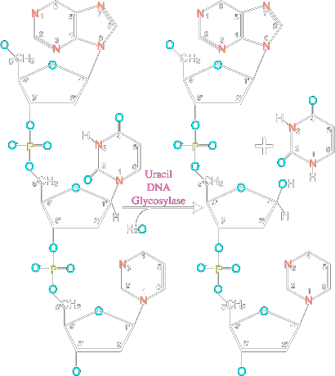
Uracil-DNA Glycosylase
Useful for generating LIC extended termini
Notes:
Uracil-DNA glycosylase excises the base from a U nucleotide in a DNA resulting in an abasic site (meaning, there is no base on the deoxyribose). DNAs can have U residues due to chemical reactions in the cell, but they can also be introduced deliberately through oligonucleotide synthesis. They can be used to generate extended sticky ends for ligation independent cloning reactions.

Slide 95
Ligation Independent Cloning (LIC)
14bp overhang
Notes:
We spoke earlier of the ligation independent cloning methods that involve in vivo repair of annealed DNAs. The key step in this procedure is the generation of extended overhangs. One way to generate such ends is to introduce a U into the oligo used for PCR.

Slide 96
Uracil-DNA Glycosylase
Useful for generating LIC extended termini
Use an oligo with a dU base 14 bp from the 5’ end
Do PCR
Treat with DNA glycosidase and T4 endonuclease V
Ready for LIC!
Notes:
You place this U residue 14 bp from the 5’ end of the oligo then incorporate it into the DNA by PCR. Treatment with Uracil DNA glycosylase removes the U resulting in an abasic site, and then treatment with T4 endnuclease V will cleave the phosphate backbone releasing the short DNA. The DNA is then ready for ligation-independent cloning.

Slide 97
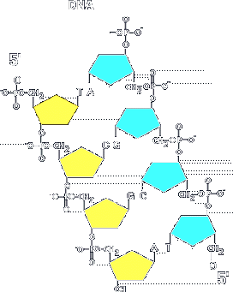
The Kinases/Phosphatases
Enzymes that add and remove phosphates
Restricted DNA has a single 5’ phosphate
Synthetic oligonucleotides have a clean 5’ hydroxyl
5’ phosphates are required for ligation
Notes:
Kinases and phosphatases add or remove the 5’ phosphate as indicated with the pink arrow. DNAs that are the products of endonucleases have a single 5’ phosphate. Synthetic oligonucleotides have a clean 5’ hydroxyl. Molecular biology protocols often require ligase which requires 5’ phosphates. Sometimes it is useful to make a DNA available or not available for ligation, and this phosphorylation state can be changed with kinases and phosphatases. Additionally, some exonucleases require a 5’ phosphate and thus the degradability of a DNA can be altered by these enzymes.

Slide 98
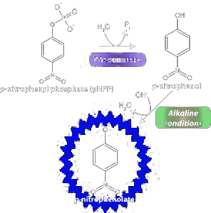
Alkaline Phosphatases
Catalyze the hydrolysis of phosphate ester non-specifically
Also act on 5’ mono, di, and triphosphates of RNA or DNA, dNTPs, and NTPs
There are very many of them in nature, often are secreted proteins
Notes:
The most commonly used class of phosphatases are the alkaline phosphatases. They catalzye the hydrolysis of phosphate esters non-specificically. So, these enzymes are used outside the context of DNA manipulation. For example, you can react an alkaline phosphatase with p-nitrophenyl phosphate and release a yellow pigment that can be detected photometrically. The enzyme will act on any exposed nucleic acid phosphate such as the 5’ ends of nucleotides or polynucleotides. These enzymes are very common in nature, from both prokaryotic and animal sources.

Slide 99
CIP: Calf Intestine Alkaline Phosphatase
Oldest and most commonly used since it is very robust and cheap
Often used to prevent re-closure of ends of a vector digested with restriction enzymes
Can also be used to destroy dNTPs in a reaction mixture
Shrimp Alkaline Phosphatase
Can be easily heat-killed
Used for exo-SAP sequencing
Antarctic Phosphatase
A lot like SAP
Claimed to be even more heat-killable
Notes:
The oldest, cheapest, and most well-known enzyme is calf intestine alkaline phosphatase, or CIP. The name means what it implies—it is a phosphatase originally isolated from calf intestine. It is Often used to prevent re-closure of ends of a vector digested with restriction enzymes. It can also be used to destroy dNTPs in a reaction mixture. * Shrimp Alkaline Phosphatase can be easily heat-killed but is otherwise the same as CIP. One useful protocol for automating sample generation for cycle sequencing is called Exo-SAP, where you degrade the unreacted primers and dNTPs of a PCR reaction by digestion with SAP and Exonuclease I. * Antarctic phosphatase is a newer version of the heat-killable alkaline phosphatase, which is claimed to be even more heat-labile.

Slide 100
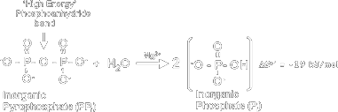
Inorganic Pyrophasphatase (IPP)
Some reactions used to manipulate DNAs are thermodynamically reversible
Most common: T7 RNA Polymerase reactions
If pyrophosphate is released, the reactions can be made irreversible
IPP is a ubiquitous enzyme used to drive things to completion in cells
There are also thermostable versions of IPP
Notes:
Some reactions that are used to manipulate DNAs are thermodynamically reversible. For example, T7 RNA polymerase will start degrading RNA if pyrophosphate accumulates in the reaction. Pyrophosphate is two phosphates linked together and is often called inorganic pyrophosphate. For reactions that release pyrophosphate, the reactions can be made irreversible by addition of inorganic pyrophosphatase, or IPP. IPP is a ubiquitous housekeeping enzyme used to drive things to completion in cells. There are also thermostable versions of IPP for use in high-temperature reactions such as PCRs.

Slide 101
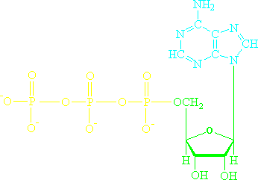
T4 Polynucleotide Kinase (PNK)
Transfers a single phosphate on the 5’ hydroxyl of an RNA or DNA
Uses the gamma phosphate of ATP as a phosphate source
Used on synthetic oligonucleotides so that they can be substrates for ligase
Not efficient on double-stranded DNAs
Also used for radioactive labeling of DNAs or RNAs using [gamma-P-32] ATP
Notes:
T4 polynucleotide kinase Transfers a single phosphate to the 5’ hydroxyl of an RNA or DNA from ATP. It is the gamma phosphate of ATP (the terminal one) that gets transferred. The enzyme is most commonly used to phosphorylate synthetic oligonucleotides so that they can be substrates for ligase. It works best on single stranded DNAs, and it is often used to radiolabel DNAs using [gamma-32-P] ATP

Slide 102
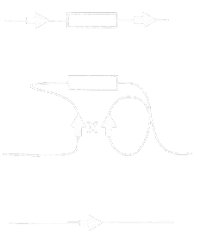
Recombinases
Site-specific ones
Ones for homologous recombination
Notes:
Recombination involves rearrangements in DNAs over homologous sequences. There are some recombinases that act on very specific sequences, while others are not specific about the sequence; they recombine similar sequences.

Slide 103
Cre Recombinase
Recombines the sequence:
ATAACTTCGTATA – NNNTANNN -TATACGAAGTTAT
Parallel sites in a DNA result in excision
Antiparallel sites result in inversion
Often used for “floxing” a gene
Many similar systems exist including the Flp/FRT and Hin/hix systems
Notes:
Cre recombinase comes from the E. coli phage P1 and recognizes a 34bp sequence and recombines two of them. The site is not palindromic, and thus is not the same sequence on both strands and it has directionality. For a DNA containing two such sites, they can be arranged in the same orientation, called parallel, or on opposing strands called antiparallel. Parallel site recombination, topologically speaking, results in excision of any intermediate sequence while antiparallel sites undergo inversion. Such flipping systems are popular targets for controlling gene expression. Floxing a gene means to encode a gene flanked by lox sites into the genome of a cell. Through later expression of cre in the cell, that gene is excised and thereby deleted.

Slide 104
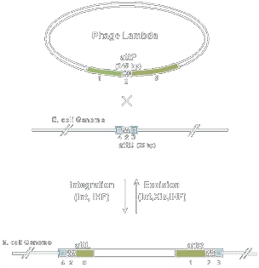
Phage att Sites
Most recombinases act on asymmetric substrates
The lox-like components are called att sites
One of the most useful sets are the phi80, lambda, HK022, P21, P22, and phiC31 systems
The cre-like components are called Int recombinases
They also can include Xis protein which switches the preferred directionality
Used for integrating DNAs into the genome
Used in the Gateway reaction
Notes:
Another popular sequence-specific recombinase type are phage att sites. Most of these recombinases act on asymmetric substrates and thus the reaction has directionality. In the most popular system, from lambda phage, a DNA with the attP sequence is recombined with a DNA (such as the genome) with an attB sequence. The resulting sequences are named attL and attR and are different sequences than attP and attB. Thus, the reaction is not symmetric and can be driven in one direction or the other. One of the most useful sets are from various prokaryotic phages, mostly-but-not-all E. coli phages. The recombinase component is called the Int recombinase, and then there is a second protein called Xis which upon expression reverses the directionality of the reaction. These enzymes are used in some methods of genome engineering, the gateway cloning method of moving DNAs from one DNA to another, and in several genetic circuits for digitally controlling gene expression.

Slide 105
Homologous Recombination
Yeast and B. subtilis readily catalyze homologous recombination
E. coli requires additional genes for it to be efficient
The lambda Red genes (from lambda phage) are one such set of genes
Used for “recombineering” which is recombination-based manipulation of the genome or plasmids in E. coli
Often used for knocking out genes in E. coli
Endogenous RecA protein is also involved in the reaction
RecA is a protein involved in DNA repair pathways that stabilizes single-stranded DNAs
RecA can also be used to promote homologous recombination in vitro
Notes:
The other type of recombinases are sequence-independent and used primarily in vivo. Yeast and B. subtilis readily catalyze homologous recombination between two very similar sequences. E. coli can also do it, but requires additional genes for it to be efficient. This is most often satisfied by introduction of the lambda Red genes (from lambda phage). This process is useful for “recombineering” which is recombination-based manipulation of the genome or plasmids in E. coli using synthetic DNAs. The most common example involves deleting specific genes in the genome by recombination with an antibiotic selection marker flanked by sequences homologous to the gene. The cellular recA protein is also involved in the reaction. In the cell it is involved in DNA repair pathways by stabilizing single-stranded DNAs. RecA can also be used to promote homologous recombination in vitro forming the basis of some DNA fabrication methods.

Slide 106

Questions to Ponder

Slide 107
1) If I transcribed a DNA template with T7 RNA polymerase, and I wanted to label the 5’ end with radioactive P32 phosphate, what enzymes could I use?
2) If I took a plasmid containing the sequence:
digested with EcoRI, digested with Mung Bean Nuclease, and then ligated with T4 DNA Ligase, what would the product be?
3) What’s wrong with this construction file?
How could you fix it?
…gatttctgGAATTCgcggcc…
Anneal oligos ca9393/ca9394 (49 bp)
Sub into pBca9145-Bca1144#5 (EcoRI/BamHI, 2057+910, L)
Product is pBca9145-Bca9393
----------------------------
ca9393 Forward oligo AATTCatgAGATCTcaggcatcaaataaaacgaaaggctcagtcgaaaG
ca9394 Reverse oligo GATCCtttcgactgagcctttcgttttatttgatgcctgAGATCTcatG

