Slide 1
The Primitives: Parts
Coding Sequences
Promoters
RNAs
Ribosome Binding Sites
Terminators
Origin of replication
Recombination Sites
Terminal Repeats
Notes:
A founding idea of synthetic biology is the objectification of specific DNA sequences as functional primitives that are useful in design. We call these Parts, and there are different kinds of parts such as coding sequences, promoters, RNAs, and the like. In some cases, parts correspond to specific molecules that are encoded by the sequence, such as protein coding sequences and RNAs. In other cases, they correspond to regions of a DNA that proteins act upon with consistent affect, such as promoters and origins of replication.

Slide 2
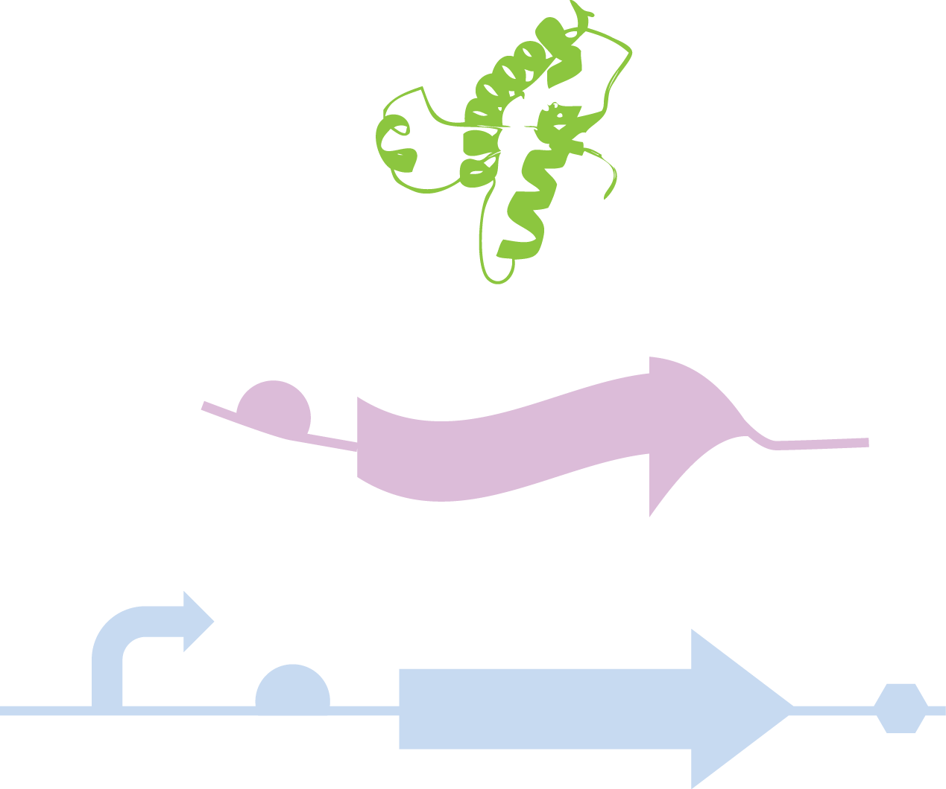

Central Dogma
Metabolites
Protein
RNA
DNA
Notes:
We can simplify the complex behavior of the cell in terms of the central dogma. There is the DNA which can be transcribed into mRNA or functional RNA molecules, and the mRNAs can be translated into protein. The sequence of the mRNA is identical to that of the DNA, exchanging T for U. The protein’s sequence is determined through simple rules from the sequence of the mRNA read three bases at a time. Then there are the metabolites of the cell that are made through the action of proteins. This includes the primary metabolites that make up processes like the Krebs cycle, but also the membrane and various polymeric materials like peptidoglycan. The part concept captures the fact that all genetic information is interpreted according to this model, and the only way to change the persisted behavior of a cell is to make changes to the DNA that underlies the process. Thus, to change the chemical composition of the cell we encode DNAs that result in a set of biochemical interactions that ultimately alter the physical state of the cell.

Slide 3
Central Dogma
Notes:
There are many permutations of interactions that can occur between these encoded components. For example, a protein might interact with a metabolite. A protein might convert one biochemical to another in which case we’d call it an enzyme. Alternatively, a protein might just bind to the biochemical. These interactions may be quite complex. For example, an enzyme might catalyze a reaction on one molecule while being inhibited by another small molecule.

Slide 4
Central Dogma
Notes:
There can also be interactions between a metabolite and an mRNA. For example, riboswitches are RNA elements that bind small molecules and change either the transcription of the gene or translation of its mRNAs.

Slide 5
Central Dogma
Notes:
It is fairly rare for small molecules to interact with DNA. However, there are examples of chemicals that will do so. Several natural products, including the antitumor agent calicheamicin binds DNA and undergoes a chemical reaction with it resulting in strand cleavage and cell death.

Slide 6
Central Dogma
Notes:
Beyond interactions with metabolites, proteins may interact with other proteins. Two proteins might bind to one another forming a complex. That interaction may be inhibitory to one of the partners, or as is often the case two proteins must come together to give rise to some new molecular function. In some cases, many proteins come together to form a large complex that gives rise to function. Also, an enzyme might catalyze a reaction that results in a chemical modification of the protein such as phosphorylation of tyrosine residues by a tyrosine kinase.

Slide 7
Central Dogma
Notes:
Proteins may also interact with RNAs. For example, RNAse P is an enzyme that does reactions on RNAs composed of a complex of an RNA and a protein. Some proteins bind to specific sequences of an mRNA. The ribosome itself is a large complex of RNAs and proteins that interact with small molecules and RNAs to generate proteins.

Slide 8
Central Dogma
Notes:
Proteins also interact with DNAs. They may bind to regions near a promoter and repress transcription. Transcription itself is performed by proteins that bind to DNA and catalyze the formation of RNA molecules. Proteins mediate the processes of replication, packaging of phage and virus particules, formation of transposomes, and so forth all due to protein:DNA reactions.

Slide 9
Central Dogma
Notes:
It is fairly rare for RNA to interact with DNAs, but there are some examples. For example, there are RNA enzymes that can cleave DNA.
Thus, when we encode a Part, we are describing a functional element in the cell composed of either a DNA, RNA, or protein. At the highest level, we can distinguish types of parts by whether they implement their specific molecular function at the DNA, RNA, or protein stage of the central dogma.

Slide 10
CDS-Based Parts
Parts that encode functional proteins
Notes:
Though many parts are DNA or RNA elements, most parts encode proteins. At the DNA level, the region of the sequence that is directly translated 3-bases at a time into protein is called the CDS, or ‘CoDing Sequence’. The proteins that get made into parts are useful by virtue of their molecular function. If you were to write out some arbitrary protein sequence, there is little chance that this protein would fold into a structure and have a function. However, rare sequences participate in highly-specific and complicated interactions with other molecules.

Slide 11
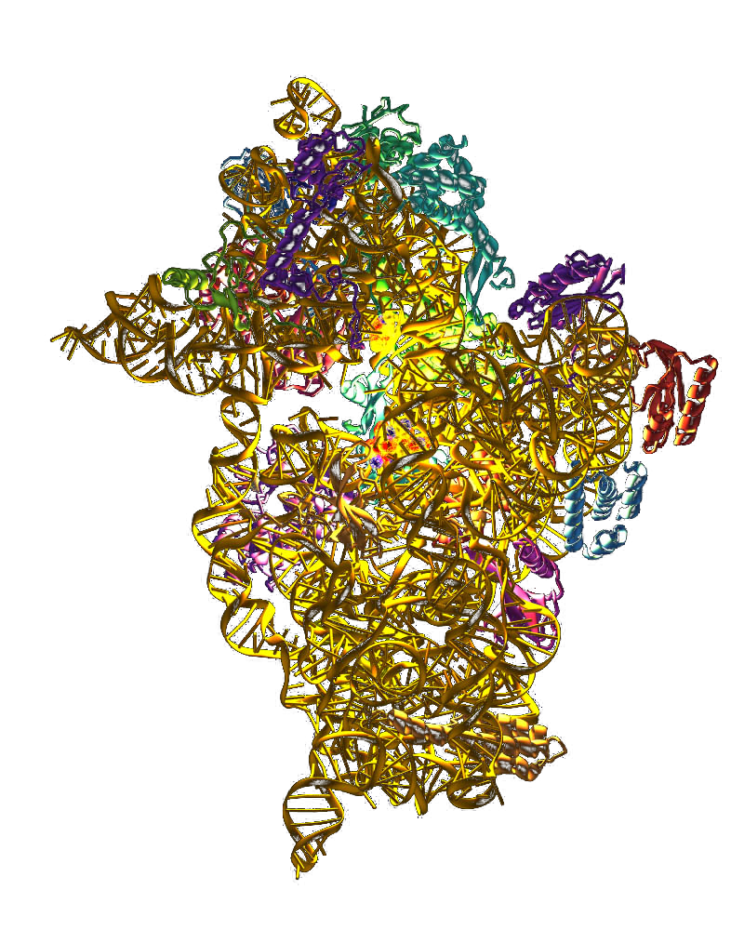
Functional Proteins/RNAs
Enzymes
Binding proteins
Transporters
Signaling
Structural proteins
Scaffolds
Notes:
We can generally describe molecular function in terms of covalent interactions, non-covalent interactions, and compartmentalization in chemical terms. However, it is more common to describe more nuanced terms for molecular function that include notions of their biological function. Enzymes are proteins that catalyze chemical reactions. They bind another biomolecule, usually a small molecule, perform a chemical modification to it, and then release it. The metabolites within the cell are interconverted and created by means of enzymes. Binding proteins bind to things. For example, antibodies usually bind to other proteins, lectins are proteins that bind to carbohydrates, and transcription factors are proteins that bind to DNA and affect transcription. Chemically speaking, all binding proteins involve non-covalent interactions between the protein and its target. However, the specific classes of targets involved and their biological affect are labeled by these more specific terms. Transporters are proteins embedded in membranes that move a biochemical from one side of the membrane to the other. Signaling molecules are usually enzymes. For example, kinases are enzymes that react ATP with another protein resulting in phosphorylation of some residues. They are usually described as a distinct class by virtue of the very different biological role that these enzymes play within the cell. Structural proteins, such the microtubules and actin are examples of binding proteins and enzymes as well. They are typified by their ability to form polymers, however the reactions involved can still be described in terms of non-covalent binding interactions, and catalytic hydrolysis of ATP. Thus, these are distinguished from other classes of proteins based on a more specific classification of their biological role in the cell. Finally, we have scaffolds which are proteins that bind to other biomolecules forming complexes. The ribosome can be thought of as a set of catalytic RNAs held together by protein scaffolds. Kinase transduction cascades are also often mediated by scaffolds that hold a trio of MAPK, MAPKK, and MAPKKK proteins together into a complex.

Slide 12
Reporter Proteins
GFP
BFP
YFP
RFP
Luciferase (Luminescence)
Fluorescent proteins
Notes:
Proteins can alternatively be classified in terms of pragmatic design abstractions. For example, reporter proteins are proteins that can be quantitatively assayed upon expression in a cell. In the case of the fluorescent proteins, they cause the cell to absorb and emit specific wavelengths of light detectable with microscopy, cytometry, or fluorimetry. This categorization of proteins does not define any commonality of biochemical mechanism. Instead, it corresponds a useful design abstraction corresponding to the commonality of usage between things like fluorescent proteins that turn the cell colors, and enzymes that catalyze reactions and emit light. Thus, the details of what these reporter proteins do mechanistically is decoupled from their utility in design. A reporter gene need not even encode protein. For example, there are RNA elements that will specifically bind the dye malachite green and become fluorescent.

Slide 13
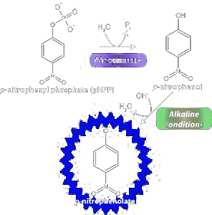
Reporter Proteins
Hydrolytic Enzymes
β-galactosidase (lacZ)
β-lactamase (bla)
Alkaline Phosphatase
Encoded by phoA
Not functional in cytoplasm
Used as a probe for localization
Notes:
In this regard, several enzymes can also be considered as reporter proteins due to their utility in assays for monitoring processes within the cell. LacZ is one very common reporter protein. It encodes a b-galactosidase which cleaves the monosaccharide galactose from various substrates. Several commercially-availability dyes are converted to chromophores or fluorophores in response to cleavage by a galactosidase. Another hydrolytic enzyme is beta-lactamase. Though this enzyme is more typically found in the context of antibiotic resistance to ampillin, it also can be used as a reporter protein. There is a chemical called nitrocephin that becomes fluorescent upon reaction with b-lactamase. Another popular reporter protein is alkaline phosphatase. In E. coli, it is encoded by the phoA gene, and it efficiently removes phosphates from molecules. One substrate is o-nitro-phenyl-phosphate. Hydrolysis of the phosphate results in o-nitro-phenol, which is yellow. Other chromagenic and fluorogenic substrates exist. One specifical property of alkaline phosphatase is that it requires periplasmic localization or secretion to be functional. Thus, this enzyme is also a useful probe for the location of the protein in the cell.

Slide 14
Selectable Markers
Toxic Genes:
Barnase
CcdB
Antibiotic Resistance to:
Ampicillin
Chloramphenicol
Kanamycin
Gentamycin
Hygromycin
Puromycin
Vancomycin
Conditional Lethal:
NfsA (nitrofurazone)
Upp (5-fluorouracil)
SacB (sucrose)
Notes:
Another functional classification of genes are selectable markers. These are proteins that upon production confer a selectable phenotype to the encoding cell. Most commonly, these are antibiotic resistance proteins. These are usually enzymes that chemically modify the antibiotic enabling the cell to selectively grow in their presence. There are also proteins toxic to the cell and can be used in counter-selection. If a cell produces barnase, it will degrade all RNA and kill the cell. CcdB similarly will kill the cell by inhibiting DNA gyrase. There are also conditionally-lethal markers. CcdB, for example, is inhibited by coexpression of CcdA protein, which blocks its lethal action. Upp is an E. coli gene that facilitates salvage of 5-fluorouracil which is converted ultimately to an inhibitor of dNTP biosynthesis. Thus, a cell lacking upp is resistant to 5-fluorouracil, and cells containing this marker can be conditionally killed by growth on 5-FU. A similar process occurs in yeast with the URA2 gene and the related substrate 5-FOA. SacB is another one of these conditional lethals. Upon expression, it renders the cell sensitive to growth on sucrose.

Slide 15
Transcription Factors
Global Transcription Factors:
HNS
IHF
CAP (catabolite repression)
Fur (iron regulation)
Histidine Kinase two-component systems
Local Transcription Factors:
LacI (lactose sensing)
VirF (virulence-related)
NahR (salicylate sensing)
AraC (arabinose sensing)
Notes:
Another important functional class are transcription factors. These are proteins that bind to DNA and affect transcription. Though it is probably not strictly meaningful to distinguish global and local ones, it is clearly the case that some play more diverse roles in the cell than others. The global transcription factors, also called pleiotropic transcription factors are proteins that bind to many (often hundreds or thousands) of different promoters in bacteria. Others, like LacI, only affect a few promoters related through their association with a similar process, in this case lactose catabolism.

Slide 16
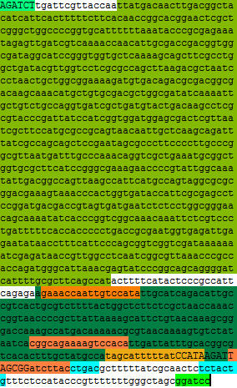
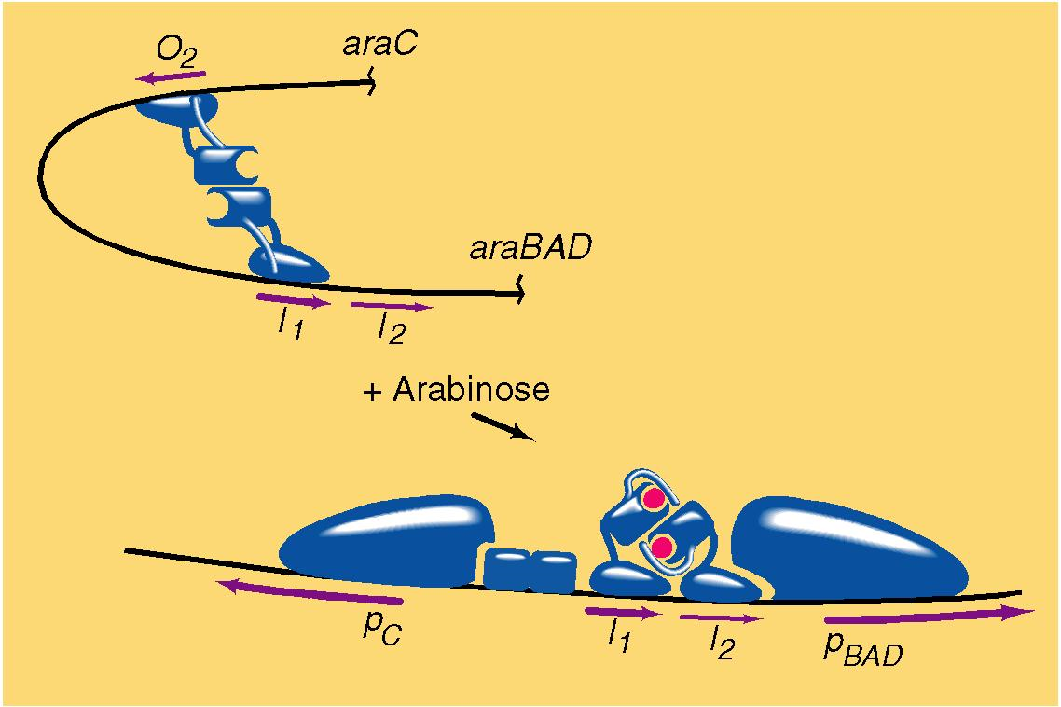
Example: Pbad Promoter
Some TF’s are only activators (CAP)
Some are only repressors (LacI)
Some can do either (AraC)
Notes:
The interactions between transcription, the promoter, and transcription factors can be simple. Some transcription factors are always activators, while others are always repressors. For example, the tet repressor binds as a dimer to the DNA only when tetracycline is absent, and in response causes repression of its promoters. Other transcription factors have more complicated interactions with their promoters. Here is the Pbad promoter that controls expression of the arabinose catabolic genes. A dimer of the transcription factor, AraC, can bind to the DNA in two different configurations. In the off configuration, it binds to the I1 and O2 regions of the promoter resulting in DNA looping and repression of transcription. Upon binding arabinose, AraC undergoes a conformational change and moves to binding I1 and I2 and becomes an activator of transcription.

Slide 17
RNA-Based Parts
Parts that encode functional RNA molecules
Parts encoding regions of mRNA
Notes:
RNA-Based Parts encode functional RNA molecules, or useful regions of a larger mRNA molecule that encodes a protein.

Slide 18
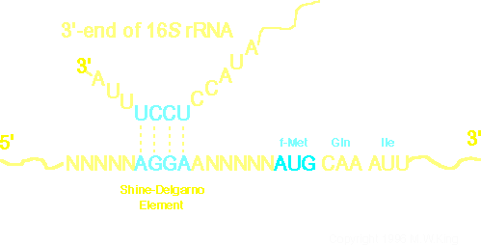
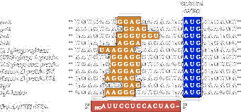
Ribosome Binding Sites
Notes:
Ribosome binding sites are RNA sequences that bind to the 16S rRNA and cause the initiation of translation. The ribosome binding site has two regions – one that binds the 16S, and another that is the first AUG codon, or start codon, of the protein. Typically these are spaced around 8 bp apart, but as you can see for this panel of arbitrarily chosen E. coli genes, the spacing is variable, and the precise sequence is variable. To a first approximation, the more similar the orange region, called the Shine-Dalgarno sequence, is to the 16S sequence, the higher the rate of translation initiation. However, expression levels are determined by multiple factors. Also note that not all start codons are AUG. The third gene in this list is a GUG. GUG codons happen in around 8% of prokaryotic genes, and UUG codons happen around 1% of the time.
How best to describe RBS sequences as Parts remains a topic of discussion. Should it be the sequence up to the start codon? Should it include the start codon? How far upstream to the 5’ end should it extend? To what degree can it be considered in isolation of its downstream sequence? Though there has been some study of this problem, it remains an important and unresolved question.
(for number refs see http://jb.asm.org/content/183/4/1277.full).

Slide 19
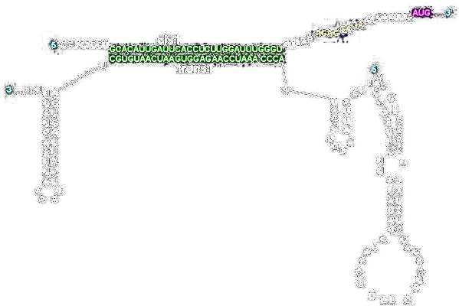

Active RNA Molecules
Riboregulators
tRNAs
Suppressor tRNAs
Notes:
Other RNAs encode more nuanced molecules. Riboregulators are RNA elements that bind other RNA elements and control gene expression. Often they work by changing the conformation of the RNA and thereby reveal or occlude a ribosome binding site. In other cases they affect premature termination of transcription.
tRNAs can also be encoded as parts. For example, UAG stop codons can be recoded as, say, a serine codon by introduction of an engineered tRNA into the cell. By changing the anticodon of a native tRNA to CUA, the cell will begin translating UAG codons as if they were sense codons. Such tRNAs are called suppressor tRNAs because they ‘suppress’ the phenotype caused by UAG mutations in genes.

Slide 20
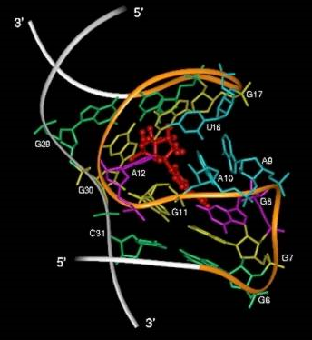
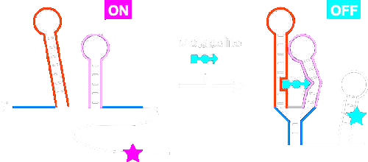
Small Molecule-Binding RNAs
Riboswitch (Natural)
Aptamers (synthetic)
Notes:
RNAs can also perform the non-covalent and covalent reactions observed more commonly in proteins. Aptamers are RNAs that bind to small molecules or proteins. They are functionally similar to anitbodies. Riboswitches are like aptamers in the sense that they bind to ligands, but upon binding they undergo conformation changes that affect a downstream protein coding sequence. They do this via occlusion or exposure of a ribosome binding site, or by causing premature termination.

Slide 21
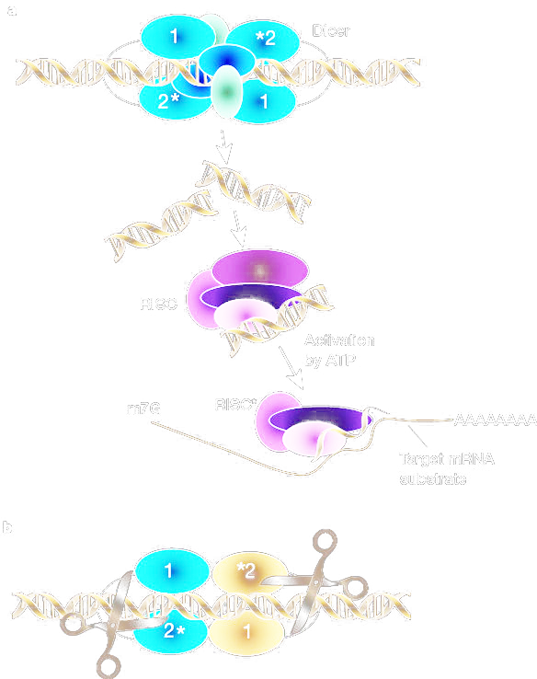
Short RNAs
RhyB
(Native E. coli antisense RNA
siRNA/miRNA Eukaryoties ONLY!
Notes:
There are also short RNAs used to downregulate gene expression. In prokaryotes, there is a phenomenon in which binding of one RNA to another can occlude a ribosome binding site or stimulate cleavage by a native nuclease. In eukaryotes, this phenomena is catalytically enhanced. siRNA, or its genetically-encoded variant miRNA, are small 20-25 bp in length duplex RNAs that are used by higher eukaryotes to direct cleavage of homologous RNA sequences.

Slide 22
Terminators
They terminate transcription
Different ones may be more or less efficient
There are distinct mechanisms, such as Rho-dependence/independence
Like RBS’s, they probably have a secondary structure context dependence
Notes:
One final class of important RNA parts are terminators. These sequences form hairpins which cause transcription to end. They come in two types: Rho-dependent and Rho-independent. They vary in strength, and like ribosome binding sites, this strength is complicated by other factors such as secondary structure. When combined together, an RBS, a protein coding sequence, and a terminator define the sequence of an mRNA molecule. When combined with a promoter part, a complete gene is generated.

Slide 23
DNA-Based Parts
Parts that encode functional DNA molecules
Notes:
Parts can also exert their function on the cell at the DNA level. By this, I mean that the molecule that performs specific interactions with other molecules in the cell is the DNA itself, not an RNA or protein that it encodes.

Slide 24
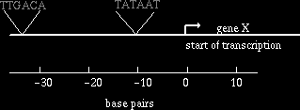
Types of Promoters
Constitutive Promoters
Inducible Promoters
Pbad Promoter (AraC)
Tet Promoter (TetR)
Plac Promoter (LacI)
Pllac Promoter (LacI)
Ptac Promoter (LacI)
Psal Promoter (NahR)
PluxI Promoter (LuxR)
TF-dependent Promoters:
T7 Promoter (T7 RNA Pol.)
SP6 Promoter (SP6 Pol.)
spoIIG (Spo0A of B. subtilis)
Zinc Fingers
Environmental:
fhuA Promoter (iron)
hdeA Promoter (O2)
katG (stationary phase)
Conditional Promoters
Notes:
One category of DNA parts are promoters. Promoters are defined by their propensity to initiate formation of a new RNA molecule in transcription. Like protein-coding parts, they can be functionally or mechanistically characterized. The simplest are the constitutive promoters. These are sequences that directly bind to sigma factors and initiate transcription. They do not require or respond to additional proteins like transcription factors. * All other promoters are some type of conditional promoter in the sense that they require something other than just sigma factor for function. TF-dependent promoters require a transcription factor. Some promoters use a different polymerase of viral origin to product RNA. These include the T7 and SP6 promoters which require T7 RNA polymerase and SP6 RNA polymerase respectively. Others employ a normal sigma-factor dependent promoter, but also a transcription factor. spoIIG promoter of B. subtilis is one of these, and it requires a transcriptional activator called Spo0A for function. Others bind to and are repressed by a transcription factor. TF-dependent promoters can also be engineered to respond to an engineered transcription factor. Particularly in eukarytes, a Zinc-finger protein can be engineered into a transcription factor for arbitrarily-chosen sequences. * Promoters can also be categorized by their inducibility with an external chemical trigger. For example, the lac promoter is normally repressed by binding of lacI. In the presence of IPTG, lacI dissociates from the DNA resulting in expression. The luxI promoter, in contrast, is activated by its ligand-dependent transcription factor. LuxR only turns on LuxI when its ligand is present. Other popular inducible promoters are tet repressor and Pbad. Mechanistically, these systems are not similar, but for design, they play a similar phenomenological role in the cell of causing transcription in response to an external chemical. * Finally, there are environmental promoters. These are promoters that respond to pleiotropic transcription factors in the cell in response to external stimuli. Examples include responses to iron, oxygen, and stationary phase.

Slide 25
Cis Elements: Origins
of Replication
colE1, p15A, F plasmid, R6K
Incompatibility Groups
See http://openwetware.org/wiki/Arking:JCAOligoTutorial8
of Transfer
F plasmid (mating between E. coli)
RP4 (mating from E. coli and most things)
of Packaging
Lambda Phage
M13 Phage
Notes:
There are other DNA elements that I’ll collectively call cis elements. They cause the larger DNA encoding them to undergo some reaction. Origins of replication are a category of these elements that initiate replication on the encoding DNA. Origins of transfer initiate rolling circle amplification and transfer of the encoding DNA to another cell during conjugation. Origins of packaging initiate the packaging of the encoding DNA into a phage or virus particle.

Slide 26
Recombination Sites
Many similar systems exist including the Flp/FRT and Hin/hix systems
Notes:
Other DNA sequences are the site of reaction of a DNA modification enzyme. For example, the sequence GGATCC is the ‘part’ that is acted upon by BamHI restriciton enzyme. Recombination sites are another type of part that are sites for recognition by sequence-specific recombinases and integrases. We’ve seen this before with Lox and its recombinase Cre, FRT sites, and hix sites.

Slide 27
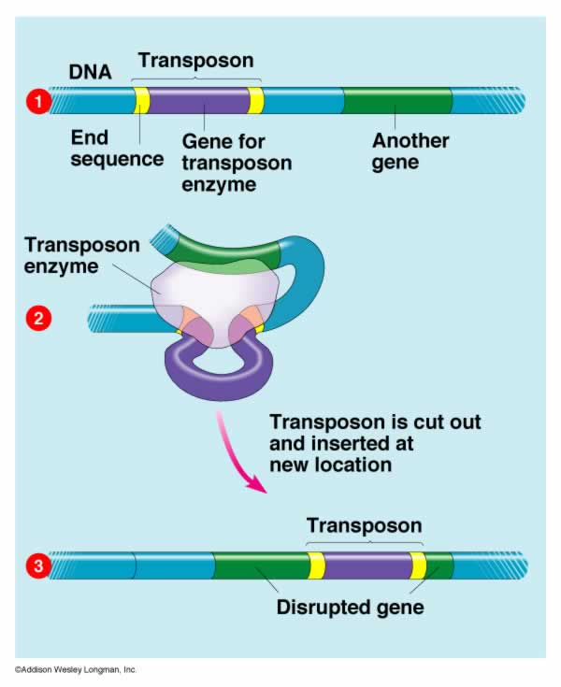
Terminal Repeats
Terminal repeats are the sites (in yellow) acted upon by a transposase
Reaction results in a transposome DNA-Protein complex
The transposome reacts mostly randomly with a recipient DNA
Notes:
Terminal repeats are DNA sequences that are acted upon by a transposase. They are the sequences bound by the transposase, are cleaved by the enzyme, and become covalently attached to it. This results in a transposome that can go on to randomly integrate into a recipient DNA.

Slide 28
Part Families
How do we organize information about parts?
Notes:
An important concept in synthetic biology today is combinatorial design. Here, sets of related parts are explored in combination with other sets of parts to generate a new device. For this, we must first define families of parts.

Slide 29
Combinatorial Assembly
Notes:
For example, let’s say we wanted to express a phosphodiesterase in E. coli at a specific constitutive level. For this, we know we’ll need a constitutive promoter, a ribosome binding site, an enzyme orf, and a terminator to construct a gene that satisfies the rules of the central dogma. If we arbitrarily pick sequences for these parts, we are unlikely to get what we want. We might pick a phosphodiesterase that does not fold properly in E. coli. We might pick an RBS that forms a secondary structure with the chosen enzyme that prevents it from being translated. We might pick a terminator that similarly interferes with translation. We might pick a promoter that gives the wrong amount of transcript. Thus far, we have no working theory for avoiding bad decisions here, and thus we must try many combinations. We might start with a library of promoters that differ by transcription rate but are all functionally constitutive. We might choose multiple ribosome binding sites with different sequences. We might choose a diverse set of orthologs of the proteins, and several options for the terminator. There is excellent cloning methodology, principally using golden gate methods, to combinatorially assemble parts arranged in bins like this. Thus, we can produce libraries of composite parts and screen through this diversity for the precise functionality we require.

Slide 30
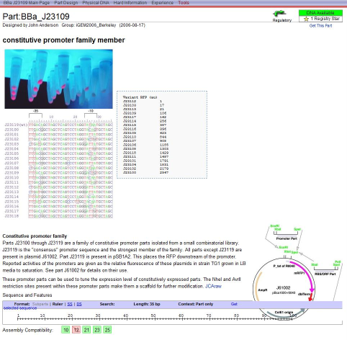
Part Families
DNA
RNA
CDS
Promoter
Prokaryotic promoter
σ70 Promoters
Constitutive Promoters
Parts
J23100 Series Pcon Library
Features
Pcon J23109
tttacagctagctcagtcctagggactgtgctagc
Strength: 33
Initiation site: -2
Notes:
This still poses a challenge of how to define part families, and how to choose the right combinations of parts to explore in an experiment. We’ve seen that we can cleanly distinguish parts into DNA, RNA, and CDS bins based on what level of the central dogma the functional molecule appears. However, these are far too general of abstractions to specify a combinatorial design. Thus, there are efforts to find other ways of specifying a more narrow set of parts. For example, we may wish to specify that a given slot in a combinatorial design be a promoter, and perhaps we more specifically wish to explore all sigma70 promoters, or perhaps more specifically only those that are constitutive, and perhaps even just a narrow clade of specific commonly-used sequences. It remains an unresolved question as to how best to organize information to support design.
Another unresolved distinction is that of a primitive element of genetic composition, and primitive elements of biochemical function. Though different words have been applied to the two situations, I’ll refer to them as ‘Standard Biological Part’ and ‘Feature’, respectively. Standard Biological Parts refer specifically to methods of standardized assembly, and from a genetic perspective this implies strict rules about the boundaries of genetic elements and means of expressing a larger sequence as a composition of other parts. However, the biochemical function of what is encoded in the DNA has nothing to do with how that DNA was fabricated or how some human being likes to think about the sequence. What matters chemically is the specific biomolecules encoded by the sequence, which is the Feature concept. Thus, some problems of design require consideration of parts, while others require features.

Slide 31

Questions to Ponder

Slide 32
If I want E. coli that fluoresce red only when grown in the presence of salicylate, what should my DNA look like?
When I transform my E. coli with two pBca9145 plasmids I’m getting strange expression levels from the proteins. Why?
I made 2 alkaline phosphatase reporter constructs. One was linked to a PelB leader sequence, and the other had no pre sequence. Only one hydrolzes o-nitrophenyl phosphate. Which one and why?

