Slide 1
DNA Fabrication
Notes:
DNA fabrication is the process of writing a physical DNA with a specific sequence.

Slide 2
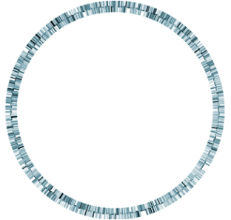
Different strategies at different scales
bases
“parts”
A T
C G
“devices”
genomes
0.5-10Mb
1-20kb
0.1-3kb
1bp
…and different purposes
…and different time/price constraints
Notes:
There are a great many methods for fabricating DNAs, and different techniques are used at different scales and different contexts. At the short end, there is the fabrication of short single-stranded DNAs called oligonucleotides. Then there is a scale in which these short DNAs are combined into gene-length DNAs. Those DNAs can be further assembled into multi-gene DNAs that can encode cellular processes like genetic circuits or biosynthetic pathways. Finally, these can be combined into genome-length DNAs. Though the decision logic about which methodology should be used for any given scenario is complicated and beyond the scope of these lectures, we will describe how the various techniques work and some of the pros and cons of the various techniques. What is important to understand about these techniques is how they work, their limitations, and which ones work for which scales.

Slide 3
Gene Synthesis
Ad hoc cloning
BioBrick Assembly
PCR-based Assembly
Site-directed mutagenesis
Notes:
The techniques we’ll discuss are ad hoc cloning, biobrick assembly methods, gene synthesis, pcr-based assembly, and site-directed mutagenesis.

Slide 4
Ad hoc Cloning
Using the full catalog of enzymes in a cloning experiment
Notes:
Ad hoc cloning means any non-standardized method of constructing DNAs. There are no constraints on the methodologies employed and these approaches make full use of the catalog of available enzymes and techniques to perform a cloning experiment. The other methodologies we’ll discuss correspond to standardized methods of fabrication. Though ad hoc cloning would be difficult both computationally and physically to automate, automation is not the catch-all-scenario solution to DNA manipulation. For example, various library generation methods are best implemented with ad hoc methods. Additionally, until the price of commercial DNA fabrication comes down one more order of magnitide, there will still be some motivation to use these methods in the wetlab in contexts where the change to a sequence is fairly simple.

Slide 5
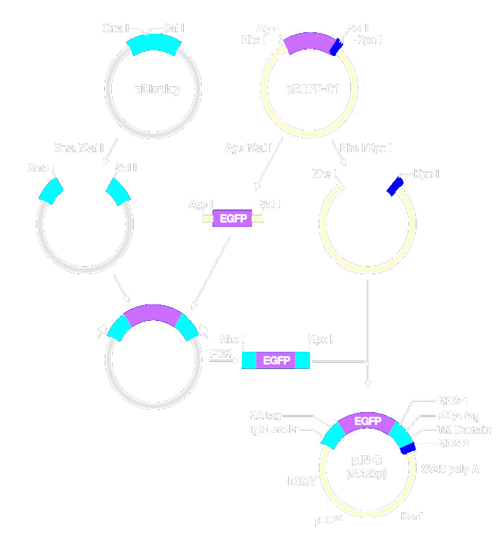
Ad Hoc Cloning Strategies
From PMID: 16524465
Notes:
The primary reason you should understand ad hoc cloning strategies is that prior to 2000, there were no standardized fabrication methods and all published work is some ad hoc strategy. Here we see an example ad hoc method. First, they take a plasmid called pDisplay, cut it with XmaI and SalI, and isolate the larger of the two resulting DNAs. They similarly digest pEGFP-C1 with AgeI and SalI, then combine the two fragments into a new plasmid. That plasmid is then used as template for PCR to introduce NheI and KpnI restriction sites, which are inserted into pEGFP-C1 DNA that has been digested with NheI and KpnI. The resulting construct is called pIN-G.
This text I just described is the sort of language you will very often find in papers, and ocassionally it will be drawn out as a diagram like the one shown. The sequence of the product is knowable based on the series of manipulations performed and the sequence of the original plasmids.

Slide 6
Example Ad Hoc Cloning
Plasmid pKQ-GFPuv was digested with BglII and Mung Bean Nuclease, purifed on a zymo column, and then digested with EcoRI. The material was run on a gel resulting in two bands. The smaller of the bands was gel purified to give fragment A. Meanwhile, plasmid pSC101 was digested with HindIII, purified, and then added to a reaction containing polymerase buffer, 0.2 mM dNTPs, and T4 DNA polymerase. After purifying the DNA on a zymo column, the material was digested with EcoRI and then subjected to gel electrophoresis. The larger of two bands was purified from the gel affording fragment B. Fragment A and fragment B were combined in a reaction with ligase buffer and T4 DNA ligase, introduced into E. coli by transformation, and spread on LB plates supplemented with Ampicillin.
Notes:
Let’s go through an example in ApE so you can see how this is done.
Here is the series of manipulations we wish to simulate in the computer. (read it, then go through it)

Slide 7
Gene Synthesis
Building up gene-length DNAs from single bases
Notes:
Gene Synthesis refers to the construction of gene-length DNA, typically 800bp to 3kb in length, at base-level precision.

Slide 8
Gene Synthesis
(aka DNA total synthesis)
bases
Oligos
Synthons
A T
C G
Devices
1-20kb
6-100bp
1kb
1bp
Solid-Phase Phosphoramidite
Chemistry
SOEing, SLIC, BioBrick-like Reactions
In vitro or in vivo recombination
Gene Synthesis Reactions
Single: IDT, Operon
Multiplex: Agilent, LC Sciences, etc.
Geneart, DNA2.0, Gen9, etc.
SGI-DNA
Trends Biotechnol. 2009 Feb;27(2):63-72 PMID: 19111926
Notes:
All current protocols for gene synthesis begin with solid-phase phorsphoramidite chemistry. Individual A, T, C, and G nucleotides are biologically derived, but they are extensively derivatized using synthetic organic chemistry. These bases are assembled stepwise under non-aqueous conditions into single-stranded oligonucleotides. Though it is possible to buy an oligonucleotide synthesizer, in practice it is rarely done anymore. Commercial suppliers led by IDT and Operon provide oligonucleotide synthesis with next-day delivery at 5x lower prices than can be achieved with the instruments that one could purchase for in-house use. Additionally, the need for water-free conditions in these reactions requires extensive monitoring and continuous use to maintain a high-quality product. When you purchase oligonucleotides from these suppliers, you receive individual pure oligonucleotide samples in screw-capped tubes, or in 96-well plates. There is another product, called multiplex oligonucleotide synthesis that is much newer in which oligos are provided as a complex mixture at much lower concentrations. Next-generation gene synthesis methods are expected to build off this alternate format due to desirable scaling and pricing qualities. Regardless of the source of these oligos, they must be assembled using in vitro molecular biology operations into gene-length DNAs. In gene synthesis facilities such as Geneart, DNA2.0, or Gen9, the procedures for fabricating larger DNAs has been standardized. When a user orders a DNA longer than can be synthesized in one round of standardized fabrication, the sequence is broken up into shorter DNAs called synthons. These synthons have a constant length and do not necessarily correspond to genetic boundaries. The synthons are individually cloned and sequence-confirmed. Various assembly reactions, like SLIC, SOEing, or Golden Gate methods, which we’ll discuss later, can be used to assemble these synthons into larger sequences. Above this scale, in vitro or in vivo recombination methodologies can be used to fabricate DNAs on the genome scale or theoretically longer. However, there is only one commercial vender of these services as of 2014, SGI-DNA.

Slide 9
Current metrics
Turnaround time: 24 hrs
Cost: $0.10 per base
Scale: 10nmol
State: Chemically pure, sequence non-clonal
IDT single-sequence oligonucleotide synthesis
Turnaround time: ~2 wks
Cost: ~$1000 for 5000 to 55,000
sequences
Scale: fmol
State: Chemically pure, sequences mixed
Multiplex oligonucleotide synthesis
Turnaround time: ~2 wks
Cost: $0.39 per base up to 3kb
Scale: 10ug as sequence-confirmed plasmid DNA
State: Chemically pure, clonal
Geneart Gene Synthesis from single-sequence oligonucleotides
Notes:
Thus, there are 3 distinct products on the market today. IDT leads in volume for single-sequence oligonucleotide synthesis. The delivery time is 24 hours, and the oligos typically cost 10 cents per base when ordered on the smallest scale which is 10 nmols of material. The materials supplied is chemically pure in the sense that it contains no salts or other reagents—it is just DNA. However, the material is not clonal. Though greater than 90% of the molecules present in these samples are precisely the ordered sequence, these molecules will be contaminated with sequences containing occasional point mutations, deletions, or 5’ truncations.
Multiplex oligonucleotide synthesis takes longer to order, around 2 wks. It costs around $1000 for 5000 to 55,000 oligos, but pricing is highly variable and requires negotiation. As of 2014 this is still an experimental product and most commerce is business-to-business rather than to end users. Only femtomoles of material are present in these products, but just like with single-sequence oligos, they are chemically pure and non-clonal. Additionally, the sequences are mixed together in a single tube.
Gene Synthesis has many suppliers. For full service gene synthesis, the per base cost in practice is around 40 cents per base up to 3kb. The material is cloned into a plasmid and is thus both chemically pure and clonal when received. It minimally takes around 2wks to order this product, but synthesis difficulties are commonplace and orders can take many months. More recent offerings include Gen9 and IDT’s gblocks which provide non-clonal products supplied as linear fragments with a faster turnaround.

Slide 10

Oligonucleotide Synthesis
Deblocking
Phosphoramidite
Coupling
Capping
Oxidation
Notes:
Regardless of the downstream processing steps and final format, gene synthesis begins with phosphoramidite chemistry. Companies such as Glen Research sell controlled-pore-glass, or CPG columns covalently attached to a single DNA base via the 3’ hydroxyl. Solid-phase oligonucleotide synthesis begins with one of these columns chosen based on the desired 3’ end of the oligo being synthesized. These bases are protected on the 5’ end with a trityl group, and several positions on the nucleobase are similar blocked to avoid side reactions. These bases initiate the formation of the oligonucleotide through cycles of reactions. * In the deblocking step, the column is treated with a strong acid to remove the trityl group. * The column is then washed with the next phosphoramidite that will be joined to the growing chain along with a catalyst. This coupling step creates the bond between the backbone phosphate and the 5’ hydroxyl. Note that there are only 3 oxygens on this phosphorus atom – it is in a different oxidation state than the phosphate in the desired DNA. * In the next step of the cycle, the phosphate is oxidized with iodine to generate the phosphate. * Finally, the column is capped with acetic anhydride to terminate any chains that did not receive the added base. At the end of the synthesis, the oligonucleotides are full-length but are immobilized on the column and contain multiple protecting groups. These linkages are broken by treatment with methylamine and ammonium hydroxide. Upon purification, a structurally-normal synthetic DNA is obtained.

Slide 11
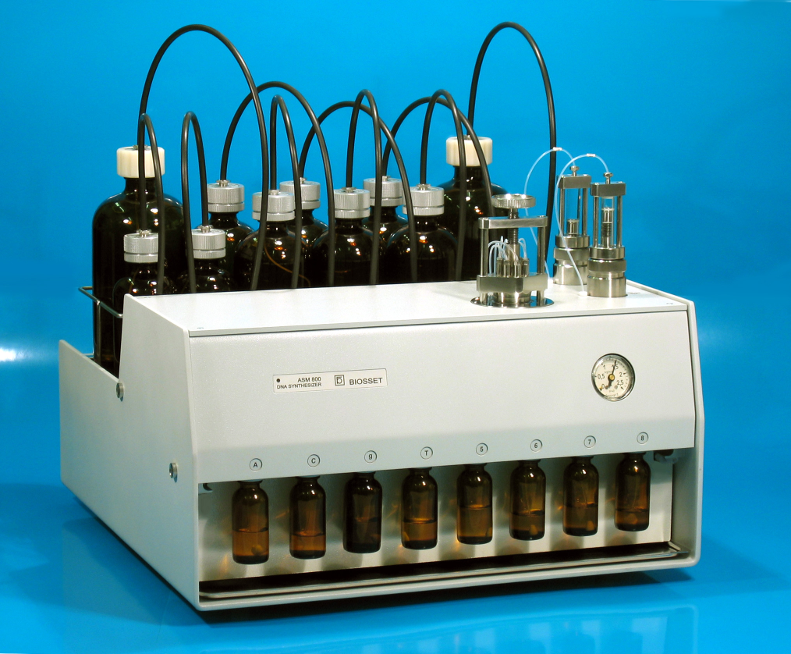
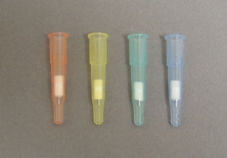
Oligonucleotide Synthesis
Reagents
Columns
Mixed bases, modifications
A, T, C, G bases
Notes:
Oligo synthesis instruments have been around since the 1970’s and look like this. * The various reagents for deblocking, coupling, oxidation, and capping are housed in bottles under a nitrogen atmosphere and carried into the instrument by tubes. * The A, T, C, and G bases have their own special positions on the instrument and are supplied in small vials sufficient for the fabrication of many oligonucleotides. * Typically, an oligo synthesis instrument will contain additional positions for addition of chemical modifications such as biotinylated bases, 5’ phosphates, or user-prepared phosphoramidites including unnatural nucleotides. Finally, there is a position to install the controlled-pore-glass columns where the synthesis will occur. Beyond this, an oligonucleotide synthesis machine is simply a bunch of tubes connected to valves and a computer that opens and closes those valves. As of 2014, you will still find instruments like these in labs that work with unnatural bases. However, these are no longer used for production of conventional oligos.

Slide 12
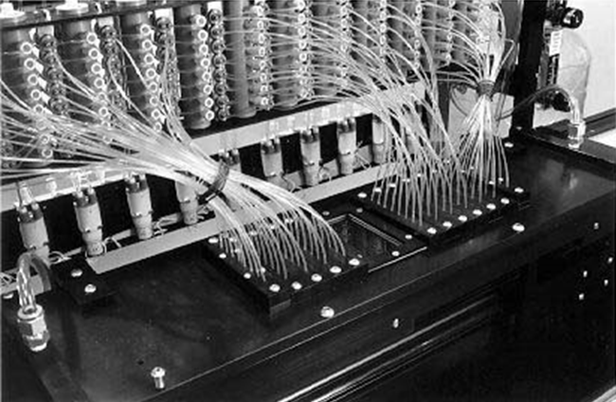
Oligonucleotide Synthesis
A modern multi-reaction oligonucleotide synthesizer
Notes:
In a high-volume commercial supplier such as IDT, oligos are synthesized at higher scale on more advanced instruments. Shown here is one that produces 96 oligonucleotides at a time.

Slide 13

Ligase Chain Assembly
Synthesize both strands as overlapping 50 mers
Thermal cycling of a Taq Ligase reaction containing oligos
Notes:
Once oligonucleotides are obtained, they must be assembled into synthons. The simplest of these methodologies is ligase chain assembly. Here, both strands of the input sequence are synthesized completely in such a way that they can all anneal to one another into the full length target sequence. Typically these sequences will be 50 bp in length, but could be as low as 30 bp, and in some variations are as long as 200 bp. Procedurally, the oligos are first treated with polynucleotide kinase to add 5’ phosphates, and then subjected to a ligase chain reaction with Taq ligase. Through cycling of the reaction through iterations of denaturation, annealing, and ligation at elevated temperatures, the individual nicks between the junctions of the oligos are sealed resulting in the full-length synthon as a contiguous double-stranded product.

Slide 14
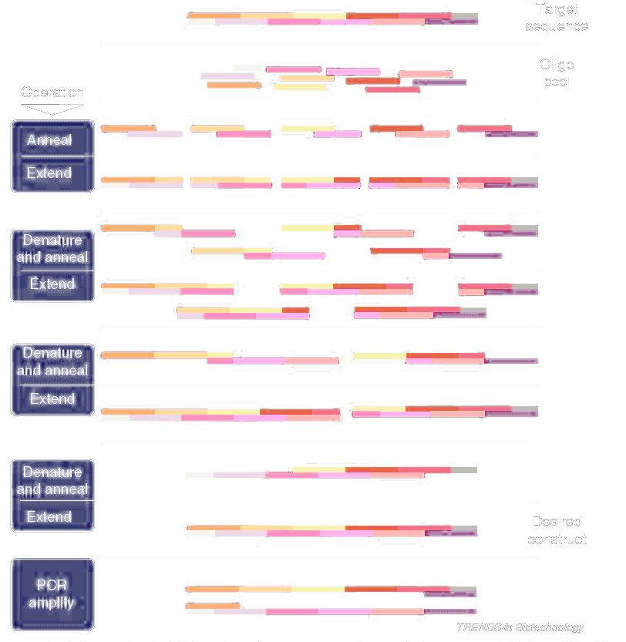
PCA Assembly
(Polymerase chain assembly)
Start with overlapping 50-60bp Oligos
Combine in a thermostable polymerase reaction
Run a PCR-like program
Use “assembly product” as template for a conventional PCR with external oligos
Clone the product into a vector to generate a synthon
Notes:
The other common way of assembling oligonuceotides into gene-length DNAs is polymerase chain assembly, or PCA. Like with LCA, the target sequence is synthesized as a pool of shorter oligonucoetide sequences that can assemble into the full length sequence in a one-pot reaction. The difference is that 1) the assembly reaction involves a thermostable polymerase rather than a ligase, and 2) there can be gaps in the sequence that will be filled in by the polymerase during assembly. Typically PCA is done in two stages. First, the equimolar mix of oligos is reacted with a polymerase under PCR-like conditions. Second, the material for the first reaction is used as the template for a conventional PCR reaction involving two external primers. Regardless of whether the double-stranded DNA is assembled using LCA, PCA, or a mixture of the two, the full length product is typically cloned into a vector, introduced into cells, and individual clones are sequence confirmed.

Slide 15
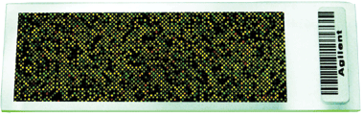
Multiplexed Methods
Many oligonucleotides in one pool, sufficient for producing >25 genes
Potential for ~20x reduction in price over CPG oligos
Assembly by PCA/LCA-like methods
Barriers
Quality of oligos is sometimes lower than single-oligo synthesis
Lower concentrations of oligos than typically used in PCA/LCA
Complexity of the synthesis pool is higher than used in PCA
Solutions
Error-correction protocols (mutS, etc).
Design the oligos as a set to optimize assembly (Tm matching)
Elaborate pre-amplification protocols
Notes:
Reducing the cost and increasing the reliability and scalability of the gene synthesis pipeline is an area of extensive industrial research. One of the most promising variants involves oligos derived from multiplex synthesis. Here, many oligonucleotides are synthesized in a pool, and mixture is sufficient to produce more than 25 genes. In some embodiments, the number of genes assembled from one pool is in the hundreds or even thousands. Because there is less separation of the reactions into parallel assemblies, and less phosphoramidite is employed, these procedures will ultimately result in a 20x reduction in price relative to CPG oligos. As of 2014, one commercial supplier, Gen9, is supplying DNAs fabricated in this manner, but seveeral others are expected to begin production soon. Despite the alternate sourcing of the oligos, the molecular biology procedures for assembling the oligos into larger DNAs still invovle PCA or LCA-like reactions. However, there are several complications that need to be worked out for this to be commonplace. First, the quality of the oligos is sometimes lower than that of single-oligo synthesis. This is primarily the result of omitting the capping step, but efforts are underway to improve this, and it is expected that these syntheses will ultimately be superior to CPG-based synthesis. Because of the lower concentration of the oligos, these methods require elaborate amplification steps that also deal with the higher complexity of the oligo pool. There are various approaches to remedying these issues including error-correction protocols such that involve mutation-detecting enzymes like mutS, the biasing of the design of the genes to be more amenable to this type of assembly, and elaborate pre-amplification protocols and emulsion methods to deal with the complexity of the reaction.

Slide 16
Why don’t we always do this?
In practice it’s slow (like months for longer things)
$$
Total number of bases for this class: 43517
Would cost about ~$22,000 for basic parts
Would cost ~$741,459 for all the composite parts
Notes:
Today, it is still the case that gene synthesis is used somewhat sparingly along side more conventional fabrication methods. It’s main drawback is that it is slow, and it is also expensive. At the current price, it is impractical for even commercial users to not reuse previously-synthesized genes. When I teach my BioE 140L course at Berkeley, around 20 students each produce around 3 parts. In a typicall year, this amounts to around 40000 bases which for the basic parts alone would cost around $20K. If all the composite parts that got generated during a project were synthesized de novo without reuse, the costs would begin pushing $1 million. Thus, this methodology has a long way to go before other methods of fabrication can be fully eliminated from the design-build-test cycle. However, combined with automated assembly methods that enable reuse of synthetic sequence, the price point for these procedures is already making non-automated DNA fabrication a thing of the past.

Slide 17
Break Filming

Slide 18
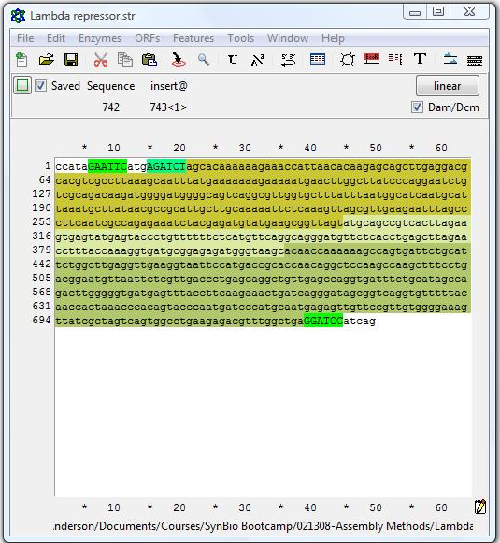
Example: Gene synthesis oligo design
{<Lam Rep!}
Design of LCR oligos using Excel

Slide 19
Example: Gene synthesis oligo design
{<Lam Rep!}
Design of PCA oligos using GeneDesign
http://54.235.254.95/gd/
“sequence analysis”
then
“BB Design (RE Overlap)”
Target 50 bp, max length 59 bp

Slide 20
BioBrick
Standard Assembly
Building up larger DNAs from standardized intermediates (Parts)
Notes:
BioBrick standard assembly was the first proposed method of fabricating multi-gene DNAs using one standardized chemistry. It was proposed by Tom Knight at MIT and was popularized through the international genetically engineered machines competition.

Slide 21
Standard Assembly
Basic Parts
Composite Parts
Notes:
The essential idea of biobricks starts with a collection of physical plasmids that vary from another only by a region of the DNA that encodes a ‘part’. These part sequences may encode a protein-coding sequence, a promoter, a ribosome binding site, or any other functional primitive of genetic composition. Using only one molecular procedure: the biobrick assembly reaction, these parts can be assembled into larger sequences such as a multi-gene operon. These larger constructions can be further joined with other parts to make yet larger DNAs. The individual parts that start the process such as single open-reading frame-encoding parts are fabricated from various methods including commercial gene synthesis or cloning from genomic DNA. Because they cannot be reduced to a simpler construct by virtue of a standardized procedure, they are referred to as ‘basic parts’. The larger DNAs from which these are assembled are referred to as ‘composite parts’.

Slide 22
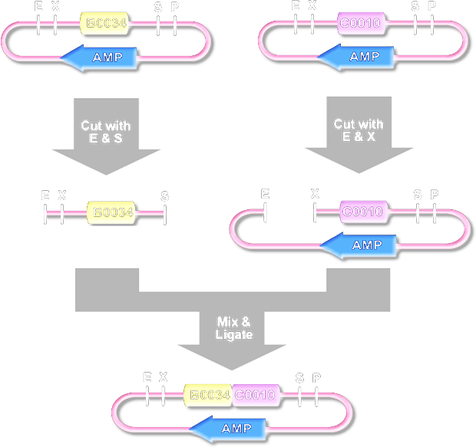
BioBrick Standard Assembly
Prefix Insertion
Suffix Insertion
(Uses EcoRI)
(Uses PstI)
Notes:
The original biobrick assembly reaction made use of the restriction enzymes SpeI and XbaI. SpeI recognizes the sequence ACTAGT and generates a CTAG sticky end. XbaI recognizes the sequence TCTAGA and similarly generates a CTAG sticky end. Because the two enzymes generate the same sticky ends, the products of digestion from the two enzymes can be joined by ligation. When an SpeI sticky end is joined with an XbaI sticky end, the resulting seqeunce is ACTAGA, which is not recognized by either sequence. BioBrick basic parts begin with plasmids in which the part is flanked by an XbaI site on the 5’ end, and a SpeI site on the 3’ end. Additionally, EcoRI and PstI sites exist beyond XbaI and SpeI. The basic parts are designed to not include any sites for these four enzymes such that these sites are unique within the plasmid. To join two basic parts into one, there are two options: a prefix insertion and a suffix insertion. Illustrated here is a prefix insertion in which the 5’ part (b0034 here) is inserted upstream of the 3’ part. The b0034 plasmid is digested with EcoRI and PstI and the short part-containing fragment is isolated. The c0010 plasmid is digested with EcoRI and XbaI, and the larger part-containing fragment is isolated. Those two fragments are then joined by ligation. The two EcoRI sites are joined together, and the XbaI and SpeI sites are similarly joined. Since the ligation product of XbaI and SpeI sticky ends cannot be recleaved by either enzyme, there is a 6 bp scar between the two parts, but the XbaI and SpeI sites on the 5’ and 3’ ends of the new composite part remain unique in the product plasmid. Thus, composite parts can be further joined in pairwise combinations with other parts. In a suffix insertion reaction, the same product results, but it is generated by cleavage with PstI instead of EcoRI.

Slide 23
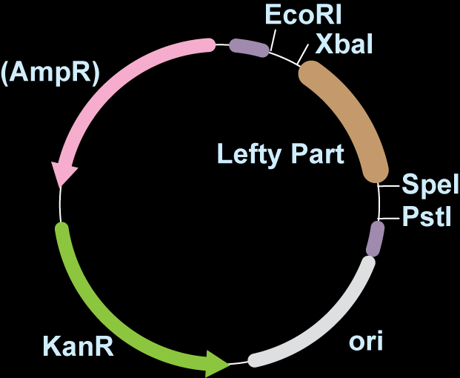
3A Assembly
pSB1AK3-PartNumber
K
pSB1AK3, pSB1AC3, pSB1AT3
Notes:
Various techniques have been developed to improve the throughput of BioBrick assembly by eliminating difficult gel purification steps. 3A assembly is the most common of these variants. Here, each basic part is incorporated into one of three entry vectors: pSB1AK3, pSB1AC3, or pSB1AT3. In addition to an ampicillin resistance gene, these plasmids also encode Kanamycin, Chloramphenicol, or Tetracycline resistance genes.

Slide 24
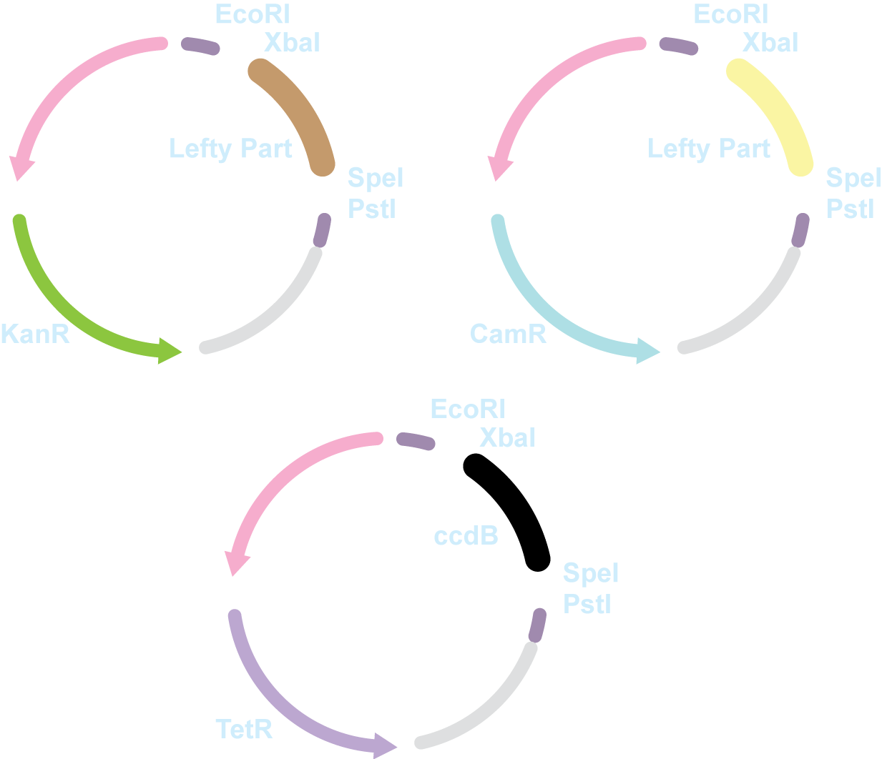
3A Assembly
Righty Part
K
C
T
Notes:
Joining parts together with 3A assembly involves the digestion and ligation of three plasmids. The first two encode the parts that will be joined together. The third plasmid is selected to have a different antibiotic resistance gene than the other two such that it can be selected over the other two after transformation. As shown here, the 5’ part, which I’ll call lefty, is in a Kanamycin-resistant plasmid. The righty part is in a chloramphenicol-resistance plasmid. Thus, you would choose pSB1AT3 to house the product plasmid. If both the lefty and righty parts were C, you could choose to assemble them with a T or K plasmid, and so on.

Slide 25
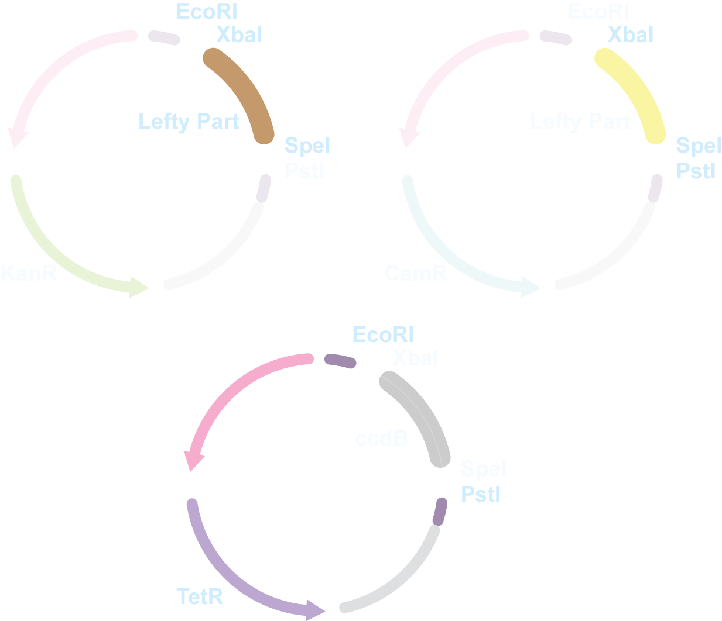
3A Assembly
Digest
EcoRI + SpeI
Digest
XbaI+ PstI
Righty Part
K
C
Digest
EcoRI+ PstI
T
Notes:
The lefty plasmid is digested with EcoRI and SpeI, and then the enzymes are heat killed. The righty plasmid is digested with XbaI and PstI and then heat killed. The recipient backbone plasmid is digested with EcoRI and PstI.

Slide 26
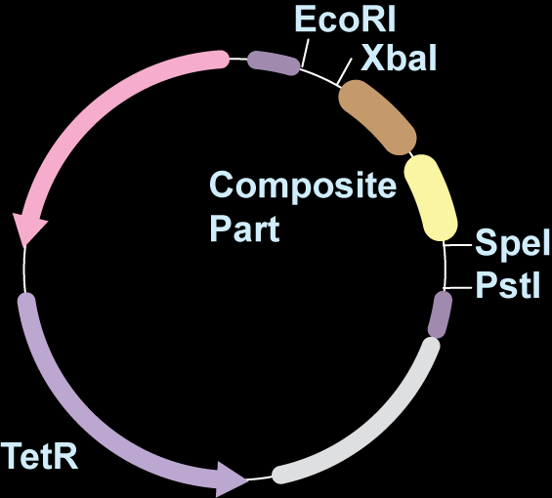
3A Assembly
Ligate
Plate on Tet
T
Notes:
Upon ligation, the three fragments recombine into a new tetracycline-resistance-coding plasmid. Upon transformation and growth on medium containing tetracycline, only these recombined plasmids produce colonies. Thus, plasmids can be easily assembled without the need for gel purifications or sifting through many colonies for the desired product.

Slide 27
BioBrick Method(s)
No oligos required after making basic parts
Parts can be assembled in any order, any number
No sequencing required (usually) since there is no PCR
Extremely reliable relative to alternatives
Cheap, readily automated
But…
Slow, have to do as a convergent, multi-step synthesis
Get scar sequences at part boundaries
Notes:
BioBrick methods have some very desirable qualities. First and foremost, they are very cheap to implement. They require no synthetic oligonucleotides beyond those required to make the basic parts. They can be assembled in any order iteratively to make parts up to around 30kb. Because only robust cut-and-paste-style manipulations are involved, BioBrick products typically do not need to be sequence confirmed since there is little chance that a mutation will result. Though it is possible to get alternate products that omit parts, it is very rare to have a full-length construct with mutations. The chemistry is also quite robust and easy to learn. This methodology has also been automated. However, none of the automation Fabs under development today are implementing BioBrick chemistries. Unfortunately, the method is quite slow. Because parts are joined in a pairwise manner, it takes multiple cloning cycles to build up larger constructs. Additionally, there are six base pair scar sequences at each basic part junction in the final construct, and there have been concerns that these scars are sometimes recombinagenic and can adversely affect expression. Thus, most fabrication facilities have opted for more expensive but faster and scarless methodologies.

Slide 28
PCR-based Assembly Methods
Employing the polymerase chain reaction to stitch together fragments into full length products
Notes:
There are many strategies for assembling synthon or gene-length DNAs into larger molecules. In PCR-based methods, DNAs are stitched together into full length products through polymerase-based reactions.

Slide 29
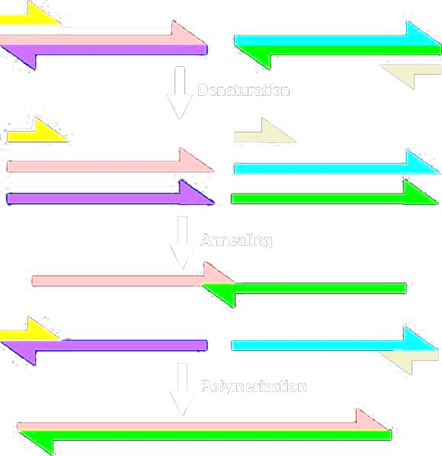
SOEing (Splicing by Overlap Extension)
Notes:
The most basic of these techniques is SOEing. In SOEing, there are two rounds of PCR. The first step is a conventional PCR to generate double-stranded linear products. In the second step, several of these linear products are combined with two external oligonucleotides, and the fragments assemble into a full length product through PCR. For this to happen, the linear products generated in the first step must share homology to one another on their termini. In the example shown, we have two such fragments in pink and in green. Typically the fragments share 20 to 40 bp of exact homology to one another on their ends. During the assembly reaction, first the DNAs are denatured resulting in single stranded products. Though there are multiple ways these strands can reanneal to one another, only a few of these configurations results in a duplex with a recessed 3’ end. One of these duplexes results from annealing of strands of the two template PCR products. The polymerase can extend that duplex to the full length double-stranded product. This full-length product can then undergo exponential amplification with the two supplied oligos. In this example, there are only two template fragments being joined together.

Slide 30
Example: multiple site substitutions
(aka cassette mutagenesis)
(aka megaprimer mutagenesis)
x
x
x
x
x
x
x
x
x
Notes:
But this procedure is robust up to at least 4 fragments. One of the more popular uses of SOEing is for introducing multiple mutations into various sites of a gene. Suppose you wish to introduce 3 mutations, designated by red X’s into a sequence. First, you would identify regions 20-40 bp in length flanking the mutation to serve as the annealing region during assembly. You would then perform PCR to construct fragments of the full sequence that each contain this homology region on their ends along with the mutation. Finally, these four fragments are recombined in a SOEing reaction to generate the desired product containing all three mutations.

Slide 31
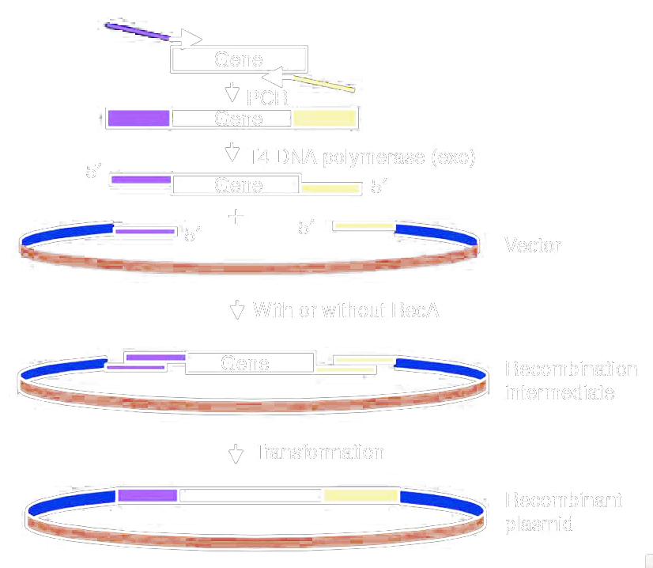
SLIC (sequence and ligation–independent cloning )
LIC (ligation independent cloning)
Nat Methods. 2007 Mar;4(3):251-6. Epub 2007 Feb 11. PMID: 17293868
Notes:
All the PCR-based assembly methods are based on the introduction of homology arms on adjacent DNAs. These DNAs are then assembled based on homology to one another. The differences between techniques are due to the specific enzymes and mechanism of assembly. SLIC was an influential technique in the field for several years that is based on the same reaction as ligation independent cloning. The individual cassettes to be joined by assembly are generated with homologous ends by PCR. These ends are then treated with T4 DNA polymerase which provides exo activity that will partially degrade the ends resulting in long single-stranded stretches. Several such ends can then be joined together in vitro, and the nicks are repaired in vivo.

Slide 32
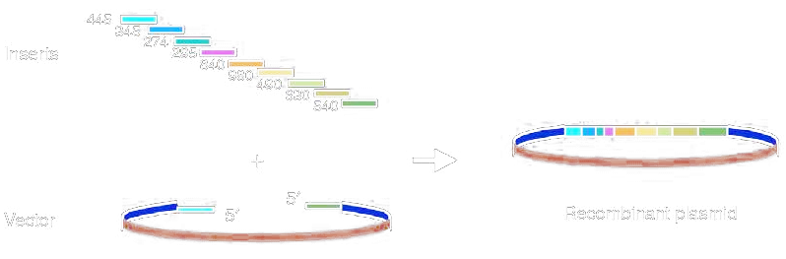
SLIC (sequence and ligation–independent cloning )
Oligo design basically the same as for SOEing assembly
Use longer overlaps (~40bp)
Uses recA not a ligase
Nat Methods. 2007 Mar;4(3):251-6. Epub 2007 Feb 11. PMID: 17293868
Notes:
This methodology can be used to assembly more DNAs than an SOEing reaction can handle. Typically the homology arms are more like 40 bp than 20 bp, but other than this the design of a SLIC experiment is the same as every other PCR assembly method. Though multiple DNAs are being joined together, there is no ligase employed in vitro. The assembly is based on homology and the stabilization of the nicked complex by recA protein. The nicks in the DNA are repaired inside the cell.

Slide 33
Gibson Method
40bp
T5 Exonuclease
Phusion Polymerase
Taq Ligase
(NAD+, dNTPs, Buffer)
One pot, 50°C
PMID: 19363495
Notes:
The Gibson method is a highly popular and actively-used method. From a design perspective, a Gibson cloning experiment is the same as SLIC involving 40 bp of homology between fragments. * The method involves a cocktail of purified enzymes containing T5 exo, phusion polymerase, and Taq ligase in a special buffer. All these reagents are combined along with the DNA fragments and incubated at 50 degrees.

Slide 34
Gibson Method
T5 Exonuclease
Phusion Polymerase
Taq Ligase
(NAD+, dNTPs, Buffer)
One pot, 50°C
T5 Exonuclease
Notes:
The T4 exonuclease activity will partially degrade the end of the DNA generating single-stranded overhangs of arbitrary length.

Slide 35
Gibson Method
T5 Exonuclease
Phusion Polymerase
Taq Ligase
(NAD+, dNTPs, Buffer)
One pot, 50°C
T5 Exonuclease

Slide 36
Gibson Method
T5 Exonuclease
Phusion Polymerase
Taq Ligase
(NAD+, dNTPs, Buffer)
One pot, 50°C
T5 Exonuclease

Slide 37
Gibson Method
T5 Exonuclease
Phusion Polymerase
Taq Ligase
(NAD+, dNTPs, Buffer)
One pot, 50°C
Annealing
Notes:
Two such ends with homology to one another can anneal

Slide 38
Gibson Method
T5 Exonuclease
Phusion Polymerase
Taq Ligase
(NAD+, dNTPs, Buffer)
One pot, 50°C
Annealing
Notes:
And a polymerase can fill in any gaps between the junction

Slide 39
Gibson Method
T5 Exonuclease
Phusion Polymerase
Taq Ligase
(NAD+, dNTPs, Buffer)
One pot, 50°C
Phusion
Nicked, but no gap
Notes:
This results in a nicked DNA with no gaps

Slide 40
Gibson Method
T5 Exonuclease
Phusion Polymerase
Taq Ligase
(NAD+, dNTPs, Buffer)
One pot, 50°C
Taq Ligase
Fast
Can handle
dsDNA, no gaps, no nicks
Notes:
And these gaps can be sealed with Taq ligase.

Slide 41
Gibson Method
Fast—order oligos (1 day), pcr (2hr), gel purify (1hr), then a 1hr ligation, transform
Can handle very large sequences
Get degradation of parts <200 bp
Most reliable of the PCR-based methods
Like all PCR methods:
Less reliable than cut-and paste methods
Requires sequencing (can get odd products)
Get deletions with repetitive target parts
Need custom oligos for each junction
Notes:
The advantages of Gibson are primarily that it is fast and automatable. Like all PCR methods, it requires the purchase of oligos specific to each junction, and this takes around 24 hours and $10 per junction, but after that the remaining steps can all be implemented in one day. Additionally, the methodology can handle very large sequences such as 25kb fragments, and in fact this methodology is best used on larger sequences. Short parts under 200 bp often get degraded under the conditions of the experiment. Gibson is currently the most popular method because it is fast and more reliable than others, and its drawbacks are those common to all methods. The reactions are less reliable than cut-and-paste procedures, and thus a fabrication strategy sometimes must be redesigned. The use of PCR can introduce mutations, and thus the constructs must be confirmed by sequencing. With repetitive sequences, there can be deletions and thus not all sequences are amenable to the reaction. Finally, PCR methods are more expensive than BioBrick or MoClo-style methods because they require custom oligos for each assembly junction.

Slide 42
In vivo recombination
Design oligos just like SOEing / SLIC / Gibson with 40bp or more homology
Make the individual PCR cassettes
Transform them into yeast (preferred) or B. subtilus or E. coli containing the lambda red genes
Recombination in vivo results in assembly
Cost/Benefit analysis similar to Gibson
Main drawback is use of cells
One-step assembly in yeast of 25 overlapping DNA fragments to form a complete synthetic Mycoplasma genitalium genome.
Gibson DG, Benders GA, Axelrod KC, Zaveri J, Algire MA, Moodie M, Montague MG, Venter JC, Smith HO, Hutchison CA 3rd.
Proc Natl Acad Sci U S A. 2008 Dec 23;105(51):20404-9. PMID: 19073939
Notes:
Dan Gibson, of Gibson reaction fame, has also extensively developed yeast-based in vivo recombination. The design of the fragments for the assembly reaction is no different than with the other methods employing 40 bp or more homology between fragments, and the fragments are constructed from parallel PCR reactions. The mix of fragments is then introduced into yeast, B. subtilis, or lambda-red-expressing E. coli wherein they undergo homologous recombination. Yeast homologous recombination is currently claimed to be the most robust homology-based assembly method. It’s main drawback is that it employs cells which slow the process down somewhat. To use Yeast, you must wait for yeast to grow which takes longer than E. coli.

Slide 43

Ligation-PCR
BsaI
ATGCCATAGCATTTTTATCCATAAGATTAGCGGATCtGAGACCccatg
TACGGTATCGTAAAAATAGGTATTCTAATCGCCTAGaCTCTGGggtac
cactgGGTCTCGGATCTTACCTGACGCTTTTTATCGCAACTCTCTAC
gtgacCCAGAGCCTAGAATGGACTGCGAAAAATAGCGTTGAGAGATG
Digest with BsaI
ATGCCATAGCATTTTTATCCATAAGATTAGCG
TACGGTATCGTAAAAATAGGTATTCTAATCGCCTAG
GATCTTACCTGACGCTTTTTATCGCAACTCTCTAC
AATGGACTGCGAAAAATAGCGTTGAGAGATG
Ligate (and then PCR with external oligos)
ATGCCATAGCATTTTTATCCATAAGATTAGCG
TACGGTATCGTAAAAATAGGTATTCTAATCGCCTAG
GATCTTACCTGACGCTTTTTATCGCAACTCTCTAC
AATGGACTGCGAAAAATAGCGTTGAGAGATG
Notes:
There are a variety of other assembly methods that may be useful during the fabrication of difficult sequences that employ Type IIs enzymes. BsaI shown here binds to a six base pair sequence, then reaches over and generates a 4bp sticky end. * In ligation-PCR, the DNA fragments are designed with bsaI restriction sites flanking a 4bp that will become the junction. * Upon digestion, the restriction site is cut off leaving behind the 4bp compatible cohesive ends. * Two DNAs can thus be ligated together. The full length product is then selectively amplified by PCR with externally-priming oligos.

Slide 44
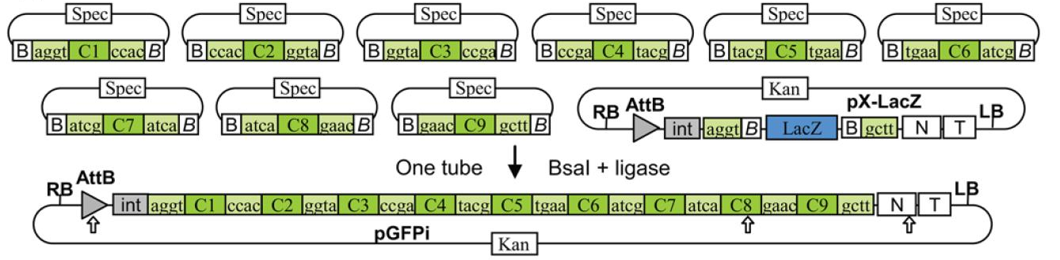
Golden Gate Cloning
One vector per bin, each has matching, unique 4bp overhangs:
Build basic parts in plasmids and sequence-confirm
Assembly them by pooling the plasmid DNA, then digest (BsaI) and ligate (T4 Ligase) simultaneously
Notes:
The golden gate method is a popular one-pot assembly method that employs type Iis-generated overhangs. A different 4 bp overhang is chosen for each junction by inclusion in a vector set. Each vector contains the BsaI site, and each fragment to be assembled is constructed as a golden gate part in one of these vectors. The various part-containing plasmids are mixed together in a reaction containing BsaI and T4 Ligase. Since all the overhangs are designed to be unique, there is only one way for the fragments to assemble into a transformable product.

Slide 45
Golden Gate Cloning
Good compromise between PCR and BioBrick-based methods
Can’t change order of parts or number of parts, but can have many parts in each bin and permute them
Good for creating part sets that, say, have 5 variants of enzyme 1, 5 of enzyme 2, 5 of enzyme 3, then permute all 125 possible variants of that configuration
A 2-step cloning process of creating “basic parts” and then assembly by cut-and-paste
Assembly is a cheap, one-pot reaction
After making basic parts, no further oligos required; no PCR, so no further sequencing required
Notes:
Golden Gate cloning is a good compromise between PCR and BioBrick-based methods. Unlike BioBrick, you can’t arbitrarily rearrange the parts without making new parts, but you can have many parts that belong to bins and you can permute within these bins. For example, suppose you have a 3 step biosynthetic pathway, and there are 5 choices of enzyme for each step. If you design each step of the pathway as a bin flanked by the same pair of sticky ends, then any of the 125 possible combinatorial variants can be composed out of 15 golden gate parts. Thus, like BioBrick, Golden Gate typically involves two rounds of cloning– one step to produce basic parts and another to assemble them. The assembly reaction itself is very cheap and robust. Though one needs to purchase oligos to make the basic parts, no further oligos are required to do assembly. Additionally, after sequence confirmation of the basic parts, there is no further PCR and thus it is unlikely to pick up additional mutations during assembly.

Slide 47
Example: assembly using Golden Gate
Joining GFPuv from pKQ-GFPuv with Psal of pBACr899 into pSB1A2 plasmid

Slide 48
Site-directed
Mutagenesis
Introducing mutations by ‘editing’ a preexisting plasmid
Notes:
Site-directed mutagenesis involves making localized edits to a preexisting DNA sequence. Typically it is used to introduce point mutations into a sequence such as to mutate a protein’s active site or alter the strength of a ribosome binding site. In a previous lecture we discussed an old-school method, Kunkel mutagenesis. That was the original technique. However, much simpler protocols exist today.

Slide 49
EIPCR Mutagenesis
BsaI
x
BsaI
BsaI
BsaI
x
PCR
BsaI Digest Ligate and transform
Mutant Product Vector
…ATGCCATAGCATTTTTATCCATAAGATTAGCGAGACCccatg
…TACGGTATCGTAAAAATAGGTATTCTAATCGCTCTGGggtac
cactgGGTCTCaTTAGTACcttACGCTTTTTATCGCAACTCTCTAC…
gtgacCCAGAGtAATCATGgaaTGCGAAAAATAGCGTTGAGAGATG…
Notes:
EIPCR stands for enzymatic inverse PCR. The term ‘inverse PCR’ refers to the fact that you are going to PCR around the backbone of the template DNA. You design two oligos that both anneal near the site of mutation, but are oriented such that polymerization occurs away from one another around the circle. * This results in a linear double-stranded PCR product like any other PCR. If a restriction site is included in the 5’ ends of the oligos, then the PCR product will contain this site on its ends. * Cleavage with the restriction enzyme generates sticky ends which can be joined by T4 ligase to re-close the circle. That material is then transformed. EIPCR can be done with conventional type II enzymes like EcoRI, and the resulting product will contain that restriction site. * Alternatively, it can be done with a type IIs enzyme like BsaI. Because BsaI will cut itself off the ends of the PCR product, it will be absent in the final product. Thus, ‘scarless’ mutagenesis can be performed. EIPCR turns out to be an exceptional method of saturation mutagenesis for construction of libraries, which we’ll revisit in a later lecture on combinatorial libraries.

Slide 50
QuikChange Mutagenesis
x
x
x
Make an oligo with 20bp homology, the mutation, and another 20 bp homology
Also synthesize the reverse complement of that
Additional design considerations at: www.stratagene.com/manuals/200518.pdf
Pretty much a PCR (just a bad one) followed by a DpnI digest
Variation with two separate initial reactions is much more robust
Notes:
QuikChange mutagenesis is the easiest-to-implement site-directed mutagenesis technique. Here you design two complementary oligos with 20 bp homology to the template plasmid, the mutation, and then another 20 bp of homology. Thus, these are typically 45 bp or so in length. These two oligos are used in a PCR containing the template. Though the conditions are identical to PCR, the complementary nature of the oligos leads it to being an inefficient PCR since the oligos can anneal to one another rather than the plasmid. This can be improved by doing a two-step procedure where first two parallel reactions are performed with just one of the two oligos, and then the two reactions are combined for future rounds. After the PCR, the template DNA is degraded with DpnI due to the presence of dam methylation such that all that remains in the mixture is the synthetic product. This is then introduced into E. coli by transformation.

Slide 51

Questions to Ponder

Slide 52
Read PMID: 16524465. What is the product of the cartoon described in the “ad hoc cloning strategies” slide?
Design a set of oligos to synthesize the GFP gene as a BglBricks part using the Ligase Chain Reaction
Design a set of oligos to synthesize the GFP gene as a BglBricks part using PCA Assembly with GeneDesign
Design EIPCR oligos to change the 5’ end of RFP in pBca9145-Bca1144#5 from atggcgagtagcgaagacg to atggctagtagcgaagacg
Design QuikChange oligos to change the 5’ end of RFP in pBca9145-Bca1144#5 from atggcgagtagcgaagacg to atggctagtagcgaagacg

