Slide 1
Library Methods:
Directed Evolution
Notes:
When constructing new functionality in cells, your initial design will most likely result in a non-optimal composition. Library employ focused diversity to explore the sequence neighborhood around your initial design to identify improved variants.
Suppose you introduce a biosynthetic pathway into an engineered cell. If all the enzymes express, the substrate chemicals are all available, and there aren’t reactions diverting your interemediates to other products, then most likely your cell will produce the target chemical. You might try knocking out some genes in the genome that you think will increase yield, and you might try different regulatory sequences to get the expression level of each enzyme just right, but often it is the case that these ‘rational’ approaches to optimizing the cell only address some problems. If you have difficulty with the expression or folding of a protein, or the protein has poor activity towards the reaction you need it to do, you will have to make changes internal to that protein’s sequence. For the scenario in which a nascent activity exists, and you just need to improve it, directed evolution techniques are incredibly useful.

Slide 2
Protein Engineering Overview
Rational design (look at the crystal structure or multiple-sequence alignments)
Computational algorithm-based design (example: Rosetta)
Modular design (fusing domains together)
Library strategies (directed evolution and combinatorial methods)
Notes:
Directed evolution involves making iterative changes to a sequence to improve its function. Though its use is not restricted to optimizing protein-coding sequences, most applications of directed evolution involve optimizing protein sequences. Directed evolution approaches are only one technique useful in protein engineering. One approach is ‘rational design’, meaning, a person looks at a crystal structure, multiple sequence alignments, and mutagenesis data and forms hypothesis in their head about modifications to a protein that will improve whatever property they need to optimize. They then design a few genetic constructs and test their hypothesis in the lab. There are also computational tools to do this sort of logic in silico. The most popular of these tools is Rosetta which is excellent for predicting improvements to protein folding, and is making headway into many other functional aspects of a protein sequence. There is also an area of protein engineering about modular design in which you fuse coding sequences together either to create new function or improve the folding, stability, or localization of your protein. The focus of this series of lectures are the library strategies directed evolution and combinatorial methods. The term ‘directed evolution’ is often applied to a broader swath of experiments that includes the combinatorial methods, but I will draw a distinction between the two for these lectures. Our focus for now is the more narrowly defined directed evolution involving iterative changes to a sequence that each produce an incremental improvement of some aspect of its function.

Slide 3
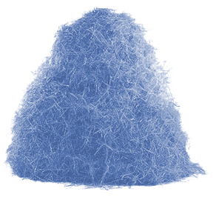
Library Approaches
Antibody selection
Directed Evolution
Combinatorial Libraries
Notes:
Library approaches to genetic engineering can be either directed evolution strategies or combinatorial methods.

Slide 4
Diversity Generation
Cells, phages, ribosomes, or microemulsions
Notes:
In all library methods, there is first diversity generation and then selection of desired variants. Here we illustrate a library of genes in which the one in tan has a property that is distinct from the others. * In all cases, we must have a linkage between the gene sequence and the protein it encodes. This can be achieved by compartmentalizing the gene in a cell or micelle. Alternatively, there are phage and ribosome display methods for connecting genotype to phenotype. ** We then apply some selective pressure to remove all the uninteresting variants and expand the gene variant with desired activity.

Slide 5
Selections and Screens
A Selection involves a procedure applied to the library population that results in selective survival of the desired population
A Screen involves individually examining members of the library and choosing those members with the desired activity
Notes:
There are many ways of generating the genetic diversity, several ways of associating genotype with phenotype, and many ways of enriching for desirable variants. The enrichment process can be either a selection or screen. In a selection, you apply a procedure to the library population that results in selective survival of the desired population. In a screen, you individually assay each member of the population and choose those with desired activity.

Slide 6
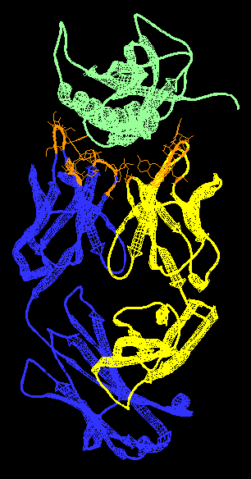
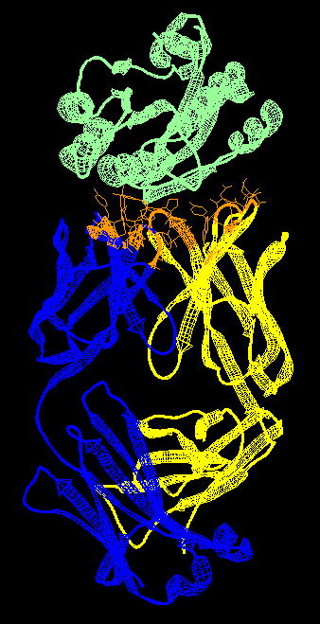
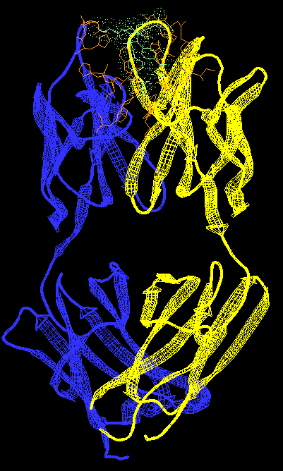
Antibody Selection
1NSN
2ADF
2DQU
Notes:
Though Directed Evolution and Combinatorial Libraries are genetic engineering techniques, analogs of these processes occur naturally during the production of antibodies in mammalian B cells.
Shown here are 3 crystal structures of Fab fragments of antibodies that each bind a different substrate. I’ve put them all in the same orientation such that you can see their structural similarity. The blue and yellow regions correspond to the heavy and light chains. Note that we are looking at just the Fab fragment of a larger protein molecule. Mature antibodies are typically IgG antibodies that contain two of these Fab fragments. Thus, an IgG molecule is composed of 4 polypeptides: two light chains and two heavy chains. Each Fab fragment is composed of 2 polypeptides: one light, one heavy.
The CDR loops, in orange, are the primary source of variability from one antibody to the next, and it is this region of the molecule that binds one specific epitope. Notice that outside this orange region, the molecules are structurally identical. The size of the binding pocket formed by the CDR loops depends entirely on their sequence, which is specific to each antibody. In 1NSN, we have a very broad flat pocket. In 2ADF, we have a more narrow pocket. In 2DQU, the antigen is a small molecule and the binding pocket is so small that it is almost entirely embedded within the antibody when it binds. Thus, the CDR loops are highly diverse structurally. Our concern here is how these CDR loop sequences are identified by the immune system.

Slide 7
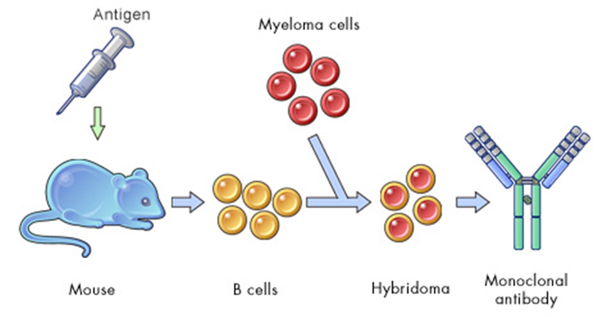
Antibody Selection
Notes:
The traditional way to make specific antibodies involved injecting a mouse with the antigen. This process of antibody generation happens within the mouse, and the cells that contain the genes for the antibody and thus produce each antibody are B cells. Different B cells will produce different antibodies. These cells are harvested from the mouse, and then immortalized by fusion with myeloma cells. The resulting hybridomas are identified as clones that each produce one specific antibody. Those clones can be expanded by re-injection into a mouse or growth in vitro to produce as much of the monoclonal antibody as desired.

Slide 8
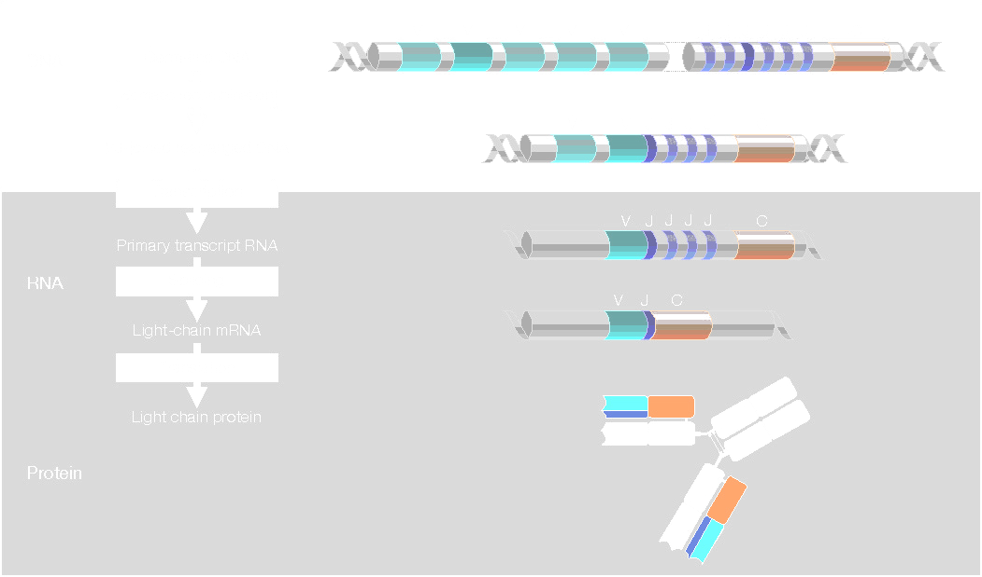
VDJ Recombination
Notes:
So, the question is what is happening within the mouse? In each mouse cell, there are gene clusters that encode the components for constructing heavy and light chains. The heavy chain genes are split into V, J, D, and C coding sequences. There are multiple Variable, Diversity, and Joining segments (VDJ), and a single constant domain. These VDJ regions encode the CDR loops of the antibody. As a B cell matures, it randomly selects one combination of V, D, and J by recombination of its genome. That VDJ combination specifies a specific antibody sequence that will be expressed by the B cell, and different B cells will produce different VDJ combinations. In this figure, we are showing the maturation of a light chain gene, which is similar to the heavy chain but lacks D segments.

Slide 9
VDJ Recombination
Heavy chain gene – located on chromosome 14
Light chain kappa (κ) gene – located on chromosome 2
Light chain lambda (λ) gene – located chromosome 22
Heavy Chain in Genome
65 Variable (V) domains
27 Diversity (D) domains
6 Joining (J) domains
65 V genes x 27 D genes x 6 J Genes
= 10530 combinations
Light Chain similarly has V and J recombination
VDJ recombination results in one antibody gene of the IgM form. An initial “hit” that binds the antigen (weakly) is selected resulting in a single B cell expressing a single IgM
Notes:
All cells in the mouse start with identical heavy and light chain gene sequences. The heavy chain gene is located on chromosome 14. There are two light chain genes called kappa and lambda located on chromosome 2 and 22. * The heavy chain gene has 65 of these V domains, 27 of the D’s, and 6 of the J’s. * If we calculate how many different ways we can rearrange these domains, there are 10,530 possible variants of the heavy chain. Though there are fewer V and J domains in the light chains, these further extend the initial diversity by a few orders of magnitude. Note that this process of VDJ recombination results in a discrete set of potential combinations. It is not an arbitrary population of molecules being generated – it is a large set of specific compositions. * The result of VDJ recombination is an IgM antibody. The choice of IgM, IgA, or IgG is defined by the sequence of the C region, and all antibodies start out in the IgM form. IgM’s contain 5 Fab regions. The presence of many identical antigen-binding regions results in cooperative binding to repetitive structures like virus particles. Thus, a fairly weak-binding antibody can nevertheless bind tightly to its antigen.

Slide 10
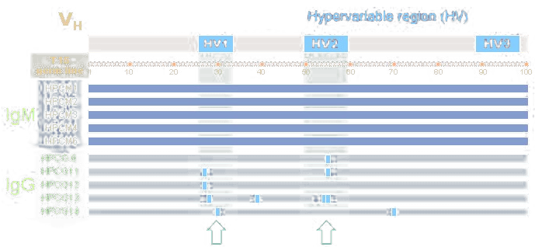
Affinity Maturation
The process by which B-cells produce antibody genes with increased affinity for antigen
Notes:
If a B-cell becomes activated by binding to an antigen, it will begin the process of affinity maturation. In this diagram, we show the VH domain. VH is the region of the Fab fragment on the heavy chain that contains the CDR loops -- it combined with the VL domain are the two balls of protein that directly bind the antigen. Thus, this diagram speaks only of one such domain. The VDJ recombination results in regions of the protein called the hypervariable loops, which is the same as the CDR loops. During affinity maturation, mutations are focused on the hypervariable regions to further improve the avidity and specificity of the antibody.

Slide 11
Affinity Maturation
Somatic Hypermutation
Activation-Induced (Cytidine) Deaminase (AID) mutates C’s to U’s in the variable regions
The G:U mismatch is repaired by a DNA repair mechanism involving an error-prone DNA polymerase
Additional mechanisms introduce codon insertions/deletions in the variable regions
Class Switching
Replacement of the heavy-chain IgM constant region with an IgG version
Notes:
There are several genetic modifications happening during affinity maturation. In somatic hypermutation, a cytidine deaminase mutates C residues to U within these hypervariable regions. This results in a G:U mismatch which is repaired in a sloppy manner to generate random mutations. There are additional genetic modifications taking place that result in insertions and deletions of triplets encoding additional codons into these hypervariable regions. This combination of mutations results in amino acid substitutions, insertions, and deletions in the CDR loops. Some of these mutations will improve binding to the antigen and the encoding B cell will be expanded further than those cells in which the mutation disrupts binding.
In parallel, affinity maturation involves class switching. Here, the C segment encoding the constant region of the antibody is switched from one encoding an IgM to one encoding an IgG. With only 2 Fab regions, the IgG must have higher affinity for the substrate than IgM. So, class switching increases the stringency of the selection.
Through iterative rounds of affinity maturation, the population of B cells make better and better antibodies for their antigens.

Slide 12
Engineering Methods
Combinatorial Libraries ≈ VDJ Recombination
Usually involves large libraries (>10⁶) and selections
Used to find activities that do not pre-exist
Typically involves a single round of mutagenesis
Directed Evolution ≈ Affinity Maturation
Usually smaller libraries (<10⁵) and screens
Used to improve or modify a nascent activity
Involves iterative rounds of mutagenesis
Notes:
The VDJ recombination process is analogous to combinatorial methods: it constructs a large, sparse matrix of variants encoding many different functions. These processes typically involve large libraries with more than a million members, and this large number of variants usually requires the use of selections rather than screens. Combinatorial libraries are most useful for identifying activities that do not already exist, and they typically involve only a single round of diversity generation.
The process of affinity maturation is analogous to directed evolution: it involves iterative improvements to a nascent activity through point modifications. In the wetlab, directed evolution libraries are typically smaller and the enrichment process can be done with screens. They are used to improve or modify a nascent activity through iterative rounds of mutagenesis and screening.

Slide 13
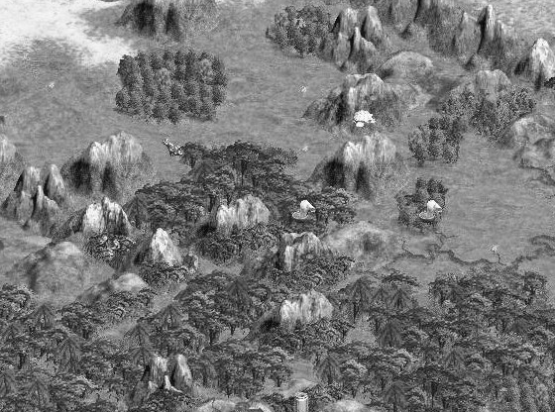
Combinatorial Libraries
RFP
GFP
phoA
Notes:
Another way to think about this is to consider a topological landscape. The X and Y coordinates of the terrain correspond to sequences, and the height of each hill is functionality. * Perhaps some of these hills correspond to GFP, RFP, and alkaline phosphatase-encoding sequences. Most sequences in this space have no activity, but there are hills where sequences similar in sequence have similar functionality, with some a little better than the others. In a combinatorial experiment, * we start with some region of sequence space * and produce a sparse matrix of constructs with the intent of finding another hill of activity. In this case, the spread of variants hits 4 additional hills of activity, but they are different hills than where our search began.

Slide 14
Directed Evolution
Notes:
In directed evolution, we similarly * start with a sequence on one of these hills of activity, but our goal is to * climb to the local maximal activity of that hill through incrememental changes.

Slide 15

Directed Evolution
Notes:
In a typical directed evolution experiment, we begin with a specific gene sequence. We then apply random mutagenesis to this sequence to generate diversity and screen for variants with an improved property. We then repeat the experiment from these improved mutants.

Slide 16
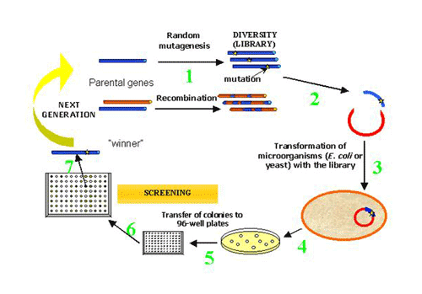
Overview
Notes:
There are two common techniques for generating diversity: random mutagenesis, or recombining parental genes. These procedures typically involve PCR, and then you subclone the library into a vector and transform cells. You then pick individual colonies of the library, screen each one for activity, then cherry-pick the ‘winners’ with improved activity. Those go back into the cycle.

Slide 17
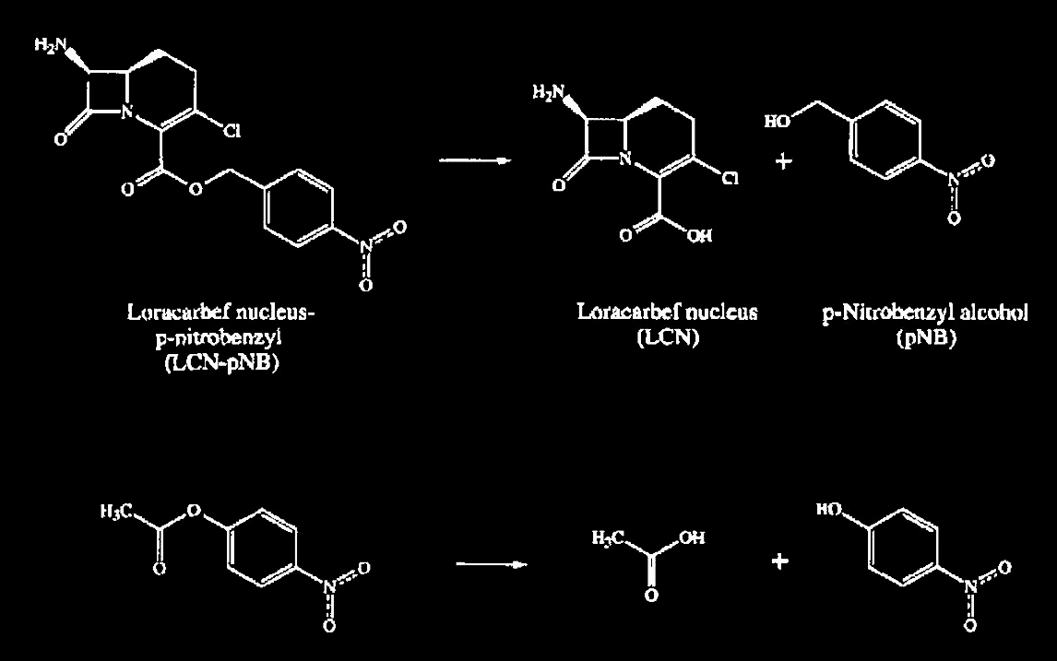
Example:
p-Nitrobenzyl Esterase Evolution
Wanted to generate an esterase that would remove nitrobenzyl ester protecting groups under conditions involving an organic solvent
Nat Biotechnol. 1996 Apr;14(4):458-67 PMID: 9630920
Notes:
Let’s look at an example from the early days of this experiment from Francis Arnold. During the synthesis of beta-lactam antibiotics, there is a difficult deprotection step that the authors wish to perform with an enzyme. They need to the enzyme to hydrolyze this nitrobenzyl ester. Unfortunately, the chemical is sparingly soluble in water, so they must add DMF to the reaction. Unfortunately, the enzyme loses activity in the presence of DMF. So, they want to improve the stability of their enzyme in DMF/water mixtures. The specific reaction they want to perform is difficult to assay. Neither the starting material nor products are chromophores, so the only way to watch this reaction would be LC-MS. For directed evolution, you typically need to assay around 10,000 variants to find useful variants. A typical LC-MS instrument takes 15 minutes per run, so this would be a very long project! So, the experimentalists note that this enzyme will also catalyze the hydrolysis of p-nitrophenyl esters such as this acetate ester. Though it has one carbon less than their ‘real’ substrate, t is structurally a very similar molecule and is also tolerated by the enzyme. P-nitrophenol, though, is yellow, so they can readily detect whether this reaction occurred without the need for cumbersome instruments.

Slide 18
Example:
p-Nitrobenzyl Esterase Evolution
Start with a plasmid encoding pNB esterase
Use “error-prone PCR” to introduce point mutations throughout the gene at a rate of 1 to 5 mutations per gene
Put one variant plasmid into each E. coli cell
Colonies were screened by picking them into a buffer containing the pNP substrate and DMF
Each clone was scored for activity
Clones showing improved activity were taken into a second round of error-prone PCR
Notes:
Experimentally, they begin with a plasmid encoding the pNB esterase. They then use a variation on your normal PCR protocol, called error-prone PCR to introduce point mutations throughout the gene at a rate of 1 to 5 mutations per gene. They then subclone the PCR products back into the plasmid and transform cells to make their library. They pick many individual colonies and then screen each one by placing the cells in a buffer contining the p-nitrophenyl acetate substrate and DMF. They then quantify the yellow absorbance of each sample to get a score for the fitness of each variant. They then cherry pick out those clones showing improved activity and take them into another round of directed evolution.

Slide 19
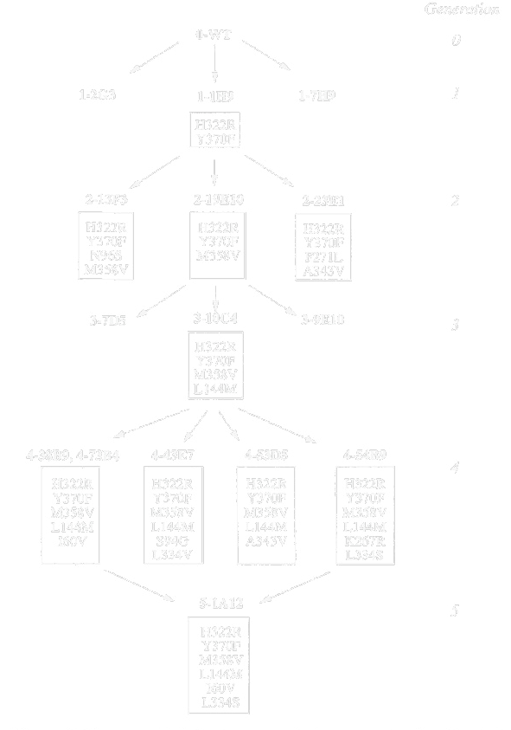
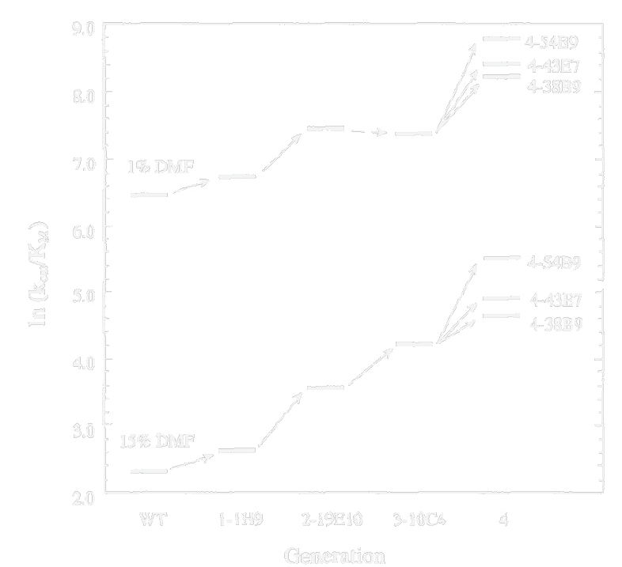
Example:
p-Nitrobenzyl Esterase Evolution
Notes:
They perform 5 rounds of directed evolution. In the first round, they identified 3 improved mutants, and one of them was chosen as the template for the next round. So, all variants in round 2 contain the mutations identified in round 1. They identify 3 additional mutants, and again pick the best one to go into round 3. In the final step, they combined all the beneficial mutations they found into a single construct.
*
With these mutants identified, they then performed more careful assays of their fitness and plot them out. Through the course of incremental mutation and screening, they generate mutants improved in their tolerance for DMF.

Slide 20
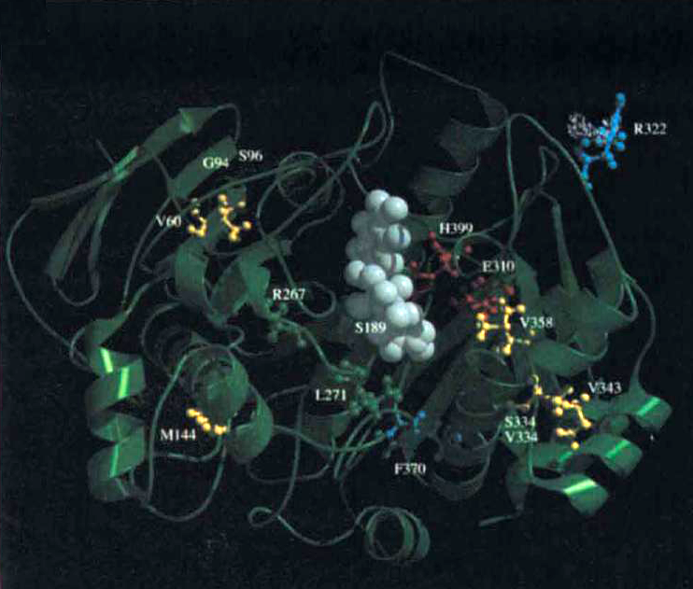
Example:
p-Nitrobenzyl Esterase Evolution
Substrate
Neutral
Improved
Notes:
They then look at the crystal structure of the protein to determine where these mutations lie. The big white blob in the middle of this protein is the substrate. The mutations identified in their screens are in yellow. Note that the mutations are quite far from the active site, and this is frequently the case. When screening for properties such as relaxation in substrate specificity, or improvements to folding, expression, thermal, or chemical stability, the mutations with increased fitness rarely are the ones that directly contact the substrate. Additionally, any mechanistic explanation of why these mutations improve chemical stability would require detailed energetic calculations about the structure. As of 2014, the computational tools still cannot reliably predict the sorts of mutations that come out of directed evolution studies, and rarely do the mutations make any intuitive sense.

Slide 21
Mutation Types
Very approximate values of occurrence:
90% of missense mutations are neutral
9% of missense mutations are deleterious
Most substitutions to the hydrophobic core eliminate the ability to fold
Most active site substitutions will have a deleterious effect on activity but not on folding
1% of missense mutations result in altered activity
Notes:
When you introduce mutations into a protein coding sequence, the effect of the mutation on activity can be neutral, deleterious, or enabling. The extreme majority of amino acid substitutions have no effect on function – they are the same as wild-type. That is around 90% of mutants. Around 9% are deleterious. Typically mutations to the hydrophobic core will eliminate the ability to fold, and very often this 9% represents core mutations. Similarly, residues that directly contact the substrate or within the second shell around those residues are necessary for activity. Substitutions to those sites have a deleterious effect on activity. It is the rare 1% of missense mutaons that result in some altered activity such an improvement in thermostability or a change in sustrate specificity. Thus, you must screen many mutants to identify those that are useful.

Slide 22
Diversity Generation
and Screening
Notes:
The diversity explored in a directed evolution experiment typically involves point mutants. By this, we mean that each member of library varies from some ancestral sequence by single-base substitutions encoding single changes in amino acid identity.

Slide 23
Point Mutation Generation
Error-Prone PCR: A Taq PCR reaction containing higher concentrations of C and T, added Mn²⁺, higher Mg²⁺ than usual. See http://www.msg.ucsf.edu/agard/Protocols/PCR_Random_Mutagenesis.htm
GeneMorph II Random Mutagenesis Kit (Stratagene): PCR with a special error-prone polymerase. Similar mutation rate to error-prone, but works better for longer templates
XL1 Red (Stratagene): An E. coli strain with high replication error rate. Gives less mutations per KB. Also generates errors such as recombinations, truncations, insertion element transposition
AID strains: New ideas involves expressing the enzyme involved in affinity maturation for targeted mutagenesis
Notes:
One common way of generating such libraries is error-prone PCR. This is just like any other PCR in terms of it containing a Buffer, a thermostable polymerase, two oligos and a template. The difference is that you tweak the concentrations of the dNTPs, add manganese, and additional magnesium. This set of conditions causes the polymerase to make errors at elevated rates, and to do so randomly. The conditions sometimes have the unfortunate consequence of also decreasing the robustness of the pcr reaction, and sometimes you won’t get product out. There are optimized commercial kits that can handle longer PCR products and do some more reliably. The GeneMorph II kit is one that works by using a mutant error-prone polymerase. It generates a similar spectrum of mutations to error-prone pcr, but it works on longer templates. One older method is the XL1 red strain. This E. coli strain replicates with a high error rate. Thus, you simply passage your plasmid through this strain to introduce mutations. The rate of mutation is significantly lower than in vitro mutatgenesis, but the in vivo nature of the method makes some interesting experiments possible. For example, if you passage a plasmid encoding a slightly toxic protein through this strain, the selective pressure towards relieving the toxicity will result in the enrichment for mutants that solve the problem. When you sequence such variants, you will often see trivial nonsense mutations (which means stop codons) but other times you will find point mutants or other types of errors such as insertion elements. When coupled with a positive selection for function, these experiments can be very informative about how to ‘fix’ a toxic protein. The main issue with XL1 Red is that the mutagenesis is global. The genome is also being mutated at a high rate rendering these cells erratic and slow growers. They can be finicky to work with, and mutations to the genome can also be selected for in an experiment. A popular research topic today is trying to engineer cells that focus mutagenesis on a particular region of an introduced plasmid, thereby restricting errors to where it is useful.

Slide 24
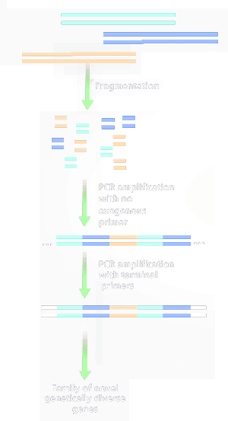
Shuffling
x
x
Pool the first-round hits
PCR the genes with external primers
Digest the PCR product to 50bp fragments with DNaseI
Recombine fragments in a PCR reaction (analogous to PCA gene synthesis)
Reamplify with external primers
Subclone into plasmids
x
x
x
x
x
x
x
Nature. 1994 Aug 4;370(6488):389-91.
Proc Natl Acad Sci U S A. 1994 Oct 25;91(22):10747-51.
Notes:
DNA Shuffling is related to error-prone pcr. The experiment starts with a pool of point mutation variants of a gene. These mutants might be the hits identified in a previous round of directed evolution. First, you PCR up the genes with external primers. You then digest the DNA into 50bp frgments with DNAse I. You then recombine those fragments in a PCR reaction which is very similar to PCA gene synthesis in terms of how things reassemble. You then reamplify with external primers and subclone the material into a plasmid and transform.

Slide 25

Shuffling
Nature. 1994 Aug 4;370(6488):389-91.
Proc Natl Acad Sci U S A. 1994 Oct 25;91(22):10747-51.
Notes:
Shuffling has largely replaced error-prone pcr because it does double-duty: it not only recombines the mutations contained in a population of genes, it is also error prone itself causing a similar spectrume of point mutations to error-prone PCR.

Slide 26
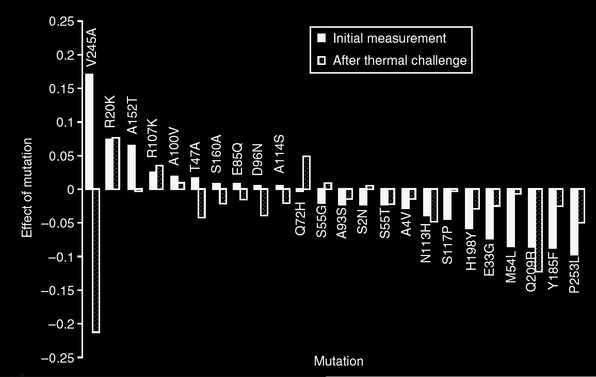
ProSAR Method
Do an initial round of random mutagenesis
Or, make all possible amino acid substitutions (for a 300 aa proteins, there would be 300*20 = 6000 variants)
Measure the activity/fitness of each one
Nat Biotechnol. 2007 Mar;25(3):338-44. Epub 2007 Feb 18.
Notes:
There are also strategies for combining computational design with directed evolution. ProSAR is one such method developed at Codexis. The first step is to generate an initial library. This can be done by error-prone, shuffling. You can also explicitly synthesize each single-amino acid mutant of a protein using gene synthesis. For a typical 300 amino acid protein, there are only 6000 such variants. As microarray-based gene synthesis becomes more available, this approach will be greatly enabled. You then measure the activity of each variant. In this example, they are doing directed evolution of thermal stability, so they are comparing activity with and without a heat challenge.

Slide 27
ProSAR Method
Write one equation for each clone
The measured fitness for each clone is y
X_{1a} values are 1 or 0 for the presence of each possible base substitution
c_{1a} are the fitness contributions associated with each mutation (which cannot be directly measured)
The contribution of most mutations is additive except active-site residues, or when two residues directly interact in the structure
Design of Experiment calculations can then be used to design an optimal set of combinations of mutations that are most likely to produce an optimal clone
Nat Biotechnol. 2007 Mar;25(3):338-44. PMID: 17322872
Notes:
You then write out some equations. You will have one equation for each clone that you assay. The measured fitness for each clone is y. Each X1a-like value is either 1 or 0 for the presence of each possible base substitution. The C1a-like values are the fitness contributions associated with each mutation. These are unknowns that we are trying to measure. If you assume that the contribution of most mtuations is additive, then you can describe the fitness observed for each variant as a linear combination of each mutation. In practice, this additivity is usually true with the exception of mutations in the active site of the protein. After solving the equations for each c value, you do additional design of experiment calculations to choose those mutation combinations that will be most informative to test in combination during the next round of mutagenesis.

Slide 28
Screening Methods
Mass spectrometry screens
High-throughput “Product Study”
Has been automated by companies such as Maxygen, Codexis, and Diversa
Colorimetric or fluorometric assays
Fusing a target gene to GFP to watch expression
Use a cell-permeable substrate (think Xgal/lacZ) for the reaction
Notes:
In addition to a mutagenesis strategy, your directed evolution experiment requires a screening method. In a company that specializes in directed evolution, they may have high-throughput mass spec instruments that can do LC-MS assays at more reasonable throughput, and thus many chemical transformations can be observed. Effectively, this is doing less-precise but faster ‘product studies’ on each mutant.
For the less expensive experiments often done in academia and small companies, plate-based methods using colorimetric or fluorometric assays are the norm. For example, you might fuse GFP to your protein to link the amount of your protein to a detectable signal. You might also use cell-permeable substrates as Arnold did with the p-nitrobenzyl esterase. Thus, these are analogous to the whole-cell assays we previously discussed. Typically you will want to grow the colonies in 384-well plates to normalize the amount of cells and then perform these assays on those more consistent cultures. This can be done somewhat easily at the 10,000-sample scale.
Basically, any quantitative assay that you can do on a single strain could be considered for use in directed evolution. The only concern is how many of those assays your labor force and materials costs enable you to do. There are companies that optimize protein expression by running each variant on a gel. Though that sounds low-throughput, if the diversity you are able to pay for is lower than the diversity required to obtain the data you need, the assay will do.

Slide 29
Applications
Improving the catalytic efficiency of an enzyme
Improving the expression/solubility of a protein
Improving the efficiency of a protein towards a non-native substrate
Improving the thermostability or buffer stability of a protein
Improving the function of a protein in the presence of toxicants (organic solvents)
Any application in which one or two point mutations give rise to a detectable change in activity, and a selection or screen can identify those changes
Notes:
There are all sorts of things you can use directed evolution to improve. You can improve catalytic efficiency sometimes, but more typically you improve expression or solubility of your protein. You can also improve the catalytic parameters, usually Km, for a non-native substrate. You can also improve the thermostability, buffer stability, and solvent-tolerance of a gene. In a nutshell, any application in which one or two point mutations give rise to a detectable change in activity, and a selection or screen can identify those changes, can be accessed with directed evolution.

Slide 30

Questions to Ponder

Slide 31
Suppose I have a P450 enzyme that won’t express in E. coli. Design an experiment to evolve a variant of the protein that does express.
In the pNP esterase evolution experiment, many of the identified mutations that improved activity were not located in the active site. Why do you suppose that is?
I applied random mutagenesis to a 4kb gene to evolve its activity using the same conditions I used for another gene that was 1kb long. I observed 6 improved-activity variants from the 1kb gene, but none for the 4kb gene. What might cause the difference?
I want to evolve a p-nitrobenzyl esterase into a fatty acid esterase. Why might this not work?

