Slide 1
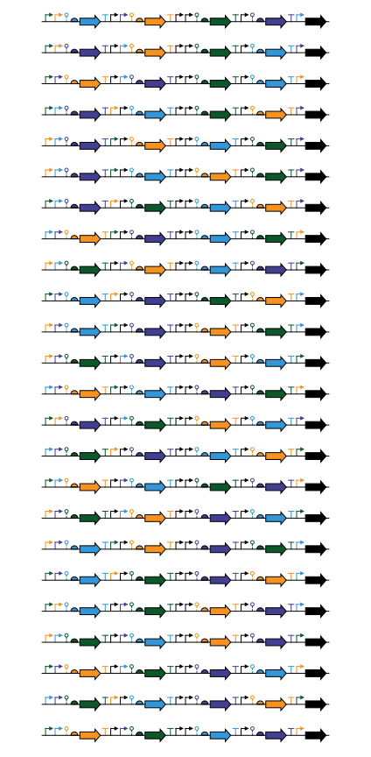
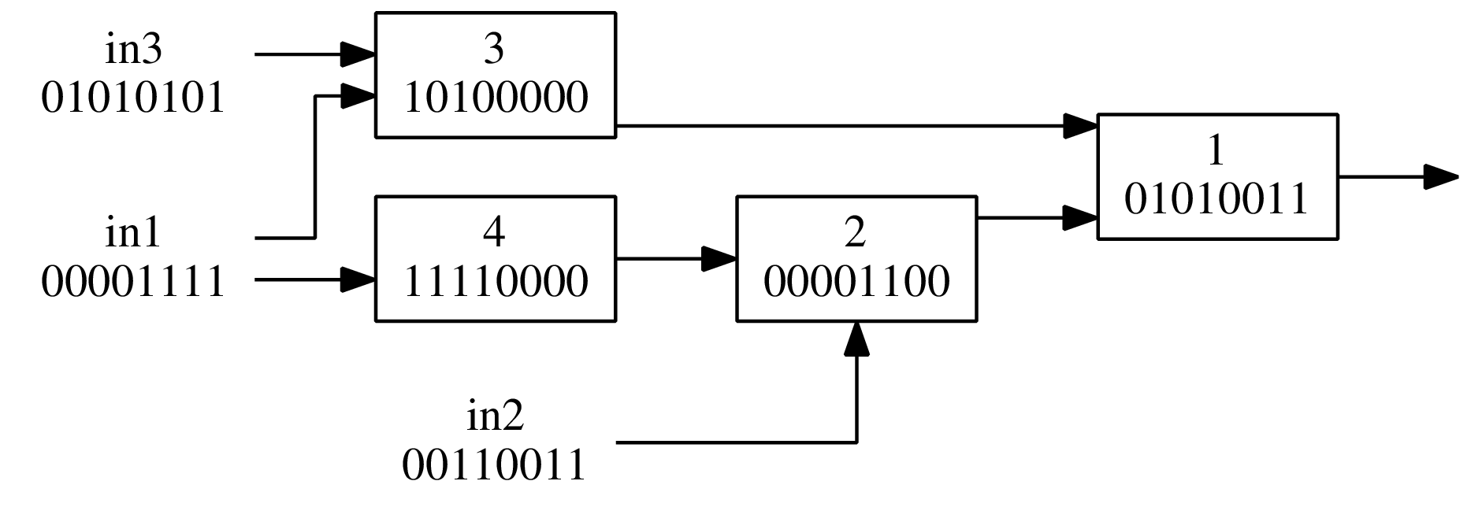

1
2
3
4
5
6
7
8
9
10
11
12
13
14
15
16
17
18
19
20
21
22
23
24
2 genes
different
Boolean gates
AGRN
4 genes
different
BetI
SrpR
Transcriptional repressors
PhlF
QacR

Slide 2
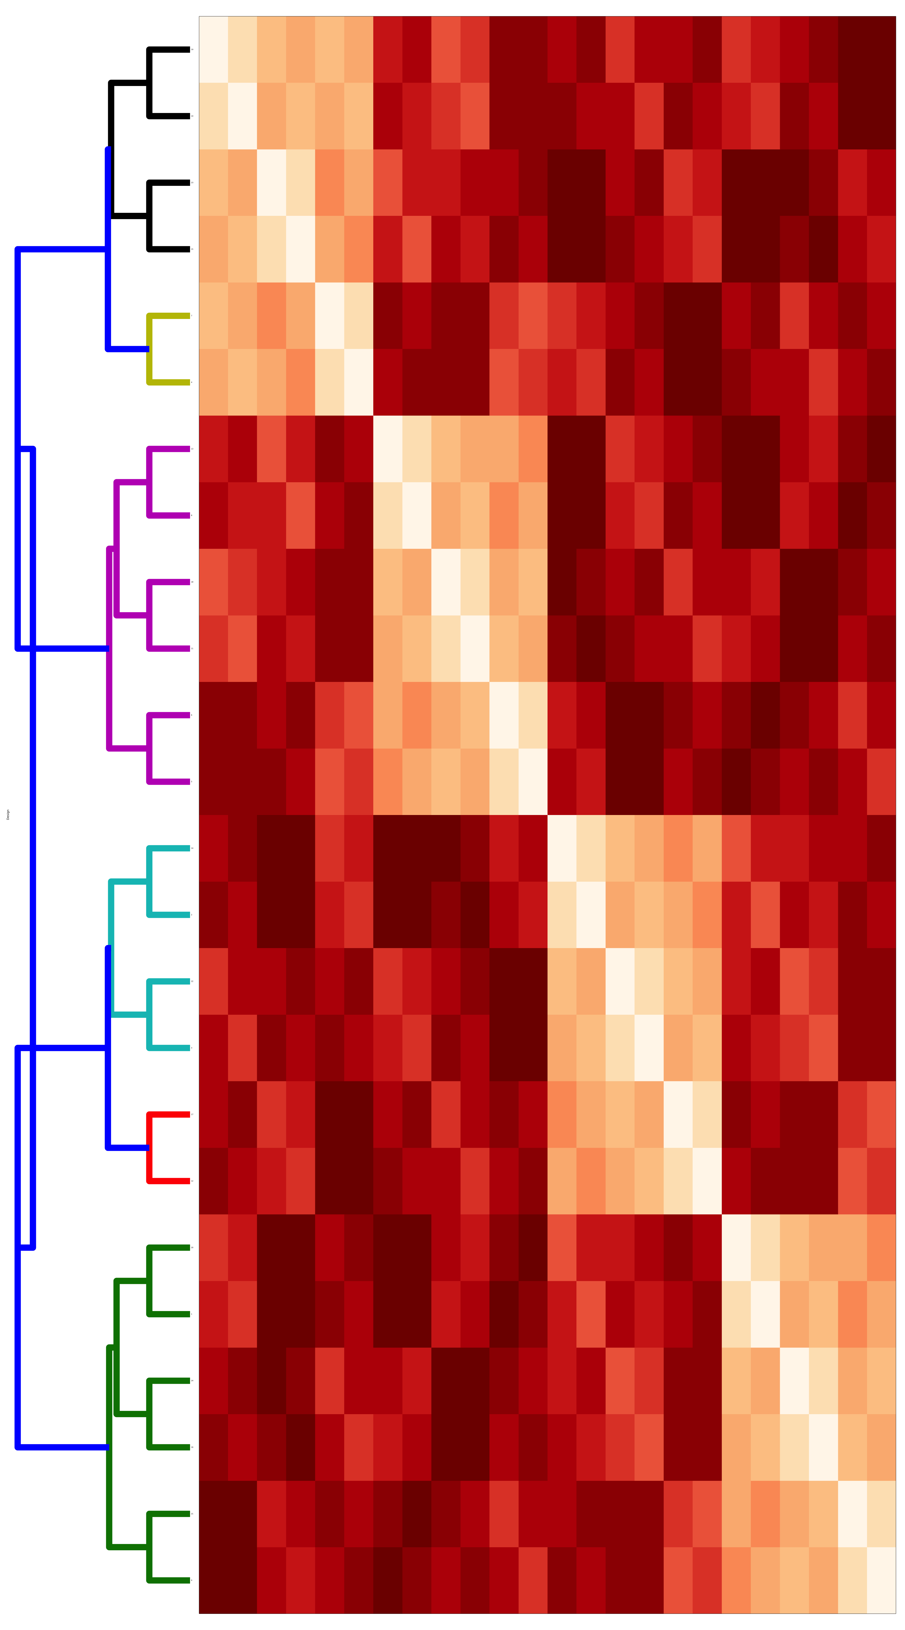
Group_1 1 9 16 20 21 24
Group_2 12 17
Group_3 2 3 14 22
Group_4 5 6 8 11 13 18
Group_5 7 4
Group_6 10 15 19 23
23
19
15
10
4
7
18
13
11
8
6
5
22
14
3
2
17
12
24
21
20
16
9
1
Tree from hierarchical clustering
Notes:
<number>

