Slide 1







How to Create a Clotho Application in 30 minutes
Prashant Vaidyanathan, Stephanie Paige
“Clotho 3.0 Launch Party”
February 26th, 2015
Rafik B. Hariri Institute for Computing and Computational Science & Engineering

Slide 2



Overview
Coding Requirements
Demo
Resources
Discussion

Slide 3



Coding Requirements (Basic)
Basic HTML
(Elements & Attributes)
JavaScript
(Basic understanding
of functions )
CSS
(Depends on how pretty
you want your app to look)

Slide 4




Power User
Basic HTML
Bower
JavaScript
Angular JS
Python
CSS

Slide 5
Building an App

Slide 6

This is the story of a Graduate Student

Slide 7





Wrote the JS Function to find
The diference matrix
Needs to
Present an app in
15 mins
SP
(Brilliant
Programmer)
Prof. BD
(Professor)
Prof. DD
(HOD)
Wrote the python function
for clustering
Needs to build an App
using CSV data
Lab - GC
PV
(Graduate
Student)
Dr. TG
(Scientist)

Slide 8
App Specifics
Login to Clotho
Upload assignments and store them in Clotho.
Input is a CSV File
Load the JS difference matrix function in Clotho
Use the cluster function python function
Display Cluster Groups

Slide 9
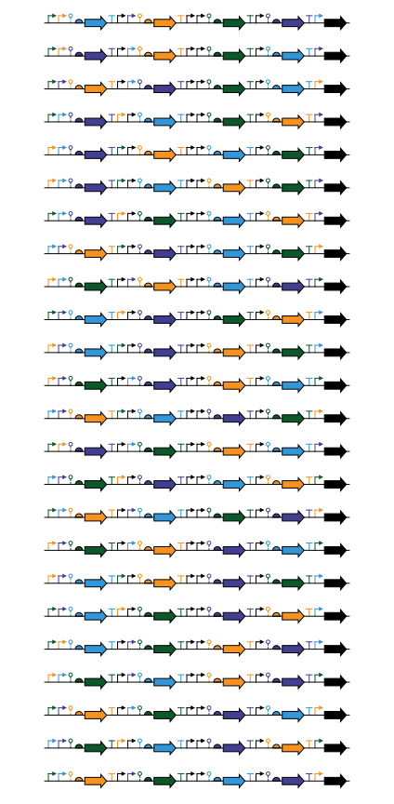
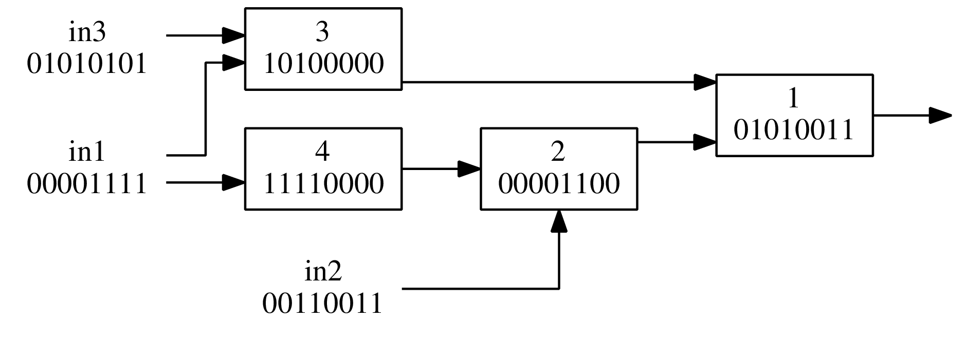

1
2
3
4
5
6
7
8
9
10
11
12
13
14
15
16
17
18
19
20
21
22
23
24
App - Background
2 genes
different
Boolean gates
AGRN
4 genes
different
BetI
SrpR
Transcriptional repressors
PhlF
QacR

Slide 10
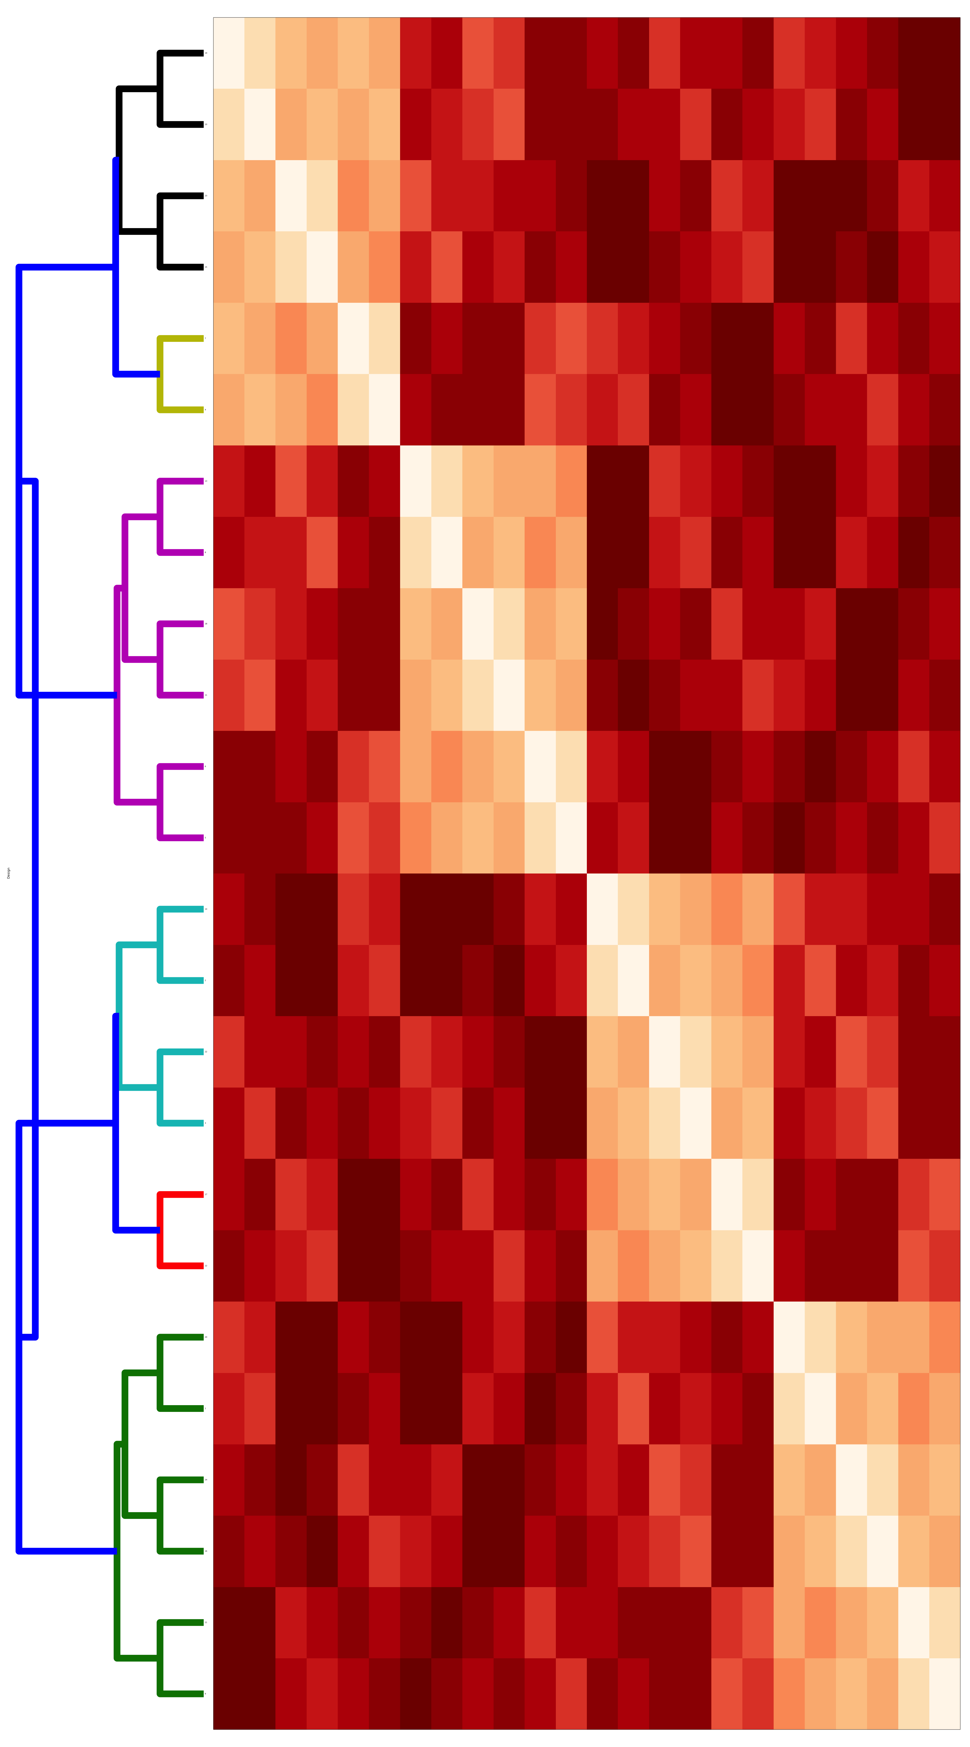
App - Background
Group_1 1 9 16 20 21 24
Group_2 12 17
Group_3 2 3 14 22
Group_4 5 6 8 11 13 18
Group_5 7 4
Group_6 10 15 19 23
Notes:
10

Slide 11
CSV - Background
CSV = comma-separated values
Eg:
[
{
“name”: “John”, “age”: “24”
},
{
“name”: “Tina”, “age”: “26”
}
]
name,age
John,24
Tina,26
=

Slide 12
DEMO

Slide 13
Demo Stand-alone App
Create a function using Clotho’s sharable editor
Create Objects, by uploading a CSV File
View the Result
Run a Python and JS function with 1 Button Click

Slide 14
Demo Stand-alone App
Create a function using Clotho’s sharable editor
Create Objects, by uploading a CSV File
View the Result
Run a Python and JS function with 1 Button Click

Slide 15
Demo Stand-alone App
Create a function using Clotho’s sharable editor
Create Objects, by uploading a CSV File
View the Result
Run a Python and JS function with 1 Button Click

Slide 16
Demo Stand-alone App
Create a function using Clotho’s sharable editor
Create Objects, by uploading a CSV File
View the Result
Run a Python and JS function with 1 Button Click

Slide 17
Demo Stand-alone App
Create a function using Clotho’s sharable editor
Create Objects, by uploading a CSV File
View the Result
Run a Python and JS function with 1 Button Click

Slide 18
Resources
JavaScript API (for Web-Applications)
https://github.com/CIDARLAB/clotho3API
Java API (For serverside Applications)
https://github.com/CIDARLAB/clotho3JavaAPI
Demo code available at:
www.clothohelp.org

Slide 19
Acknowledgements
National Science Foundation Grant #1147158
Rafik B. Hariri Institute for Computing and Computational Science & Engineering
Azer Bestavros
Linda Grosser
Lauren Dupee
Bryan Der
Tom Gorochowski
Emerson
Kevin Leshane
Densmore Lab
Prof. Douglas Densmore
Stephanie Paige
Nicholas Roehner
Anderson Lab
Prof. J. Christopher. Anderson
Bill Cao
Mina Li

