Slide 1
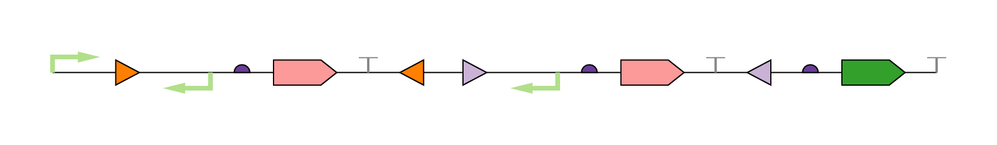
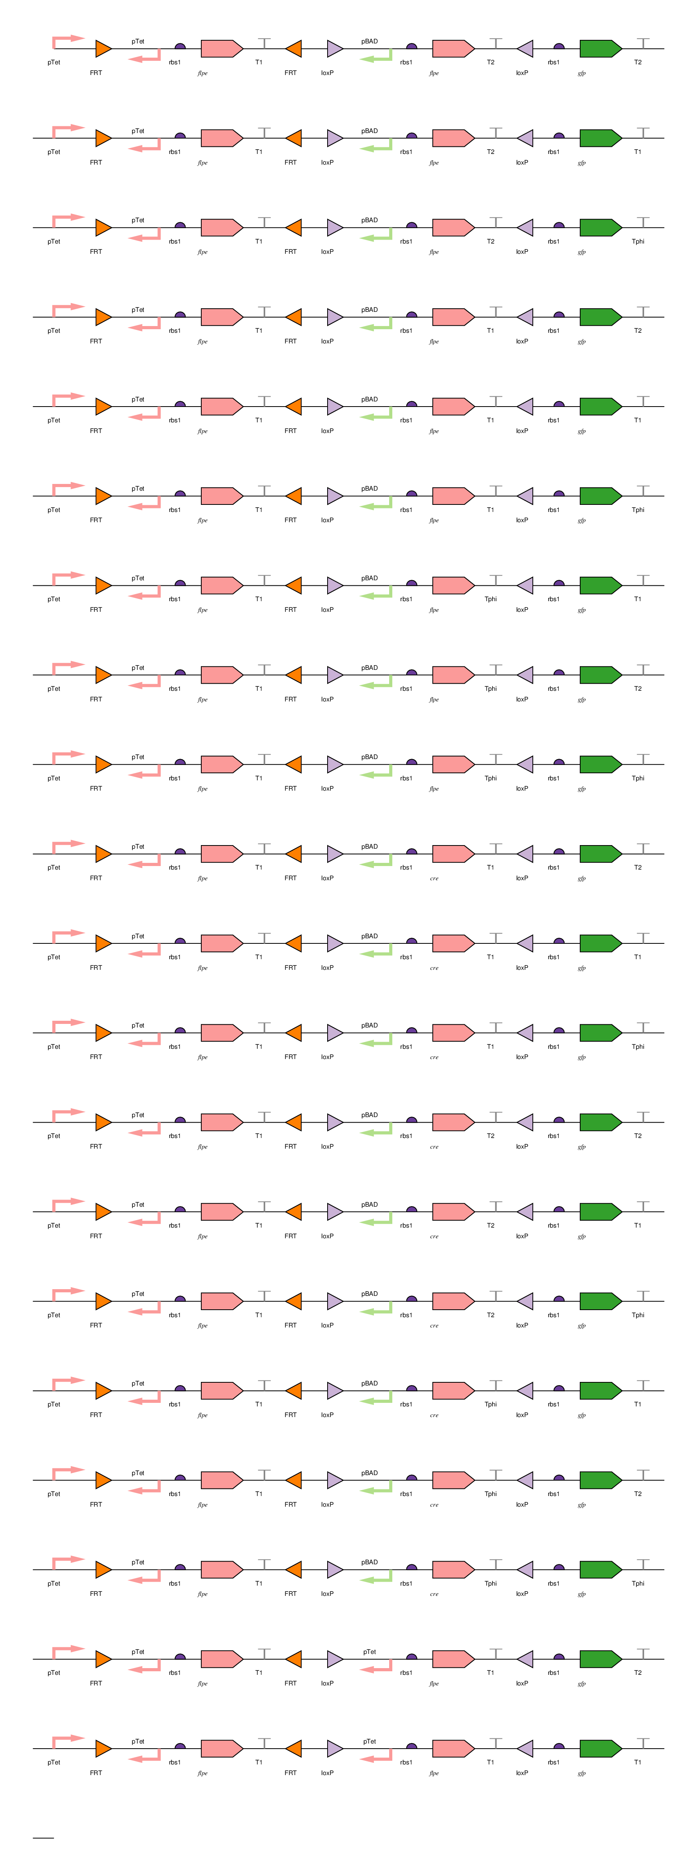
Device Counter(
Promoter,
InvertaseSite, -Promoter, RBS, Gene, Terminator, -InvertaseSite,
InvertaseSite, -Promoter, RBS, Gene, Terminator, -InvertaseSite,
RBS, Reporter, Terminator);
Rule r(
ON Counter:
// - matching Invertase sites
Counter[1] MATCHES Counter[6]
AND
Counter[7] MATCHES Counter[12]
AND
// - different Invertase sites
FRTf WITH loxPf
AND
// - GFP should be our reporter
CONTAINS gfp
);
Design Space:
3 Promoters
4 Invertase Sites
1 RBS
2 Genes
1 Reporter
3 Terminators
Stats:
Size 16
Possible 746,496
Rules 4
Valid 5,832
Runtime 0.185sec

