Slide 1
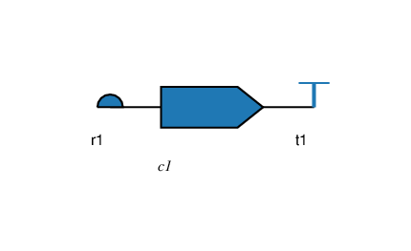
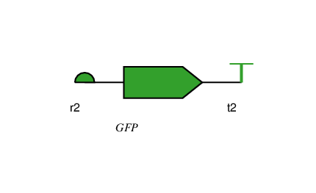
Repressing Cassette
N=3
Reporting Cassette
N=3
Composition Rules
N=5
// INDUCIBLE PROMOTERS
in0 INDUCES pIn0
in1 INDUCES pIn1
pIn0 EXACTLY 1
pIn1 EXACTLY 1
FORWARD pIn0
FORWARD pIn1
pIn0 DRIVES c1
pIn1 DRIVES c1
// REPRESSIBLE PROMOTER
FORWARD p1
p1 EXACTLY 1
c1 REPRESSES p1
p1 AFTER c1
p1 DRIVES GFP
// PARTS
CONTAINS r1
CONTAINS c1
CONTAINS t1
// ORDER
r1 BEFORE c1
r1 NEXTTO c1
c1 BEFORE t1
// ORIENTATION
FORWARD r1
FORWARD c1
FORWARD t1
// PARTS
CONTAINS r2
CONTAINS GFP
CONTAINS t2
// ORDER
r2 BEFORE GFP
r2 NEXTTO GFP
GFP BEFORE t2
// ORIENTATION
FORWARD r2
FORWARD GFP
FORWARD t2

Slide 2
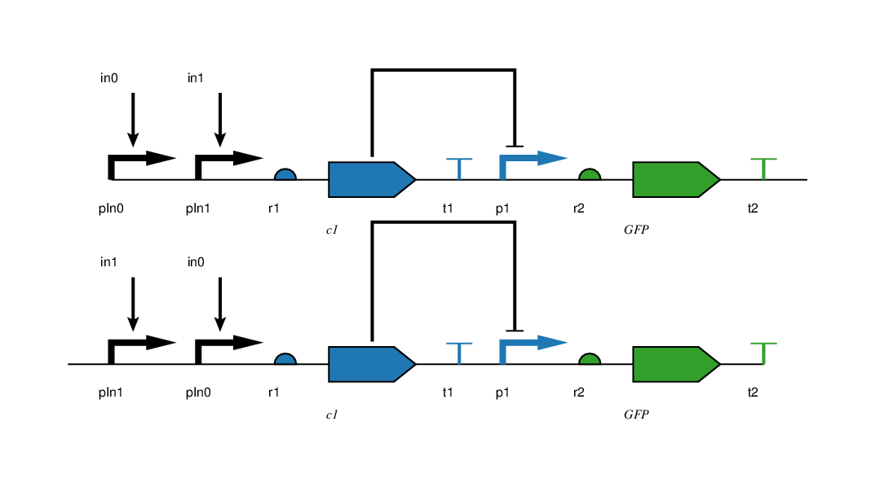
Resulting NOR Gates
N=9

Slide 3
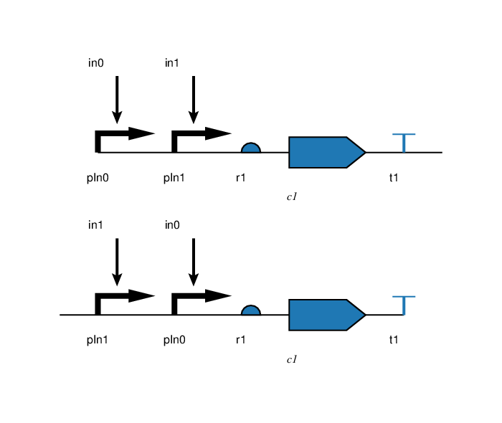
Repressing Cassette
// COUNTING
r1 EXACTLY 1
c1 EXACTLY 1
t1 EXACTLY 1
// POSITIONING
r1 BEFORE c1
r1 NEXTTO c1
c1 BEFORE t1
c1 NEXTTO t1
// ORIENTATION
FORWARD r1
FORWARD c1
FORWARD t1
// INTERACTIONS
in0 INDUCES pIn0
in1 INDUCES pIn1
pIn0 EXACTLY 1
pIn1 EXACTLY 1
FORWARD pIn0
FORWARD pIn1
pIn0 DRIVES c1
pIn1 DRIVES c1
Statistics:
Size of the Design: 5
Number of Parts: 5
Number of Rules: 17
Possible Solutions: 3125
Valid Solutions: 2
Solution Finding Time: 2.4ms

Slide 4
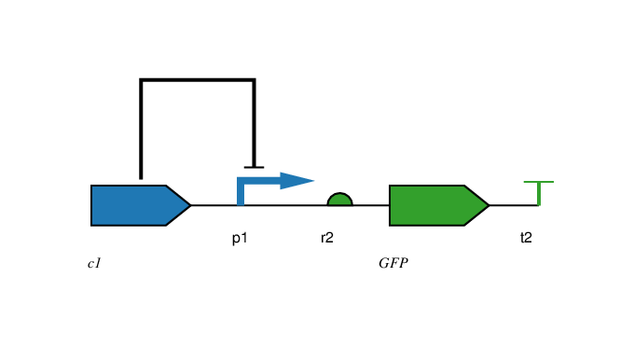
Reporting Cassette
// COUNTING
r2 EXACTLY 1
GFP EXACTLY 1
t2 EXACTLY 1
// POSITIONING
r2 BEFORE GFP
r2 NEXTTO GFP
GFP BEFORE t2
GFP NEXTTO t2
// ORIENTATION
FORWARD r2
FORWARD GFP
FORWARD t2
// INTERACTIONS
FORWARD p1
p1 EXACTLY 1
p1 AFTER c1
c1 REPRESSES p1
p1 DRIVES GFP
Statistics:
Size of the Design: 5
Number of Parts: 5
Number of Rules: 15
Possible Solutions: 3125
Valid Solutions: 1
Solution Finding Time: 1.95ms

Slide 5
NOR Gates
Statistics:
Size of the Design: 9
Number of Parts: 9
Number of Rules: 33
Possible Solutions: 387,420,489
Valid Solutions: 2
Solution Finding Time: 14.53ms

